Slide 1


Slide 2
UNIFIED MODELLING LANGUAGE DIAGRAMS :
We prepare UML diagrams to understand the system in a better and simple way.
A single diagram is not enough to cover all the aspects of the system.
UML defines various kinds of diagrams to cover most of the aspects of a system.
There are two categories of diagrams and they are again divided into subcategories :-
1. Structural Diagrams
2. Behavioural Diagrams
Structural Diagrams :
Structural diagrams represent the static aspect of the system.
They are four Diagrams, They are :
Class Diagram, Object diagram, Component diagram, Deployment diagram.
Behavioural Diagrams :
Behavioral diagrams represents the dynamic aspect of a system.
Dynamic aspect can be further described as the changing/moving parts of a system.
They are of five types , They are:-
Use case diagram, Sequence diagram, Collaboration diagram, Statechart diagram, Activity diagram.

Slide 3
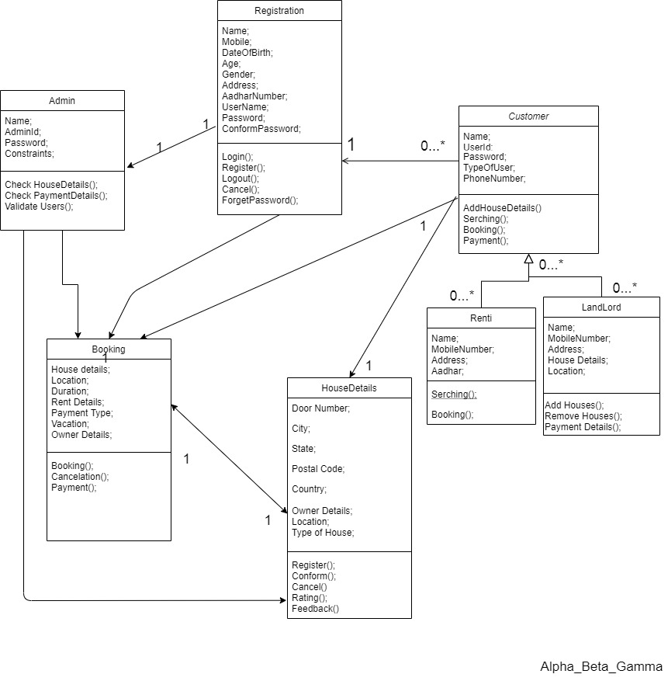
CLASS DIAGRAM

Slide 4
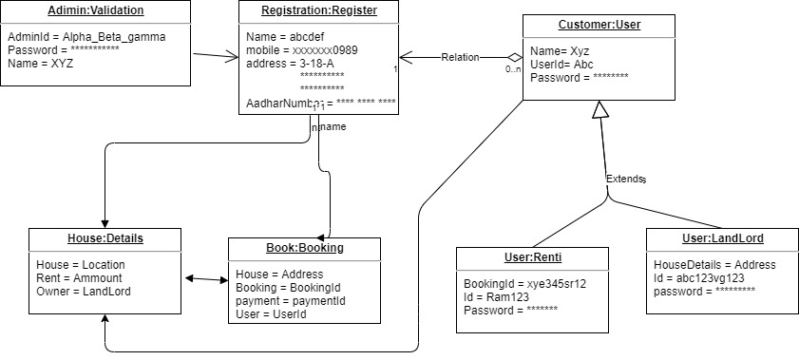
OBJECT DIAGRAM

Slide 5
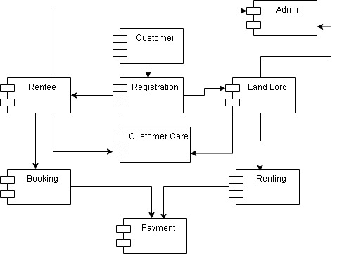
COMPONENT DIAGRAM

Slide 6
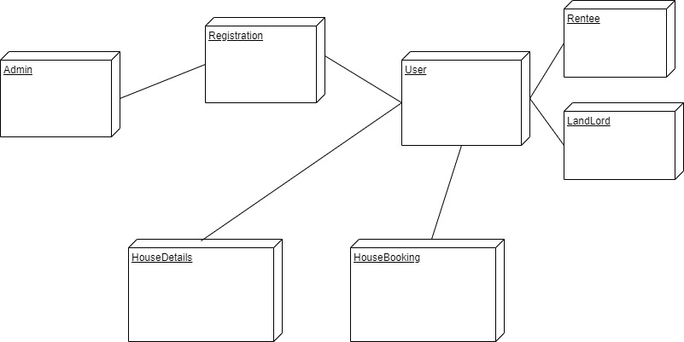
DEPLOYMENT DIAGRAM

Slide 7
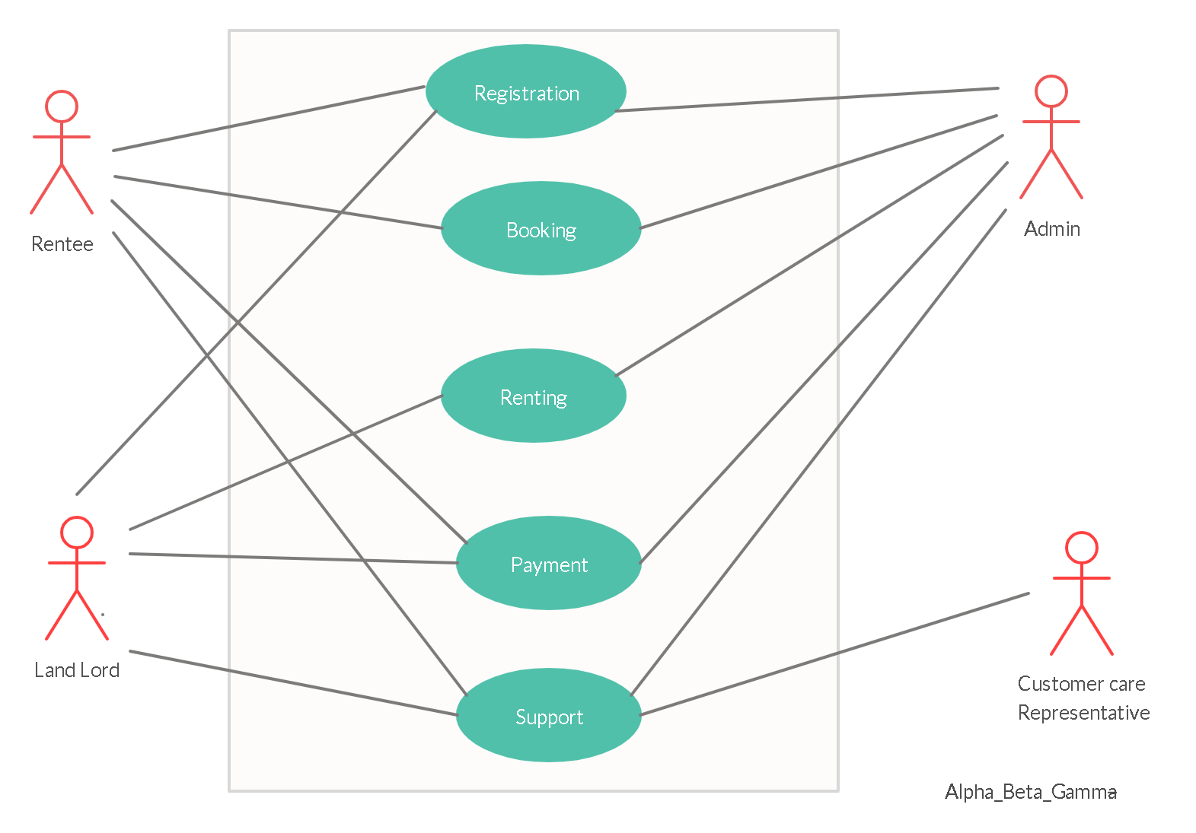
U
S
E
C
A S E
D
I
A
G
R A M

Slide 8
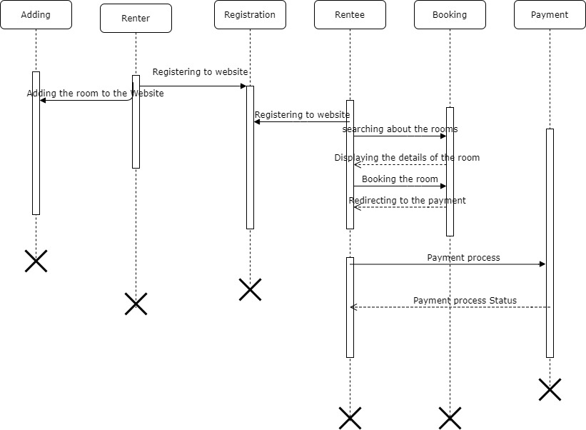
SEQUENCE DIAGRAM

Slide 9
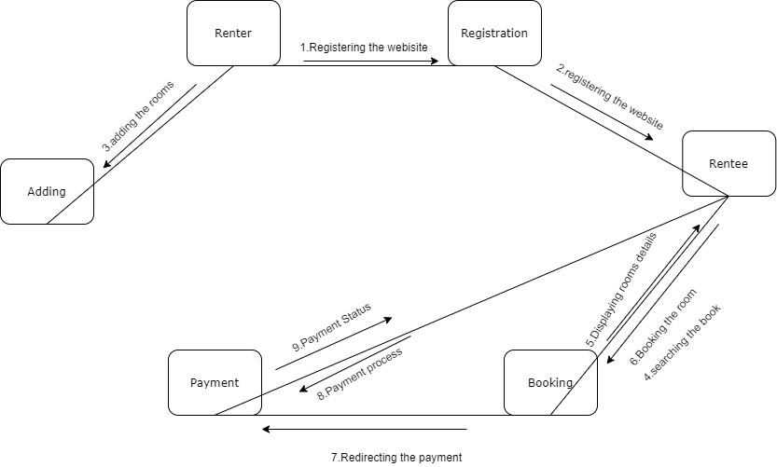
COLLABORATION
DIAGRAM

Slide 10
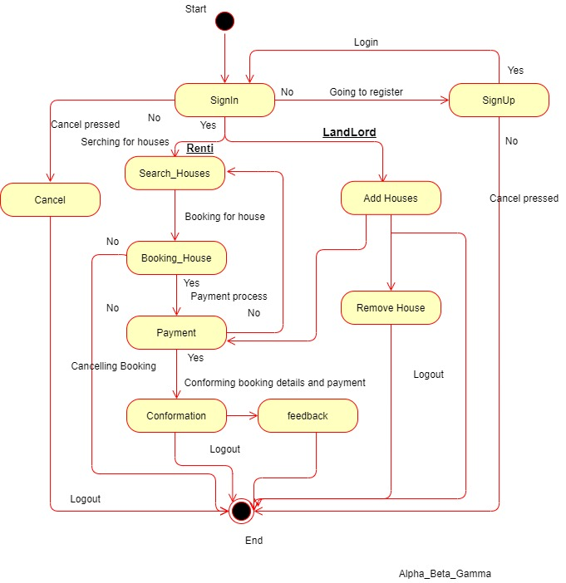
STATE – CHART DIAGRAM

Slide 11
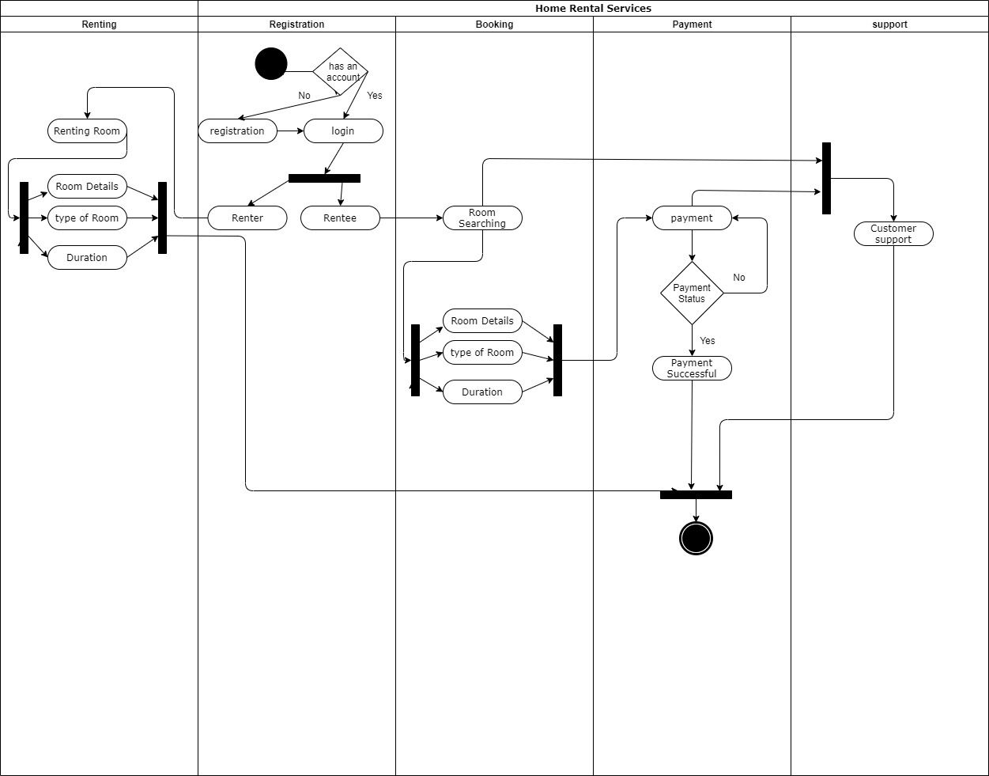
ACTIVITY DIAGRAM

Slide 12
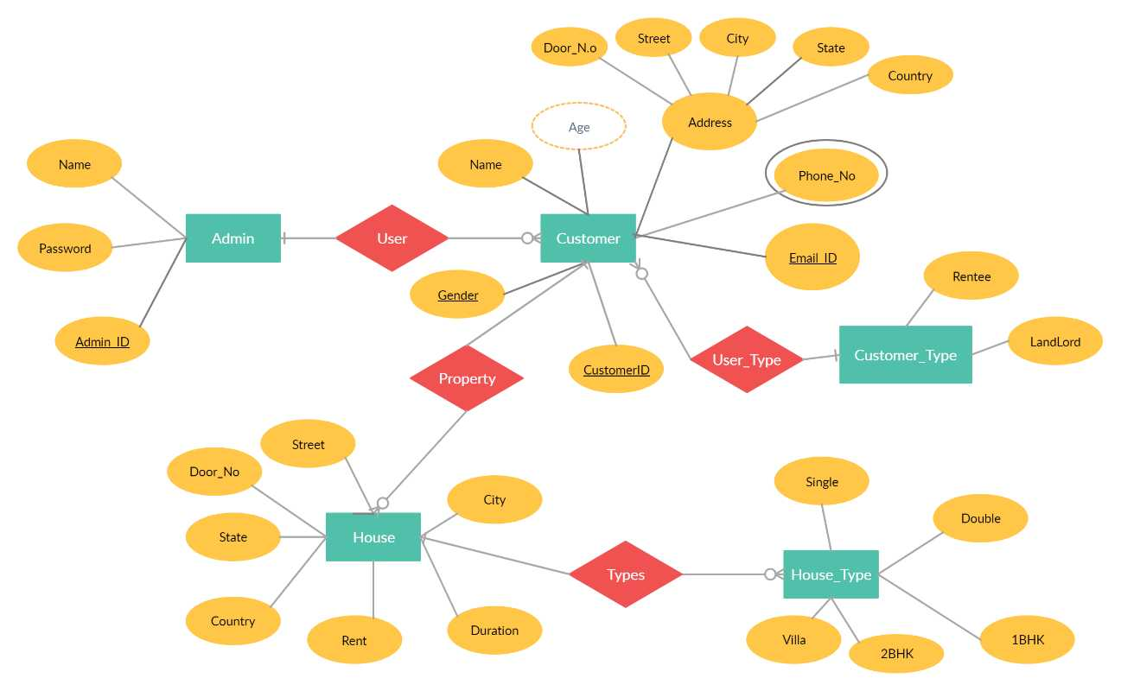
ENTITY- RELATIONSHIP DIAGRAM

Slide 13


