Slide 1
CAPSTONE PROJECT
PLAY STORE APP ANALYSIS
Presented By:
Pranay .P – 2021308033
ACTECH, Anna University
BTech. Pharmaceutical Technology

Slide 2

OUTLINE
Problem Statement
Proposed System/Solution
System Development Approach
Algorithm & Deployment
Result
Conclusion
Future Scope
References

Slide 3
PROBLEM STATEMENT
The Play Store apps data has enormous potential to drive app-making businesses to success. Actionable insights can be drawn for developers to work on and capture the Android market.
Play store is one of the largest and most popular android app stores with over a million apps and the app reviews have a significant impact on the success of an app, influencing download rates, user engagement, and long-term retention.
Our main objective is to analyze the dataset and find out which features contribute to app success and how app review features affect the user engagement with the app.

Slide 4
PROPOSED SOLUTION
App version has significant impact on app success. This may be due to feature updates which provide improvements in user interface(UI), bug fixes, and performance enhancements. These updates can attract existing users to continue using the app and encourage new users to download it. Overall it enhances user experience and user engagement.
High rating with high thumbs-up count contribute to app success. They contribute to overall success of app by increasing visibility, user trust, downloads, engagement, retention, and monetization opportunities.
The legitimacy of the rating of a review can be inferred from the thumbs-up count, hence it can be considered as a pathway for review data analysis.
By leveraging insights from user reviews, developers can iteratively improve their app, address user concerns, and create a more enjoyable and valuable experience for their users, ultimately driving app success and user satisfaction.

Slide 5
SYSTEM APPROACH
Building the proposed solution would involve a combination of data processing, feature engineering and machine learning. Here are the key system and library requirements:
System requirements:
Hardware :
A laptop with sufficient processing power, preferably with multiple cores of a GPU for faster training of machine learning models
Adequate RAM to handle the size of the dataset and computational requirements
Software :
An operating system compatible with the required machine learning libraries (Eg: Windows)
Library requirements:
Data Processing and Analysis:
Pandas : For data manipulation and analysis
NumPy : For numerical operations on data
Data Visualization :
Matplotlib and Seaborn : For creating visualizations to understand data patterns

Slide 6
ALGORITHM & DEPLOYMENT
Algorithm Selection
Data exploration:
Explore the Google play store app review dataset’s structure, feature and target variables
Identify potential patterns, correlations and outlines
Problem Formulation:
Define the problem: To predict correlation between app engagement and success using app review dataset
Algorithm Selection:
Regression task
Consider the bar graph and correlation table

Slide 7
ALGORITHM & DEPLOYMENT
Data Input:
Data Collection:
Gather historical app review dataset including information on rating, size, category and more and relevant app review details
Data Cleaning:
Handle missing values by finding and filling the values and any inconsistencies in the dataset
Convert categorical variables into numerical representations through encoding techniques
Feature Engineering:
Create new features or modify existing ones based on domain knowledge
Extract meaningful information from app review and version variables such as app version, review version, thumbs up count and score

Slide 8
ALGORITHM & DEPLOYMENT
Training Process:
Model Training:
Use the selected algorithm to train the model ops the training dataset
Model Evaluation:
Evaluate the model on testing dataset using appropriate matrices
Fine tune the model if necessary
Result interpretation:
Interpret the models prediction in the context of the problem at hand

Slide 9
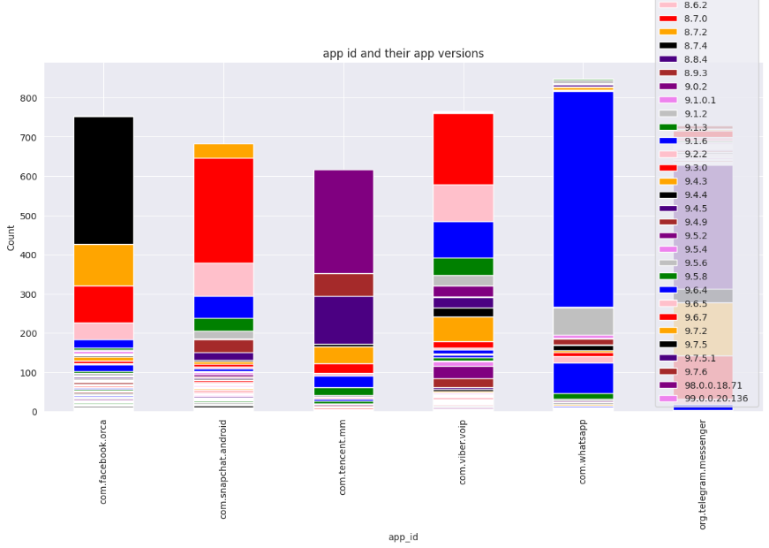
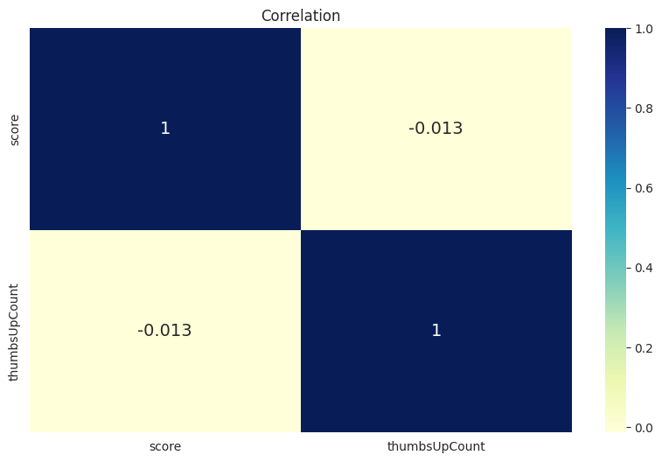
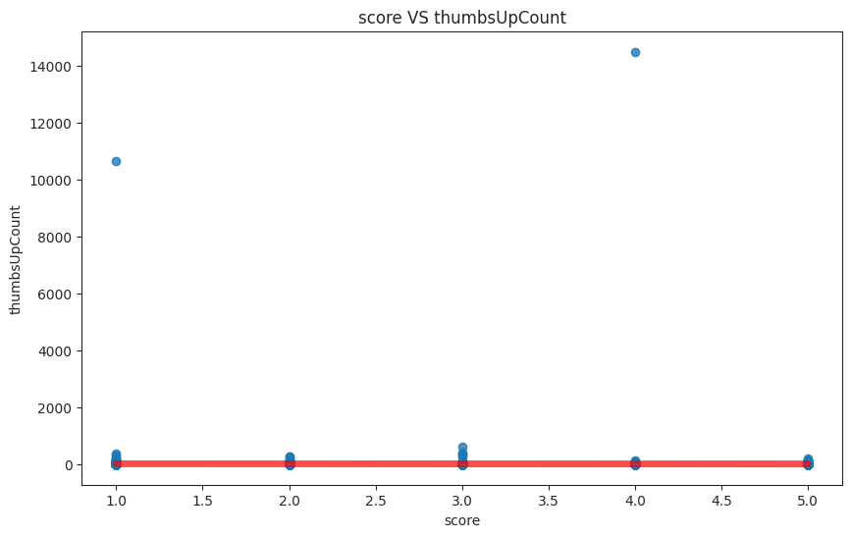
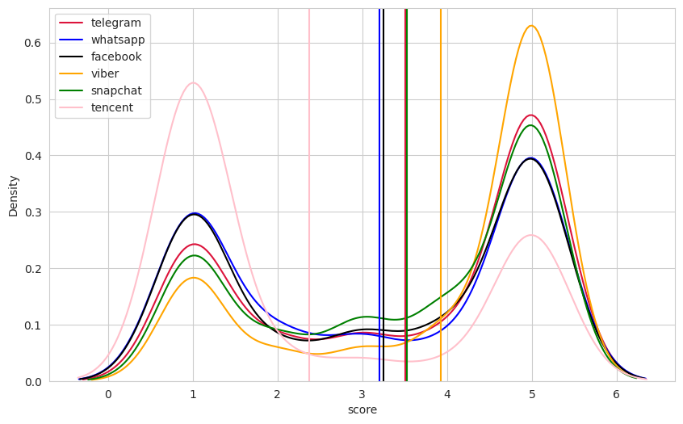
RESULT

Slide 10
CONCLUSION
In conclusion, our proposed solution harnesses the power advance machine learning algorithms to transform the app review process into a dynamic and optimised experience by meticulously analysing extensive, historical app review data, we unlock patterns and correlations that are pivotal in addressing key challenges faced by app developers and reviewers

Slide 11
FUTURE SCOPE
The proposed solution lays the foundation from ongoing advancements in the realm of app review optimisation. Here are key areas for future exploration and enhancement;
Real-time predictions:
Move towards real time predictive models that account for app success and dynamic factors to provide Google play store app users with up-to-the-minute insights for app reviews.
Personalisation and customisation:
Enhance the predictive models to offer more personalised recommendations by considering individual app reviewer preferences, rating, and thumbs up count providing a tailor experience for each app review

Slide 12
REFERENCES
https://edunetfoundationorg-my.sharepoint.com/:x:/g/personal/shabaz_edunetfoundation_org/ESpO815l5R9Aruy5jgsatkcBLyst5OdlVPUnodRvz11VkA?e=CeN6Vo
https://seaborn.pydata.org/
https://pandas.pydata.org/docs/user_guide/index.html
https://matplotlib.org/stable/users/index

Slide 13
THANK YOU

