Slide 1
Local Train Ticket Booking System
Presented And Developed By
Pranay Surve Kaushik More PRN :2016017000773851 PRN :2016017000747006
RISHI SUMESARA
2016017000743055

Slide 2
Introduction
This Project is Based On Local Train Ticket Booking
This Web Aaplication Mainly Used To Book Ticket Quickly Rather Then Another Methods.
The User Can Book Ticket From Their Mobile Smart Phone Or On Computer.

Slide 3
How To Book Ticket
Before Booking Any Tickets You May Have To Register On Ticket Booking Portal.
Once, Successfully Register Then You can book Ticket At Any Time.

Slide 4
Step 1
Make sure your device is connected to Internet

Slide 5
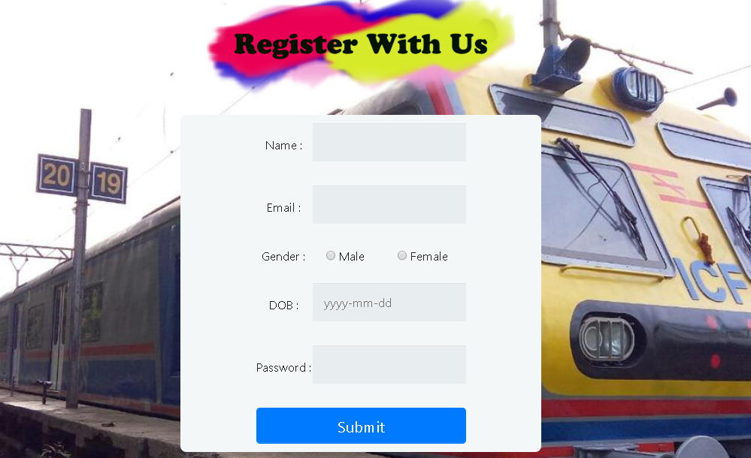
Step 2
Register With Us Go to Register Page

Slide 6

Step 3
After Filling All Correct Detail And Clicking On Submit.
You Have Been successfully Registered
After That in Order to Login Click on Login Button.

Slide 7
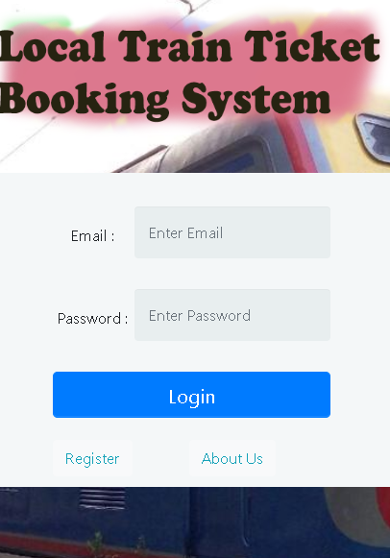
Step 4
After Successful Registration You Can Login with Your Email and Password.
The email Should be Same,as you used to registered.
If You Already Register Than Simply Login

Slide 8
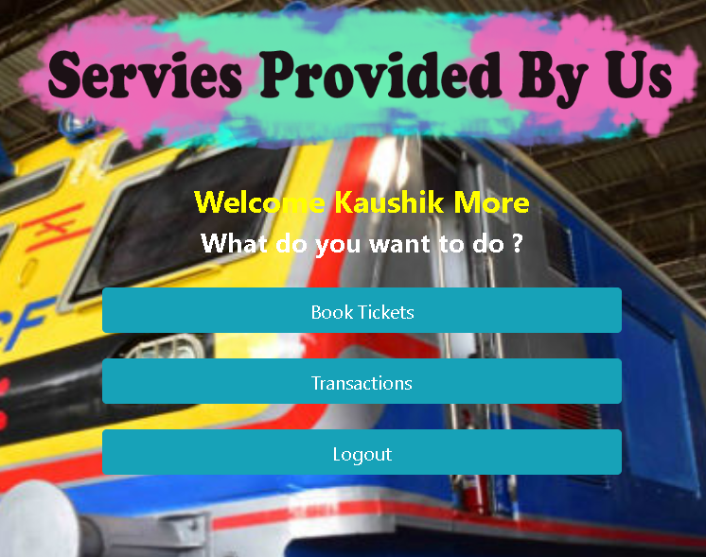
Step 5
After Login The Welcome Page Will Open
Now You have Full Access To Your Account and Booking Fetures.

Slide 9
Why to Use Website Only
While The Users Use Smartphones High Varient And Many Users Use Base Or Low Specification Smartphones.
The ratio is 64 % users use Low and medium Range Phones Since The Redmi Comes in Market.(Male/Female)
Because of Mid range the Specification is low than they should keep Minimum Applications. The App takes Much more Space To Store.(Hang Problem Occurs)
Howevere, Website Not Need Any Space in phones Only required Browser And Internet Access.

Slide 10
Advantages
Removing the bottleneck of phone booking systems.
Key Point is Its Provide Wide Range To Book Your Tickets.
A modern approach to booking.
Its Elimates Standing In Line in front of Ticket Counter.
Increased revenue thanks to upselling.

Slide 11
Disadvantages
You need internet access.
Page Load Slow When Traffic of Users are More.

Slide 12
Conclusion
Its makes the user to get ticket easly on online instead of queue up to by the tickets.

