Slide 1
CV COURSE PROJECT
ClassGraph
Temporal Scene-Graph Group-Activity Analytics for Classrooms
Identity-persistent, behaviour-level engagement analytics — turning raw classroom video into per-student attention trajectories and group-level insight, without reducing students to a single score.
Perception + Identity
Stages 1–2 built & tested
Scene Graph + Temporal
Stages 3–4 designed
Group Activity
Stage 5 designed

Slide 2
Review Roadmap
This deck is organised 1:1 against the five evaluation criteria.
1
Problem Understanding
slide 3
THE THESIS
Clarity of problem, objectives, motivation
Represent a classroom as a dynamic scene graph — students are nodes, attention behaviours are edges — keep identity stable within the session, and reason over how that graph evolves to recognise individual and group engagement.
2
Research Paper Selection
slide 6
Relevance, novelty, correctness of base paper
3
Literature Review Depth
slide 7
Related work identification & comparison
4
Dataset Identification
slide 10
Appropriateness, data format, challenges
5
Project Feasibility & Plan
slide 11
Workflow, timeline, results, risks
Status at this review
Stages 1–2 implemented, 109 automated tests passing, validated on real classroom footage.
ClassGraph
2

Slide 3
CRITERION 1 — PROBLEM UNDERSTANDING
Attendance is solved. Engagement is not.
The classroom already has cameras. What it does not have is any way to answer the question a teacher actually cares about.
The problem
A teacher cannot continuously observe 30–40 students while also teaching.
Manual observation is subjective, sampled at a few moments, and does not scale to every student across a whole lecture.
Why existing tools fall short
Attendance and face-recognition systems answer “who is present”, not “who is engaged”.
Emotion classifiers give a per-frame label with no memory — no system reasons about behaviour over time or across the group.
What we mean by “engagement” — defined before it is measured
We measure observable behaviour, not inner emotional state. Where a student is looking, whether their eyes are open, whether a phone is present, how their body is oriented, and how all of that changes over time. We never infer feelings — that is both scientifically weaker and, in education settings, legally restricted.
Detect
Track
Estimate
Flag
Relate
Report
every student in frame, including back rows
stable identity for the whole session
attention state over a time window
device distraction & eye closure
peer orientation & group activity
trajectories + class-level trends
ClassGraph
3

Slide 4
CRITERION 1 — MOTIVATION
Why this matters, and why now
30–40
THIS PROBLEM IS ALREADY BEING SOLVED BADLY
83
Hong Kong schools now using “4 Little Trees”, which reads a child's face and scores their emotion in real time.
students one teacher must watch at once in a typical class
A Hangzhou school scans every student's face every 30 seconds and posts a live attention score on the classroom wall.
~50%
of detected students have no usable face from a real ceiling camera — measured on our own footage
Both were built on facial emotion recognition and both drew real privacy backlash — the exact design mistake this project deliberately avoids.
Why now — feasibility changed
Detection, face mesh, head pose and body pose are all strong pretrained models today. The open question is no longer “can we see it” but “what does it mean, and over what timescale”.
Where it applies
Schools, colleges and coaching centres · hybrid learning · corporate training · teaching-quality feedback · educational research on attention.
Our framing: behaviour, not emotion — and a trend a teacher can act on, not a score per student. “Attention across the room dropped sharply 22 minutes in” is actionable and fair. A live per-child score on the classroom wall is neither.
ClassGraph
4

Slide 5
CRITERION 1 — OBJECTIVES
Objectives, each with a measurable success criterion
Stated so progress can be checked rather than asserted. Status reflects this review.
# | Objective | Measurable success criterion | Status
O1 | Detect every student in frame | Recall on real classroom frames; back rows not lost to downscaling | Done
O2 | Maintain stable identity within a session | One track_id per student across occlusion; identity never crosses sessions | Done
O3 | Per-student attention state over time | Windowed distribution over 6 behaviour categories, not per-frame verdicts | Done
O4 | Flag device distraction and eye closure | Phone-overlap + gaze-down evidence; EAR-based eye state | Done
O5 | Model peer orientation and group activity | Geometric pair detection now; scene-graph + GAR next | In progress
O6 | Report trajectories and class-level trends | Class summary by default, individual as explicit drill-down | Partial
Note on scope: O1–O4 are implemented and covered by automated tests. O5–O6 are partially built — the honest position at this review is a working perception + attention core with the relational layer designed and started, not finished.
ClassGraph
5

Slide 6
CRITERION 2 — RESEARCH PAPER SELECTION
Three base papers: robust temporal facial-signal modelling + group activity
All three are peer-reviewed, address a real sub-problem we face, and are used for their method, not their task — see the note below on why.
TEMPORAL ROBUSTNESS · 1 OF 2
TEMPORAL ROBUSTNESS · 2 OF 2
GROUP-LEVEL REASONING
Robust Dynamic Facial Expression Recognition
Dynamic Objectives Learning for Facial Expression Recognition
Learning Actor Relation Graphs for Group Activity Recognition
Liu, Wang & Shen — IEEE Trans. on Biometrics, Behavior, and Identity Science, 2025
Wen, Chang, Li & Jiang — IEEE Trans. on Multimedia, vol. 22, pp. 2914–2925, 2020
Wu, Wang, Wang, Guo & Wu — CVPR 2019
A dual-stream network that disentangles short-term facial movements from longer-term state, and explicitly separates genuinely hard samples from noisy/mislabelled ones using prediction agreement across resampled clips.
Splits training into stages with different objectives, and proposes a loss that explicitly widens the gap between easily-confused expression categories rather than forcing every sample into a single confident class.
Builds an Actor Relation Graph capturing both appearance and position relations between actors, learned end-to-end with a GCN. Benchmarked on Volleyball and Collective Activity.
What we take: NOT emotion classification. We take the principle of separating a momentary signal from a sustained state — our 15-second rolling window does exactly this for gaze and posture.
What we take: the same lesson without training a classifier — our “head-down, no device” category stays deliberately separate and uncertain instead of being forced into “engaged” or “distracted”.
What we take: the actor-relation graph + GCN readout to turn per-student states into one class-level activity label — used directly, not adapted.
Why facial-expression papers for a system that doesn't classify emotion: we deliberately excluded emotion inference (see slide 3), but the *methodology* both papers use for handling ambiguous, noisy facial signal over time is exactly our problem too — we cite the technique, not the task.
ClassGraph
6

Slide 7
CRITERION 3 — LITERATURE REVIEW DEPTH
Related work, method, result, and the gap each leaves open
Not just our 3 base papers — the actual state of the art in each pillar, so the gap we claim is checked against what already exists, not assumed.
Area | Key work (venue, year) | Method in one line | Benchmark | Limitation for our setting
Cloth-changing Re-ID | CAL (CVPR 2022); AIM, DeepChange (2023) | Adversarial / causal loss suppresses clothing cues to keep RGB-only identity | PRCC, LTCC, DeepChange | Built for surveillance re-identification; never applied to session-scoped classroom identity
Dynamic/robust facial signal | Liu et al. (2025); Wen et al. (2020) | Disentangle short-term movement from sustained state; separate hard samples from noisy ones | DFEW, FERV39K | Built for emotion classification, not behaviour geometry — we take the method (temporal + ambiguity handling), not the task
Group activity recognition | ARG (CVPR 2019); GroupFormer (ICCV 2021) | Actor relation graph / joint spatio-temporal attention over a GCN | Volleyball, Collective Activity | Sports/crowd domains; one group label per clip, not sustained engagement
Classroom CV | SCB-Dataset (2023–25); DAiSEE, EmotiW | Per-frame behaviour detection; affect classification from webcam video | SCB, DAiSEE | No identity across time, no relational or group reasoning, single-subject framing
Reading across the rows: identity, relations and group reasoning have each been solved separately, and classroom CV has solved per-frame detection. No row does two of these at once — that gap is what we build on next.
ClassGraph
7

Slide 8
CRITERION 3 — LITERATURE REVIEW DEPTH
The second half: what should the labels even be?
A CV-only review would stop at the previous slide. But the hardest question here is not architectural — it is what counts as “engaged”, and over what timescale. We reviewed the education and psychology literature to answer it.
1. Most systems invent their own labels
A field-wide review found most engagement-detection systems make up their own categories instead of using a validated one — so their results can't even be compared to each other. We took that as a warning about our own design.
2. So we used a real, validated one instead
BOSS is a published classroom-observation method already used by school psychologists: on-task vs. three kinds of off-task. Our six categories are built to match it, and we say plainly where they can't.
3. We picked our time window from real studies
One study showed a short mental break actually protects attention rather than harming it. Two separate lines of research — gaze tracking and classroom observation — both independently point to measuring over about 10–15 seconds, not judging a single frame.
4. We know where a camera has to stop guessing
Two students turned toward each other could be discussing the lesson or just chatting — telling those apart needs hearing them, not just seeing them. So we report “these two are facing each other” and refuse to guess why.
Bottom line: the 15-second window already running in our code came from this research, not a guess — and two unrelated fields agree on it.
ClassGraph
8

Slide 9
CRITERION 3 — RESEARCH GAP
The white space, stated precisely
Identity persists
Relations are modelled
The group is read out
✓ Re-ID gives a stable student across a session
✓ VidSGG gives evolving subject–predicate–object graphs
✓ GAR gives one activity label for a set of actors
✗ but only ever demonstrated for surveillance
✗ but with generic predicates, never attention
✗ but on sports clips, not sustained engagement
THE GAP WE ADDRESS
No prior work combines identity persistence, relational scene graphs and temporal group reasoning for classrooms — and none of the classroom systems ground their behaviour labels in a validated observation instrument.
Our claim is deliberately narrow
We are not claiming a new Re-ID loss, a new scene-graph architecture, or a new GAR backbone. The contribution is the integration and the domain: an identity-persistent, behaviour-grounded, temporally-reasoned classroom analytics system — plus the honest reporting of where vision alone cannot decide, which the reviewed classroom literature consistently glosses over.
ClassGraph
9

Slide 10
CRITERION 4 — DATASET IDENTIFICATION
Primary dataset: OUC-CGE (Classroom Group Engagement)
Reselected after the previous candidate turned out to be a moving target: an arXiv-only preprint revised seven times with no fixed, citable version.
Why this one
Peer-reviewed and published in Nature Scientific Data (2025) — a fixed, citable dataset paper, not a preprint that keeps changing under us.
Filmed with three real classroom cameras, including one mounted above the teacher's head — the same elevated angle behind our hardest problem.
Labels are group-level engagement (High / Medium / Low), which is exactly the unit our Group Activity stage (Pillar 3, ARG) needs to be evaluated on.
Openly archived with a permanent DOI on OSF, MIT-licensed code — one stable link, not a repository that has been rewritten under the same name.
Scale & format
BEING HONEST ABOUT ITS LIMITS
Video segments
~7,705 clips
Small (17 students, 16 female/1 male) and group-level only.
Total footage
12h 50m
It cannot tell us whether ONE student is bowed over reading vs. bowed over a phone — that per-student behaviour granularity is what the supporting dataset below is for. We are using OUC-CGE for what it is actually strong at: real classroom camera angles and citable group-engagement ground truth.
Participants
17 students
Camera angles
3 (incl. overhead)
Label unit
group, per clip
Archive
OSF · DOI, MIT code
Supporting dataset — SCB-Dataset, for per-student behaviour labels
OUC-CGE has no equivalent to this: SCB's bow head / read / write / using the phone / turn head / talk / discuss classes are supervision for the exact ambiguity our own geometry cannot resolve (see Problem 6). Used as a secondary reference, not the primary dataset, precisely because of the version-stability issue above — cite specific frozen commits, not "latest".
ClassGraph
10

Slide 11
CRITERION 5 — WORKFLOW & PLAN
Five stages, one team of three, and where we are today
Each stage consumes the previous one's output through a fixed JSON schema, so three people build in parallel against stable interfaces. Stage number doubles as the project month.
MONTH 1
BUILT
MONTH 2
BUILT
MONTH 3
NEXT
MONTH 4
NEXT
MONTH 5
NEXT
Perception
Identity
Scene Graph
Temporal
Group Activity
YOLOv11 · Face Mesh Body pose · head pose
ByteTrack now cloth-invariant Re-ID next
nodes = students edges = behaviours
sequence decoder over the graph
ARG-style graph readout + dashboard
who & where
stable IDs
what relates to what
how it evolves
the class as a whole
A
owner
A
owner
B
owner
B
owner
C
owner
The frozen contract + privacy by design
One JSON object per frame, validated against a fixed schema on every run. Identity is computed from motion/geometry only, scoped to one session — no face-recognition database — and two tests enforce it cannot leak between sessions.
The risk that is already retired
The biggest open question — “can this actually work on real classroom footage from a bad camera angle?” — has been answered empirically, with seven real failure modes found and fixed (next two slides).
ClassGraph
11

Slide 12
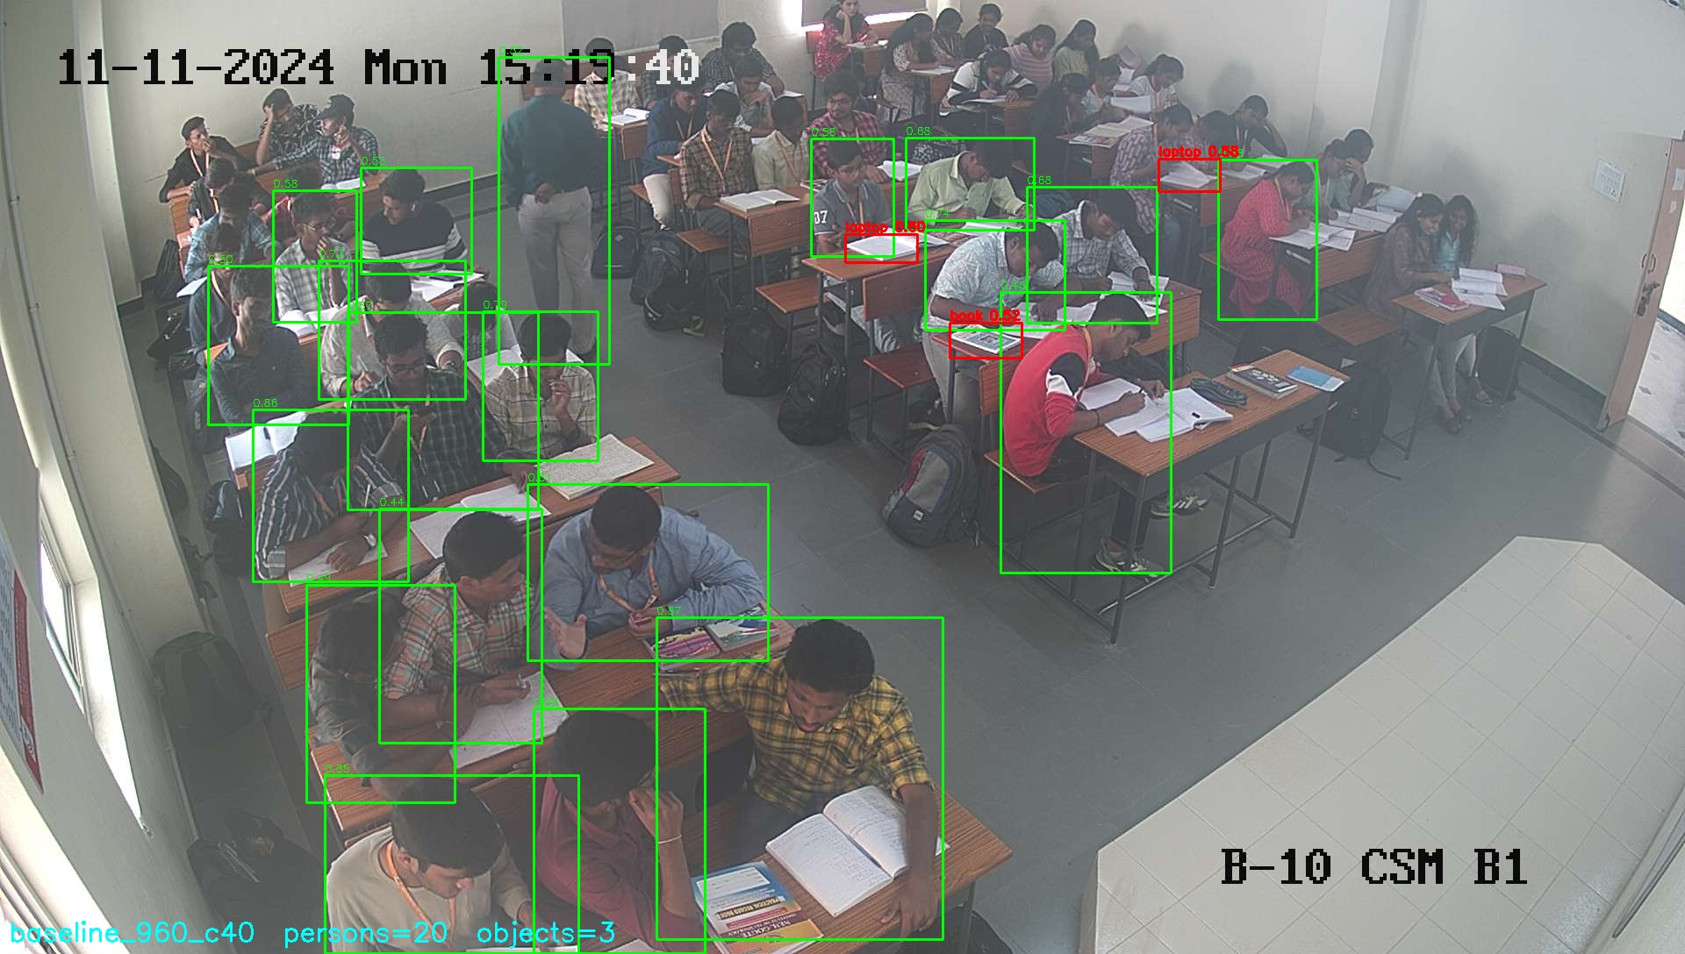
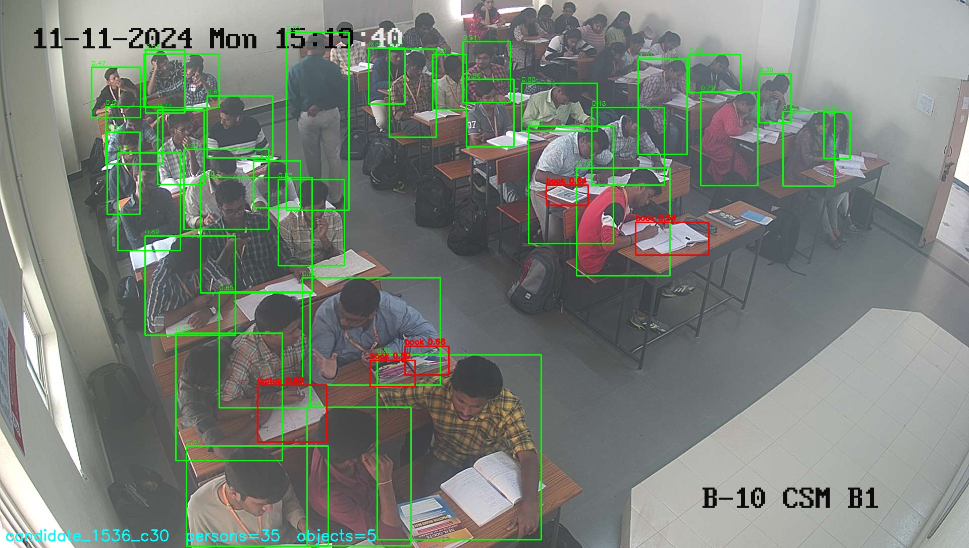
CRITERION 5 — RESULTS
Measured improvements, before and after
Every figure below is from a real run on real classroom images in this repository — not an estimate.
Metric | Before | After | Change
Persons detected — 12-image classroom set | 139 | 236 | +70%
Persons detected — img01.jpg (~42 visible, counted by eye) | 20 (48%) | 30 (71%) | recall +23 pts
Faces detected on real footage — same 12 images | 0 | 95 | 0 → usable
Gaze label “down” reachable at all | No (bug) | Yes | fixed
Automated tests passing | 10 (9 skipped) | 109 (0 skipped) | +99
Throughput, 4K video on RTX 4050 | 11.0 FPS | 7.8 FPS | cost of posture
BEFORE — 960 px, conf 0.40 → 20 found
AFTER — 1536 px, conf 0.30 → 35 found
Why the throughput row is on this slide
Adding the body-pose fallback took us from 11.0 to 7.8 FPS. We are reporting the cost next to the benefit rather than quoting only the coverage gain — the trade is worth it for offline analysis, and it is the number a reviewer should be able to challenge us on.
Rendered at 1536 px so the extra boxes are easy to see. The shipped default is 1280 px (30 found, the number in the table) — 1536 finds a few more still, at 1.5× the compute cost.
ClassGraph
12

Slide 13
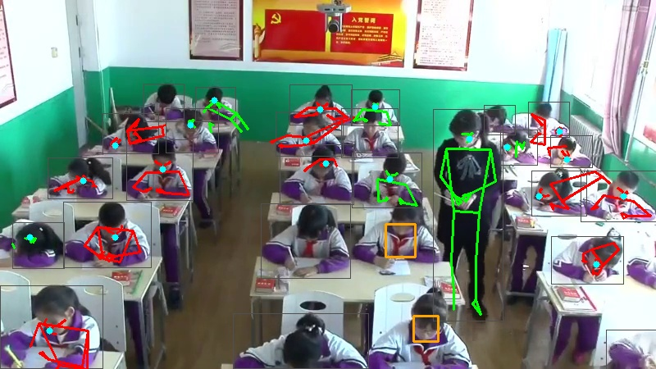
CRITERION 5 — PROBLEMS FACED (1 / 2)
Perception problems, root causes, and what we did
These were found by running the pipeline on real footage — none of them were visible in synthetic tests.
THE FALLBACK, WORKING
PROBLEM 1
PROBLEM 2
Camera angle — a hard ceiling, not a bug
Face detection returned zero faces on real footage
Real classroom cameras sit high in a rear corner. A student bowed over a desk shows the camera the crown of their head. We measured a ~45% ceiling on face availability: 130 of 236 detected students had no face that ANY face model could find.
Face Mesh was run once over the whole frame. MediaPipe downscales its input, so a face that is small relative to a 4K frame is destroyed before detection runs. Result: 0 faces on every real image, while synthetic tests passed.
Solution: Accepted it as a constraint instead of chasing it. Added a face-independent signal (body pose) so those students are still measurable — coverage went from 265/321 to 321/321.
Solution: Run Face Mesh per detected person crop instead. 0/139 → 95/139 faces. We also measured that padding the crop makes it worse, and shipped zero padding against our own initial intuition.
Body pose recovered for students with no detectable face. The single upright skeleton is the standing teacher — correctly distinguished from every seated student, which is a real check that the signal means something.
PROBLEM 3
PROBLEM 4
Back-row students missed entirely
Low-resolution input collapses face detection
Inference resolution 960 px shrank a 60 px student to ~30 px.
Measured 7% face rate below 480 px vs 44% at 720–1080 px.
→ imgsz 1280 + conf 0.30 → 139 to 236 persons.
→ Set a minimum capture resolution as a deployment requirement.
ClassGraph
13

Slide 14
CRITERION 5 — PROBLEMS FACED (2 / 2)
Interpretation problems — and where we say “we cannot tell”
PROBLEM 5
PROBLEM 6 — THE TWO DISTRACTION CASES
Gaze direction was silently inverted
“Head down” means two different things
The head-pose model reports pitch as up-positive; our contract assumed down-positive. Students bowed over desks were being labelled “looking back/up”, and “down” could never fire at all. Confirmed by reading the library's own source, not guessed.
head_down_WITH_device
head_down_NO_device
Gaze down + a phone detected overlapping the student. Defensible behavioural reading → we do flag this.
Gaze down, nothing detected. Could be reading, writing, thinking — or disengaged. We refuse to guess.
Solution: negate at the source + a regression test pinning the convention. “down” labels went 0 → 6 on the same images; “back” 2 → 0.
THE PRINCIPLE WE ADOPTED
PROBLEM 7 — Peer interaction: a false positive we found and kept
Our geometric pair detector flagged its highest-confidence pair on real footage. We rendered it and looked: two students at different, non-adjacent desks, both bent over their own work, not interacting.
We documented the false positive in the code and measured that the proximity threshold is looser than real desk spacing — rather than quietly tuning it until the demo looked good.
Keep ambiguous cases ambiguous. BOSS — a validated human observation instrument — has the same unresolved confusion between “quiet, head down, working” and “quiet, head down, disengaged”. Forcing a confident split would be less honest than the established instrument itself.
ClassGraph
14

Slide 15
ORIGINALITY
Three things we can do that no single pillar can do alone
Each needs identity AND relations AND time together — that is the argument for why all three pillars must coexist in one system.
01
02
03
See a student's attention as a trend, not a snapshot
Notice when distraction spreads between neighbours
Say “we don't know” instead of guessing
Because we know it's the same student for the whole class, we can draw one line per student across the entire lecture and point to exactly when it dropped — instead of a pile of disconnected per-frame guesses.
By connecting students who are near and facing each other, we can ask whether one student losing focus is followed by the student next to them doing the same — a pattern invisible if every student is analysed alone.
When a student's face is hidden, or two students could be discussing the lesson or just chatting, we report exactly that — instead of forcing a confident answer we can't actually back up. That's what makes the output safe to hand to a teacher.
Framed honestly: novel in combination and in this domain — not a claim to have invented a better Re-ID, scene-graph or group-activity method on its own. That's a defensible position for a course project and an honest one for a paper.
ClassGraph
15

