Slide 1
CV PROJECT REVIEW 2
ClassGraph
Temporal Scene-Graph Group-Activity Analytics for Classrooms
Identity-persistent, behaviour-level engagement analytics — turning raw classroom video into per-student attention trajectories and group-level insight, without reducing students to a single score.
Perception + Identity
Stages 1–2 built & tested
Scene Graph + Temporal
Stages 3–4 designed
Group Activity
Stage 5 designed

Slide 2
Review Roadmap
This deck is organised 1:1 against the five evaluation criteria.
1
Problem Understanding
slide 3
THE THESIS
Clarity of problem, objectives, motivation
Represent a classroom as a dynamic scene graph — students are nodes, attention behaviours are edges — keep identity stable within the session, and reason over how that graph evolves to recognise individual and group engagement.
2
Research Paper Selection
slide 6
Relevance, novelty, correctness of base paper
3
Literature Review Depth
slide 7
Related work identification & comparison
4
Dataset Identification
slide 10
Appropriateness, data format, challenges
5
Project Feasibility & Plan
slide 11
Workflow, timeline, results, risks
Status at this review
Stages 1–2 implemented, 109 automated tests passing, validated on real classroom footage.
ClassGraph · Review 2
2

Slide 3
CRITERION 1 — PROBLEM UNDERSTANDING
Attendance is solved. Engagement is not.
The classroom already has cameras. What it does not have is any way to answer the question a teacher actually cares about.
The problem
A teacher cannot continuously observe 30–40 students while also teaching.
Manual observation is subjective, sampled at a few moments, and does not scale to every student across a whole lecture.
Why existing tools fall short
Attendance and face-recognition systems answer “who is present”, not “who is engaged”.
Emotion classifiers give a per-frame label with no memory — no system reasons about behaviour over time or across the group.
What we mean by “engagement” — defined before it is measured
We measure observable behaviour, not inner emotional state. Where a student is looking, whether their eyes are open, whether a phone is present, how their body is oriented, and how all of that changes over time. We never infer feelings — that is both scientifically weaker and, in education settings, legally restricted.
Detect
Track
Estimate
Flag
Relate
Report
every student in frame, including back rows
stable identity for the whole session
attention state over a time window
device distraction & eye closure
peer orientation & group activity
trajectories + class-level trends
ClassGraph · Review 2
3

Slide 4
CRITERION 1 — MOTIVATION
Why this matters, and why now
30–40
THIS PROBLEM IS ALREADY BEING SOLVED BADLY
83
Hong Kong schools now using “4 Little Trees”, which reads a child's face and scores their emotion in real time.
students one teacher must watch at once in a typical class
A Hangzhou school scans every student's face every 30 seconds and posts a live attention score on the classroom wall.
~50%
of detected students have no usable face from a real ceiling camera — measured on our own footage
Both were built on facial emotion recognition and both drew real privacy backlash — the exact design mistake this project deliberately avoids.
Why now — feasibility changed
Detection, face mesh, head pose and body pose are all strong pretrained models today. The open question is no longer “can we see it” but “what does it mean, and over what timescale”.
Where it applies
Schools, colleges and coaching centres · hybrid learning · corporate training · teaching-quality feedback · educational research on attention.
Our framing: behaviour, not emotion — and a trend a teacher can act on, not a score per student. “Attention across the room dropped sharply 22 minutes in” is actionable and fair. A live per-child score on the classroom wall is neither.
ClassGraph · Review 2
4

Slide 5
CRITERION 1 — OBJECTIVES
Objectives, each with a measurable success criterion
Stated so progress can be checked rather than asserted. Status reflects this review.
# | Objective | Measurable success criterion | Status
O1 | Detect every student in frame | Recall on real classroom frames; back rows not lost to downscaling | Done
O2 | Maintain stable identity within a session | One track_id per student across occlusion; identity never crosses sessions | Done
O3 | Per-student attention state over time | Windowed distribution over 6 behaviour categories, not per-frame verdicts | Done
O4 | Flag device distraction and eye closure | Phone-overlap + gaze-down evidence; EAR-based eye state | Done
O5 | Model peer orientation and group activity | Geometric pair detection now; scene-graph + GAR next | In progress
O6 | Report trajectories and class-level trends | Class summary by default, individual as explicit drill-down | Partial
Note on scope: O1–O4 are implemented and covered by automated tests. O5–O6 are partially built — the honest position at this review is a working perception + attention core with the relational layer designed and started, not finished.
ClassGraph · Review 2
5

Slide 6
CRITERION 2 — RESEARCH PAPER SELECTION
Three base papers, one per technical pillar
All three are peer-reviewed at top-tier venues (CVPR / ICCV), have public code, and map 1:1 onto a pillar of our architecture.
PILLAR 1 · IDENTITY
PILLAR 2 · RELATIONS OVER TIME
PILLAR 3 · THE GROUP
Clothes-Changing Person Re-Identification With RGB Modality Only
Spatial-Temporal Transformer for Dynamic Scene Graph Generation
Learning Actor Relation Graphs for Group Activity Recognition
Gu, Chang, Ma, Bai, Shan & Chen — CVPR 2022, pp. 1060–1069
Cong, Liao, Ackermann, Rosenhahn & Yang — ICCV 2021
Wu, Wang, Wang, Guo & Wu — CVPR 2019
Proposes a Clothes-based Adversarial Loss (CAL) that penalises the model's ability to predict clothing, forcing it to learn clothes-irrelevant identity cues (face, hairstyle, body shape, gait) from RGB alone.
STTran pairs a spatial encoder (relations within a frame) with a temporal decoder (dependencies across frames), and accepts variable-length video without clipping. Benchmarked on Action Genome.
Builds an Actor Relation Graph capturing both appearance and position relations between actors, learned end-to-end with a GCN; adds spatially localised and temporally randomised sparsification. Benchmarked on Volleyball and Collective Activity.
What we take: identity that survives appearance change and occlusion, so a student who turns away and back is not counted as a new person.
What we take: the dynamic scene-graph formulation and the temporal decoder — our classroom graph must evolve, not be re-guessed every frame.
What we take: the actor-relation graph + GCN readout to turn per-student states into one class-level activity label.
Correctness of selection: each paper is the standard reference for its pillar, not a peripheral choice. Our novelty is not in re-deriving any one of them — it is in fusing all three in a domain none of them targets.
ClassGraph · Review 2
6

Slide 7
CRITERION 3 — LITERATURE REVIEW DEPTH
Related work, method, result, and the gap each leaves open
Not just our 3 base papers — the actual state of the art in each pillar, so the gap we claim is checked against what already exists, not assumed.
Area | Key work (venue, year) | Method in one line | Benchmark | Limitation for our setting
Cloth-changing Re-ID | CAL (CVPR 2022); AIM, DeepChange (2023) | Adversarial / causal loss suppresses clothing cues to keep RGB-only identity | PRCC, LTCC, DeepChange | Built for surveillance re-identification; never applied to session-scoped classroom identity
Video scene graph | STTran (ICCV 2021) | Spatial encoder + temporal decoder over variable-length video | Action Genome | Generic object–object predicates; nothing for attention, gaze or education
Group activity recognition | ARG (CVPR 2019); GroupFormer (ICCV 2021) | Actor relation graph / joint spatio-temporal attention over a GCN | Volleyball, Collective Activity | Sports/crowd domains; one group label per clip, not sustained engagement
Classroom CV | SCB-Dataset (2023–25); DAiSEE, EmotiW | Per-frame behaviour detection; affect classification from webcam video | SCB, DAiSEE | No identity across time, no relational or group reasoning, single-subject framing
Reading across the rows: identity, relations and group reasoning have each been solved separately, and classroom CV has solved per-frame detection. No row does two of these at once — that gap is what we build on next.
ClassGraph · Review 2
7

Slide 8
CRITERION 3 — LITERATURE REVIEW DEPTH
The second half: what should the labels even be?
A CV-only review would stop at the previous slide. But the hardest question here is not architectural — it is what counts as “engaged”, and over what timescale. We reviewed the education and psychology literature to answer it.
1. Most systems invent their own labels
A field-wide review found most engagement-detection systems make up their own categories instead of using a validated one — so their results can't even be compared to each other. We took that as a warning about our own design.
2. So we used a real, validated one instead
BOSS is a published classroom-observation method already used by school psychologists: on-task vs. three kinds of off-task. Our six categories are built to match it, and we say plainly where they can't.
3. We picked our time window from real studies
One study showed a short mental break actually protects attention rather than harming it. Two separate lines of research — gaze tracking and classroom observation — both independently point to measuring over about 10–15 seconds, not judging a single frame.
4. We know where a camera has to stop guessing
Two students turned toward each other could be discussing the lesson or just chatting — telling those apart needs hearing them, not just seeing them. So we report “these two are facing each other” and refuse to guess why.
Bottom line: the 15-second window already running in our code came from this research, not a guess — and two unrelated fields agree on it.
ClassGraph · Review 2
8

Slide 9
CRITERION 3 — RESEARCH GAP
The white space, stated precisely
Identity persists
Relations are modelled
The group is read out
✓ Re-ID gives a stable student across a session
✓ VidSGG gives evolving subject–predicate–object graphs
✓ GAR gives one activity label for a set of actors
✗ but only ever demonstrated for surveillance
✗ but with generic predicates, never attention
✗ but on sports clips, not sustained engagement
THE GAP WE ADDRESS
No prior work combines identity persistence, relational scene graphs and temporal group reasoning for classrooms — and none of the classroom systems ground their behaviour labels in a validated observation instrument.
Our claim is deliberately narrow
We are not claiming a new Re-ID loss, a new scene-graph architecture, or a new GAR backbone. The contribution is the integration and the domain: an identity-persistent, behaviour-grounded, temporally-reasoned classroom analytics system — plus the honest reporting of where vision alone cannot decide, which the reviewed classroom literature consistently glosses over.
ClassGraph · Review 2
9

Slide 10
CRITERION 4 — DATASET IDENTIFICATION
Primary dataset: SCB-Dataset (Student Classroom Behavior)
Selected after comparing classroom-specific options against our actual deployment conditions and our actual failure modes.
Why this one
Real classroom images from elevated / rear-corner cameras — the same viewpoint that causes our hardest problems, not clean frontal webcam video.
Covers both student and teacher behaviour in one label space.
Benchmarked with YOLO-series detectors, so it drops directly into our existing YOLOv11 detection stage.
Public and actively maintained (arXiv 2304.02488, v7 · Aug 2025).
Scale & format
THE DECIDING FACTOR
Detection split
13,330 images
Its label set resolves the exact ambiguity our geometry cannot.
Detection labels
122,977 boxes
Classification split
21,019 images
From head pose alone we can tell a student is looking down — but not whether they are reading, writing, or disengaged. SCB labels bow head, read, write, using the phone, turn head, talk and discuss as separate classes, which is supervision for precisely the distinction we documented as unresolvable without it.
Behaviour classes
19–20
Annotation format
bbox + class / image
Benchmarked with
YOLO series, VLMs
Class labels that map directly onto our behaviour categories
hand-raising
read
write
bow head
turn head
talk
discuss
using the phone
using the computer
stand
answer
yawn
leaning on desk
teacher
ClassGraph · Review 2
10

Slide 11
CRITERION 5 — WORKFLOW & PLAN
Five stages, one team of three, and where we are today
Each stage consumes the previous one's output through a fixed JSON schema, so three people build in parallel against stable interfaces. Stage number doubles as the project month.
MONTH 1
BUILT
MONTH 2
BUILT
MONTH 3
NEXT
MONTH 4
NEXT
MONTH 5
NEXT
Perception
Identity
Scene Graph
Temporal
Group Activity
YOLOv11 · Face Mesh Body pose · head pose
ByteTrack now CAL Re-ID next
nodes = students edges = behaviours
STTran-style decoder over the graph
ARG-style graph readout + dashboard
who & where
stable IDs
what relates to what
how it evolves
the class as a whole
A
owner
A
owner
B
owner
B
owner
C
owner
The frozen contract + privacy by design
One JSON object per frame, validated against a fixed schema on every run. Identity is computed from motion/geometry only, scoped to one session — no face-recognition database — and two tests enforce it cannot leak between sessions.
The risk that is already retired
The biggest open question — “can this actually work on real classroom footage from a bad camera angle?” — has been answered empirically, with seven real failure modes found and fixed (next two slides).
ClassGraph · Review 2
11

Slide 12
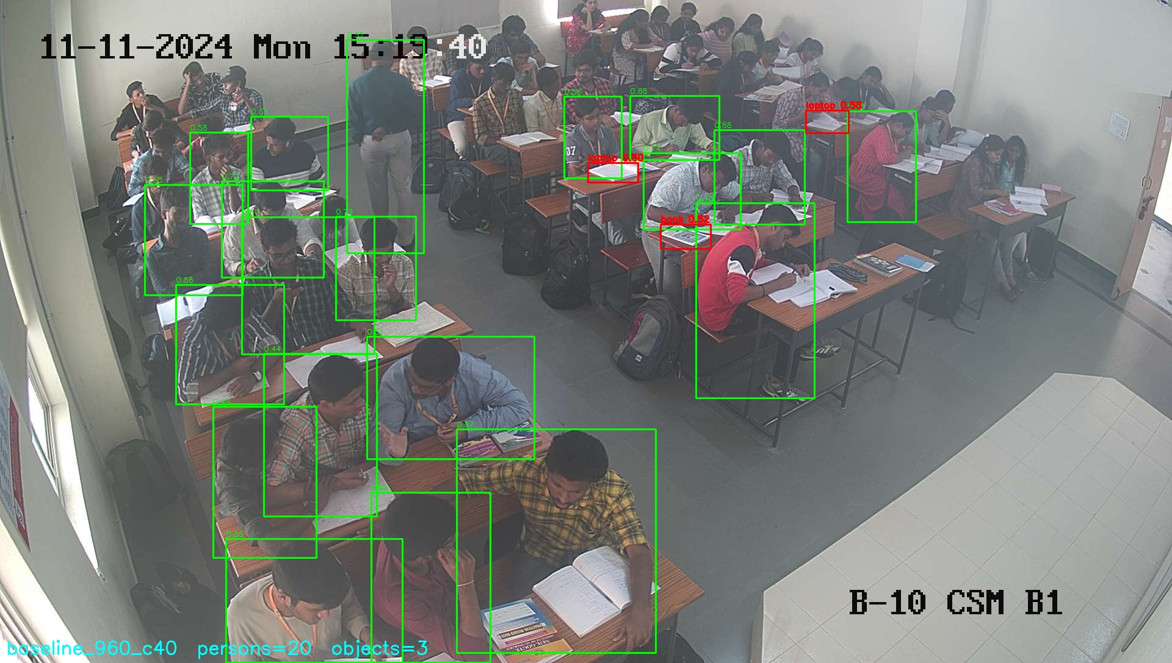
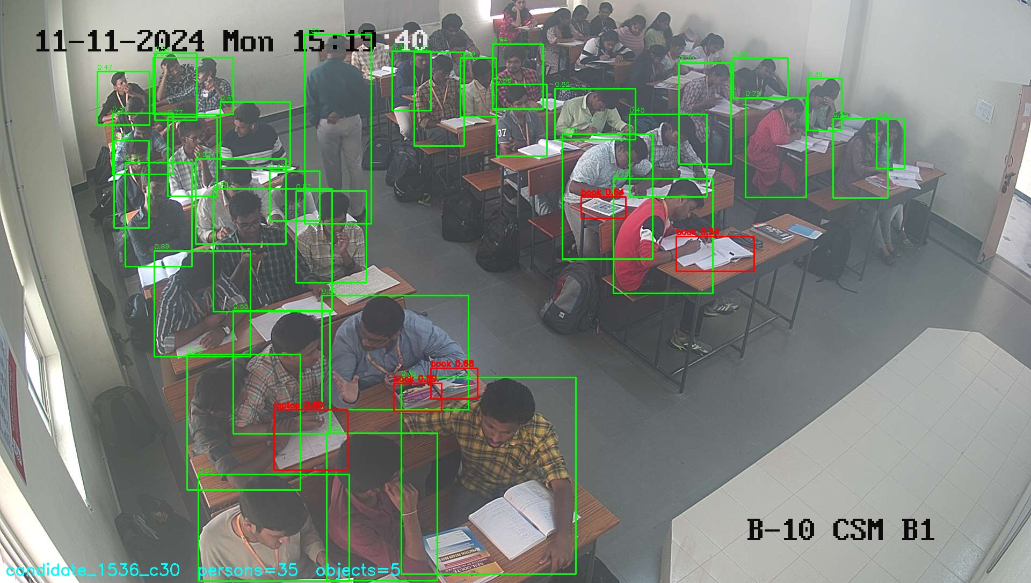
CRITERION 5 — RESULTS
Measured improvements, before and after
Every figure below is from a real run on real classroom images in this repository — not an estimate.
Metric | Before | After | Change
Persons detected — 12-image classroom set | 139 | 236 | +70%
Persons detected — img01.jpg (~42 visible, counted by eye) | 20 (48%) | 30 (71%) | recall +23 pts
Faces detected on real footage — same 12 images | 0 | 95 | 0 → usable
Gaze label “down” reachable at all | No (bug) | Yes | fixed
Automated tests passing | 10 (9 skipped) | 109 (0 skipped) | +99
Throughput, 4K video on RTX 4050 | 11.0 FPS | 7.8 FPS | cost of posture
BEFORE — 960 px, conf 0.40 → 20 found
AFTER — 1536 px, conf 0.30 → 35 found
Why the throughput row is on this slide
Adding the body-pose fallback took us from 11.0 to 7.8 FPS. We are reporting the cost next to the benefit rather than quoting only the coverage gain — the trade is worth it for offline analysis, and it is the number a reviewer should be able to challenge us on.
Rendered at 1536 px so the extra boxes are easy to see. The shipped default is 1280 px (30 found, the number in the table) — 1536 finds a few more still, at 1.5× the compute cost.
ClassGraph · Review 2
12

Slide 13
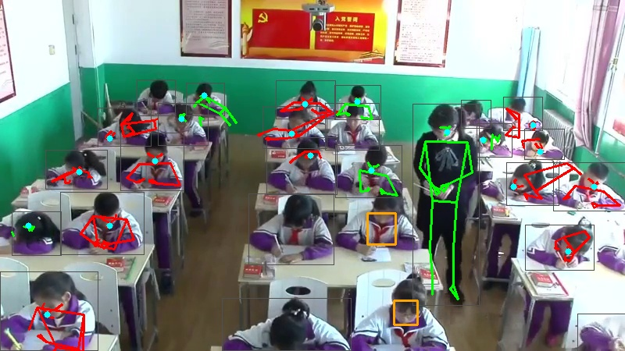
CRITERION 5 — PROBLEMS FACED (1 / 2)
Perception problems, root causes, and what we did
These were found by running the pipeline on real footage — none of them were visible in synthetic tests.
THE FALLBACK, WORKING
PROBLEM 1
PROBLEM 2
Camera angle — a hard ceiling, not a bug
Face detection returned zero faces on real footage
Real classroom cameras sit high in a rear corner. A student bowed over a desk shows the camera the crown of their head. We measured a ~45% ceiling on face availability: 130 of 236 detected students had no face that ANY face model could find.
Face Mesh was run once over the whole frame. MediaPipe downscales its input, so a face that is small relative to a 4K frame is destroyed before detection runs. Result: 0 faces on every real image, while synthetic tests passed.
Solution: Accepted it as a constraint instead of chasing it. Added a face-independent signal (body pose) so those students are still measurable — coverage went from 265/321 to 321/321.
Solution: Run Face Mesh per detected person crop instead. 0/139 → 95/139 faces. We also measured that padding the crop makes it worse, and shipped zero padding against our own initial intuition.
Body pose recovered for students with no detectable face. The single upright skeleton is the standing teacher — correctly distinguished from every seated student, which is a real check that the signal means something.
PROBLEM 3
PROBLEM 4
Back-row students missed entirely
Low-resolution input collapses face detection
Inference resolution 960 px shrank a 60 px student to ~30 px.
Measured 7% face rate below 480 px vs 44% at 720–1080 px.
→ imgsz 1280 + conf 0.30 → 139 to 236 persons.
→ Set a minimum capture resolution as a deployment requirement.
ClassGraph · Review 2
13

Slide 14
CRITERION 5 — PROBLEMS FACED (2 / 2)
Interpretation problems — and where we say “we cannot tell”
PROBLEM 5
PROBLEM 6 — THE TWO DISTRACTION CASES
Gaze direction was silently inverted
“Head down” means two different things
The head-pose model reports pitch as up-positive; our contract assumed down-positive. Students bowed over desks were being labelled “looking back/up”, and “down” could never fire at all. Confirmed by reading the library's own source, not guessed.
head_down_WITH_device
head_down_NO_device
Gaze down + a phone detected overlapping the student. Defensible behavioural reading → we do flag this.
Gaze down, nothing detected. Could be reading, writing, thinking — or disengaged. We refuse to guess.
Solution: negate at the source + a regression test pinning the convention. “down” labels went 0 → 6 on the same images; “back” 2 → 0.
THE PRINCIPLE WE ADOPTED
PROBLEM 7 — Peer interaction: a false positive we found and kept
Our geometric pair detector flagged its highest-confidence pair on real footage. We rendered it and looked: two students at different, non-adjacent desks, both bent over their own work, not interacting.
We documented the false positive in the code and measured that the proximity threshold is looser than real desk spacing — rather than quietly tuning it until the demo looked good.
Keep ambiguous cases ambiguous. BOSS — a validated human observation instrument — has the same unresolved confusion between “quiet, head down, working” and “quiet, head down, disengaged”. Forcing a confident split would be less honest than the established instrument itself.
ClassGraph · Review 2
14

Slide 15
ORIGINALITY
Three things we can do that no single pillar can do alone
Each needs identity AND relations AND time together — that is the argument for why all three pillars must coexist in one system.
01
02
03
See a student's attention as a trend, not a snapshot
Notice when distraction spreads between neighbours
Say “we don't know” instead of guessing
Because we know it's the same student for the whole class, we can draw one line per student across the entire lecture and point to exactly when it dropped — instead of a pile of disconnected per-frame guesses.
By connecting students who are near and facing each other, we can ask whether one student losing focus is followed by the student next to them doing the same — a pattern invisible if every student is analysed alone.
When a student's face is hidden, or two students could be discussing the lesson or just chatting, we report exactly that — instead of forcing a confident answer we can't actually back up. That's what makes the output safe to hand to a teacher.
Framed honestly: novel in combination and in this domain — not a claim to have invented a better Re-ID, scene-graph or group-activity method on its own. That's a defensible position for a course project and an honest one for a paper.
ClassGraph · Review 2
15

