Slide 1
23CSE304 · EMBEDDED SYSTEMS · CASE STUDY
HASTHA
A Multi-Modal Assistive Robotic Arm
STM32F401 · IR wireless · ADC teleoperation · Morse-to-text handwriting
Team: <Name 1 - Team Leader> · <Name 2> · <Name 3> · <Name 4>

Slide 2
WHY THIS PROJECT
The Problem
1
Locked in, unable to act
People with severe paralysis or speech loss (ALS, quadriplegia, locked-in syndrome) cannot speak, write, or move objects - even though their minds are sharp.
2
Existing options fall short
Assistive devices are costly and bulky, and low-cost robotic arms are single-mode and have no safety - so they are unsuitable for use near a person.
3
The gap
There is no affordable, multi-modal system that both communicates (writes) and manipulates (picks and places) - safely, on one small board.

Slide 3
STAKEHOLDERS
Who Faces This?
A
Persons with impairment
Need a way to communicate and handle objects that does not rely on fine motor control.
B
Caregivers & rehab centres
Need affordable tools that reduce dependence and support daily therapy.
C
People handling objects
Picking up medicine, a cup or a pen is impossible without help for limited-mobility users.
D
Small workshops & labs
Low-cost teleoperated pick-and-place for light, repetitive handling tasks.

Slide 4
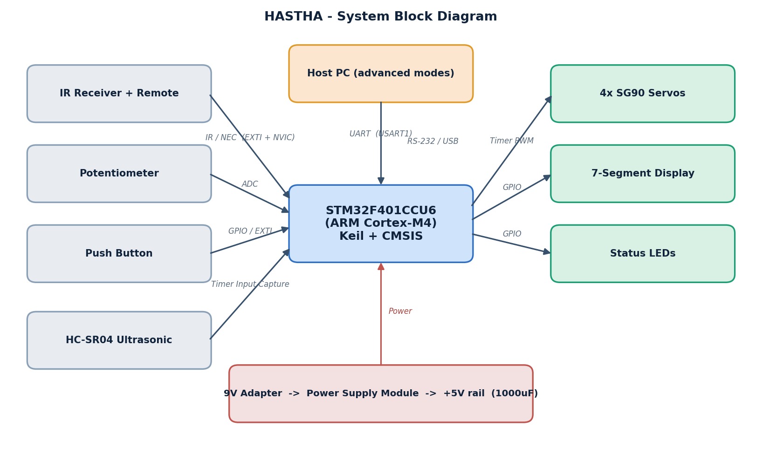
PROPOSED SYSTEM
Our Solution: HASTHA
An STM32F401 drives a 4-DOF arm (base, shoulder, elbow, gripper) with PWM. It accepts an IR remote, an analog potentiometer, and a PC link - and writes decoded Morse as letters on paper.
Figure 1 - HASTHA system block diagram

Slide 5
MULTI-MODAL
One Arm, Three Ways to Control
1
2
3
IR REMOTE
POTENTIOMETER
PC / MORSE
Wireless
ADC knob
Assistive
Press a button on an IR remote; the receiver decodes it (NEC) via an interrupt (NVIC) and the arm reacts. Satisfies the wireless requirement.
Turn a knob; its 0-3.3 V is read by the ADC (0-4095) and mapped to a joint angle in real time. Satisfies the ADC requirement.
Eye blinks are decoded to Morse on a PC and streamed over UART; the arm writes the letters and does pick-and-place.

Slide 6
WORKING PRINCIPLE
How It Moves: The Equations
1 - Servo rotation (angle -> PWM)
pulse (us) = 500 + ( angle x 2000 / 180 )
0 deg -> 500 us, 90 deg -> 1500 us, 180 deg -> 2500 us
2 - Reach a point (inverse kinematics)
cos(theta_elbow) = ( r^2 + z^2 - L1^2 - L2^2 ) / ( 2 . L1 . L2 )
theta_shoulder = atan2(z, r) - atan2(L2.sin theta_e , L1 + L2.cos theta_e)
3 - Write a capital letter
(x, y) on paper -> inverse kinematics -> theta_base, theta_shoulder, theta_elbow -> PWM
each letter = strokes of points; pen up/down by changing height z

Slide 7
MANIPULATION
Pick-and-Place
1
2
3
4
5
6
>
>
>
>
>
Position above object
Lower onto it
Close gripper - grasp
Lift up
Rotate base to drop
Open gripper - release
The same angle-control method is reused whether the target is an object to pick or a point on the paper to write.

Slide 8
HANDWRITING
Writing Capital Letters
LETTER
>
STROKES
>
INVERSE
KINEMATICS
>
PWM
>
PEN
e.g. "A"
points (x, y)
joint angles
servo pulses
traces on paper
Each capital letter is stored as straight strokes on a small grid (A = two slanted lines + one cross-bar).
Every stroke point is scaled to the letter size and run through the inverse-kinematics equations, so the pen tip traces the shape. The pen lifts between strokes by raising the target height z.

Slide 9
WHAT WE USE
Hardware Components
STM32F401CCU6
ARM MCU - the brain
SG90 Servo x4
Arm joints - Timer PWM
IR Receiver + Remote
Wireless control - IR/NVIC
Potentiometer
Manual control - ADC
7-Segment Display
Status output - GPIO
HC-SR04 Ultrasonic
Emergency stop - Timer capture
USB-to-Serial
PC link - UART
Power module + 9V + caps
Regulated 5 V rail

Slide 10
GUIDELINE COMPLIANCE
Meets Every Requirement
✓
STM32F401 microcontroller
Blackpill F401 - required MCU
✓
Wireless protocol
IR remote + receiver (NEC)
✓
ADC / digital interface
Potentiometer via ADC + GPIO
✓
NVIC interrupts
IR, timers, echo capture, UART RX
✓
Display interface
7-segment display
✓
External protocol
UART (USART1) to PC
✓
Keil + CMSIS
Firmware toolchain
✓
Breadboard build
Circuit on breadboard

Slide 11
WHERE IT HELPS
Applications
1
Assistive communication
Blinks -> Morse -> the arm writes the message as capital letters on paper.
2
Pick-and-place handling
Pick a small object and place it at a target using stored or computed angles.
3
Assisted daily handling
Fetch or move small items - medicine, a cup, stationery - for limited-mobility users.
4
Rehabilitation & therapy
A controllable, safe arm for guided exercises and interaction.

Slide 12
HASTHA
Write. Pick. Place.
One low-cost STM32F401 arm - multi-modal, assistive, and safe.
Thank you · Live demonstration to follow

