Slide 1
Deep Learning (CS 898-BD)
Fall 2023
Course Presenter:
Sai Karthik Garnepudi Dr. Shruti Kshirsagar

Slide 2
Office Hours
Office Location:
Sai Karthik Garnepudi: Room 244, Jabara Hall
Dr. Shruti kshirsagar: Room 210, Jabara Hall
Office Hours:
Sai Karthik Garnepudi or Dr. Shruti kshirsagar: Tuesday-Thursday 2-4 pm
Classroom Day/Time:
Monday (8-9.15 am) Jabara Hall, Room-226
Wednesday (8-9.15 am) Jabara Hall, Room-226

Slide 3
Deep learning
• Instructor: Sai Karthik Garnepudi, Dr. Shruti Kshirsagar
Department: School Of Computing
Contact information:
• Email
Sai karthik garnepudi: saikarthik.garnepudi@wichita.edu
Dr. Shruti kshirsagar: kshirsagarshruti1@gmail.com

Slide 4
TA information
• Teaching Assistant & TA Contact: TBA

Slide 5
Prerequisites
Basic knowledge of Probability Theory/statistics (STAT761 Statistics), calculus (MATH 242) and linear algebra (MATH011 ,MATH012, Mathematics) is required. it is a graduate-level course.
The course is intended for hard-working, highly motivated students.
Participants will be expected to display initiative, creativity, scientific rigour, critical thinking, and good communication skills.
Basic knowledge of python language: Tutorials will be given on python basics and required softwares
Prerequisites: python, CS 770, CS797O, or instructor’s consent.

Slide 6
Online Tutorial Links
Python Tutorial:
http://web.stanford.edu/class/cs224n/readings/cs224n-python-review.pdf
Pytorch tutorial: https://colab.research.google.com/drive/13HGy3-
uIIy1KD_WFhG4nVrxJC-3nUUkP?usp=sharing
https://pytorch.org/tutorials/beginner/basics/intro.html
Tensorflow & Keras : Google Co-lab Introduction Video

Slide 7
Useful Online Courses covering the Prerequisites
Prof. Gilbert Strang's video lectures on linear algebra.
Prof. John Tsitsiklis's video lectures on Applied Probability.
Prof. Krishna Jagannathan's video lectures on Probability Theory.
Prof. Deepak Khemani's video lectures on Artificial Intelligence.
Notes:
In response to the agreement, a faculty senate sub-committee was organized to look at accessibility issues surrounding textbooks and other class resources. On April 23, 2018, the Faculty Senate ratified the following statement regarding accessibility and course materials: “The Faculty at Wichita State University are committed to providing the highest quality instruction for all students. As a part of that commitment, we make continual efforts to seek new information and methods to teach in our subject areas.
Instructional content at WSU is the responsibility of the faculty teaching each individual course; the accessibility of that content is also the responsibility of that faculty, and as we do many other critical issues, we will take accessibility into account as we consider textbooks, resources, and tools for our classes.

Slide 8
Course description
Deep Learning course is designed to provide a comprehensive and practical
understanding of the fundamentals and recent advances in the area of deep learning.
Our focus will be on neural network-type models including convolutional neural
networks and recurrent neural networks such as LSTMs. We will also review recent
work on attention mechanism and efforts to incorporate memory structures into neural network models.
We will also consider some of the modern neural network-base
generative models such as Generative Adversarial Networks and Variational
Autoencoders.

Slide 9
Course Main objective
Upon successful completion of this course, students will be:
Delve into the theoretical foundations of deep learning and gain hands-on experience in implementing deep neural networks using popular frameworks like TensorFlow or PyTorch.
Course Main objective:
Understand the application, concepts, techniques, and fundamentals of various deep learning algorithms.
Develop Deep Learning approaches/techniques to solve various problems.
Develop, design, train and debug and evaluate Deep Learning algorithms to solve
various problems.
To gain experience doing independent study and research.

Slide 10
Reference book
Introduction to Deep Learning, Eugene Charniak
Deep Learning, Ian Goodfellow, Yoshua Bengio, and Aaron Courville
Deep Learning with Python, Francois Chollet
Dive into Deep Learning, Aston Zhang et al
Reference/supplemental materials: The course will be supplemented by additional
reading on programming languages. This reading material will be handed out in class or will be available on blackboard. Lecture notes will be based on the above text book but will not be exclusively taken from it.

Slide 11
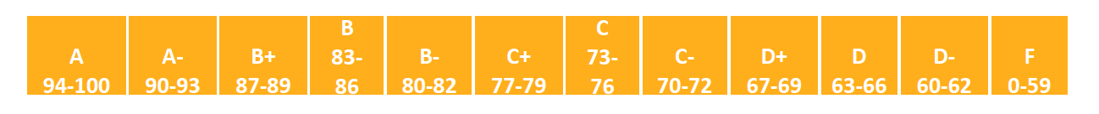
Grade Evaluation
Your letter grade will be based on the following components:
Assignments- 40 %
Final Exam- 30%
Project- 30%
Your final course grade will be based on the following:

Slide 12
Assignments
There will be four assignments
1. Convolutional Neural Network
2. Recurrent Neural Network
3. Transformer
4. Generative Adversarial Network

Slide 13
Important Dates
1st Assignment Due: Week 4-5
2nd Assignment Due: Week 7-8
3rd Assignment Due: Week 10-11
4th Assignement Due: Week 13-14
Final Exam: date and location TBA

Slide 14
Late Assignments
Each student will have a total of three free late (calendar) days to use for homeworks.
Once these late days are exhausted, any assignments turned in late will be penalized.
20% per late day. However, no assignment will be accepted more than three days after its due date.
Each 24 hours or part there of that a homework is late uses up one full late day.

Slide 15
Homework Assignment & Missed Exams
Homework Assignments
Home assignments, and their due dates, will be announced in class, and
posted on the course’s Blackboard page.
Late assignment policy: Late Assignments will be accepted up to 2 days past
the due day, with 20% late penalty. Makeup exams will only be given for strong
reasons (with documented proof.)
Missed Exams
Makeup for missed exams will be given only when there is an emergency,
with clear proof. It is your responsibility to provide the proof. It is also
recommended that, you should talk to me before the exam.

Slide 16
Academic Dates
August 21th, 2023: First day of classes
October 27th , 2023: Last day to withdraw from course with W (“withdrawn”)
Dec 3rd, 2023: Last day of classes
Dec …., 2023: Final Exam Period

Slide 17
Attendance policy
Attendance: You are required to attend each class. Proper documentation is required for all University excused absences. You are responsible for all course material presented and no make-up quizzes/tests will be administered for non-excused absences. A request for an excused or rescheduled exam or
presentation must be made in person at least one week before the regularly scheduled exam/presentation date (except in unavoidable situations, such as a medical emergency) and is at the discretion of the instructor.

Slide 18
Disabilities
If you have a physical, psychiatric/emotional, or learning disability that may
impact on your ability to carry out assigned course work, I encourage you to
contact the Office of Disability Services (DS).The office is located in Grace
Wilkie, room 203, (316) 978-3309 (voice/tty) (316-854-3032 videophone).
DS will review your concerns and determine, with you, what academic
accommodations are necessary and appropriate for you. All information and
documentation of your disability is confidential and will not be released by DS
without your written permission.

Slide 19
Academic Honesty
Violations of the Academic Honesty Policy, including but not limited to plagiarism, unauthorized distribution of course materials, possession of banned electronic devices, etc., will result in the following penalties:
1. First offense: A zero on the assignment or exam.
2. Second offense: An F in the course.

Slide 20
Final and Missed Exams
Exam Information: Final exam is in-person and mandatory. You must be able to attend or make alternative arrangements for your exam to be proctored elsewhere.
Missed Exams
To be eligible to make up a missed exam, the student must provide documentation as to the reason for missing work/exams. The student MUST contact the instructor BEFORE the exam if possible.

Slide 21
Tentative Schedule
1 Introduction, Recap-ML, Neural Network basic
2 Deep Neural Network
3 Convolutional Neural Network, Assignment 1-CNN
4 Recurrent Neural Network
5. Practical Aspects of Deep Learning, Optimization method for training NN.
6. Regularization of NN Hyperparameter tuning, and Programming Frameworks Assignment 2-RNN
7. Batch Normalization, Normalization method Project paper selection
8.Attention mechanism, Memory Models

Slide 22
Tentative Schedule
9.Transformer Networks Assignment 3-Transformer
10.Meta Learning
11.Autoencoder, Variational Autoencoder
12.Generative Adversarial network Assignment 4-GAN
13.Autoregressive Generative Models
14.RBMs and DBMs
Final Exam, Project submission and report and presentation

Slide 23
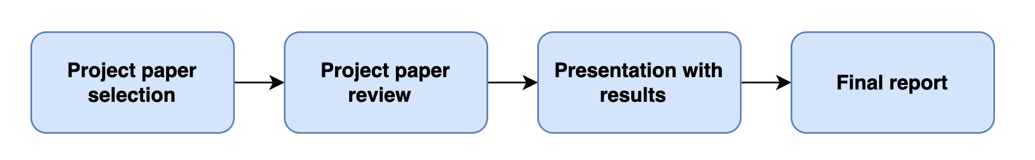
Project
One of the main goals of this course is to prepare you to develop deep learning systems of practical use. If you are interested in research, this course should also leave you well-qualified to do research in deep learning in an academic setting. The final project in this course will offer you an opportunity to do exactly this.

Slide 24
Project logistics
Project paper selection- Week 3-Week 5
Project paper review -Week 5-Week 7
Implementation Presentation with review-Week 7- Week 13-14
Final report-Week 15

Slide 25
Future roadmap

Slide 26
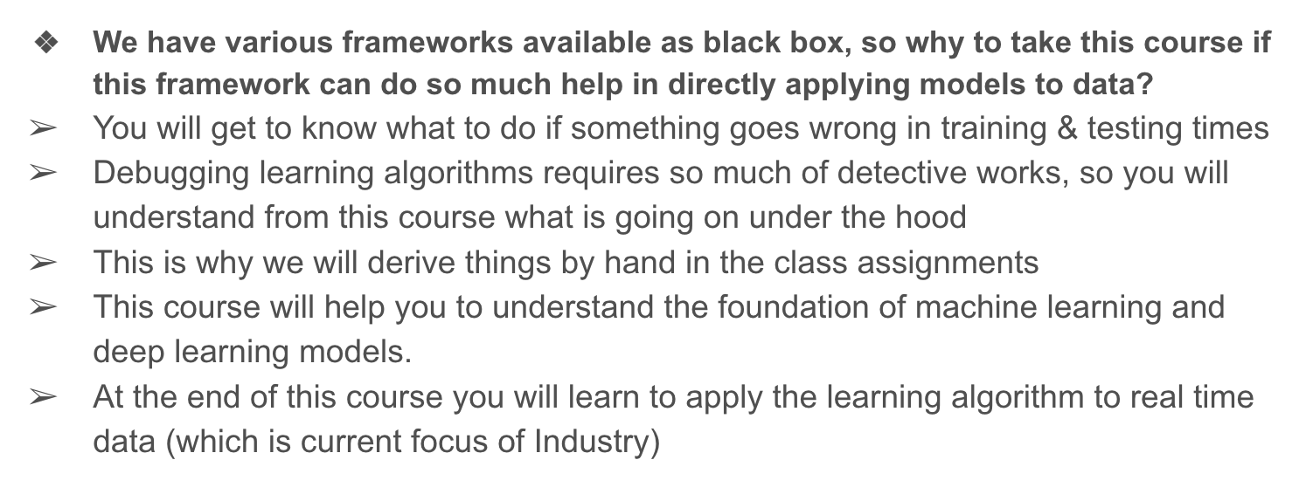
Future Roadmap

Slide 27
Next class topic
Introduction- Machine Learning & Deep Learning
Recap-Machine Learning

Slide 28
Questions?
Sai Karthik Garnepudi
saikarthik.garnepudi@wichita.edu
Dr.Shruti Kshirsagar
Kshirsagarshruti1@gmail.com

Slide 29
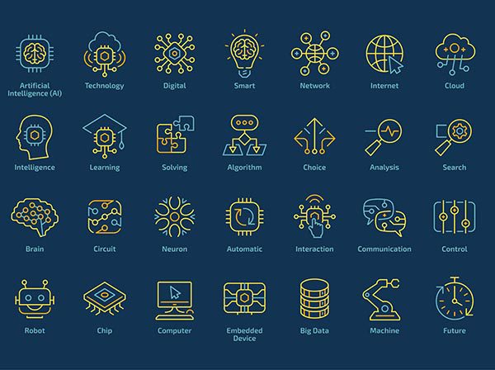
Introduction to Machine Learning:
What is Machine Learning ?
How and where can we use machine learning ?
Real time applications : Examples
History of Machine learning

Slide 30
Introduction to Machine Learning:
What is Machine Learning ?
Machine learning is a subset of artificial intelligence that enables computer systems to learn from data and perform tasks normally requiring human intelligence

Slide 31
Introduction to Machine Learning:
How and where can we use machine learning ?
Machine Learning is currently being used in every sector and is considered as a key aspect in every field from Mass manufacturing facilities to medical science, agriculture, astronomy.
ML is used to predication, analysis and providing data with precision.

Slide 32
Introduction to Machine Learning:
Real time applications : Examples
Amazon: Product recommendations
Healthcare: Diagnosis for neurological diseases
Bank of America: Financial Accuracy
Google: Email spam filtering

Slide 33


Slide 34
Introduction to Machine Learning:
History of Machine learning
This was first used as early as 1952 by IBM for a game of checkers : Arthur Samuel
Alan Turning creates a “TURNING TEST” in 1950
Frank Rosenblatt designed the first neural network for computers (the perceptron), which simulate the thought processes of the human brain in 1957

Slide 35
Introduction to Machine Learning:
History of Machine learning
The “nearest neighbor” algorithm was written, allowing computers to begin using very basic pattern recognition. This could be used to map a route for traveling salesmen, starting at a random city but ensuring they visit all cities during a short tour in 1967
Students at Stanford University invent the “Stanford Cart” which can navigate obstacles in a room on its own in 1979
Gerald Dejong introduces the concept of Explanation Based Learning (EBL), in which a computer analyses training data and creates a general rule it can follow by discarding unimportant data in 1981

Slide 36
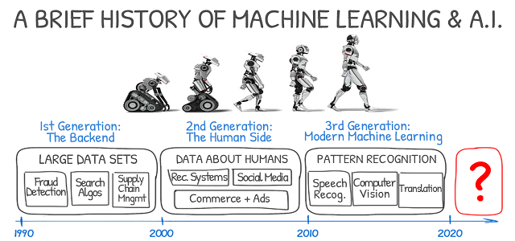
History of Machine Learning:

Slide 37
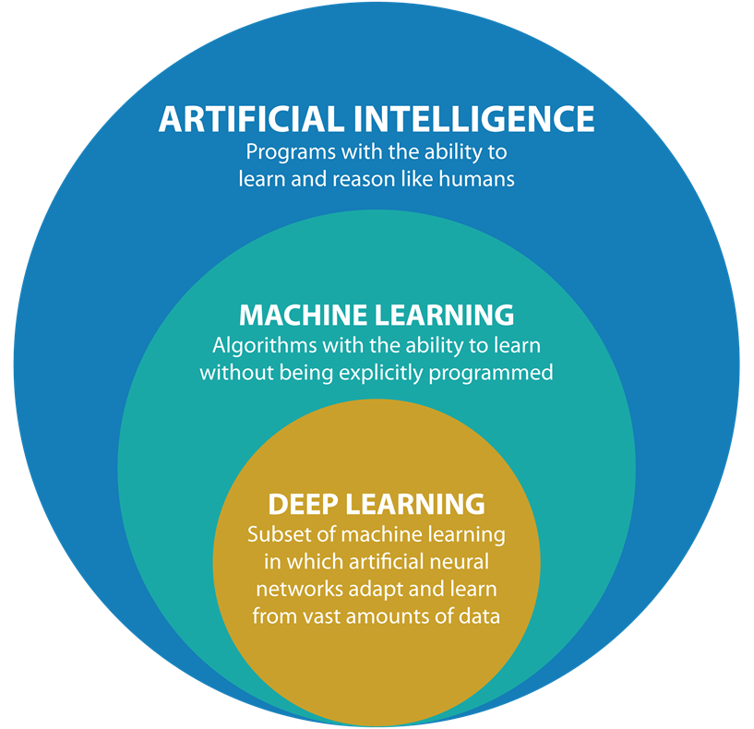
Difference Between AI , ML and DL

Slide 38
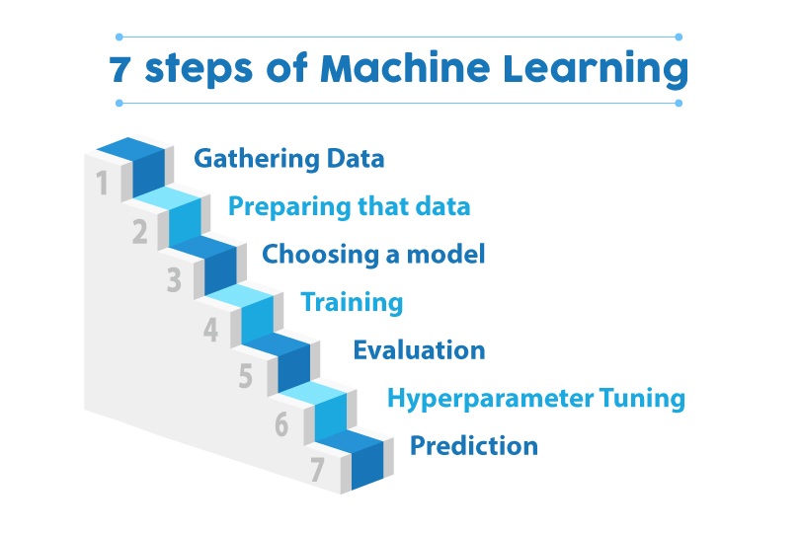
Basics of Machine Learning:
Let’s understand the Basics of Machine Learning?

Slide 39
Basics of Machine Learning:
Machine Learning is generally categorized into 3 departments mainly
Supervised Learning
2. Unsupervised Learning
3. Reinforcement Learning

Slide 40
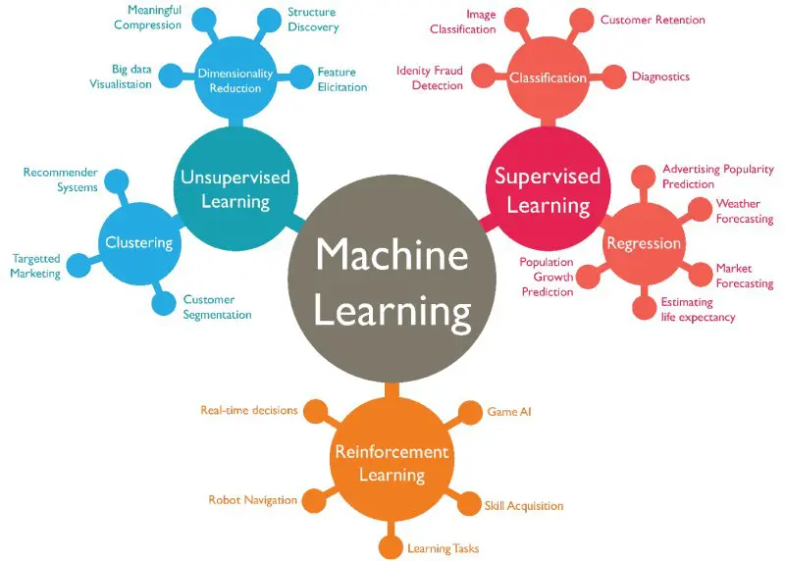
Supervised Vs Unsupervised Vs Reinforcement:

Slide 41
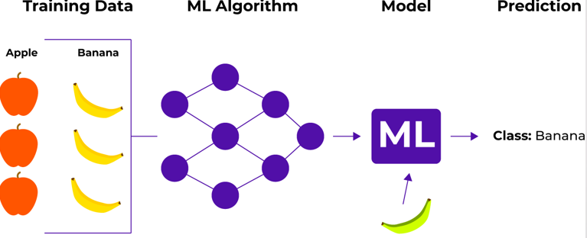
Supervised Learning:

Slide 42
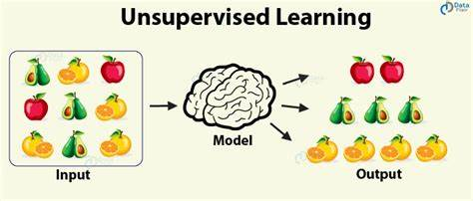
Unsupervised Learning:

Slide 43
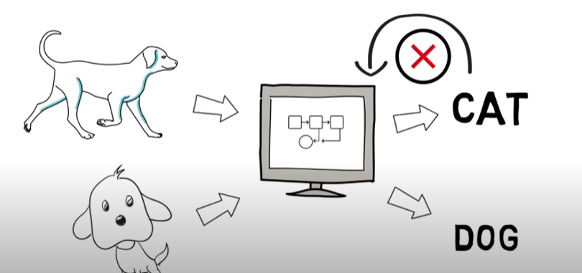
Reinforcement Learning:

Slide 44
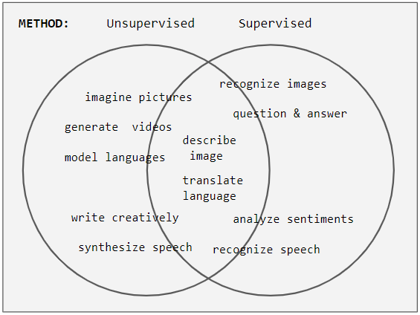
Semi-supervised Learning:

Slide 45
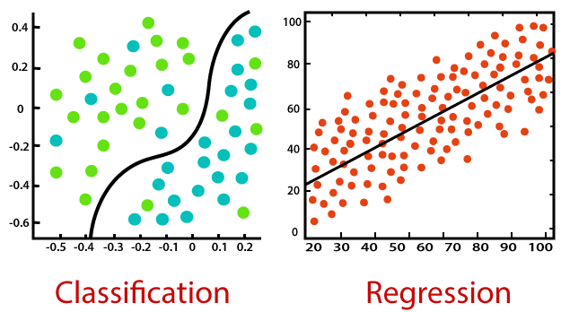
Supervised: Classification Vs Regression:

Slide 46
Supervised Learning: Classification Learning:
Classification is a process of finding a function which helps in dividing the dataset into classes based on different parameters. In Classification, a computer program is trained on the training dataset and based on that training, it categorizes the data into different classes.
Example: The best example to understand the Classification problem is Email Spam Detection. The model is trained based on millions of emails on different parameters, and whenever it receives a new email, it identifies whether the email is spam or not. If the email is spam, then it is moved to the Spam folder.
Machine Learning Classification Algorithms:
Logistic regression, Support vector machines, Decision tree and random Forest

Slide 47
Supervised Learning: Regression Learning:
Regression is a process of finding the correlations between dependent and independent variables. It helps in predicting the continuous variables such as prediction of Market Trends, prediction of House prices, etc.
Example: Suppose we want to do weather forecasting, so for this, we will use the Regression algorithm. In weather prediction, the model is trained on the past data, and once the training is completed, it can easily predict the weather for future days.
Machine Learning Regression Algorithms:
Simple Linear Regression, Multiple Linear regression and Polynomial regression

Slide 48
Unsupervised Learning: Clustering Learning:
Clustering or cluster analysis is a machine learning technique, which groups the unlabeled dataset. It can be defined as "A way of grouping the data points into different clusters, consisting of similar data points. The objects with the possible similarities remain in a group that has less or no similarities with another group.“
It is an unsupervised learning method; hence no supervision is provided to the algorithm, and it deals with the unlabeled dataset.
Example: it is used by the Amazon in its recommendation system to provide the recommendations as per the past search of products. Netflix also uses this technique to recommend the movies and web-series to its users as per the watch history.
Machine learning regression algorithms: Density-based, fuzzy and hierarchal clustering

Slide 49
Perceptron:
A Perceptron, in machine learning, is an algorithm that is used in supervised learning of binary classifiers.
Input Nodes or Input Layer:
This is the primary component of Perceptron which accepts the initial data into the system for further processing. Each input node contains a real numerical value.
Wight and Bias:
Weight parameter represents the strength of the connection between units. This is another most important parameter of Perceptron components. Weight is directly proportional to the strength of the associated input neuron in deciding the output. Further, Bias can be considered as the line of intercept in a linear equation.

Slide 50
Perceptron:
Activation Function:
These are the final and important components that help to determine whether the neuron will fire or not. Activation Function can be considered primarily as a step function.
Types of Activation functions:
Sign function
Step function, and
Sigmoid function

Slide 51
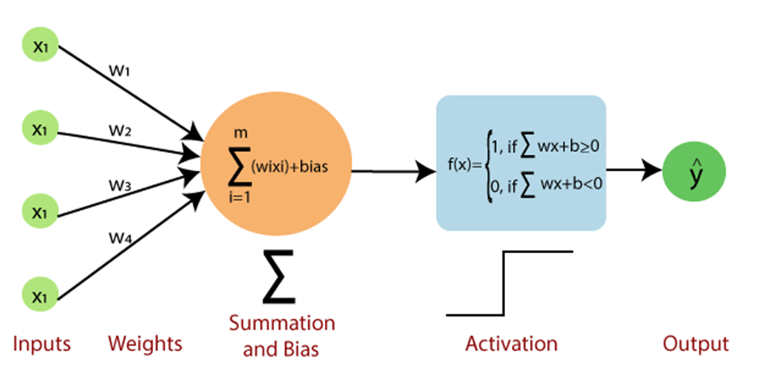
Perceptron:

Slide 52
Perceptron:
f(x)=1; if w.x+b>0
otherwise, f(x)=0
w' represents real-valued weights vector
'b' represents the bias
'x' represents a vector of input x values.
Based on the layers, Perceptron models are divided into two types. These are as follows:
Single-layer Perceptron Model
Multi-layer Perceptron model

Slide 53
Perceptron:
Limitations of Perceptron Model
A perceptron model has limitations as follows:
The output of a perceptron can only be a binary number (0 or 1) due to the hard limit transfer function.
Perceptron can only be used to classify the linearly separable sets of input vectors. If input vectors are non-linear, it is not easy to classify them properly.

Slide 54
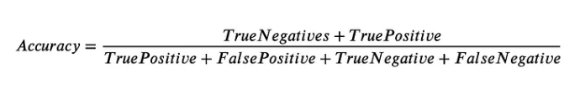
Evaluation method-accuracy, F1 score:
Accuracy is an evaluation metric that allows you to measure the total number of predictions a model gets right. The formula for accuracy is below:
Accuracy will answer the question, what percent of the model predictions were correct? Accuracy looks at True Positives and True Negatives.

Slide 55
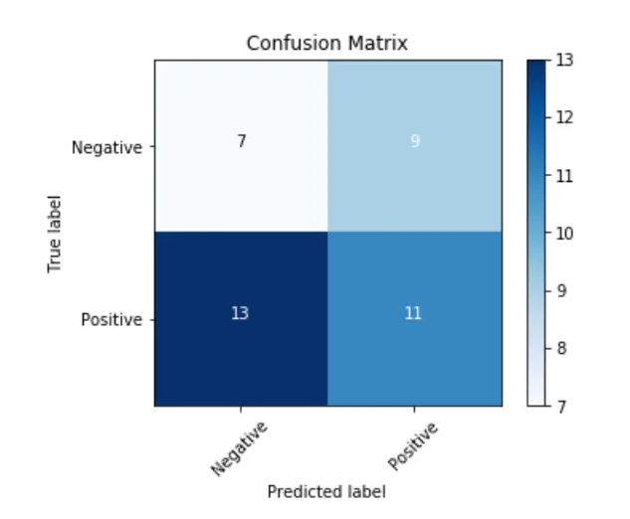
Evaluation method-accuracy, F1 score:

Slide 56
Evaluation method-accuracy, F1 score:
F1 score is a machine learning evaluation metric that measures a model’s accuracy. It combines the precision and recall scores of a model.
The accuracy metric computes how many times a model made a correct prediction across the entire dataset. This can be a reliable metric only if the dataset is class-balanced; that is, each class of the dataset has the same number of samples.
How do we calculate F1 score ?

Slide 57
Evaluation method-accuracy, F1 score:
How do we calculate F1 score ?
To understand the calculation of the F1 score, we first need to look at a confusion matrix.
A confusion matrix represents the predictive performance of a model on a dataset. For a binary class dataset (which consists of, suppose, “positive” and “negative” classes), a confusion matrix has four essential components:
True Positives (TP): Number of samples correctly predicted as “positive.”
False Positives (FP): Number of samples wrongly predicted as “positive.”
True Negatives (TN): Number of samples correctly predicted as “negative.”
False Negatives (FN): Number of samples wrongly predicted as “negative.”

Slide 58
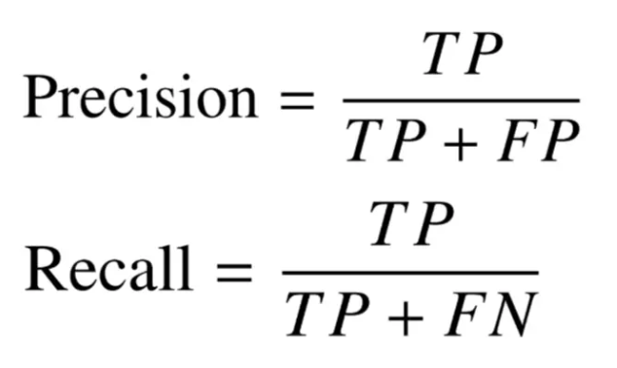
Evaluation method-accuracy, F1 score:
Using the components of the confusion matrix, we can define the various metrics used for evaluating classifiers—accuracy, precision, recall, and F1 score.
The F1 score is defined based on the precision and recall scores, which are mathematically defined as follows:

Slide 59
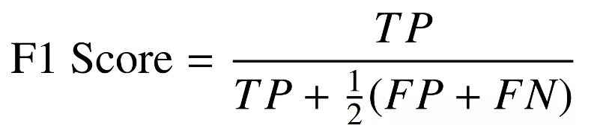
Evaluation method-accuracy, F1 score:

Slide 60
Under fitting Vs Overfitting:
Before understanding the overfitting and underfitting, let's understand some basic term that will help to understand this topic well:
Signal: It refers to the true underlying pattern of the data that helps the machine learning model to learn from the data.
Noise: Noise is unnecessary and irrelevant data that reduces the performance of the model.
Bias: Bias is a prediction error that is introduced in the model due to oversimplifying the machine learning algorithms. Or it is the difference between the predicted values and the actual values.
Variance: If the machine learning model performs well with the training dataset, but does not perform well with the test dataset, then variance occur

Slide 61
Under fitting Vs Overfitting:
Overfitting occurs when our machine learning model tries to cover all the data points or more than the required data points present in the given dataset. Because of this, the model starts caching noise and inaccurate values present in the dataset, and all these factors reduce the efficiency and accuracy of the model. The overfitted model has low bias and high variance.
The chances of occurrence of overfitting increase as much we provide training to our model. It means the more we train our model, the more chances of occurring the overfitted model.
Overfitting is the main problem that occurs in supervised learning.

Slide 62
Under fitting Vs Overfitting:
Underfitting occurs when our machine learning model is not able to capture the underlying trend of the data. To avoid the overfitting in the model, the fed of training data can be stopped at an early stage, due to which the model may not learn enough from the training data. As a result, it may fail to find the best fit of the dominant trend in the data.
In the case of underfitting, the model is not able to learn enough from the training data, and hence it reduces the accuracy and produces unreliable predictions.
An underfitted model has high bias and low variance.

Slide 63
Gradient Descent:
Gradient descent (GD) is an iterative first-order optimization algorithm used to find a local minimum/maximum of a given function. This method is commonly used in machine learning (ML) and deep learning(DL) to minimize a cost/loss function (e.g., in a linear regression). Due to its importance and ease of implementation, this algorithm is usually taught at the beginning of almost all machine learning courses.
However, its use is not limited to ML/DL only, it’s being widely used also in areas like:
control engineering (robotics, chemical, etc.)
computer games
mechanical engineering

Slide 64
Gradient Descent:
Advantages:
Gradient descent is an efficient algorithm that can handle large datasets and high-dimensional parameter spaces.
Gradient descent can be used with a variety of loss functions and machine learning models, including linear regression, logistic regression, and neural networks.
Gradient descent updates the model parameters incrementally, which means it can converge to the optimal solution faster than other optimization algorithms.
Gradient descent can be easily parallelized, allowing for faster optimization on multiple processors.

Slide 65
Gradient Descent:
Disadvantages:
Gradient descent can be sensitive to the choice of learning rate, which determines the size of the step taken in each iteration. A learning rate that is too small can result in slow convergence, while a learning rate that is too large can cause the algorithm to overshoot the minimum and diverge.
Gradient descent can converge to local minima rather than the global minimum, especially in non-convex optimization problems.
While gradient descent is efficient for large datasets, it can still be computationally expensive for very large datasets or high-dimensional parameter spaces.

Slide 66
Stochastic Gradient Descent:
Stochastic Gradient Descent (SGD) is a variant of the Gradient Descent algorithm that is used for optimizing machine learning models. It addresses the computational inefficiency of traditional Gradient Descent methods when dealing with large datasets in machine learning projects.

Slide 67
Stochastic Gradient Descent:
Advantages of Stochastic Gradient Descent
Speed: SGD is faster than other variants of Gradient Descent such as Batch Gradient Descent and Mini-Batch Gradient Descent since it uses only one example to update the parameters.
Memory Efficiency: Since SGD updates the parameters for each training example one at a time, it is memory-efficient and can handle large datasets that cannot fit into memory.
Avoidance of Local Minima: Due to the noisy updates in SGD, it has the ability to escape from local minima and converges to a global minimum.

Slide 68
Stochastic Gradient Descent:
Disadvantages of Stochastic Gradient Descent
Noisy updates: The updates in SGD are noisy and have a high variance, which can make the optimization process less stable and lead to oscillations around the minimum.
Slow Convergence: SGD may require more iterations to converge to the minimum since it updates the parameters for each training example one at a time.
Sensitivity to Learning Rate: The choice of learning rate can be critical in SGD since using a high learning rate can cause the algorithm to overshoot the minimum, while a low learning rate can make the algorithm converge slowly.
Less Accurate: Due to the noisy updates, SGD may not converge to the exact global minimum and can result in a suboptimal solution. This can be mitigated by using techniques such as learning rate scheduling and momentum-based updates.

Slide 69
Parametric Vs non-parametric:
Parametric model: its capacity is fixed and does not increase with the amount of training data
‣ examples: linear classifier, neural network with fixed number of hidden units, etc.
Non-parametric model: the capacity increases with the amount of training data
‣ examples: k nearest neighbors' classifier, neural network with adaptable hidden layer size, etc.

Slide 70

Next Class: Neural Network

