Slide 1
Deep Learning (CS 898-BD)
Fall 2023
Dr. Shruti Kshirsagar
Sai Karthik Garnepudi

Slide 2
Contents:Recap of last class
What is NN
Activation functions
Capacity of single Neurons
Multilayer Neural Network
Universal approximation
Biological inspiration
Gradient Computation
Backpropagation
Regularization
Knowing when to stop

Slide 3
Contents:
Parameter initialization
Model selection
Optimization
Gradient descent
Tutorial on MNIST data- code and example

Slide 4
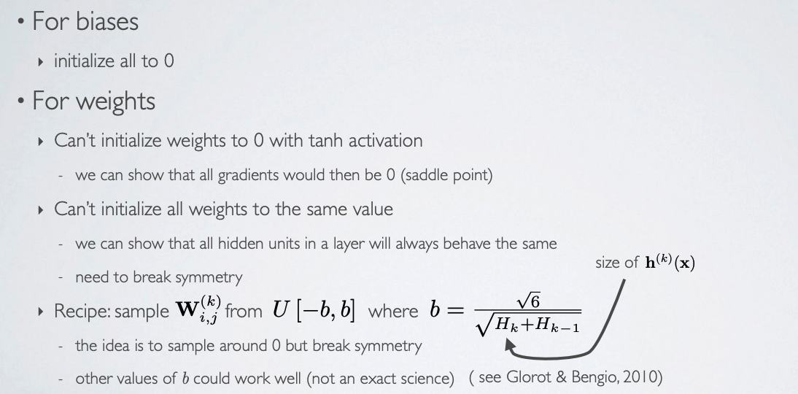
Parameter initialization

Slide 5
Different methods:
Zero or constant initialization:
Random Initialization
Xavier or Glorot Initialization
He Initialization

Slide 6
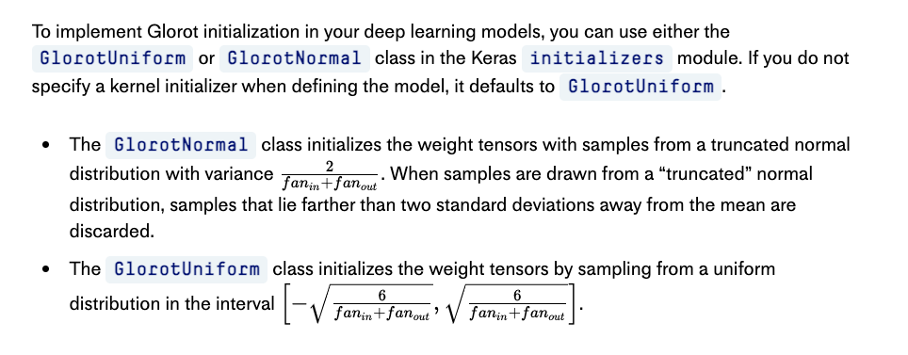
Glorot Initialization

Slide 7
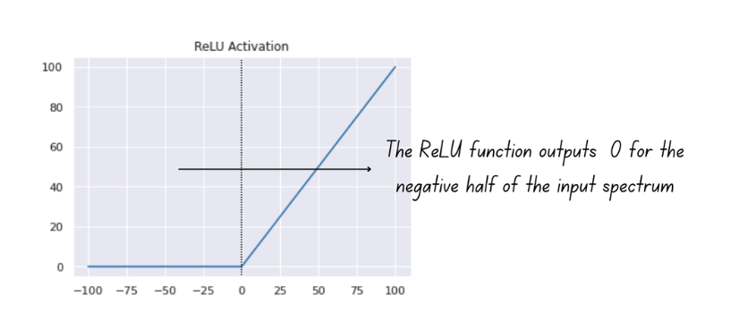
He initialization

Slide 8
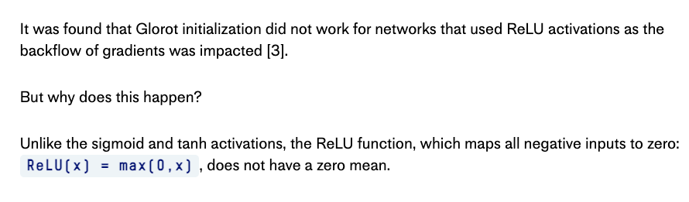
He Initialization

Slide 9
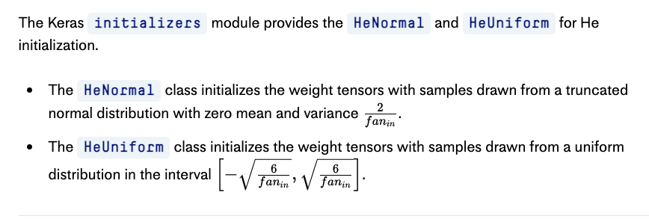
He Initialization

Slide 10
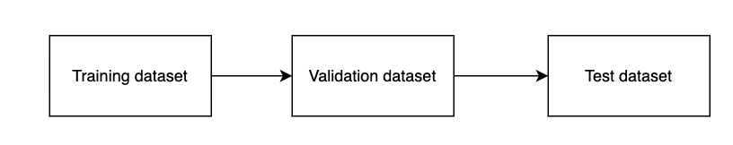
Model selection

Slide 11
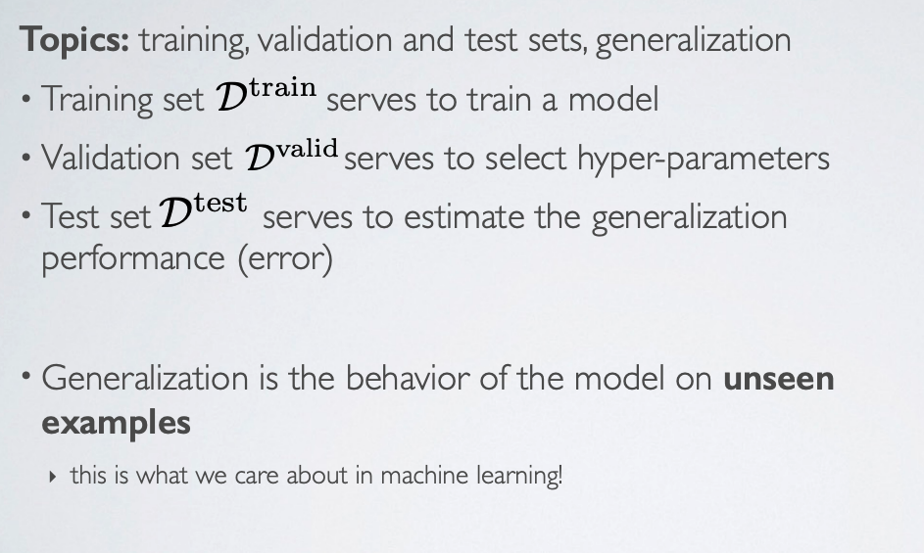
Model Selection

Slide 12
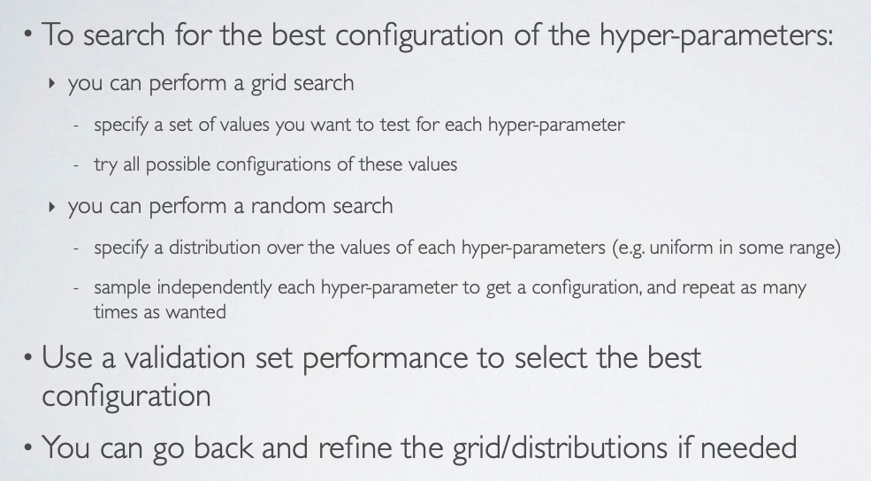
Model selection

Slide 13
Model Selection
Hyper parameter Tuning:
Optimization methods
Learning rate
Loss function
Number of Neurons in hidden layers
Number of layers
Batch size
Dropout
Activation functions
Network weight Initialization

Slide 14
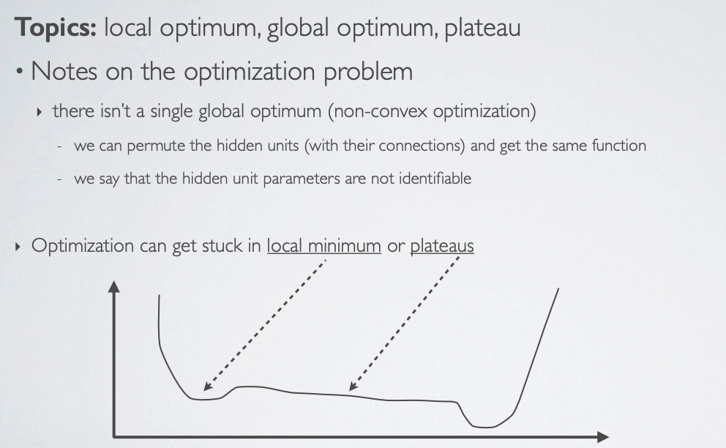
Optimization methods

Slide 15
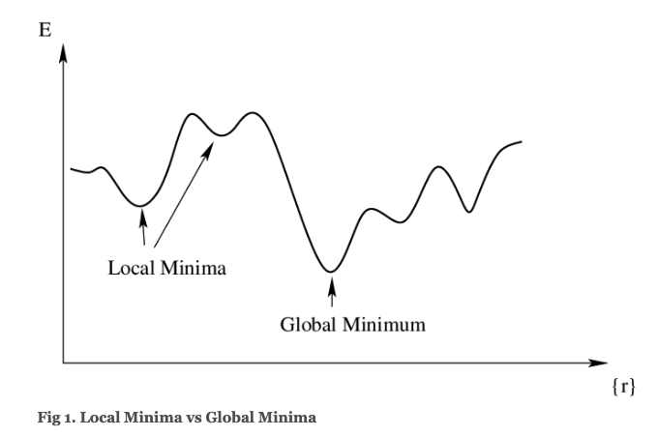
Example

Slide 16
Optimization methods
Gradient descent
Adaptive Gradient descent
ADAM
RMSprop

Slide 17
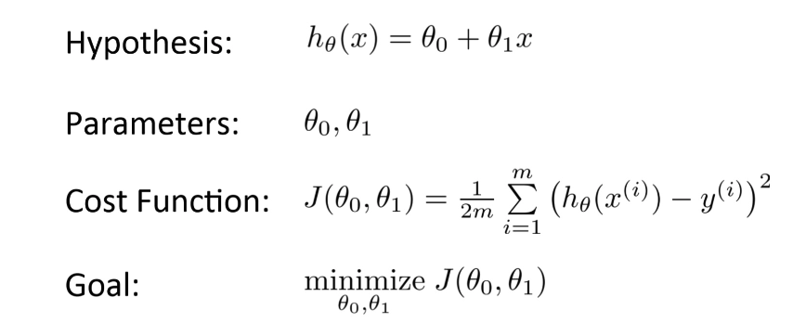
Gradient Descent

Slide 18
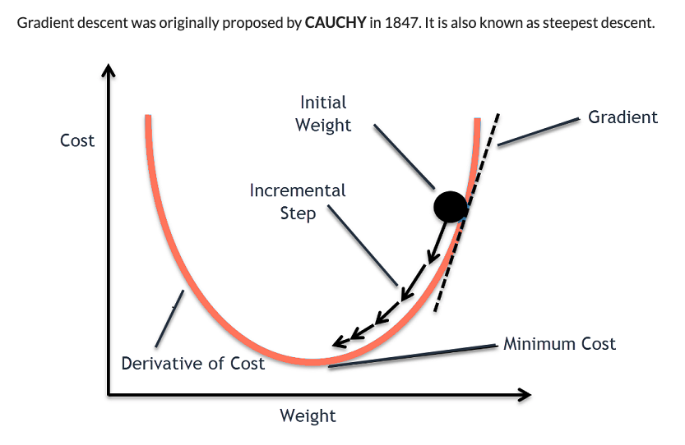
Gradient Descent

Slide 19
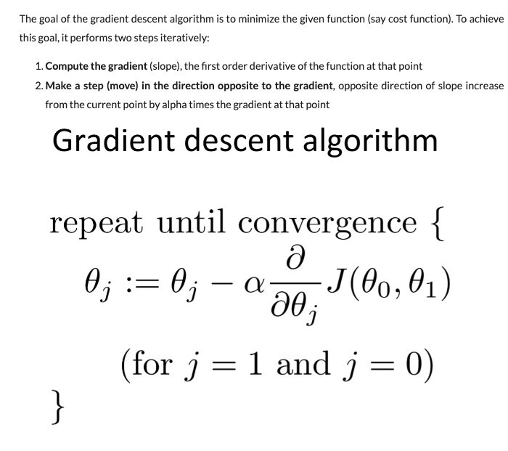
Gradient Descent

Slide 20
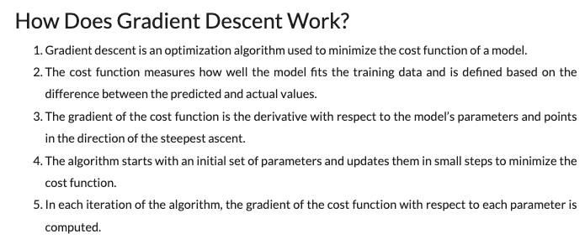
Gradient Descent

Slide 21
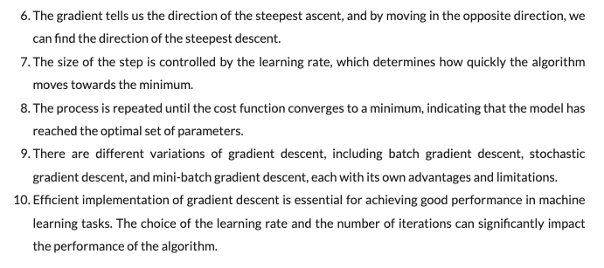
Gradient Descent

Slide 22
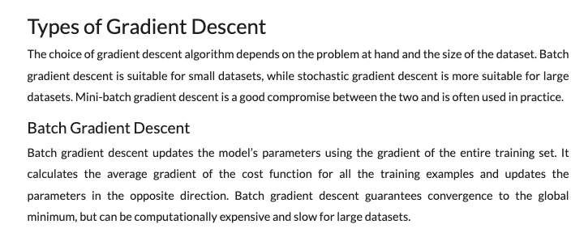
Gradient Descent

Slide 23
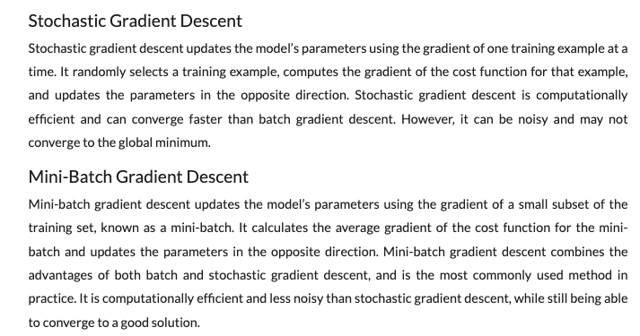
Gradient Descent

Slide 24
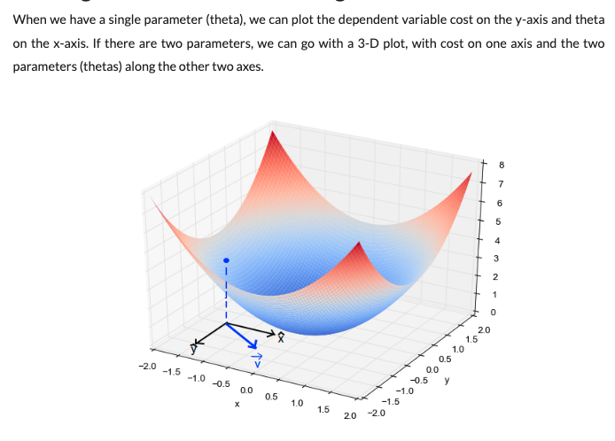
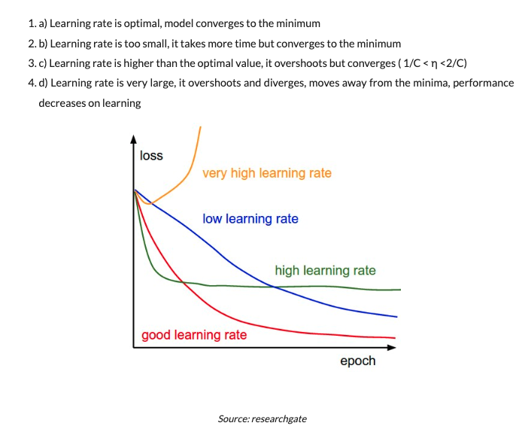
Gradient Descent

Slide 25
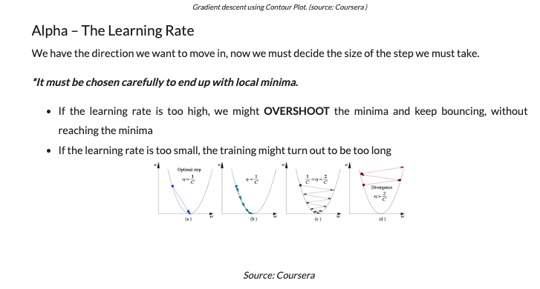
Gradient Descent

Slide 26
Gradient Descent

Slide 27
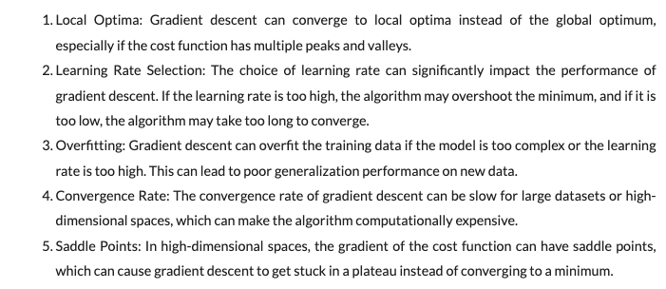
Challenges of Gradient Descent

Slide 28
Questions?
Sai Karthik Garnepudi
saikarthik.garnepudi@wichita.edu
Dr.Shruti Kshirsagar
Kshirsagarshruti1@gmail.com

Slide 29
References
1.https://www.pinecone.io/learn/weight-initialization/
2.https://www.analyticsvidhya.com/blog/2020/10/how-does-the-gradient-descent-algorithm-work-in-machine-learning/

Slide 30
Next class
Convolutional Neural Network

