Slide 1

APEX INSTITUTE OF TECHNOLOGY. AIT-IBM CSE CHANDIGARH UNIVERSITY, MOHALI

Slide 2
IMB/DBMS
CST – 251/CST-274
Session: Jan – May 2019

Slide 3

Unit-1
Overview of Databases: Database concepts, DBMS, Data Base System Architecture (Three Level ANSI-SPARC Architecture), Advantages and Disadvantages of DBMS, Data Independence, DBA and Responsibilities of DBA, Relational Data Structure, Keys, Relations, Attributes, Schema and Instances, Referential integrity, Entity integrity.
Data Models: Relational Model, Network Model, Hierarchical Model, ER Model: Design, issues, Mapping constraints, ER diagram, Comparison of Models.
Relational Algebra & Relational Calculus: Introduction, Syntax, Semantics, Additional operators, Grouping and Ungrouping, Relational comparisons, Tuple Calculus, Domain Calculus, Calculus Vs Algebra, Computational capabilities.
Apex Institute of Technology- CSE

Slide 4
Learning Objectives
To have good understanding of database system concepts and design databases for different applications.
To learn how to use a DBMS and RDBMS.
To implement and understand different types of DDL, DML and DCL statements.
To understand transaction concepts related to databases and recovery/backup techniques required for the proper storage of data.
Apex Institute of Technology- CSE

Slide 5
(Introduction to RDBMS)
Overview of Databases: Database concepts, DBMS, Data Base System Architecture (Three Level ANSI-SPARC Architecture), Advantages and Disadvantages of DBMS, Data Independence, DBA and Responsibilities of DBA, Relational Data Structure, Keys, Relations, Attributes, Schema and Instances, Referential integrity, Entity integrity.
Apex Institute of Technology- CSE

Slide 6

Common terms
Data: Facts, figures, statistics etc. having no particular meaning (e.g. 1, ABC, 19 etc).
Record: Collection of related data items, e.g. in the above example the three data items had no meaning. But if we organize them in the following way, then they collectively represent meaningful information.
Apex Institute of Technology- CSE

Slide 7
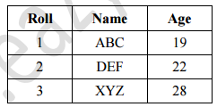
Introduction to RDBMS
Table or Relation: Collection of related records
The columns of this relation are called Fields, Attributes or Domains. The rows are called Tuples or Records.
Apex Institute of Technology- CSE

Slide 8
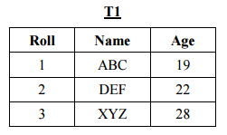
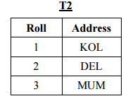
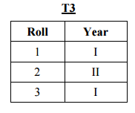
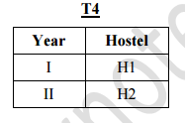
(Introduction to RDBMS)
Database: Collection of related relations. Consider the following collection of tables:
Apex Institute of Technology- CSE

Slide 9
Files and Databases
File: A collection of records or documents dealing with one organization, person, area or subject (Rowley)
Manual (paper) files
Computer files
Database: A collection of similar records with relationships between the records (Rowley)
Bibliographic, statistical, business data, images, etc.
Apex Institute of Technology- CSE

Slide 10
Purpose of Database Systems
In the early days, database applications were built directly on top of file systems
Drawbacks of using file systems to store data:
Data redundancy and inconsistency
Multiple file formats, duplication of information in different files
Difficulty in accessing data
Need to write a new program to carry out each new task
Data isolation — multiple files and formats
Integrity problems
Integrity constraints (e.g. account balance > 0) become “buried” in program code rather than being stated explicitly
Hard to add new constraints or change existing ones
Apex Institute of Technology- CSE

Slide 11
Purpose of Database Systems (Cont.)
Drawbacks of using file systems (cont.)
Atomicity of updates
Failures may leave database in an inconsistent state with partial updates carried out
Example: Transfer of funds from one account to another should either complete or not happen at all
Concurrent access by multiple users
Concurrent accessed needed for performance
Uncontrolled concurrent accesses can lead to inconsistencies
Example: Two people reading a balance and updating it at the same time
Security problems
Hard to provide user access to some, but not all, data
Database systems offer solutions to all the above problems
Apex Institute of Technology- CSE

Slide 12
Importance of DBMS
It helps make data management more efficient and effective.
Its query language allows quick answers to ad hoc queries.
It provides end users better access to more and better-managed data.
It promotes an integrated view of organization’s operations -- “big picture.”
It reduces the probability of inconsistent data.
Data Independence
Efficient data access
Data integrity and security
Data administration
Concurrent access and crash recovery
Apex Institute of Technology- CSE

Slide 13
Examples of Database Applications
Banking: all transactions
Airlines: reservations, schedules
Universities: registration, grades
Sales: customers, products, purchases
Online retailers: order tracking, customized recommendations
Manufacturing: production, inventory, orders, supply chain
Human resources: employee records, salaries, tax deductions
Apex Institute of Technology- CSE

Slide 14
Three Views of Data
Physical level: describes how a record (e.g., customer) is stored.
Logical level: describes data stored in database, and the relationships among the data.
View level: application programs hide details of data types. Views can also hide information (such as an employee’s salary) for security purposes.
The database can be viewed from different levels of abstraction to reveal different levels of details. From a bottom-up manner, we may find that there are three levels of abstraction or views in the database.
The term Abstraction is very important here. Generally it means the amount of detail you want to hide. Any entity can be seen from different perspectives and levels of complexity to make it a reveal its current amount of abstraction.
Apex Institute of Technology- CSE

Slide 15
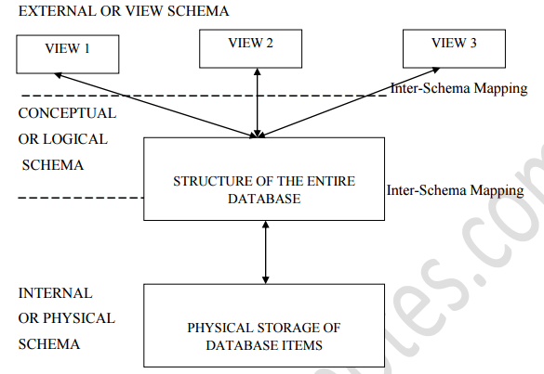
Three Views of Data
The word schema means arrangement – how we want to arrange things that we have to store. The diagram above shows the three different schemas used in DBMS, seen from different levels of abstraction.
Instance – the actual content of the database at a particular point in time
★ Analogous to the value of a variable
Apex Institute of Technology- CSE

Slide 16
Three Views of Data…..contd
Three General levels :-
Internal View (Physical View) :-
The way the data is stored in the storage media. (Specified by the DBA)
Conceptual View (Logic View):-
Describes the structure and constraints for the whole database. (Specified and used by the programmers).
External View (Sub-Scheme):-
The view of the database as seen by the end user.
Apex Institute of Technology- CSE

Slide 17
Internal or Physical schema
The lowest level, called the Internal or Physical schema, deals with the description of how raw data items (like 1, ABC, KOL, H2 etc.) are stored in the physical storage (Hard Disc, CD, Tape Drive etc.). It also describes the data type of these data items, the size of the items in the storage media, the location (physical address) of the items in the storage device and so on. This schema is useful for database application developers and database administrator.
Apex Institute of Technology- CSE

Slide 18
Conceptual or Logical Schema
The middle level is known as the Conceptual or Logical Schema, and deals with the structure of the entire database. Please note that at this level we are not interested with the raw data items anymore, we are interested with the structure of the database. This means we want to know the information about the attributes of each table, the common attributes in different tables that help them to be combined, what kind of data can be input into these attributes, and so on. Conceptual or Logical schema is very useful for database administrators whose responsibility is to maintain the entire database.
Apex Institute of Technology- CSE

Slide 19
External or View Schema
The highest level of abstraction is the External or View Schema. This is targeted for the end users. Now, an end user does not need to know everything about the structure of the entire database, rather than the amount of details he/she needs to work with.
Apex Institute of Technology- CSE

Slide 20
Data Independence
It is the property of the database which tries to ensure that if we make any change in any level of schema of the database, the schema immediately above it would require minimal or no need of change.
Ability to modify a schema definition in one level without affecting a schema definition in the next higher level.
The interfaces between the various levels and components should be well defined so that changes in some parts do not seriously influence others.
What does this mean? We know that in a building, each floor stands on the floor below it. If we change the design of any one floor, e.g. extending the width of a room by demolishing the western wall of that room, it is likely that the design in the above floors will have to be changed also. As a result, one change needed in one particular floor would mean continuing to change the design of each floor until we reach the top floor, with an increase in the time, cost and labour. Would not life be easy if the change could be contained in one floor only? Data independence is the answer for this. It removes the need for additional amount of work needed in adopting the single change into all the levels above.
Apex Institute of Technology- CSE

Slide 21
Types of Data Independence
Data independence can be classified into the following two types:
Physical Data Independence
Logical Data Independence
Physical Data Independence: This means that for any change made in the
physical schema, the need to change the logical schema is minimal. This is
practically easier to achieve.
Logical Data Independence: This means that for any change made in the
logical schema, the need to change the external schema is minimal. As we
shall see, this is a little difficult to achieve.
Apex Institute of Technology- CSE

Slide 22
(Database Users)
Data Base Administrator (DBA):-
Authorizing access to the database
Coordinating and monitoring its use
Acquiring software and hardware resources
Database designers are responsible for:
Identifying the data to be stored
Choosing appropriate structures to represent and store this data
System analysts
Determine requirements of end users
Application programmers
Implement these specifications as programs
Apex Institute of Technology- CSE

Slide 23
Database Users….contd
End users : People whose jobs require access to the database
Types
Casual end users: access database occasionally by sophisticated query language when needed.
(Manager)
Naive or parametric end users: they make up a large section of the end-user population. Learn only a few facilities that they may use repeatedly
(bank clerk)
Sophisticated end users: These include business analysts, scientists, engineers, others thoroughly familiar with the system capabilities.
Standalone users: Normal users
Apex Institute of Technology- CSE

Slide 24
Database Administrator
Coordinates all the activities of the database system
has a good understanding of the enterprise’s information resources and needs.
Database administrator's duties include:
Schema definition
Storage structure and access method definition
Schema and physical organization modification
Granting users authority to access the database
Backing up data
Monitoring performance and responding to changes
Database tuning
Apex Institute of Technology- CSE

Slide 25
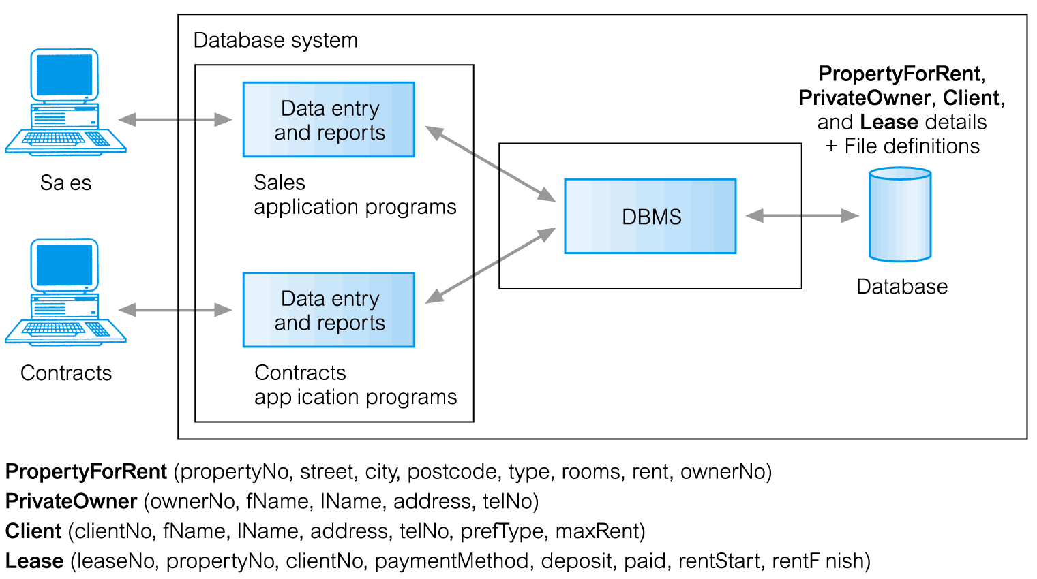
Database Management System (DBMS)
Apex Institute of Technology- CSE

Slide 26
Key Constraint
Values in a column (or columns) of a relation are unique: at most one row in a relation instance can contain a particular value(s)
Key - set of attributes satisfying key constraint
e.g., Id in Student,
e.g., (StudId, CrsCode, Semester) in Transcript
Super Key
Super Key is defined as a set of attributes within a table that uniquely identifies each record within a table. Super Key is a superset of Candidate key.
Candidate Key
Candidate keys are defined as the set of fields from which primary key can be selected. It is an attribute or set of attribute that can act as a primary key for a table to uniquely identify each record in that table.
Apex Institute of Technology- CSE

Slide 27
Key Constraint…contd
Primary Key
Primary key is a candidate key that is most appropriate to become main key of the table. It is a key that uniquely identify each record in a table. PK must be unique and Not Null.
Foreign Key
Foreign Key is a field or set of fields that are identical to a primary key in another table.
Apex Institute of Technology- CSE

Slide 28
Key Constraint…contd
Composite Key
Key that consist of two or more attributes that uniquely identify an entity occurance is called Composite key. But any attribute that makes up the Composite key is not a simple key in its own.
Secondary or Alternative key
The candidate key which are not selected for primary key are known as secondary keys or alternative keys
Non-key Attribute
Non-key attributes are attributes other than candidate key attributes in a table.
Non-prime Attribute
Non-prime Attributes are attributes other than Primary attribute.
Apex Institute of Technology- CSE

Slide 29
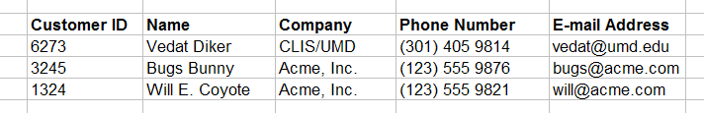
Key Constraint…contd
Primary Key
Customers
Apex Institute of Technology- CSE

Slide 30
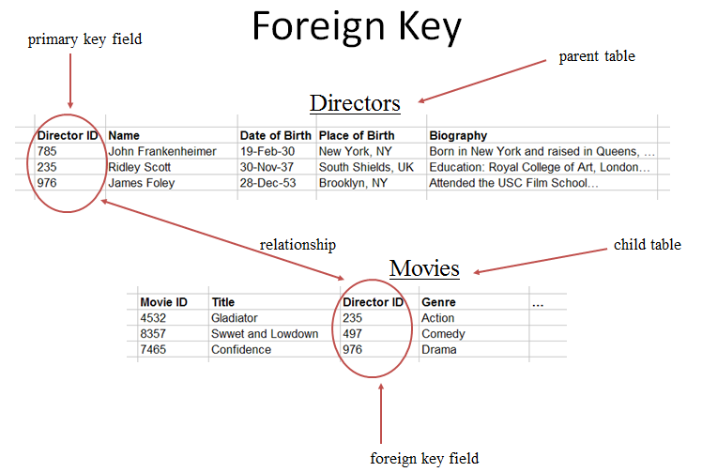
Key Constraint…contd
Apex Institute of Technology- CSE

Slide 31
RDBMS Concepts
Relational Database management System(RDBMS) is a database management system based on relational model introduced by E.F Codd. In relational model, data is represented in terms of tuples(rows).
RDBMS is used to manage Relational database. Relational database is a collection of organized set of tables from which data can be accessed easily. Relational Database is most commonly used database. It consists of number of tables and each table has its own primary key.
Apex Institute of Technology- CSE

Slide 32
Codd’s rules
E.F Codd was a Computer Scientist who invented Relational model for Database management. Based on relational model, Relation database was created. Codd proposed 13 rules popularly known as Codd's 12 rules to test DBMS's concept against his relational model. Codd's rule actualy define what quality a DBMS requires in order to become a Relational Database Management System(RDBMS). Till now, there is hardly any commercial product that follows all the 13 Codd's rules. Even Oracle follows only eight and half out(8.5) of 13. The Codd's 12 rules are as follows.
Apex Institute of Technology- CSE

Slide 33
Codd’s rules…contd
Rule zero
This rule states that for a system to qualify as an RDBMS, it must be able to manage database entirely through the relational capabilities.
Rule 1 : Information rule
All information(including metadeta) is to be represented as stored data in cells of tables. The rows and columns have to be strictly ordered.
Rule 2 : Guaranted Access
Each unique piece of data(atomic value) should be accesible by : Table Name + primary key(Row) + Attribute(column).
Rule 3 : Systemetic treatment of NULL
Null has several meanings, it can mean missing data, not applicable or no value. It should be handled consistently. Primary key must not be null. Expression on NULL must give null.
Apex Institute of Technology- CSE

Slide 34
Codd’s rules…contd
Rule 4 : Active Online Catalog
Database dictionary(catalog) must have description of Database. Catalog to be governed by same rule as rest of the database. The same query language to be used on catalog as on application database.
Rule 5 : Powerful language
One well defined language must be there to provide all manners of access to data. Example: SQL. If a file supporting table can be accessed by any manner except SQL interface, then its a violation to this rule.
Rule 6 : View Updation rule
All view that are updated should be updatable by the system.
Apex Institute of Technology- CSE

Slide 35
Codd’s rules…contd
Rule 7 : Relational Level Operation
There must be Insert, Delete, Update operations at each level of relations. Set operation like Union, Intersection and minus should also be supported.
Rule 8 : Physical Data Independence and logical data dependence
The physical storage of data should not matter to the system. If say, some file supporting table were renamed or moved from one disk to another, it should not effect the application. If there is change in the logical structure(table structures) of the database the user view of data should not change. Say, if a table is split into two tables, a new view should give result as the join of the two tables. This rule is most difficult to satisfy.
Apex Institute of Technology- CSE

Slide 36
Codd’s rules…contd
Rule 9 : Integrity Independence
Integrity constraints ensure that the data insertion, updating, and other processes have to be performed in such a way that data integrity is not affected. Key and Check constraints etc should be stored in Data Dictionary.
Rule 10 : Distribution Independence
A database should work properly regardless of its distribution across a network. This lays foundation of distributed database.
Rule 11 : Non subversion rule
If low level access is allowed to a system it should not be able to subvert or bypass integrity rule to change data. This can be achieved by some sort of looking or encryption.
Apex Institute of Technology- CSE

Slide 37
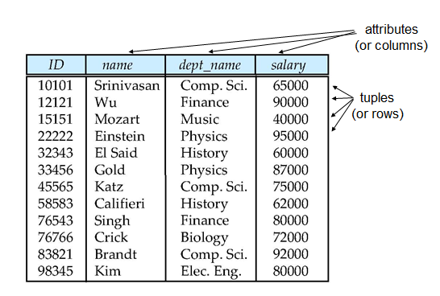
Example of relation
Apex Institute of Technology- CSE

Slide 38
Attribute Types
The set of allowed values for each attribute is called the domain of the attribute
Apex Institute of Technology- CSE

Slide 39
Integrity Constraints
Domain Constraints
Allow values for an attribute.
Domain integrity means the definition of a valid set of values for an attribute. You define - data type, - lenght or size - is null value allowed - is the value unique or not for an attribute.
Entity Integrity
No primary key attribute may be null. All primary key fields MUST have data
Entity:- Any thing which has some attributes is called an entity. Like hospital, doctor, car etc
Apex Institute of Technology- CSE

Slide 40
Integrity constraint
Integrity constraints are a set of rules. It is used to maintain the quality of information.
Types of Integrity Constraint

Slide 41
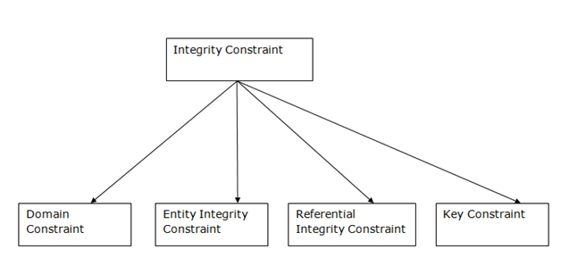

Slide 42
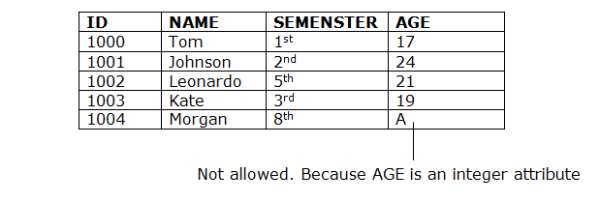
Domain constraints Domain constraints can be defined as the definition of a valid set of values for an attribute. The data type of domain includes string, character, integer, time, date, float etc. The value of the attribute must be available in the corresponding domain.

Slide 43
2. Entity integrity constraints
The entity integrity constraint states that primary key value can't be null.
This is because the primary key value is used to identify individual rows in relation and if the primary key has a null value, then we can't identify those rows.
A table can contain a null value other than the primary key field.

Slide 44
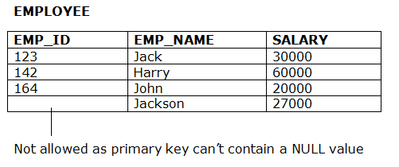

Slide 45
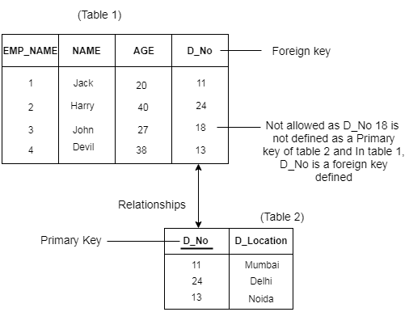
3. Referential Integrity Constraints

Slide 46
A referential integrity constraint is specified between two tables.
In the Referential integrity constraints, if a foreign key in Table 1 refers to the Primary Key of Table 2, then every value of the Foreign Key in Table 1 must be null or be available in Table 2.

Slide 47
Key constraints
Keys constrains decides that column does not have incorrect values. An entity set can have multiple keys, but out of which one key will be the primary key. A primary key can contain a unique and null value in the relational table.

Slide 48
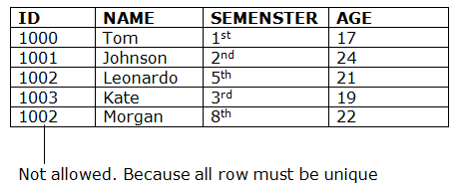

Slide 49
Referential Integrity
The rule that states that any foreign key value (on the relation of the many side) MUST match a primary key value in the relation of the one side. (Or the foreign key can be null)
The rules are(yes) 1. You can't delete a record from a primary table if matching records exist in a related table. 2. You can't change a primary key value in the primary table if that record has related records. 3. You can't enter a value in the foreign key field of the related table that doesn't exist in the primary key of the primary table. 4. However, you can enter a Null value in the foreign key, specifying that the records are unrelated.
Apex Institute of Technology- CSE

Slide 50
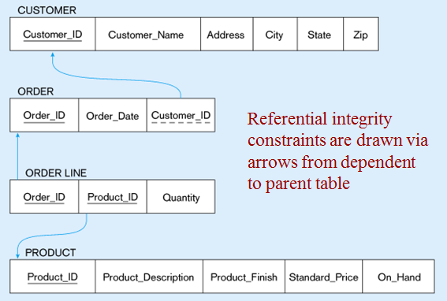
Referential Integrity….contd
Apex Institute of Technology- CSE

Slide 51
Entity Integrity rule
The entity integrity constraint states that primary keys can't be null. There must be a proper value in the primary key field. This is because the primary key value is used to identify individual rows in a table. If there were null values for primary keys, it would mean that we could not indentify those rows.
On the other hand, there can be null values other than primary key fields. Null value means that one doesn't know the value for that field. Null value is different from zero value or space.
not
Apex Institute of Technology- CSE

Slide 52
Data Dictionary
It contains information about the data attributes, elements relationship, user details, security restrictions and integrity constraints.
Apex Institute of Technology- CSE

Slide 53
Relationships
Relationships: Link between different entities of the database is called
relationship.
Types of Relationships:
One - One Relationship:- (1 – 1)
Each value in the first table could relate with only one record in the second table.
One – Many Relationship:- (1 - ∞)
Each value in the first table could relate with many records in the second table.
Many – Many Relationship (∞ - ∞)
Each value in the first table could relate with many records in the second table and each value of the second table could relate with many records in the first table.
Apex Institute of Technology- CSE

Slide 54
Data Definition Language (DDL)
■ not Specification notation for defining the database schema
★ E.g. create table account ( account-number char(10), balance integer)
■ DDL compiler generates a set of tables stored in a data dictionary
■ Data dictionary contains metadata (i.e., data about data)
★ database schema
★ Data storage and definition language
✔ language in which the storage structure and access methods used by the database system are specified
✔ Usually an extension of the data definition language
Apex Institute of Technology- CSE

Slide 55
Data Manipulation Language (DML)
■ Language for accessing and manipulating the data organized by the appropriate data model
★ DML also known as query language
■ Two classes of languages
★ Procedural – user specifies what data is required and how to get those data
★ Nonprocedural – user specifies what data is required without specifying how to get those data
■ SQL is the most widely used query language not
Apex Institute of Technology- CSE

Slide 56
Types of database language
1. Data Definition Language
DDL stands for Data Definition Language. It is used to define database structure or pattern.
Create: It is used to create objects in the database.
Alter: It is used to alter the structure of the database.
Drop: It is used to delete objects from the database.
Rename: It is used to rename an object.
2. Data Manipulation Language
DML stands for Data Manipulation Language. It is used for accessing and manipulating data in a database. It handles user requests.

Slide 57
Select: It is used to retrieve data from a database.
Insert: It is used to insert data into a table.
Update: It is used to update existing data within a table.
Delete: It is used to delete all records from a table.
DCL stands for Data Control Language. It is used to provide the privileges to databases.
Grant: It is used to give user access privileges to a database.
Revoke: It is used to take back permissions from the user.

Slide 58
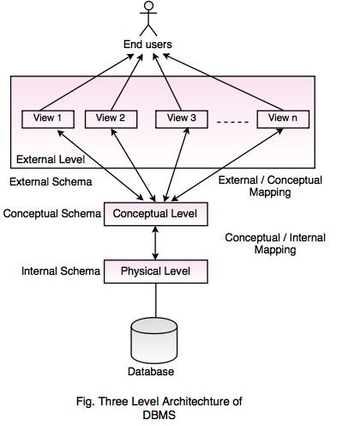

Slide 59
Mapping is the process of transforming request /response between various database levels of architecture.
In Conceptual / Internal mapping, it is necessary to transform the request from the conceptual to internal levels.
Not discussed

Slide 60
(Data Models
Data Models: Relational Model, Network Model, Hierarchical Model, ER Model: Design, issues, Mapping constraints, ER diagram, Comparison of Models.
Apex Institute of Technology- CSE

Slide 61
What is a Data Model?
Definition: data model can be as an integrated collection of concepts for describing and manipulating data, relationship between data and constraints on the data .
Categories of data models:
Object based data models
Physical based data models
Record based data models
Apex Institute of Technology- CSE

Slide 62
Categories of data models
Object Based Data Models: Object based data models use concepts such as entities, attributes, relationships.
Entity:- Any thing which has some attributes (means properties) is called an entity. Like hospital, doctor, car, student etc., relationship is an association between entities.
Types of OBDM
Entity Relationship(describes entities and relationships)
Object Oriented(in rdbms we have records , in oo we have objects)
Physical Data Models –describes how data is stored in the computer, give us the information like record structures.
Unifying Model langauage
Record Based Data Models: Record based logical models are used in describing data at the logical(what data is stored) and view levels
Hierarchical
Network
Relational
Apex Institute of Technology- CSE

Slide 63
Entity relationship models- in this we represent the data in the form entities and the relationships exist among them.
Object-oriented-in this we represent the data in the form of classes and objects.
The object and record based used to describe data at the conceptual and external levels and physical data model used to describe the data at internal levels.

Slide 64
Schemas versus Instances
Database Schema: The description of a database. Includes descriptions of the database structure and the constraints that should hold on the database.
Schema Diagram: A diagrammatic display of (some aspects of) a database schema.
Database Instance: The actual data stored in a database at a particular moment in time. Also called database state (or occurrence).
Apex Institute of Technology- CSE

Slide 65
Database Schema Vs. Database State
Database State: Refers to the content of a database at a moment in time.
Initial Database State: Refers to the database when it is loaded
Valid State: A state that satisfies the structure and constraints of the database.
Apex Institute of Technology- CSE

Slide 66
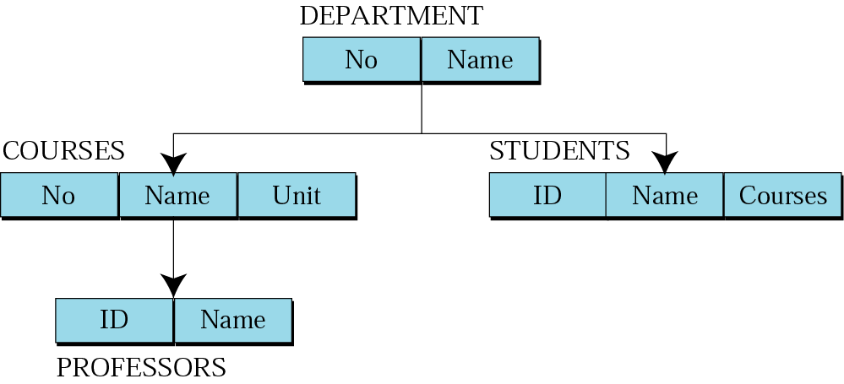
Hierarchical model
Apex Institute of Technology- CSE

Slide 67
2)In h-m data is stored in the form of hierarchy 3,establish one to many relationships. 1)the data is organized into tree like structure.
In hm there will be separate rows for reach entity. in this records are linked with other superior records on which they are dependent and also on the records which are dependent on them.

Slide 68
Hierarchical model….contd
Advantages
Simplicity- the design of this model is simple, the relationship between various layers is simple to create.
This model is very efficient when there is lots of 1:N relationship.
Data integrity- there is always exist relationship between child to parent. THE child segment are always atomically referred by its parent. Maintain integrity.
Disadvantages
Complex to implement (should have good knowledge about physical data consideration.)
Difficult to manage(change database structure also need to change application programs the access the database)
The many to many relationships which are more common in real life it is very difficult to implement.
Apex Institute of Technology- CSE

Slide 69
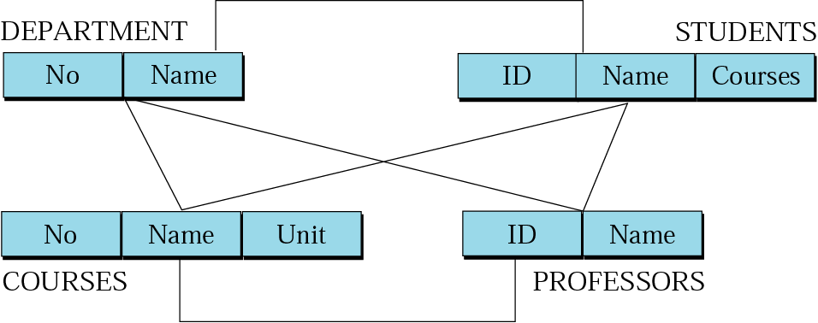
Network model: graph
Apex Institute of Technology- CSE

Slide 70
Network model….contd
Advantages
It is also easy to design
Capability to handle more relationships(n:n)
The data access is easier and flexible than the hirararical model.
Disadvantages-all the records are maintained by using pointers it makes whole database structure very complex.
Network models insertion, deletion and updation operations of any record require large no of pointers
adjustments , which makes implementations very complex.
Apex Institute of Technology- CSE

Slide 71
The replaces the hierarchical tree with a graph thus allowing more general connections among nodes.it has ability to handle the many to many relations.
Allows a record to have more than one parent in thus models are represented by collection of records and relationships .these records are linked with each other through pointers.

Slide 72
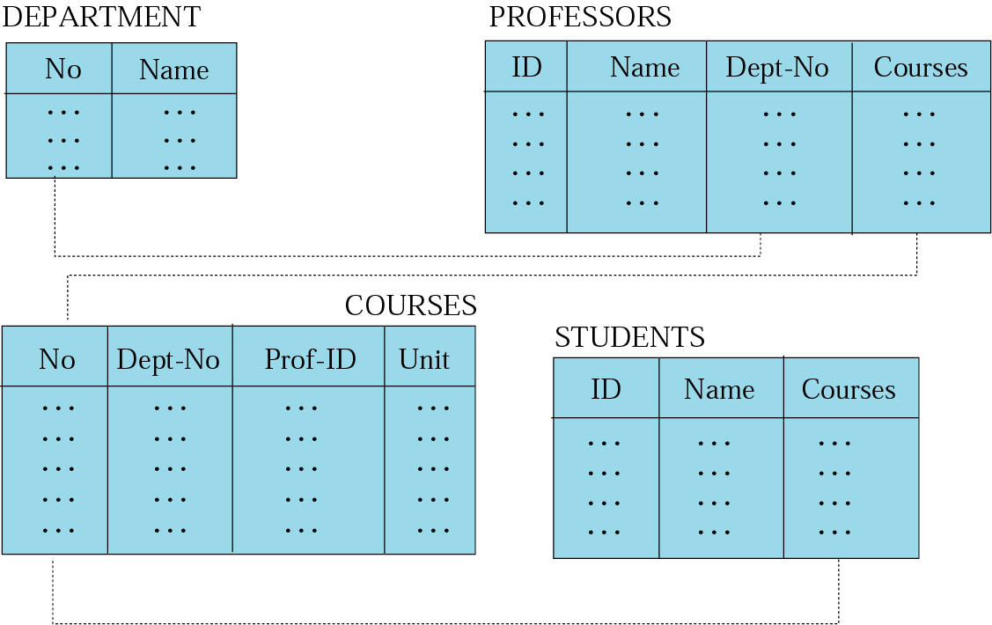
Relational model
Apex Institute of Technology- CSE

Slide 73
Relational Database
Relational database stores data in the form of tables or relations. Each table have multiple column and each column has a unique name. relations consists of tuples and attributes.
Apex Institute of Technology- CSE

Slide 74
Each row of data is called tuple. data fields are called attributes.
Cardinality of relation=the number of tuples in a relation determines its cardinality.
Degree of relation-each column in the tuple is called attribute. The number of attributes in a relation determines called degree.
Domains-a domain definition specifies the kind of data represented by the attributes.
Extension and intension-------------------------------

Slide 75
Relational Model
Advantages – the main advantages of this model to ability to represent data in a simplified format.
The process of manipulating data record is simplified with the use of certain key attribute to retrieve data.
Disadvantages- cost-One disadvantage of relational databases is the expensive of setting up and maintaining the database system.
Limited size of data types-When you design the database, you have to specify the amount of data you can fit into a field.
Apex Institute of Technology- CSE

Slide 76
The extension of a given relation is the set of tuples appearing in that relation at any given instance. The extension thus varies with time. It changes as tuples are created, destroyed, and updated. Exp=no of records .
The intension of a given relation is independent of time. It is the permanent part of the relation. The intension is a combination of two things : a structure and a set of integrity constraints.

Slide 77
Entity-Relationship Model
Entity Relationship Modeling (ER Modeling) is a graphical approach to database design. It uses Entity/Relationship to represent real world objects.
ER Model is best to represent graphical form of a database.
Apex Institute of Technology- CSE

Slide 78
Entity-Relationship Model….contd
ER Model is based on −
Entities and their attributes.
Relationships among entities.
Entity − An entity is an object whose information is stored in the database.
Relationship − A relationship represents an association or link between two or more entities. An entity set is a set of entities of the same type that share the same properties.
Example: set of all persons, companies, trees, holidays
Apex Institute of Technology- CSE

Slide 79
Entity-Relationship Model..contd
Types of Attributes
Simple attribute − A Simple attributes is an attribute composed of a single component with an independent existence. For example, age, salary.
Composite attribute − Composite attributes are made of more than one simple attribute. For example, a student's complete name may have first_name and last_name.
Derived attribute − derived attributes is one that represents a value that is derive from the value of related attributes. For example, age can be derived from data_of_birth.
Apex Institute of Technology- CSE

Slide 80
Entity-Relationship Model..contd
Types of Attributes
Single-value attribute − Single-value attributes contain single value. For example − age
Multi-value attribute − Multi-value attributes may contain more than one values. For example, a person can have more than one phone.
Apex Institute of Technology- CSE

Slide 81
A mapping constraint is a data constraint that expresses the number of entities to which another entity can be related via a relationship set.
It is most useful in describing the relationship sets that involve more than two entity sets.
For binary relationship set R on an entity set A and B, there are four possible mapping cardinalities. These are as follows:
One to one (1:1)
One to many (1:M)
Many to one (M:1)
Many to many (M:M)

Slide 82
Types of Relationships
One - One Relationship:- (1 – 1)
Each value in the first table could relate with only one record in the second table.
One – Many Relationship:- (1 - ∞)
Each value in the first table could relate with many records in the second table.
Many – Many Relationship (∞ - ∞)
Each value in the first table could relate with many records in the second table and each value of the second table could relate with many records in the first table.
Many – One Relationship(∞-1)
More than one entities from entity set A can be associated with at most one entity of entity set B, however an entity from entity set B can be associated with more than one entity from entity set A.
Apex Institute of Technology- CSE

Slide 83
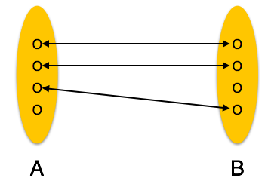
Relationships….contd
One - One Relationship:- (1 – 1)
Each value in the first table could relate with only one record in the second table
Apex Institute of Technology- CSE

Slide 84
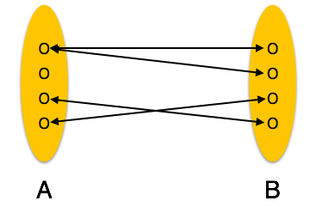
Relationships….contd
One – Many Relationship:- (1 - ∞)
Each value in the first table could relate with many records in the second table.
Apex Institute of Technology- CSE

Slide 85
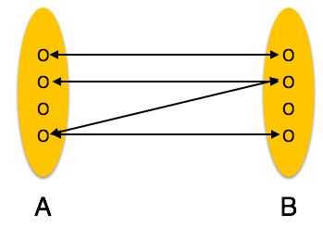
Relationships….contd
Many-to-many − One entity from A can be associated with more than one entity from B and vice versa
Apex Institute of Technology- CSE

Slide 86
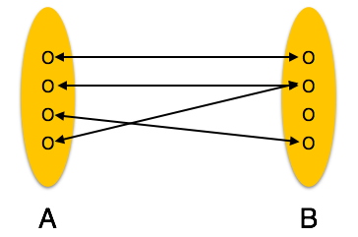
Relationships….contd
Many-to-one − More than one entities from entity set A can be associated with at most one entity of entity set B, however an entity from entity set B can be associated with more than one entity from entity set A.
Apex Institute of Technology- CSE

Slide 87
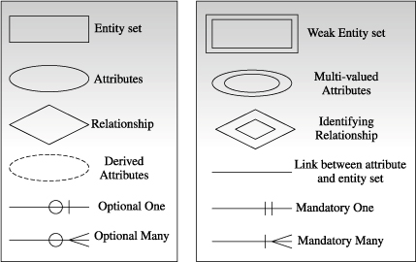

Slide 88
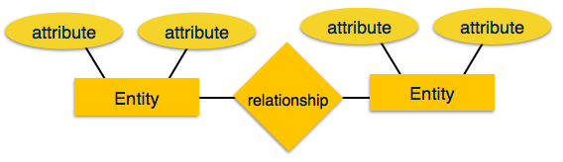
Entity-Relationship Model..contd
Apex Institute of Technology- CSE

Slide 89
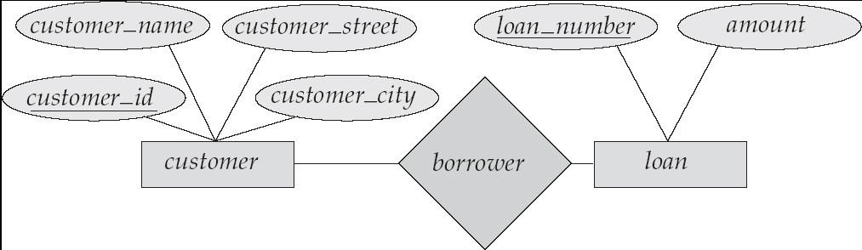
E-R Diagrams
Rectangles represent entity sets.
Diamonds represent relationship sets.
Lines link attributes to entity sets and entity sets to relationship sets.
Ellipses represent attributes
Double ellipses represent multivalued attributes.
Dashed ellipses denote derived attributes.
Underline indicates primary key attributes (will study later)
Apex Institute of Technology- CSE

Slide 90
Strong and weak entities set=
The entity set which does not have sufficient attributes to from a primary key is called as weak entities set.
The entity set that has a primary key called strong entity set.
The primary key of a weak entity set is formed by the primary key of , strong entity set on which the weak entity set is existence dependent and with the discriminator. Dis—is the attribute in weak entity set which helps us to identify the records.

Slide 91
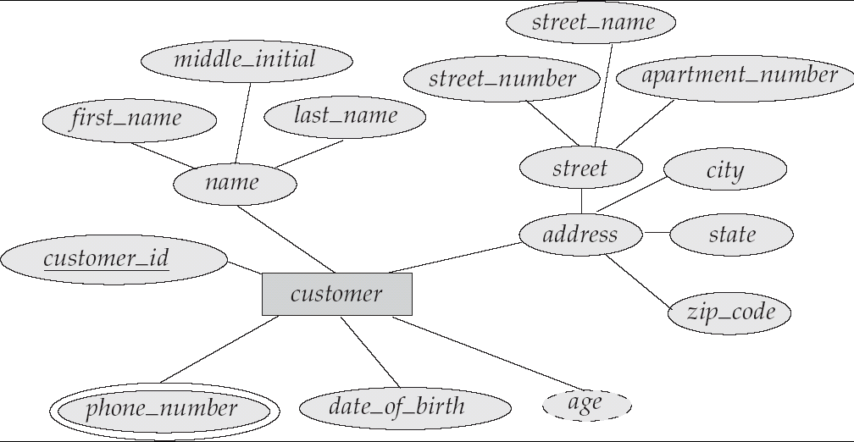
E-R Diagram With Composite, Multivalued, and Derived Attributes
Apex Institute of Technology- CSE

Slide 92
Design Issues
Use of entity sets vs. attribute Choice mainly depends on the structure of the database being modeled.
Use of entity sets vs. relationship sets
Explain proper relationship among entities which describe an proper action that occurs between entities
Binary versus n-ary relationship sets it is possible to replace any nonbinary (n-ary, for n > 2) relationship set with a number of different binary relationship sets,
placement of relationship attributes with properties like
Apex Institute of Technology- CSE

Slide 93
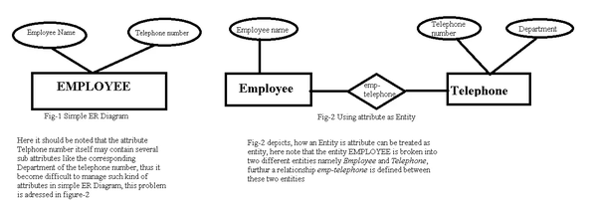

Slide 94
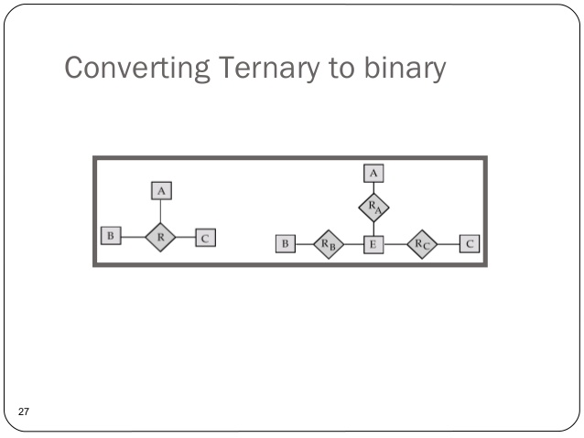

Slide 95
Specialization
It is a top-down approach in which one higher level entity can be broken down into two lower level entity..
Generalization
Generalization is a bottom-up approach in which two lower level entities combine to form a higher level entity.
Aggregation
Aggregation is a process when relation between two entities is treated as a single entity.
Apex Institute of Technology- CSE

Slide 96
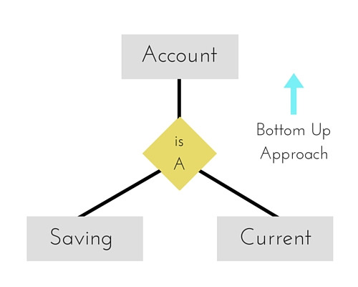
Saving and Current account types entities can be generalised and an entity with name Account can be created, which covers both.
generalization

Slide 97
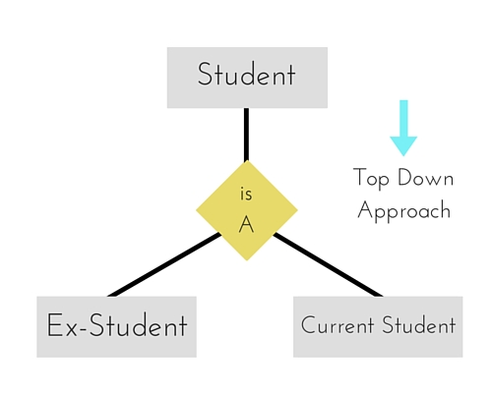
specialization

Slide 98
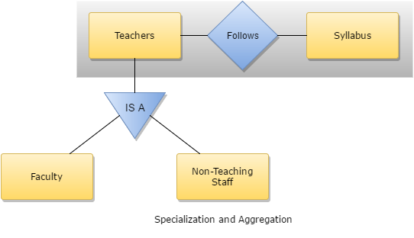

Slide 99
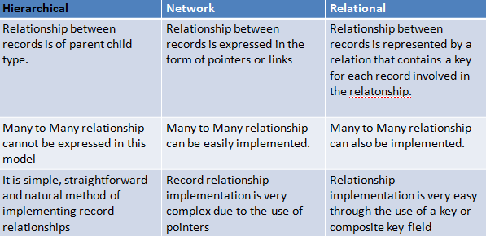
Comparison of Record based model
Apex Institute of Technology- CSE

Slide 100
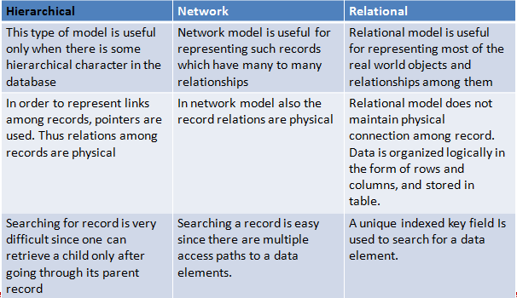
Comparison of Record based model
Apex Institute of Technology- CSE

Slide 101
Data Models: A Summary
Each new data model capitalized on the shortcomings of previous models
Common characteristics:
Conceptual simplicity without compromising the semantic completeness of the database
Represent the real world as closely as possible
Representation of real-world transformations (behavior) must comply with consistency and integrity characteristics of any data model
Apex Institute of Technology- CSE

Slide 102
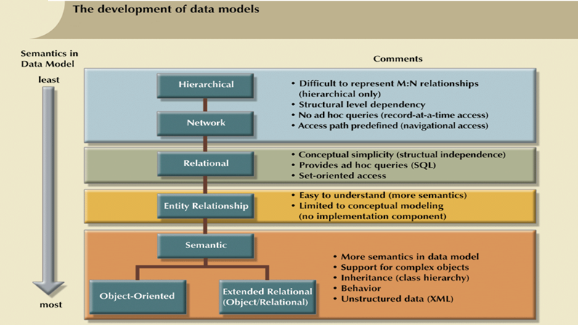
Data Models: A Summary
Apex Institute of Technology- CSE

Slide 103
Relational Algebra & Relational Calculus
Relational Algebra & Relational Calculus: Introduction, Syntax, Semantics, Additional operators, Grouping and Ungrouping, Relational comparisons, Tuple Calculus, Domain Calculus, Calculus vs Algebra, Computational capabilities.
Apex Institute of Technology- CSE

Slide 104
Introduction
Relational algebra -
It is a procedural language that can be used to tell the dbms how to build a new relation from one or more relation in the database. In R-A user has to specify what is required and what are the steps or procedures to obtain the required output.
Relational calculus- it is non procedural language used to specifying the queries. In this user just specifies what is required and need not to specify how to obtain it.
Apex Institute of Technology- CSE

Slide 105
Relational Algebra and Relational Calculus are the formal or
theoretical
query languages for a relational model. they both just provide
the theory
concepts which we used to build a sql
Both form the base for
the SQL language which is used in most of
the relational DBMS.
Relational Algebra is a procedural language.
Relational Calculus is a non procedural language.

Slide 106
Relational Algebra
R –A is a theoretical language with operations that work on one or more relations to define another relations with
Out changing the original relation.
Five basic operations in relational algebra: Selection, Projection, Cartesian product, Union and Set Difference,join ,intersection
Apex Institute of Technology- CSE

Slide 107
Relational Algebra
Basic operations:
Selection ( ) Selects a subset of rows from relation.
Projection ( ) select attributes or column from relation.
Cross-product ( ) Allows us to combine two relations.
Set-difference ( ) Tuples in reln. 1, but not in reln. 2.
Union ( ) Tuples in reln. 1 or in reln. 2.
Intersection, join,
Apex Institute of Technology- CSE

Slide 108
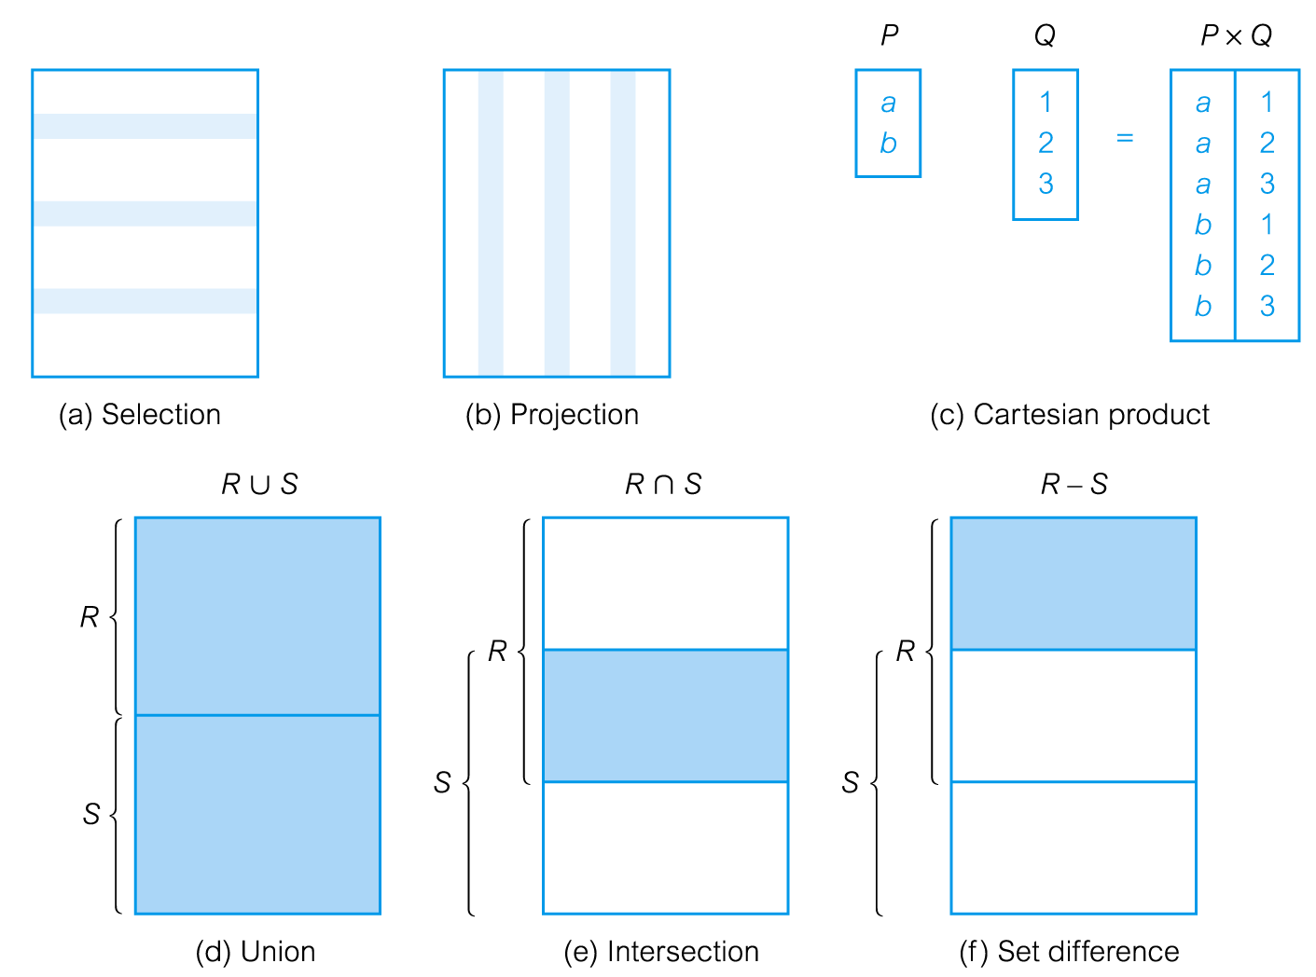
Relational Algebra Operations
Apex Institute of Technology- CSE

Slide 109
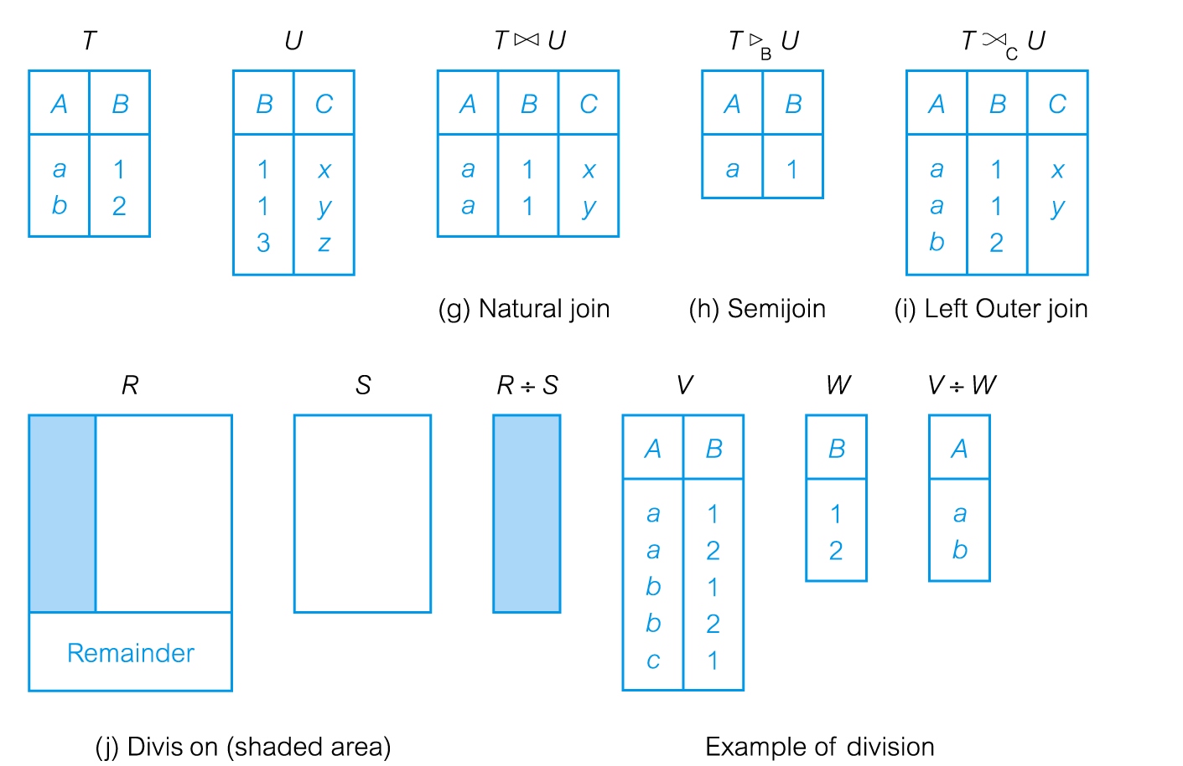
Relational Algebra Operations
Apex Institute of Technology- CSE

Slide 110
Selection (or Restriction)
σ_{predicate} (R)
Works on a single relation R and defines a relation that contains only those tuples (rows) of R that satisfy the specified condition (predicate).
Selects rows that satisfy selection condition.
Apex Institute of Technology- CSE

Slide 111
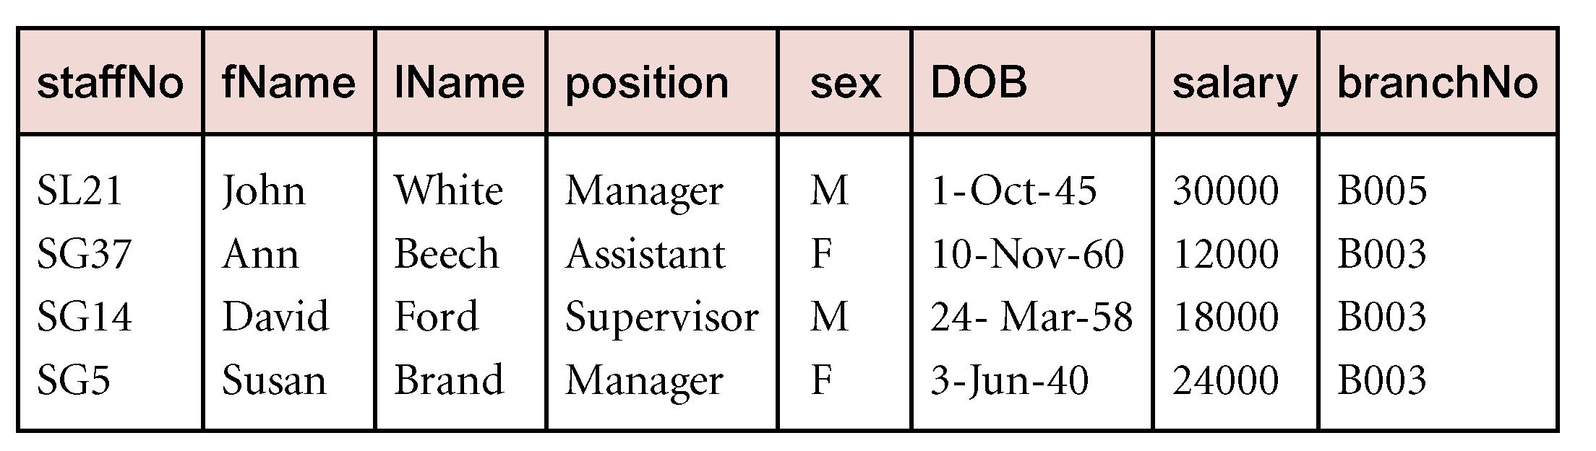
Example - Selection Restriction)
List all staff with a salary greater than £10,000.
σ_{salary > 10000} (Staff)
Apex Institute of Technology- CSE

Slide 112
Projection
Π_{col1, . . . , coln}(R)
Works on a single relation R and defines a relation that contains a vertical subset of R, extracting the values of specified attributes
Apex Institute of Technology- CSE

Slide 113
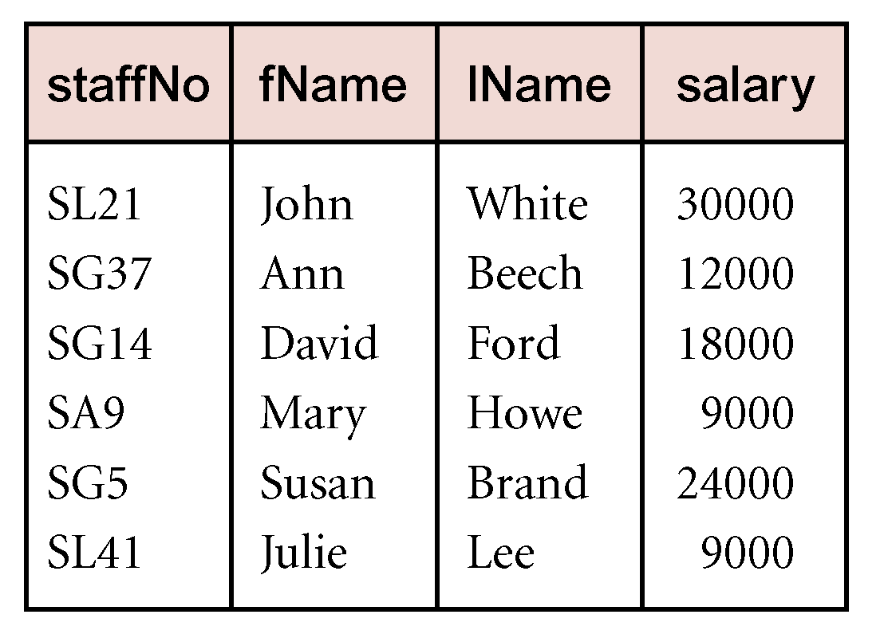
Example - Projection
Produce a list of salaries for all staff, showing only staffNo, fName, lName, and salary details.
Π_{staffNo, fName, lName, salary}(Staff)
Apex Institute of Technology- CSE

Slide 114
Union
R ∪ S
Union of two relations R and S defines a relation that contains all the tuples of R, or S, or both R and S, duplicate tuples being eliminate.
Apex Institute of Technology- CSE

Slide 115
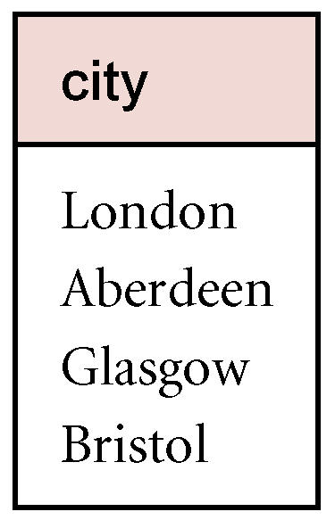
Example - UNION
List all cities where there is either a branch office or a property for rent.
Π_{city}(Branch) ∪ Π_{city}(PropertyForRent)
Apex Institute of Technology- CSE

Slide 116
Set Difference
R – S
Defines a relation consisting of the tuples that are in relation R, but not in S.
Apex Institute of Technology- CSE

Slide 117
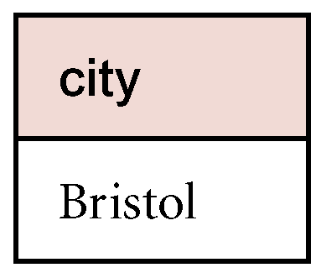
List all cities where there is a branch office but no properties for rent.
Π_{city}(Branch) – Π_{city}(PropertyForRent)
Apex Institute of Technology- CSE

Slide 118
Intersection
R ∩ S
Defines a relation consisting of the set of all tuples that are in both R and S.
R and S must be union-compatible.
Expressed using basic operations:
R ∩ S = R – (R – S)
Apex Institute of Technology- CSE

Slide 119
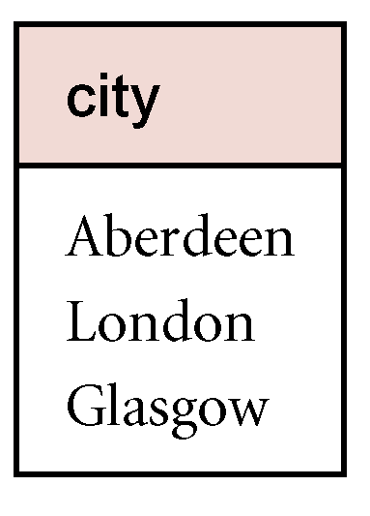
Example - Intersection
List all cities where there is both a branch office and at least one property for rent.
Π_{city}(Branch) ∩ Π_{city}(PropertyForRent)
Apex Institute of Technology- CSE

Slide 120
Cartesian product
R X S
Defines a relation that is the concatenation of every tuple of relation “R with every tuple of relation S”
Apex Institute of Technology- CSE

Slide 121
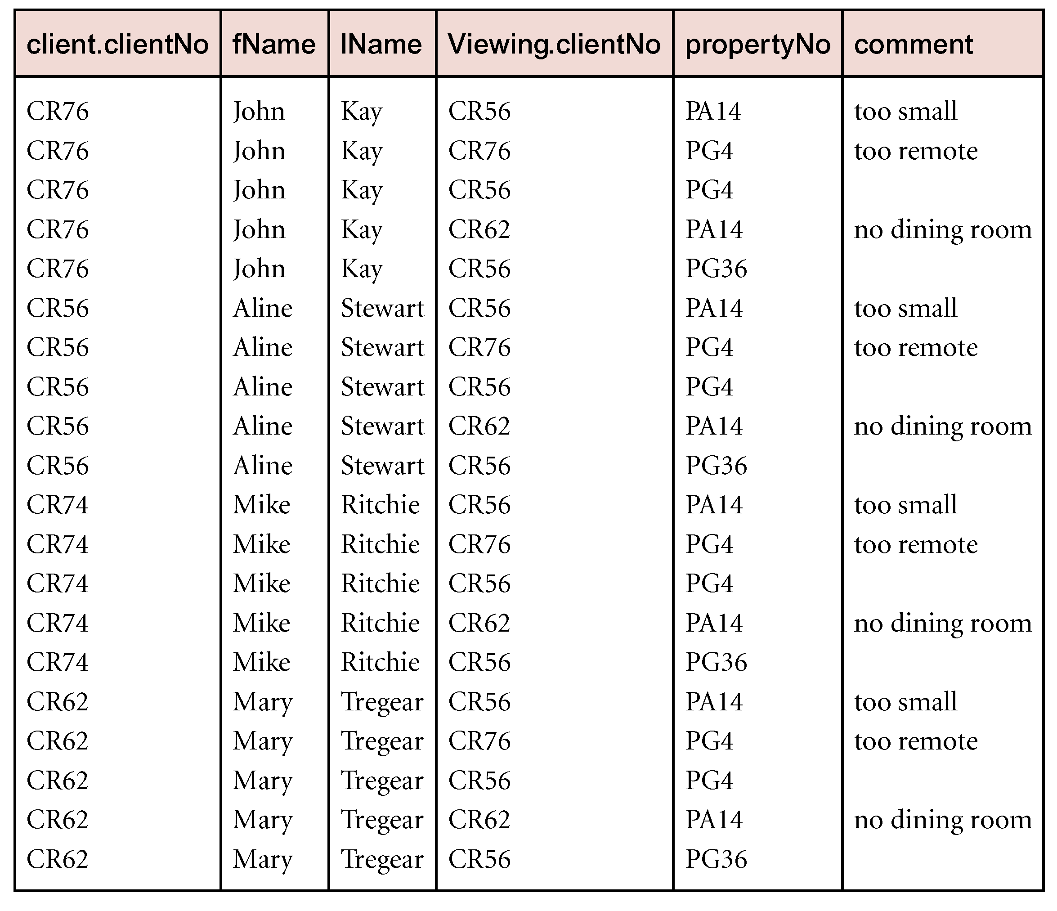
Example - Cartesian product
List the names and comments of all clients who have viewed a property for rent.
(Π_{clientNo, fName, lName}(Client)) X (Π_{clientNo, propertyNo, comment} (Viewing))
Apex Institute of Technology- CSE

Slide 122
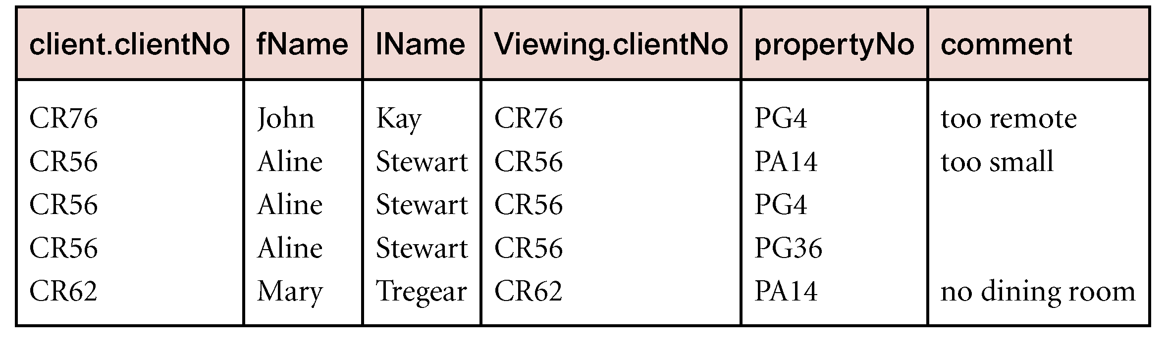
Example - Cartesian product and Selection
Use selection operation to extract those tuples where Client.clientNo = Viewing.clientNo.
sClient.clientNo = Viewing.clientNo((Õ_{clientNo, fName, lName}(Client)) Χ (Õ_{clientNo, propertyNo, comment}(Viewing)))
Cartesian product and Selection can be reduced to a single operation called a Join.
Apex Institute of Technology- CSE

Slide 123
Join Operations
JOINs can be used to combine tables but atleast one column is common.
Join is a derivative of Cartesian product.
Equivalent to performing a Selection, using join predicate as selection formula, over Cartesian product of the two operand relations.
One of the most difficult operations to implement efficiently in an RDBMS and one reason why RDBMSs have intrinsic performance problems.
Apex Institute of Technology- CSE

Slide 124
Join Operations
Various forms of join operation
JOIN (Inner Join) : Return rows when there is at least one match in both tables
LEFT JOIN(Left Outer Join): Return all rows from the left table, even if there are no matches in the right table
RIGHT JOIN(Right Outer Join): Return all rows from the right table, even if there are no matches in the left table
FULL JOIN: Return rows when there is a match in one of the tables
Apex Institute of Technology- CSE

Slide 125
SQL INNER JOIN Syntax
SELECT column_name(s) FROM table_name1 INNER JOIN table_name2 ON
table_name1.column_name=table_name2.column_name
INNER JOIN is the same as JOIN
The word "INNER" is optional
Apex Institute of Technology- CSE

Slide 126
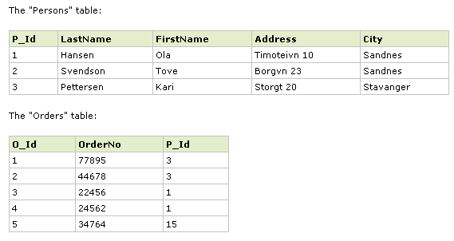
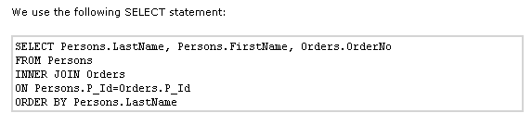
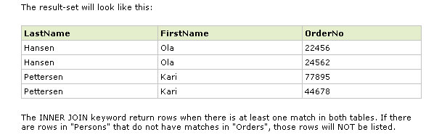
Example - Inner Join
Apex Institute of Technology- CSE

Slide 127
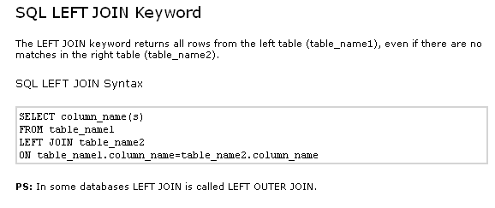
Left Join
Apex Institute of Technology- CSE

Slide 128
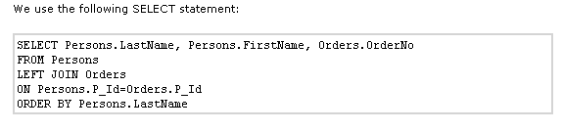

Example - Left Join
Apex Institute of Technology- CSE

Slide 129

Right Join
Apex Institute of Technology- CSE

Slide 130


Example – Right Join
Apex Institute of Technology- CSE

Slide 131

Full Join
Apex Institute of Technology- CSE

Slide 132


Example – Full Join
Apex Institute of Technology- CSE

Slide 133
Relational Calculus
There are two versions of the relational calculus:
Tuple relational calculus (TRC)
Domain relational calculus (DRC)
The calculus is non-procedural (‘declarative’) compared to the relational algebra
Calculus has variables, constants, comparison ops, logical connectives and quantifiers.
TRC: Variables range over (i.e., get bound to) tuples.
DRC: Variables range over domain elements (= field values).
Both TRC and DRC are simple subsets of first-order logic.
Expressions in the calculus are called formulas. An answer tuple is essentially an assignment of constants to variables that make the formula evaluate to true.
Apex Institute of Technology- CSE

Slide 134
Relational Calculus
TRC and DRC are semantically similar
In TRC, tuples share an equal status as variables, and field referencing can be used to select tuple parts
In DRC, formal variables are explicit
Apex Institute of Technology- CSE

Slide 135
Tuple Relational Calculus
Query: {T | P(T)}
T is tuple variable
P(T) is a formula that describes T
Result, the set of all tuples t for which P(t) evaluates True.
Find all sailors with a rating above 7.
Atomic formula
R.a op S.b , op is one of
R.a op constant
Apex Institute of Technology- CSE

Slide 136
Tuple Relational Calculus
A logical language with variables ranging over tuples:
{ T | Cond }
Return all tuples T that satisfy the condition Cond.
• { T | R(T) }: returns all tuples T such that T is a tuple in relation R.
• { T.name | F ACULT Y (T) AND T.DeptId = ‘CS’ }.
returns the values of name field of all faculty tuples with the value ’CS’ in their department id field.
– The variable T is said to be free since it is not bound by a quantifier (for all, exists).
– The result of this statement is a relation (or a set of tuples) that correspond to all possible ways to satisfy this statement.
– Find all possible instances of T that make this statement true.
Apex Institute of Technology- CSE

Slide 137

Domain Relational Calculus
Apex Institute of Technology- CSE

Slide 138

Domain Relational Calculus
Apex Institute of Technology- CSE

Slide 139
Summary
Relational algebra is more operational; useful as internal representation for query evaluation plans.
Relational calculus is non-operational, and users define queries in terms of what they want, not in terms of how to compute it. (Declarativeness.)
Algebra and safe calculus have same expressive power, leading to the notion of relational completeness.
Apex Institute of Technology- CSE

Slide 140
Learning Outcomes
Be familiar with a commercial relational database system (Oracle) by writing SQL using the system.
Be familiar with the relational database theory, and be able to write relational algebra expressions for queries
Be familiar with basic database storage structures and access techniques: file and page organizations, indexing methods including B‐tree, and hashing.
Be familiar with the basic issues of transaction processing and concurrency control.
Apex Institute of Technology- CSE

Slide 141
Programme Outcomes
The Program outcomes of department are that the students after successful completion of the course will secure:
An ability to apply knowledge in mathematics, science and engineering subjects.
An ability to identify, formulate and solve engineering problems.
An ability to design and conduct experiments to interpret data and analyze the results.
An ability to apply professional ethics and pledge to the norms/responsibilities in the engineering practice of Computer Science.
An ability to function on multi-disciplinary teams.
An ability to work individually and in teams to attain a common goal.
An ability to understand professional and ethical responsibilities.
An ability to communicate impressively.
An ability to use techniques, skills and modern engineering tools necessary for engineering practice
An ability to gain knowledge to understand the impact of engineering solutions in a global, environmental and societal context.
An ability to apply knowledge of layered network Models, their protocols and technologies in building network and Internet based applications.
Ability to identify the need and engage in lifelong learning in the field of Computer Science and its related areas.

Slide 142
References
RamezElmasri and Shamkant B. Navathe, “Fundamentals of Database System”, The Benjamin / Cummings Publishing Co.
Korth and Silberschatz Abraham, “Database System Concepts”, McGraw Hall.
C.J.Date, “An Introduction to Database Systems”, Addison Wesley.
Thomas M. Connolly, Carolyn & E. Begg, “Database Systems: A Practical Approach to Design, Implementation and Management”, 5/E, University of Paisley, Addison-Wesley.

