Slide 1

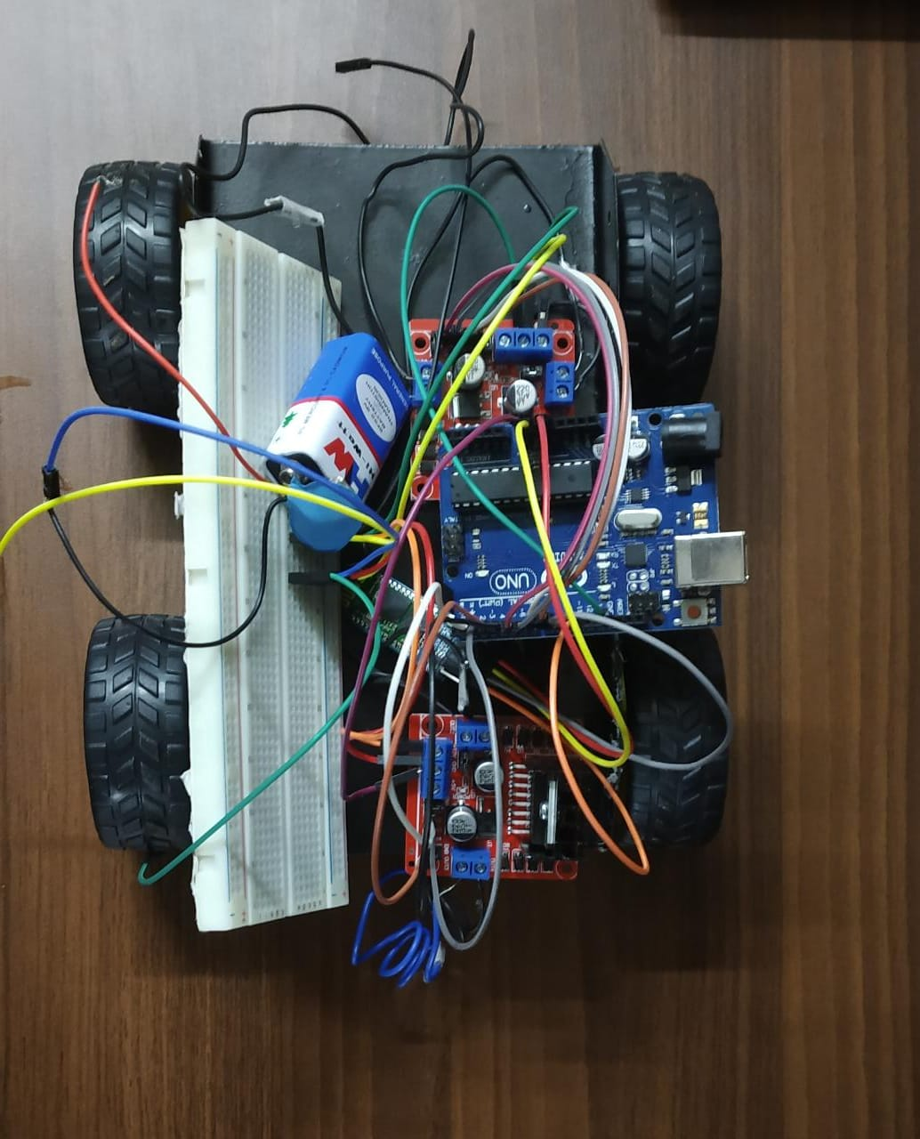
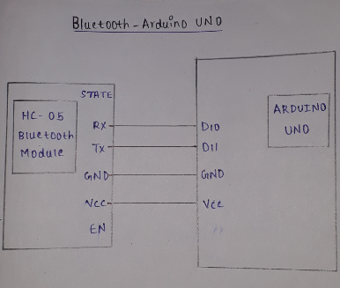
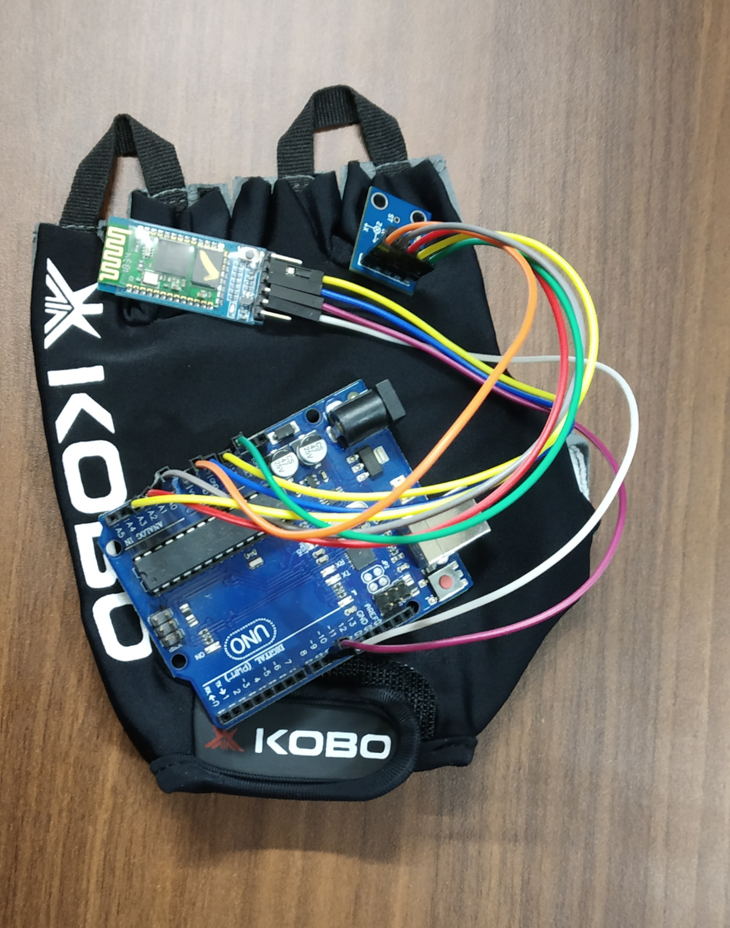
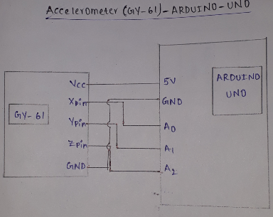
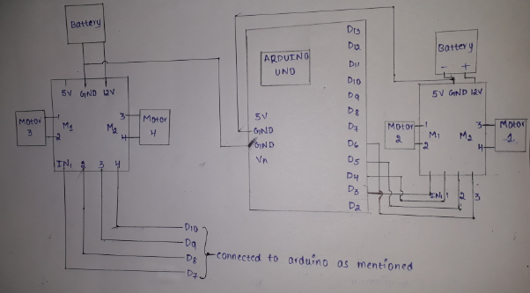
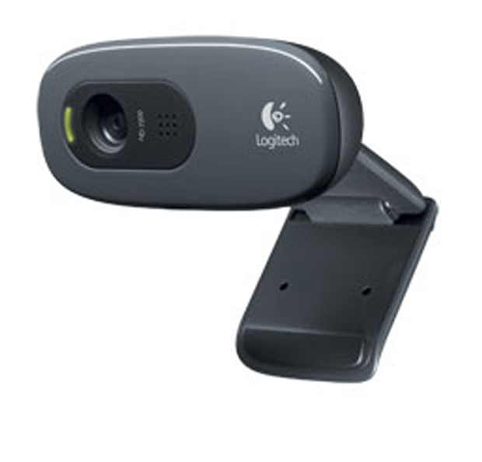
WIRELESS GESTURE CONTROLLED CAR
K. Sai Pranay | Guide : Prof. John Pradeep | VIT-AP UNIVERSITY
Motivation/ Introduction
Results
Now a days, we can see a lot of news about the persons who are going accidentally in to caves and they were missing. We are unable to rescue them because we don’t know the exact location where they were and we are losing them.
So, we came up with an idea of a car which can be controlled using hand gestures and to know the situation we kept an camera so that we can see the actual situations happening in the cave.
SCOPE of the Project
This is a device which can be controlled by any person irrespective of his background and age because we are using hand gestures which is the best way to tell the direction to the car.
We can observe the exact situation inside the cave by live video transmission so that we can respond to the situation accordingly.
As this is a wireless device, it can be controlled without using wire from the gesture control location to the car location
Methodology
Connect 2-Bluetooth module to 2-arduino’s and make one as Slave and other as Master using AT commands.
Connect the accelerometer to one of the Arduino and connect the motor to another one.
Connect the motor drivers and motors to the Arduino which is used as a slave.
Connect the camera module to the raspberry pi for live streaming
Dump the code in to the both Arduino’s
Conclusion/ Summary
We can save a lot of people who are losing their lives in these cases using this project
As we are using the camera for live transmission, this can be used to monitor the movements of car
We don’t want to bother much about losing connections because we made it using minimum wires and wireless transmission between car and hand positions.
Contact Details
pranay.kaipu@vit.ac.in
Acknowledgments/ References
>> www.arduinoforum.com
>> Project manual

