Slide 1
Side Trip
Instant itinerary on the go

Slide 2
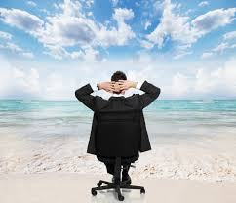
Meet This Executive

Slide 3
Problem !
Arrived at Singapore
Meetings in line with some free time in between .
Looking to find places nearby for refreshments.
He Search for places.
Downloads a Singapore travel app .
Google map to the find distances /travel options.
Finally decides to go to random place ,after wasting 15 minutes.

Slide 4
Get Set and Go
Tell how much you have , Side Trip recommends the best places to visit.
We recommend itinerary intelligently for a business traveler with time constraints.

