Slide 1

By Pranay Seela
Indiana State University
CS699-101
Summer 2016
Advisor : Dr. Jeff Kinne

Slide 2

Intern Company : NIRVANA, Indianapolis
Intern Period : June, 2016 – July, 2016
E-commerce web development project using Asp.net, C#
I completed my required 100 hours by serving, where i dedicated my work in implementing the functional requirements for the store website.

Slide 3

 | Development Tools and Environment
Programming language | C#/ASP.NET(.NET 4)– main development platform. HTML5/CSS3/JavaScript - user Interface (web frontend)
Database | MySQL5.6 – SQL database
System Design Tools | Visual Studio 2010 - IDE
Browser | IE 8.0 or above

Slide 4

The virtual shop remains open and operational 24x7.
You build your brand more quickly - as more people will know, talk, post and blog about you on social networks.
Setting up a website and maintaining it is lots cheaper than maintaining a store.

Slide 5

Actors:
Guest: can log in and register
User: can logout, look, buy products and view cart
Admin: can add, delete products and log out
End Users(Buyers)
Designers
Developers

Slide 6

Learning Microsoft Visual Studio application.
Learning MySql and connecting it to the Visual studio.
Meetings with different committees due to schedule conflicts.
Made several trials and testing each functionality as many times as possible.
Many more challenges faced with .dll files.

Slide 7

MySql Server 5.7
MySql Connector Net 6.9.9
MySql for Visual Studio 1.2.6
MySql installer Community
MySql Workbench 6.3 CE

Slide 8

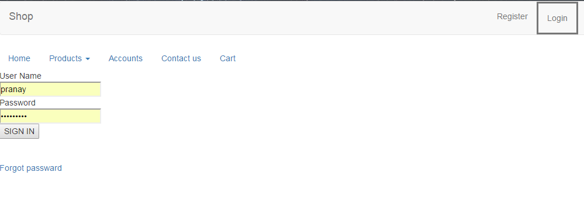

Slide 9

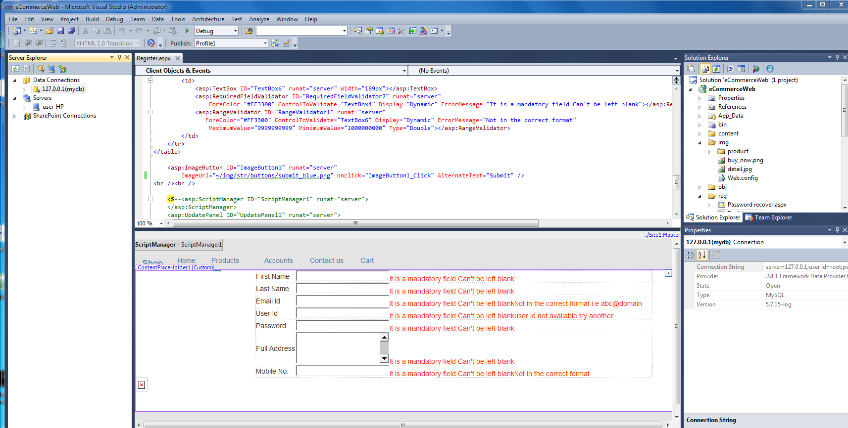

Slide 10

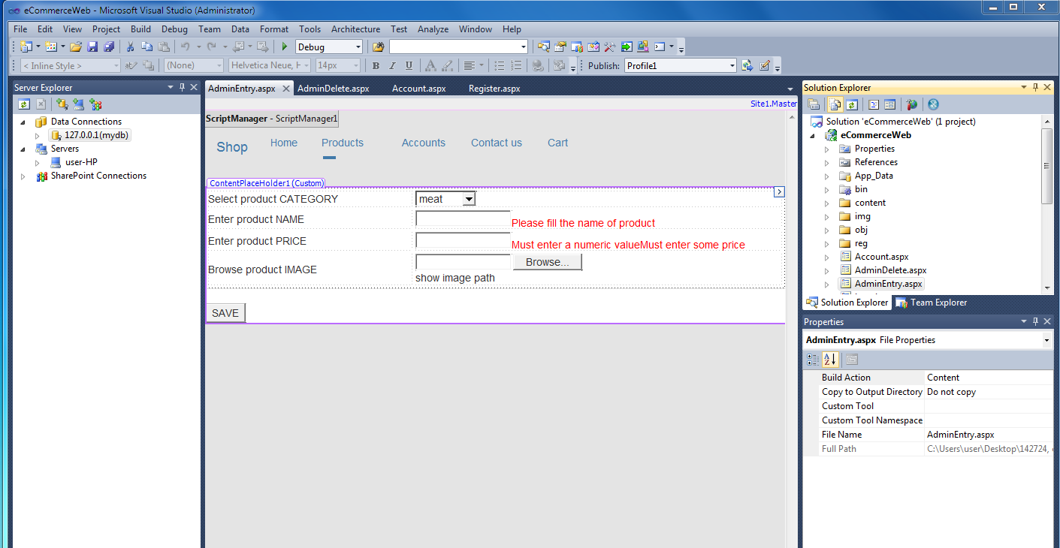

Slide 11

It has the following pages
Login.aspx
Register.aspx
Account.aspx
Adminentry.aspx
Admindelete.aspx
Contact.aspx
Default.aspx
Manageuser.aspx
Productdetail.aspx

Slide 12

cart | completecart | login | product | udetail
id uName pName quantity date status | id uName pName img quantity price | UserName Pwd Role | Id Productname Image Category Price | FirstName lastName UserId Pwd Address Mob Email

Slide 13

I have become quite skillful using Microsoft Visual Studio.
I have developed a stronger relationship with the stakeholders of the company through my involvement of this project.

Slide 14

The current website is for a small store. Limited for only 3 types of products.
Can add credit card payments, cash on delivery or apple pay method. So that different payments can be accepted.
This can be enhanced for different variety of products and more users can be able to access it without breakdown of the website.

Slide 15


