Slide 1
Kubernetes
Pranay Shahare

Slide 2
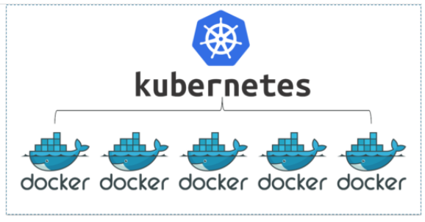
Container Orchestration

Slide 3
Why Container Orchestration?
Requirement: We want 10 instances of Microservice (See next slide) A container, 15 instances of Microservice B container and ....
Typical Features:
Auto Scaling - Scale containers based on demand
Service Discovery - Help microservices find one another
Load Balancer - Distribute load among multiple instances of a microservice
Self Healing - Do health checks and replace failing instances
Zero Downtime Deployments - Release new versions without downtime

Slide 4
Container Orchestration Options
Docker Swarm
Apache Mesos
Cattle, Nomad, Empire
AWS ECS (Elastic Container Service)
Kubernetes
EKS (Elastic Container Service for Kubernetes)
AWS Fargate

Slide 5
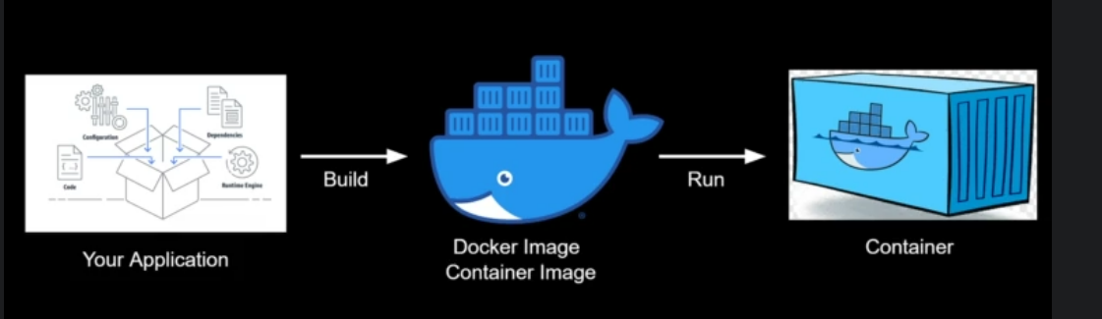
Basic idea

Slide 6
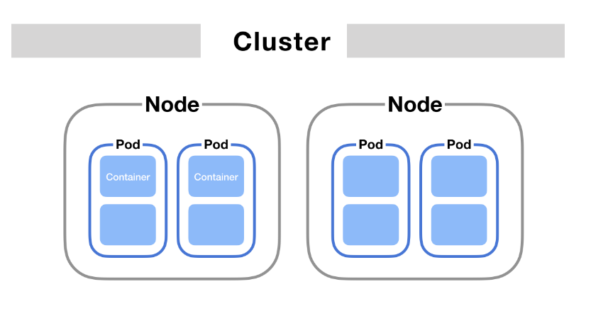
Kubernetes Components

Slide 7
Pod

Slide 8
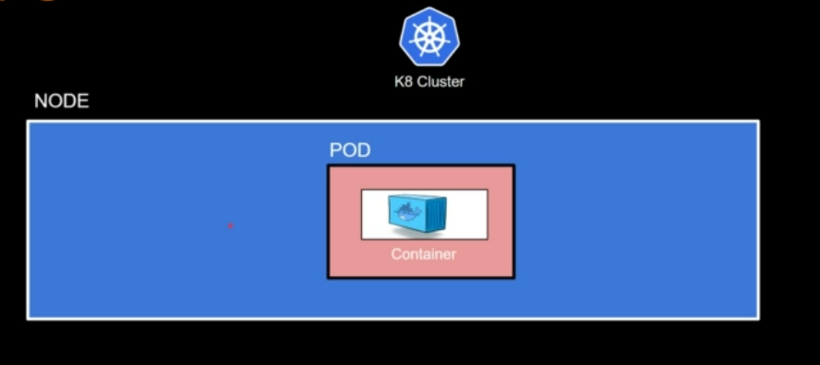
Pod Concept
Kubernetes does not deploy containers directly on the worker nodes.
A container is encapsulated into a Kubernetes object called as Pod.
Pod = A Single instance of an application
A Pod is the smallest object that we can create in Kubernetes.
Remember NPC – Node contains Pod contains Container

Slide 9
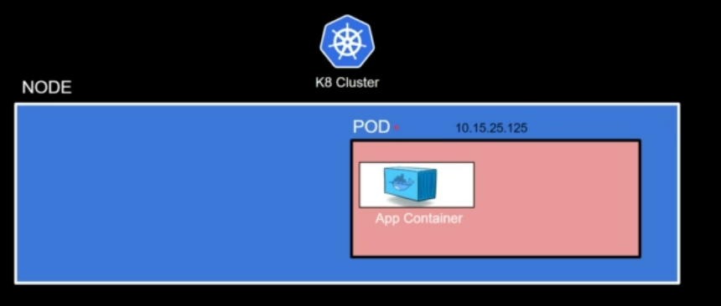
Each Pod has a unique IP address

Slide 10
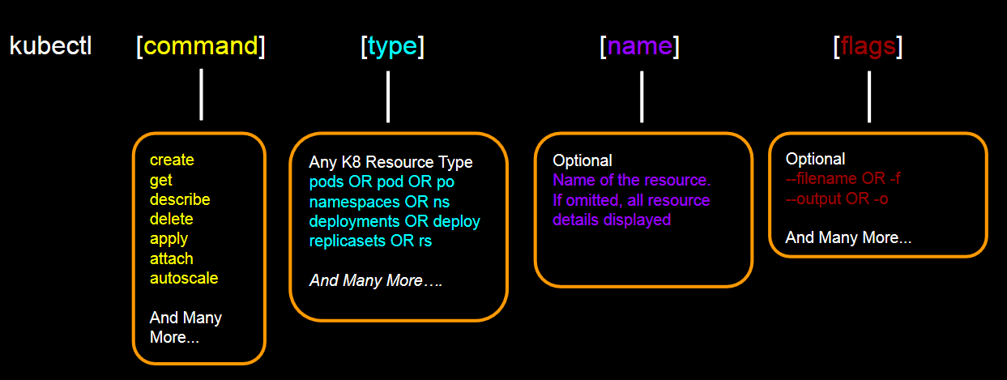
kubectl command

Slide 11
Simplest Tutorial
https://kubernetes.io/docs/tutorials/hello-minikube/

