Slide 1
Exercise
Consider that we have a single network having IP Address 200.1.2.0
We want to do subnetting and divide this network into 4 subnets

Slide 2
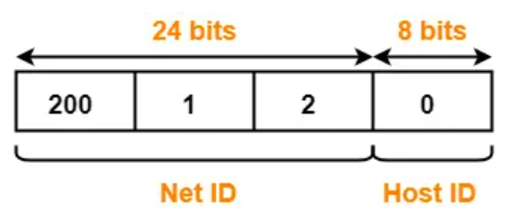
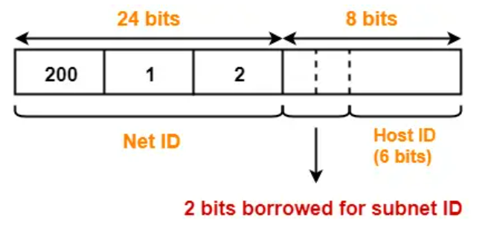
Solution
The network belongs to class C
To create 4 subnets, we need 2 bits from the host id to be used as subnet id
Host id will now have 6 bits
Subnet IDs
Subnet ID 1: 00
Subnet ID 2: 01
Subnet ID 3: 10
Subnet ID 4: 11

Slide 3
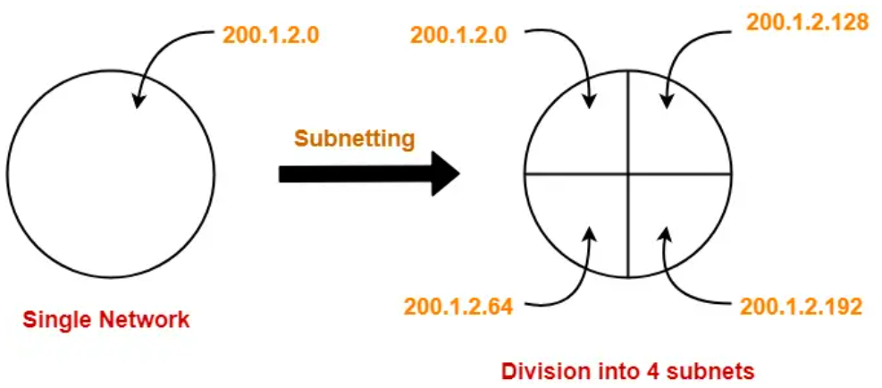
Solution
IP addresses of the four subnets
200.1.2.00000000 = 200.1.2.0
200.1.2.01000000 = 200.1.2.64
200.1.2.10000000 = 200.1.2.128
200.1.2.11000000 = 200.1.2.192

Slide 4
Subnet 1
Network Address of the subnet = 200.1.2.0
Total number of IP Addresses = 2⁶ = 64
Total number of hosts that can be configured = 64 – 2 = 62
Range of IP Addresses = [200.1.2.00000000, 200.1.2.00111111] = [200.1.2.0, 200.1.2.63]
Broadcast Address = 200.1.2.00111111 = 200.1.2.63

Slide 5
Subnet 2
Network Address of the subnet = 200.1.2.64
Total number of IP Addresses = 2⁶ = 64
Total number of hosts that can be configured = 64 – 2 = 62
Range of IP Addresses = [200.1.2.01000000, 200.1.2.01111111] = [200.1.2.64, 200.1.2.127]
Broadcast Address = 200.1.2.01111111 = 200.1.2.127

Slide 6
Subnet 3
Network Address of the subnet = 200.1.2.128
Total number of IP Addresses = 2⁶ = 64
Total number of hosts that can be configured = 64 – 2 = 62
Range of IP Addresses = [200.1.2.10000000, 200.1.2.10111111] = [200.1.2.128, 200.1.2.191]
Broadcast Address = 200.1.2.10111111 = 200.1.2.191

Slide 7
Subnet 4
Network Address of the subnet = 200.1.2.192
Total number of IP Addresses = 2⁶ = 64
Total number of hosts that can be configured = 64 – 2 = 62
Range of IP Addresses = [200.1.2.11000000, 200.1.2.11111111] = [200.1.2.192, 200.1.2.255]
Broadcast Address = 200.1.2.11111111 = 200.1.2.255

Slide 8
Subnetting Exercise
For an address 192.168.5.85 /24, we want to create 5 subnets.
What will be the first host address on the first subnet and the second host address on the second subnet?
How many hosts are possible per subnet?

Slide 9
Solution
Our network address is 192.168.5.85 /24.
We want to create 5 subnets. So, 3 bits from the host id portion will be used for the subnet id. So, 5 bits will be left for the host id.
First subnet id in binary will be: 000
First address possible in the first subnet will be: 00000. But this is not the first host address, as this is reserved as the first subnet address.
So, the first host address within the first subnet will be 00001.
The first host address within the first subnet will be:
192.168.5.(000 00001) to the base 2
192.168.5.1 - First host address in the first subnet
The second host address within the second subnet will be:
192.168.5.(001 00010) to the base 2
192.168.5.34
Number of hosts per subnet = 2^{h} – 2 = 2⁵ – 2 = 30

Slide 10
Subnetting Exercise – 3
Consider a class C network with IP address 198.34.5.0.
You are asked to create 6 subnets.

Slide 11
Solution
(1) Write the default mask in decimal.
=> 24 bits are reserved for the network id, 8 bits are reserved for the host id
So, the default mask will be 255.255.255.0
(2) Write the subnet mask in decimal.
=> We want to create 6 subnets. For 6 subnets, we will need to reserve 3 bits for the subnet id (because 2 to the power 3 = 8, which is >= 6)
As we know, the default mask is 255.255.255.0 in decimal
In binary, it will be 11111111.11111111.11111111.00000000
Subnet mask will be: 11111111.11111111.11111111.11100000
Subnet mask in decimal will be: 255.255.255.224
(3) Write the subnetted address for this network.
=> Default network address for this network is 198.34.5.0/24.
Subnetted address for the same network will be 198.34.5.224/27.
(4) What will be the first host address of the first subnet in this network?
=>
There are 6 subnets.
3 bits are reserved for the subnet id.
Subnet ids will be:
First subnet id: 000
Second subnet id: 001
Third subnet id: 010
...
Eigthth subnet id: 111
From above, the first subnet id is 000.
Within this first subnet, the first possible address is 00000
However, the first address is any network or in any subnet is reserved as the network address.
Thus, the first host address will be 00001.
Thus, the full address for the first host in the first subnet will be 00000001 in binary, or 1 in decimal.
And its complete IP address will be 198.34.5.1/27.
(5) How many hosts are possible in the third subnet? What will be the network address for the third subnet, what will be the first host address for the third subnet, and what will be the last host address for the third subnet?

Slide 12
Subnetting Exercise – 4
What are the network address, broadcast address, and valid host addresses for the IP address 198.22.45.173/26?
What is the subnet mask in dotted decimal notation?

Slide 13
Solution
Let’s figure out the subnet mask in dotted decimal notation first because that’s easy...
/26 borrows the first 2 bits in the last octet
128 + 64 = 192
So the subnet mask is 255.255.255.192

Slide 14
Solution - Subnets and Hosts
Our given address is 198.22.45.173/26
Since two bits are reserved for the subnet id, 4 subnets 00, 01, 10, and 11 are possible
We need to think “Our IP address will fall in which of these four subnets?”
To answer this, let us calculate the address range for each of the four subnets

Slide 15
Solution - Subnets and Hosts
Subnet Number (Decimal) | Subnet ID (Binary) | First full address in the subnet (Binary) | Last full address in the subnet (Decimal) | First full address in the subnet (Binary) | Last full address in the subnet (Decimal) | Our target IP address (173)
1 | 00 | 00000000 | 00111111 | 0 | 63 | Not here
2 | 01 | 01000000 | 01111111 | 64 | 127 | Not here
3 | 10 | 10000000 | 10111111 | 128 | 191 | Here
4 | 11 | 11000000 | 11111111 | 192 | 255 | Not here
Our given address is 198.22.45.173/26

Slide 16
Solution
Next let’s calculate the address range for this subnet
The network portion of the address is the first 26 bits
198.22.45.128 is the network address (First address of the third subnet – See the previous slide)
The line is after 64, so add 64 to get the network address of the next subnet
The next subnet begins at 198.22.45.192
So the broadcast address is 198.22.45.191
And the valid host addresses are 198.22.45.129 to 198.22.45.190

Slide 17
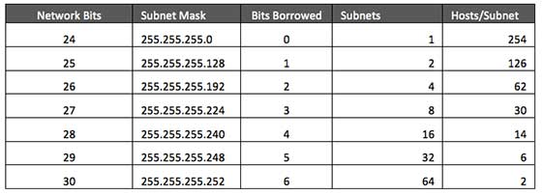
Summary: Subnetting in Class C

Slide 18
Variable Length Subnet Mask (VLSM)

Slide 19
VLSM Concept
Early routing protocols only supported Fixed Length Subnet Masking (FLSM) where all subnets had to be the same size.
You couldn’t have a subnet with 14 hosts and another subnet with 64 hosts in the same network.
All modern routing protocols support Variable Length Subnet Masking (VLSM).
This allows us to size subnets differently according to how many hosts they have.

Slide 20
VLSM Considerations
How many locations do we have in the network?
How many hosts are in each location?
What are the IP addressing requirements for each location? (Should different departments or types of host be in different subnets?)
What size is appropriate for each subnet? (Don’t waste addresses, but leave room for growth.)

Slide 21
VLSM Example
Suppose there is an administrator that has four departments to manage.
These are sales and purchase department with 120 computers, development department with 50 computers, accounts department with 26 computers and management department with 5 computers.
If the administrator has IP 192.168.1.0/24, how can department wise IPs be allocated?

Slide 22
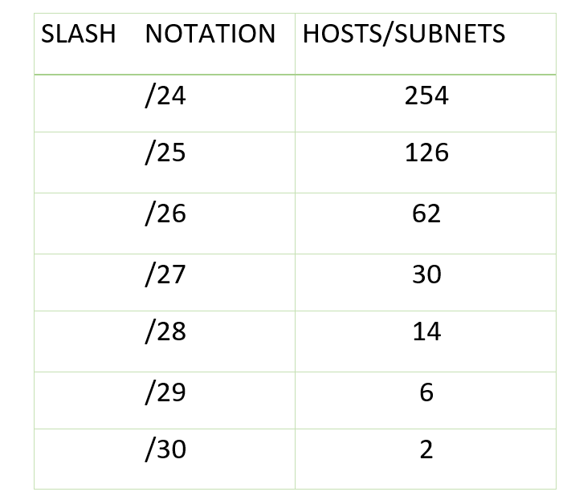
Variable Length Subnet Mask (VLSM)
Step 1: For each segment select the block size that is >= the actual requirement. Make a list of subnets possible:

Slide 23
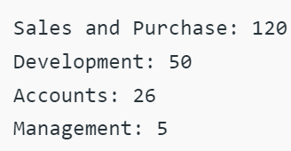
Variable Length Subnet Mask (VLSM)
Step 2: Arrange all the segments in descending order based on the block size that is from highest to lowest requirement:

Slide 24
Variable Length Subnet Mask (VLSM)
Step 3: The highest IP available has to be allocated to highest requirement, so the sales and purchase department gets 192.168.1.0/25, which has 126 valid addresses that can easily be available for 120 hosts. The subnet mask used is 255.255.255.128.
Network address: 192.168.1.0
Host range: 192.168.1.1 – 192.168.1.126
Broadcast address: 192.168.1.127

Slide 25
Variable Length Subnet Mask (VLSM)
Step 4: The next segment (Development) requires an IP to handle 50 hosts. We need /26 for 62 hosts. The subnet mask used is 255.255.255.192.
Network address: 192.168.1.128
Host range: 192.168.1.129 – 192.168.1.190
Broadcast address: 192.168.1.191

Slide 26
Variable Length Subnet Mask (VLSM)
Step 5: Accounts needs 26 hosts. We will need /27, as it has 30 valid hosts. The mask used is 255.255.255.224.
Network address: 192.168.1.192
Host range: 192.168.1.193 – 193.168.1.222
Broadcast address: 192.168.1.223

Slide 27
Variable Length Subnet Mask (VLSM)
Step 6: The last segment (Management) requires 5 valid hosts IP, which means /29. Subnet mask is 255.255.255.248
Network address: 192.168.1.224
Host range: 192.168.1.225 to 192.168.1.230
Broadcast address: 192.168.1.231

Slide 28
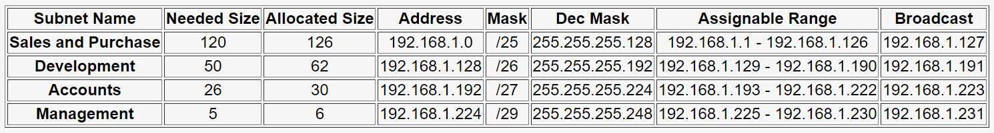
Summary

Slide 29
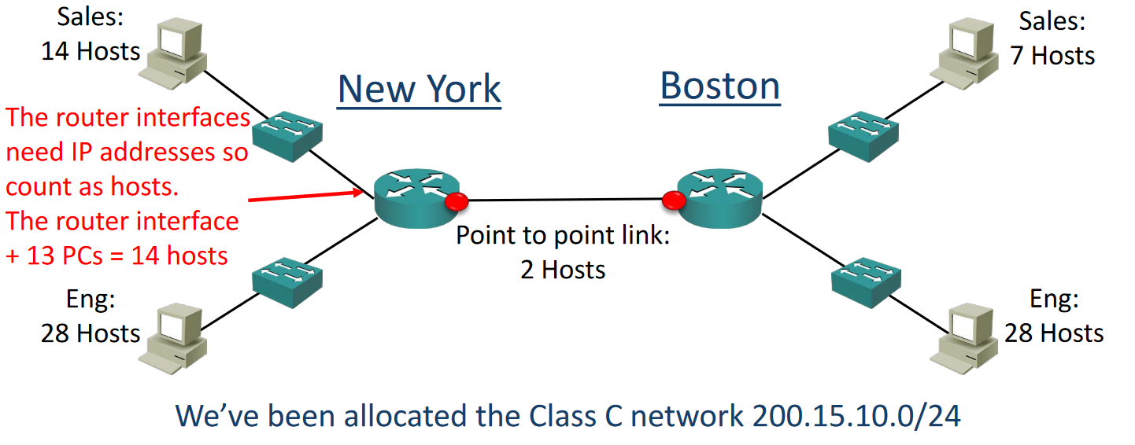
VLSM Example

Slide 30
VLSM Example – Design Steps
Find the largest segment and allocate a suitable subnet size for it.
Allocate this subnet at the start of the address space.
Continue going down the list.

Slide 31
VLSM Example – Design Steps
The Engineering departments in both sites have 28 hosts.
For our example we’ve been told that the departments will not grow and we need to use the smallest subnets possible to maximise our address space.
Calculate the optimal subnet mask for the Engineering departments.
Also determine the network and broadcast addresses that will be allocated to both Engineering departments, and the range of host addresses.

Slide 32
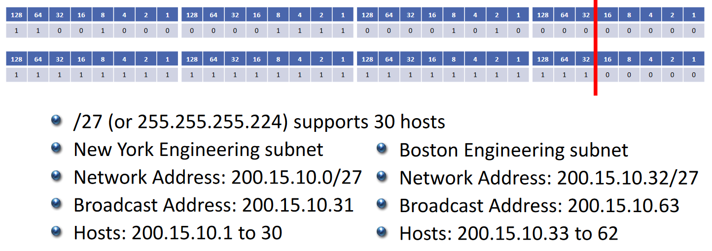
Engineering Departments
We’ve been allocated 200.15.10.0/24

Slide 33
New York Sales Department
The next largest subnet is New York Sales which requires 14 hosts.
Calculate the optimal subnet mask.
Also determine the network and broadcast addresses that we will allocate, and the range of host addresses.

Slide 34
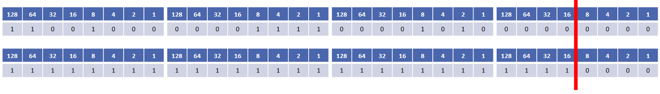
New York Sales Department
We’ve been allocated 200.15.10.0/24
New York Sales Department
We’ve been allocated 200.15.10.0/24
/28 (or 255.255.255.240) supports 14 hosts
200.15.10.0 to 200.15.10.63 are already in use by the Engineering departments, so this network address will start at 200.15.10.64
The network address goes up in values of 16, so the next one is 200.15.10.80
Our broadcast address is 200.15.10.79
Valid host addresses are 200.15.10.65 to 200.15.10.78

Slide 35
Boston Sales Department
The next largest subnet is Boston Sales which requires 7 hosts.
Calculate the optimal subnet mask.
Also determine the network and broadcast addresses that we will allocate, and the range of host addresses.

Slide 36
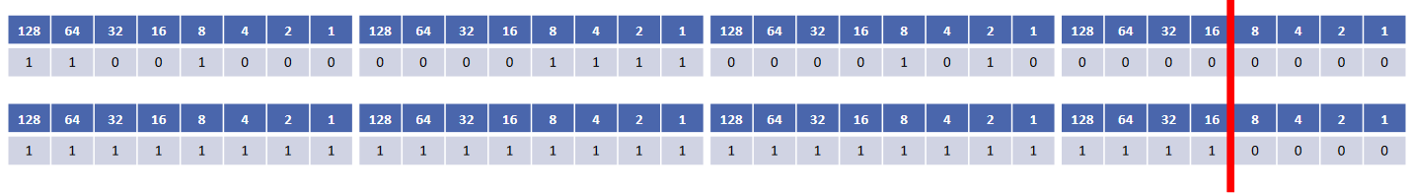
Boston Sales Department
We’ve been allocated 200.15.10.0/24
/28 (or 255.255.255.240) supports 14 hosts
/29 does not support 8 hosts! Remember to subtract 2 for the network and broadcast address
200.15.10.0 to 200.15.10.79 are already in use, so this network address will start at 200.15.10.80
The network address goes up in values of 16, so the next one is 200.15.10.96
Our broadcast address is 200.15.10.95
Valid host addresses are 200.15.10.81 to 200.15.10.94

Slide 37
Are we done?
Don’t forget the links between routers

Slide 38
New York to Boston Link
The last subnet is the link between the New York and Boston routers.
Calculate the optimal subnet mask.
Also determine the network and broadcast addresses that we will allocate, and the range of host addresses.

Slide 39
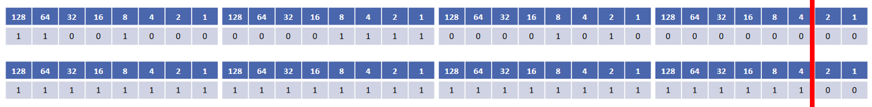
New York to Boston Link
We’ve been allocated 200.15.10.0/24
/30 (or 255.255.255.252) supports 2 hosts
200.15.10.0 to 200.15.10.95 are already in use, so our network address will be 200.15.10.96
The network address goes up in values of 4, so the next one is 200.15.10.100
Our broadcast address is 200.15.10.99
Valid host addresses are 200.15.10.97 to 200.15.10.98

Slide 40
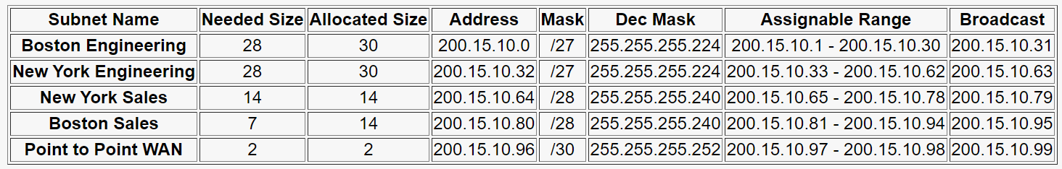
Summary

Slide 41
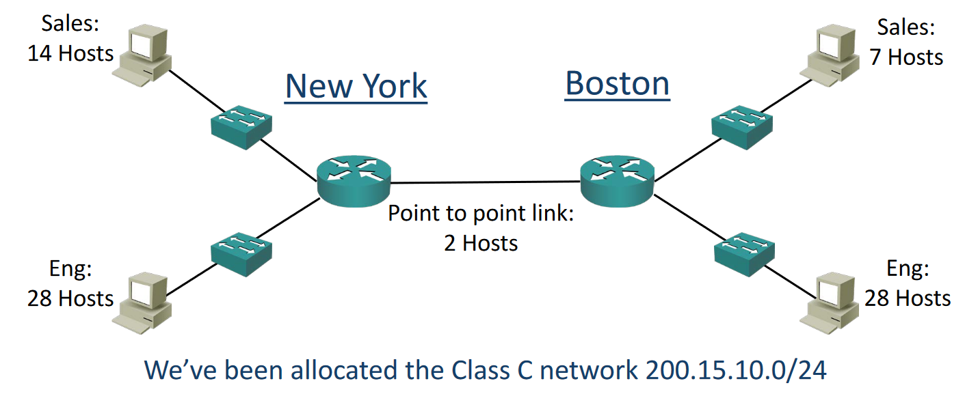
Original Network Diagram

Slide 42
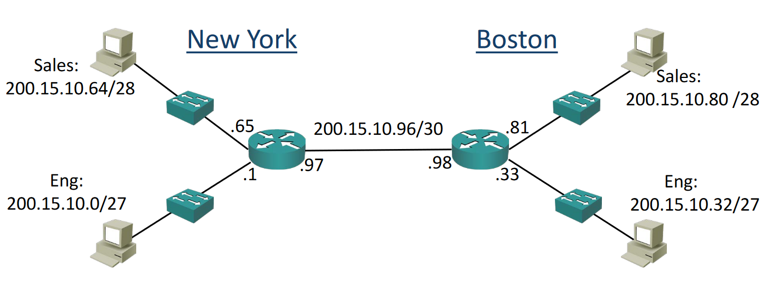
Diagram with Network Topology

Slide 43
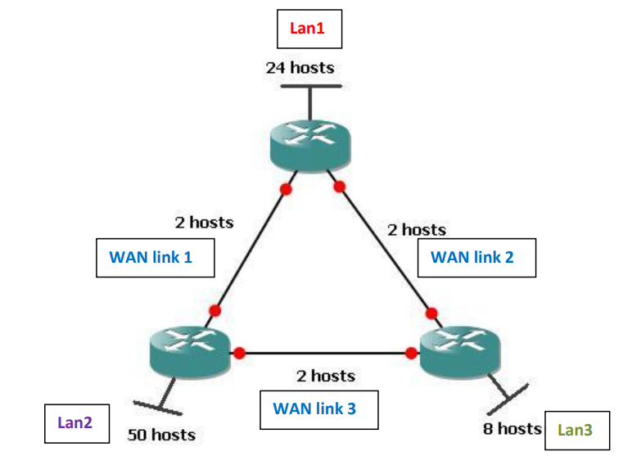
VLSM Problem
Create VLSM
IP address: 205.15.43.0/24

