Slide 1
Subnetting
Notes:
1

Slide 2
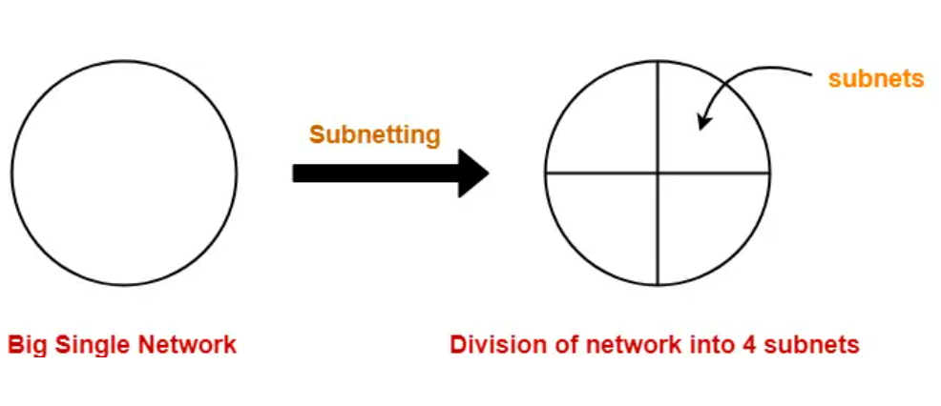
Subnetting Concept

Slide 3
Subnet Concept
Network id
Host id
Two ways to address a particular house
Building number, House number (Normal IP address)
Building number, Floor number, House number (IP address with subnet)
Subnet id
Network id
Host id
Notes:
3

Slide 4
Subnetting
Divide a network into smaller sub-networks with each subnet having its own IP address
Allow a network to be split into several internal sub-networks, but act like a single network to the outside world
Motivation: Make better use of the IP address space
IP addresses: Two levels of hierarchy; subnetting makes it three
Notes:
4

Slide 5
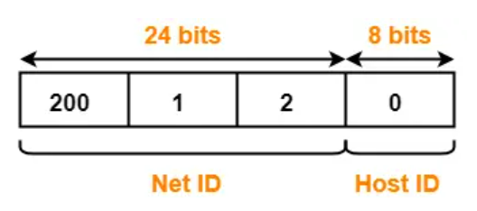
Subnetting Example
Consider a network having IP address 200.1.2.0
We want to divide this into two parts, creating two subnets
Analysis: Network belongs to class C

Slide 6
Subnetting Example
We want to create two subnets
Subnet 1 will have id 0₂
Subnet 2 will have id 1₂
IP address length is always 32 bits
For the current example, we have:
Net id: 24 bits
Host id: 8 bits
We need one bit for the subnet id: From where to take, and why?

Slide 7
Subnetting Example
If we take 1 bit from the net ID
Net id will become 23 bit
What will be the impact?
Current net ID is:
Which bit to take?
Suppose we take the last bit in the third octet (i.e. 0)
Now net ID will become 200.1.1 (because last octet will now be of only 7 bits 0000001)
Suppose we take the first bit in the first octet (i.e. 1)
Now net ID will become 72.1.1 (because first octet will now be of only 7 bits 1001000)
Conclusion: We cannot touch the net ID
200 | 1 | 2
11001000 | 00000001 | 00000010

Slide 8
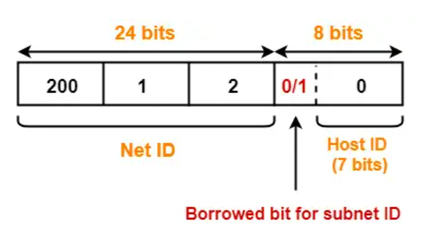
Subnetting Example
Conclusion: We must take one bit from the host id
This bit must be from the leftmost part of the host id
Now, the host id will only have 7 bits
If borrowed bit = 0, then it represents the first subnet
If borrowed bit = 1, then it represents the second subnet

Slide 9
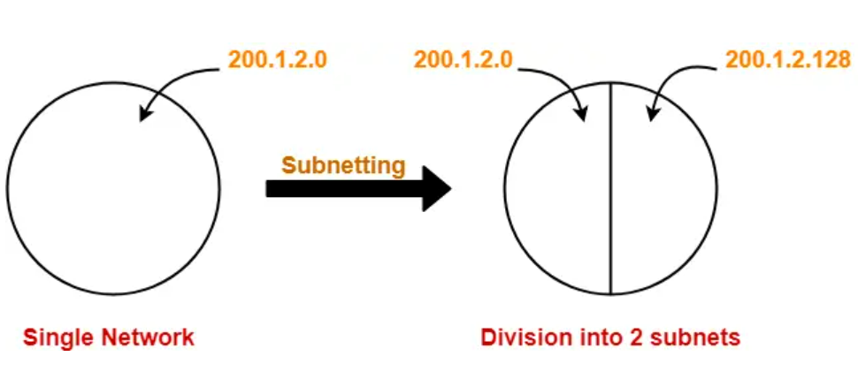
Resulting Subnets
IP addresses of the two subnets:
200.1.2.00000000 = 200.1.2.0
200.1.2.10000000 = 200.1.2.128

Slide 10
Subnet 1
Network address of the subnet = 200.1.2.0
Total number of IP Addresses = 2⁷ = 128
Total number of hosts that can be configured = 128 – 2 = 126
Range of IP Addresses = [200.1.2.00000000, 200.1.2.01111111] = [200.1.2.0, 200.1.2.127]
Broadcast Address = 200.1.2.01111111 = 200.1.2.127

Slide 11
Subnet 2
Network address of the subnet = 200.1.2.128
Total number of IP Addresses = 2⁷ = 128
Total number of hosts that can be configured = 128 – 2 = 126
Range of IP Addresses = [200.1.2.10000000, 200.1.2.11111111] = [200.1.2.128, 200.1.2.255]
Direct Broadcast Address = 200.1.2.11111111 = 200.1.2.255

