Slide 1





Ministry of Electronics
and Information Technology Government of India
GPU Architecture
Pranay Shahare
Student
CDAC, Pune
One Vision. One Goal... Advanced Computing for Human Advancement…

Slide 2
Topics
Evolution of HPC
CPU vs GPU
GPU Architecture
CUDA Programming
Flow of a CUDA program

Slide 3
Evolution of HPC System
Memory
Memory
Memory
Memory
…….
CPU
CPU
CPU
CPU
CPU
NETWORK
Sequential program Mega Flops
Shared Memory Giga Flops
Parallel programs using OpenMP and MPI
Multiple nodes Tera Flops
Infiniband (200Gbps) Distributed memory

Slide 4
Evolution of HPC System (contd…)
Architecture innovations
Width: 8 bit to 16 bit to 64 bit
Multicore: single processor to multi cores
Instructions per cycle: 4-10 cycles per instructions to 4+ instructions per cycle
Clock rate : 3MHz to 4GHz

Slide 5
CPU vs GPU : Silicon Budget
 | CPU | GPU
ALU | Less | More
Control | More | Less
Cache | More | Less

Slide 6
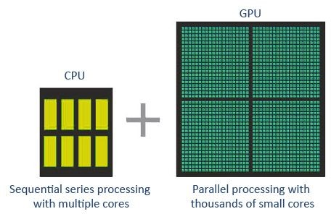
CPU vs GPU : Silicon Budget

Slide 7
CPU vs GPU
CPU | GPU
Small number of large cores | Large number of small cores
Low latency | High throughput
Optimized for serial processing | Optimized for parallel processing
Designed for running complex programs | Designed for repetitive and complex calculations
Cost efficient for smaller workloads | Cost efficient for bigger workloads

Slide 8
CUDA
CUDA : Compute Unified Device Architecture
Run programs by utilizing power of GPUs
Extension of C/C++ that allows CPUs and GPUs to work together

Slide 9
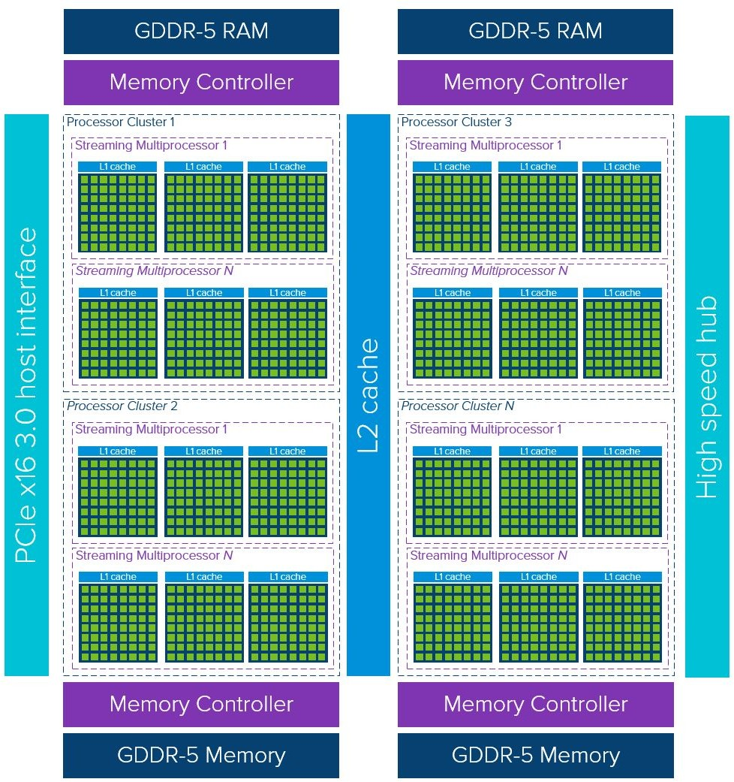
GPU Architecture

Slide 10
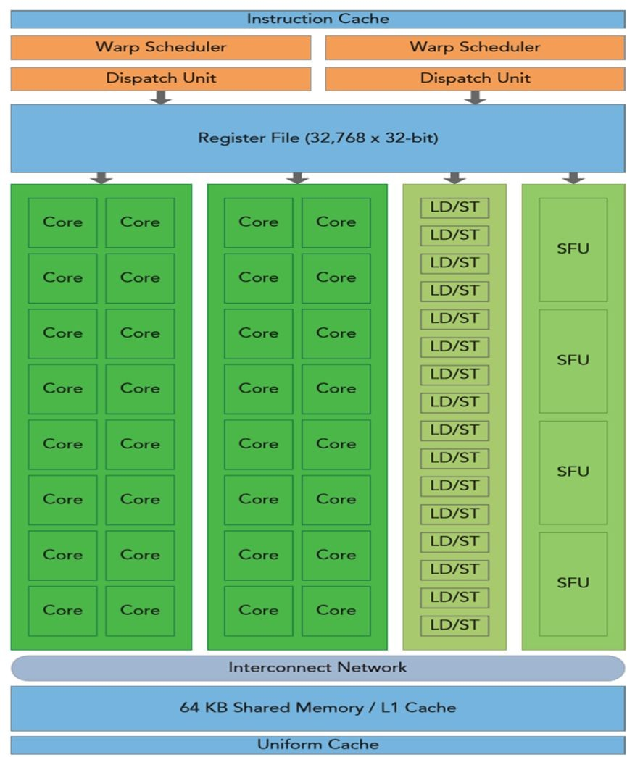
Streaming Multiprocessors
Core
LD/ST - Load and store units
SFU - Special Function units
Warp Scheduler

Slide 11
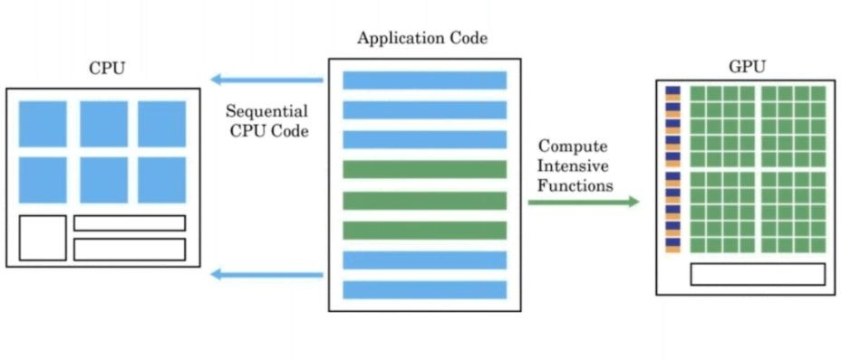
GPU Programming Paradigm

Slide 12
Elements of CUDA program
Host code - code that runs on CPU
Device code - code that runs on GPU
global void cuda_hello(){
printf("Hello World from GPU!\n");
}
int main() { cuda_hello<<<,1>>>(); return 0;
}

Slide 13
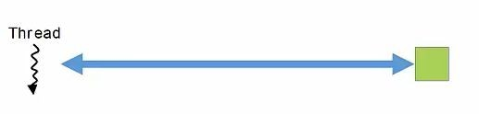

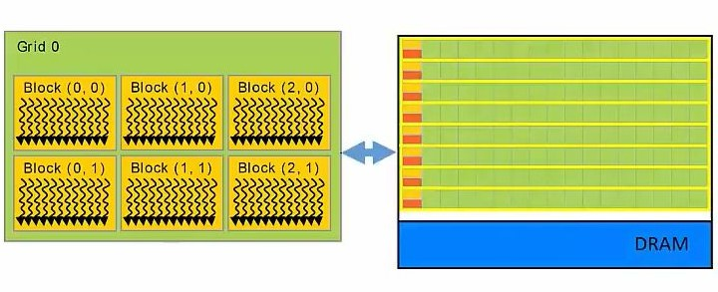
Organization of threads

Slide 14
Organization of threads (contd…)
Threads
- Kernel executes as a set of threads
Blocks
- Threads are grouped into blocks
Grids
- Blocks are grouped into grids
Kernel executes as a Grid of Blocks of Threads

Slide 15
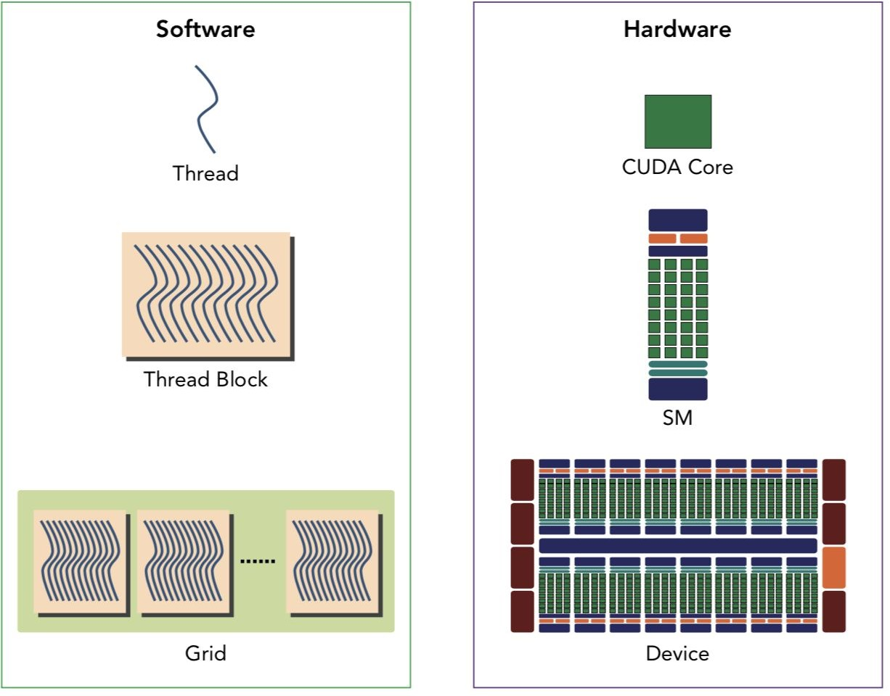
Software abstraction

Slide 16
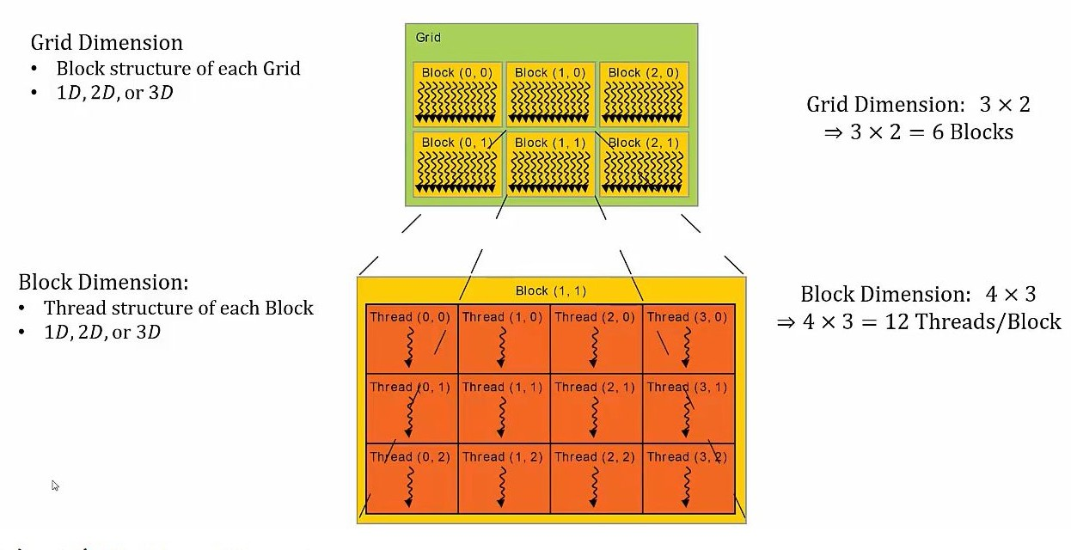
Dimensions of Grids and Blocks

Slide 17
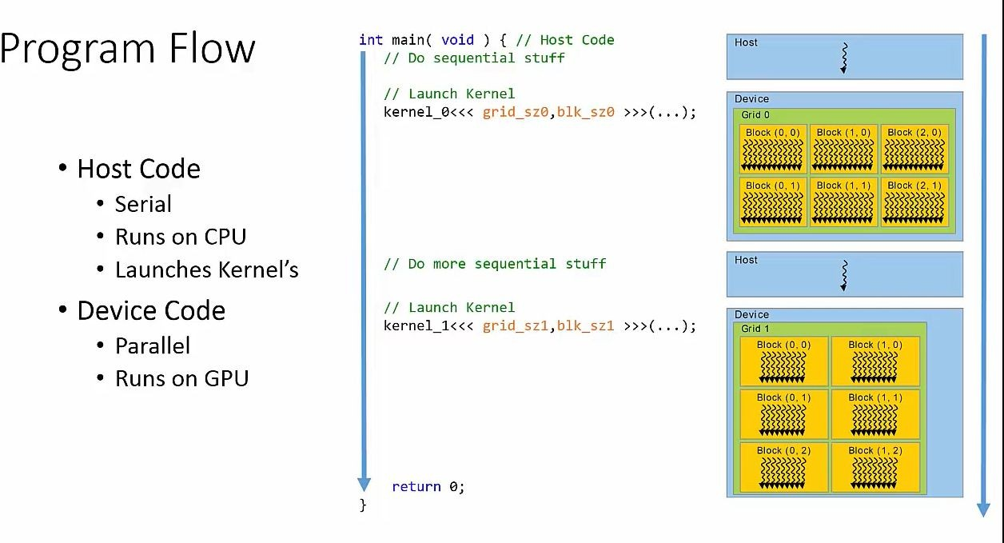

Slide 18
Kernel Launch Syntax
// Launch kernel
KernelName <<< grid_size, block_size >>> (...)

Slide 19
Kernel Launch Syntax
// Launch kernel
KernelName <<< grid_size, block_size >>> (...) KernelName <<< no_of_blocks, threads_per_block >>> (...)

Slide 20
Kernel Launch Syntax
// dim3 variable
dim3 grid_size (x, y, z) dim3 block_size (x, y, z)
// Launch kernel
global KernelName <<< grid_size, block_size >>> (...)
global KernelName <<< no_of_blocks, threads_per_block >>> (...)

Slide 21
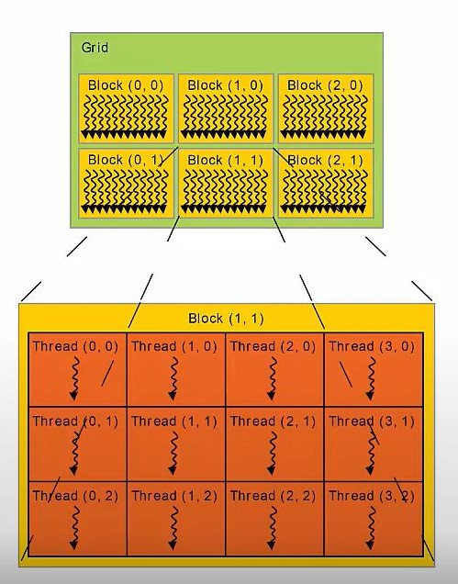
Kernel Launch
// dim3 variable
dim3 grid_size (3, 2)
dim3 block_size (4, 3)
// Launch kernel
global KernelName <<< grid_size, block_size >>> (...)

Slide 22
Function qualifiers
 | Executed on | Only callable from
 | device | device
global | device | host
 | host | host

Slide 23
Function qualifiers
 | Executed on | Only callable from
device | device | device
global | device | host
host | host | host

Slide 24
1 Block - threads in 1D
int main()
0 1 2 3 4 5 6 7 8 9
{
fun <<< 1, 10 >>> ();
}
global void fun()
{
int tx = threadIdx.x; printf(“%d”, tx);
}

Slide 25
1 Block - threads in 2D
int main()
{
0 1 2 3 4
dim3 threadsPerBlock(5, 2);
fun <<< 1, threadsPerBlock >>> ();
0
}
global void fun()
{
1
int tx = threadIdx.x;
int ty = threadIdx.y; printf(“%d %d”, tx, ty);
}

Slide 26
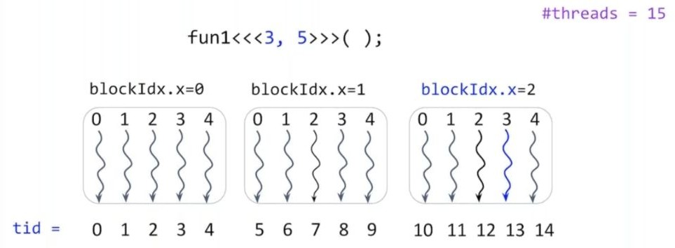
Blocks in 1D -threads in 1D

Slide 27
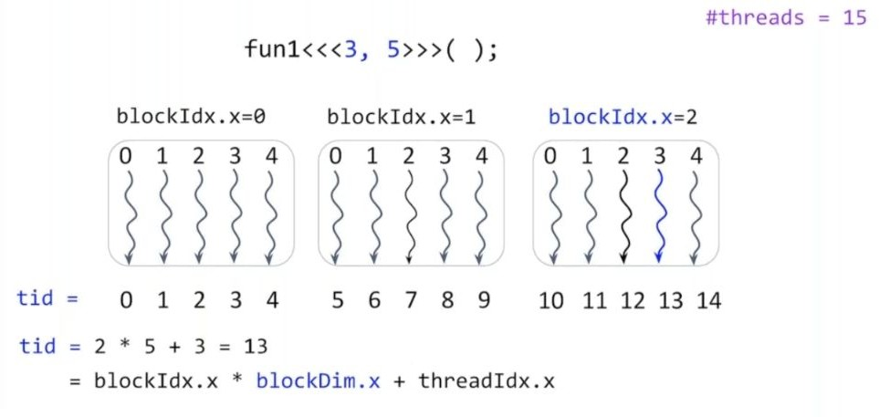
Blocks in 1D -threads in 1D

Slide 28
Flow of a CUDA program
Allocate host memory and initialize data
Allocate device memory
Transfer data from host to device memory
Execute kernels
Transfer data from device to host
Reclaim memory

Slide 29
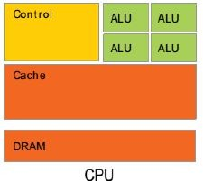
Flow of a CUDA program
int main(void){
// sequential code
Host
Host code
- Sequential code
}

Slide 30
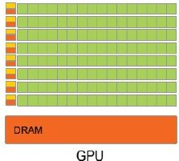
Flow of a CUDA program
Host
Host code
- Sequential code
Allocate memory on device
int main(void){
// sequential code
// Allocate memory on device cudaMalloc(...)
}

Slide 31
Flow of a CUDA program
int main(void){
// sequential code
Host
Host code
- Sequential code
Allocate memory on device
Copy data from host to device
- Copy data from CPU to GPU
// Allocate memory on device cudaMalloc(...)
// Copy data from host to device cudaMemcpy(...)
}

Slide 32
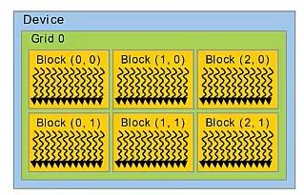
Flow of a CUDA program
int main(void){
// sequential code
Host
Host code
- Sequential code
Allocate memory on device
Copy data from host to device
- Copy data from CPU to GPU
Launch kernel
- Execute threads in parallel on GPU
// Allocate memory on device cudaMalloc(...)
// Copy data from host to device cudaMemcpy(...)
// Launch kernel KernelName <<< grid_size, block_size >>> (...)
}

Slide 33
Flow of a CUDA program
int main(void){
// sequential code
Host
Host code
- Sequential code
Allocate memory on device
Copy data from host to device
- Copy data from CPU to GPU
Launch kernel
- Execute threads in parallel on GPU
Copy data from device to host
// Allocate memory on device cudaMalloc(...)
// Copy data from host to device cudaMemcpy(...)
// Launch kernel KernelName <<< grid_size, block_size >>> (...)
// Copy data from device to host cudaMemcpy(...)
Host
//sequential code return 0;
}

Slide 34
Allocating device memory
In C:
- malloc(...)
- free(...)
In CUDA:
cudaMalloc(Location, Size)
cudaFree()
Location: Memory location on device to allocate memory
Size: number of bytes to allocate

Slide 35
Copy data from host to device
cudaMemcpy( destination, source, numBytes, direction)
Direction
Host to device (cudamemcpyhtod)
Device to host (cudamemcpydtoh)
Device to device (cudamemcpydtod)

Slide 36
Running a cuda program
- Save file with .cu extension
- test.cu
Load cuda compiler
Spack load nvhpc
Compiler the program
nvcc test.cu -o test
Run the executable
./test

Slide 37
THANK YOU

