Slide 1
Paper III Digital Electronics and Microprocessor UNIT – I Logic Gates & Logic Families
ONLINE / LIVE TEACHING CLASSES
SESSION 2020-2021
DATE: 6 February 2021

Slide 2
Unit I – Logic Gates & Logic Families
Logic Gates: Symbol, diode/transistor switch circuit and logical expression, truth table of basic gates (AND, OR, NOT), Universal gates (NAND, NOR) and special purpose gates (Ex-OR, Ex-NOR), Tristate Logic.
2

Slide 3
Logic Gates & Logic Families
3

Slide 4
Unit Outcomes
Develop basic gates using the given NAND/NOR gates as universal gates.
Simplify the given expression using Boolean Expression.
Develop logic circuits using the given Boolean expressions.
Compare the salient characteristics of the given digital logic families.
4

Slide 5
Unit II – Logic Gates & Logic Families
Logic Gates: Symbol, diode/transistor switch circuit and logical expression, truth table of basic gates (AND, OR, NOT), Universal gates (NAND, NOR) and special purpose gates (Ex-OR, Ex-NOR), Tristate Logic.
5

Slide 6
Basics…..
Logic gates are the fundamental building blocks of digital systems.
The name logic gate is derived from the ability of such devices to make decisions, in the sense that it produces one output level when some combinations of input levels are present
6

Slide 7
Basics…..
Inputs & Outputs for Logic Circuits
Input & Output of logic gates can occur only in two levels.
HIGH
True ON 1
LOW
False OFF 0
7

Slide 8




Basics…..
Truth Table
A table which lists all the possible combinations of input variables and the corresponding outputs is called a “Truth Table”.
It shows how the logic circuits output responds to various
combinations of logic levels at the inputs
Switches in parallel => OR
Switch 1 | Switch 2 | Output
OFF | OFF | OFF
OFF | ON | GLOW
ON | OFF | GLOW
ON | ON | GLOW
23

Slide 9
Basics…..
Logic
A logic in which the voltage levels represent logic 1 and logic 0.
Level logic may be Positive or Negative.
A “Positive Logic” is the one which the higher of the two voltage levels represents the logic 1 and the lower of the two voltage level represents the logic 0.
A “Negative Logic” is the one which the lower of the two voltage levels represents the logic 1 and the higher of the two voltage level represents the logic 0.
9

Slide 10
Basics…..
Logic
Positive Logic
Logic 0 (LOW)=0V
Logic 1 (HIGH)=+5V
Negative Logic
Logic 0 (LOW)=+5V
Logic 1 (HIGH)=0V
10

Slide 11
Logic Gates
Logic Gates
Basic Gates
Universal Gates
Special Purpose Gates
AND Gate OR Gate NOT Gate
NAND Gate NOR Gate
Ex-OR Gate Ex-NOR Gate
11

Slide 12
AND Gate
An AND gate has two or more inputs but only one output.
The output assumes the logic 1 state, when both inputs are at logic 1 state.
The output assumes the logic 0 state even if one of its inputs is at logic 0 state.
A
B
Y=A.B
Logic Symbol
27

Slide 13
AND Gate
Inputs |  | Output
A | B | Y=A.B
0 | 0 | 0
0
A
B
Y=A.B
0
0
13

Slide 14
AND Gate
Inputs |  | Output
A | B | Y=A.B
0 | 0 | 0
0 | 1 | 0
0
A
B
Y=A.B
0
1
14

Slide 15
AND Gate
Inputs |  | Output
A | B | Y=A.B
0 | 0 | 0
0 | 1 | 0
1 | 0 | 0
1
A
B
Y=A.B
0
0
15

Slide 16
AND Gate
Inputs |  | Output
A | B | Y=A.B
0 | 0 | 0
0 | 1 | 0
1 | 0 | 0
1 | 1 | 1
1
A
B
Y=A.B
1
1
16

Slide 17
Realization of AND Gate using Diode
+5V
R
D1
A
Output
D2
B
17

Slide 18
Realization of AND Gate using Diode
Case I: When A = 0 and B = 0
+5V
R
D1
Output = 0
A = 0
Inputs |  | Output
A | B | Y=A.B
0 | 0 | 0
 |  | 33
D2
B = 0

Slide 19
Realization of AND Gate using Diode
Case II: When A = 0 and B = 1
+5V
R
D1
Output = 0
A = 0
Inputs |  | Output
A | B | Y=A.B
0 | 0 | 0
0 | 1 | 0
 |  | 34
D2
B = 1
+5V

Slide 20
Realization of AND Gate using Diode
Case III: When A = 1 and B = 0
+5V
R
D1
+5V
Output = 0
A = 1
Inputs |  | Output
A | B | Y=A.B
0 | 0 | 0
0 | 1 | 0
1 | 0 | 0
 |  | 35
D2
B = 0

Slide 21
Realization of AND Gate using Diode
Case IV: When A = 1 and B = 1
+5V
R
D1
+5V
Output = 1
A = 1
Inputs |  | Output
A | B | Y=A.B
0 | 0 | 0
0 | 1 | 0
1 | 0 | 0
1 | 1 | 3¹6
D2
+5V
B = 1

Slide 22
Realization of AND Gate using Transistor
+5V
R
R
R
A
Q1
Output
R
R
B
Q2
Q3
37

Slide 23
Realization of AND Gate using Transistor
Case I: When A = 0 and B = 0
+5V
R
R
R
A
Q1
OFF
Output = 0
V <0.7
BE
Inputs |  | Output
A | B | Y=A.B
0 | 0 | 0
 |  | 38
R
R
B
Q2
Q3
ON
OFF
+
V_{BE}<0.7
V_{BE}>0.7
-

Slide 24
Realization of AND Gate using Transistor
Case II: When A = 0 and B = 1
+5V
R
R
R
A
Q1
OFF
Output = 0
V_{BE}<0.7
Inputs |  | Output
A | B | Y=A.B
0 | 0 | 0
0 | 1 | 0
 |  | 39
R
R
B
Q2
Q3
ON
+5V
+
ON
+
V_{BE}>0.7
V_{BE}>0.7
-
-

Slide 25
Realization of AND Gate using Transistor
Case III: When A = 1 and B = 0
+5V
R
R
R
_{A}+5V
Q1
ON
+
Output = 0
V_{BE}>0.7
-
Inputs |  | Output
A | B | Y=A.B
0 | 0 | 0
0 | 1 | 0
1 | 0 | 0
 |  | 40
R
R
B
Q2
Q3
ON
OFF
+
V_{BE}<0.7
V_{BE}>0.7
-

Slide 26
Realization of AND Gate using Transistor
Case IV: When A = 1 and B = 1
+5V
R
R
R
_{A}+5V
Q1
ON
+
Output = 1
V_{BE}>0.7
-
Inputs |  | Output
A | B | Y=A.B
0 | 0 | 0
0 | 1 | 0
1 | 0 | 0
1 | 1 | 4¹1
R
R
+5V
B
Q2
Q3
OFF
+
ON
V_{BE}>0.7
V_{BE}<0.7
-

Slide 27
3 - Input AND Gate
Truth Table : 3 – Input AND Gate
3 – Input AND Gate using 2 – Input AND Gate
Input |  |  | Output Y=A.B.C
A | B | C | Y
0 | 0 | 0 | 0
0 | 0 | 1 | 0
0 | 1 | 0 | 0
0 | 1 | 1 | 0
1 | 0 | 0 | 0
1 | 0 | 1 | 0
1 | 1 | 0 | 0
1 | 1 | 1 | 1
Y₁=A.B
A B
Y=Y₁.C
=A.B.C
C
Symbol : 3 – Input AND Gate
A B
C
Y=A.B.C
27

Slide 28
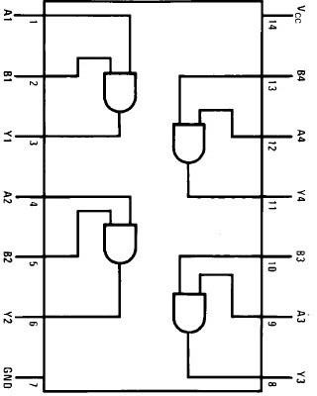
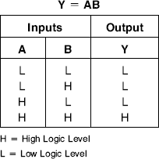
AND Gate IC – IC 7408 (Quad 2 I/P AND Gate)
This device contains four independent gates each of which performs the logic AND function.
Pin Configuration of IC 7408
Function Table of IC 7408
28

Slide 29
Verification of AND Gate IC 7408
+5V
R 330Ω
29

Slide 30
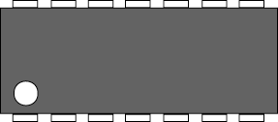
Verification of AND Gate IC 7408
Double check the pin numbers when working with ICs.
14
8
1
7
30

Slide 31
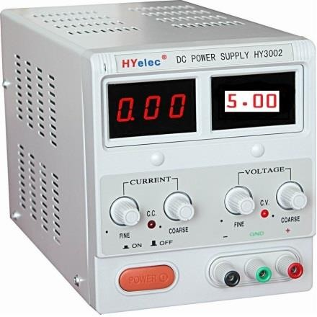
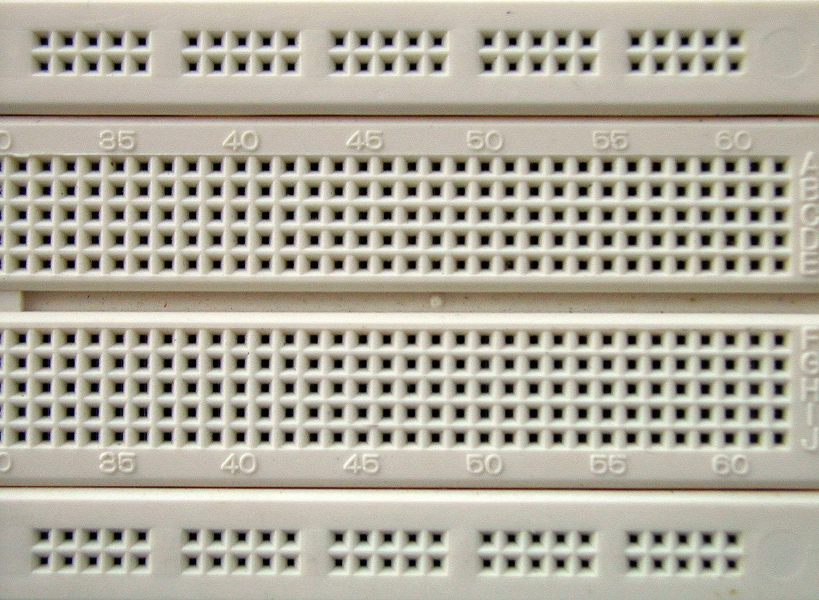
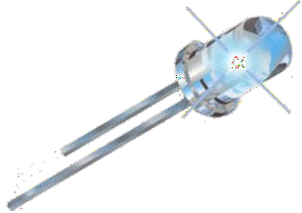

Verification of AND Gate IC 7408
^{V}CC
A
B
^{G}ND
31

Slide 32
OR Gate
An OR gate has two or more inputs but only one output.
The output assumes the logic 1 state, when even if one of its inputs is in logic 1 state.
The output assumes the logic 0 state only when both the inputs are in logic 0 state.
A
Y=A+B
B
Logic Symbol

Slide 33
OR Gate
Inputs |  | Output
A | B | Y=A+B
0 | 0 | 0
0
A
B
Y=A+B
0
0
33

Slide 34
OR Gate
Inputs |  | Output
A | B | Y=A+B
0 | 0 | 0
0 | 1 | 1
0
A
B
Y=A+B
1
1
34

Slide 35
OR Gate
Inputs |  | Output
A | B | Y=A+B
0 | 0 | 0
0 | 1 | 1
1 | 0 | 1
1
A
B
Y=A+B
1
0
35

Slide 36
OR Gate
Inputs |  | Output
A | B | Y=A+B
0 | 0 | 0
0 | 1 | 1
1 | 0 | 1
1 | 1 | 1
1
A
B
Y=A+B
1
1
36

Slide 37
Realization of OR Gate Using Diodes
D1
A
Output
D2
B
R
37

Slide 38
Realization of OR Gate Using Diodes
Case I: When A = 0 and B = 0
Inputs |  | Output
A | B | Y=A+B
0 | 0 | 0
D1
A=0
Output =0
D2
B=0
R
38

Slide 39
Realization of OR Gate Using Diodes
Case II: When A = 0 and B = 1
Inputs |  | Output
A | B | Y=A+B
0 | 0 | 0
0 | 1 | 1
D1
A=0
Output = 1
D2
B=1
+5V
R
39

Slide 40
Realization of OR Gate Using Diodes
Case III: When A = 1 and B = 0
Inputs |  | Output
A | B | Y=A+B
0 | 0 | 0
0 | 1 | 1
1 | 0 | 1
D1
A=1
Output = 1
+5V
D2
B=0
R
40

Slide 41
Realization of OR Gate Using Diodes
Case IV: When A = 1 and B = 1
D1
A=1
Output = 1
+5V
D2
B=1
+5V
Inputs |  | Output
A | B | Y=A+B
0 | 0 | 0
0 | 1 | 1
1 | 0 | 1
1 | 1 | 5¹6
R

Slide 42
Realization of OR Gate Using Transistors
+5V
R
R
Output
R
A
Q1
Q2
Q3
R
B
57

Slide 43
Realization of OR Gate Using Transistors
Case I: When A = 0 and B = 0
+5V
R
R
Output = 0
R
OFF
A=0
Q1
Q2
Q3
ON
Inputs |  | Output
A | B | Y=A.B
0 | 0 | 0
 |  | 58
+
V_{BE}<0.7
R
V <0.7 ^{OFF}
V >0.7
BE
BE
-
B=0

Slide 44
Realization of OR Gate Using Transistors
Case II: When A = 0 and B = 1
+5V
R
R
Output = 1
R
OFF
A=0
Q1
Q2
Q3
V_{BE}<0.7 OFF
Inputs |  | Output
A | B | Y=A.B
0 | 0 | 0
0 | 1 | 1
 |  | 59
+
V_{BE}<0.7
R
V_{BE}>0.7
ON
B=1
-
+5V

Slide 45
Realization of OR Gate Using Transistors
Case III: When A = 1 and B = 0
+5V
R
R
Output = 1
R
A=1
Q1
Q2
Q3
V_{BE}<0.7 OFF
Inputs |  | Output
A | B | Y=A.B
0 | 0 | 0
0 | 1 | 1
1 | 0 | 1
 |  | 60
+
^{+5V} V_{BE}>0.7 ON
R
V_{BE}<0.7 ^{OFF}
B=0
-

Slide 46
Realization of OR Gate Using Transistors
Case IV: When A = 1 and B = 1
+5V
R
R
Output = 1
R
A=1
Q1
Q2
Q3
V_{BE}<0.7 OFF
Inputs |  | Output
A | B | Y=A.B
0 | 0 | 0
0 | 1 | 1
1 | 0 | 1
1 | 1 | 6₁1
+
^{+5V} V_{BE}>0.7 ON
R
V_{BE}>0.7 ON
B=1
-

Slide 47
Three Input OR Gate
Truth Table : 3 – Input OR Gate
3 – Input OR Gate using 2 – Input OR Gate
Input |  |  | Output Y=A+B+C
A | B | C | Y
0 | 0 | 0 | 0
0 | 0 | 1 | 1
0 | 1 | 0 | 1
0 | 1 | 1 | 1
1 | 0 | 0 | 1
1 | 0 | 1 | 1
1 | 1 | 0 | 1
1 | 1 | 1 | 1
Y₁=A+B
A
Y=Y₁+C
B
=A+B
C
Symbol : 3 – Input OR Gate
A
B
C
Y=A+B+C
47

Slide 48
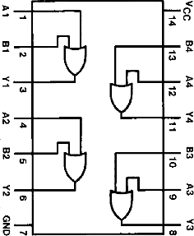
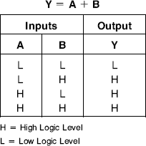
OR Gate IC – IC 7432 (Quad 2 I/P OR Gate)
This device contains four independent gates each of which performs the logic OR function
Pin Configuration of IC 7432
Function Table of IC 7432
48

Slide 49
NOT Gate (Inverter)
A NOT gate, also called inverter, has only one input and of course only one output.
It is a device whose output is always the complement of its input.
That is, the output of a NOT gate assumes the logic 1 state when its input is in logic 0 state and vice versa.
−
A
Y = A
Logic Symbol
64

Slide 50
NOT Gate
Input | Output
A | − Y = A
0 | 1
Y = A
1
−
A
0
50

Slide 51
NOT Gate
Input | Output
A | − Y = A
0 | 1
1 | 0
Y = A
0
−
A
1
51

Slide 52
Realization of NOT Gate using Transistor
+5V
R
Output
R
A
Q1
52

Slide 53
Realization of NOT Gate using Transistor
Case I: When A = 0
+5V
R
Output= 1
Input | Output
A | − Y = A
0 | 1
R
A=0
Q1
OFF
V_{BE}<0.7
53

Slide 54
Realization of NOT Gate using Transistor
Case II: When A = 1
+5V
R
Output= 0
Input | Output
A | − Y = A
0 | 1
1 | 0
R
A=1
Q1 ON
+5V
V_{BE}>0.7
54

Slide 55
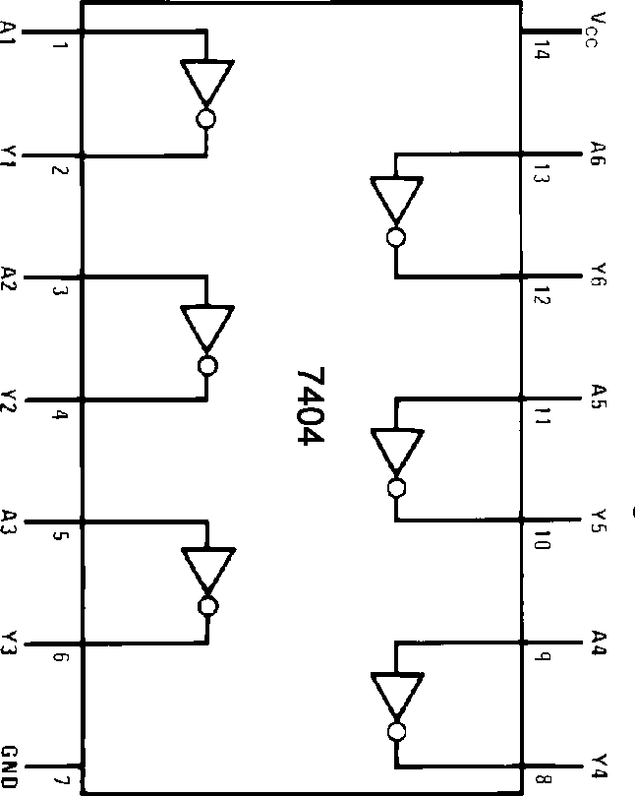
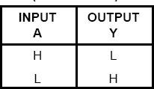
NOT Gate IC – IC 7404 (Hex Inverters)
This device contains six independent inverters
Function Table of IC 7404
Pin Configuration of IC 7404
55

Slide 56
Unit II – Logic Gates & Logic Families
Logic Gates: Symbol, diode/transistor switch circuit and logical expression, truth table of basic gates (AND, OR, NOT), Universal gates (NAND, NOR) and special purpose gates (Ex-OR, Ex-NOR), Tristate Logic.
56

Slide 57
Universal Gates (NAND and NOR Gate)
NAND and NOR gates are Universal Gates.
Both NAND and NOR gates can perform all the three basic logic functions (AND, OR and NOT).
Therefore, AOI logic can be converted to NAND logic or NOR logic
57

Slide 58
NAND Gate
NAND means NOT AND i.e. AND output is inverted.
So NAND gate is a combination of an AND gate and a NOT gate.
A
AB
A.B
A
A.B
B
B
AND Gate
NOT Gate
NAND Gate
58

Slide 59
NAND Gate
The output is logic 0 level, only when all the inputs are logic 1 level.
For any other combination of inputs, the output is a logic 1 level.
A
B
Y = A.B
Logic Symbol
59

Slide 60
NAND Gate
Inputs |  | Output
A | B | Y = A.B
0 | 0 | 1
0
A
B
Y = A.B
1
0
60

Slide 61
NAND Gate
Inputs |  | Output
A | B | Y = A.B
0 | 0 | 1
0 | 1 | 1
0
A
B
Y = A.B
1
1
61

Slide 62
NAND Gate
Inputs |  | Output
A | B | Y = A.B
0 | 0 | 1
0 | 1 | 1
1 | 0 | 1
1
A
B
Y = A.B
1
0
62

Slide 63
NAND Gate
Inputs |  | Output
A | B | Y = A.B
0 | 0 | 1
0 | 1 | 1
1 | 0 | 1
1 | 1 | 0
1
A
B
Y = A.B
0
1
63

Slide 64
Realization of NAND Gate using Transistor
+5V
R
R
D1
A
Output
B
Q1
D2
64

Slide 65
3 - Input NAND Gate
INPUT |  |  | OUTPUT
A | B | C | Y
0 | 0 | 0 | 1
0 | 0 | 1 | 1
0 | 1 | 0 | 1
0 | 1 | 1 | 1
1 | 0 | 0 | 1
1 | 0 | 1 | 1
1 | 1 | 0 | 1
1 | 1 | 1 | 0
A B C
Y = A.B.C
65

Slide 66
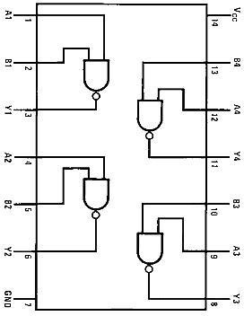
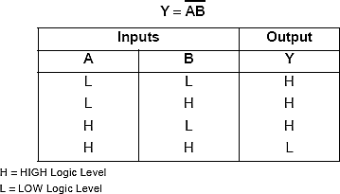
NAND Gate IC – IC 7400 (Quad 2 I/P NAND Gate)
This device contains
four
independent
gates
each
of
which performs
the logic
NAND function.
Pin Configuration of IC 7400
Function Table of IC 7400
66

Slide 67
NOR Gate
NOR means NOT OR i.e. OR output is inverted.
So NOR gate is a combination of an OR gate and a NOT gate.
A
B
A + B
A + B
A
B
Y = A + B
OR Gate
NOT Gate
NOR Gate
67

Slide 68
NOR Gate
The output is logic 1 level, only when all the inputs are logic 0 level.
For any other combination of inputs, the output is a logic 0 level.
A
B
Y = A + B
Logic Symbol
68

Slide 69
NOR Gate
Inputs |  | Output
A | B | Y = A + B
0 | 0 | 1
0
A
B
Y = A + B
1
0
69

Slide 70
NOR Gate
Inputs |  | Output
A | B | Y = A + B
0 | 0 | 1
0 | 1 | 0
0
A
B
Y = A + B
0
1
70

Slide 71
NOR Gate
Inputs |  | Output
A | B | Y = A + B
0 | 0 | 1
0 | 1 | 0
1 | 0 | 0
1
A
B
Y = A + B
0
0
71

Slide 72
NOR Gate
Inputs |  | Output
A | B | Y = A + B
0 | 0 | 1
0 | 1 | 0
1 | 0 | 0
1 | 1 | 0
1
A
B
Y = A + B
0
1
72

Slide 73
Realization of NOR Gate using Transistor
+5V
R
Output
R
A
Q1
Q2
R
B
73

Slide 74
3 – Input NOR Gate
INPUT |  |  | OUTPUT
A | B | C | Y
0 | 0 | 0 | 1
0 | 0 | 1 | 0
0 | 1 | 0 | 0
0 | 1 | 1 | 0
1 | 0 | 0 | 0
1 | 0 | 1 | 0
1 | 1 | 0 | 0
1 | 1 | 1 | 0
A B C
Y = A + B + C
74

Slide 75
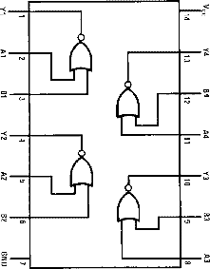
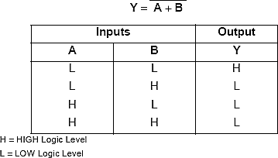
NOR Gate IC – IC 7402 (Quad 2 I/P NOR Gate)
independent
This device contains
Four
gates
each
of
which performs
The logic
NOR function.
Pin Configuration of IC 7402
Function Table of IC 7402
75

Slide 76
Universal Gate
NOT Gate using NAND Gate
A
−
Y = A
A
Y = A.A
Y = A
......... (A.A=A)
76

Slide 77

Universal Gate
AND Gate using NAND Gate
A B
Y=A.B
Y 1 = A.B
A
B
Y = A.B
Y = A.B
( A=A )
77

Slide 78

Universal Gate
OR Gate using NAND Gate
A
Y=A+B
B
Y 1 = A
A
Y = A.B
Y = A + B
Y = A + B
( Demorgan's Theorem)
B
Y 2 = B
78

Slide 79
Universal Gate
NOR Gate using NAND Gate
A
B
Y = A + B
Y 1 = A
Y 3 = A.B
Y 3 = A + B
A
Y = A + B
B
Y 2 = B
79

Slide 80
Universal Gate
NOT Gate using NOR Gate
A
−
Y = A
A
Y = A + A
Y = A ......... (A+A=A)
80

Slide 81

Universal Gate
A
OR Gate using NOR Gate
Y=A+B
B
A
Y 1 = A + B
Y = A + B
Y = A + B
B
( A=A )
81

Slide 82
Universal Gate
AND Gate using NOR Gate
A B
Y=A.B
Y 1 = A
A
Y = A+B
Y = A.B
Y = A.B
( Demorgan's Theorem)
B
Y 2 = B
82

Slide 83
Universal Gate
NAND Gate using NOR Gate
A
B
Y = A.B
Y 1 = A
Y 3 = A+B Y 3 = A.B
A
Y = A.B
B
Y 2 = B
83

Slide 84
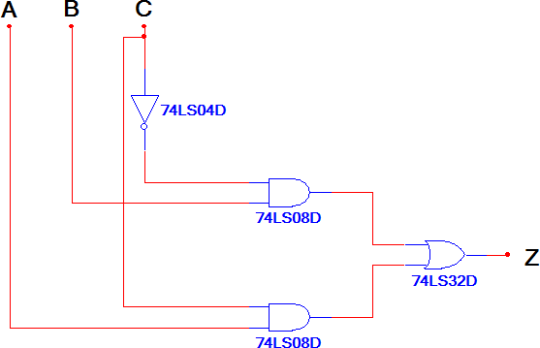
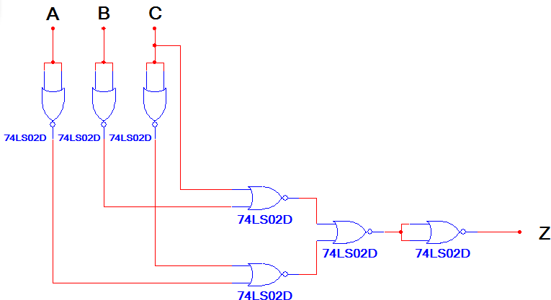
Why NAND Logic or NOR Logic?
AOI Logic
NOR Logic
IC Type | Gates | Gate / IC | # ICs
74LS04 | 1 | 6 | 1
74LS08 | 2 | 4 | 1
74LS32 | 1 | 4 | 1
Total Number of ICs → |  |  | 3
IC Type | Gates | Gate / IC | # ICs
74LS02 | 7 | 4 | 2
Total Number of ICs → |  |  | 2
84

Slide 85
Unit II – Logic Gates & Logic Families
Logic Gates: Symbol, diode/transistor switch circuit and logical expression, truth table of basic gates (AND, OR, NOT), Universal gates (NAND, NOR) and special purpose gates (Ex-OR, Ex-NOR), Tristate Logic.
85

Slide 86
Special Purpose Gate – Ex-OR Gate
An Ex-OR gate is two input, one output logic circuit.
The output assumes the logic 1 state, when one and only one of its two inputs assumes a logic 1 state.
Under the conditions when both the inputs assume the logic 0 state or logic 1 state, the output assumes logic 0.
86

Slide 87
Ex-OR Gate
If input variables are represented by A and B and the output variable by Y the representation for the output of this gate is as
A
B
Y = A ⊕ B
− −
Y = AB + AB
Logic Symbol
Logic Expression
87

Slide 88
Ex-OR Gate
Inputs |  | Output
A | B | Y = A ⊕ B
0 | 0 | 0
0
A
B
Y = A ⊕ B
0
0
88

Slide 89
Ex-OR Gate
Inputs |  | Output
A | B | Y = A ⊕ B
0 | 0 | 0
0 | 1 | 1
0
A
B
Y = A ⊕ B
1
1
89

Slide 90
Ex-OR Gate
Inputs |  | Output
A | B | Y = A ⊕ B
0 | 0 | 0
0 | 1 | 1
1 | 0 | 1
1
A
B
Y = A ⊕ B
1
0
90

Slide 91
Ex-OR Gate
Inputs |  | Output
A | B | Y = A ⊕ B
0 | 0 | 0
0 | 1 | 1
1 | 0 | 1
1 | 1 | 0
1
A
B
Y = A ⊕ B
0
1
91

Slide 92
3 – Input Ex-OR Gate
INPUT |  |  | OUTPUT
A | B | C | Y = A ⊕ B ⊕ C
0 | 0 | 0 | 0
0 | 0 | 1 | 1
0 | 1 | 0 | 1
0 | 1 | 1 | 0
1 | 0 | 0 | 1
1 | 0 | 1 | 0
1 | 1 | 0 | 0
1 | 1 | 1 | 1 107
A B
C
Y = A ⊕ B ⊕ C
A
B
A ⊕ B
C
Y = A ⊕ B ⊕ C

Slide 93
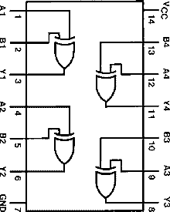
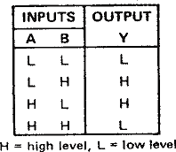
Ex-OR Gate IC – IC 7486 (Quad 2 I/P Ex-OR Gate)
This device contains
four
independent gates each of which performs the logic XOR function.
Pin Configuration of IC 7486
Function Table of IC 7486

Slide 94
Special Purpose Gate – Ex-NOR Gate
An Ex-NOR gate is two input, one output logic circuit.
The output assumes a logic 0 state, when one of the input assumes a logic 0 state and other a logic 1 state.
The output assumes a logic 1 state only when both the inputs assume a logic 0 state or when both the inputs assume a logic state.

Slide 95

Ex-NOR Gate
If input variables are represented by A and B and the output variable by Y the representation for the output of this gate is as
A
B
Y = A B
− −
Y = AB + AB
Logic Symbol
Logic Expression
110

Slide 96
Ex-NOR Gate
Inputs |  | Output
A | B | Y = A B
0 | 0 | 1
0
A
B
Y = A B
1
0

Slide 97
Ex-NOR Gate
Inputs |  | Output
A | B | Y = A B
0 | 0 | 1
0 | 1 | 0
0
A
B
Y = A B
0
1

Slide 98
Ex-NOR Gate
Inputs |  | Output
A | B | Y = A B
0 | 0 | 1
0 | 1 | 0
1 | 0 | 0
1
A
B
Y = A B
0
0

Slide 99
Ex-NOR Gate
Inputs |  | Output
A | B | Y = A B
0 | 0 | 1
0 | 1 | 0
1 | 0 | 0
1 | 1 | 1
1
A
B
Y = A B
1
1

Slide 100
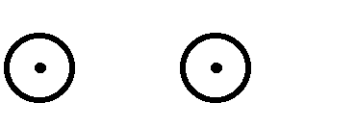

3 – Input Ex-NOR Gate
INPUT |  |  | OUTPUT
A | B | C | Y = A B C
0 | 0 | 0 | 1
0 | 0 | 1 | 0
0 | 1 | 0 | 0
0 | 1 | 1 | 1
1 | 0 | 0 | 0
1 | 0 | 1 | 1
1 | 1 | 0 | 1
1 | 1 | 1 | 0
A B C
Y = A B C
A
B
A B
C
Y = A B C

Slide 101
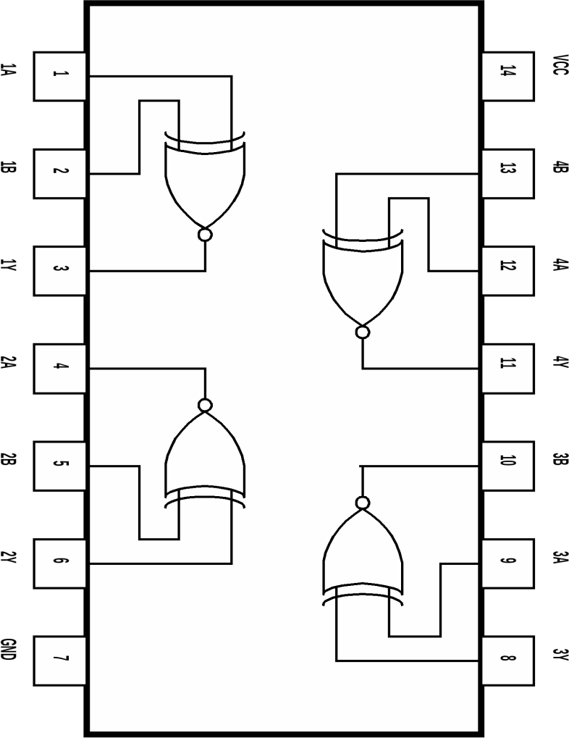
Ex-NOR Gate IC – IC 74266
This device contains
four
independent
gates
each
of
which performs
The logic
XNOR function.
Pin Configuration of IC 74266

