Slide 1
Intel 8086 MICROPROCESSOR ARCHITECTURE
1

Slide 2
Features
It is a 16-bit μp.
8086 has a 20 bit address bus can access up to 2²⁰ memory locations (1 MB).
•
•
It can support up to 64K I/O ports. It provides 14, 16 -bit registers.
Word size is 16 bits and double word size is 4 bytes.
It has multiplexed address and data bus AD0- AD15 and A16 – A19.
2

Slide 3
8086 is designed to operate in two modes, Minimum and Maximum.
•
•
It can prefetches up to 6 instruction bytes from memory and queues them in order to speed up instruction execution.
•
It requires +5V power supply.
A 40 pin dual in line package.
•
•
Address ranges from 00000H to FFFFFH
3

Slide 4
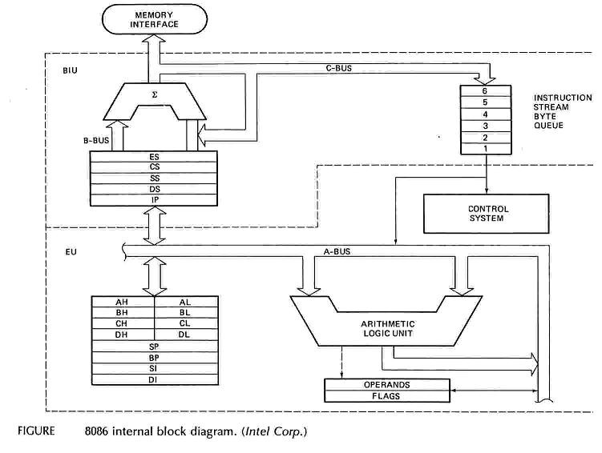
Intel 8086 Internal Architecture
4

Slide 5
Internal architecture of 8086
8086 has two blocks BIU and EU.
The BIU handles all transactions of data and addresses on the buses for EU.
The BIU performs all bus operations such as
instruction operands addresses
fetching, reading and writing
for memory and calculating
the of the memory operands. The
the
instruction bytes
are transferred to
instruction queue.
•
EU executes instructions from the instruction system byte queue.
5

Slide 6
BIU contains Instruction queue, Segment registers, Instruction pointer, Address adder.
EU contains Control circuitry, Instruction decoder, ALU, Pointer and Index register, Flag register.
6

Slide 7
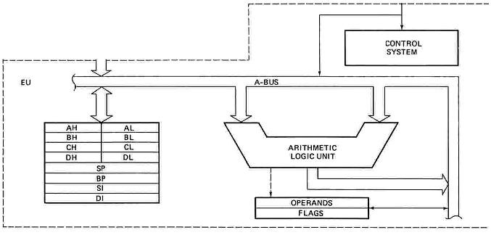
EXECUTION UNIT
Decodes instructions fetched by the BIU
Generate control signals,
Executes instructions.
The main parts are:
Control Circuitry
Instruction decoder
ALU
7

Slide 8
EXECUTION UNIT – General Purpose Registers
16 bits
8 bits
8 bits
AH
AL
AX
Accumulator
BH
BL
Base
BX
CH
CL
CX
Count
DH
DL
DX
Data
SP
Stack Pointer
Pointer
BP
Base Pointer
SI
Source Index
Index
DI
Destination Index
8

Slide 9
EXECUTION UNIT – General Purpose Registers
Register Purpose
AX Word multiply, word divide, word I /O
AL Byte multiply, byte divide, byte I/O, decimal arithmetic
AH Byte multiply, byte divide
BX Store address information
CX String operation, loops
CL Variable shift and rotate
DX
Word multiply, word divide, indirect I/O
(Used to hold I/O address during I/O instructions. If the result is more than 16-bits, the lower order 16-bits are stored in accumulator and higher order 16-bits are stored in DX register)
9

Slide 10
Pointer And Index Registers
Used to keep offset addresses.
Used in various forms of memory addressing.
In the case of SP and BP the default reference to form a physical address is the Stack Segment (SS- will be discussed under the BIU)
The index registers (SI & DI) and the BX generally default to the Data segment register (DS).
SP: Stack pointer
– Used with SS to access the stack segment
BP: Base Pointer
– Primarily used to access data on the stack
– Can be used to access data in other segments
10

Slide 11
SI: Source Index register
– is required for some string operations
•
– When string operations are performed, the SI register points to memory locations in the data segment which is addressed by the DS register. Thus, SI is associated with the DS in string operations.
•
DI: Destination Index register
is also required for some string operations.
When string operations are performed, the DI register points to memory locations in the data segment which is addressed by the ES register. Thus, DI is associated with the ES in string operations.
•
The SI and the DI registers may also be used to access data
stored in arrays
11

Slide 12
EXECUTION UNIT – Flag Register
•
A flag is a flip flop which indicates some conditions produced by the execution of an instruction or controls certain operations of the EU .
In 8086 The EU contains
➢ a 16 bit flag register
➢9 of the 16 are active flags and remaining 7 are undefined.
➢ 6 flags indicates some conditions- status flags
➢3 flags –control Flags
U U U U OF DF IF TF SF ZF U AF U PF U CF
•
Sign
Auxiliary
Carry
Interrupt
Trap
Zero
Parity
Over flow
Direction
U - Unused
12

Slide 13
EXECUTION UNIT – Flag Register
Flag Purpose
Carry (CF)
Holds the carry after addition or the borrow after subtraction. Also indicates some error conditions, as dictated by some programs and procedures .
Parity (PF)
PF=0;odd parity, PF=1;even parity.
Auxiliary (AF)
Holds the carry (half – carry) after addition or borrow after subtraction between bit positions 3 and 4 of the result
(for example, in BCD addition or subtraction.)
Zero (ZF)
Shows the result of the arithmetic or logic operation. Z=1; result is zero. Z=0; The result is 0
Sign (SF)
Holds the sign of the result after an arithmetic/logic instruction
execution. S=1; negative, S=0
13

Slide 14
Flag
Purpose
A control flag.
Enables the trapping through an on-chip debugging feature.
Trap (TF)
A control flag.
Controls the operation of the INTR (interrupt request) I=0; INTR pin disabled. I=1; INTR pin enabled.
Interrupt (IF)
A control flag.
It selects either the increment or decrement mode for DI and /or SI registers during the string instructions.
Direction (DF)
Overflow occurs when signed numbers are added or subtracted. An overflow indicates the result has exceeded the capacity of the Machine
Overflow (OF)
14

Slide 15
Execution unit – Flag Register
Six of the flags are status indicators reflecting properties of the last arithmetic or logical instruction.
For example, if register AL = 7Fh and the instruction ADD AL,1 is executed then the following happen
AL = 80h
CF = 0; there is no carry out of bit 7
PF = 0; 80h has an odd number of ones AF = 1; there is a carry out of bit 3 into bit 4 ZF = 0; the result is not zero
SF = 1; bit seven is one
OF = 1; the sign bit has changed
15

Slide 16
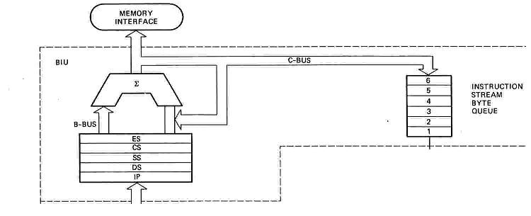
BUS INTERFACE UNIT (BIU)
Contains
•
•
•
•
6-byte Instruction Queue (Q)
The Segment Registers (CS, DS, ES, SS). The Instruction Pointer (IP).
The Address Summing block (Σ)
16

Slide 17
THE QUEUE (Q)
The BIU uses a mechanism known as an instruction stream queue to implement a pipeline architecture.
This queue permits pre-fetch of up to 6 bytes of instruction code. Whenever the queue of the BIU is not full, it has room for at least two more bytes and at the same time the EU is not requesting it to read or write operands from memory, the BIU is free to look ahead in the program by pre-fetching the next sequential instruction.

Slide 18






Segmented Memory
Physical Memory
00000
♣The memory in an 8086/88 based system is organized as segmented memory.
Code segment (64KB)
♣The CPU 8086 is able to address 1Mbyte of memory.
Data segment (64KB)
1 MB
Extra segment (64KB)
♣The Complete physically available memory may be divided into a number of logical segments.
Stack segment (64KB)
FFFFF

Slide 19
The size of each segment is 64 KB
•
•
•
A segment may be located any where in the memory
Each of these segments can be used for a specific function.
Code segment is used for storing the instructions.
The stack segment is used as a stack and it is used to store the return addresses.
The data and extra segments are used for storing data byte.

Slide 20
•
•
•
The 4 segments are Code, Data, Extra and Stack segments. A Segment is a 64kbyte block of memory.
The 16 bit contents of the segment registers in the BIU actually point to the starting location of a particular segment.
Segments may be overlapped or non-overlapped
•

Slide 21
Segment registers
In 8086/88 the processors have 4 segments registers
Code Segment register (CS), Data Segment register (DS), Extra Segment register (ES) and Stack Segment (SS) register.
All are 16 bit registers.
Each of the Segment registers store the upper 16 bit address of the starting address of the corresponding segments.

Slide 22
Memory Address Generation
Offset Value (16 bits)
Segment Register (16 bits)
0 0 0 0
Adder
Physical Address (20 Bits)

Slide 23
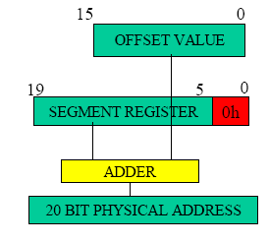

Slide 24




The following examples shows the CS:IP scheme of address formation:
•
CS
34BA
IP
8AB4
Code segment
34BA0
Inserting a hexadecimal 0H (0000B)
with the CSR or shifting the CSR four binary digits left
8AB4 (offset)
3D654
3 4 B A 0 ( C S ) +
8 A B 4 ( I P )
3 D 6 5 4 (next address)
44B9F

Slide 25
Segment and Address register combination
CS:IP
SS:SP SS:BP
DS:BX DS:SI
DS:DI (for other than string operations)
ES:DI (for string operations)

Slide 26
Summary of Registers & Pipeline of 8086 µP
EU |  |  | C O D E O U T | Fetch & store code bytes in PIPELINE PIPELINE (or) QUEUE |  | C O D E I N | CS IP | IP DS BX DI SI | BIU ES SS DI SP BP
AX
BX
CX
DX | DL | E
 | FLAGS | ALU |  | Timing control | Default Assignment
AH | AL
BH | BL
CH | CL
DH
D
C O
D
E
R
SP
BP
SI
DI

