Slide 1
Instruction set of 8086 Microprocessor

Slide 2
Software
The sequence of commands used to tell a microcomputer what to do is called a program,
Each command in a program is called an instruction
A program written in machine language is referred to as machine code
ADD AX, BX
(Opcode)
(Destination operand)
(Source operand )

Slide 3
Instructions
LABEL: INSTRUCTION
Address identifier
Ex. START: MOV AX, BX
; COMMENT
Does not generate any machine code
; copy BX into AX
There is a one-to-one relationship between assembly and machine language instructions
A compiled machine code implementation of a program written in a high-level language results in inefficient code
– More machine language instructions than an assembled version of an equivalent handwritten assembly language program

Slide 4
Two key benefits of assembly language programming
It takes up less memory
It executes much faster

Slide 5
Applications
One of the
most
beneficial
uses of
Assembly language
programming
real-time applications.
Real time means the task required by the application must be completed before any other input to the program that will alter its operation can occur
For example the device service routine which controls the operation of the floppy disk drive is a good example that is usually written in assembly language

Slide 6
Assembly controlling
language not only hardware devices
good for but also
performing pure software operations
Code translation from ASCII to EBCDIC
Table sort routines
MathemaSearching through a large table of data for a special string of characters
tical routines
Assembly language: perform real-time operations
High-level languages: used to write those parts that are not time critical

Slide 7

Converting Assembly Language Instructions to Machine Code
An instruction can be coded with 1 to 6 bytes Byte 1 contains three kinds of information
– Opcode field (6 bits) specifies the operation (add, subtract, move)
•
•
– Register Direction Bit (D bit) Tells the register operand in REG field in byte 2 is source or destination operand
1: destination 0: source
- Data Size Bit (W bit) Specifies whether the operation will be performed on 8-bit or 16-bit data
0: 8 bits 1: 16 bits

Slide 8
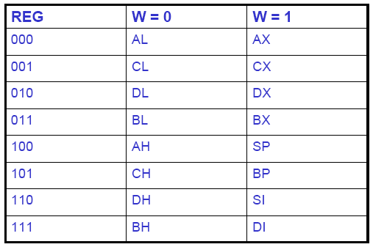
Byte 2 has three fields
Mode field (MOD)
Register field (REG) used to identify the register for the first operand
Register/memory field (R/M field)

Slide 9
Data Transfer Instructions - MOV
Mnemonic | Meaning | Format | Operation | Flags affected
MOV | Move | Mov D,S | (S) ◊ (D) | None
Destination Source
Memory Accumulator
Register Register Memory Register Memory Seg reg Seg reg Reg 16 Memory
Accumulator Memory
NO MOV
Register Memory Register Immediate Immediate Reg 16
Mem 16 Seg reg
Seg reg
Memory Immediate
Memory
Segment Register Segment Register
Segment Register
EX: MOV AL, BL
9

Slide 10

Data Transfer Instructions - XCHG
Mnemonic Meaning Format Operation Flags affected
XCHG Exchange XCHG D,S (S) (D) None
Destination Source
Example: XCHG START [BX]
Accumulator Reg 16
Memory Register
Register Register
Register Memory
NO XCHG
MEMs SEG REGs

Slide 11
Data Transfer Instructions – LEA, LDS, LES
Mnemo Meaning Format Operation nic
Flags affected
LEA
Load Effective Address
Load Register And DS
LEA Reg16,EA EA ◊ (Reg16)
None
LDS
LDS Reg16,MEM
(MEM) ◊
(Reg16)
(DS)
None
(Mem+2)
LES
Load Register and ES
LES Reg16,MEM
(MEM) ◊
(Reg16)
None
(Mem+2)
(ES)
LEA SI DATA
(or) MOV SI Offset DATA

Slide 12
The XLAT Instruction
Mnemonic Meaning Format Operation Flags
XLAT Translate XLAT ((AL)+(BX)+(DS)0) ◊ (AL) None
Example:
Assume (DS) = 0300H, (BX)=0100H, and (AL)=0DH
XLAT replaces contents of AL by contents of memory location with
PA=(DS)0 +(BX) +(AL)
= 03000H + 0100H + 0DH = 0310DH
Thus
(0310DH) ◊ (AL)

Slide 13
Arithmetic Instructions: ADD, ADC, INC, AAA, DAA
Mnemonic
Meaning
Format
Operation
Flags affected
ADD
Addition
ADD D,S
(S)+(D) ◊ (D)
carry ◊ (CF)
(S)+(D)+(CF)
carry ◊
ALL
ADC
Add with carry
ADC D,S
(D)
ALL
(CF)
INC | Increment by one | INC D | (D)+1 ◊ (D) | ALL but CY
AAA | ASCII adjust for addition | AAA | After addition AAA instruction is used to make sure the result is the correct unpacked BCD | AF,CF
DAA | Decimal adjust for addition | DAA | Adjust AL for decimal Packed BCD | ALL

Slide 14
Examples:
Ex.1
ADD AX,2 ADC AX,2
Ex.2
INC BX
INC WORD PTR [BX]
Ex.3 ASCII CODE 0-9 = 30-39h
ADD CL,DL
; [CL]=32=ASCII FOR 2
; [DL]=35=ASCII FOR 5
; RESULT[CL]=67
;Move the ascii result into AL since AAA adjust only [AL]
;[AL]=07, unpacked BCD for 7.
MOV AL,CL
AAA

Slide 15
Arithmetic Instructions – SUB, SBB, DEC, AAS, DAS, NEG
Mnemonic | Meaning | Format | Operation | Flags affected
SUB | Subtract | SUB D,S | (D) - (S) ◊ (D) | All
SBB | Subtract with borrow | SBB D,S | (D) - (S) - (CF) ◊ (D) | All
DEC | Decrement | DEC D | (D) - 1 ◊ (D) | All but CF
Borrow
(CF)
by one Negate
NEG
NEG D
All
DAS
Decimal adjust for subtraction
ASCII
adjust for subtraction
DAS
Convert the result in AL to packed decimal format
All
AAS
AAS
(AL) difference (AH) dec by 1 if borrow
CY,AC

Slide 16
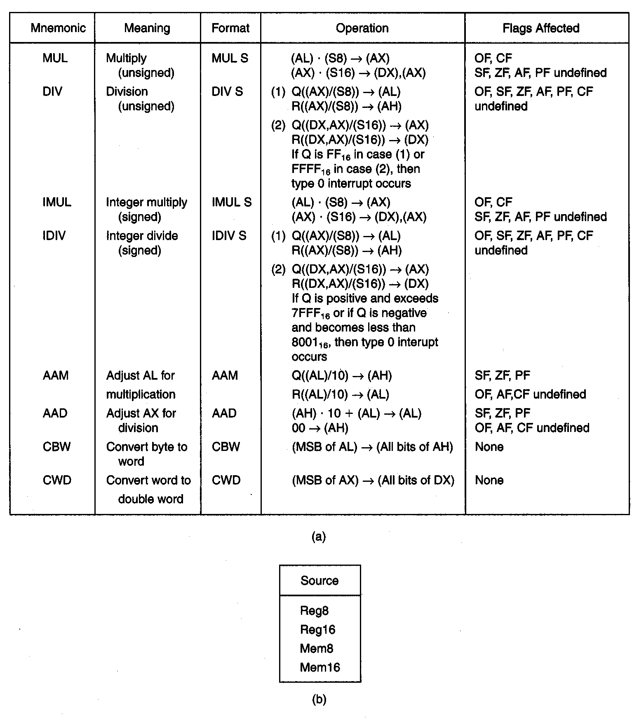
Multiplication and Division
1
6

Slide 17
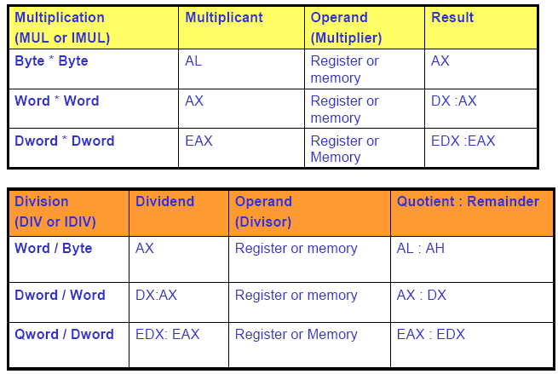
Multiplication and Division
17

Slide 18
Multiplication and Division
Multiplication Multiplicand (MUL or IMUL)
Byte*Byte AL
Word*Word AX
Operand (Multiplier)
Result
Register or memory
AX
Register or memory
DX :AX
Dword*Dword
EAX
Register or memory
EAX :EDX
Division (DIV or IDIV)
Operand (Divisor)
Dividend
Quotient: Remainder
Word/Byte
AX
Register or Memory
AL : AH
Dword/Word
DX:AX
Register or Memory
AX : DX
Qword/Dword
EDX: EAX
Register or Memory
EAX : EDX

Slide 19
Multiplication and Division Examples
Ex1: Assume that each instruction starts from these values: AL = 85H, BL = 35H, AH = 0H
MUL BL → AL . BL = 85H * 35H = 1B89H → AX = 1B89H
IMUL BL → AL . BL = 2’S AL * BL = 2’S (85H) * 35H
= 7BH * 35H = 1977H→ 2’s comp → E689H → AX.
AH AL
•
DIV BL → AX = ^{0085H} = 02 (85-02*35=1B) →
1B
02
_{BL} 35H
AX 0085H
BL ⁼
AH AL
4. IDIV BL →
35H
=
1B 02

Slide 20
Ex2: AL = F3H, BL = 91H, AH = 00H
1. MUL BL → AL * BL = F3H * 91H = 89A3H → AX = 89A3H
2. IMUL BL → AL * BL = 2’S AL * 2’S BL = 2’S (F3H) * 2’S(91H) =
0DH * 6FH = 05A3H → AX.
AX ₌
00F 3H
00F 3H
= = 2→ (00F3 – 2*6F=15H)
3.IDIV BL →
2' S (91H )
6FH
BL
AH AL
15 | 02
R Q
AH AL
15 | FE
POS ₌
→
NEG
NEG
→ 2’s(02) = FEH→
AX
00F 3H
AH AL
62 | 01
R Q
4. DIV BL → =
BL
= 01→(F3-1*91=62) →
91H

Slide 21
Ex3: AX= F000H, BX= 9015H, DX= 0000H
DX AX
8713 | B000
1. MUL BX = F000H * 9015H =
2. IMUL BX = 2’S(F000H) * 2’S(9015H) = 1000 * 6FEB =
F 000H
DX AX
06FE | B000
3. DIV BL =
= B6DH → More than FFH → Divide Error.
15H
2' S (F 000H )
1000H
⁼ 15H
4. IDIV BL →
= C3H > 7F → Divide Error.
15H

Slide 22
Ex4:
AX= 1250H, BL= 90H
AX
1. IDIV BL → _{BL} =
1250H
POS POS
⁼ NEG ⁼ 2' sNEG
1250H
1250H
⁼ 70H
90H
=
2' s(90H )
= 29H (Q) → (1250 – 29 * 70) = 60H (REM)
29H ( POS) → 2’S (29H) = D7H →
R Q
60H | D7H
AX
1250H
R Q
50H | 20H
AH AL
2. DIV BL → =
BL
90H
= 20H→1250-20*90 =50H →

Slide 23

Logical Instructions
Mnemonic Meaning AND Logical AND
Format
Operation
Flags Affected
AND D,S
(S) · (D) → (D)
OF, SF, ZF, PF, CF
AF undefined OF, SF, ZF, PF,
CF
AF undefined OF, SF, ZF, PF, CF
AF undefined None
OR
Logical Inclusive OR
OR D,S
(S)+(D) → (D)
XOR
Logical Exclusive OR
XOR D,S
(S)₊
(D)→(D)
_
(D) → (D)
NOT
LOGICAL NOT
NOT D
Destination Source
Destination
Register Register Memory Register Memory Accumulator
Register Memory Register Immediate Immediate Immediate
Register Memory

Slide 24
LOGICAL Instructions
AND
Uses any addressing mode except memory-to-memory and segment registers
Especially used in clearing certain bits (masking) xxxx xxxx AND 0000 1111 = 0000 xxxx
(clear the first four bits)
– Examples:
AND BL, 0FH AND AL, [345H]
OR
– Used in setting certain bits
xxxx xxxx OR 0000 1111 = xxxx 1111 (Set the upper four bits)

Slide 25
XOR
– Used in Inverting bits
xxxx xxxx XOR 0000 1111 = xxxxx’x’x’x’
-Example: Clear bits 0 and 1, set bits 6 and 7, invert bit 5 of register CL:
AND CL, OFCH | ; | 1111 1100B
OR CL, 0C0H | ; | 1100 0000B
XOR CL, 020H | ; | 0010 0000B

Slide 26

Shift and Rotate Instructions
SHL/SAL: shift logical left/shift arithmetic left
SHR: shift logical right
SAR: shift arithmetic right
ROL: rotate left
ROR: rotate right
RCL: rotate left through carry
RCR: rotate right through carry

Slide 27


Logical vs Arithmetic Shifts
A logical shift fills the newly created bit position with zero:
An arithmetic shift fills the newly created bit position with a copy of the number’s sign bit:

Slide 28
Shift Instructions
Mnemonic | Meaning | Format | Operation | Flags Affected
SAL/SHL | Shift arithmetic Left/shift Logical left | SAL/SHL D, Count | Shift the (D) left by the number of bit positions equal to count and fill the vacated bits positions on the right with zeros | CF,PF,SF,ZF AF undefined OF undefined if count ≠1
SHR | Shift | SHR D, Count | Shift the (D) right by the number of bit positions | CF,PF,SF,ZF AF undefined
 | logical right |  | equal to count and fill the vacated bits positions on the left with zeros | OF undefined if count ≠1
Shift the (D) right by the
Number of bit positions equal to count and fill the
vacated bits positions on the left with the original most significant bit
SAR D, Count
SAR
Shift arithmetic right
CF,PF.SF.ZF
AF undefined OF undefined if count ≠1

Slide 29
Allowed operands
Destination Count
Register 1
Register CL
Memory 1
Memory CL

Slide 30
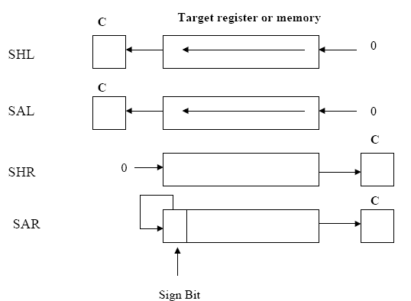
30

Slide 31

SHL Instruction
The SHL (shift left) instruction performs a logical left shift on the destination operand, filling the lowest bit with 0.
•
Operand types: SHL reg,imm8 SHL mem,imm8 SHL reg,CL SHL mem,CL
31

Slide 32

Fast Multiplication
Shifting left 1 bit multiplies a number by 2
mov dl,5
shl dl,1
Fo_{m}r _{o}e_{v}xam_{dl}p
Shifting left n bits multiplies the operand by ₂n
,le₅, 5 * 2² = 20
shl dl,2
; DL = 20

Slide 33
Ex.
; Multiply
AX by 10
SHL AX, 1 MOV BX, AX MOV CL,2 SHL AX,CL ADD AX, BX

Slide 34
SHR Instruction
The SHR (shift right) instruction performs a logical right shift on the destination operand. The highest bit position is filled with a zero.
Shifting right n bits divides the operand by 2^{n}
MOV | DL,80
SHR | DL,1 | ; DL = 40
SHR | DL,2 | ; DL = 10

Slide 35
SAR Instruction
SAR (shift arithmetic right) performs a right arithmetic shift on the destination operand.
An arithmetic shift preserves the number's sign.
MOV DL,-80 SAR DL,1
; DL = -40
SAR DL,2
; DL = -10

Slide 36
Rotate Instructions
Mnemonic | Meaning | Format | Operation | Flags Affected
ROL | Rotate Left | ROL D,Count | Rotate the (D) left by the number of bit positions equal to Count. Each bit shifted out from the left most bit goes back into the rightmost bit position. | CF OF undefined if count ≠ 1
ROR | Rotate Right | ROR D,Count | Rotate the (D) right by the number of bit positions equal to Count. Each bit shifted out from the rightmost bit goes back into the leftmost bit position. | CF OF undefined if count ≠ 1
RCL | Rotate Left through Carry | RCL D,Count | Same as ROL except carry is attached to (D) for rotation. | CF OF undefined if count ≠ 1
RCR | Rotate right through Carry | RCR D,Count | Same as ROR except carry is attached to (D) for rotation. | CF OF undefined if count ≠ 1 36

Slide 37

ROL Instruction
ROL (rotate) shifts each bit to the left
The highest bit is copied into both the Carry flag and into the lowest bit
No bits are lost
MOV | Al,11110000b
ROL | Al,1 | ; | AL | = 11100001b
MOV | Dl,3Fh
ROL | Dl,4 | ; | DL | = F3h

Slide 38

ROR Instruction
•
•
ROR (rotate right) shifts each bit to the right
The lowest bit is copied into both the Carry flag and into the highest bit
No bits are lost
•
MOV | AL,11110000b
ROR | AL,1 | ; AL = 01111000b
MOV | DL,3Fh
ROR | DL,4 | ; DL = F3h

Slide 39
RCL Instruction
•
•
•
RCL (rotate carry left) shifts each bit to the left Copies the Carry flag to the least significant bit Copies the most significant bit to the Carry flag
CF
CLC |  | ; | CF = | 0
MOV | BL,88H | ; | CF,BL | = | 0 10001000b
RCL | BL,1 | ; | CF,BL | = | 1 00010000b
RCL | BL,1 | ; | CF,BL | = | 0 00100001b
39

Slide 40
RCR Instruction
•
•
•
RCR (rotate carry right) shifts each bit to the right Copies the Carry flag to the most significant bit Copies the least significant bit to the Carry flag
STC |  | ; | CF = | 1
MOV | AH,10H | ; | CF,AH | = | 00010000 1
RCR | AH,1 | ; | CF,AH | = | 10001000 0

Slide 41
Rotate Instructions
Destination Count
Register 1
Register CL
Memory 1
Memory CL

Slide 42
Flag control instructions
MNEM- ONIC
CLC Clear Carry Flag STC Set Carry Flag
CMC Complement
Carry Flag
CLD Clear Direction
Flag
MEANING
OPERATION
Flags Affected
CF CF CF
(CF) ⇓ 0
(CF) ⇓ 1
(CF) ⇓ (CF)^{l}
(DF) ⇓ 0
SI & DI will be auto incremented while DF string instructions are executed.
(DF) ⇓ 1
STD Set Direction Flag
SI &
DI will be auto decremented DF
while string instructions are executed. (IF) ⇓ 0
CLI Clear Interrupt
Flag
STI Set Interrupt Flag
IF
IF
42
(IF) ⇓ 1

Slide 43
Compare Instruction, CMP
Mnemonic Meaning Format Operation
Flags Affected
CMP Compare CMP D,S
(D) – (S) is used in setting or resetting the flags
CF, AF, OF, PF, SF, ZF
Allowed Operands
(D) = (S)
(D) > (S)
(D) < (S)
; ZF=0
; ZF=0, CF=0
; ZF=0, CF=1
Destination RegisterRegister RegisterMemory Memory
Source
Register
RegisterImmediate
Memory Accumulator
Immediate Immedia⁴te³

Slide 44
String?
An array of bytes or words located in memory
Supported String Operations
Copy (move, load)
Search (scan)
Store
Compare
44

Slide 45
String Instruction Basics
Source DS:SI, Destination ES:DI
You must ensure DS and ES are correct
You must ensure SI and DI are offsets into DS and ES respectively
Direction Flag (0 = Up, 1 = Down)
CLD - Increment addresses (left to right)
STD - Decrement addresses (right to left)
45

Slide 46
String Instructions
Instruction prefixes
Prefix
REP
Used with
MOVS STOS
Meaning
Repeat while not end of string CX ≠ 0
Repeat while not end of string and strings are equal. CX ≠ 0 and ZF = 1
REPE/REPZ
CMPS SCAS
CMPS SCAS
Repeat while not end of string and strings are not equal. CX ≠ 0 and ZF = 0
REPNE/REP NZ

Slide 47
Instructions
Mnemonic meaning
format
Operation
Flags effected
none
MOVS
Move string DS:SI
ES:DI
MOVSB/ MOVSW
((ES)0+(DI)) ⇓ ((DS)0+(SI)) (SI) ⇓ (SI) ± 1 or 2
(DI) ⇓ (DI) ± 1 or 2
CMPS
Compare string
DS:SI
ES:DI
CMPSB/ CMPSW
Set flags as per ((DS)0+(SI)) - ((ES)0+(DI)) (SI) ⇓ (SI) ± 1 or 2
(DI) ⇓ (DI) ± 1 or 2
All status flags

Slide 48
Mnemonic | meaning | format | Operation
SCAS | Scan string | SCASB/ | Set flags as per
 | AX – ES:DI | SCASW | (AL or AX) - ((ES)0+(DI))
 |  |  | (DI) ⇓ (DI) ± 1 or 2
LODS | Load string DS:SI ◊ AX | LODSB/ LODSW | (AL or AX) ⇓ ((DS)0+(SI)) (SI) ⇓ (SI) ± 1 or 2
STOS | Store string ES:DI ⇓ AX | STOSB/ STOSW | ((ES)0+(DI)) ⇓ (AL or A) ± 1 or 2 (DI) ⇓ (DI) ± 1 or 2

Slide 49
Branch group of instructions
Branch instructions provide lot of convenience to the programmer to perform operations selectively, repetitively etc.
Branch group of instructions
Conditional jumps
Uncondi- tional jump
Iteration instructions
CALL
instructions
Return instructions

Slide 50
SUBROUTINE & SUBROUTINE HANDILING INSTRUCTIONS
Main program
Call subroutine A
Next instruction
Call subroutine A
Next instruction
Subroutine A
First Instruction
Return

Slide 51
A subroutine is a special segment of program that can be called for execution from any point in a program.
♣
♣
♣
An assembly language subroutine is also referred to as a “procedure”.
Whenever we need the subroutine, a single instruction is inserted in to the main body of the program to call subroutine.
To branch a subroutine the value in the IP or CS and IP must be modified.
After execution, we want to return the control to the instruction that immediately follows the one called the subroutine i.e., the original value of IP or CS and IP must be preserved.
Execution of the instruction causes the contents of IP to be saved on the stack. (this time (SP) ⇓ (SP) -2 )
A new 16-bit (near-proc, mem16, reg16 i.e., Intra Segment) value which is specified by the instructions operand is loaded into IP.
♣
♣
♣
♣
♣
Examples:
CALL 1234H CALL BX CALL [BX]

Slide 52
•
Inter Segment
At starting CS and IP placed in a stack.
New values are loaded in to CS and IP given by the operand.
After execution original CS, IP values placed as it is.
Far-proc Memptr32
These two words (32 bits) are loaded directly into IP and CS with execution at CALL instruction.
First 16 ◊ IP Next 16 ◊ CS

Slide 53
Meaning
Mnemonic
Format
Operation
Flags Affected
CALL
Subroutine call
CALL operand
Execution continues from
none
the address of the
subroutine specified by the operand. Information required to return back to the main program such as IP and CS are saved on the stack.
Operand
Near-proc Far – proc Memptr 16
Regptr 16
Memptr 32
53

Slide 54
RETURN
•
Every subroutine must end by executing an instruction that returns control to the main program. This is the return (RET) instruction.
•
By execution the value of IP or IP and CS that were saved in the stack to be returned back to their corresponding regs. (this time (SP) ⇓ (SP)+2 )
Mnemonic | Meaning | Format | Operation |  |  | Flags
RET | Return | RET or | Return to | the | main | Affected None
RET operand
program by restoring IP (and CS for far-proc). If operands is present, it is added to the contents of SP.
Operand
None Disp16
54

Slide 55
Loop Instructions
These instructions are used to repeat a set of instructions several times.
•
•
•
Format: LOOP Short-Label Operation: (CX) ⇓ (CX)-1
Jump is initialized to location defined by short label if CX≠0. otherwise, execute next sequential instruction.
Instruction LOOP works w.r.t contents of CX. CX must be preloaded with a count that represents the number of times the loop is to be repeat.
•
•
Whenever the loop is executed, contents at CX are first decremented then checked to determine if they are equal to zero.
If CX=0, loop is complete and the instruction following loop is executed.
If CX ≠ 0, content return to the instruction at the label specified in the loop instruction.
•
•

Slide 56
LOOP Instruction contd.
General format : LOOP r8
; r8 is 8-bit signed value.
It is a 2 byte instruction.
Used for backward jump only.
Maximum distance for backward jump is only 128 bytes.
LOOP AGAIN is almost same as:
DEC CX JNZ AGAIN
LOOP instruction does not affect any flags.

Slide 57
Mnemonic
meaning
format
Operation
LOOP
Loop
Loop short-label
(CX) ⇓ (CX) – 1
Jump to location given by short-label if CX ≠ 0
LOOPE/ LOOPZ
Loop while equal/ loop while zero
LOOPE/LOOPZ
short-label
(CX) ⇓ (CX) – 1
Jump to location given by short-label if CX ≠ 0 and ZF=1
LOOPNE/ LOOPNZ
Loop while not equal/ loop while not zero
LOOPNE/LOOPNZ
short-label
(CX) ⇓ (CX) – 1
Jump to location given by short-label if CX ≠ 0 and ZF=0

Slide 58
Control flow and JUMP instructions
Unconditional Jump
Part 1
JMP AA
Unconditional JMP
Part 2
Skipped part
Part 3
XXXX
AA
Next instruction
JMP ◊ unconditional jump JMP Operand

Slide 59
Unconditional Jump
Unconditional Jump Instruction
Near Jump or Intra segment Jump
(Jump within the segment)
Is limited to the address with in the current segment. It is achieved by modifying value in IP
Far Jump or Inter segment Jump
(Jump to a different segment)
Permits jumps from one code
segment to another. It is
achieved by modifying CS and IP
Operands
Short label Near label Far label Memptr16 Regptr16 memptr32
Inter Segment Jump
59
Inter Segment Jump

Slide 60
Conditional Jump
Part 1
Jcc AA
Conditional Jump
Part 2
NO
Skipped part
condition
XXXX
YES
Part 3
AA XXXX
Next instruction

Slide 61
Conditional Jump instructions
Conditional Jump instructions in 8086 are just 2 bytes long. 1-byte opcode followed by 1-byte signed displacement (range of –128 to
+127).
Conditional Jump Instructions
Jumps based on a single flag
Jumps based on more than one flag

Slide 62
Conditional Jump Instructions
Mnemonic : Meaning : Format : Operation :
Jcc
Conditional Jump Jcc operand
If condition is true jump to the address specified by operand. Otherwise the next instruction is executed.
None
Flags affected :

Slide 63
TYPES
Mnemonic | meaning | condition
JA | Above | CF=0 and ZF=0
JAE | Above or Equal | CF=0
JB | Below | CF=1
JBE | Below or Equal | CF=1 or ZF=1
JC | Carry | CF=1
JCXZ | CX register is Zero | (CF or ZF)=0
JE | Equal | ZF=1
JG | Greater | ZF=0 and SF=OF
JGE | Greater or Equal | SF=OF
JL | Less | (SF XOR OF) = 1
63

Slide 64
Mnemonic
JLE
JNA JNAE JNB JNBE JNC JNE JNG JNGE
meaning
Less or Equal Not Above
Not Above nor Equal
Not Below
Not Below nor Equal Not Carry
Not Equal
Not Greater
Not Greater nor Equal
Not Less
condition
((SF XOR OF) or ZF) = 1 CF =1 or Zf=1
CF = 1
CF = 0
CF = 0 and ZF = 0 CF = 0
ZF = 0
((SF XOR OF) or ZF)=1 (SF XOR OF) = 1
JNL
SF = OF

Slide 65
Mnemonic | meaning | condition
JNLE | Not Less nor Equal | ZF = 0 and SF = OF
JNO | Not Overflow | OF = 0
JNP | Not Parity | PF = 0
JNZ | Not Zero | ZF = 0
JNS | Not Sign | SF = 0
JO | Overflow | OF = 1
JP | Parity | PF = 1
JPE | Parity Even | PF = 1
JPO | Parity Odd | PF = 0
JS | Sign | SF = 1
JZ | Zero | ZF = 1

Slide 66
Jumps Based on a single flag
JZ | r8 | ;Jump if zero flag set to 1 (Jump if result is zero)
JNZ | r8 | ;Jump if Not Zero (Z flag = 0 i.e. result is nonzero)
JS | r8 | ;Jump if Sign flag set to 1 (result is negative)
JNS | r8 | ;Jump if Not Sign (result is positive)
JC | r8 | ;Jump if Carry flag set to 1
JNC r8 ;Jump if No Carry ^{There is no jump} based on AC flag
JP | r8 | ;Jump if Parity flag set to 1 (Parity is even)
JNP | r8 | ;Jump if No Parity (Parity is odd)
JO | r8 | ;Jump if Overflow flag set to 1 (result is wrong)
JNO | r8 | ;Jump if No Overflow (result is correct)

Slide 67
JZ r8 ; JE (Jump if Equal) also means same.
JNZ r8 ; JNE (Jump if Not Equal) also means same.
JC r8 ;JB (Jump if below) and JNAE (Jump if Not Above or Equal) also mean same.
JNC r8 ;JAE (Jump if Above or Equal) and JNB (Jump if Not Above) also mean same.
JZ, JNZ, JC and JNC used after arithmetic operation
JE, JNE, JB, JNAE, JAE and JNB are used after a compare operation.
JP r8 ; JPE (Jump if Parity Even) also means same. JNP r8 ; JPO (Jump if Parity Odd) also means same.

Slide 68
Examples for JE or JZ instruction
Ex. for forward jump (Only examples for JE given)
CMP SI, DI
JE SAME
Should be
<=127
bytes
ADD CX, DX
;Executed if Z = 0
:
(if SI not equal to DI)
:
SAME:
SUB BX, AX
;Executed if Z = 1
(if SI = DI)

Slide 69
Examples for JE or JZ instruction
Ex. for backward jump
BACK:
Should be
<= 128
bytes
SUB BX, AX
:
: CMP SI, DI JE BACK ADD CX, DX
; executed if Z = 1 (if SI = DI)
;executed if Z = 0
(if SI not equal to DI)

Slide 70
Jumping beyond -128 to +127?
Requirement CMP SI, DI JE SAME ADD CX, DX
:
: SUB BX, AX
Then do this! CMP SI, DI JNE NEXT JMP SAME ADD CX, DX
:
: SUB BX, AX
What if
>127
bytes
NEXT:
SAME:
SAME:
Range for JMP (unconditional jump) can be +2¹⁵ = + 32K JMP instruction discussed in detail later

Slide 71
Terms used in comparison
Above and Below used for comparing Unsigned nos. Greater than and less than used with signed numbers. All Intel microprocessors use this convention.
95H is above 65H | Unsigned comparison - | True
95H is less than 65H | Signed comparison - | True
95H is negative, 65H is positive
65H is below 95H | Unsigned comparison - | True
65H is greater than 95H | Signed comparison - | True

Slide 72
Jump on multiple flags
Conditional Jumps based on more than one flag are used after a CMP (compare) instruction.
JBE or JNA
Jump if Below or Equal Jump if Not Above
Jump if | No Jump if | Ex.
Cy = 1 OR Z= 1 | Cy = 0 AND Z = 0 | CMP BX, CX
Below OR Equal | Surely Above | JBE BX_BE
BX_BE (BX is Below or Equal) is a symbolic location

Slide 73
Jump on multiple flags contd.
JNBE or JA
Jump if Not (Below or Equal) Jump if Above
Jump if | No Jump if | Ex.
Cy = 0 AND Z= 0 | Cy = 1 OR Z = 1 | CMP BX, CX
Surely Above | Below OR Equal | JA BXabove
BXabove (BX is above) is a symbolic location

Slide 74
Jump on multiple flags contd.
JLE or JNG
Jump if Less than OR Equal Jump if Not Greater than
Jump if
S = 1 AND V = 0
(surely negative) OR (S = 0 AND V = 1)
(wrong answer positive!) OR Z = 1 (equal)
i.e. S XOR V = 1 OR Z = 1
No Jump if
S = 0 AND V = 0
(surely positive) OR (S = 1 AND V = 1)
(wrong answer negative!) AND Z = 0 (not equal)
i.e. S XOR V = 0 AND Z = 0

Slide 75
Jump on multiple flags contd.
JNLE or JG
Jump if Not (Less than OR Equal) Jump if Greater than
Jump if
No Jump if
S = 0 AND V = 0
(surely positive) OR (S = 1 AND V = 1)
(wrong answer negative!) AND Z = 0 (not equal)
i.e. S XOR V = 0 AND Z = 0
S = 1 AND V = 0
(surely negative) OR (S = 0 AND V = 1)
(wrong answer positive!) OR Z = 1 (equal)
i.e. S XOR V = 1 OR Z = 1

Slide 76
Jump on multiple flags contd.
JL or JNGE
Jump if Less than
Jump if Not (Greater than OR Equal)
Jump if
S = 1 AND V = 0
(surely negative) OR (S = 0 AND V = 1)
(wrong answer positive!)
i.e. S XOR V = 1
When S = 1, result cannot be 0
No Jump if
S = 0 AND V = 0
(surely positive) OR (S = 1 AND V = 1)
(wrong answer negative!)
i.e. S XOR V = 0
When S = 0, result can be 0

Slide 77
Jump on multiple flags contd.
JNL or JGE
Jump if Not Less than
Jump if Greater than OR Equal
Jump if
S = 0 AND V = 0
(surely positive) OR (S = 1 AND V = 1)
(wrong answer negative!)
i.e. S XOR V = 0
When S = 0, result can be 0
No Jump if
S = 1 AND V = 0
(surely negative) OR (S = 0 AND V = 1)
(wrong answer positive!)
i.e. S XOR V = 1
When S = 1, result cannot be 0

Slide 78
Near Jump
Near Jump
Direct Jump (common)
Indirect Jump (uncommon)
Short Jump
Long Jump
2 or more bytes Starting with FFH
Range: complete segment
2 bytes
3 bytes
EB r8
E9 r16
range + 2⁷ range +2¹⁵
3 Near Jump and 2 Far Jump instructions have the same mnemonic JMP but different opcodes

Slide 79
Short Jump
2 byte (EB r8) instruction Range: -128 to +127 bytes
Backward jump: Assembler knows the quantum of jump. Generates Short Jump code if <=128 bytes is the required jump Generates code for Long Jump if >128 bytes is the required jump
Forward jump: Assembler doesn’t know jump quantum in pass 1. Assembler reserves 3 bytes for the forward jump instruction.
If jump distance turns out to be >128 bytes, the instruction is coded as E9 r16 (E9H = Long jump code).
If jump distance becomes <=128 bytes, the instruction is coded as EB r8 followed by code for NOP (E8H = Short jump code).

Slide 80
Short Jump contd.
SHORT Assembler Directive
Assembler generates only 2 byte Short Jump code for forward jump, if the SHORT assembler directive is used.
JMP SHORT
:
:
MOV CX, DX
SAME
Programmer should ensure that the Jump distance is <=127 bytes
SAME:

Slide 81
Long Jump
3-byte (E9 r16) instruction Range: -32768 to +32767 bytes
Long Jump can cover entire 64K bytes of Code segment
CS:0000H
Long Jump can handle it as jump quantum is
<=32767
CS:8000H
JMP FRWD
:
:
FRWD =
CS:FFFFH

Slide 82
Long Jump contd.
It can cover entire 64K bytes of Code segment
Long Jump can handle it as jump quantum is
<=32768
BKWD =
CS:0000H
CS:8000H
JMP BKWD
:
:
CS:FFFFH

Slide 83
Long Jump or Short Jump?
CS:0000H
:
:
JMP FRWD
:
:
Jump distance
=FFE0H. Too
very long
forward jump
Can be treated as a small (20H) backward branch!
CS:000DH CS:0010H
FRWD=
CS:FFF0H CS:FFFFH

Slide 84
Long Jump or Short Jump?
CS:0000H
:
:
:
:
JMP BKWD
Jump distance
=FFE0H. Too
very long
backward jump
Can be treated as a small (20H) forward branch!
BKWD=
CS:0010H
CS:FFF0H CS:FFFFH

Slide 85
Intra segment indirect Jump
Near Indirect Jump is uncommon. Instruction length: 2 or more bytes Range: complete segment
Ex.1: JMP DX
If DX = 1234H, branches to CS:1234H 1234H is not signed relative displacement
Ex. 2: JMP wordptr 2000H[BX]
BX | 1234H | DS:3234H | 5678H | Branches to
 |  | DS:3236H | AB22H | CS:5678H

Slide 86
Far Jump
Far Jump
Direct Jump (common)
Indirect Jump (uncommon)
5 bytes
2 or more bytes Starting with FFH Range: anywhere
EA,2 byte offset, 2 byte segment
Range: anywhere
3 Near Jump and 2 Far Jump instructions have the same mnemonic JMP but different opcodes

Slide 87
Inter segment Direct Jump
Also called Far Direct Jump
It is the common inter segment jump scheme
It is a 5 byte instruction 1 byte opcode (EAH)
2 byte offset value
2 byte segment value
Ex. JMP Far ptr LOC

Slide 88
Inter segment Indirect Jump
Instruction length depends on the way jump location is specified
It can be a minimum of 2 bytes
Ex. JMP DWORD PTR 2000H[BX]

Slide 89
Inter segment Indirect Jump
Also called Far Indirect Jump It is not commonly used
Instruction length is a minimum of 2 bytes.
It depends on the way jump location is specified
Ex. JMP DWORD PTR 2000H[BX]
BX | 1234H | Branches to ABCDH:5678H
DS:3234H | 5678H | It is a 4-byte instruction
DS:3236H | ABCDH

Slide 90
Machine control instructions
HLT instruction – HALT processing
the HLT instruction will cause the 8086 to stop fetching and executing instructions. The 8086 will enter a halt state. The only way to get the processor out of the halt state are with an interrupt signal on the INTR pin or an interrupt signal on NMI pin or a reset signal on the RESET input.
NOP instruction
this instruction simply takes up three clock cycles and does no processing. After this, it will execute the next instruction. This instruction is normally used to provide delays in between instructions.
ESC instruction
whenever this instruction executes, the microprocessor does NOP or access a data from memory for coprocessor. This instruction passes the information to 8087 math processor. Six bits of ESC instruction provide the opcode to coprocessor.
when 8086 fetches instruction bytes, co-processor also picks up these bytes and puts in its queue. The co-processor will treat normal 8086 instructions as NOP. Floating point instructions are executed by 8087 and during this 8086 will be in WAIT.

Slide 91
Machine control instructions contd
LOCK instruction
this is a prefix to an instruction. This prefix makes sure that during execution of the instruction, control of system bus is not taken by other microprocessor.
in multiprocessor systems, individual microprocessors are connected together by a system bus. This is to share the common resources. Each processor will take control of this bus only when it needs to use common resource.
the lock prefix will ensure that in the middle of an instruction, system bus is not taken by other processors. This is achieved by hardware signal ‘LOCK’ available on one of the CPU pin. This signal will be made active during this instruction and it is used by the bus control logic to prevent others from taking the bus.
once this instruction is completed, lock signal becomes inactive and microprocessors can take the system bus.
WAIT instruction
this instruction takes 8086 to an idle condition. The CPU will not do any processing during this. It will continue to be in idle state until TEST pin of 8086 becomes low or an interrupt signal is received on INTR or NMI. On valid interrupt, ISR is executed and processor enters the idle state again.

