Slide 1

Computer Graphics
Module-I
Graphics Systems

Slide 2
Objective
Video Display Device
CRT
Types of Display System
Color Generation Technique
Input/Output Device
Numerical based on display System
Application of Computer Graphics

Slide 3

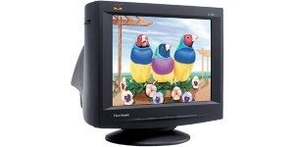
Video Display Devices
The primary output device in a graphical system is the video monitor.

Slide 4
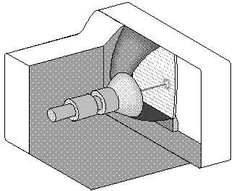
Cathode-ray tubes (CRT)
Focusing System
Y deflect
Base
Phosphor
Connector
x deflect
Pins
Electron Gun
Control grid voltage
4

Slide 5
Basic operations of a CRT
Steps
The electron gun emits a beam of electrons (cathode rays).
The electron beam passes through focusing and deflection systems that direct it towards specified positions on the phosphor-coated screen.
When the beam hits the screen, the phosphor emits a small spot of light at each position contacted by the electron beam.
Because the light emitted by the phosphor fades very quickly some method is needed for maintaining the screen picture.
1. Redraw the picture by quickly directing the electron beam back over the same screen points. ₅

Slide 6
Phosphor Persistence
Definition: The time from the initial light output to the moment when has decayed to its 10%.
There are different kind of phosphors for use in a CRT. Besides color, a major difference is their persistence – how long they continue to emit light after the CRT beam is removed.
A phosphor with low-persistence is useful in animation.
A high-persistence phosphor is useful for displaying highly complex, static pictures.
Graphics monitors are usually constructed with a persistence in the range from 10 to 60 microseconds.
6

Slide 7
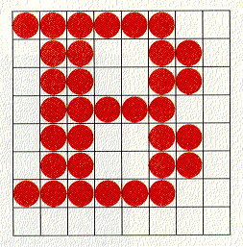
Raster Scan Displays
Developed in the early seventies.
It is today's dominant hardware technology. Almost all graphics systems are raster-based.
A picture is produced as an array – the raster – of picture elements.
This elements are called Pixels or Pels (Picture Elements). A pixel corresponds to a location, or small area, in the image.
Collectively, the pixels are stored in a part of memory called the refresh buffer or frame buffer.
7

Slide 8
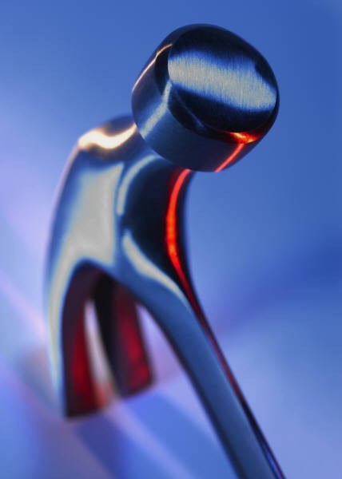
Resolution
The maximum number of points (pixels) that can be displayed without overlap on a screen is referred to as the resolution, and determines the detail that can be seen in an image.
A more precise definition is the number of points per centimeter that can be plotted horizontally and vertically, although it is often simply stated as the total number of points in each direction (i.e. 1280 × 1024).
The physical size of a graphics monitor, on the other hand,
is given as the length (in inches) of the screen diagonal.
8

Slide 9
The aspect ratio gives the ratio of vertical points to horizontal points necessary to produce equal- length lines in both directions on the screen. So 4:3 (most common) means that a vertical line plotted with 4 points has the same length as a horizontal line plotted with 3 points.

Slide 10


The Frame Buffer
0
800
0
x
pixel at address (x,y)
spot at (x,y)
600
y
Frame buffer
Display surface
at (800,600)

Slide 11
Frame Buffers
A frame buffer may be thought of as computer memory organized as a two-dimensional array with each (x,y) addressable location corresponding to one pixel.
Bit Planes or Bit Depth is the number of bits corresponding to each pixel.
A typical frame buffer resolution might be
– 640 x 480 x 8
– 1280 x 1024 x 8
– 1280 x 1024 x 24
11

Slide 12
Monochrome Display (Bit-map Display)
1 bit
2 levels
Electron
Gun

Slide 13
3-Bit Color Display
3
red
green
blue
COLOR: black red green blue yellow cyan magenta white
R |  | 0 |  | 1 |  | 0 |  | 0 |  | 1 |  | 0 |  | 1 |  | 1
G |  | 0 |  | 0 |  | 1 |  | 0 |  | 1 |  | 1 |  | 0 |  | 1
B |  | 0 |  | 0 |  | 0 |  | 1 |  | 0 |  | 1 |  | 1 |  | 1

Slide 14
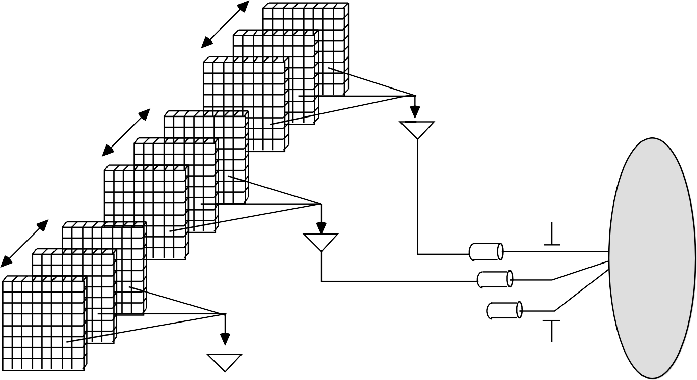
True Color Display
24 bit planes, 8 bits per color gun.
2²⁴ = 16,777,216
N
N
N
Red
Green
Blue

Slide 15
Refresh Rate
Definition: The number of times per second the image is redrawn.
The entire contents of the frame buffer are displayed on the CRT at a rate high enough to avoid flicker. This rate is called the refresh rate.
For a human to see a steady image on most CRT displays, the same path must be retraced, or refreshed, by the beam at least 60 times per second.
Current raster-scan displays perform refreshing at the rate of 60 to 80 frames per second, although some systems now have refresh rates of up to 120 frames per second.
Refresh rates are described in units of cycles per second, or Hertz (Hz), where a cycle corresponds to one frame (i.e. a refresh rate of 60 frames per second = 60 Hz).

Slide 16
Refresh-rate for films and TV
On films, below 24 frames per second, we can perceive a gap between successive screen images.
– Old silent films show flicker because they where photographed at a rate of 16 frames per second.
When sound systems were developed in the 1920s, motion picture film rates increased to 24 frames per second removing flickering.
Today TV refresh rate is 25 frames per second in Europe and 30 frames per second in the USA.
–
–

Slide 17
The depth (or intensity) of the frame buffer, defined as the number of bits that are used for each pixel, determines properties such as how many colors can be represented on a given system.
1-bit-deep frame buffer allows 2¹ colors (black and white)
8-bit-deep frame buffer allows 2⁸ (=256) colors
In full color systems (also called RGB-color systems), there are 24 (or more) bits per pixel in order to display sufficient colors to represent most images realistically.

Slide 18
Raster Scan Displays
Raster: A rectangular array of points or dots
Pixel: One dot or picture element of the raster.
Its intensity range for pixels depends on capability of the system
Scan line: A row of pixels
Picture elements are stored in a memory called frame buffer

Slide 19
Raster Scan Displays
Electron beam “paints” the picture on screen one
line at a time.
Scan line
Horizontal retrace
Vertical retrace
000000000000000000000
000000000111000000000
000000111111111000000
000111111111111111000
000111110000011111000
000111111111111111000
000111111000111111000
000111111000111111000
000111111000111111000
000111111000111111000
000111111111111111000
000000000000000000000
19

Slide 20
Raster Scan Displays
They are based on TV technology
Refresh rate = 60 to 80 frames per second.
Note: Below 24 frames/second, eye detects flicker.
Each screen point is visited every refresh cycle.
Their capability to store intensity information for each screen point makes them well suited for the realistic display of scenes containing shading and color patterns.
The frame-buffer with 1-bit intensity is called a bitmap.
The frame-buffer with multiple-bits intensity is called a pixmap.

Slide 21
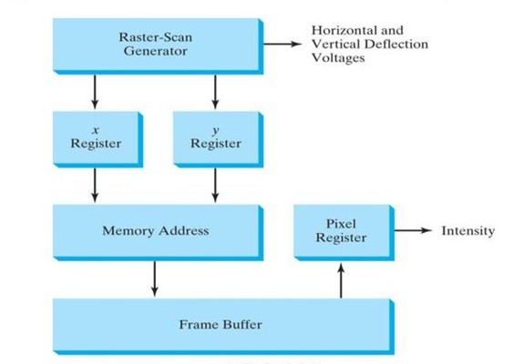
Operation of Video Controller

Slide 22
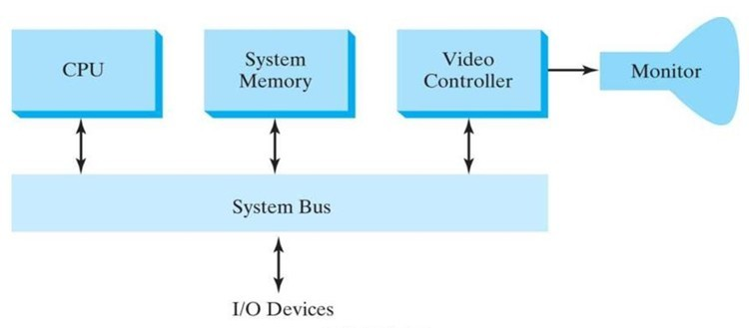
Simple Raster Scan System

Slide 23
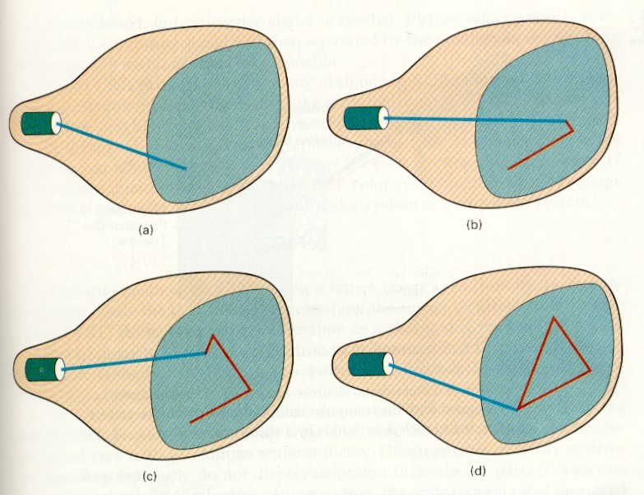
Random-Scan (Vector) displays
Vector stands for line.
Developed in the mid-sixties and in common use until the mid-eighties.
The electron beam is directed only to parts of the screen where the picture is to be drawn.
MoveTo (300,800)
LineTo (700,800)
LineTo (500,300)
LineTo (300,800)

Slide 24
Random Scan Displays
Picture is stored as a set of point- and line-drawing commands with (x,y) or (x,y,z) endpoint coordinates, as well as character-plotting commands.
Refresh rate depends on the number of lines to be displayed. To avoid flicker it must be at least 30 times per second (30 Hz).
They are designed to draw all the component lines of a picture 30 to 60 times per second – more than 60 could burn the phosphor.
High quality vector systems are capable of handling approximately 100,000 lines at this refresh rate.
They are designed for line drawing applications and cannot display realistic shaded images.

Slide 25

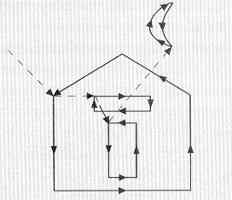
Raster Scan Vs Random Scan
Raster scan
Random scan

Slide 26
2 Basic Techniques for Color Display
Beam-Penetration Method
Shadow-Mask Method

Slide 27
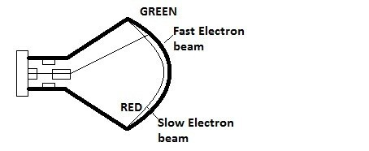
Beam-Penetration Method
ω
ω
ω
Used with random scan monitors
The screen has two layers of phosphor: usually red and green
The displayed color depends on how far the electron beam penetrates through the two layers.
A beam of slow electrons excites only the outer of the red layer, a beam of fast electrons penetrates through the red layer and excites the inner green layer, and at intermediate beam speeds, combinations of the two colors are emitted to show other colors (yellow & orange).
ω

Slide 28
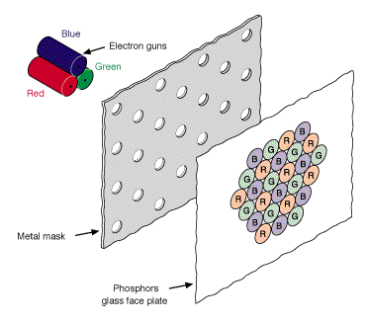
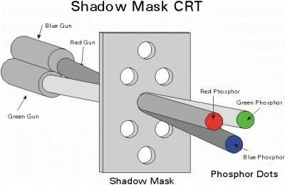
Shadow-Mask Method
Color CRTs have
Three electron guns
A metal shadow mask to differentiate the beams

Slide 29
ω
The Shadow mask in the previous image is known as the delta-delta
shadow-mask.
ω
The 3 electron beams are deflected and focused as a group onto the shadow mask, which contains a series of holes aligned with the phosphor-dot patterns.
ω
The 3 beams pass through a hole in the shadow mask and activate a dot triangle, which appears as a small color spot on the screen.

Slide 30
Beam Penetration VS Shadow mask
30

Slide 31
Controlling Colors in shadow mask
ω
Different colors can be obtained by varying the intensity levels of the three electron beams.
ω
Example: Simply turning off the red and green guns, we get only the color coming from the blue phosphor.
ω
ω
ω
Yellow = Green + Red Magenta = Blue + Red Cyan = Blue + Green
ω
White is produced when all the 3 guns possess equal amount of intensity.

Slide 32
Display Processor
Also called either a Graphics Controller or Display Co-Processor.
Specialized hardware to assist in scan converting output primitives into the frame buffer.
The display processor is used to convert digital information from the CPU into analog value needed by the display device.
A major task of display processor is to perform a process called scan conversion. It is the process of separating contiguous graphics objects as a collection of ellipse, rectangles and polygons.

Slide 33






Video
Controller
Cycles through the frame buffer, one scan line at a time. Contents of the memory are used the control the CRT's beam intensity or color.
M
e m
o r y
X address
Set or increment
Linear
Raster scan generator
Horizontal and vertical deflection signals
address
Y address
Set or decrement
Data
Pixel value(s)
Intensity or color

Slide 34

Input Devices
Each device is more suitable for certain tasks than for others
Keyboard
– Entering non-graphical data (i.e. text)

Slide 35

Mouse
Used to select a location to the screen.
The motion of the roller at the bottom of the mouse is converted into signals sent back to the computer.
Optical Detector Mouse
Measure distance traveled by counting lines on a special pad.

Slide 36
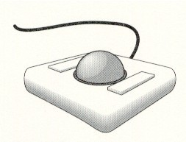
Trackball
Similar in use to the mouse.
Popular with portable computers because they can be incorporated directly into the keyboard.
There exist various pressure-sensitive devices in keyboards that perform similar functions to the mouse and trackball.

Slide 37
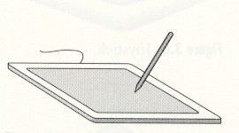
Data Tablet
It has rows and columns of wires embedded under its surface. The position of the stylus is determined through electromagnetic interactions between signals traveling through the wires and sensors in the stylus.
Touch-Sensitive Screens
Have many of the same properties as Data Tablet.
37

Slide 38
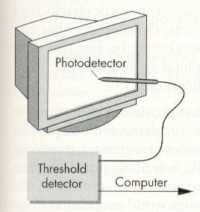
Light pen
If it is positioned on the face of the CRT at a location, a signal is sent to the computer.
Not very popular as other devices.

Slide 39
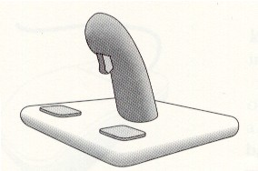
Joystick
The motion of the screen in two orthogonal directions is encoded and integrated to identify a screen location.
Variable sensitive device – well suited for flight simulators and games.

Slide 40
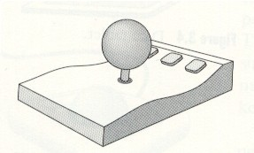
Spaceball
3D input device
Stick does not move but it has pressure sensors (rotations).
3 independent twists (translations).

Slide 41
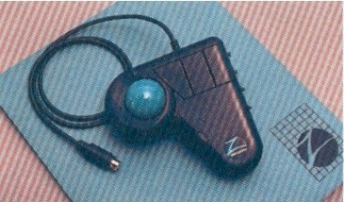
Z-mouse
3D input device
It has three buttons, a thumbwheel on the sided, a trackball on the top, and a standard mouse ball underneath.

Slide 42
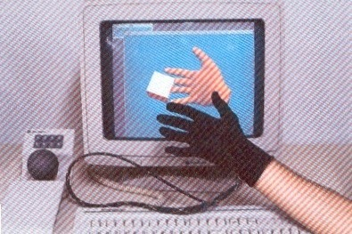
Data Glove
Used to grasp a “virtual” object.
Sensors detect hand and finger motions.

Slide 43
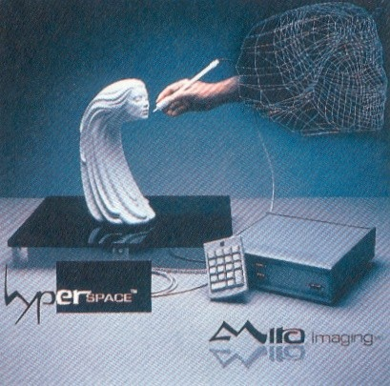
Digitizers
2D or 3D input devices.
Interactive selection of coordinate positions on an object.
Wireframe models – rectangular grid

