Slide 1
Output Primitives
Points and Lines
Line Drawing Algorithms
DDA Algorithm
Bresenham’s Line Algorithm
Midpoint Circle Algorithm
Midpoint Ellipse Algorithm
Filled Area Primitives

Slide 2
Points and Lines
Point is the fundamental element of picture representation.
It is the position in the plan defined as either pair or triplets of number depending upon the dimension.
Two points represent line or edge and 3 or more points a polygon.
Curved lines are represented by the short straight lines.

Slide 3
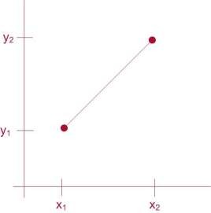
Line Drawing Algorithms
Slope-Intercept Equation
y = m.x +b
Slope
y₁
m = ^{y2}
x₂ − x₁
Intercept
b = y₁ − m.x₁
Interval Calculation
Δy = m.Δx
Δx = ^{Δy}
m

Slide 4
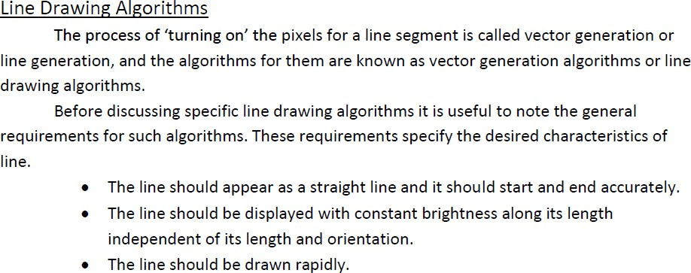
Line Drawing Algorithm

Slide 5
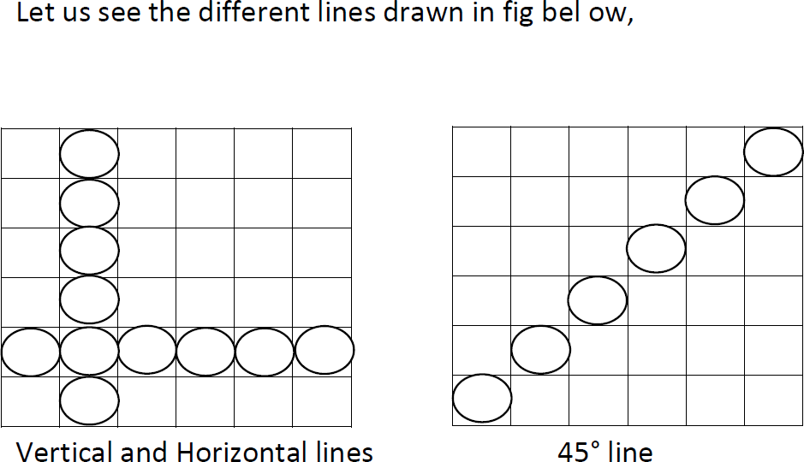

Slide 6
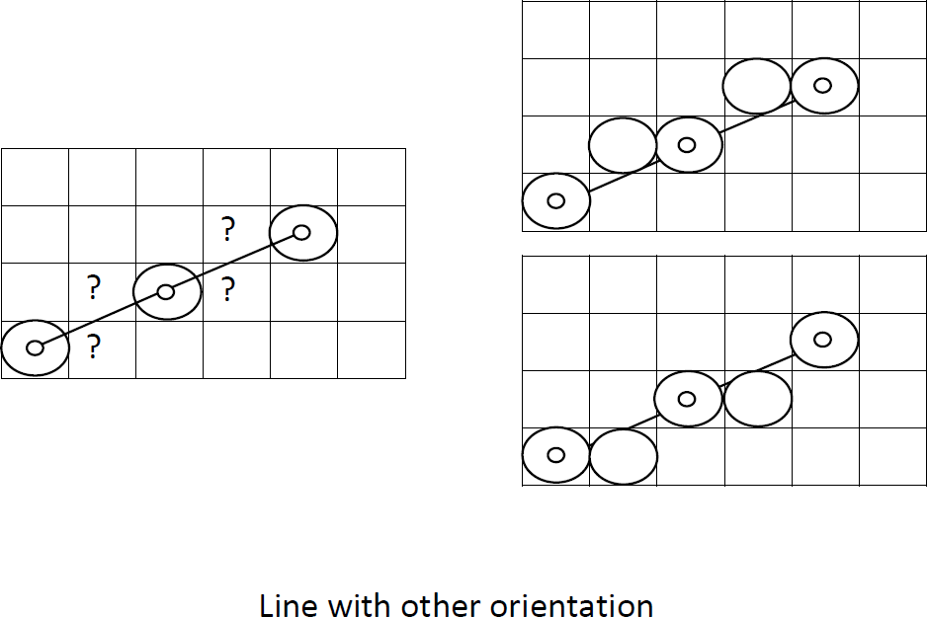

Slide 7
DDA Algorithm
🡪 Digital Differential Analyzer
Sample the line at unit intervals in one coordinate
Determine the corresponding integer values nearest the line path in another co-ordinate
The digital differential analyzer (DDA) is a scan-conversion line algorithm based on calculating either Δy or Δx, using Δy=mΔx or Δx= Δy/m

Slide 8
DDA Algorithm (left to right)
Slope
_{m =} ^{y}k +1 ^{− y}k
₌ Δy
^{x}k +1 ^{− x}k
Δx
For |m|<1 (|Δy|< |Δx|)
– Sample line at unit interval in x co-ordinate
^{y}k +1 ^{= y}k
m
Δx = x_{k +1} − x_{k} = 1
For |m|>1 (|Δy|> |Δx|)
– Sample line at unit interval in y co-ordinate
₊ 1
m
^{x}k +1 ^{= x}k
Δy = y − y = 1
k +1
k

Slide 9
DDA Algorithm (right to left)
Slope
_{m =} ^{y}k +1 ^{− y}k
₌ Δy
^{x}k +1 ^{− x}k
Δx
For |m|<1 (|Δy|< |Δx|)
– Sample line at unit interval in x co-ordinate
^{y}k +1 ^{= y}k
m
Δx = x_{k +1} − x_{k} = −1
For |m|>1 (|Δy|> |Δx|)
– Sample line at unit interval in y co-ordinate
₋ 1
m
^{x}k +1 ^{= x}k
Δy = y − y = −1
k +1
k

Slide 10
DDA Algorithm
Input the two line endpoints and store the left endpoint in (x₀,y₀)
Plot first point (x₀,y₀)
Calculate constants Δx, Δy
If |Δx| > |Δy| steps = |Δx| else steps = |Δy|
Calculate XInc = |Δx| / steps and YInc = |Δy| / steps
At each x_{k} along the line, starting at k=0, Plot the next pixel at (xk + XInc, yk
+ YInc)
Repeat step 6 steps times

Slide 11
Algorithm:
(x1,y1) (x2,y2) are the end points and dx, dy are the float variables.
(i) If abs(x2-x1) > abs(y2-y1) then length = abs(x2-x1)
else
length = abs(y2-y1)
endif
(ii) dx = (x2-x1)/length
dy = (y2-y1)/length
x = x1
y = y1
(iv) i = 0
(v)Plot (trunc(x), trunc(y))
(vi) x = x + dx
y = y + dy
(vii) i = i + 1
(viii) If i < length then go to step (v)
(ix) Stop

Slide 12
Pseudo Code
Void lineDDA(int xa, int ya, int xb, int yb)
{
int dx = xb – xa, dy = yb – ya, steps, k;
float xIncrement, yIncrement, x = xa, y = ya;
if( abs (dx) > abs (dy) ) steps = abs (dx); else steps = abs (dy);
xIncrement = dx / (float) steps; yIncrement = dy / (float) steps; setPixel (ROUND (x), ROUND (y)); for (k=0; k<steps; k++){
x += xIncrement; y += yIncrement;
setPixel (ROUND(x), ROUND(y));
}
}

Slide 13
Ex. 1 Consider a line from (0,0) to (6,7). Use DDA algorithm to rasterize this line
Initialization: (x_{a},y_{a}) =(0,0)
(x_{b},y_{b}) =(6,7)
dx=6-0=6
dy=7-0=7
Length=7
Δ x=6/7=0.857
Δy=7/7=1
x=0 y=0

Slide 14
Plotting begins
i | Setpixel(x,y) | x | y
 | (0,0) | 0 | 0
1 | (1,1) | 0.857 | 1
2 | (2,2) | 1.714 | 2
3 | (3,3) | 2.571 | 3
4 | (3,4) | 3.428 | 4
5 | (4,5) | 4.285 | 5
6 | (5,6) | 5.142 | 6
7 | (6,7) | 5.999 | 7

Slide 15
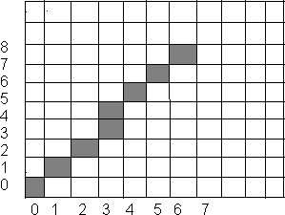
Results of DDA algorithm

Slide 16
Use DDA algorithm for rasterizing line (0,0) to (6,6).
Use DDA algorithm for rasterizing line (0,0) to (4,6).

Slide 17
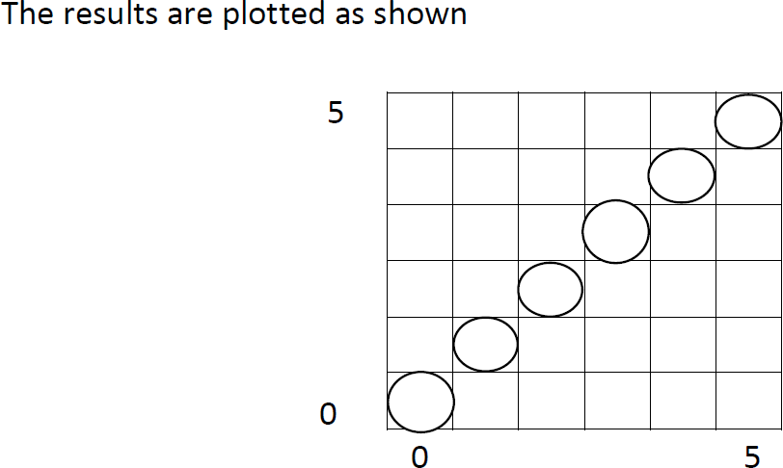

Slide 18
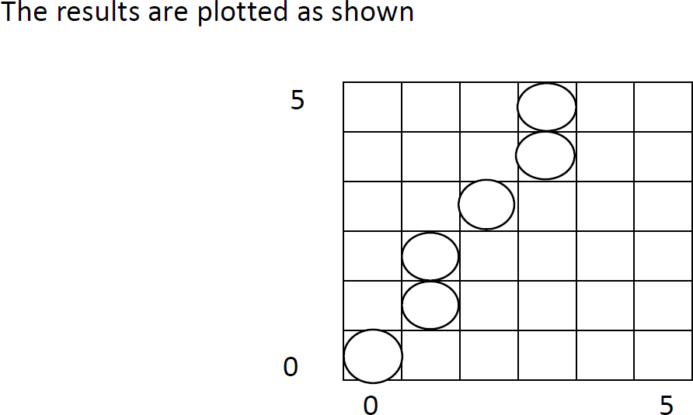

Slide 19
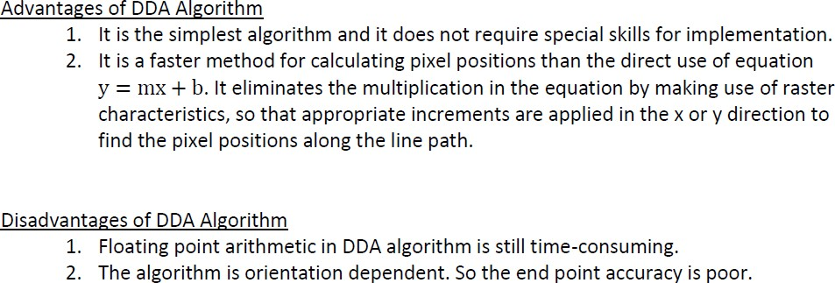

Slide 20
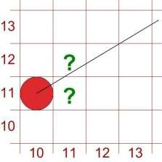
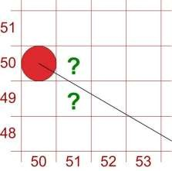
Bresenham’s Line Algorithm
Uses only incremental integer calculations
Which pixel to draw ?
– (11,11) or (11,12) ?
– (51,50) or (51,49) ?
– Answered by Bresenham

Slide 21
For |m|<1
Start from left end point (x₀,y₀) step to each successive column (x samples) and plot the pixel whose scan line y value is closest to the line path.
After (x_{k},y_{k}) the choice could be (x_{k}+1,y_{k}) or (x_{k}+1,y_{k}+1)

Slide 22
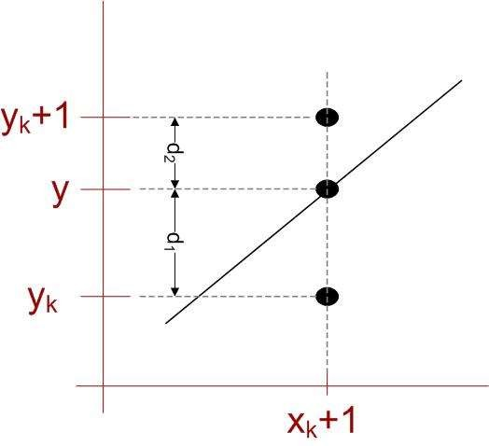
y = m(x_{k} +1) + b
d₁ = y − y_{k}
= m(x_{k} +1) + b − y_{k}
d₂ = ( y_{k} +1) − y
= y_{k} +1− m(x_{k} +1) − b
Then
And
Difference between separations
d₁ − d₂ = 2m(x_{k} +1) − 2 y_{k} + 2b −1

Slide 23
Defining decision parameter
Constant=2Δy + Δx(2b-1) Which is independent of pixel position
p_{k} = Δx(d₁ − d₂ )
[1]
= 2Δy.x_{k} − 2Δx.y_{k} + c
Sign of p_{k} is same as that of d₁-d₂ for Δx>0 (left to right sampling)
p_{k +1} = 2Δy.x_{k +1} − 2Δx.y_{k +1} + c
c eliminated here
^{p}k +1 ^{− p}k
= 2Δy(x_{k +1} − x_{k} ) − 2Δx( y_{k +1} − y_{k} )
because x_{k+1} = x_{k} + 1
^{p}k +1 ^{= p}k
+ 2Δy − 2Δx( y_{k +1} − y_{k} )
For Recursive calculation, initially
y_{k+1}-y_{k} = 0 if p_{k} < 0 y_{k+1}-y_{k} = 1 if p_{k} ≥ 0
p₀ = 2Δy − Δx
Substitute b = y₀ – m.x₀ and m = Δy/Δx in [1]

Slide 24
Algorithm Steps (|m|<1)
Input the two line endpoints and store the left endpoint in (x₀,y₀)
Plot first point (x₀,y₀)
Calculate constants Δx, Δy, 2Δy and 2 Δy- 2Δx, and obtain p₀ = 2Δy – Δx
At each x_{k} along the line, starting at k=0, perform the following test: If p_{k}<0, the next point plot is (x_{k}+1,y_{k}) and
P_{k+1} = p_{k} + 2Δy
Otherwise, the next point to plot is (x_{k} + 1, y_{k}+1) and P_{k+1} = p_{k} + 2Δy - 2Δx
Repeat step 4 Δx times

Slide 25
What’s the advantage?
Answer: involves only the calculation of constants Δx, Δy, 2Δy and 2Δy- 2Δx once and integer addition and subtraction in each steps

Slide 26
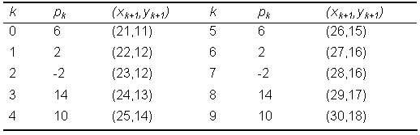
Example
Endpoints (20,10) and (30,18)
Slope m = 0.8 Δx = 10, Δy = 8
P₀ = 2Δy - Δx = 6
2Δy = 16, 2Δy-2Δx = -4
Plot (x₀,y₀) = (20,10)

Slide 27
Use Bresenham’s algorithm for rasterizing the line (5,5) to (13,9)

Slide 28
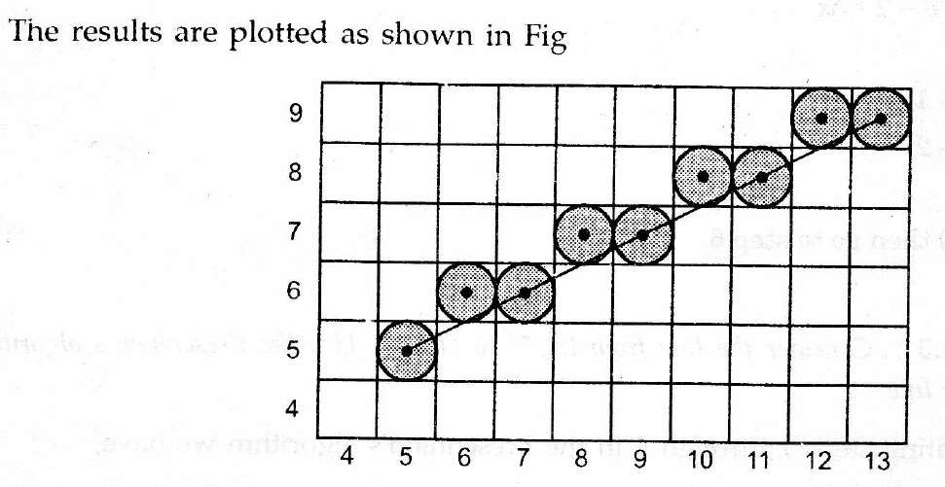

Slide 29
Digitize a line with endpoints (15,18) and (10,15) using BLA.

Slide 30
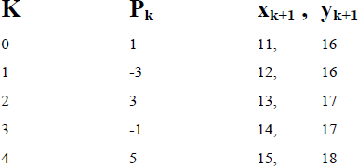
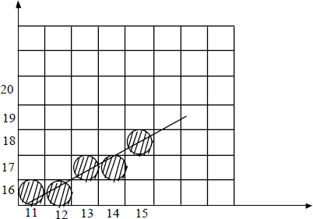

Slide 31
Digitize a line with endpoints (15,15) and (10,18) using BLA.

Slide 32
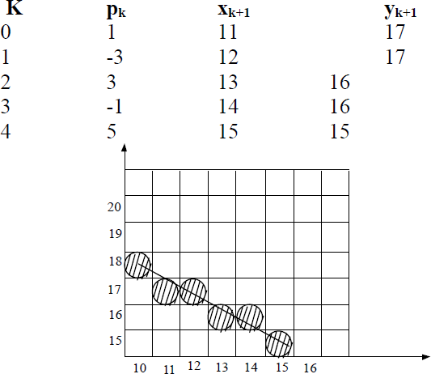

Slide 33
Algorithm Steps (|m|>1)
Input the two line endpoints and store the left endpoint in (x₀,y₀)
Plot first point (x₀,y₀)
Calculate constants Δx, Δy, 2Δx and 2 Δx- 2Δy, and obtain p₀ = 2Δx – Δy
At each x_{k} along the line, starting at k=0, perform the following test: If p_{k}<0, the next point plot is (x_{k}, y_{k}+1) and
P_{k+1} = p_{k} + 2Δx
Otherwise, the next point to plot is (x_{k} + 1, y_{k}+1) and P_{k+1} = p_{k} + 2Δx - 2Δy
Repeat step 4 Δx times

Slide 34
Use BLA algorithm for rasterizing line (0,0) to (4,6).

Slide 35
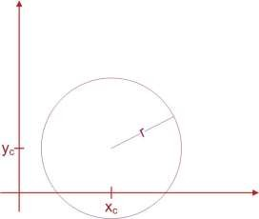
Circle-Generating Algorithms (Basic Foundations)
Circle Equation:
(x − x_{c} )² + ( y − y_{c} )² = r²
Points along circumference could be calculated by stepping along x-
axis:
y = y ± r ² − (x − x)²
c c

Slide 36
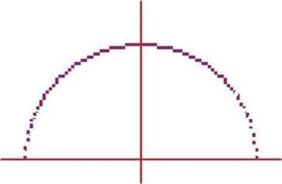
Problem (in above method)
Computational complexity
Spacing:
– Non-uniform spacing of plotted pixels

Slide 37
Adjustments (To fix problems)
Spacing problem (2 ways):
Interchange the role of x and y whenever the absolute value of the slope of the circle tangent > 1
Use polar co-ordinate:
x = x + r cosθ
c
y = y_{c} + r sinθ
Equally spaced points are plotted along the circumference with fixed angular step size.
step size chosen for θ depends on the application and display device.
Computation Problem:
– Use symmetry of circle; i.e calculate for one octant and use symmetry for others.

Slide 38
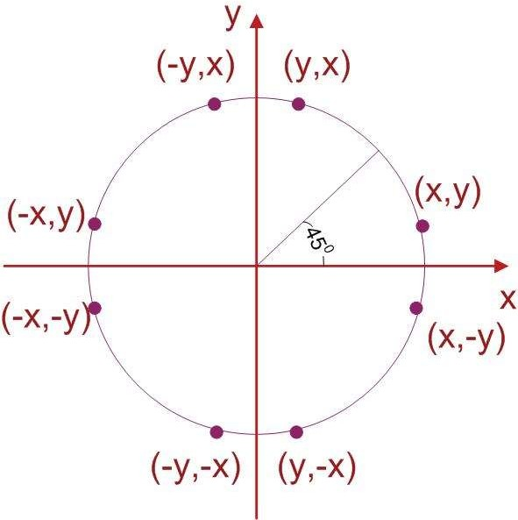
Circle Symmetry

Slide 39
Bresenham’s Algorithm Could Be Adapted ??
Yes
How ?
Setting decision parameter for finding the closest pixel to the circumference
And what to do For Non-linear equation of circle ?
Comparison of squares of the pixel separation distance avoids square root calculations

Slide 40
Midpoint Circle Algorithm
Circle function defined as:
f_{circle} (x, y) = x²+ y²− r²
Any point (x,y) satisfies following conditions
⎧< 0,
if (x, y)
if (x, y)
if (x, y)
is inside the circle boundary is on the circle boundary
is outside the circle boundary
f (x, y)⎪= 0,
circle
⎨
⎪> 0,
⎩

Slide 41
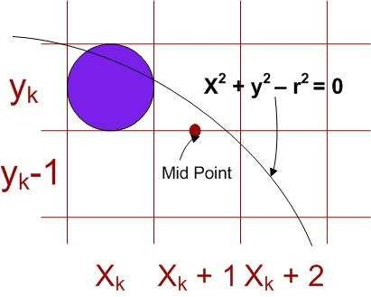
Decision parameter is the circle function; evaluated as:
p = f (x +1, y − ¹ )
k
circle k k
2
=(x
+1)² + ( y − ¹ )² − r ²
k
k
2
p = f (x +1, y − ¹ )
k +1
circle k +1 k +1
2
=[(x +1) +1]² + ( y − ¹ )² − r ²
k k +1
2
^{p}k +1 ^{= p}k
2 2
+ 2(x_{k} +1) + ( y_{k +1} − y_{k} ) − ( y_{k +1} − y_{k} ) +1

Slide 42
^{y}k+1 ^{= y}k
if p_{k}<0
y_{k+1} = y_{k}-1 otherwise
Thus
P_{k+1} = P_{k} + 2x_{k+1}+1 if pk<0
P_{k+1} = P_{k} + 2x_{k+1}+1-2y_{k+1} otherwise
Also incremental evaluation of 2x_{k+1} and 2y_{k+1}
2x_{k+1} = 2x_{k} + 2
2y_{k+1} = 2y_{k} – 2 if p_{k} >0
At start position (x₀,y₀) = (0,r)
2x₀ = 0 and 2y₀ = 2r

Slide 43
Initial decision parameter
p = f (1, r − ¹ )
0 circle
1
2
2
r ²
=1+ (r −
= ⁵ − r
₎2
4
For r specified as an integer, round p₀ to
P₀ = 1-r
(because all increments are integers)

Slide 44
Algorithm
Input radius r and circle center (x_{c}, y_{c}) and obtain the first point on the circumference of
a circle centered on the origin as
(x₀,y₀) = (0,r)
Calculate the initial value of the decision parameter as
P₀ = 5/4 – r
At each x_{k} position, starting at k = 0, perform the following test:
If p_{k} < 0, the next point along the circle centered on (0,0) is (x_{k+1},y_{k}) and
P_{k+1} = p_{k} + 2x_{k+1} + 1
Otherwise, the next point along the circle is (x_{k}+1,y_{K}-1) and
P_{k+1} = p_{k} + 2x_{k+1} + 1 -2y_{k+1}
Where 2x_{k+1} = 2x_{k} + 2 and 2y_{k+1} = 2y_{k}-2
Determine the symmetry points in the other seven octants.
Move each calculated pixel position (x,y) onto the circular path
centered on (x_{c},y_{c}) and plot the co-ordinate values:
x = x + x_{c}, y = y+y_{c}
Repeat steps 3 through 5 until x ≥ y

Slide 45
Given radius =10 use mid-point circle drawing algorithm to determine the pixel in the first quadrant.
Solution:
P0 = 1-r = -9 (x0 , y0)=(0,10) 2x0 =0
2y0 =20

Slide 46
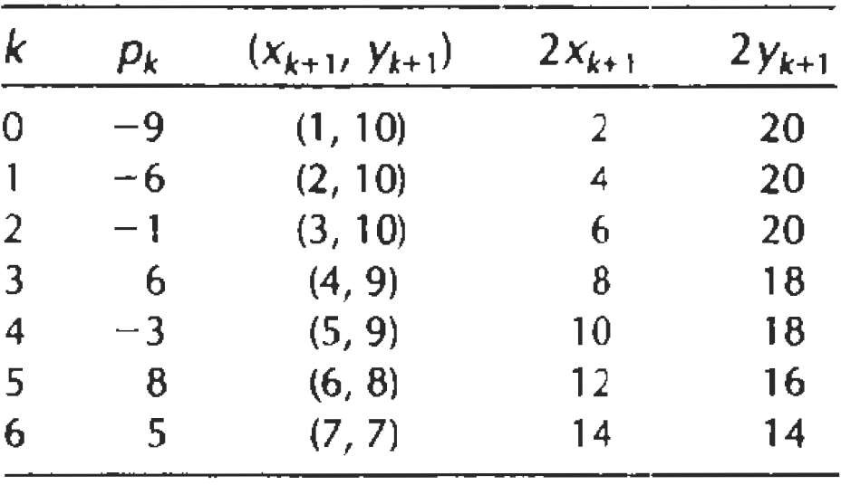

Slide 47
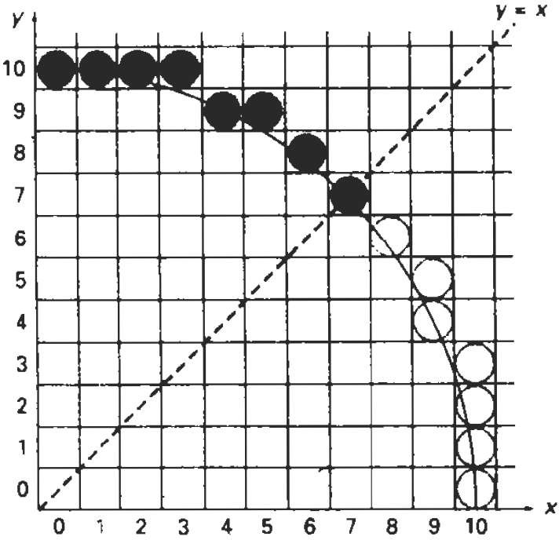

Slide 48
Digitize the circle (x-2)^2+(y-3)^2=25 in first quadrant.
Solution:
P0=(1-r)= -4 (x0 , y0)=(0,5) 2x0 =0
2y0 =10

Slide 49
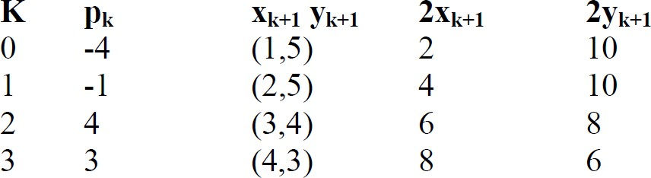

Slide 50
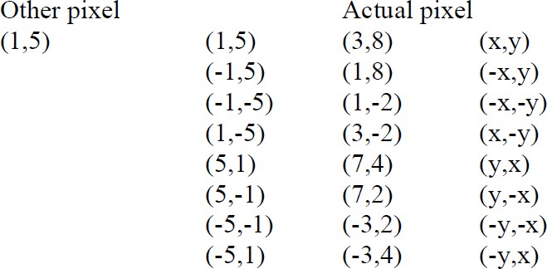

Slide 51
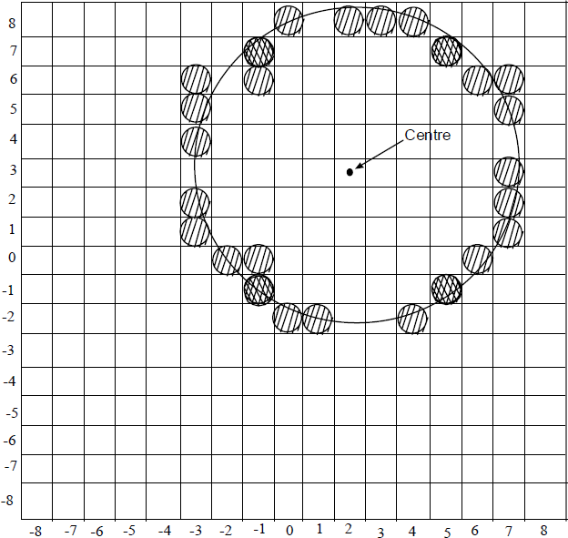

Slide 52
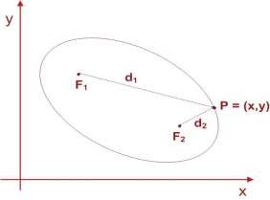
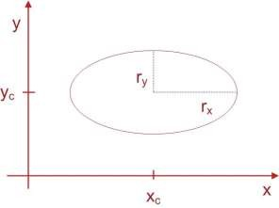
Ellipse Generating Algorithms
Equation of ellipse:
d₁ + d₂ = constant
F1🡪(x₁,y₁), F2🡪(x₂,y₂)
(x − x )² + ( y − y )² + (x − x )² + ( y − y )² = constant
1 1 2 2
General Equation
Ax² + By ² + Cxy + Dx + Ey + F = 0
Simplified Form
⎛ x − x ^{⎞2 ⎛} y − y ^{⎞2}
⎜ c ⎟
r
+ ^{⎜ c ⎟} = 1
⎝ x ⎠
⎜
r
⎟
⎝ ⎠
y
In polar co-ordinate
x = x_{c} + r_{x} cosθ
y = y_{c} +r _{y} sinθ

Slide 53
Ellipse function
f (x, y) = r ² x² + r ² y² − r ²r ²
ellipse y x y
x
⎧⎪< 0,
if (x, y)
if (x, y)
if (x, y)
is inside the ellipse boundary is on the ellipse boundary
is outside the ellipse boundary
f_{ellipse} (x, y)⎨= 0,
⎪⎩> 0,

Slide 54
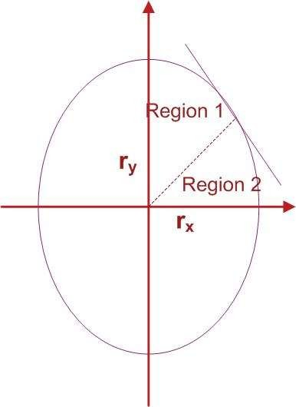
From ellipse tangent slope:
dy
2r
2 _{x}
= −
y
dx
2r ² y
x
At boundary region (slope = -1):
2r ² x = 2r ² y
y x
Start from (0,r_{y}), take x samples to boundary between 1 and 2
Slope=-1
Switch to sample y from boundary between 1
and 2
(i.e whenever
2 2
)
2r x ≥ 2r y
y x

Slide 55
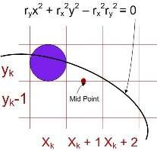
In the region 1
For increment calculation; Initially:
2r ² x = 0
p1 = f (x +1, y − ¹ )
k ellipse k k
2
y
1
2
2 2
= r ² (x +1)² + r ² ( y − ) − r r
2r ² y = 2r ²r
y k x k
2
x y
x x y
For next sample
Incrementally:
Update x by adding
1
^{p1}k +1 ^{= f}ellipse ^{(x}k +1 ^{+1, y}k +1 ⁻ ₂⁾
2r_{y} to first equation and update y by subtracting 2r_{x}² to second equation
= r_{y} [ ] + r ( y
1
2
2 2
2
2
2 2
(x +1) +1
) − r r
k
x k +1
2
x y
_{1 ⎞}2
_{1 ⎞}2 ⎤
⎡⎛
⎛
2 2
p1 = p1 + 2r ² (x +1) + r + r y
− − ⎜ y −
k +1 k y k
⎢⎜
⎟
⎟ ⎥
y x k +1
⎢⎣⎝
2 ⎠
⎝
k
2 ⎠ ⎥⎦
Thus increment
⎧
2
if p1 < 0
, if
2r x
+ r ² ,
increment = ⎨
y k +1 y
k
2
⎩
2r x + r ² − 2r ² y
p1 ≥ 0
y k +1 y x k +1
k

Slide 56
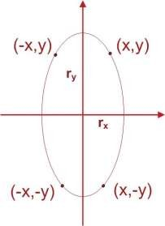
Initial value
₋ 1 ⎞
p1 = f
⎛1, r
₂ ⎟
0 ellipse ⎜ y
⎝
⎠
_{1 ⎞}2
⎛
2
= r ² + r r
− − r ²r ²
⎜
⎟
y x ⎝ y
x y
(0,r_{y})
2 ⎠
1
p1 = r ² − r ²r + r
2
0 y x y
4
x

Slide 57
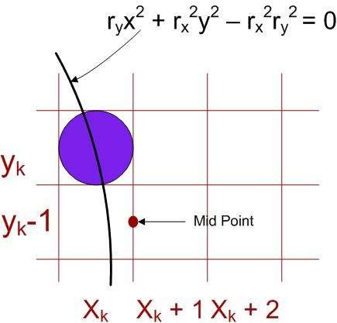
In the region 2
p2 = f (x + ¹ , y −1)
k ellipse k
2
k
1
2
2
= r ² (x + ) + r ( y −1)² − r ² r ²
y k x k
x y
2
For next sample
p2 = f (x + ¹ , y −1)
k +1 ellipse k +1
2
k +1
2 ⎛
_{1 ⎞}2
+ r [(y −1)−1] − r
= r x
+
2
2
2 2
⎜
⎟
r
y k +1
2
x k
x y
⎝ ⎠
_{1 ⎞}2
_{1 ⎞}2 ⎤
⎡⎛
⎛
For simplification calculation of p2₀ can be done by selecting pixel positions in counter clockwise order starting at (r_{x},0) and unit samples to positive y direction until the boundary between two regions
2 2
p2 = p2 + 2r ² ( y −1) + r + r x
+
⎟
− ⎜ x −
⎢⎜
⎟ ⎥
k +1 k x k x y k +1
2 ⎠
k
2 ⎠
⎝
⎝
⎢⎣
⎥⎦
Initially
⎛
1
⎞
p2 = f
⎜
x + , y −1
⎟
0 ellipse
0 0
⎝
2
⎠
⎛
_{1 ⎞}2
p2 = r ² ⎜ x +
⎟
+ r ² ( y −1)² − r ² r ²
x 0 x y
0
y ⎝ 0
2 ⎠

Slide 58
Algorithm
1. Input r_{x},r_{y}, and the ellipse center(x_{c},yc) and obtain the first point on an ellipse centered on the origin as
(x₀,y₀) = (0,r_{y})
2. Calculate the initial value of the decision parameter in region 1 as
1
p1 = r ² − r ²r + r
2
0 y x y
4
x
3. At each x_{k} position in region 1, starting at k = 0, perform the following test: If p1_{k} < 0, the next point along the
ellipse centered on (0,0) is (x_{k+1},y_{k}) and
p1 = p1 + 2r² x + r²
k +1 k y k +1 y
Otherwise, the next point along the ellipse is (x_{k}+1,y_{k}-1) and
p1 = p1 + 2r² x − 2r² y + r²
k +1 k y k +1 x k +1 y
With
2r² x = 2r² x + 2r² , 2r² y
y k +1 y k y x k +1
= 2r² y − 2r²
x k x
and continue until
2r² x ≥ 2r² y
y x

Slide 59
4. Calculate the initial value of decision parameter in region 2 using the last point (x₀,y₀) calculated in region 1 as
_{1 ⎞}2
⎛
p2 = r ² ⎜ x +
⎟
+ r ² ( y −1)² − r ²r ²
x 0 x y
0
y ⎝ 0
2 ⎠
5. At each y_{k} position in region 2, starting at k = 0, perform the following test: If p2k>0, the next point along the ellipse centered on (0,0) is (x_{k},y_{k}-1) and
p2_{k +1} = p2_{k}
− 2r ² y + r ²
x k +1
x
Otherwise the next point along the ellipse is (x_{k}+1,y_{k}-1) and
p2 = p2 + 2r² x
− 2r² y + r²
k +1 k y k +1 x k +1 x
Using the same incremental calculations for x and y as in region 1.
Determine the symmetry points in the other three quadrants.
Move each calculated pixel position (x,y) onto the elliptical path centered on (x_{c},y_{c}) and plot the co-ordinate
values:
X = x + x_{c}, y = y+ y_{c}
Repeat the steps for region 1 until
2r² x ≥ 2r² y
y x

Slide 60
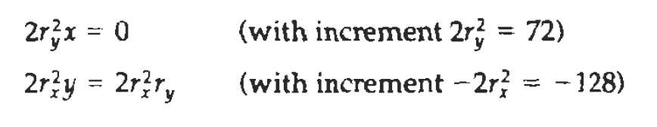
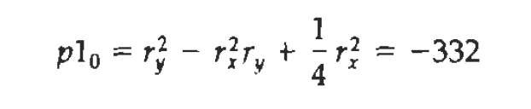
Digitize the ellipse with parameter rx =8 and ry =6 in first quadrant.
Solution:

Slide 61
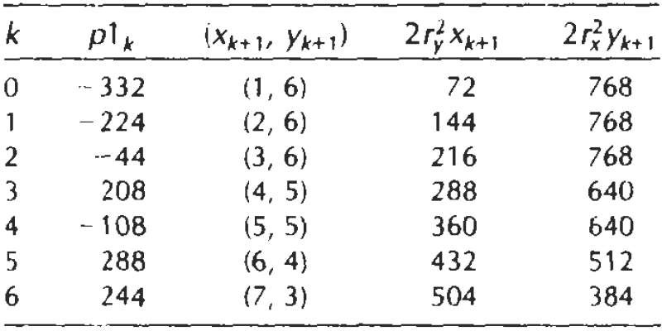

Slide 62
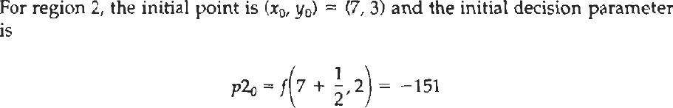
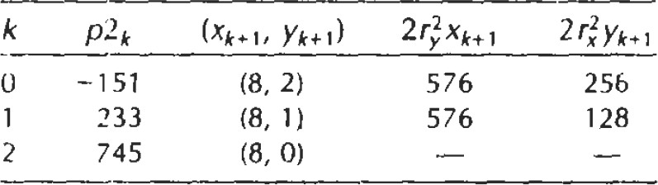

Slide 63
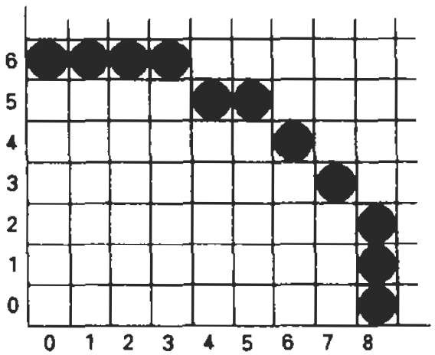

Slide 64
Filled Area Primitives
Two basic approaches for area filling:
By determining overlap intervals for scan lines
Start from given interior position and filling outwards

Slide 65
Scan Line Polygon Filled Algorithm
Intersection points of scan line with the polygon edge are calculated.
Points are sorted from left to right.
Corresponding frame buffer position between each intersection pair are set by specified color.

Slide 66
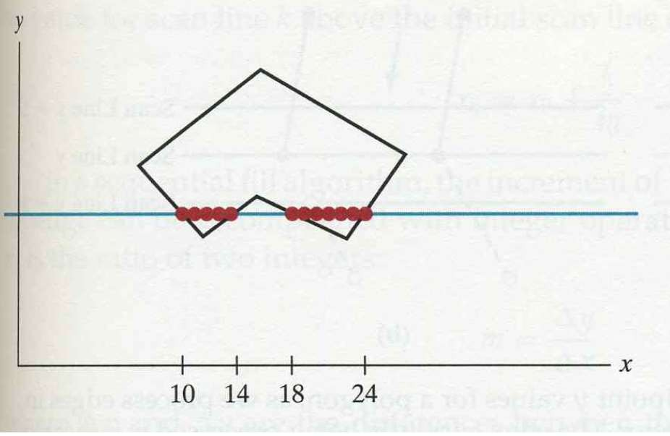

Slide 67
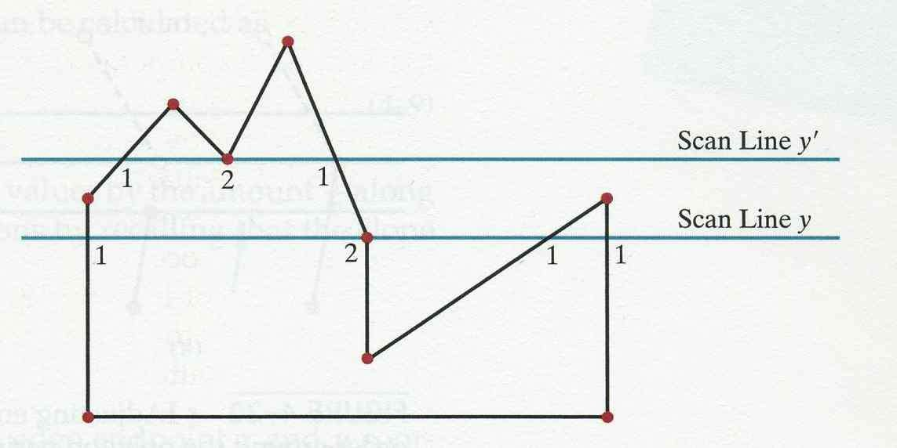
A scan line pass through vertex, intersect two polygon edges.

Slide 68
Scan line y’
Intersect even number of edges
2 pairs of intersection points correctly find the interior span
Scan line y
Intersect an odd number of edges(5)
Must count the vertex intersection as only one point

Slide 69
How to distinguish these cases?
Scan line y
Intersecting edges are on the opposite side
Scan line y’
Intersecting edges are on the same side.
By tracing around the boundary,
If the endpoint y values of two consecutive edges monotonically increases or decreases count middle vertex as single

Slide 70
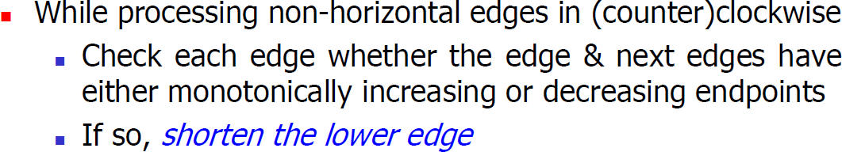
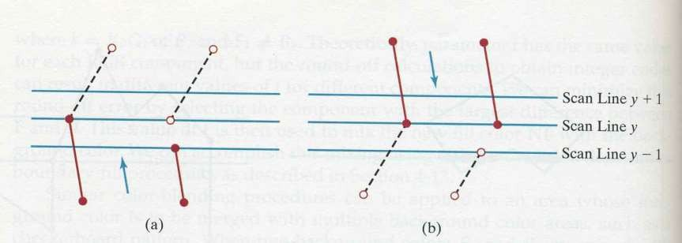
Implementation

Slide 71
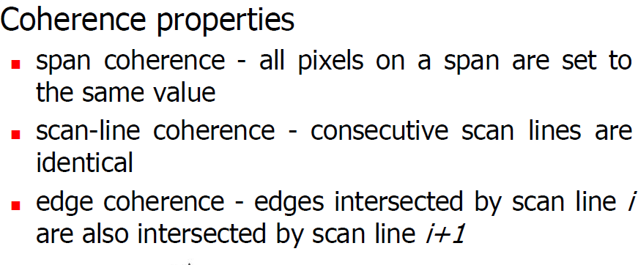

Slide 72
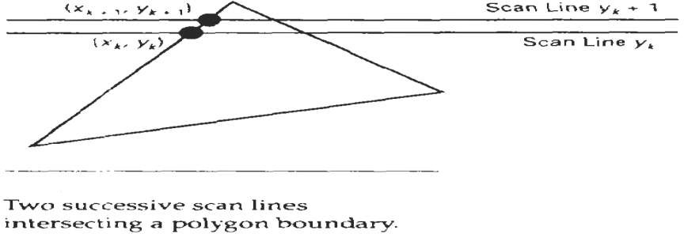
In determining edge intersection, we can set up incremental set up calculation using fact that slope of edge is constant.

Slide 73
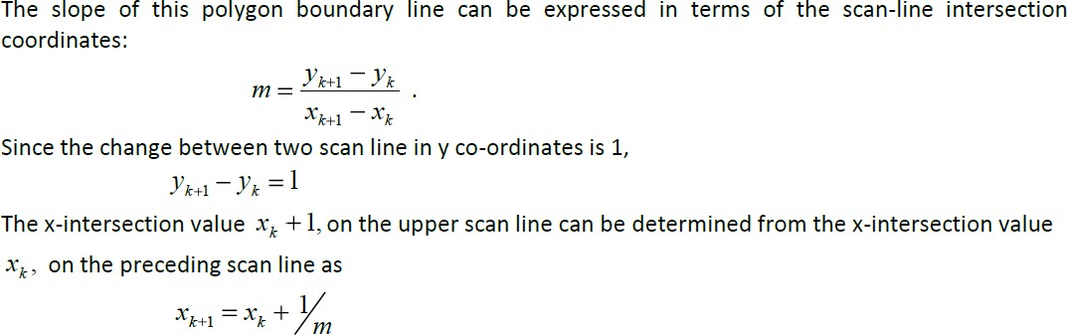

Slide 74
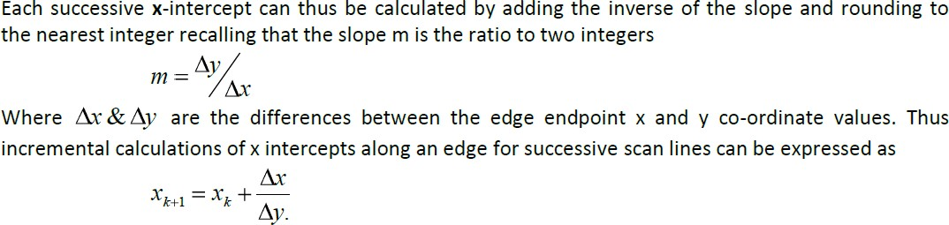

Slide 75
Inside Outside test
Odd Even rule:
Odd edge means interior
Non zero winding number rule
Non zero winding number means interior

Slide 76
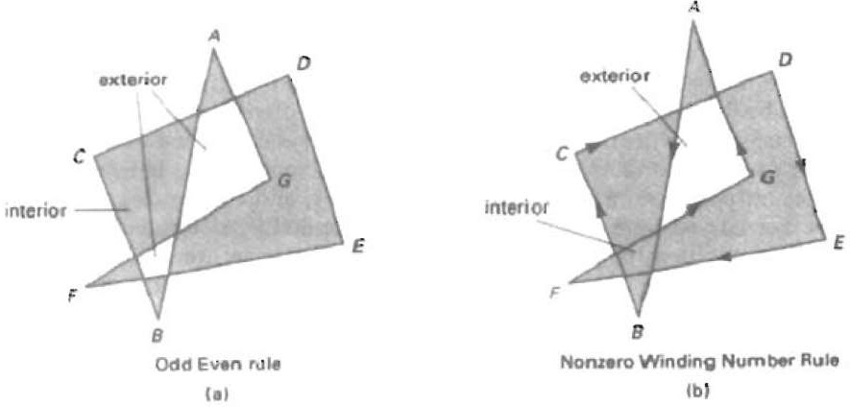

Slide 77
Scan line fill for Curved Area
Require more works than polygon filling due to non-linear boundary.
We calculate the scan line intersection and fill all the interior points.
Symmetries between the quadrant can be used to reduce the calculation.

Slide 78
Boundary fill algorithm
Fill the region starting from the interior point until the appropriate color boundary is reached.
Two ways:
4 connected
8 connected

Slide 79
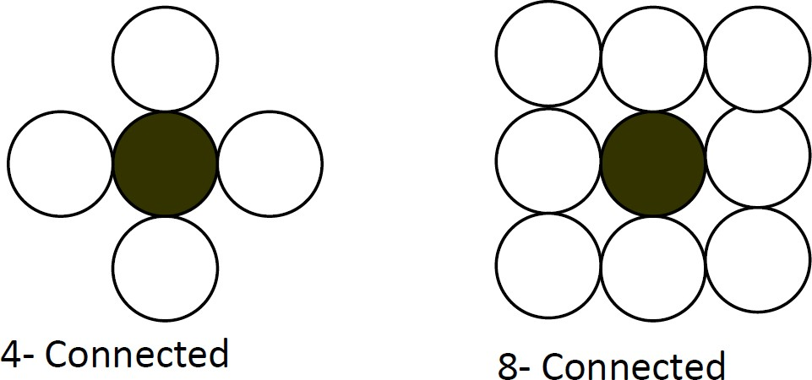

Slide 80
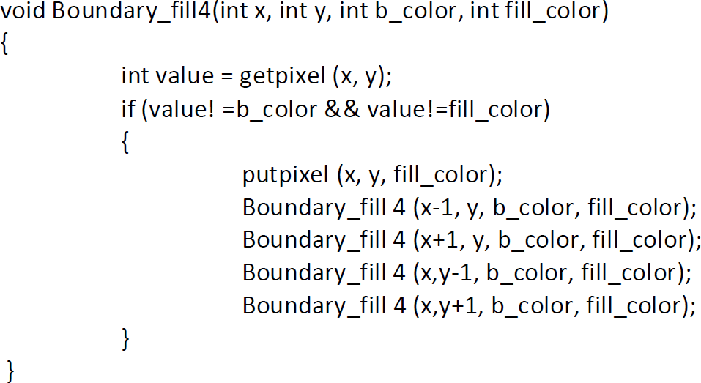
4 connected

Slide 81
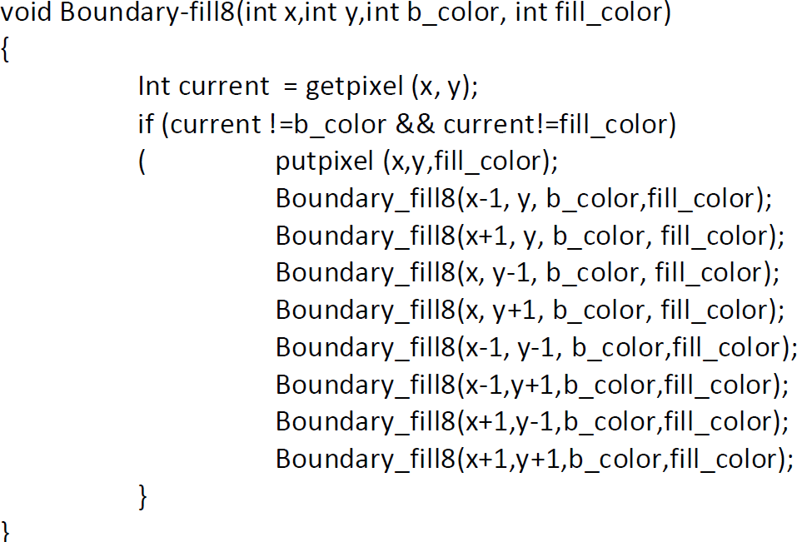
8 connected

Slide 82
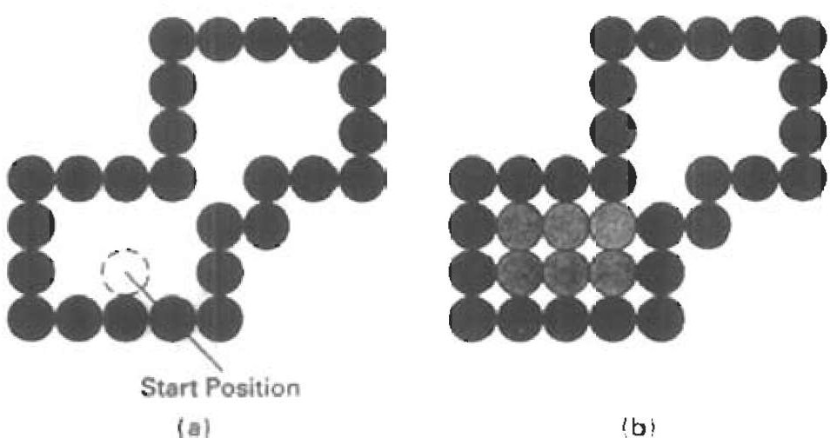
Using 4 connected flood fill algorithm

