Slide 1
UNIT II
Scan conversion and Output Primitives

Slide 2
Line drawing algorithm
Computer screen is divided into rows and columns.
The intersection area is known as pixel.
Process of determining which combination of pixels provide the best approximation of a desired line is known as Rasterization
Rasterization is combined with rendering of the picture in scan line order, then it is known as scan conversion.

Slide 3
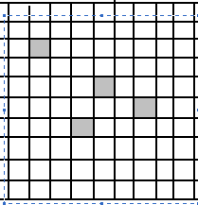
Pixels

Slide 4
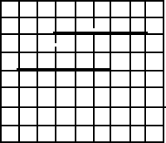
Horizontal lines

Slide 5
General requirement for requirement of a line
Line must appear to be straight
Lines should start and end accurately
Lines should have constant brightness along their length.
Lines should be drawn rapidly

Slide 6
On the raster system, lines are plotted with pixels
Step sizes in horizontal or vertical directions are constrained by pixel sepration.
Equation for a straight line y=mx+c
m is slope of line c is y-intercept m= Δ y/ Δ x
m= y₂-y₁/x₂-x₁

Slide 7
DDA algorithm
Digital Differential Analyzer is a scan conversion line algorithm based on calculating either Δy or Δx
DDA Procedure
Line end points are (x_{a},y_{a}) and (x_{b},y_{b})
dx=x_{b}-x_{a} dy=y_{b}-y_{a}
Determine the length of line

Slide 8
If abs(dx)>=abs(dy) then length=abs(dx)
else length=abs(dy) Δ x= dx / length
Δ y= dy / length
x= x_{a} y =y_{a}
setpixel (round(x), round(y));
8

Slide 9
i=1
while (i<=length)
x= x+ Δ x
y= y+ Δ y
setpixel(round(x),round(y);
i=i+1
end while Finish

Slide 10
Ex. 1 Consider a line from (0,0) to (6,7). Use DDA algorithm to rasterize this line
Initialization: (x_{a},y_{a}) =(0,0)
(x_{b},y_{b}) =(6,7)
dx=6-0=6
dy=7-0=7
Length=7
Δ x=6/7=0.857
Δy=7/7=1
x=0 y=0

Slide 11

Plotting begins
i | Setpixel(x,y) | x | y
 | (0,0) | 0 | 0
1 | (1,1) | 0.857 | 1
2 | (2,2) | 1.714 | 2
3 | (3,3) | 2.571 | 3
4 | (3,4) | 3.428 | 4
5 | (4,5) | 4.285 | 5
6 | (5,6) | 5.142 | 6
7 | (6,7) | 5.999 | 7

Slide 12
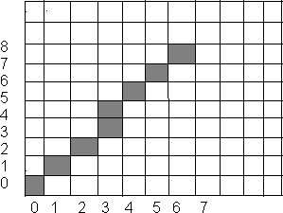
Results of DDA algorithm

Slide 13
Drawbacks
Although fast, accumulation of round of error may drift the long line segments
Rounding off is time consuming

Slide 14
Bresenham’s line drawing Algorithm
It determines which points in an n-dimensional raster should be plotted to form approximate straight line between two points.
It chooses the integer y corresponding to the pixel center that is closest to the ideal (fractional) y for the same x; on successive columns y can remain the same or increase by 1.
Depends upon the slope of the line.

Slide 15
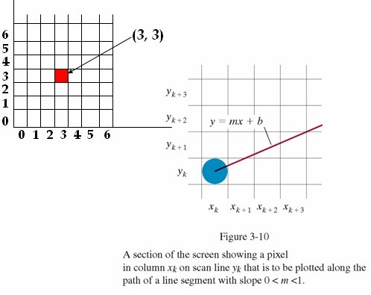

Slide 16
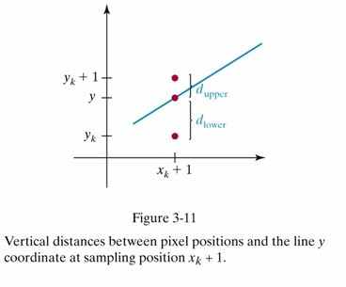

Slide 17

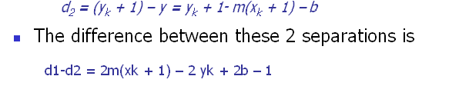
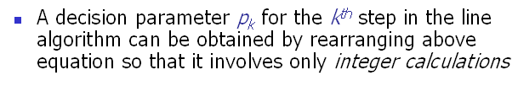

Slide 18
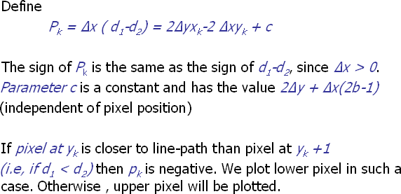

Slide 19
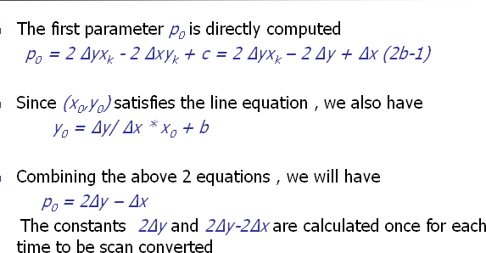

Slide 20
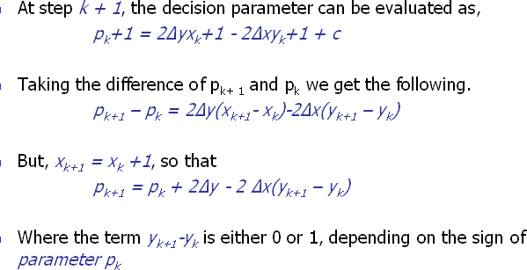

Slide 21



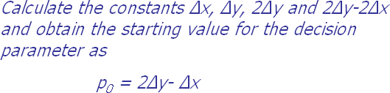

Slide 22



Slide 23
Generalized algorithm for all quadrants
Initialize variable x=x₁
y=y₁ dx=abs(x₂-x₁) dy=abs (y₂-y₁)
S_{x} =Sign (x₂-x₁) S_{y} = Sign (y₂-y₁)
Determine the length of the line

Slide 24
if dy > dx then,
t = dx dx = dy dy = t
steps = dy flag = 1
else
steps = dx flag = 0
endif

Slide 25
P_{k} = 2dy-dx
setpixel (x,y) for i=1 to steps
while (P _{k} =>0)
y = y+1
x = x + S _{x}
P _{k} = P _{k}+2dy- 2dx
endwhile
25

Slide 26
If flag = 1 then y = y +1
x = x else
x = x + Sx y= y
endif
Pk = Pk + 2dy Setpixel (x,y) next i
finish

Slide 27
Use Bresenham’s algorithm to rasterize a line from (0,0) to (6,7)
Initializations (x_{1,}y₁)=(0,0); (x_{2,}y₂)=(6,7)
x = 0
y = 0
dx=abs(6-0)= 6
dy=abs (7-0) =7
S_{x} =Sign (x₂-x₁)= +1
S_{y} = Sign (y₂-y₁) = +1
steps (length of the line) = 7 flag = 1, dx = 7, dy = 6, P_{k} =5

Slide 28
Plotting begins
i | Setpixel (x,y) | P_{k} | x | y
 | (0,0)
1 | (1,1) | 5 | 1 | 1
2 | (2,2) | 3 | 2 | 2
3 | (3,3) | 1 | 3 | 3
4 | (3,4) | -1 | 3 | 4
5 | (4,5) | 11 | 4 | 5
6 | (5,6) | 9 | 5 | 6
7 | (6,7) | 7 | 6 | 7

Slide 29
Results of algorithm

Slide 30
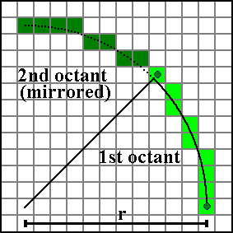
Bresenhem Circle drawing Algorithm
Algorithm for 1st octant only

Slide 31
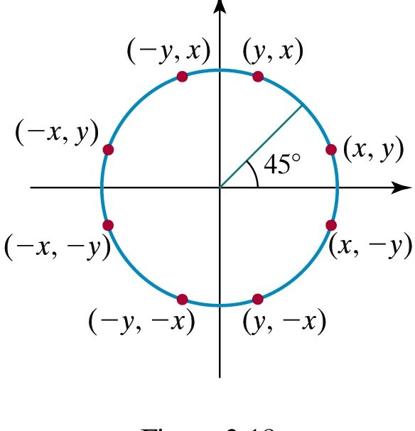

Slide 32
Properties of a circle:
A circle is defined as a set of points that are all the given distance (x_{c},y_{c}).
This distance relationship is expressed by the Pythagorean theorem in Cartesian coordinates as
(x – x_{c})² + (y – y_{c}) ² = r²

Slide 33
Midpoint Circle Algorithm
We will first calculate pixel positions for a circle centered around the origin (0,0).
Then, each calculated position (x,y) is moved to its proper screen position by adding xc to x and yc to y
Note that along the circle section from x=0 to x=y in the first octant, the slope of the curve varies from 0 to -1
Circle function around the origin is given by fcircle(x,y) = x² + y² – r²
Any point (x,y) on the boundary of the circle satisfies the equation and circle function is zero

Slide 34
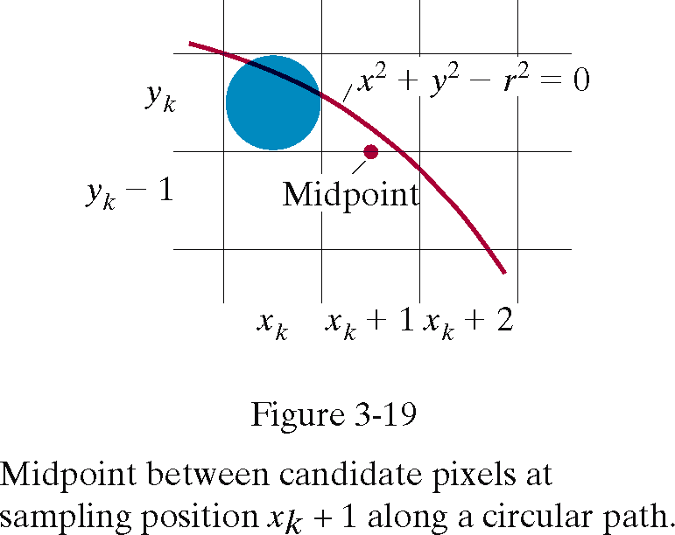

Slide 35
For a point in the interior of the circle, the circle function is negative and for a point outside the circle, the function is positive
Thus,
fcircle(x,y) < 0 if (x,y) is inside the circle boundary
fcircle(x,y) = 0 if (x,y) is on the circle boundary
fcircle(x,y) > 0 if (x,y) is outside the circle boundary

Slide 36
Midpoint circle algorithm
Input the origin as centre (x₀, y₀) = (0,r)
Decision parameter p₀=5/4 - r 3.If p_{k}<0 then (x_{k}+1, y_{k})
p_{k+1}= p_{k}+ 2x_{k+1} +1 else (x_{k}+1, y_{k}-1)
p_{k+1}= p_{k}+ 2x_{k+1} + 1- 2y_{k-1}
where 2x_{k+1}= 2x_{k}+2 and 2y_{k-1}=2 y_{k} – 2
Determine symmetry points on seven octants
Move the pixels x=x+ x_{c}, y=y+y_{c}
Repeat the steps till x>=y

Slide 37
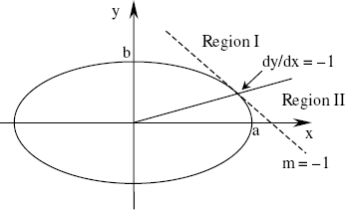
Midpoint ellipse algorithm
One quarter of an ellipse is divided into two regions. In region I, the slope on the curve is greater than –1 while in region II less than –1.
Equation of an ellipse, b²x² + a²y² – a²b² = 0 where a = horizontal radius b = vertical radius,
Set f(x,y) = b²x² + a²y² – a²b²

Slide 38
First point in ellipse centered on origin is (x₀,y₀)= (0,b)
Initial value of decision parameter P₀= f(1, b-1/2)

Slide 39
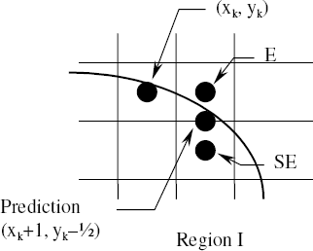
In region I (dy/dx > –1),
(x_{k}, y_{k}), Prediction- (x_{k}+1, y_{k}–½)
SE or E

Slide 40
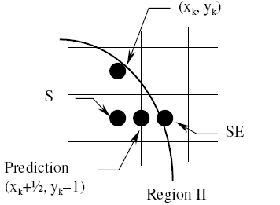
In region II (dy/dx < –1), all calculations are similar to that in region I except that y is
decremented in each step. Prediction-(x_{k}+½, y_{k}–1)
SE or S

Slide 41
When 2b²x>=2a²y
Move from region 1 to region 2 Decision parameter in region 1 P_{1k}= f(x_{k}+1, y_{k}-1/2)
Decision parameter in region 2 P_{2k}= f(x_{k}+1/2, y_{k}-1)

Slide 42
Midpoint Ellipse Algorithm
Initial point = (0,b)
Decision parameter in Region 1 P1₀=b²-a²b+a²/4
If P1₀<0, next point (x_{k+1}, y_{k}) P1_{k+1}= P1_{k}+2b²x_{k+1}+b²
If P1₀>=0, next point (x_{k+1}, y_{k}-1) P1_{k+1}= P1_{k}+2b²x_{k+1} + b² -2a²y_{k+1}

Slide 43
Repeat till 2b²x<2a²y
Last point of region 1 is the initial point for region 2
Decision parameter for region 2 P2₀= b² (x₀+1/2)²+ a² (y₀-1)²- a²b²
If P2_{k}>0 next point (x_{k}, y_{k}-1) P2_{k+1}= P2_{k}- 2a²y_{k+1}+a²
If P2_{k}<=0 next point (x_{k}+1, y_{k}-1) P2_{k+1}= P2_{k}- 2a²y_{k+1}+ a² + 2b²x_{k+1}
pIot the coordinates x=x+ x_{c}, y=y+y_{c}
46

Slide 44
a=7, b=3, centre (5,-3)
Let (x₀,y₀)= (0,3), 2a²=98, 2b²=18
Pk
^{X}k+1 ^{Y}k+1
2b²x_{k+1} 2a²y_{k+1}
-125.75 | 1 | 3 | 18 | 294 | 2b²x<2a²y
-98.75 | 2 | 3 | 36 | 294 | 2b²x<2a²y
-53.75 | 3 | 3 | 54 | 294 | 2b²x<2a²y
9.25 | 4 | 2 | 72 | 196 | 2b²x<2a²y

Slide 45
2a²y_{k+1}
Pk
^{X}k+1
^{Y}k+1
2b²x_{k+1}
-105.75 | 5 | 2 | 90 | 196 | 2b²x<2a²y
-6.75 | 6 | 2 | 108 | 196 | 2b²x<2a²y
110.25 | 7 | 1 | 126 | 98 | 2b²x>2a²y
65.25 | 7 | 0

Slide 46
Plotting pixels
x | y | Actual x | Actual y
0 | 3 | 5 | 0
1 | 3 | 6 | 0
2 | 3 | 7 | 0
3 | 3 | 8 | 0
4 | 2 | 9 | -1
5 | 2 | 10 | -1
6 | 2 | 11 | -1
7 | 1 | 12 | -2
7 | 0 | 12 | -3
49

Slide 47
Plot
1
0
-1
-2
-3
-4
-5
-6
-7
-4 -3 -2 -1 0 1 2 3 4 5 6 7 8 9 10 11 12
50

Slide 48
Ellipse a=6, b=4 centre (-2,7) Let (x₀,y₀)= (0,4), 2a²=72, 2b²=32
^{Pk X}k+1 ^{Y}k+1 ^{2b2x}k+1
2a²y_{k+1}
-119 | 1 | 4 | 32 | 288 | 2b²x<2a²y
-71 | 2 | 4 | 64 | 288 | 2b²x<2a²y
9 | 3 | 3 | 96 | 216 | 2b²x<2a²y
-95 | 4 | 3 | 128 | 216 | 2b²x<2a²y

Slide 49
2a²y_{k+1}
Pk
^{X}k+1
^{Y}k+1
2b²x_{k+1}
49 | 5 | 2 | 160 | 144 | 2b²x>2a²y
-56 | 6 | 1 | 192 | 72 | 2b²x>2a²y
100 | 6 | 0

Slide 50
Pixels
x | y | Actual x | Actual y
0 | 4 | -2 | 11
1 | 4 | -1 | 11
2 | 4 | 0 | 11
3 | 3 | 1 | 10
4 | 3 | 2 | 10
5 | 2 | 3 | 9
6 | 1 | 4 | 8
6 | 0 | 4 | 7

Slide 51
12
11
10
9
8
7
6
5
4
3
2
1
-10
-9 -8 -7 -6 -5 -4 -3 -2 -1 0 1 2 3 4 5
6
54

Slide 52
a=8, b=6 centre (7,-3) 2a²=128, 2b²= 72 (x₀,y₀)=(0,6)
P_{k}
2b²x_{k+1} 2a²y_{k+1}
Check
< 2a²y
^{X}k+1 ^{Y}k+1
(region 1) |  |  |  |  | 2b²x
-332 | 1 | 6 | 72 | 768 | Yes
-224 | 2 | 6 | 144 | 768 | yes
-44 | 3 | 6 | 216 | 768 | Yes
208 | 4 | 5 | 288 | 640 | Yes
-108 | 5 | 5 | 360 | 640 | Yes
288 | 6 | 4 | 432 | 512 | Yes
244 | 7 | 3 | 504 | 384 | no
55

Slide 53
Check
P_{k}
^{X}k+1
^{Y}k+1
2b²x_{k+1}
2a²y_{k+1}
(regio |  |  |  |  | 2b²x < 2a²y
n 1)
-151 | 8 | 2 | 576 | 256 | no
233 | 8 | 1 | 576 | 128 | no
745 | 8 | 0 |  |  |  | 56

Slide 54
(xc,yc)= (-3,-1) Actual x= x+ xc Actual y=y+yc
x | y | Actual x | Actual y
1 | 6 | -2 | 5
2 | 6 | -1 | 5
3 | 6 | 0 | 5
4 | 5 | 1 | 4
5 | 5 | 2 | 4
6 | 4 | 3 | 3
7 | 3 | 4 | 2
8 | 2 | 5 | 1
8 | 1 | 5 | 0
8 | 0 | 5 | -1
57

Slide 55
5
4
3
2
1
0
-1
-2
-3
-4
-5
-6
-7
58

Slide 56
Filled area primitives
In graphics packages this is referred to as filled polygons.
Scan line fill algorithm
Boundary fill or flood fill algorithm.

Slide 57
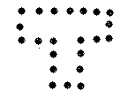

Polygon filling
Region filling is a process of ‘colouring in’ a defined area.
Classified as-
Boundary defined:-defined in terms of bounding pixels that outline it
Interior defined region:-defined in terms of pixels which it comprises of

Slide 58
Scan line algorithm
A scan line intersects a polygon at one or more points.
For each scan line crossing a polygon, algorithm locates the intersection points of the scan line with the polygon edges.
Intersection is considered in pairs.
For interval between the pair of intersection, colour is that of background.

Slide 59
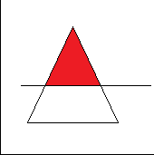

Slide 60
It starts with the closed polygon with defined interior and exterior regions.
Colour of interior and vertices of the polygon to be filled are known.
Scan line moves downwards from top to bottom.

Slide 61
For regular geometric figures, such as squares or rectangles, edges are well defined.
Area can be filled directly by edge detection.
Some polygons may requires special handling hen there are more than one intersection along the scan line.

Slide 62
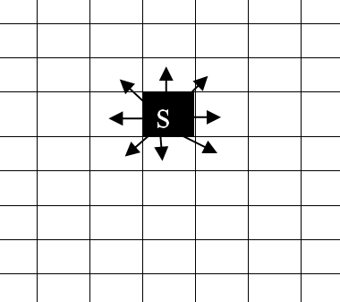
Flood Fill algorithm

Slide 63
In flood fill algorithm user provides a seed pixel
Starting from the seed pixel, algorithm will inspect each of the surrounding pixel to determine the extent of reach.
Process is repeated until all pixels inside the region are inspected

Slide 64
The seed pixel progresses recursively towards the boundary.
If it encounters the boundary the chain terminates.
The seed pixel enlarges to fill the area within the boundary.
The enlargement of area and examining of neighbouring pixels can progress in two ways:

Slide 65
Firstly to the four connected pixels, adjacent to it like right , left, bottom and top.
Secondly through eight connected pixels including diagonal pixels.
First way may fail to fill the complete area.
Eight connected pixel is preferred.
A curve or a circle leaves several diagonal pasages which prevents the application of boundary filling algorithm.

Slide 66
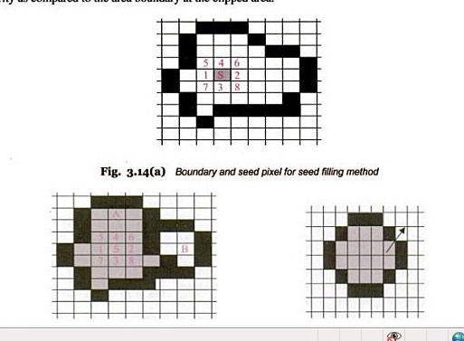

Slide 67
Scan line seed fill algorithm
In seed fill algorithm, the stack size is very large.
The duplicate pixels make the process slow.
SLSF algorithm minimizes the duplicate pixels.
Algorithm processes in raster pattern, along left to right in each scan line.

Slide 68
Flow of Algorithm
A seed pixel located on the scan line is selected.
The line or span containing the seed pixel is filled from left to right
including the seed pixel itself until the boundary is found.
The extreme left and extreme right unprocessed pixel in the span are saved.
The scan lines above and below the current scan line are examined in the range of x-right and x-left.

