Slide 1
Area fill algorithms for various graphics primitives

Slide 2
Polygon Filling Algorithms
1.Scan line Fill Algorithm 2.Boundary Fill Algorithm 3.Flood Fill Algorithm

Slide 3
Polygon Filling
Types of filling
Solid-fill
All the pixels inside the polygon’s boundary are illuminated.
Pattern-fill
the polygon is filled with an arbitrary predefined pattern.

Slide 4
Polygon Representation
The polygon can be represented by listing its n vertices in an ordered list.
P = {(x₁, y₁), (x₂, y₂), ……., (x_{n}, y_{n})}.
The polygon can be displayed by drawing a line between (x₁, y₁), and (x₂, y₂), then a line between (x₂, y₂), and (x₃, y₃), and so on until the end vertex.
In order to close up the polygon, a line between (x_{n}, y_{n}), and (x₁, y₁) must be drawn.
One problem with this representation is that if we wish to translate the polygon, it is necessary to apply the translation transformation to each vertex in

Slide 5
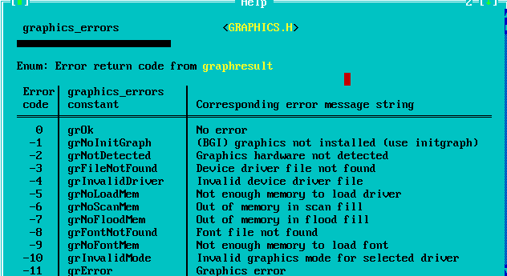
C graphic program to demonstrate drawpoly function
#include <graphics.h> #include <stdio.h>
int main( )
{
int gd=DETECT, gm;
int points[]={150,130,350,130,350,400,250,400,150,130};
initgraph(&gd,&gm,"C:\\tc\\bgi");
// read result of initialization
// graphresult return error code of graphics
errorcode=graphresult( );
if( errorcode!=grOk ) // grOk is graphics error constant
{// an error has now been occurred
// grapherrormsg return address of error message string printf(“graphics error:%s”,grapherrormsg(errorcode)); printf(“press any key to halt:”);
getch();
// terminate with error code exit(1);
}
drawpoly(5,points);
getch(); closegraph(); return 0;
}

Slide 6
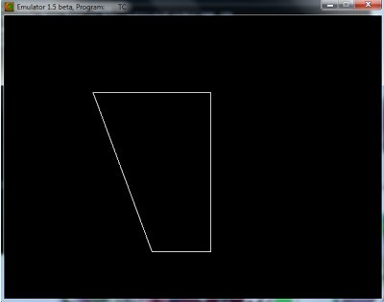

Slide 7
Types of Polygons: Convex and Concave
Convex Polygon - For any two points P₁, P₂ inside the polygon, all points on the line segment which connects P₁ and P₂ are inside the polygon.
Concave Polygon
- A polygon which is not convex.
Convex Polygon
Concave Polygon
?
Larry Hodges, Zachary Wartell

Slide 8
Inside-Outside Tests
when filling polygons we should decide whether a particular point is interior or exterior to a polygon.
A rule called the odd-parity (or the odd-even rule) is applied to test whether a point is interior or not.
To apply this rule, we conceptually draw a line starting from the particular point and extending to a distance point outside the coordinate extends of the object in any direction such that no polygon vertex intersects with the line.

Slide 9
Inside-Outside Tests (Even – odd method)
The point is considered to be interior if the number of intersections between the line and the polygon edges is odd. Otherwise, The point is exterior point.
Outside
8
7
6
5
4
3
2
1
0
0 1 2 3 4 5 6 7 8 9 10 11
Inside

Slide 10
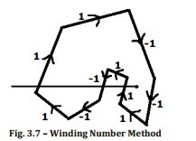
WINDING NUMBER METHOD FOR INSIDE OUT SIDE TEST
If the winding number is nonzero
then
P is defined to be an interior point
Else
P is taken to be an exterior point.
Sum of edge is nonzero means Inside the polygon
Sum of edge is zero means outside the polygon

Slide 11
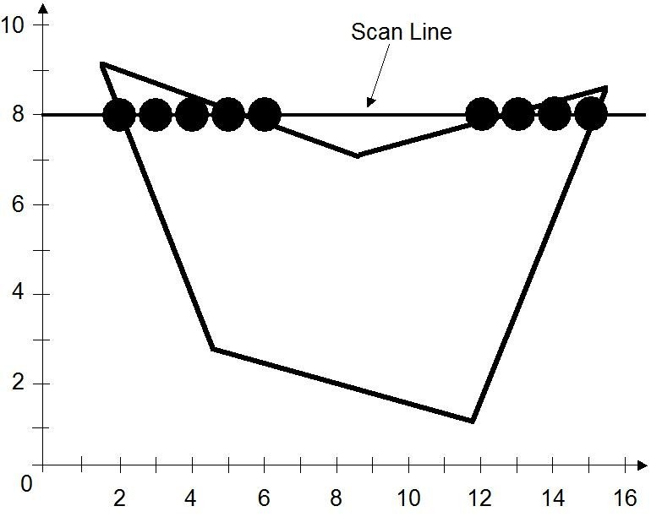
The Scan-Line Polygon Fill Algorithm
The scan-line polygon-filling algorithm involves
The horizontal scanning of the polygon from its
lowermost to its topmost vertex,
Identifying which edges intersect the scan-line, and finally drawing the interior horizontal lines with the specified fill color.

Slide 12
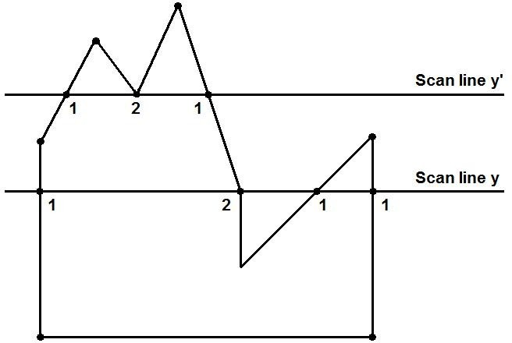
The Scan-Line Polygon Fill Algorithm
Dealing with vertices
Odd Intersection Color Filling Start
Even Intersection Color Filling Stop
Student Please make correction, Here please count number of intersection 1.

Slide 13
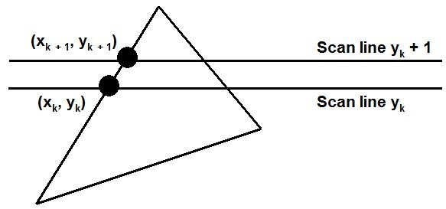
The Scan-Line Polygon Fill Algorithm
Determining Edge Intersections
m = (y_{k+1} – y_{k}) / (x_{k+1} – x_{k})
y_{k+1} – y_{k} = 1 x_{k+1} = x_{k} + 1/m

Slide 14
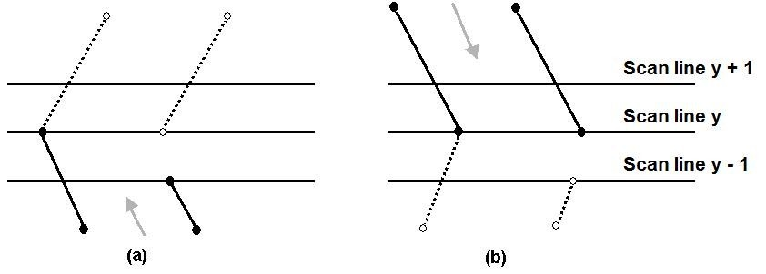
The Scan-Line Polygon Fill Algorithm
Dealing with vertices
When the endpoint y coordinates of the two edges are increasing, the y value of the upper endpoint for the current edge is decreased by one (a)
When the endpoint y values are decreasing, the y value of the next edge is decreased by one (b)

Slide 15
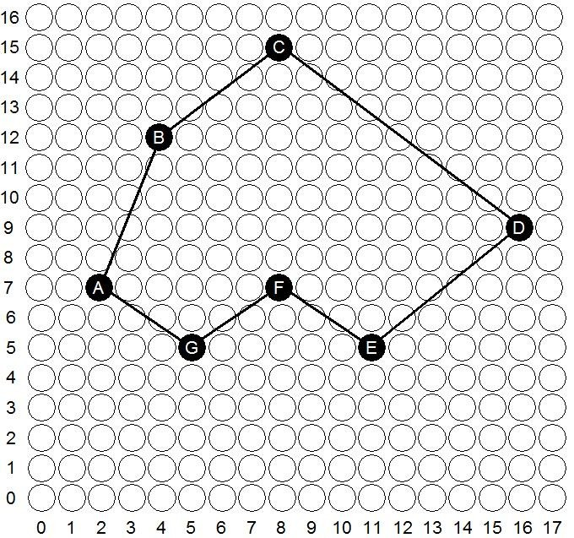
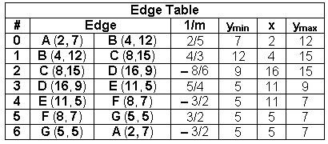
The Scan-Line Polygon Fill Algorithm
(Example) Polygon = {A, B, C, D, E, F, G}
Polygon = {(2, 7), (4, 12), (8,15), (16, 9), (11, 5), (8, 7), (5, 5)}
Here x represents in above table x coordinate of polygon edge where first intersection of scan line on vertex of polygon will occur.

Slide 16
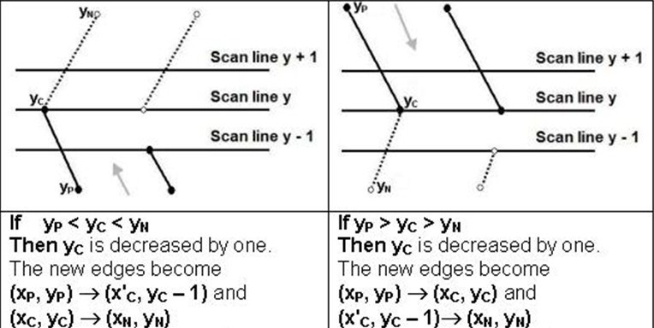
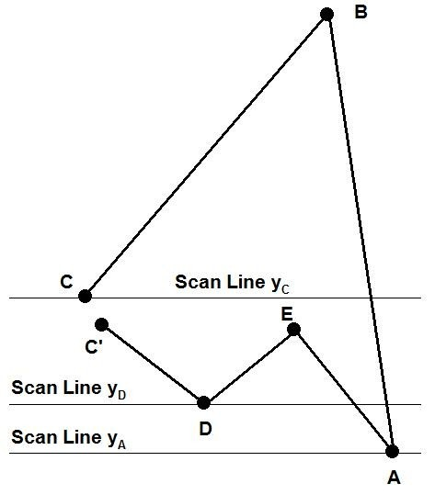
The Scan-Line Polygon Fill Algorithm
(Example)

Slide 17
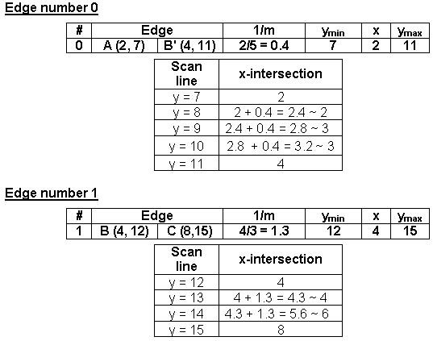
The Scan-Line Polygon Fill Algorithm
(Example)

Slide 18
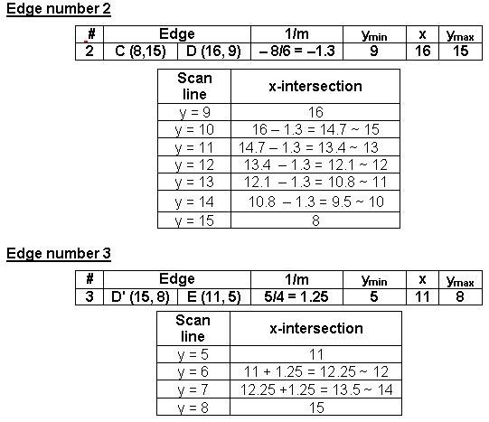
The Scan-Line Polygon Fill Algorithm
(Example)

Slide 19
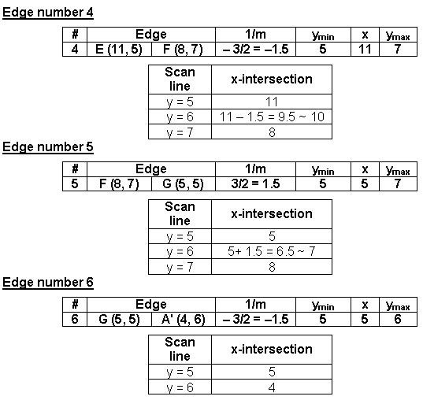
The Scan-Line Polygon Fill Algorithm
(Example)
Correction: A’(3,6)

Slide 20
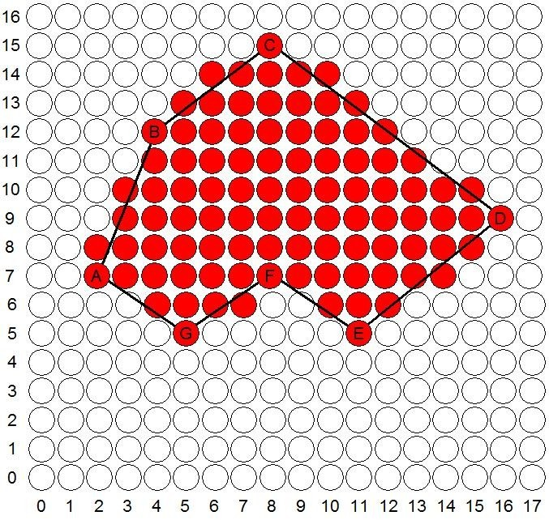
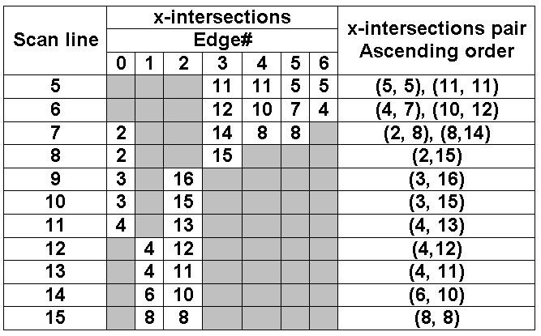
The Scan-Line Polygon Fill Algorithm
(Example)
Edge no-0

Slide 21
Edge Table
-sort vertices by y coordinate building Edge Table (ET)
ET
Not needed Because Intersection over D and C gives Even intersection points.
^{D} C
^{y}max
^{y}D,C
F
GF
T5
y_{G}
y_{E}
y_{B}
G
T6
T4
EF
ED
E
T3
BC
B
H
T2
y_{H} y_{A}
HG
T1
AH AB
A
Z^{y}ac⁼hary Wartell

Slide 22
Scan AET with AEL
-scan up through ET and track Active Edge Table (AET). At each scan-line fill in span of pixel for each edge pair.
ET
AET
k
^{y}max
(k = 1..10)
D
C
[(DE,BC)]
[(GF,EF),
(DE,BC)]
[(HG,EF),
F
GF
T5
y_{G}
y_{E}
y_{B}
G
T6
T4
EF
ED
(DE,BC)]
E
T3
[(HG,BC)]
BC
B
H
[(HG,AB)]
[(AH,AB)]
T2
y_{H}
HG
T1
y
AH
AB
A
A
y=0

Slide 23
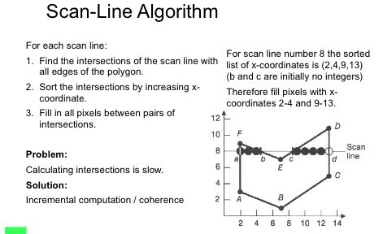

Slide 24
Boundary Fill Algorithm
Another approach to area filling is to start at a point inside a region and paint the interior outward toward the boundary.
If the boundary is specified in a single color, the fill algorithm processed outward pixel by pixel until the boundary color is encountered.
A boundary-fill procedure accepts as input the coordinate of the interior point (x, y), a fill color, and a boundary color.

Slide 25
Boundary Fill Algorithm
The following steps illustrate the
recursive boundary-fill algorithm:
idea of the
Start from an interior point.
If the current pixel is not already filled and if it is not an edge point, then set the pixel with the fill color, and store its neighboring pixels (4 or 8- connected) in the stack for processing. Store only neighboring pixel that is not already filled and is not an edge point.
Select the next pixel from the stack, and continue with step 2.

Slide 26
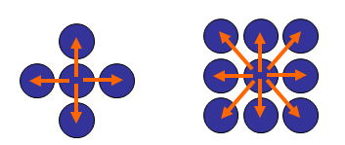
Boundary Fill Algorithm
The order of pixels that should be added to stack using 4-connected is above, below, left, and right. For 8-connected is above, below, left, right, above- left, above-right, below-left, and below-right.

Slide 27
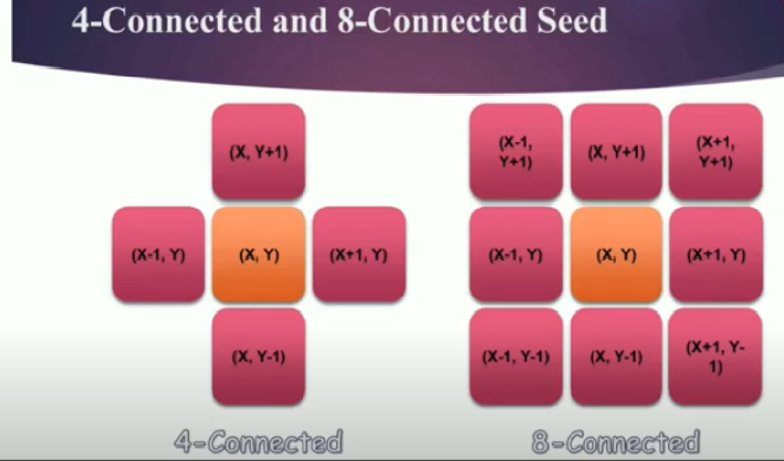

Slide 28
Boundary Fill Algorithm
4-connected (Example)
Start Position

Slide 29
Boundary Fill Algorithm
4-connected (Example)
3
2
1
1
2
3

Slide 30
Boundary Fill Algorithm
4-connected (Example)
4
2
1
1 4
2

Slide 31
Boundary Fill Algorithm
4-connected (Example)
2
1
1
2

Slide 32
Boundary Fill Algorithm
4-connected (Example)
5
1
5 1

Slide 33
Boundary Fill Algorithm
4-connected (Example)
1
1

Slide 34
Boundary Fill Algorithm
4-connected (Example)

Slide 35
Boundary Fill Algorithm
8-connected (Example)
Start Position

Slide 36
Boundary Fill Algorithm
8-connected (Example)
4 1 5
2 3
5
4
3
2
1

Slide 37
Boundary Fill Algorithm
8-connected (Example)
6
4 1
2
6
4
3
2
1
3

Slide 38
Boundary Fill Algorithm
8-connected (Example)
7 8
8
7
4
3
2
1
4 1
2
3

Slide 39
Boundary Fill Algorithm
8-connected (Example)
12
11
10
9
7
4
3
2
1
11 9 12
7 10
4 1
2
3

Slide 40
Boundary Fill Algorithm
8-connected (Example)
11 9
7
11
10
9
7
4
3
2
1
10
4 1
2
3

Slide 41
Boundary Fill Algorithm
8-connected (Example)
9
7
10
10
9
7
4
3
2
1
4 1
2
3

Slide 42
Boundary Fill Algorithm
8-connected (Example)
9
7
9
7
4
3
2
1
4 1
2
3

Slide 43
Boundary Fill Algorithm
8-connected (Example)
7
4 1
2
7
4
3
2
1
3

Slide 44
Boundary Fill Algorithm
8-connected (Example)
4 1
2
3
4
3
2
1

Slide 45
Boundary Fill Algorithm
8-connected (Example)
1
2
3
3
2
1

Slide 46
Boundary Fill Algorithm
8-connected (Example)
1
2
2
1

Slide 47
Boundary Fill Algorithm
8-connected (Example)
1
1

Slide 48
Boundary Fill Algorithm
8-connected (Example)

Slide 49
Boundary Fill Algorithm
In boundary fill algorithm we start from a seed pixel and start fill the color until boundary color does not encountered. In this algorithm if color of seed pixel is already fill color then we have to make this pixel as background color and then start fill color.
Functions used in this algorithm
Getpixel( )- This function is used to fetch color of a pixel on the screen.
Putpixel( ) – To give color on a particular pixel.

Slide 50
Boundary Fill Algorithm (Code)
void boundaryFill(int x, int y,
int fillColor, int borderColor)
{
getPixel(x, y, color);
if ((color != borderColor)
&& (color != fillColor)) { putpixel(x,y, RED); boundaryFill(x+1,y,fillColor,borderColor); boundaryFill(x-1,y,fillColor,borderColor); boundaryFill(x,y+1,fillColor,borderColor); boundaryFill(x,y-1,fillColor,borderColor);
}
}
49

Slide 51
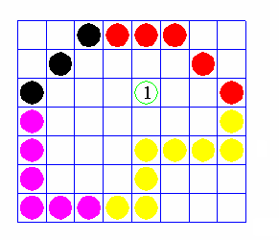
Flood Fill Algorithm
Sometimes we want to fill in (recolor) an area that is not defined within a single color boundary.
We paint such areas by replacing a specified interior color instead of searching for a boundary color value.
This approach is called a flood-fill algorithm.

Slide 52
Flood Fill Algorithm
We start from a specified interior pixel (x, y) and reassign all pixel values that are currently set to a given interior color with the desired fill color.
If the area has more than one interior color, we can first reassign pixel values so that all interior pixels have the same color.
Using either 4-connected or 8-connected approach, we then step through pixel positions until all interior pixels have been repainted.
In this algorithm we match color of a pixel with background color of the object. We stop color fill until we does not find a pixel where color is not same as background color.

Slide 53
Flood Fill Algorithm (Code)
void floodFill(int x, int y,
int fillColor, int oldColor)
{
if (getpixel(x,y) == oldColor)
{
putpixel(x,y, RED);
floodFill(x+1, y, fillColor, oldColor); floodFill(x-1, y, fillColor, oldColor); floodFill(x, y+1, fillColor, oldColor); floodFill(x, y-1, fillColor, oldColor);
}
}
52

