Slide 1



2D Geometric Transformations
Topic – I : Basic Transformation

Slide 2

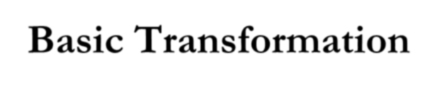















Basic Transformation
We can reposition and resize two-dimensional objects by applying :
Translation
Rotation
– Scaling

Slide 3

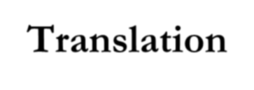
























Translation
A translation is applied to an object by repositioning it along a straight-line path from one coordinate location to another.
To translate a two-dimensional point by adding translation distances, t_{x} and t_{y}, to the original coordinate position (x, y) to move the point to a new position (x', y').
x' = x + t_{x}, y' = y + t_{y}
pair (t_{x}, t_{y}) is translation vector or shift vector.

Slide 4

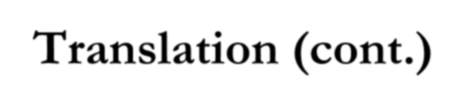









Translation (cont.)
We can express the translation equations as a single matrix equation by using column vectors to represent coordinate positions and the translation vector :
Y
P'
T
P
X
_{T = ⎡}tx ⎤
P = ^{⎡x⎤}, P' = ^{⎡x'⎤}
⎢_{y}⎥ ⎢_{y'}⎥
⎢ ⎥
⎣ ⎦
⎣ ⎦
ty
⎣ ⎦
Also: P' = P + T

Slide 5

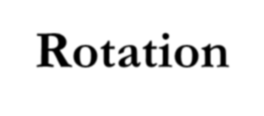


























Rotation
A two-dimension rotation is applied to an object by repositioning it along a circular path in the xy plane.
To generate a rotation, we specify a rotation angle θ and the position (x_{r}, y_{r}) of the rotation point (or pivot point) about which the object is to be rotated.
Positive values for the rotation angle define counterclockwise rotations about the pivot point.
Negative values rotate objects in the clock direction.

Slide 6

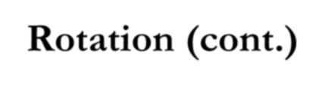















Rotation (cont.)
The original coordinates of the point in polar coordinates are :
x = r cos φ, y = r sin φ
We can express the transformed coordinates in terms of angles θ and φ as:
x' = r cos (φ + θ) = r cos φ cos θ - r sin φ sin θ y' = r cos (φ + θ) = r cos φ sin θ + r sin φ cos θ
Then
x' = x cos θ - y sin θ;
y' = x sin θ + y cos θ
^{(OR)} ⎡cos θ −sin θ⎤
P' = R * P, where
^{R = ⎢}sin θ cos θ ⎥
⎣ ⎦

Slide 7
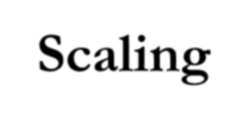















Scaling
A scaling transformation alters the size of an objects.
This operation can be carried out for polygons by multiplying the coordinate values (x, y) of each vertex by scaling factors s_{x} and s_{y} to produce the transformed coordinates (x', y'):
x' = x * s_{x}, y' = y * s_{y}
Scaling factor s_{x} scales objects in the x direction, and s_{y} in the y direction.

Slide 8

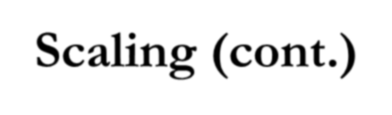



















Scaling (cont.)
Any positive numeric values can assigned to the scaling factor s_{x} and s_{y}.
Values <1, reduce the size of object.
Values >1, enlarge the size of object.
Both values =1, unchanged size.
When s_{x} and s_{y} are assigned the same value, it is uniform scaling.
Unequal values for s_{x} and s_{y} is,
differential scaling.

Slide 9
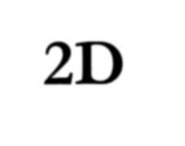
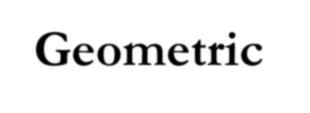
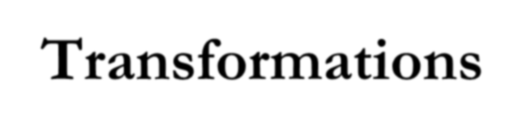



2D Geometric Transformations
Topic – II : Matrix Representation &
Homogeneous Coordinates

Slide 10
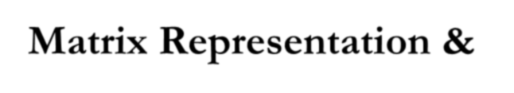
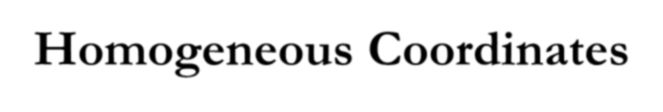





















Matrix Representation & Homogeneous Coordinates
The basic transformations can be expressed in the
general matrix form:
P' = M1 ⋅ P + M 2
With coordinate positions P and P' represented as column vector.
M₁ is a 2x2 array matrix containing multiplicative factor,
M₂ is two-element column matrix containing translational terms.
For translation, M₁ is the identity matrix.
For rotation or scaling, M₂ contains the translational terms
associated with the pivot point or scaling fixed point.

Slide 11
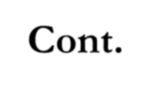








Cont.
It produce a sequence of transformations with equation, such as scaling followed by rotation then translation.
A more efficient approach would be to combine the transformations so that the final coordinate position are obtained directly from the initial coordinates. It eliminates intermediate coordinates.
We can combine the multiplicate and translational terms for 2D geometric transformations into a single matrix representation by expanding 2x2 matrix to 3x3.

Slide 12

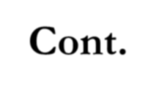
















Cont.
To express any 2D transformation as a matrix multiplication, we represent each Cartesian coordinate position (x, y) with the homogeneous coordinate triple (x_{h}, y_{h}, h).
xh yh
x =
, y =
h h
Can also be written as (h.x, h.y, h).
h to be any nonzero value.
There is infinite number of equivalent homogeneous representations for each coordinate point (x, y).
A convenient choice is simply to set h=1. then, homogeneous coordinates (x, y, 1).

Slide 13









Cont.
Expressing positions in homogeneous coordinates allow us to represent all geometric transformation equations as matrix multiplications.
Coordinates are represented with three-element column vector, and transformation operations are written as 3x3 matrices.

Slide 14

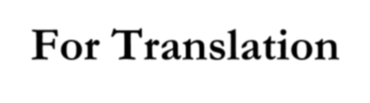







For Translation
⎡ _{x}¹ ⎤
⎡1 0 t
= ⎢0 1 t
0
⎤ ⎡ ^{x} ⎤
⎢ ⎥
x
⎥ ⎢ ⎥
_{y}1
⋅ y
⎢ ⎥
⎢
⎢_{⎣0}
^{y} ⎥ ⎢ ⎥
⎢_{⎣ 1} ⎥⎦
₁ ⎥⎦ ⎢_{⎣1}⎥⎦
Λ (OR)Λ
P' = T (t_{x} , t_{y} ) ⋅ P
The inverse of the translation matrix is obtained by replacing the translation parameters t_{x} and t_{y} with –t_{x} and –t_{y}.

Slide 15

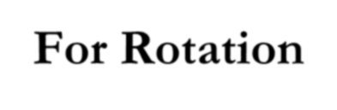






For Rotation
⎡ _{x}¹ ⎤
⎡cosθ − sin θ
cosθ 0
⁰⎤ ⎡ ^{x}⎤
⎢ y^{1 ⎥} = ⎢sin θ
₀⎥ ⋅⎢ _{y}⎥
⎢ ⎥
⎢_{⎣ 1} ⎥⎦
⎢
⎢⎣
⎥ ⎢ ⎥
₁⎥⎦ ⎢_{⎣1}⎥⎦
0
Λ (OR)Λ
P' = R(θ ) ⋅ P
The inverse of the rotation matrix θ is replaced by – θ.

Slide 16

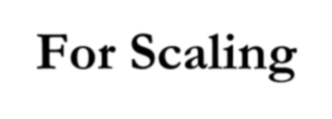




For Scaling
⎡ _{x}¹ ⎤
⎡s
0
⁰⎤ ⎡ ^{x} ⎤
⎢ ⎥
x
⎥ ⎢ ⎥
_{y}1 ⎢
= 0 s 0 ⋅ y
⎢ ⎥
⎢
⎢_{⎣ 0 1}⎥⎦ ⎢_{⎣1}⎥⎦
y
⎥ ⎢ ⎥
⎢_{⎣ 1} ⎥⎦
0
Λ (OR)Λ
P' = S (s_{x} , s_{y} ) ⋅ P
The inverse scaling matrix is replacing s_{x} and s_{y} by 1/s_{x} and 1/s_{y}.

