Slide 1


Computer Graphics

Slide 2

Geometric Transformations

Slide 3
Geometric Transformations
Basic transformations:
Translation
Scaling
Rotation
Purposes:
To move the position of objects
To alter the shape / size of objects
To change the orientation of objects

Slide 4
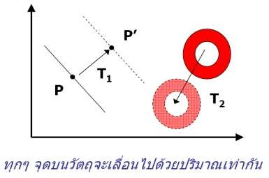
Basic two-dimensional geometric transformations (1/1)
Two-Dimensional translation
One of rigid-body transformation, which move objects without deformation
Translate an object by Adding offsets to coordinates to generate new coordinates positions
Set t_{x},t_{y} be the translation distance, we have
x' = x + t_{x}
y' = y + t_{y}
– In matrix format, where T is the translation vector
_{P' =} ⎡^{x'}⎤
_{P =} ⎡^{x}⎤
_{T =} ⎡^{t} _{x} ⎤
⎢_{y'}⎥
⎢_{y}⎥
⎢ ⎥
⎣ ⎦
⎣ ⎦
P'= P+T
t
⎣ ⎦
y

Slide 5
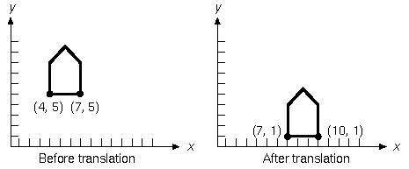
Basic two-dimensional geometric transformations (1/2)
We could translate an object by applying the equation to
every point of an object.
Because each line in an object is made up of an infinite set of points, however, this process would take an infinitely long time.
Fortunately we can translate all the points on a line by translating only the line’s endpoints and drawing a new line between the endpoints.
This figure translates the “house” by (3, -4)

Slide 6
Translation Example
y
6
5
4
(2, 3)
3
2
1
(1, 1)
(3, 1)
0
x
1
2
3
4
5
6
7
8
9
10

Slide 7
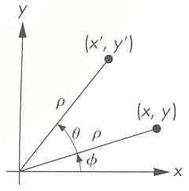
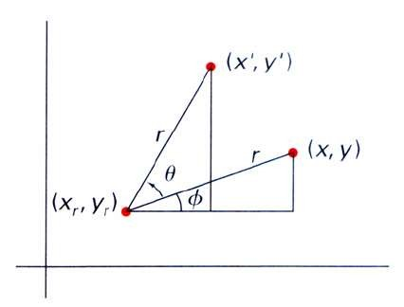
Basic two-dimensional geometric transformations (2/1)
Two-Dimensional rotation
Rotation axis and angle are specified for rotation
Convert coordinates into polar form for calculation
r
r
x = rcosφ
y = r sin φ
– Example, to rotation an object with angle a
The new position coordinates
x' = r cos(φ + θ ) = r cosφ cosθ − r sin φ sinθ = x cosθ − y sinθ
y' = r sin(φ + θ ) = r cosφ sinθ + r sin φ cosθ = x sinθ + y cosθ
In matrix format
⎡cosθ −sinθ ⎤
^{R = ⎢}sinθ cosθ ⎥
P' = R⋅P
⎣ ⎦
Rotation about a point (x_{r}, y_{r})
x' = x_{r} + (x − x_{r} ) cosθ − ( y − y_{r} ) sinθ
y' = y_{r} + (x − x_{r} ) sinθ + ( y − y_{r} ) cosθ

Slide 8
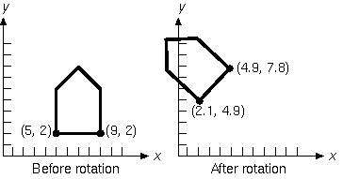
Basic two-dimensional geometric transformations (2/2)
– This figure shows the rotation of the house by 45
degrees.
y
6
5
4
3
2
1
θ = ^{π}
6
0
x
1 2 3 4 5 6 7 8 9 10
Positive angles are measured counterclockwise (from x towards y)
For negative angles, you can use the identities:
– cos(-θ) = cos(θ) and sin(-θ)=-sin(θ)

Slide 9
Rotation Example
y
6
5
4
(4, 3)
3
2
1
(3, 1)
(5, 1)
0
1
2
3
4
5
6
7
8
9
10

Slide 10
Basic two-dimensional geometric transformations (3/1)
Two-Dimensional scaling
– To alter the size of an object by multiplying the coordinates with scaling factor s_{x} and s_{y}
x' = x ⋅ s_{x}
y = y ⋅ s_{y}
– In matrix format, where S is a 2by2 scaling matrix
⎡^{x'}⎤ ₌ ^{⎡s}_{x} ^{0 ⎤} ⋅ ⎡^{x}⎤
P' = S⋅P
⎢_{y'}⎥
⎢ ₀
_{s} ⎥ ⎢_{y}⎥
⎣ ⎦
⎣
^{y} ⎦ ⎣ ⎦
– Choosing a fix point (x_{f}, y_{f}) as its centroid to perform scaling
x' = x ⋅ s_{x} + x_{f} (1− s_{x} )
y' = y ⋅ s_{y} + y_{f} (1− s_{y} )

Slide 11
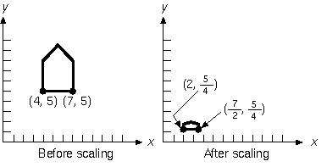
Basic two-dimensional geometric transformations (3/2)
In this figure, the house is scaled by 1/2 in x and 1/4 in y
Notice that the scaling is about the origin:
– The house is smaller and closer to the origin

Slide 12
Scaling
– If the scale factor had been greater than 1, it would be larger and farther away.
WATCH OUT: Objects grow and move!
y
6
5
4
3
⎡⁶⎤
⎡⁹⎤
⎢₃⎥
⎢₃⎥
2
⎣ ⎦
⎣ ⎦
1
⎡²⎤
⎡³⎤
⎢₁⎥
⎢₁⎥
⎣ ⎦
⎣ ⎦
0
1 2 3 4 5 6 7 8 9 10
Note: House shifts position relative to origin
x

Slide 13
Scaling Example
y
6
5
4
(2, 3)
3
2
1
(1, 1)
(3, 1)
0
1
2
3
4
5
6
7
8
9
10

Slide 14
Homogeneous Coordinates
A point (x, y) can be re-written in homogeneous coordinates as (x_{h}, y_{h}, h)
The homogeneous parameter h is a non- zero value such that:
x = ^{xh}
y = ^{yh}
h
h
We can then write any point (x, y) as (hx, hy, h)
We can conveniently choose h = 1 so that
(x, y) becomes (x, y, 1)

Slide 15
Why Homogeneous Coordinates?
Mathematicians commonly use homogeneous coordinates as they allow scaling factors to be removed from equations
We will see in a moment that all of the transformations we discussed previously can be represented as 3*3 matrices
Using homogeneous coordinates allows us use matrix multiplication to calculate transformations – extremely efficient!

Slide 16
Homogenous Coordinates
Combine the geometric transformation into a single matrix with 3by3 matrices
Expand each 2D coordinate to 3D coordinate with homogenous parameter
Two-Dimensional translation matrix
0
⎢y'⎥ = ⎢0 1
0
⎡^{x'}⎤ ⎡¹
^{t} _{x} ⎤ ⎡^{x}⎤
_{t} ⎥ ⋅ ⎢_{y}⎥
⎢ ⎥ ⎢
⎢_{⎣ 1}⎥⎦ ⎢_{⎣0}
^{y} ⎥ ⎢ ⎥
₁ ⎥⎦ ⎢_{⎣1}⎥⎦
Two-Dimensional rotation matrix
⎡^{x'}⎤ ⎡^{cosθ − cosθ}
cosθ 0
⁰⎤ ⎡^{x}⎤
⎢y'⎥ = ⎢ sinθ
₀⎥ ⋅ ⎢_{y}⎥
⎢ ⎥ ⎢
⎢_{⎣ 1}⎥⎦ ⎢⎣
⎥ ⎢ ⎥
₁⎥⎦ ⎢_{⎣1}⎥⎦
0
Two-Dimensional scaling matrix
⎡^{x'}⎤ ⎡^{s}_{x} ⁰ ⁰⎤ ⎡^{x}⎤
⎢y'⎥ = ⎢ 0 s
₀⎥ ⋅ ⎢_{y}⎥
⎢ ⎥ ⎢
⎢_{⎣ 1}⎥⎦ ⎢_{⎣ 0}
y
⎥ ⎢ ⎥
₁⎥⎦ ⎢_{⎣1}⎥⎦
0

Slide 17
Inverse transformations
Inverse translation matrix
0
T⁻¹ = ⎢0 1 − t ⎥
0
⎡¹
^{t} _{x} ⎤
⎢
⎢_{⎣0}
y ⎥
₁ ⎥⎦
Two-Dimensional ROTATION matrix
⎡ ^{cosθ sinθ 0}⎤
cosθ 0
R⁻¹ = ⎢− sinθ
₀⎥
⎢
⎢⎣
⎥
₁⎥⎦
0
Two-Dimensional SCALING matrix
⎡ ¹ ₀⎤
⎢_{s}
0
1
⎥
⎥
⎢
x
S⁻¹ = ⎢ 0
₀⎥
⎢
s_{x}
0
⎥
⎢ ₀
₁⎥
⎢
⎢⎣
⎥
⎥⎦

Slide 18
Two-dimensional composite transformation (1)
Composite transformation
A sequence of transformations
Calculate composite transformation matrix rather than
applying individual transformations
P' = M₂ ⋅ M₁ ⋅P
P' = M⋅P
Composite two-dimensional translations
Apply two successive translations, T₁ and T₂
T₁ = T (t_{x1}, t_{y1} )
T₂ = T (t_{x 2} , t_{y 2} )
P' = T₂ ⋅ (T₁ ⋅ P) = (T₂ ⋅T₁ ) ⋅ P
Composite transformation matrix in coordinate form
T (t_{x 2} , t _{y 2} ) ⋅T (t_{x1} , t_{y1} ) = T (t_{x1} + t_{x 2} , t_{y1} + t_{y 2} )

Slide 19
Two-dimensional composite transformation (2)
Composite two-dimensional rotations
– Two successive rotations, R₁ and R₂ into a point P
P' = R(θ₂ ) ⋅{R(θ₁ ) ⋅ P}
P' ={R(θ₂ ) ⋅ R(θ₁ )}⋅ P
– Multiply two rotation matrices to get composite transformation matrix
R(θ₂ ) ⋅ R(θ₁ ) = R(θ₁ +θ₂ )
P' = R(θ₁ +θ₂ ) ⋅ P
Composite two-dimensional scaling
S(s_{x1}, s_{y1} ) ⋅ S(s_{x2} , s_{y 2} ) = S(s_{x1} ⋅ s_{x2} , s_{y1} ⋅ s_{y 2} )
P' = S(s_{x1} ⋅ s_{x2} , s_{y1} ⋅ s_{y 2} ) ⋅ P

Slide 20
Two-dimensional composite transformation (3)
General two-dimensional Pivot-point rotation
Graphics package provide only origin rotation
Perform a translate-rotate-translate sequence
Translate the object to move pivot-point position to origin
Rotate the object
Translate the object back to the original position
Composite matrix in coordinates form
T(x_{r} ,y_{r} ) ⋅R(θ ) ⋅ T(−x_{r} ,−y_{r} ) = R(x_{r} ,y_{r} ,θ )

Slide 21
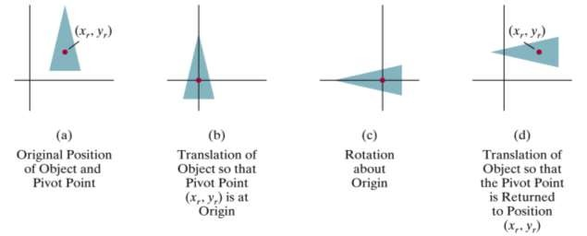
Two-dimensional composite transformation (4)
Example of pivot-point rotation

Slide 22
Pivot-Point Rotation
(x_{r},y_{r}) |  | (x_{r},y_{r}) |  | (x_{r},y_{r}) |  | (x_{r},y_{r})
Translate
Rotate
Translate
T (x_{r} , y_{r} )⋅ R(θ )⋅T (− x_{r} ,− y_{r} ) = R(x_{r} , y_{r} ,θ )
⎡1 0 x_{r ⎤ ⎡}cosθ − sinθ
1 cosθ
0 0 0
0⎤ ⎡1
0 − x_{r ⎤ ⎡}cosθ
1 − y ⎥ = ⎢sinθ
0
sinθ x_{r} (1 − cosθ ) + y_{r} sinθ ⎤
cosθ 0
⎢₀
y ⎥ ⋅ ⎢sinθ
0⎥ ⋅ ⎢0
y (1 − cosθ ) − x sinθ ⎥
⎢
⎢_{⎣0}
^{r} ⎥ ⎢
₁ ⎥⎦ ⎢⎣
⎥ ⎢
₁⎥⎦ ⎢_{⎣0}
^{r} ⎥ ⎢
₁ ⎥⎦ ⎢⎣
r r
⎥
⎥⎦
0
1

Slide 23
Two-dimensional composite transformation (5)
General two-dimensional Fixed-point scaling
Perform a translate-scaling-translate sequence
Translate the object to move fixed-point position to
origin
Scale the object wrt. the coordinate origin
Use inverse of translation in step 1 to return the object back to the original position
Composite matrix in coordinates form
T(x_{f} ,y_{f} ) ⋅ S(s_{x} ,s_{y} ) ⋅ T(−x_{f} ,−y_{f} ) = S(x_{f} ,y_{f} ,s_{x},s_{y} )

Slide 24
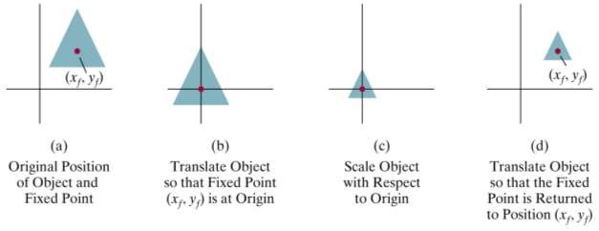
Two-dimensional composite transformation (6)
Example of fixed-point scaling

Slide 25
General Fixed-Point Scaling
(x_{r},y_{r})
(x_{r},y_{r})
(x_{r},y_{r})
(x_{r},y_{r})
Translate
Scale
Translate
T (x y )⋅ S(s , s )⋅T (− x ,− y )= S(x y , s , s )
f , f x y f f f , f x y
⎡1 0 x _{f} 0 0⎤ ⎡1 0 − x _{f ⎡}s_{x} 0 x _{f} (1 − s_{x} )⎤ 1 1 − y
0 0 0 1
⎤ ⎡^{s}_{x}
⎤
⎢₀
y
⎥ ⋅ ⎢ ₀
s 0⎥ ⋅ ⎢0
⎥ ₌ ⎢ ₀
s y (1 − s )⎥
⎢
⎢_{⎣0}
^{f} ⎥ ⎢
⎥ ⎢
₁⎥⎦ ⎢_{⎣0}
f ⎥
y
⎢
⎥⎦ ⎢_{⎣ 0}
y f y
⎥
⎥⎦
₁ ⎥⎦ ⎢_{⎣ 0}
0
1

Slide 26
Two-dimensional composite transformation (7)
General two-dimensional scaling directions
Perform a rotate-scaling-rotate sequence
Composite matrix in coordinates form
R⁻¹(θ ) ⋅ S(s ,s ) ⋅R(θ )
1 2
⎡s cos² θ + s sin² θ (s − s )cosθ sinθ
₀⎤
⎥
⎢
1 2 2 1
= (s
s )cosθ sinθ
s sin² θ + s cos² θ 0
1 2
⎢
2
1
⎥
⎢
0
0
₁⎥
⎣
⎦
s1
θ
s2

Slide 27

General Scaling Directions
Converted to a parallelogram
y
y
(1/2,3/2)
(2,2)
(0,1)
(1,1)
(3/2,1/2)
(0,0)
(1,0)
x
(0,0)
x
Scale
_{y} s
⎡s cos² θ + s sin² θ
(s − s ) cosθ sinθ
₀⎤
⎥
⎢ 1
2
2 1
2
R⁻¹ (θ ) ⋅ S(s , s ) ⋅ R(θ ) = (s − s ) cosθ sinθ
s sin² θ + s cos² θ 0
1 2
1 2
⎢
⎢⎣
2 1
⎥
0
0
₁⎥⎦
⬀ ^{xs}
1

Slide 28
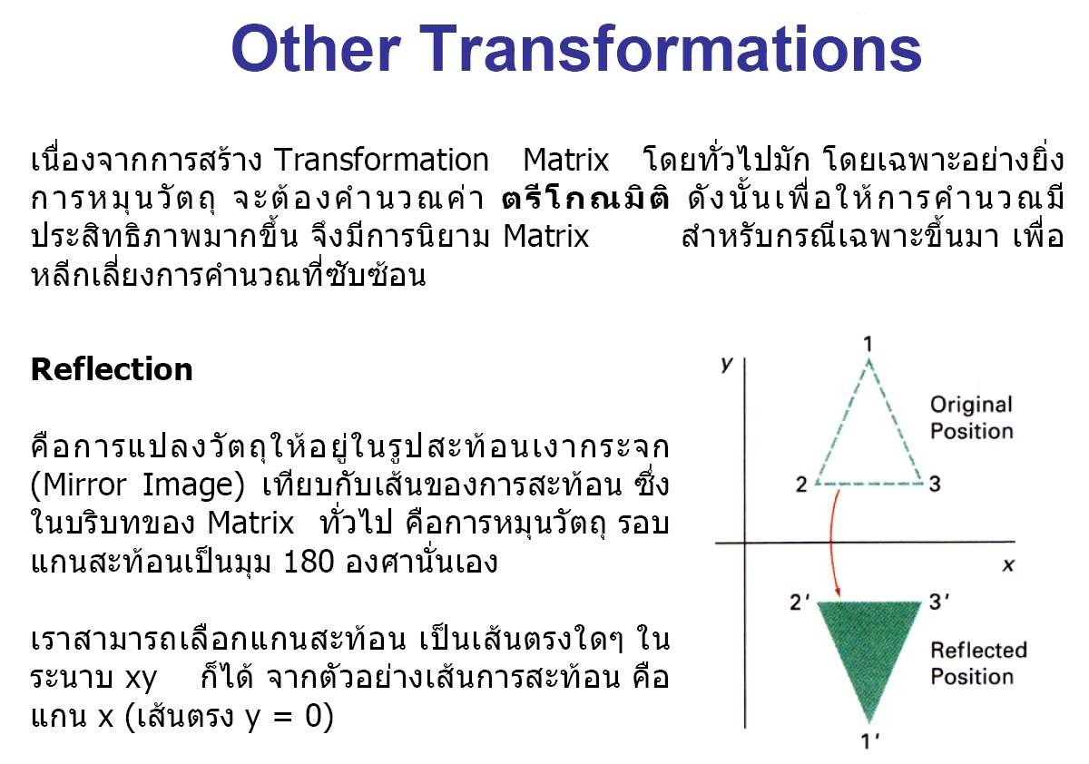
Basic transformations such as translation, rotation and scaling are include in most graphics package. Some package provide additional transformations that are useful in certain applications. Two such transformations are reflection and shear.
A reflection is a transformation that produces a
mirror image of an object.
The mirror image generated by rotating an object 180 deg about reflection axis
We can choose axis of reflection in the xy
plane or perpendicular to xy plane.

