Slide 1
Scaling And Shearing

Slide 2
Transformation
Basic Transformation
Additional Transformation
Shearing
Reflection
Translation
Rotation
Scaling
NON- RIGID BODY TRANFORMATIONS

Slide 3
Scaling
To change the size of an object, scaling transformation is used.
In the scaling process, we can either expand or compress the dimensions of the object.
Scaling can be achieved by multiplying the original coordinates of the object with the scaling factor to get the desired result.

Slide 4
Scaling
Homogenous Co-ordinates
Differential Co- ordinates
Shape Does not Changes
Size changes
Sx=Sy
Shape Does Changes
Size changes
Sx !=Sy

Slide 5
Scaling with respect to Origin
Example-
Original coordinates are (X, Y), Scaling factors are (S_{X}, S_{Y}), New coordinates are (X’, Y’)
->General Representation
X' = X . S_{X} and Y' = Y . S_{Y}
-> Matrix Representation
(X′Y′) = (XY) Sx 0
0 Sy

Slide 6
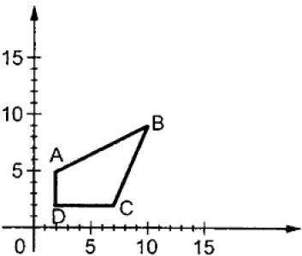
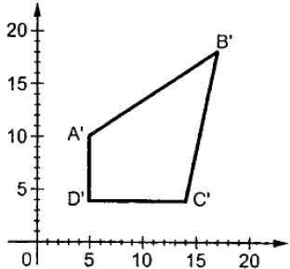
Scaling with respect to Origin
Normal Object
Object After Scaling
Scaling Factor < 1 🡪 Compress(shrink) Scaling Factor > 1 🡪 Expand (stretch) Scaling Factor = 1 🡪 No Change Scaling Factor < 0 🡪 Reflect the shape

Slide 7
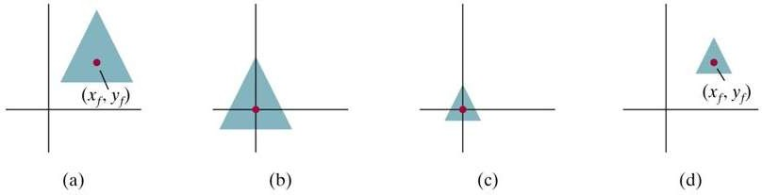
Scaling with respect to Point
STEPS-
STEP1 -> Translate to origin.
STEP2-> Scaling is done.
STEP3 -> Translate it back to that point.

Slide 8
Shearing
Shearing is also known as Skewing.
It is a transformation that slants the shape of an object.
Shearing Transformation
X- Shearing
Y- Shearing
X-Y -- Shearing

Slide 9
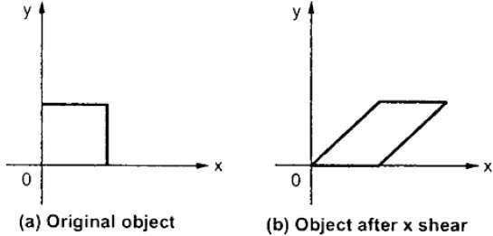
X- Shearing
X-Shear preserves the Y coordinate and changes are made to X coordinates.
X _{Sh} = 1 0
Sh_{x} 1
X’= X+ (Sh_{x} * Y)
Y’=Y

Slide 10
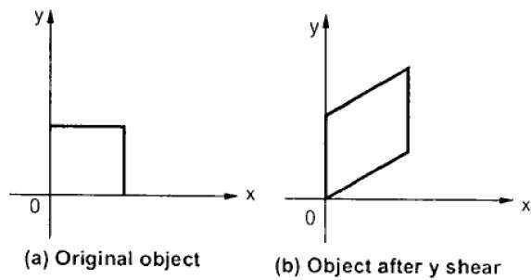
Y- Shearing
Y-Shear preserves the X coordinate and changes are made to Y coordinates.
Y _{Sh} = 1 0
Sh_{Y} 1
Y’=Y+ (Sh_{Y} * X)
X’=X

Slide 11
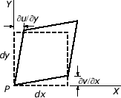
X-Y - Shearing
Here, both co – ordinates changes.
XY _{Sh} =
1 Sh_{y}
Sh_{x} 1
Y’=Y+ (Sh_{Y} * X) X’=X+ (Sh_{X} * Y)

