Slide 1
Geometric Transformation-2D

Slide 2
Overview
2D Transformations
Basic 2D transformations
Matrix representation
Composite Transformation
Computational Efficiency
Homogeneous representation
Matrix composition

Slide 3
Geometric Transformations
Linear Transformation
Euclidean Transformation
Affine Transformation
Projective Transformation
Notes:
More detail: mrl.snu.ac.kr/courses/CourseGraphics/Transforms.ppt

Slide 4
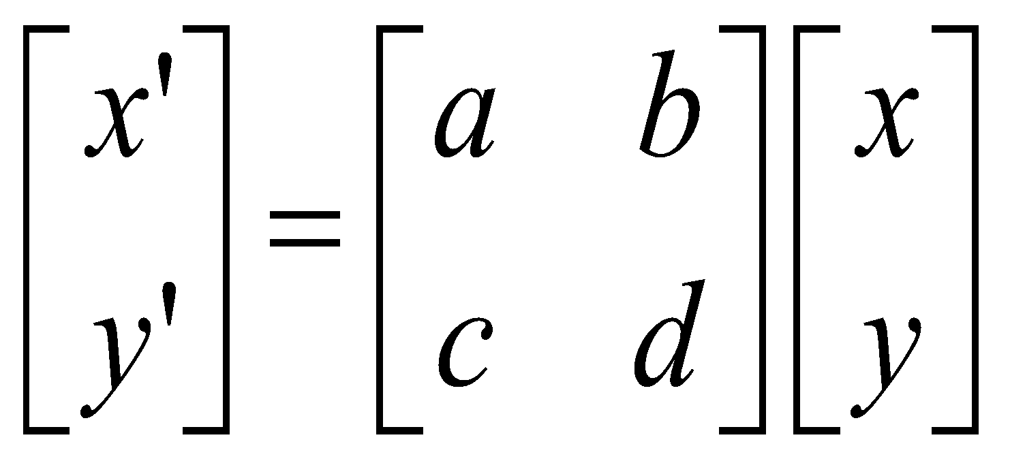
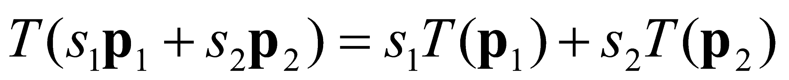
Linear Transformations
Linear transformations are combinations of …
Scale,
Rotation,
Shear, and
Mirror
Properties:
Satisfies:
Origin maps to origin
Lines map to lines
Parallel lines remain parallel
Ratios are preserved

Slide 5
Euclidean Transformations
The Euclidean transformations are the most commonly used transformations. An Euclidean transformation is either a translation, a rotation, or a reflection.
Properties:
Preserve length and angle measures
Notes:
http://planetmath.org/encyclopedia/Rotate.html

Slide 6
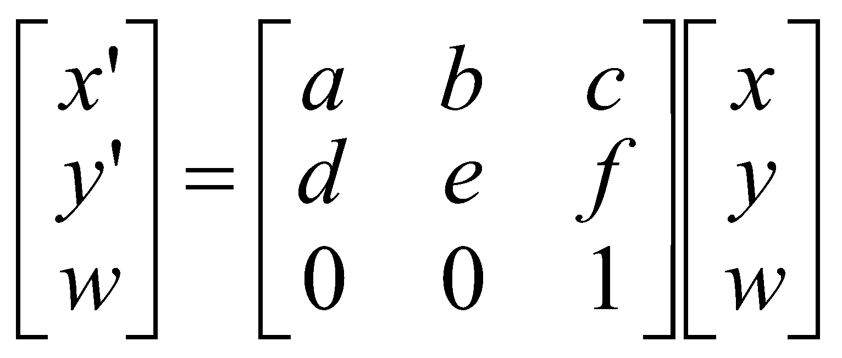
Affine Transformations
Affine transformations are the generalizations of Euclidean transformation and combinations of
Linear transformations, and
Translations
Properties:
Origin does not necessarily map to origin
Lines map to lines but circles become ellipses
Parallel lines remain parallel
Ratios are preserved
Length and angle are not preserved

Slide 7
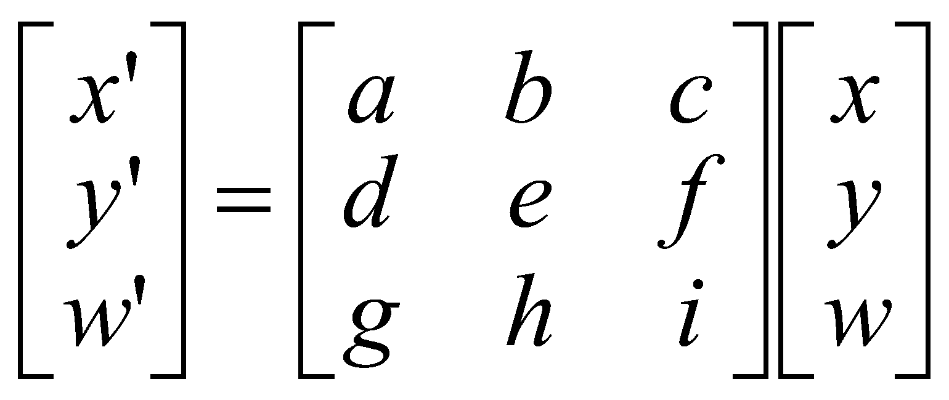
Projective Transformations
Projective transformations are the most general linear transformations and require the use of homogeneous coordinates.
Properties:
Origin does not necessarily map to origin
Lines map to lines
Parallel lines do not necessarily remain parallel
Ratios are not preserved
Closed under composition

Slide 8
Transformation of Objects
Basic transformations are:
Translation
Rotation
Scaling
Application:
Such as animation: to give life, virtual reality
We use parameterised transformations that change over time t
Thus for each frame the object moves a little further, just like a movie
y
Translation
z
x
y
Rotation
z
y
x
Scaling
z
x

Slide 9
2D Translation
A translation of a single point is achieved by adding an offset to its coordinates, so as to generate a new coordinate position:
t_{x} = 2
t_{y} = 3

Slide 10
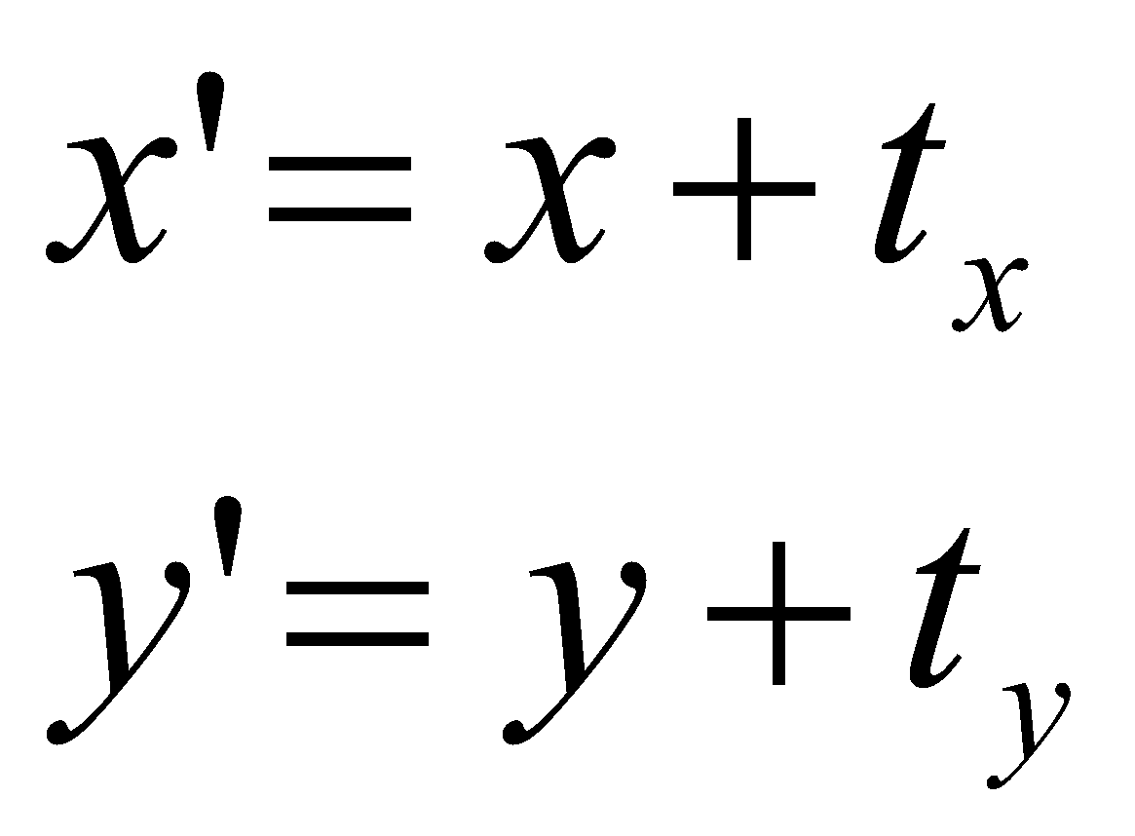
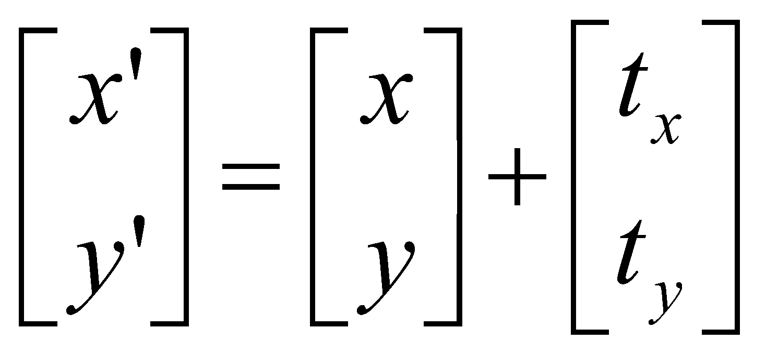
2D Translation
Translation operation:
Or, in matrix form:
translation matrix

Slide 11
2D Scaling
Scaling a coordinate means multiplying each of its components by a scalar
Uniform scaling means this scalar is the same for all components:
× 2

Slide 12
2D Scaling
Non-uniform scaling: different scalars per component:
How can we represent this in matrix form?
x × 2 y × 0.5

Slide 13
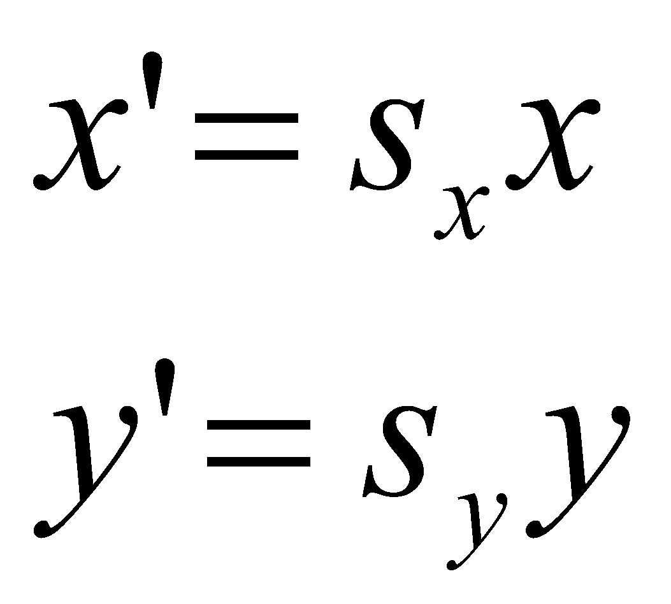
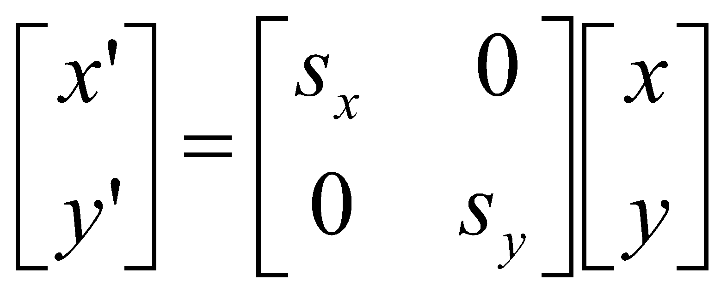
2D Scaling
Scaling operation:
Or, in matrix form:
scaling matrix

Slide 14
2D Scaling
Does non-uniform scaling preserve angles?
No
Consider the angle α that the vector (1, 1) makes with the x axis.
Scaling y by 2 creates the vector (1, 2). The angle β that this vector makes with the x axis is different, i.e., α ≠ β, the angle is not preserved.

Slide 15
2D Rotation
To rotate a polygon or other graphics primitive, we simply apply the (same) rotation transformation to all of its vertices
30⁰

Slide 16
2D Rotation
(x', y')
Counter Clock Wise
RHS
(x, y)
x' = x cos(θ) - y sin(θ)
y' = x sin(θ) + y cos(θ)
θ

Slide 17
2D Rotation
x = r cos (φ)
y = r sin (φ)
x’ = r cos (φ + θ)
y’ = r sin (φ + θ)
Trig Identity…
x’ = r cos(φ) cos(θ) – r sin(φ) sin(θ)
y’ = r sin(φ) cos(θ) + r cos(φ) sin(θ)
Substitute…
x’ = x cos(θ) - y sin(θ)
y’ = x sin(θ) + y cos(θ)
(x’, y’)
(x, y)
θ
φ

Slide 18
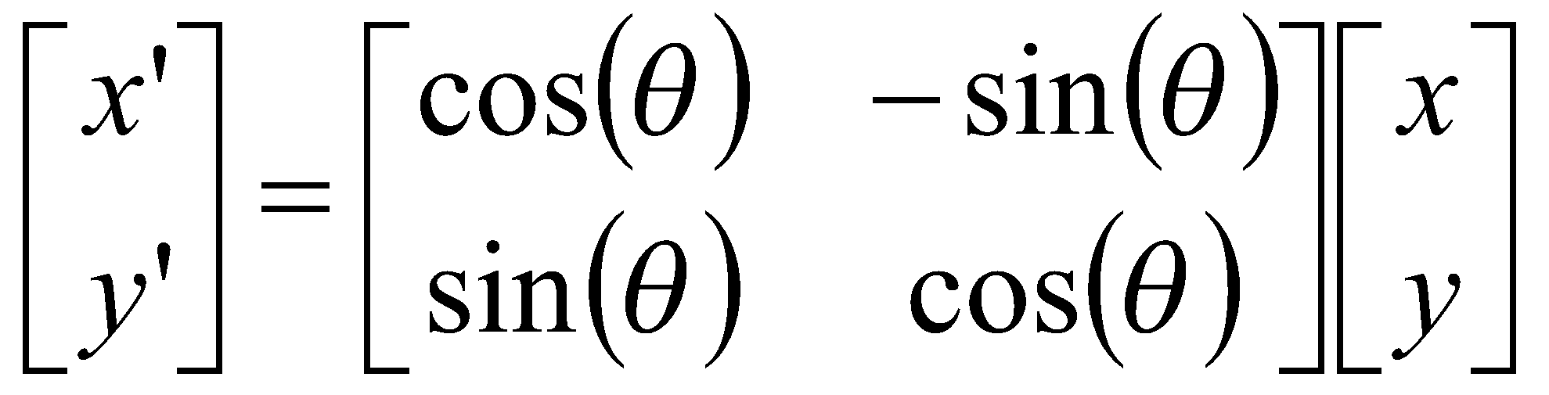
2D Rotation
This is easy to capture in matrix form:
x’ = x cos(θ) - y sin(θ)
y’ = x sin(θ) + y cos(θ)
=>
rotation matrix

Slide 19
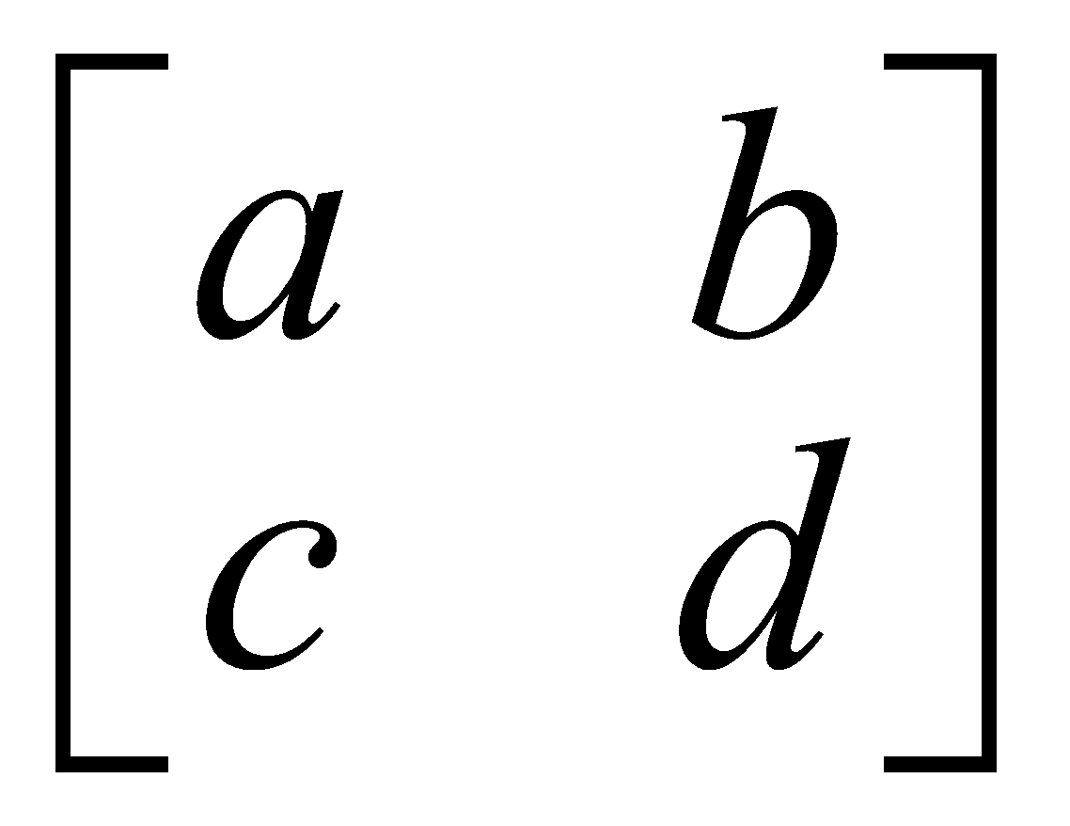
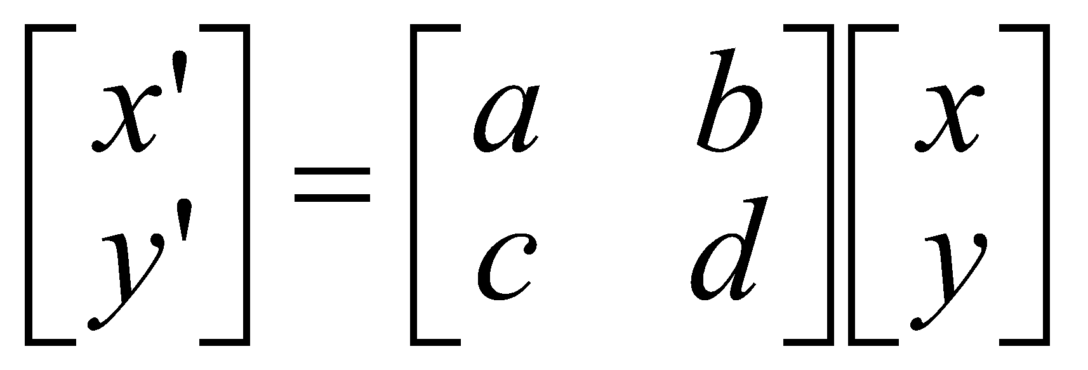
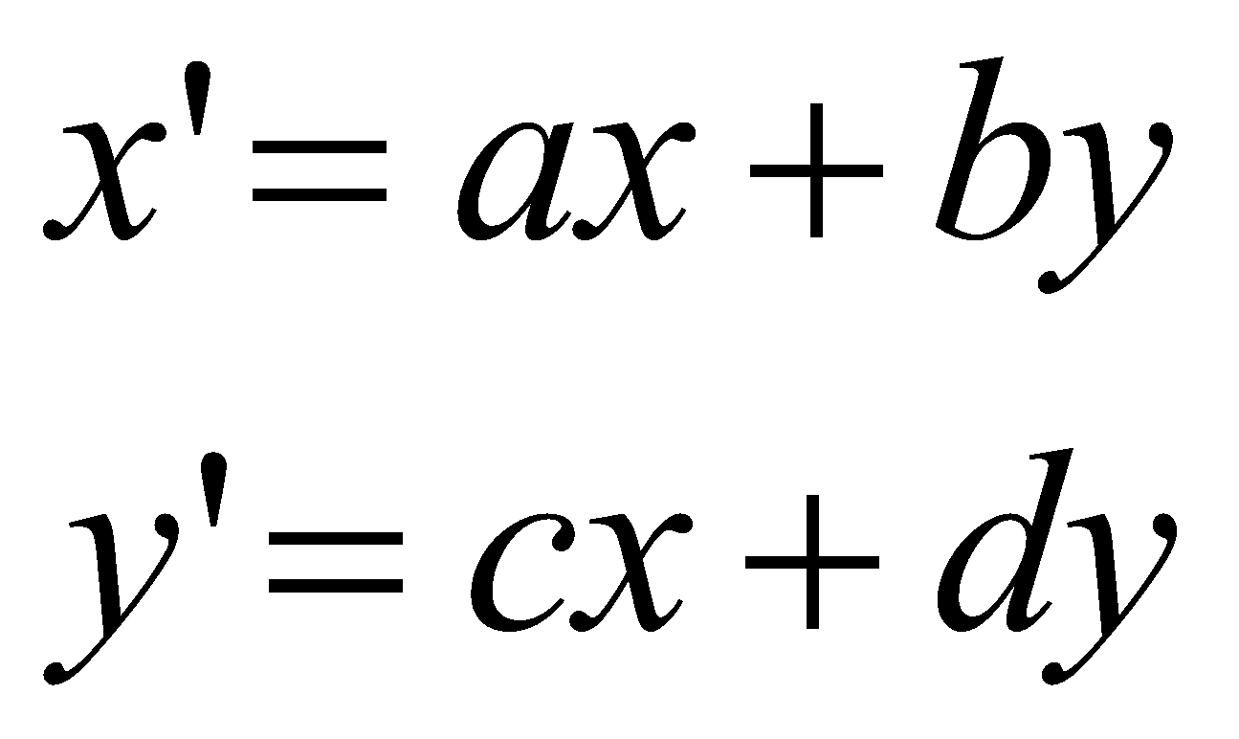
Matrix Representation
Represent 2D transformation by a matrix
Multiply matrix by column vector ⇔ apply transformation to point

Slide 20
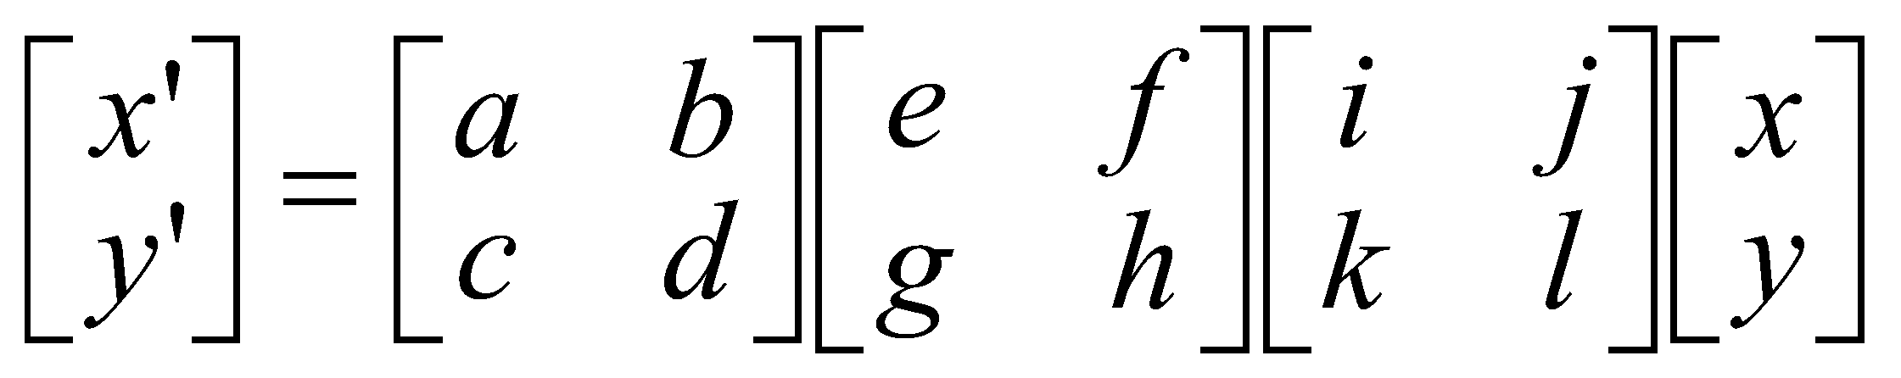
Composite Transformation
Matrices are a convenient and efficient way to represent a sequence of transformations
Transformations can be combined by multiplication, like

Slide 21
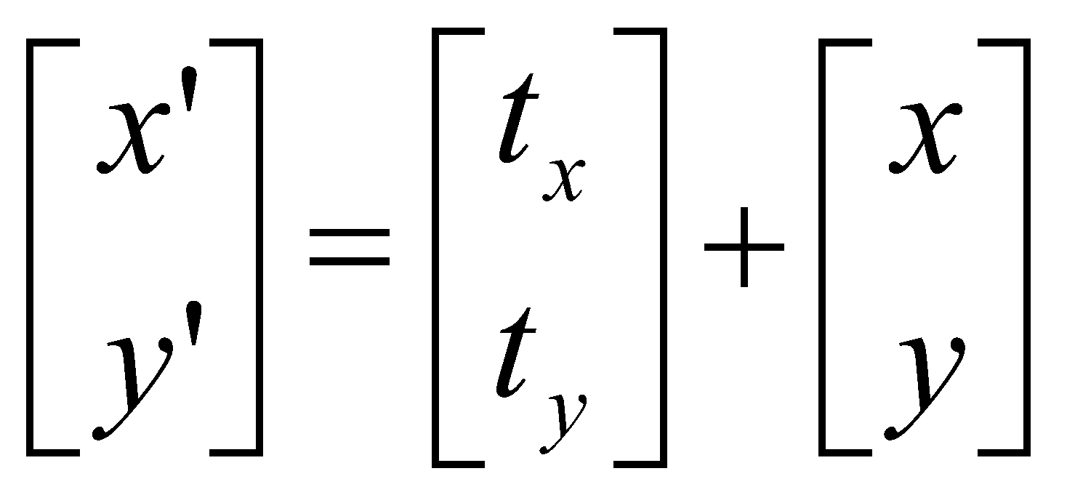
Transformation in Matrix Representation
Translation
Scaling
Rotation
Can we make a composite matrix?

Slide 22
Homogeneous Coordinates
We can express a translation in terms of a matrix multiplication operation by expanding the transformation matrix from its representation by a 2x2 matrix to representation by a 3x3 matrix
This is accomplished by using homogeneous coordinates, in which 2D points (x, y) are expressed as (x_{h}, y_{h}, h),
where h ≠ 0 and x = x_{h} / h, y = y_{h} / h
Typically, we use h = 1.

Slide 23
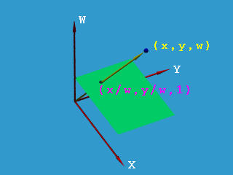
# Homogeneous Coordinates
http://www.cs.mtu.edu/~shene/COURSES/cs3621/NOTES/geometry/homo-coor.html

Slide 24
Homogeneous Coordinates
Add a 3rd coordinate to every 2D point
(x, y, w) represents a point at location (x/w, y/w)
(x, y, 0) represents a point at infinity
(0, 0, 0) is not allowed
Convenient coordinate system to represent many useful transformations
y
2
(2,1,1)
or (4,2,2)
or (6,3,3)
1
1
2
x

Slide 25
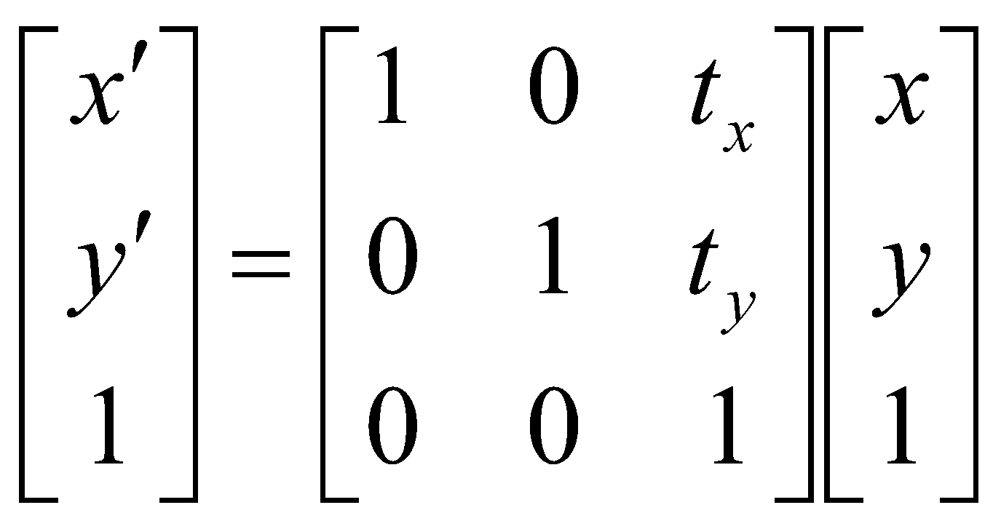
2D Translation Matrix
Using homogeneous coordinates, we can express the equations that define a 2D translation of a coordinate position:
=>

Slide 26
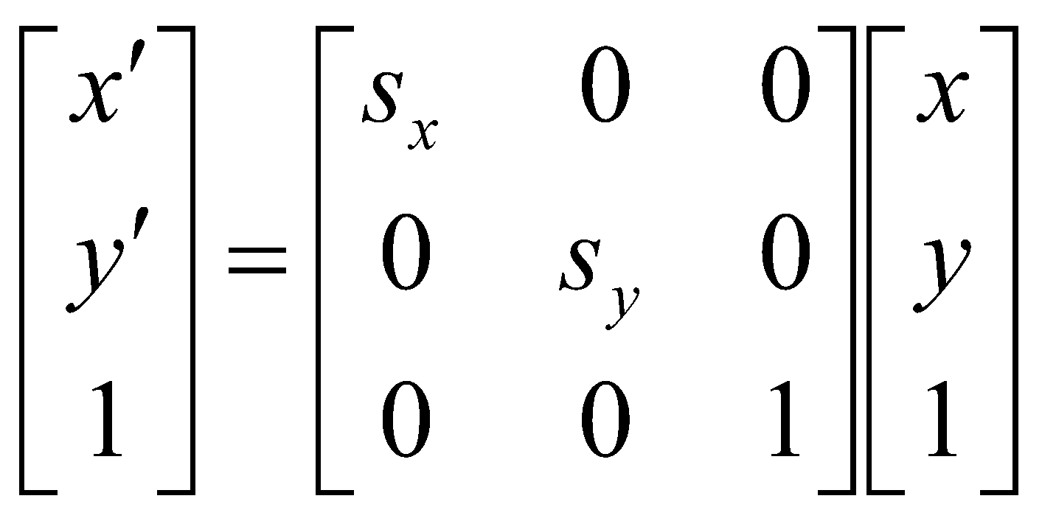
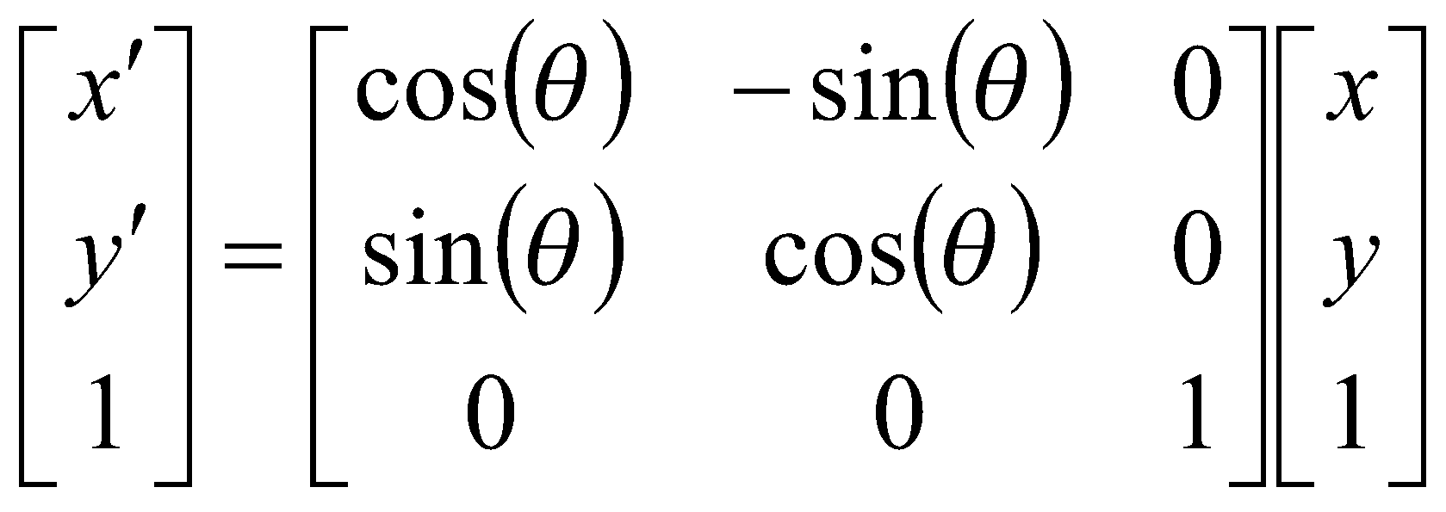
Transformation in Matrix Representation
Translation
Scaling
Rotation
Can we make a composite matrix now?

Slide 27
Composite Transformation
If we want to apply two transformations, M₁ and M₂ to a point P, this can be
expressed as:
P′ = M₂.M₁.P
or
P′ = M.P
where M = M₂.M₁
Note: The transformations appear in right-to-left order

Slide 28
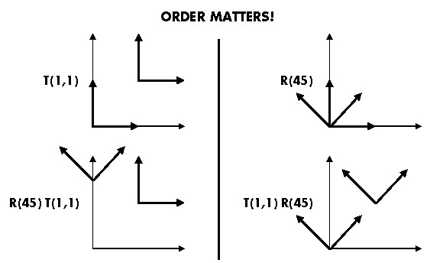
Composite Transformation
T_{a} T_{b} = T_{b} T_{a}, R_{a} R_{b} != R_{b} R_{a} and T_{a} R_{b} != R_{b} T_{a}
rotations around different axes do not commute

Slide 29
Composite Transformation
Matrix Concatenation Properties
Multiplication of matrices is associative
The transformations appear in right-to-left order
Same type of transformation can commute
Rotation and uniform scaling can commute
Rotations around different axes do not commute

Slide 30
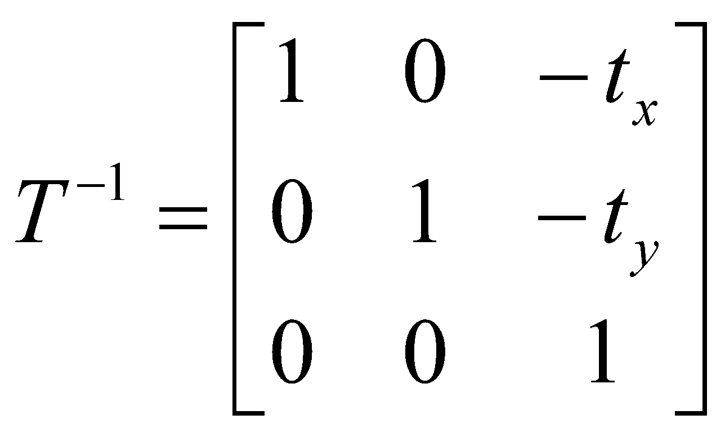
Inverse Transformations
For translation, the inverse is accomplished by translating in the opposite direction:
Note: T⁻¹(t_{x}, t_{y}) = T(-t_{x}, -t_{y})

Slide 31
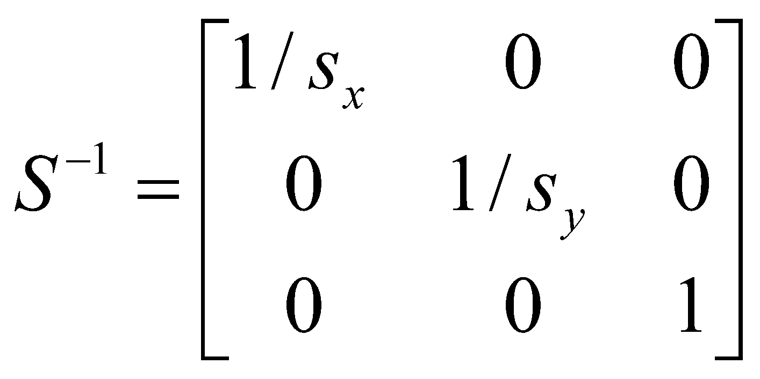
Inverse Transformations
For scaling, the inverse is accomplished by scaling by the reciprocal of the original amount in each direction:
Note: S⁻¹(s_{x}, s_{y}) = S(1/s_{x}, 1/s_{y})

Slide 32
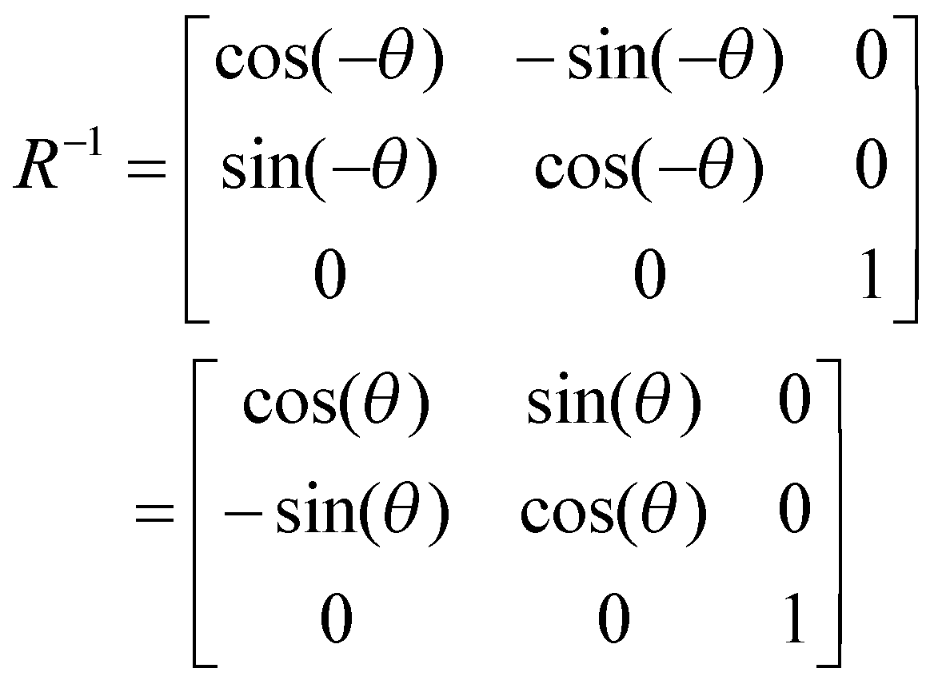
Inverse Transformations
For rotation, the inverse is accomplished by rotating about the negative of the angle:
Note that R⁻¹(θ) = R^{T}(θ) = R (-θ)

Slide 33
Transformation about a Pivot Point
The transformation sequence is:
translate all vertices of the object by the vector T = (-t_{x}, -t_{y}), where (t_{x}, t_{y}) is the current location of object.
transform (rotate or scale or both) the object
translate all vertices of the object by the vector T⁻¹
i.e.,
P′ = T⁻¹.M.T

Slide 34
Transformation about a Pivot Point
General 2D Pivot-Point Rotation
i.e., rotation of angle θ about a point (x_{c}, y_{c})
T(x_{c}, y_{c}).R(x_{c}, y_{c}, θ).T(-x_{c}, -y_{c}) = ?
General 2D Fixed-Point Scaling
i.e., scaling of parameters (s_{x}, s_{y}) about a point (x_{c}, y_{c})
T(x_{c}, y_{c}).S(x_{c}, y_{c}, s_{x}, s_{y}).T(-x_{c}, -y_{c}) = ?

Slide 35
Transformation about a Pivot Point
General 2D Scaling & Rotation about a point (x_{c}, y_{c})
T((x_{c}, y_{c}).R(x_{c}, y_{c}, θ).S(x_{c}, y_{c}, s_{x}, s_{y}).T((-x_{c}, -y_{c}) = ?

Slide 36
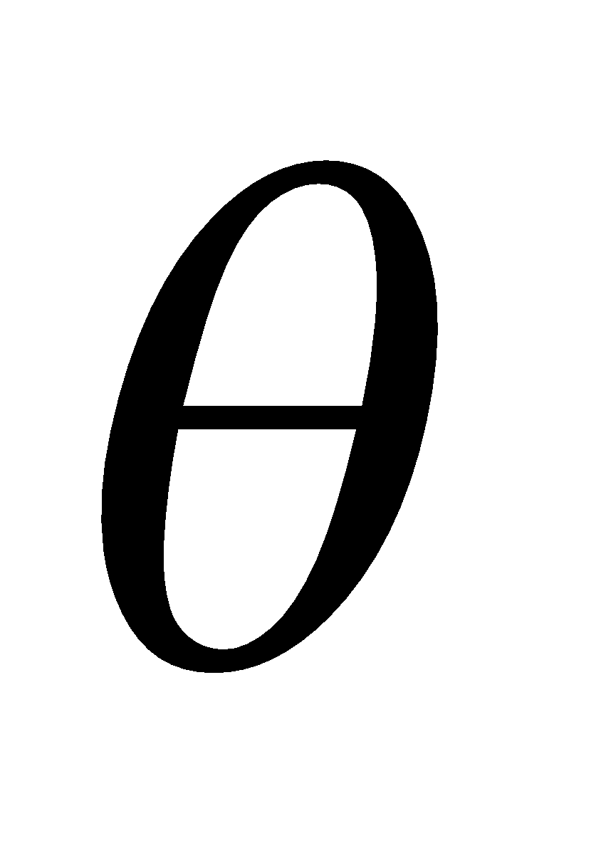
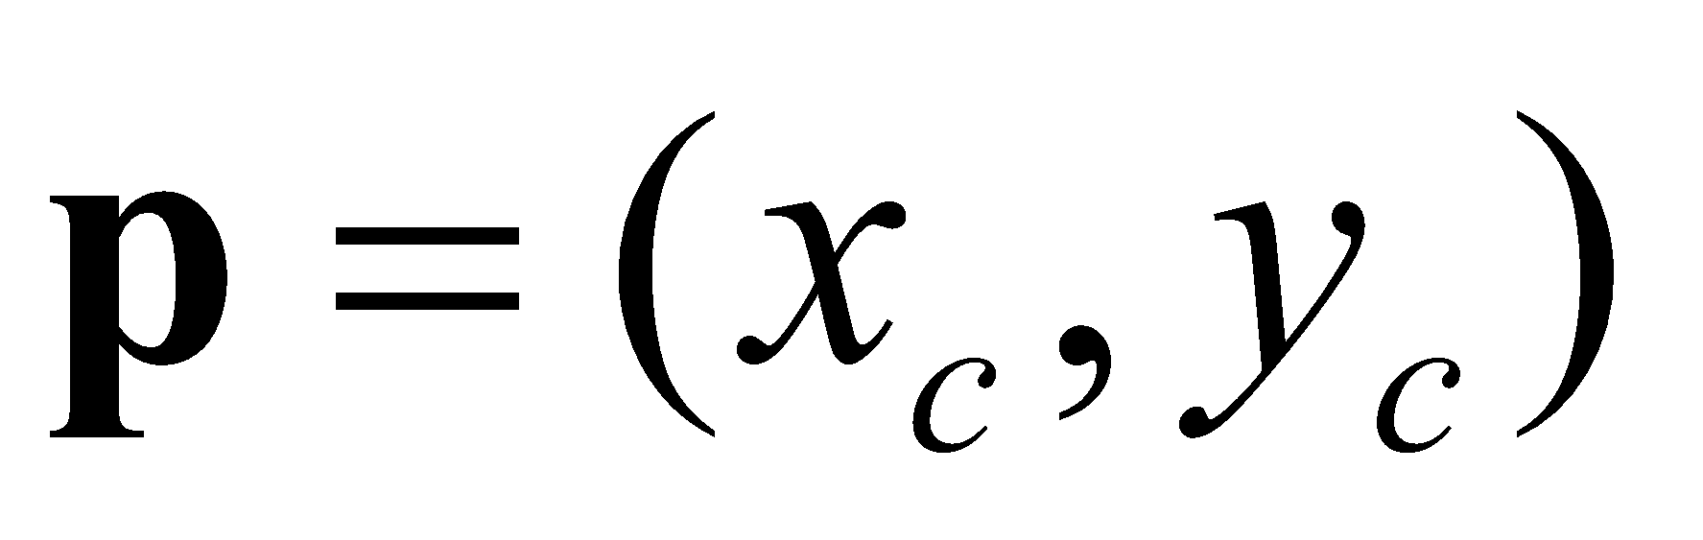
Transformation about a Pivot Point
rotate about
p by
translate p
to origin
rotate about
origin
translate p
back
F_{W}
T(x_{c}, y_{c}).R(x_{c}, y_{c}, θ ).T(-x_{c}, -y_{c})

Slide 37
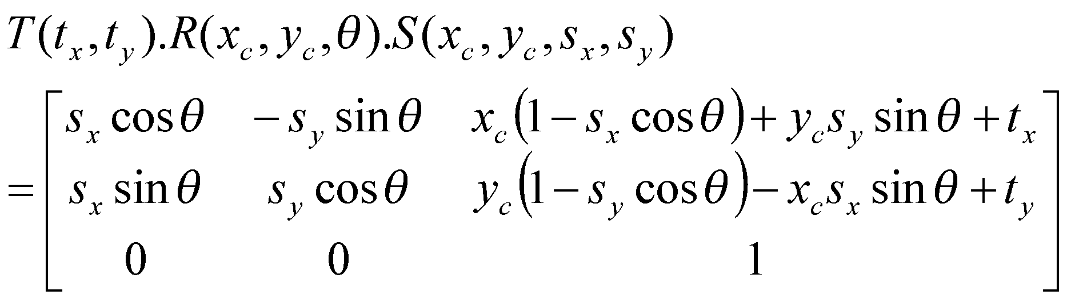
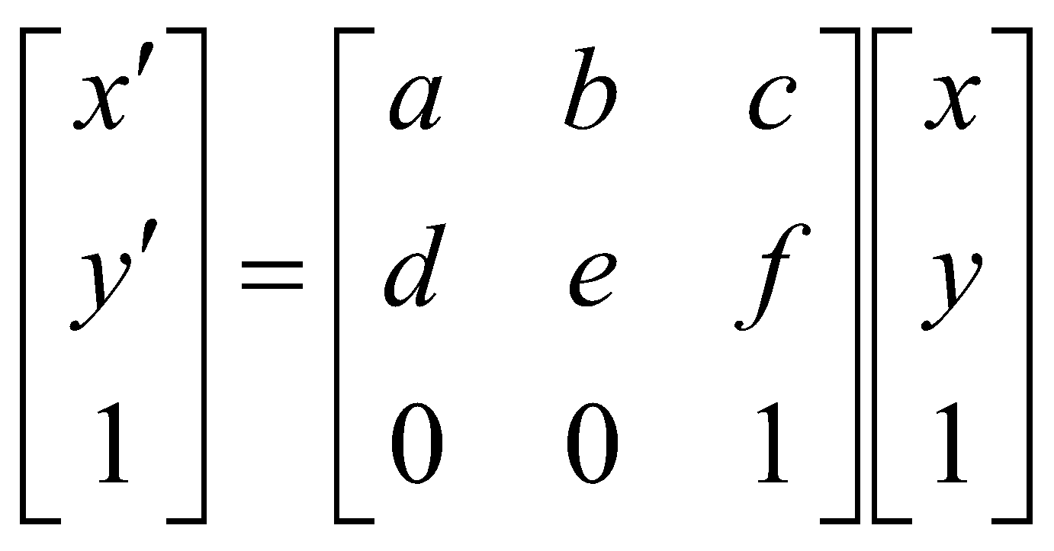
Computational Efficiency
However, after matrix concatenation and simplification, we have
or x’ = a x + b y + c; y’ = d x + e y + f
having just 4 multiplications & 4 additions ,
which is the maximum number of computation required for any transformation sequence.
needs a lot of multiplications and additions.

Slide 38

Question 1
Calculate the transformation matrix for rotation about (0, 2) by 60°.
Hint: You can do it as a product of a translation, then a rotation about the origin, and then an inverse translation.
Cos[60⁰] = 0.5, Sin[60⁰] = Sqrt[3]/2
Sol.
Notes:
http://cgi.cse.unsw.edu.au/~cs3421/

Slide 39
Question 2
Show that the order in which transformations is important by first sketching the result when triangle A(1,0), B(1,1), C(0,1) is rotating by 45° about the origin and then translated by (1,0), and then sketch the result when it is first translated and then rotated.

Slide 40
Question 2 - Solution
Show that the order in which transformations is important by first sketching the result when triangle A(1,0), B(1,1), C(0,1) is rotating by 45° about the origin and then translated by (1,0), and then sketch the result when it is first translated and then rotated.
Sol.
If you first rotate and then translate you get
If you first translate and then rotate you get

Slide 41
Question 3
Calculate a chain of 3 x 3 matrices that, when post-multiplied by the vertices of the house, will translate and rotate the house from (3, 0) to (0, -2). The transformation must also scale the size of the house by half.
y
(3,0)
x
(0,-2)

Slide 42
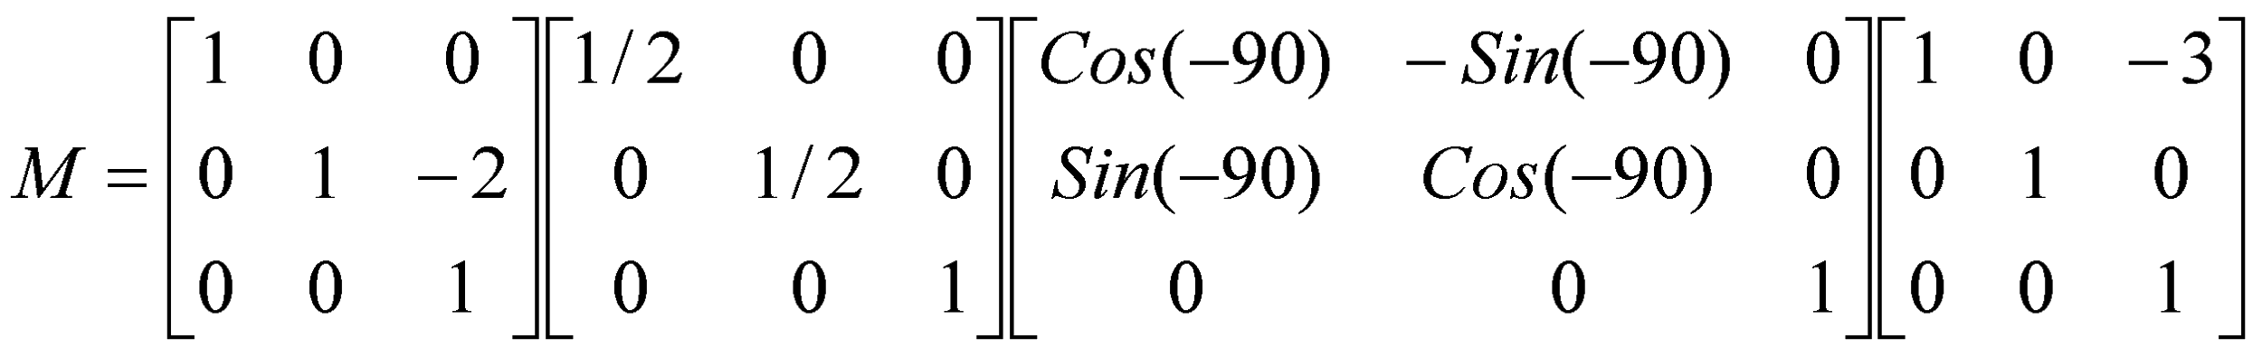
Question 3 - Solution
Calculate a chain of 3 x 3 matrices that, when post-multiplied by the vertices of the house, will translate and rotate the house from (3, 0) to (0, -2). The transformation must also scale the size of the house by half.
y
(3,0)
x
(0,-2)
Sol.

Slide 43
Transformation about a Pivot Point
Exercise:
Find a general 2D composite matrix M for transformation of an object about its centroid by using the following parameters:
Translation: -x_{c}, -y_{c}
Rotation angle: θ
Scaling: s_{x}, s_{y}
Inverse Translation: x_{c}, y_{c}
Reading: HB5

Slide 44
Other 2D Transformations
Reflection
Shear

Slide 45
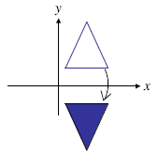
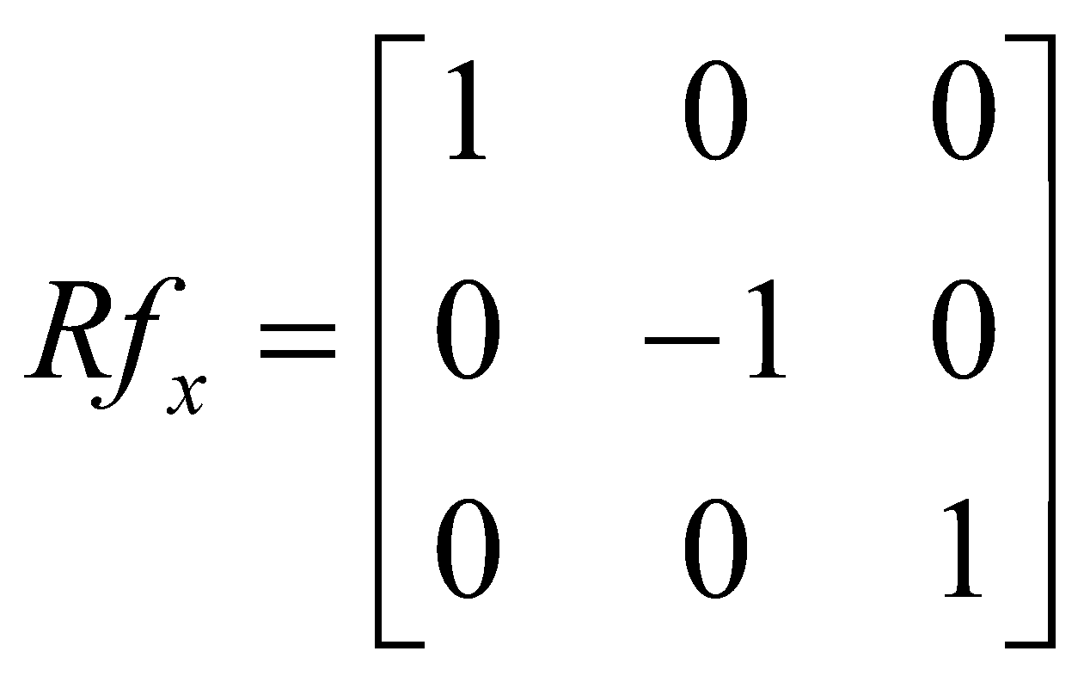
Reflection
Rf_{x} is equivalent to performing a non-uniform scaling by S = (1,-1)

Slide 46
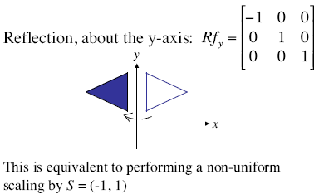
Reflection

Slide 47
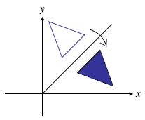
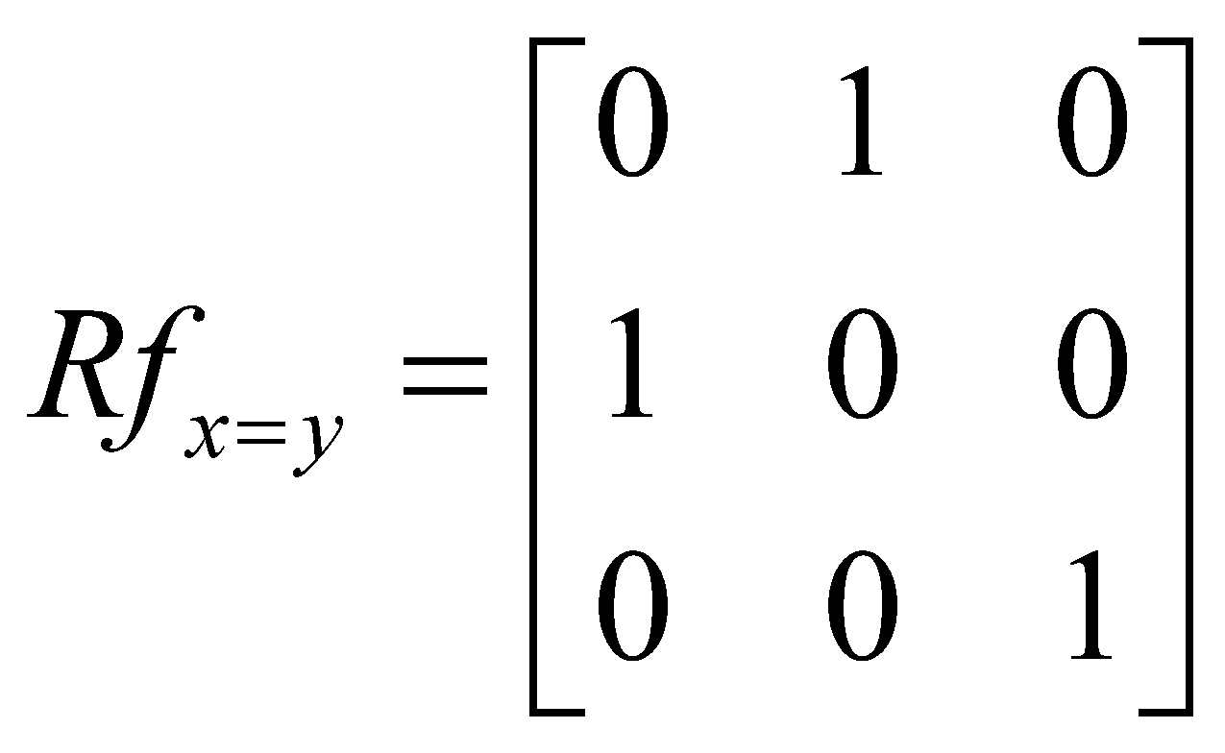
Reflection

Slide 48
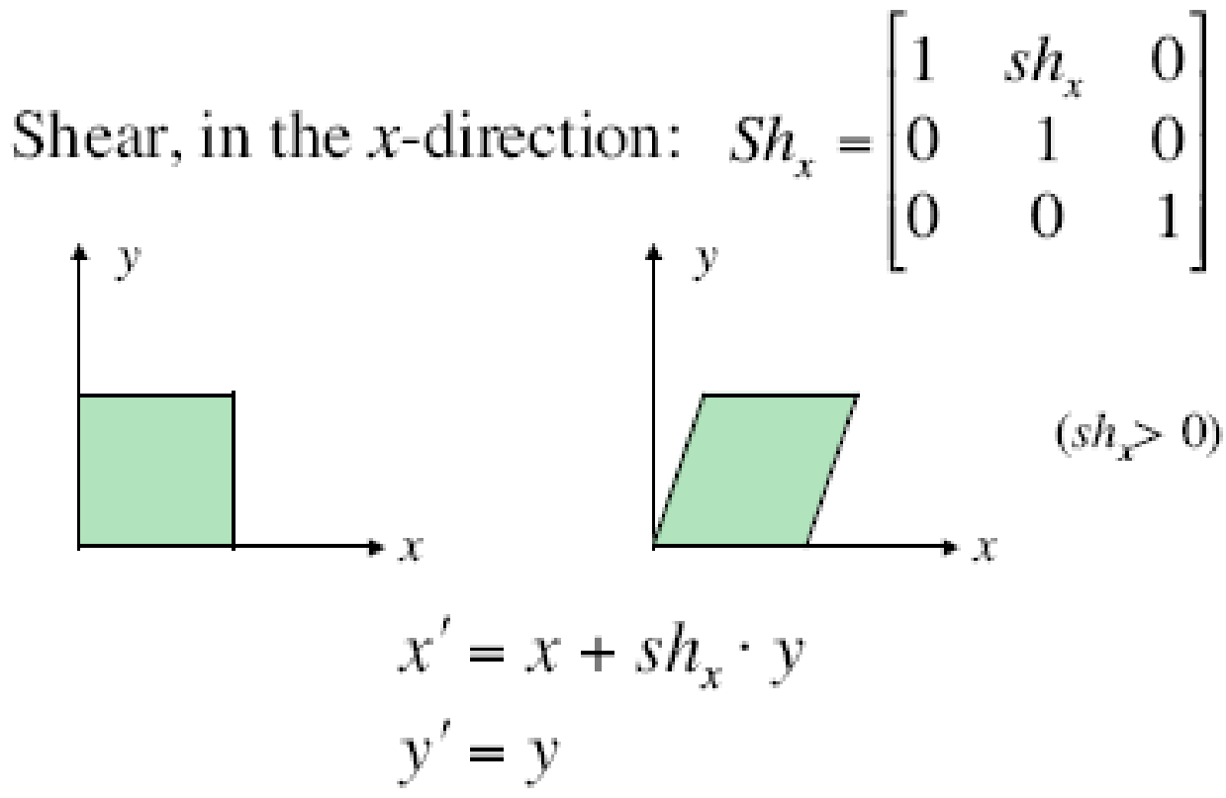
Shear

Slide 49
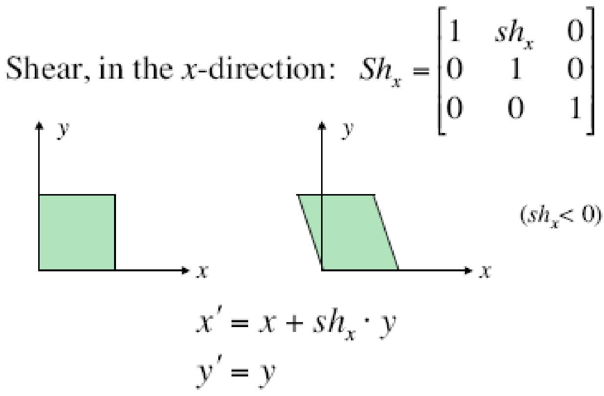
Shear

Slide 50
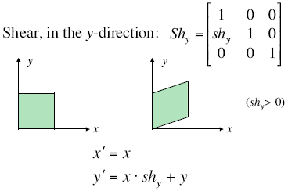
Shear

Slide 51
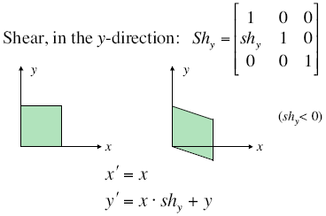
Shear

Slide 52
Shear
Does shear preserve parallel lines?
Yes
A shear transformation is an affine transformation.
All affine transformations preserve lines and parallelism

Slide 53
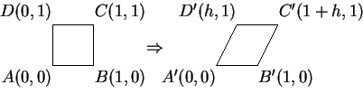
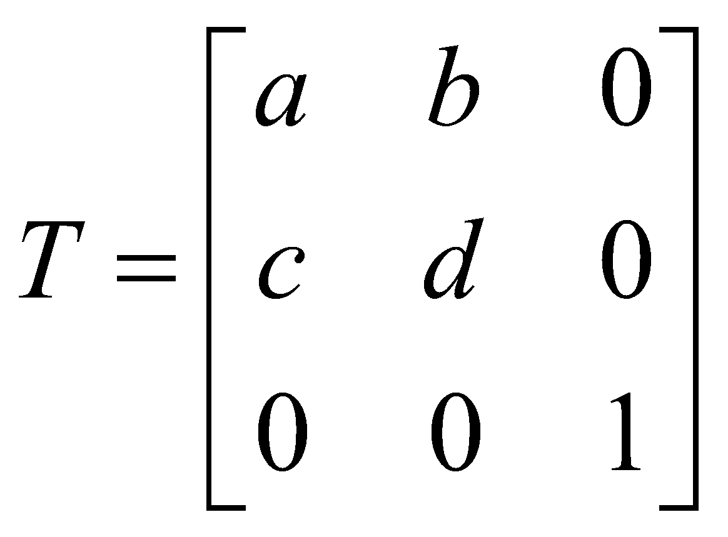
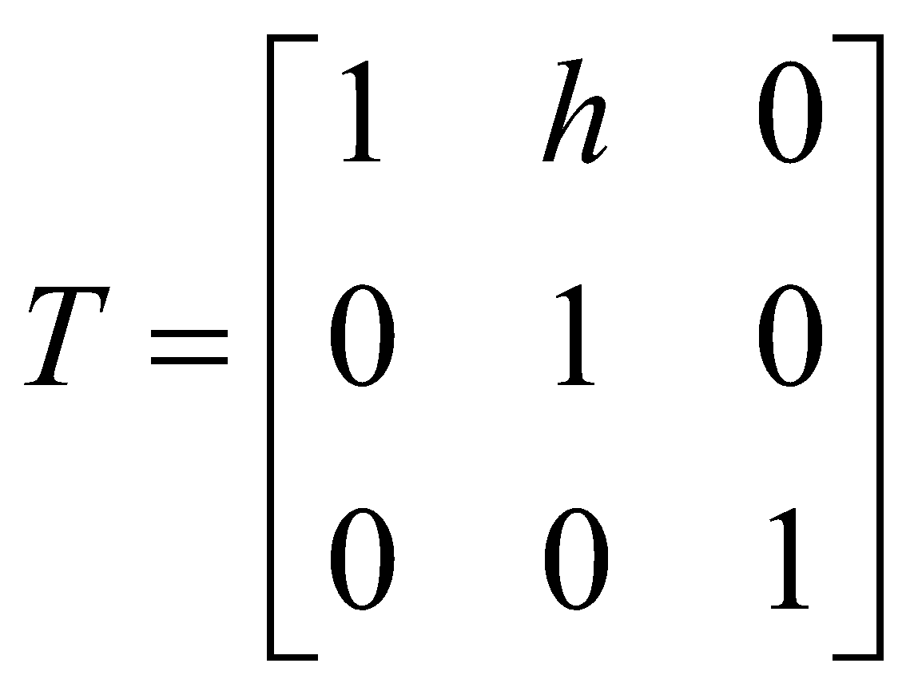
Question 4
A shear transformation maps the unit square
A(0,0), B(1,0), C(1,1), D(0,1) to
A’(0,0), B’(1,0), C’(1+h,1), D’(h,1).
Find the transformation matrix for this transformation.
Hint: Let
and solve for a, b, c, d.
Sol.

Slide 54
Question 5
Prove that we can transform a line by transforming its endpoints and then constructing a new line between the transformed endpoints.
Can you do the same thing for circles by transforming the centre and a point on the circle?

Slide 55

Question 5 - Solution
Prove that we can transform a line by transforming its endpoints and then constructing a new line between the transformed endpoints. Can you do the same thing for circles by transforming the centre and a point on the circle?
Sol.
The parametric equation of a line segment joining a and b is
This is true whether or not we use homogenous coordinates.
If T is a transform, the transform of the line is
(Matrix multiplication obeys distributive law)
Which is the line segment connecting the transformed endpoints.
A scaling by (2,1) (i.e. double x values and leave y unchanged) turns circles into ellipses so it is not true for circles.

