Slide 1




















Outline
Definition of Viewing & Clipping?
Viewing pipeline
Viewing transformation system
Several types of clipping
Cohen-Sutherland Line Clipping
Application of Clipping
Conclusion

Slide 2


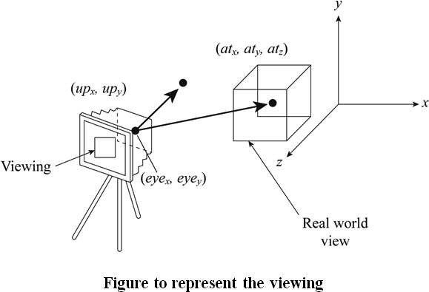
2D Viewing
The two dimensional viewing is a transformation process of real world object into position point which
is relative to the viewing volume, especially, the points behind the viewer.

Slide 3

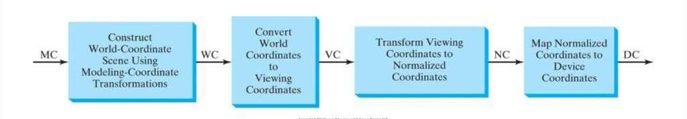
Viewing Pipeline
Window
a world-coordinate area selected for display
define what is to be viewed
View port
area on a display device which a window is mapped
define where it is to be displayed
Windows & viewport
be rectangles in standard position, with the rectangle edges parallel to the coordinate axes
other geometries : take longer to process

Slide 4

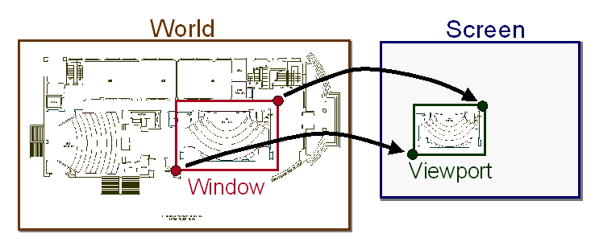
Viewing transformation system
The process of mapping a part of the world co-ordinate scene to device co-ordinate system is known as viewing transformation.
A world co-ordinate area selected for display is called as a window and an area on display device to which a window is mapped is called as a view point.
Window defines ‘What’ to be viewed and the viewport defines ‘Where’ it is to be displayed

Slide 5
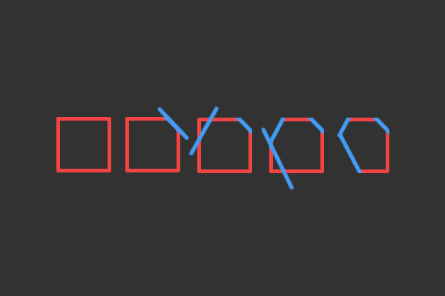





























Clipping
Clipping is a computer graphics process to remove the lines, objects, or line segments, all of which are outside the viewing region.
Any Procedure that identifies those portions of a picture that are either insider outside of a specified region of a space is referred to as a Clipping algorithm or simply Clipping.

Slide 6














Types of Clipping
Point Clipping
Line Clipping
Polygon Clipping
Curve Clipping
Text Clipping

Slide 7
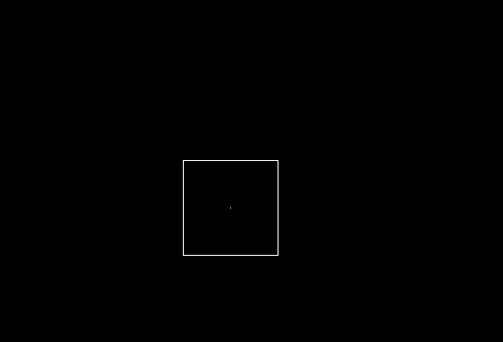

Point Clipping
Point Clipping is used to determining, whether the point is inside the window or not. For this following conditions are checked.
x ≤ x_{max}
x ≥ x_{min}
y ≤ y_{max}
y ≥ y_{min}
That’s mean a point P = (x, y) for display if the following inequalities are satisfied
Xwmin <= X <= Xwmax
Ywmin <= Y <= Ywmax
where the Xwmin, Ywmin, Xwmax, Ywmax are the edge of the Clip Window.

Slide 8

Line Clipping
Line clipping procedure
Test a given line segment to determine whether it lies completely inside the clipping window
If it doesn’t, we try to determine whether it lies completely outside the window
If we can’t identify a line as completely inside or completely outside, we must perform intersection calculations with one or more clipping boundaries
It is performed by using the line clipping algorithm. The line clipping algorithms are:
Cohen Sutherland Line Clipping Algorithm
Midpoint Subdivision Line Clipping Algorithm
Liang-Barsky Line Clipping Algorithm

Slide 9



Cohen-Sutherland Line Clipping
The Cohen–Sutherland algorithm is a computer-graphics algorithm used for line clipping. The algorithm divides a two-dimensional space into 9 regions and then efficiently determines the lines and portions of lines that are visible in the central region of interest (the viewport).
1001 | 1000 | 1010
0001 | 0000 Window | 0010
0101 | 0100 | 0110
^{y}max
^{y}min
^{x}min
^{x}max
10

Slide 10
Cohen-Sutherland Line Clipping
Region Code Creation
Region Code
Bit 1: left
Bit 2: right
1001 | 1000 | 1010
0001 | 0000 Window | 0010
0101 | 0100 | 0110
^{y}max
Bit 3: below
Bit 4: above
1 | 2 | 3 | 4
^{y}min
y > ymin
∩
ymax
y < ymax
interior
=
^{x}min
^{x}max
ymin
x < xmax
xmin xmax
x > xmin
11

Slide 11
Cohen-Sutherland Line Clipping
Cohen-Sutherland line clipping remember part🡪
^{y}end
y₀
Calculate Intersection Point
Using the slope-intercept form
m =
^{x}end
x₀
y − y₁
To find x value 🡪
x = x₁ +
m
y = y₁ + m(x − x₁ )
To find y value 🡪
‹#›

Slide 12



Cohen-Sutherland Line Clipping
Example
B(-1,7)
Ymax = 6
A(-4,2)
Ymin = 1
Xmin=-3
Xmax=2
‹#›

Slide 13
sign(y-ymax) : sign(ymin-y) : sign(x-xmax) : sign(xmin-x)
bit 4 : bit 3 : bit 2 : bit 1 Top : Bottom : Right : Left
Bit = true if sign(…) >= 0 Bit = false if sign(…) < 0
B(-1,7)
Ymax = 6
A(-4,2)
Ymin = 1
Xmin=-3
Xmax=2
from endpoint codes to last point
A(-4,2)
sign(2-6) : sign(1-2) : sign(-4-2) : sign(-3+4)
<0 : <0 : <0 : >0
0 : 0 : 0 : 1
14

Slide 14
sign(y-6) : sign(1-y) : sign(x-2) : sign(-3-x)
bit 4 : bit 3 : bit 2 : bit 1 Top : Bottom : Right : Left
Bit = true if sign(…) >= 0 Bit = false if sign(…) < 0
B(-1,7)
Ymax = 6
A(-4,2)
Ymin = 1
Xmin=-3
Xmax=2
from endpoint codes to last point
B(-1,7)
sign(7-6) : sign(1-7) : sign(-1-2) : sign(-3+1)
>0 : <0 : <0 : <0
1 : 0 : 0 : 0
15

Slide 15
Summery of endpoint codes to the last point
B:1000
A:0001
A AND B = (0001) & (1000) = 0000 🡺 Maybe
16

Slide 16



A(-4,2):0001 The first bit is true that the line was cut at the left edge.
B(-1,7):1000
x = x_{min} = −3
y = y₁ + m(x − x₁ )
A(-4,2):0001
y = 2 + ⁵ {(− 3)− 4}= ¹¹
3
(y_{min} <= 11/3 <= y_{max})
The left is a cutting edge(-3,11/3)
3
− y₀ 7 − 2 5
3
m =
^{y}end
=
=
^{x}end
− x₀ −1− (−4)
17

Slide 17



B(-1,7):1000 bit 4 is true The line was cut at the top
B(-1,7):1000
y = y_{max} = 6
y − y₁
x = x
1
m
A(-4,2):0001
x = (−1) + ^{⎧3} × (6 − 7)⎫ = −^{⎛ 8 ⎞}
⎨₅ ⎬
⎜ ₅ ⎟
⎩
(x_{min} <= -8/5 <= x_{max})
⎭
⎝ ⎠
− y₀ 7 − 2 5
3
m =
^{y}end
=
=
Point on the cutting edge (-8/5,6)
^{x}end
− x₀ −1− (−4)
18

Slide 18
(-8/5,6)
Ymax = 6
(-3,11/3)
Ymin = 1
Xmin=-3
Xmax=2
‹#›

Slide 19

















































Application 2D Clipping
Extracting part of a defined scene for viewing
Identifying visible surfaces in 2D views
Antialiasing line segments or object boundaries
Creating objects using solid-modeling procedures
Displaying a multi window environment
Drawing & painting operations that allow parts of a picture to be
selected for copying, moving, erasing, or duplicating
‹#›

Slide 20
































































Conclusion
Good clipping strategy is important in the development of video games in order to maximize the game's frame rate and visual quality. Despite GPU chips that are faster every year, it remains computationally expensive to transform, texture, and shade polygons, especially with the multiple texture and shading passes common today. Hence, game developers must live within a certain "budget" of polygons that can be drawn each video frame.
‹#›

