Slide 1

3D GRAPHICS

Slide 2
3D Transformations
▶ Geometric transformations and object modeling in 3D are extended from 2D methods by including considerations for the z coordinate.
Translation
▶ A point is translated from position P=(x,y, z) to position
y
P’=(x’,y’, z’) with matrix operation
x′ = x + t_{x}
y′ = y + t_{y}
z′ = z + t_{z}
₍x′, y′, z′₎
⎡1 0 0
1 0
0 1
0 0
₍x, y, z₎
z
⎡ ^{x′}⎤
^{t}_{x} ⎤ ⎡ ^{x} ⎤
⎢ _{y′}⎥
⎢₀
_{t} ⎥ ⎢ _{y}⎥
⎢ ⎥ ₌ ⎢
^{y} ⎥ ⋅ ⎢ ⎥
x
⎢ _{z}′⎥
⎢₀
_{tz} ⎥ ⎢ _{z} ⎥
⎢ ₁ ⎥
⎢₀
₁ ⎥ ⎢₁⎥
⎣ ⎦ ⎣
⎦ ⎣ ⎦

Slide 3
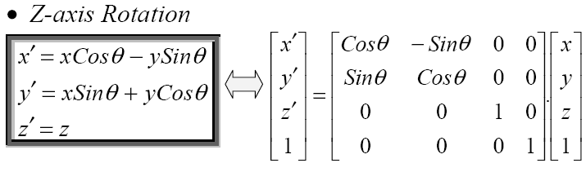
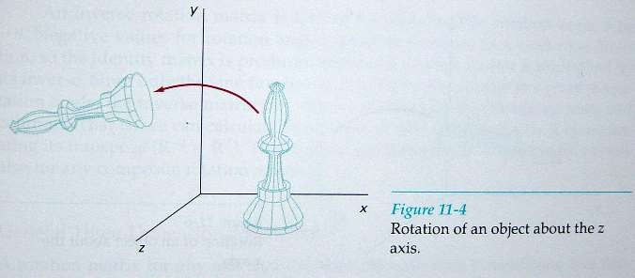
▶ Positive rotation angles produce anticlockwise rotations about a coordinate axis
Rotation

Slide 4
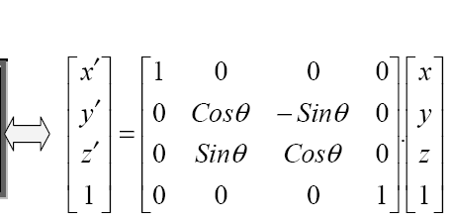
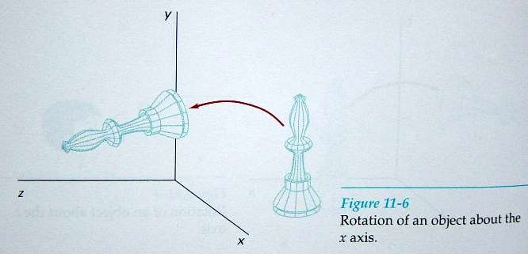
X- ais Rotation
y' = y cosθ − zsin θ z' = y sin θ + z cosθ x' = x

Slide 5
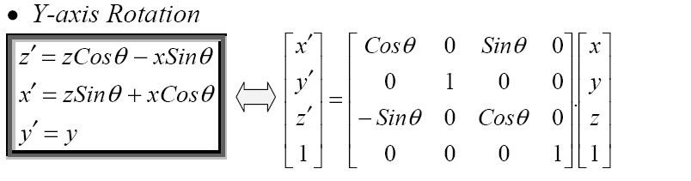
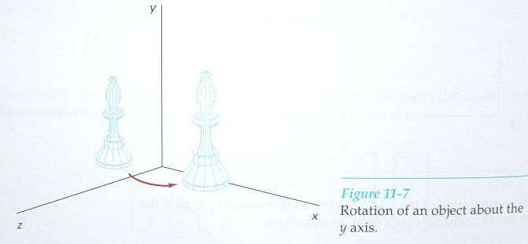

Slide 6
Scaling
▶ The matrix expression for the scaling transformation of a position P = (x, y, z) relative to coordinate origin can be written as
x' = x. s
x
y' = y . s
y
z' = z. s
z
⎡ x'⎤ ⎡s 0 0
0
s_{z}
0
y
⁰⎤ ⎡ ^{x}⎤
y
x
⎢ _{y'}⎥ ⎢ ₀
₀⎥ ⎢ _{y}⎥
s
⎢ ⎥ ₌ ⎢
y
⎥ ⋅ ⎢ ⎥
⎢ _{z'}⎥ ⎢ ₀
⎢ ₁ ⎥ ⎢ ₀
0
0
₀⎥ ⎢ _{z} ⎥
₁⎥ ⎢₁⎥
⎣ ⎦ ⎣
⎦ ⎣ ⎦
z
z
x
x

Slide 7
▶ The matrix representation for an arbitrary fixed-point (x_{f}, y_{f}, z_{f}) can be expressed as:
⎡s_{x} 0 0 (1− s_{x} )x_{f ⎤}
⎢ 0 s 0
(1− s ) y ⎥
y f ⎥
T (x , y , z ) ⋅ S(s , s , s ) ⋅T (−x ,− y ,−z ) = ⎢
y
f f f x y z f f f
⎢ 0 0 s (1− s )z ⎥
⎣ 0 0 0
⎢
z
z f
₁ ⎥
⎦

Slide 8
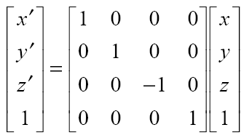
Reflections
▶ The matrix expression for the reflection transformation of a position P = (x, y, z) relative to xy plane can be written as:
▶ similarly, as reflections relative to yz plane and xz
plane, respectively.

Slide 9
▶ The matrix expression for the shearing transformation of a position P = (x, y, z)
Shear
Transformation in z axis
⎡1 0 sh_{x} 0⎤
1 sh
0 1
0 0
⎢₀
₀⎥
SH
₌ ⎢
y
⎥
₀⎥
z
⎢₀
⎢₀
₁⎥
⎣
⎦

Slide 10
⎡1 sh_{x} 0 0⎤
Transformation in y axis
⎢0 1 0
sh_{z} 1
0 0
₀⎥
SH_{y} = ⎢
⎥
₀⎥
⎢₀
Transformation in x axis
⎢₀
₁⎥
⎣
⎦
⎡ 1 0 0 0⎤
⎢sh 1 0 ⎥
⎢sh 0 1 0⎥
⎣ 0 0 0 1⎦
₀⎥
SH
₌ ⎢
y
x
⎢
z
⎥

Slide 11
3D Display Methods
▶ 3D graphics deals with generating and displaying three dimensional objects in a two-dimensional space(eg: display screen).
▶ In addition to color and brightness, a 3-D pixels adds a depth property that indicates where the point lies on the imaginary z-axis.
▶ To generate realistic picture we have to first setup a coordinate reference for camera. This co-ordinate reference defines the position and orientation for the plane of the camera.

Slide 12
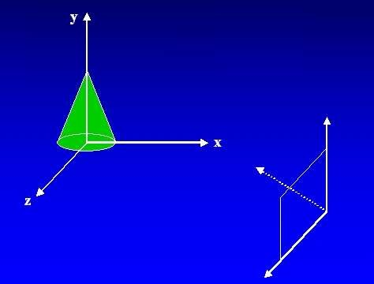
▶ This plane used to display a view of the object
▶ Object description has to transfer to the camera reference co- ordinates and projected onto the selected display plane.

Slide 13
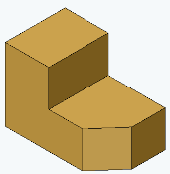
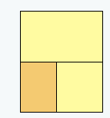
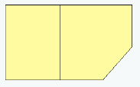
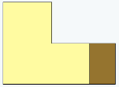
▶Project points on the object surface along parallel lines onto the display plane.
▶Parallel lines are still parallel after projection.
Parallel Projection
▶Used in engineering and architectural drawings.
▶Views maintain relative proportions of the object.
Top View
Side View
Front View

Slide 14
Perspective Projection
Project points to the display plane along converging paths.
This is the way that our eyes and a camera lens form images and so the displays are more realistic.
Parallel lines appear to converge to a distant point in the background.
Distant objects appear smaller than objects closer to the viewing position.

Slide 15
▶To easily identify the front and back of display objects.
Depth Cueing
▶Depth information can be included using various methods.
▶A simple method to vary the intensity of objects according to their distance from the viewing position.
▶Eg: lines closest to the viewing position are displayed with the higher intensities and lines farther away are displayed with lower intensities.

Slide 16
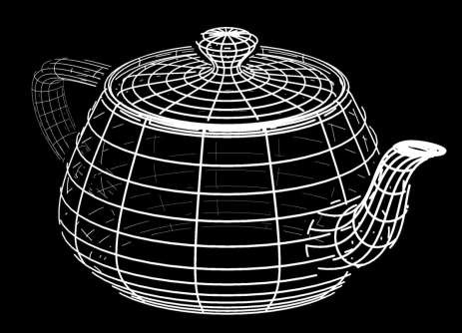
▶ Application :modeling the effect of the atmosphere on the pixel intensity of objects. More distant objects appear dimmer to us than nearer objects due to light scattering by dust particles, smoke etc.

Slide 17
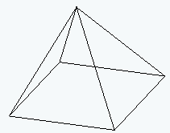
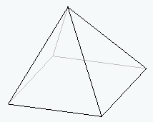
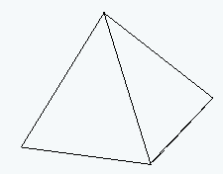
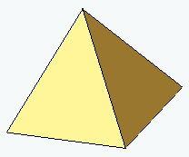
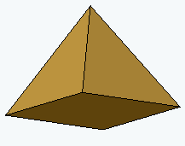
Visible line and surface identification
Highlight the visible lines or display them in different color
Display nonvisible lines as dashed lines
Remove the nonvisible lines

Slide 18
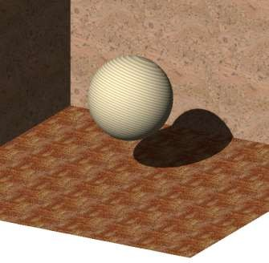
Surface rendering
Set the surface intensity of objects according to
▶Lighting conditions in the scene
▶Assigned surface characteristics
▶ Lighting specifications include the intensity and positions of light sources and the general background illumination required for a scene.
▶ Surface properties include degree of transparency
and how rough or smooth of the surfaces

Slide 19
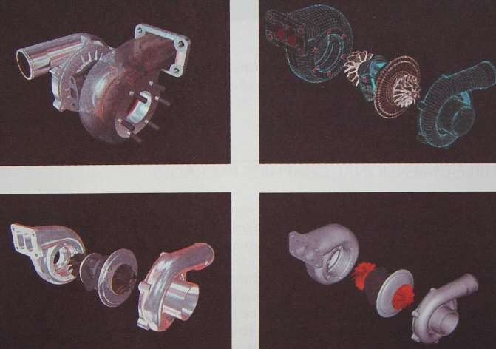
Exploded and Cutaway Views
▶ To maintain a hierarchical structures to include internal details.
▶ These views show the internal structure and relationships of the object parts

Slide 20
▶ To display objects using stereoscopic views Stereoscopic devices present 2 views of scene
Stereoscopic Views
▶ One for left eye.
▶ Other for right eye.
▶ These two views displayed on alternate refresh cycle of a raster monitor
▶ Then viewed through glasses that alternately darken first one lens then the other in synchronized with the monitor refresh cycle.

Slide 21
3D Object Representation
▶ Graphics scenes contain many different kinds of objects and material surfaces
▶ Trees, flowers, clouds, rocks, water, bricks, wood paneling,
rubber, paper, steel, glass, plastic and cloth
▶ Polygon and Quadric surfaces: For simple Euclidean objects eg: polyhedron and ellipsoid
▶ Spline surfaces and construction: For curved surfaces eg: aircraft wings , gears
▶ Procedural methods – Fractals: For natural objects eg: cloud, grass
▶ Octree Encoding: For internal features of objects eg:CT image

Slide 22
Representation schemes categories into 2
Boundary representation(B –reps)
▶ A set of surfaces that separate the object interior from the
environment
▶ Eg) Polygon facets, spline patches
Space-partitioning representation
▶ Used to describe interior properties.
▶ Partitioning the spatial region into a set of small, non overlapping, contiguous solids (usually cubes)
▶ Eg) octree representation

Slide 23
Polygon Surfaces
▶ Most commonly used boundary representation.
Polygon table
▶ Specify a polygon surfaces using vertex coordinates and attribute parameter.
Polygon data table organized into 2 group.
Geometric data table
Attribute table
1. Geometric data table: vertex coordinate and parameter to identify the spatial orientation.
3 lists
Vertex table –coordinate values of each vertex.
Edge table - pointer back to vertex table to identify the vertices for polygon edge.
Polygon table- pointer back to edge table to identify the edges for each polygon

Slide 24
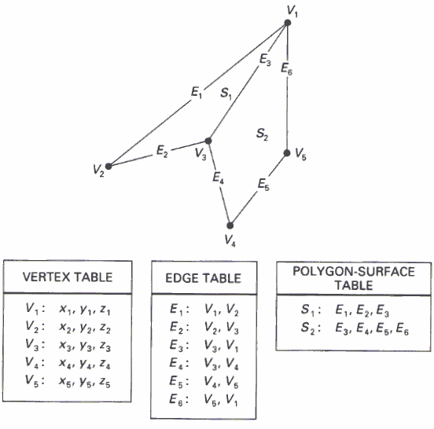

Slide 25
2. Attribute table: Degree of transparency and surface reflectivity etc.
Some consistency checks of the geometric data table:
▶ Every vertex is listed as an endpoint for at least 2 edges.
▶ Every edge is part of at least one polygon.
▶ Every polygon is closed.
▶ Each polygon has at least one shared edge.

Slide 26
▶ The equation for a plane surface expressed at the form
Plane Equation
Ax+By+Cz+D=0
▶ We can obtain the values of A,B,C,D by solving 3 plane equations using the coordinate values for 3
noncollinear points in the plane(x₁,y₁, z₁), (x₂,y₂, z₂), (x₃,y₃, z₃).
( A / D)x_{k} + (B / D) y_{k} + (C / D)z_{k} = −1,
k = 1,2,3

Slide 27



Slide 28
If we substitute any arbitrary point (x,y, z) into this equation, then,
Ax + By + Cz + D ≠0 implies that the point (x,y,z) not on a surface
Ax + By + Cz + D < 0 implies that the point (x,y,z) is inside the
surface.
Ax + By + Cz + D >0 implies that the point (x,y,z) is outside the surface.

Slide 29
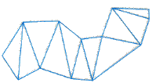
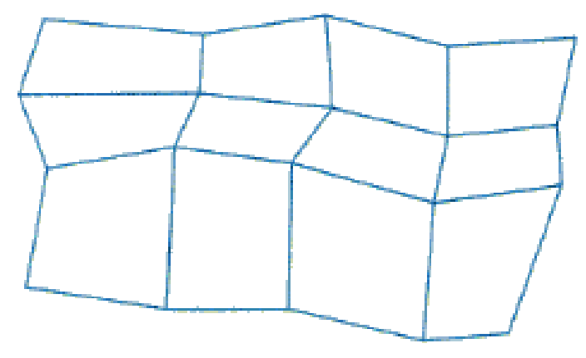
Polygon Meshes
▶ Object surfaces are tiled to specify the surface facets with mesh function.
Triangle strip - Produce n-2 connected triangles ,for n
vertices
Quadrilateral mesh - Produce (n-1)×(m-1) quadrilateral for
n×m array of vertices.

Slide 30
Quadric Surfaces
▶ Described with second degree equations
Quadric surfaces include:
▶ Spheres
▶ Ellipsoids
▶ Torus

Slide 31
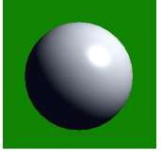
Sphere
▶ A spherical surface with radius r centred on the origin is defined as the set of points (x, y, z) that satisfy the equation
_{x}2
z axis
+ y² + z ² = r ²
▶ This can also be done in parametric
form using latitude and longitude angles
P ( x, y, z )
− ^{π} ₂ ≤ φ ≤ ^{π} ₂
−π ≤θ ≤ π
x axis
r
x = r cosφ cosθ y = r cosφ sinθ z = r sin φ
φ
θ
y axis

Slide 32
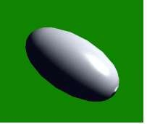
Ellipsoid
▶ An extension of a spherical surface
Where the radii in three mutually perpendicular directions ,have different values.
⎛ _{x} ⎞²
2
⎛ _{y} ⎞
⎛ _{z} ⎞²
⎜ ⎟
₊ ⎜ ⎟
₊ ⎜
⎟ = 1
r
⎜ _{r} ⎟
r
⎝ ^{x} ⎠
⎝
y ⎠ ⎝ z ⎠
▶ parametric form using latitude and longitude angles
x = r_{x} cosφ cosθ
₋ π
≤ φ ≤ ^{π}
y = r cosφ sin θ
2
2
y
z = r_{z} sin φ
−π ≤θ ≤ π

Slide 33
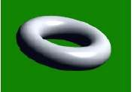
▶ Doughnut –shaped object.
Torus
⎡
2
⎛ _{x} ⎞²
⎛ _{y} ⎞ ⎤
2
⎛ _{z} ⎞²
⎢r −
⎜ ⎟
₊ ⎜
⎟ ⎥
₊ ⎜
⎟ = 1
⎢
⎢⎣
r
⎜ _{r} ⎟ ⎥
r
⎝ ^{x} ⎠
⎝
y ⎠ ⎥⎦ ⎝ z ⎠
▶ parametric form using latitude and longitude angles
x = r_{x} (r + cosφ ) cosθ
y = r_{y} (r + cosφ ) sin θ
z = r_{z} sin φ
−π ≤ φ ≤ π
−π ≤θ ≤ π

Slide 34
SuperQuadrics
▶ A generalization of quadric surfaces, formed by including additional parameters into quadric equations
▶ Increased flexibility for adjusting object shapes.
Superellipse
_{⎛ x ⎞}2 / S
2 / S
⎛ _{y} ⎞
⎜⎜ ⎟⎟
₊ ⎜
⎟
= 1
r
⎜ _{r} ⎟
⎝ ^{x} ⎠
⎝
y ⎠

Slide 35
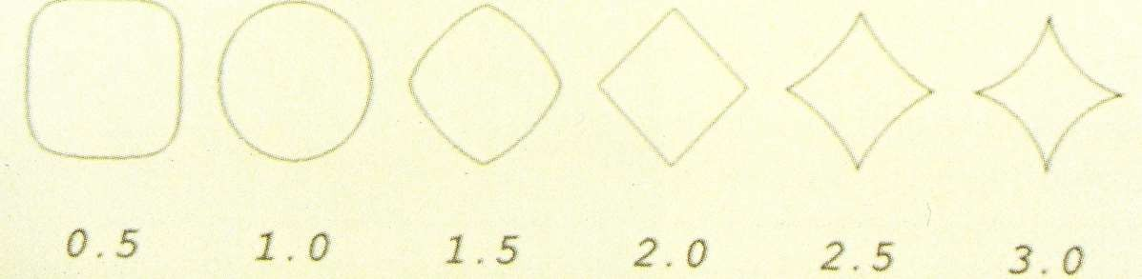
▶ When s=1 ,get an ordinary ellipse
▶ Parametric representation.
x = r cos^{s} θ
x
−π ≤θ ≤ π
y = r sin ^{s} θ
y

Slide 36
Superellipsoid
2 / S₂
⎤
S₂ / S₁
⎡⎛ _{x} ⎞
2 / S
1
⎛ _{y} ⎞
⎛ _{z} ⎞
2 / S
1
⎢⎜
⎟
₊ ⎜ ⎟ ⎥
₊ ⎜ ⎟
= 1
⎣⎝ r_{x} ⎠ r_{y⎠}
⎝ z ⎠
⎝
⎦
▶ For s1=s2=1_{r} ge t an ordinary ellipsoid
▶ Parametric representation.
x = r cos φ
y = r cos φ sin θ
z =
− ^{π} ₂ ≤ φ ≤ ^{π} ₂
−π ≤θ ≤ π
s
cos θ
1
s
2
x
s s
1 2
y
r sin φ
s
1
z

Slide 37
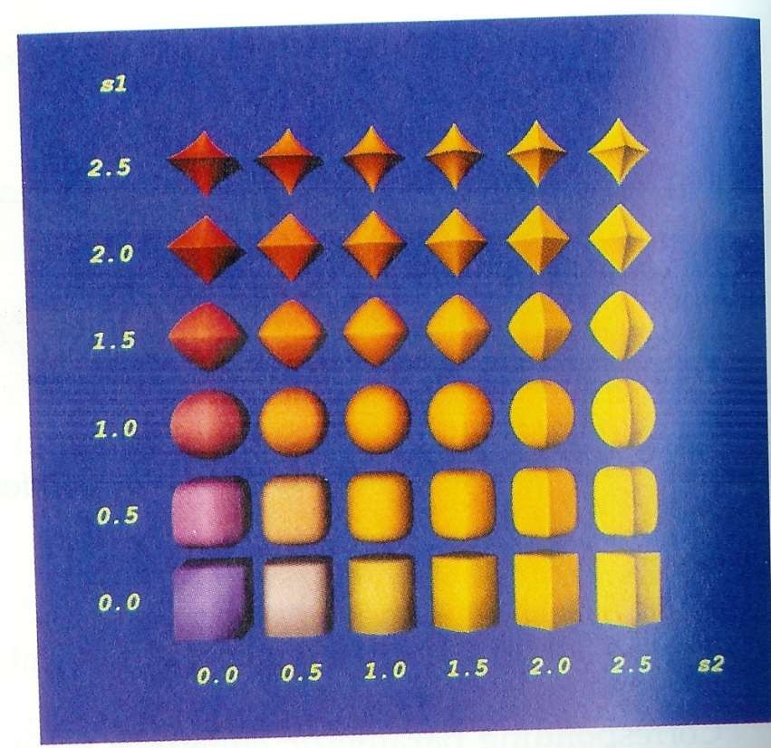

Slide 38
Spline Representation
▶ Spline is a flexible strip used to produce a smooth curve through a designed set of points.
▶ Spline mathematically describe with a piecewise cubic polynomial function whose first and second derivative are continuous across the various curve section.

Slide 39


▶ A spline curve is specified using a set of coordinate position called control points , which indicates the general shape of the curve.
▶ There are two ways to fit a curve to these points:
▶ Interpolation - the curve passes
through all of the control points.
▶ Approximation - the curve does not pass through all of the control points, that are fitted to the
general control-point path

Slide 40
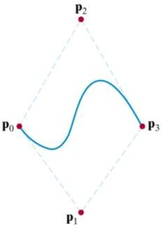
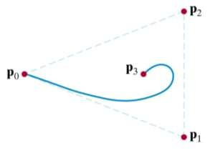
▶ The spline curve is defined, modified and manipulated with operation on the control points.
▶ The boundary formed by the set of control points for a spline is known as a convex hull

Slide 41
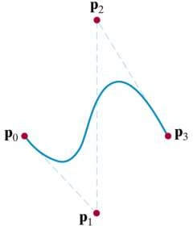
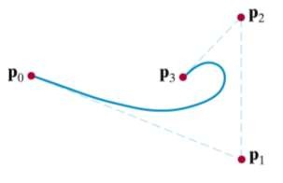
▶ A polyline connecting the control points is known as a control graph.
▶ Usually displayed to help designers keep track of their splines.

Slide 42
▶ For the smooth transition from one section of a piecewise parametric curve to the next, impose continuity condition at the connection points.
Parametric Continuity Condition
▶ Each section of a spline is described with parametric coordinate functions
x = x(u)
y = y(u)
z = z(u)
u₁ ≤ u ≤ u₂

Slide 43
Zero –order Parametric continuity (C⁰ )
▶ Simply means that the curves meet. That is x,y and z evaluated at u2 for the first curve section are equal to the values of x,y and z evaluated at u1 for the next curve section.
First –order Parametric continuity (C¹ )
▶ The first parametric derivatives(tangent lines) of the coordinate functions for two successive curve sections are equal at their joining point.
Second –order Parametric continuity (C² )
▶ Both first and second parametric derivatives of the two curve sections are the same at the intersection.

Slide 44
Geometric Continuity Condition
▶ In Geometric Continuity ,only require parametric derivatives of the two sections to be proportional to each other at their common boundary
Zero –order Geometric continuity (G⁰ )
▶ Same as Zero –order parametric continuity. That is the two curves sections must have the same coordinate position at the boundary point.
First –order Geometric continuity (G¹ )
▶ The first parametric derivatives(tangent lines) of the coordinate functions for two successive curve sections are proportional at their joining point.
Second –order Geometric continuity (G² )
▶ Both first and second parametric derivatives of the two curve sections are proportional at their boundary.

Slide 45
▶ Three methods for specifying a spline representation.
Spline Specification
We can state the set of boundary conditions that are imposed on the spline.
We can state the matrix that characterizes the spline.
We can state the set of blending functions.

Slide 46
▶ Parametric cubic polynomial representation for the x coordinate of a spline section
x(u) = a u³ + b u ² + c u + d , 0 ≤ u ≤ 1
x x x x
▶ Boundary condition set on the endpoint coordinates x(0) and x(1) and on first parametric derivatives at the endpoints x’(0) and x’(1).

Slide 47
▶ From the boundary condition, obtain the matrix that characterizes the spline curve.
⎡ª_{x} ⎤
⎢_{b} ⎥
³ ² _{1⎤} ⎢ _{x} ⎥
x(u) = ⎡u
u u
⎢⎣
⎥⎦ ⎢_{cx} ⎥
⎢_{d} ⎥
⎢⎣ ^{x ⎥}⎦
= U ⋅ C
^{C = M}spline ^{⋅ M}geom
x(u) = U ⋅ M_{spline} ⋅ M_{geom}

Slide 48
Finally the polynomial representation
x(u) = ∑ g_{k} ⋅ BF_{k} (u)
3
k =0

Slide 49
Bezier Curve and Surfaces
▶ This spline approximation method developed by the French engineer Pierre Bezier for use in the design of Renault automobile bodies.
▶ Easy to implement.
▶ Available in CAD system, graphic package, drawing and painting packages.
Bezier Curve
▶ A Bezier curve can be fitted to any number of control points.
▶ Given n+1 control points position
p_{k}=(x_{k}, y_{k}, z_{k}) 0≤k≤n

Slide 50
▶ The coordinate positions are blended to produce the position vector P(u) which describes the path of the Bezier polynomial function between p₀ and p_{n}
P(u) = ∑ p_{k} BEZ _{k ,n} (u),
k =0
n
0 ≤ u ≤ 1
▶ The Bezier blending functions BEZ_{k,n}(u) are the
Bernstein polynomials
BEZ (u) = C(n, k)u^{k} (1− u)^{n−k}
k,n

Slide 51
▶where parameters C(n,k) are the binomial coefficients
n!
C(n, k) =
k!(n − k)!
▶The individual curve coordinates can be given as follows
x(u) = ∑ x_{k} BEZ _{k ,n} (u)
k =0
y(u) = ∑ y_{k} BEZ_{k ,n} (u)
k =0
n
n
z(u) = ∑ z_{k} BEZ _{k ,n} (u)
k =0
n

Slide 52
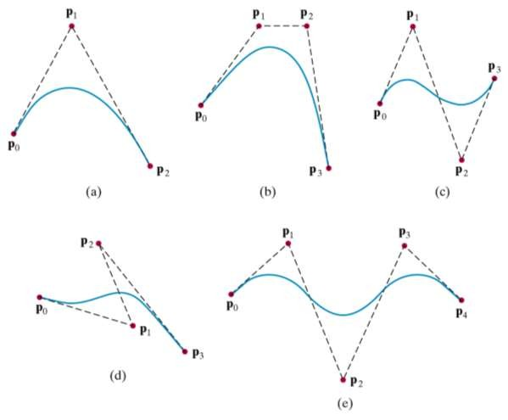
Properties Of Bezier Curves
▶ Bezier Curve is a polynomial of degree one less than the number of control points

Slide 53
▶ Bezier Curves always passes through the first and last control points.
P(0) = p₀
P(1) = p_{n}
▶ Bezier curves are tangent to their first and last edges of control garph.
▶ The curve lies within the convex hull as the Bezier blending functions are all positive and sum to 1
∑ BEZ_{k ,n} (u) = 1
k =0
n

Slide 54
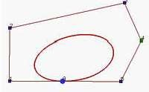
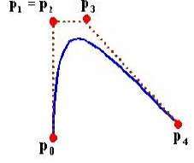
Design Techniques
▶ Closed Bezier curves are generated by specifying the first and last control points at same position.
▶ Specifying multiple control points at a single coordinate position gives more weight to that position.

Slide 55
Cubic Bezier Curve
▶ Cubic Bezier curves are generated with 4 control points.
▶ Cubic Bezier curves gives reasonable design flexibility while avoiding the increased calculations needed with higher order polynomials.
The blending functions when n = 3
BEZ = (1− u)³ BEZ = 3u(1− u)² BEZ = 3u² (1− u) BEZ = u³
0,3
1,3
2,3
3,3

Slide 56
▶ At u=0, BEZ_{0,3}=1, and at u=1, BEZ_{3,3}=1. thus, the curve will always pass through control points P₀ and P₃.
▶ The functions BEZ_{1,3} and BEZ_{2,3}, influence the shape of the curve at intermediate values of parameter u.
▶ The resulting curve tends toward points P1 and P3.

Slide 57
▶ Two sets of orthogonal Bezier curves are used to design surface.
Bezier Surface
m n
P(u, v) = ∑ ∑ p _{j ,k} BEZ _{j ,m} (v)BEZ _{k ,n} (u)
j =0 k =0
P_{j,k} specify the location of the control points.

Slide 58
B-Spline Curves and Surfaces
The degree of a B-spline polynomial can be set independently of the number of control points.
B-splines allow local control over the shape of a spline curve (or surface)

Slide 59
▶ The point on the curve that corresponds to a knot is referred to as a knot vector.
▶ The knot vector divide a B-spline curve into curve subinterval, each of which is defined on a knot span.

Slide 60
▶ Given n + 1 control points P₀, P₁, ..., P_{n}
▶ Knot vector U = { u₀, u₁, ..., u_{n+d} }
▶ The B-spline curve defined by these control points and knot vector
n
P(u) = p B
(u), u ≤ u , 2 ≤ d ≤ n +1
∑
k = 0
k k, d
min max
P_{k} is kth control point Blending function B_{k,d}
of degree d-1

Slide 61
if u_{k} ≤ u_{k +1}
▶ Blending functions defined with Cox-deBoox recursive form
B (u) = ^{⎧ 1,}
⎨
k ,1
⎩0, otherwise
^{u}k +d
u
B (u) = ^{u − uk}
B (u) +
B
(u)
k ,d
u
k ,d −1
u − u
k +1,d −1
k +d −1
k +d
k +1

Slide 62
To change the shape of a B-spline curve, modify one or more of these control parameters:
The positions of control points
The positions of knots
The degree of the curve

Slide 63
Uniform B-Spline
▶ The spacing between knot values is constant.
Non-uniform B-spline
▶ Unequal spacing between the knot values.
Open uniform B-Spline
▶ This B-Spline is across between Uniform B-Spline and non-uniform B-Spline.
▶ The knot spacing is uniform expect at the ends where knot values are repeated d times

Slide 64
Similar to Bezier surface
B-Spline Surfaces
n₁ n₂
P(u, v) = ∑ ∑ p_{k1 ,k2} B_{k1 ,d1} (u)B_{k2 ,d2} (v)
k₁ =0 k₂ =0

Slide 65
Sweep Representations
▶ Sweep representations are useful for constructing 3 dimensional objects that possess translational, rotational or other symmetries.
▶ Objects are specified as a 2 dimensional shape and a sweep that moves that shape through a region of space

Slide 66
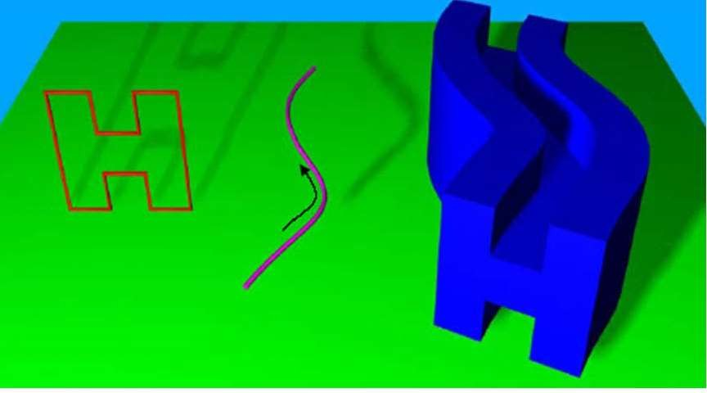

Slide 67
Octrees
▶ Octrees are hierarchical tree structures used to represent solid objects.
▶ Octrees are particularly useful in applications that require cross sectional views – for example medical applications.

Slide 68
▶ Octrees are based on a two-dimensional representation scheme called quadtree encoding.
Octrees & Quadtrees
▶ Quadtree encoding divides a square region of space into four equal areas until homogeneous regions are found.
▶ These regions can then be arranged in a tree

Slide 69
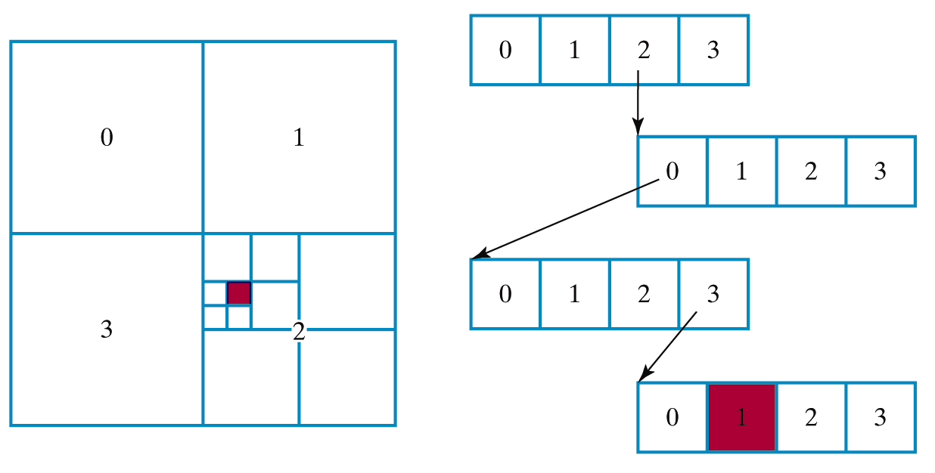
▶ Quadtree Example

Slide 70
▶ An octree takes the same approach as quadtrees, but divides a cube region of 3D space into octants.
▶ Each region within an octree is referred to as a
volume element or voxel.
▶ Division is continued until homogeneous regions are discovered

Slide 71
