Slide 1
Computer Graphics
Color Models
1

Slide 2

Properties of Light Color Models
Standard primaries and the chromaticity diagram The RGB color model
The YIQ and related color model The HSV color model
The HSL Color model
The CMY and CMYK Color models
Color Models Applications
2

Slide 3
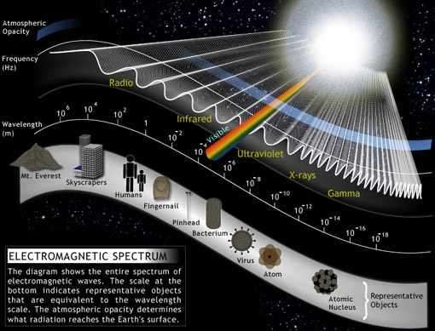
Properties of Light
FIGURE-1
Each frequency value within the visible region of the electromagnetic spectrum corresponds to a distinct spectral color.
3

Slide 4
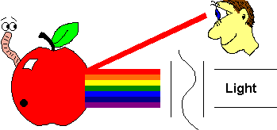
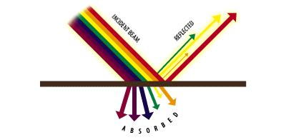
Properties of Light
When white light is incident on an opaque object , some frequencies are reflected and some are absorbed.
The combination of frequencies present in the reflected in the reflected light determines the color of the object that we see.(Dominant frequency or Hue)
‹#›

Slide 5
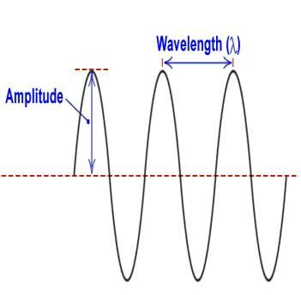
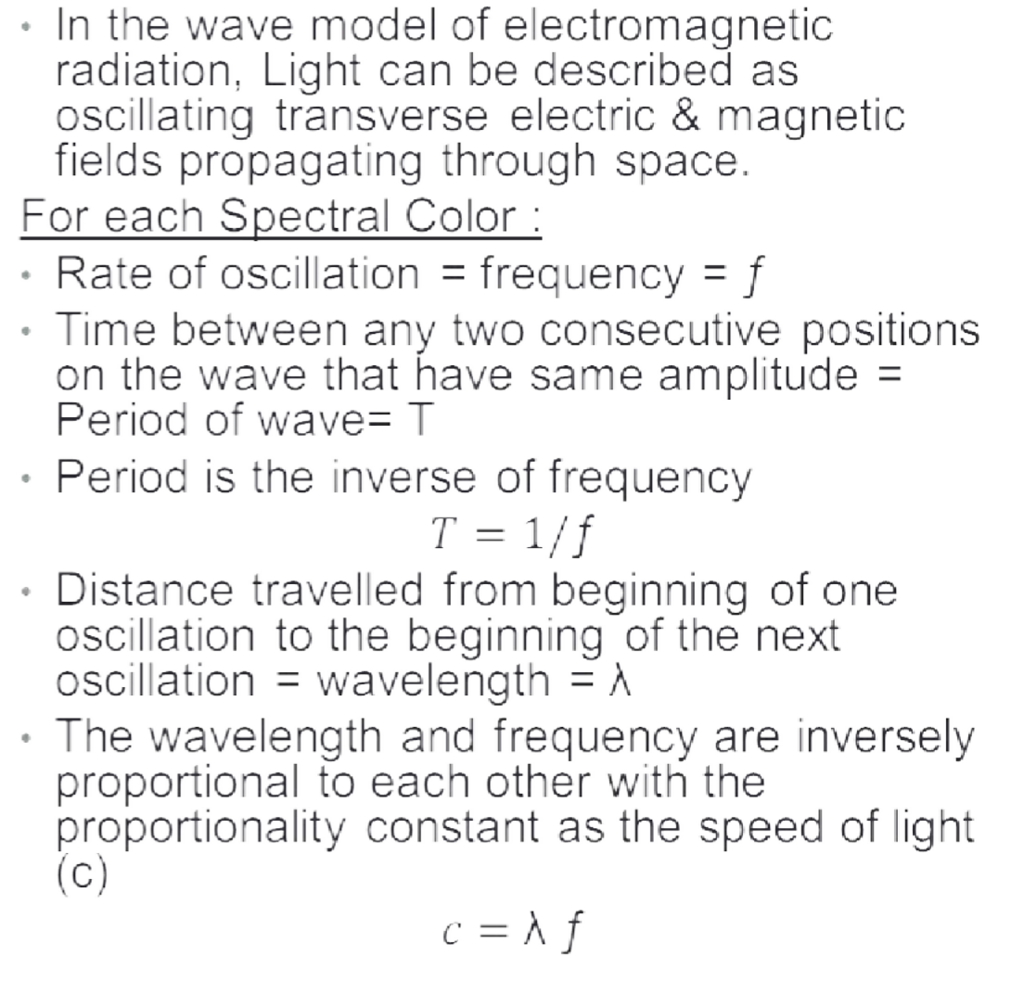
Properties of Light
Period (T)
‹#›

Slide 6
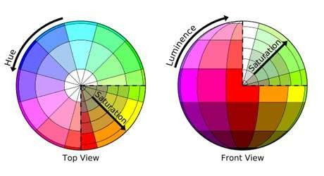
Characteristics of Color
Dominant Frequency (Hue) The color we see (red, green, purple).
Brightness
The total light energy, how bright is the color (How bright are the lights illuminating the object?)
Purity (Saturation)
Purity describes how close a light appears to be to a pure spectral color, such as pink is less saturated than red.
Chromaticity refers to the two properties (purity & hue) together.
6

Slide 7
Color Model
A color model is an abstract mathematical model describing the way colors can be represented as tuples of numbers, typically as three or four values or color components. [Wikipedia]
Any method for explaining the properties or behavior of color within some particular context is called a Color Model.[Hearn, Baker ,computer graphics with OpenGL]
7

Slide 8
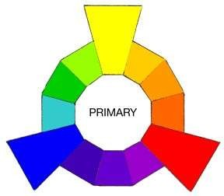
Color Model
Primary Colors
Sets of colors that can be combined to make a useful range of colors
Color Gamut
Set of all colors that we can produce from the primary colors.
Complementary Colors
Pairs of colors which, when combined in the right proportions,
produce white.
Example, in the RGB model: red & cyan , green & magenta , blue & yellow.
No finite set of real primary colors can be combined to produce all possible visible
colors.
However, given a set of three primary colors, we can characterize any fourth color
using color-mixing processes.
8

Slide 9
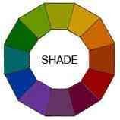
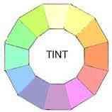
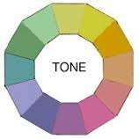
Color Model
Shades , Tints & Tones
A shade is produced by “dimming ” a hue.[Adding black].
Dark Blue = pure blue + black
A tint is produced by "lightening" a hue. [Adding white].
Pastel red = pure red + white
Tone refers to the effects of reducing the "colorfulness" of a hue. [adding gray] or [adding black & white].
Thus, shading takes a hue toward black, tinting takes a hue
towards white, and tones cover the range between.
9

Slide 10
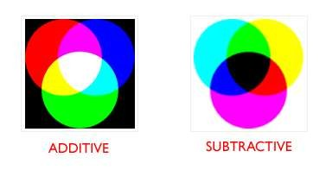
Color Model
Additive color
Uses light to display color. Mixing begins with black and ends with white; as more
color is added, the result is lighter and tends to white. Used for computer displays
Example: The RGB colors are light primaries and colors are created with light.
A subtractive color
Uses ink to display color. Mixing means that one begins with white and ends with black; as one adds color, the result gets darker and tends to black. Used for printed material
It is called 'subtractive' because its wavelength is less than sum of the wavelengths
of its constituting colors.
Example: The CMYK color system is the color system used for printing.
10

Slide 11
Standard Primaries & the chromaticity diagram
This is an international standard for primary colors
established in 1931.
It allows all other colors to be defined as weighted sum of the three "primary" colors.
There are no real three colors that can be combined to give all possible colors. Therefore the Three standard primaries are selected [imaginary numbers].
They are defined mathematically with positive color-matching functions that specify the amount of each primary needed to describe any spectral color.
11

Slide 12
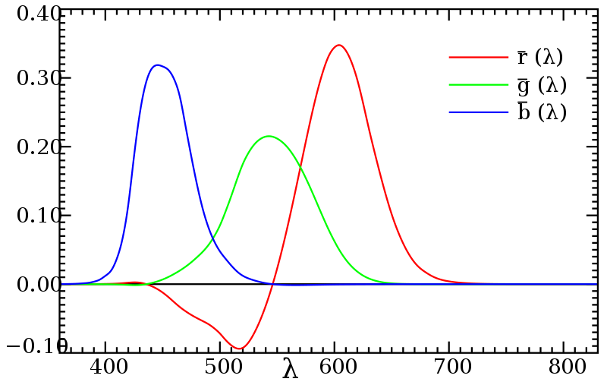
Standard Primaries & the chromaticity diagram
Color-matching functions
A color in the vicinity of 500nm can be matched only but subtracting an amount of red light from a combination of blue and green lights.
12

Slide 13
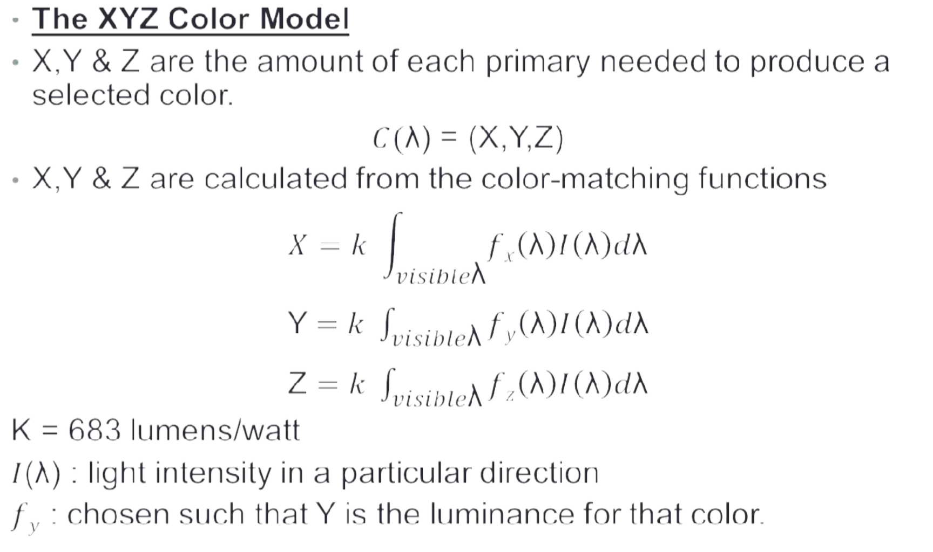
Standard Primaries & the chromaticity diagram
13

Slide 14
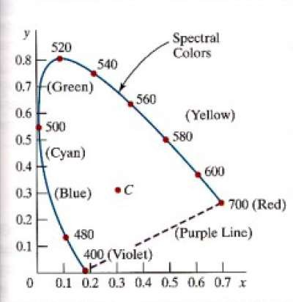

Standard Primaries & the chromaticity diagram
To define a color in CIE model, provide weights for the X, Y and Z primaries, just as you would for an RGB display (e.g. color = xX + yY + zZ).
X, Y and Z form a three dimensional color volume.
We can ignore the dimension of luminance by
normalizing with total light intensity, x+y+z = 1.
14
CIE chromaticity diagram.

Slide 15
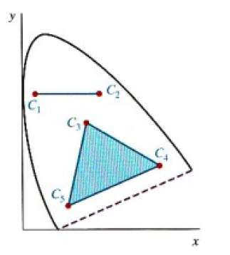
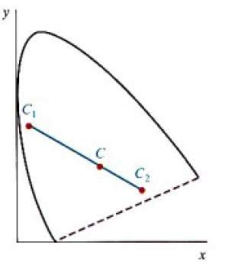
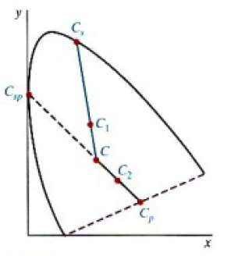
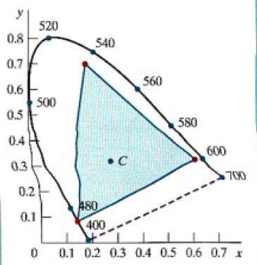
Standard Primaries & the chromaticity diagram
Gamut Color
Complementary Color
Dominant Wavelength
& Purity
RGB Model
15

Slide 16
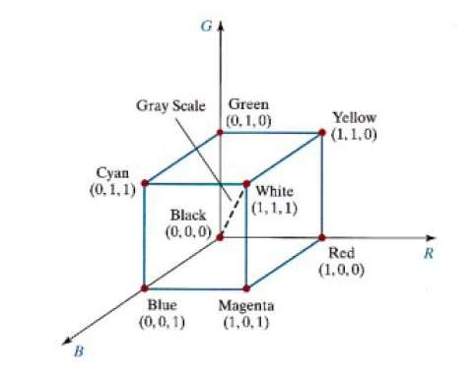
RGB Model
The red, green, and blue (RGB) color space is
widely used throughout computer graphics.
Additive Color Model.
Unit Cube defined on R, G & B axes.
The Origin (0,0,0) represents black and the diagonally opposite vertex (1,1,1) is White.
Vertices of the cube on the axes represent primary colors, and the remaining vertices are the complementary color points for each of the primary colors.
Shades of gray are represented along the main diagonal.
16

Slide 17
RGB Model
Each color point within the unit cube can be represented as w weighted vector sum of the primary colors, using unit vectors R,G and B.
C(λ) =(R,G,B) = RR +GG+ BB
Where R,G, and B are assigned values in the range from 0 to 1.0.
For example , the magenta vertex is obtained by adding the
maximum red and blue values to produce : (1,0,1)

Slide 18
YIQ model
YIQ model is used for US TV broadcast.
This model was designed to separate chrominance (I and
Q) from luminance (Y).
This was a requirement in the early days of color television when black-and-white sets still were expected to pick up and display what were originally color pictures
The Y-channel contains luminance information (sufficient for black-and-white television sets) while the I and Q channels carried the color information.

Slide 19
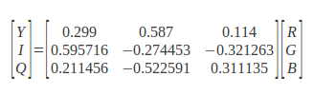

YIQ model
A color television set would take these three channels, Y, I, and Q, and map
the information back to R, G, and B levels for display on a screen.
The advantage of this model is that more bandwidth can be assigned to the Y-component (luminance) because the human visual system is more sensitive to changes in luminance than to changes in hue or saturation
Convert From RGB To YIQ
Convert From YIQ To RGB

Slide 20
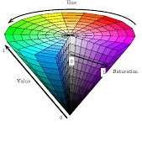
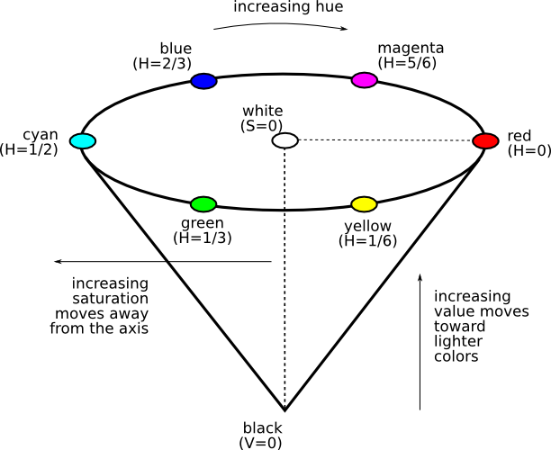
HSV Model
Every color is represented by three components Hue ( H ),
Saturation ( S ) and Value ( V )

Slide 21
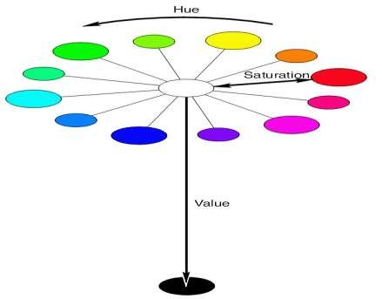
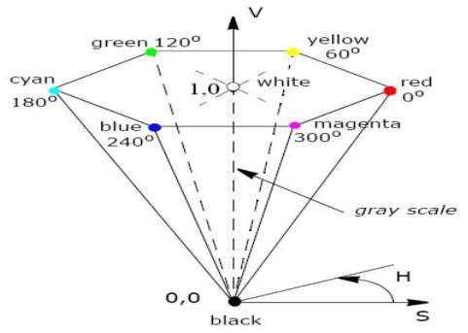
HSV Model
The Hue (H) of a color refers to which pure color it resembles. All tints, tones and shades of red have the same hue. (simply the color we see)

Slide 22
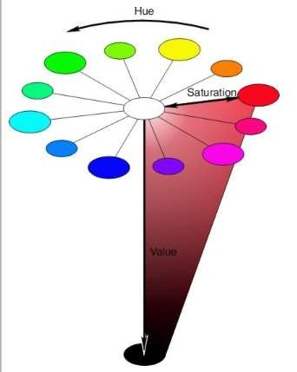
HSV Model
The Saturation (S) of a color describes how white the color is. Or the amount of white added to the color. A pure red is fully saturated (S=1) means no white added

Slide 23
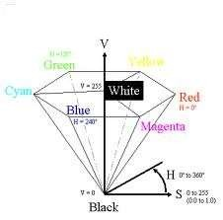
HSV Model
The Value (V) of a color, also called its lightness, describes how dark the color is. A value of 0 is black, with increasing lightness moving away from black.

Slide 24
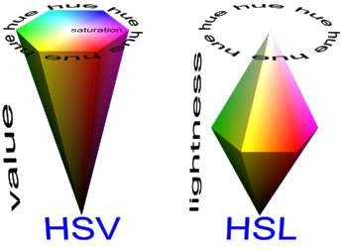
HSL Model
Double-cone Representation
Parameters are :
Hue (H)
Lightness (L)
Saturation (S)

Slide 25
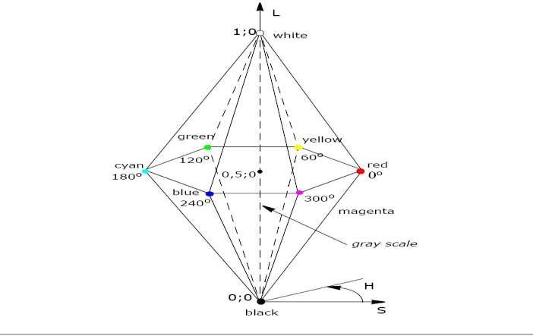
HSL Model
Vertical Axis is called Lightness(L).
At L=0 we have black , and at L=1 we have white
Grayscale values are along the L axis
The pure colors lie at the axis where L=0.5 and S=1.0

Slide 26
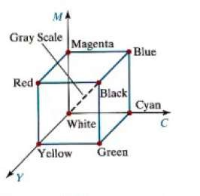
CMY and CMYK Model
Subtractive Color Model.
Stands for cyan-magenta-yellow.
Used for hardcopy devices (ex. Printers).
A printed color that looks red absorbs the other two components G and B and reflects R.
Thus the C-M-Y coordinates are just the complements of the R-G-B coordinates.
26

Slide 27


CMY and CMYK Model
In additive color models such as RGB, white is the “additive” combination of all primary colored lights, while black is the absence of light.
In the CMYK model, it is the opposite: white is the natural color of the paper or other background, while black results from a full combination of colored inks.
RGB To CMY CMY To RGB
27

Slide 28
CMY and CMYK Model
CMYK Color Model
Although cyan, magenta and yellow inks might be expected be sufficient for
color printing, most actual color printing uses black ink in addition.
This is partly because a mixture of the first three inks may not yield a black that is neutral enough, or dark enough, but also because the use of black spares the use of the more expensive colored inks, and also reduces the total amount of ink used, thus speeding drying times.
K used instead of equal amounts of CMY
called under color removal
richer black
less ink deposited on paper – dries more quickly
First approximation – nonlinearities must be accommodated:
K = min(C, M, Y) C’ = C – K
M’ = M – K
Y’ = Y – K
28

Slide 29
Color Models Applications
Color Model Application Area | Color Model Application Area
RGB | Computer graphics Image processing Image Analysis Image Storage
CMY(K) | Printing
HSV, HSL | Human visual perception Computer graphics processing Computer Vision Image Analysis Design image Human vision Image editing software Video editor
YIQ | TV broadcasting Video system

