Slide 1
RGB And CMY COLOR MODEL
‹#›

Slide 2
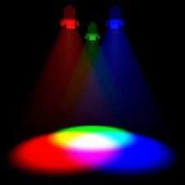
Color Model
“Color model is an orderly system for creating a whole ranges of color from a small set of primary color”.
A color model is a way to turn colors into numbers with a mathematical formula.
‹#›

Slide 3
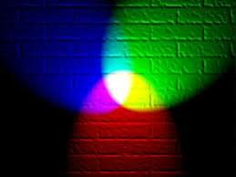





TYPES OF COLOR MODEL
RGB Color Model
CMY(K) Color Model
‹#›

Slide 4


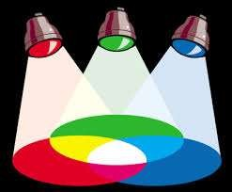
Additive color model.
For computer displays.
Uses light to display color.
Colors result from transmitted light.
Red + Green + Blue = White.
‹#›

Slide 5

If we are working on a computer, the colors we see on the screen are created
with light using
the method. Additive color
additive mixing
color begins
with black and ends with white; as more color is added, the result is lighter and tends to white.
‹#›

Slide 6


The RGB primaries
colors and
are colors
light are
created with light.
Percentages of red, green, & blue are used to generate color on a computer screen.
‹#›

Slide 7




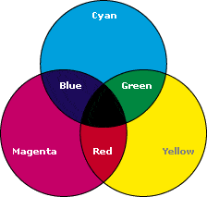
Subtractive color model.
For printed material.
Uses ink to display color.
Colors result from reflected light.
Cyan + Magenta + Yellow = Black.
‹#›

Slide 8

subtractive color
When we mix colors using paint, or through the printing process, we are using the subtractive color method. Subtractive color mixing means that one begins with white and ends with black; as one adds color, the result gets darker and tends to black.
8

Slide 9
The CMYK color system is the color system used for printing
Those colors used in painting- an example of the subtractive color method
9

Slide 10
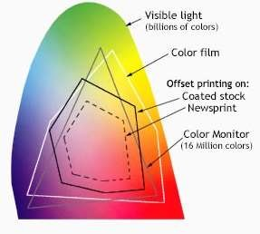
Working with systems
Visible spectrum consists of billions of colors, a monitor can display millions, a high quality printer is only capable of producing thousands, and older computer systems may be limited to 216 cross-platform colors.
Reproducing color can be problematic with regard to print digital media.
A computer monitor able to display 'true color' (16,000,000 colors).
10

Slide 11



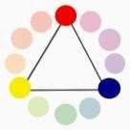
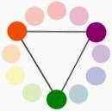
* Primary Colors: colors at their basic essence; those that cannot be created by mixing others
* Secondary Colors: Those colors achieved by a mixture of two primaries

Slide 12



* Tertiary Colors: Those colors achieved by a mixture of primary and secondary hues
* Complementary Colors : Those colors located opposite each other on a color wheel.

Slide 13

Importance of rgb color model
The color model RGB is used in hardware applications like PC monitors, cameras and scanners,
It is used for Web graphics, but it cannot be used for print production.
It directly reflects the physical properties of "True-color" displays

Slide 14

Importance of rgb color model
It is used—
For sensory representation
Display of text images in electronic system,
For example-Computer, T.V., Camera

Slide 15
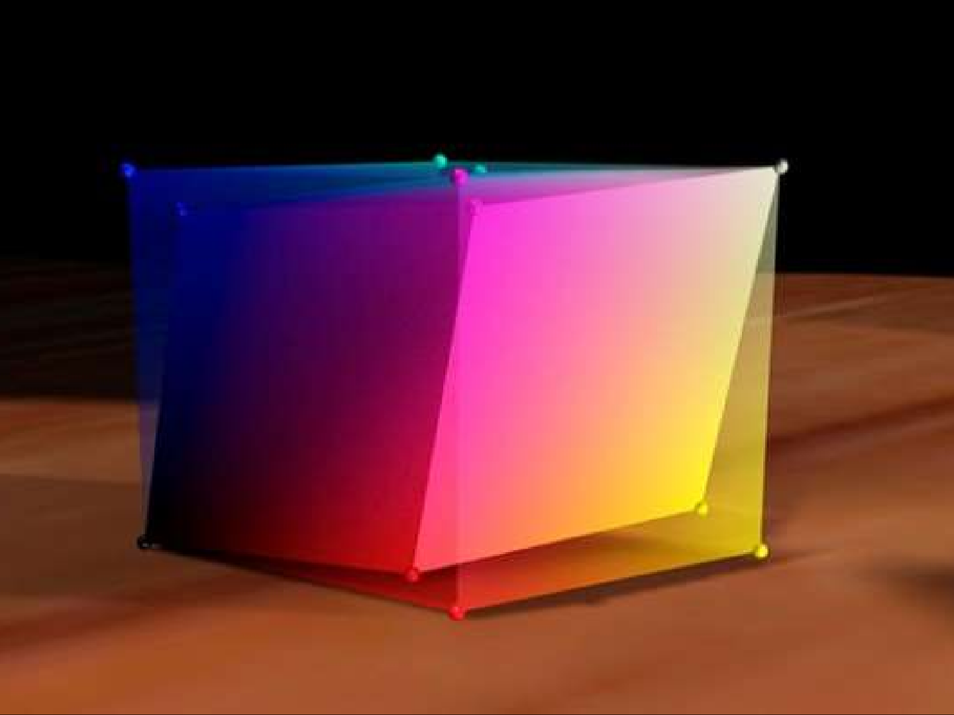
Importance of cmy color model
the CMY color model is used in color printers.
It is created by the subtractive mode
Used in most commercial color printing (books, magazines, etc.)

Slide 16

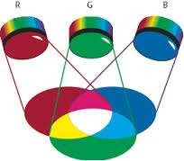
Primary colors are:
Red – Green - Blue
Secondary colors are:
Red + Blue =Magenta
Green +Blue = Cyan
Red + Green = Yellow
Other Possible Combinations:
White = Blue (Primary) + Yellow (Secondary)
White = Green (Primary) + Magenta (Secondary) White = Red (Primary) + Cyan (Secondary)

Slide 17
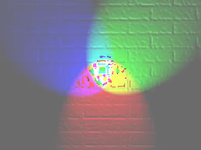
Numeric representations
Atypical RGB color selector in graphic software. Each slider ranges from 0 to 255.
Hexadecimal 8-bit RGB representations of the main 125 colors
A color in the RGB color model is described by indicating how much of each of the red, green, and blue is included.

Slide 18
Numeric representations
The color is expressed as an RGB triplet (r,g,b), each component of which can vary from zero to a defined maximum value. If all the components are at zero the result is black; if all are at maximum, the result is the brightest represent able white.

Slide 19
Numeric representations
Notation | RGB triplet
Arithmetic | (1.0, 0.0, 0.0)
Percentage | (100%, 0%, 0%)
Integer number | (255, 0, 0)

Slide 20
Some examples of 24-bit repesentation of colors:
(255, 255, 255) represents white
(0, 0, 0) represents black
(255, 0, 0) represents red
(0, 0, 255) represents blue
(0, 255, 0) represents green
(255, 255, 0) represents yellow
(255, 0, 255) represents magenta
(0, 255, 255) represents cyan
Full range RGB can represent up to 255 shades of a given hue. But, pure reds, blues, or greens have this full range of shades.
20

