Slide 1
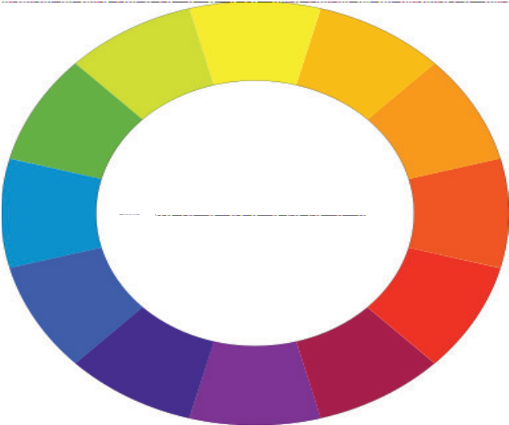
Color Model
🞆
Color Model

Slide 2
COLOR MODEL
There are conventionally two types models
Additive color model such as RGB
Subtractive color model such as CMY
Additive colors use light to display color.
Subtractive color use printing inks.
of color

Slide 3
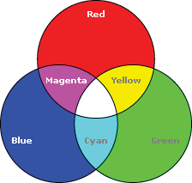


































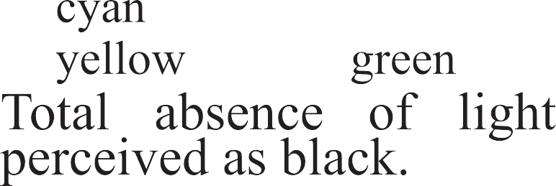


COLOR MODEL
RGB color model
●
●
●
●
●
●
●
●
🞆

Slide 4
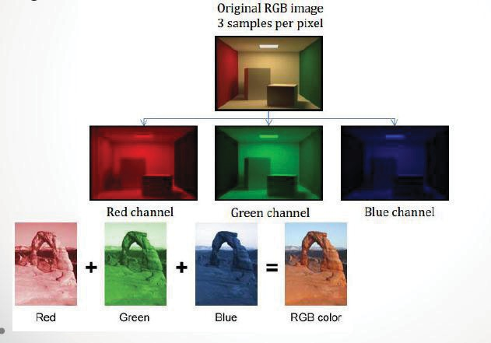
COLOR MODEL

Slide 5
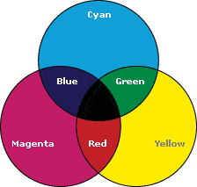
























COLOR MODEL
CMYK Color Model:
●
●
●
●
●
●

Slide 6
COLOR MODEL
Storage of colors
Direct coding
Lookup tables
Lets say we have 1 bit to represent colors.
RGB would require 3 bits.
Total possible colors are 2³.
R | G | B
0 | 0 | 0
0 | 0 | 1
0 | 1 | 0
0 | 1 | 1
1 | 0 | 0
1 | 0 | 1
1 | 1 | 0
1 | 1 | 1

Slide 7
COLOR MODEL
Widely accepted standard uses 3 bytes/ pixel
How many bits for each channel (RGB) ?
How many different colors do we have ?
Image of 1000 x 1000 would requires how many bytes of memory to store pixel colors ?

