Slide 1
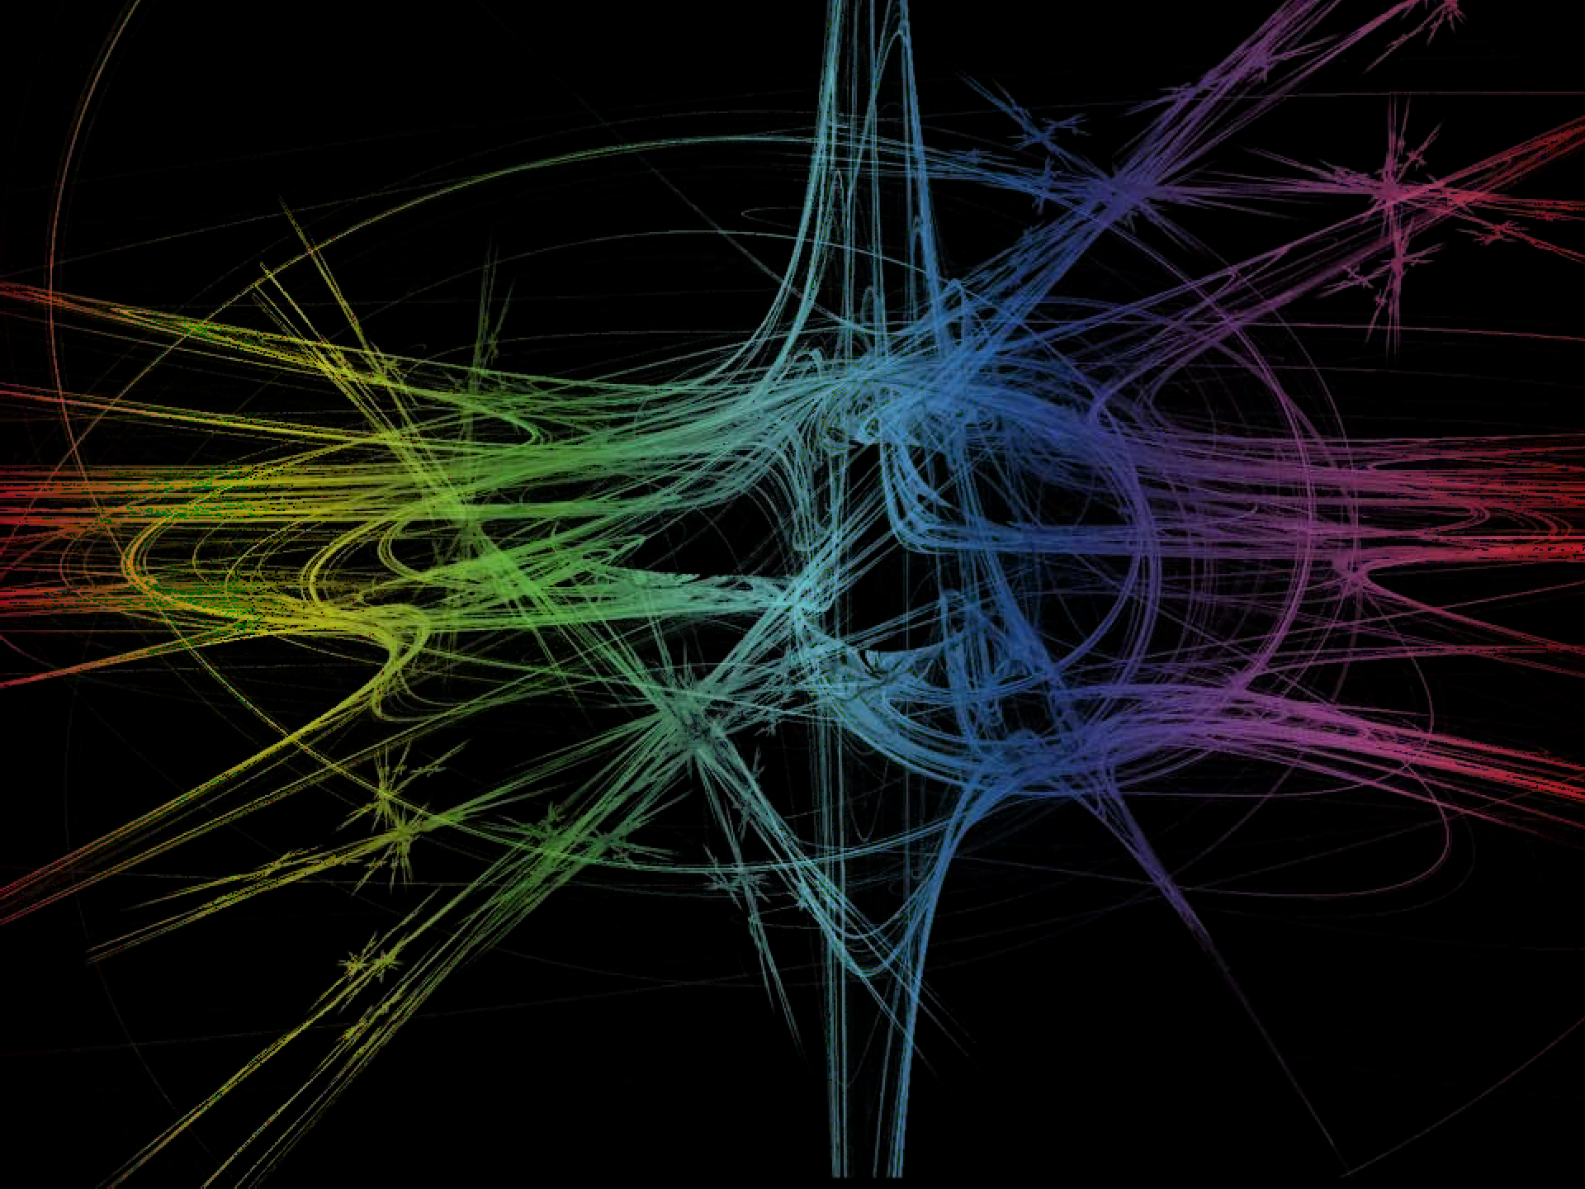
COLOR MODELS

Slide 2
RGB Color Model
Based on “tristimulus theory of vision”
eyes perceive color through the stimulation of three visual pigments in the cones of the retina
peak sensitivity at wavelengths of about 630 nm (red), 530 nm (green), and 450 nm (blue)
Represented as a unit cube defined on R, G, B axes
Color C_{k} = RR + GG + BB

Slide 3
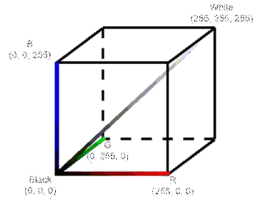
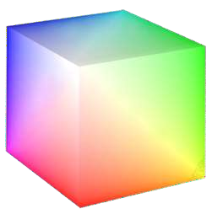
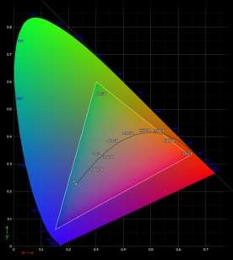
RGB Color Model (Contd..)
"Cie Chart with sRGB gamut by spigget" by Spigget - Own work. Licensed under Creative Commons Attribution-Share Alike 3.0 via Wikimedia Commons - http://commons.wikimedia.org/wiki/File:Cie_Chart_with_sRGB_gamut_ by_spigget.png#mediaviewer/File:Cie_Chart_with_sRGB_gamut_by_spig get.png

Slide 4
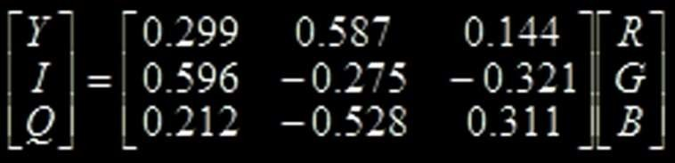

YIQ Color Model
National Television System Committee (NTSC) color model for forming the composite video signal

Slide 5
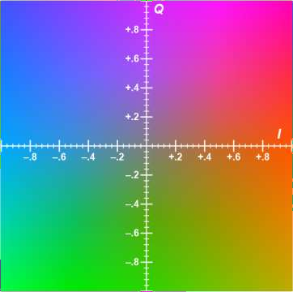
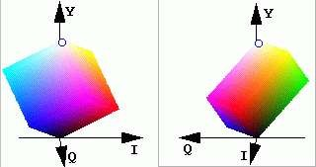
YIQ Color Model (Contd…)
"YIQ IQ plane" by Tonyle - Own work. Licensed under Creative Commons Attribution-Share Alike 3.0 via Wikimedia Commons - http://commons.wikimedia.org/wiki/File:YIQ_IQ_plane.s vg#mediaviewer/File:YIQ_IQ_plane.svg

Slide 6
CMY Color Model
Defined with the primary colors cyan, magenta, and yellow
Useful for describing color output to hard- copy devices

Slide 7
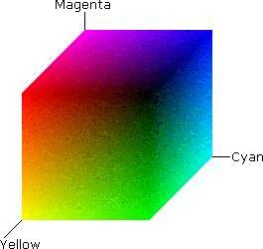
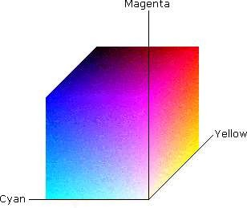
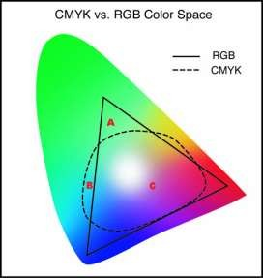
CMY Color Model (Contd…)

Slide 8
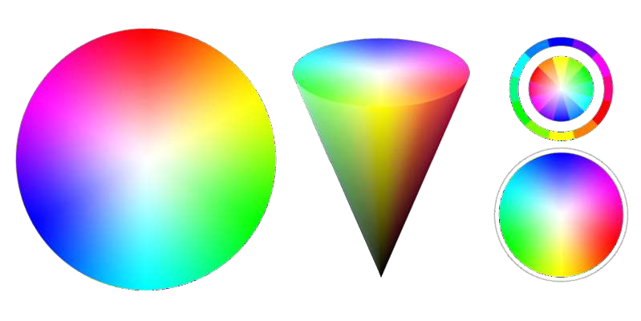
HSV Color Model
Color parameters in this model are hue ( H ) , saturation( S ) and value( V )
3D representation is derived from RGB Cube.

Slide 9
Reference
Donald Hearn, Pauline Baker, Computer Graphics – C Version, Second Edition, Pearson Education, 2004.

