Slide 1
Fractal Geometry Methods
Geometry methods can be used to model objects with smooth surfaces and regular shapes
BUT are inadequate to model irregular objects like
shorelines,
mountains,
trees,
clouds, etc

Slide 2
Fractal Geometry Methods (cont)
Typically used to model objects with following properties:
Irregular
Randomly jagged, but constrained
Non-fluid
On zooming in, the shape becomes more irregular
On zooming out, the shape becomes less irregular

Slide 3
Fractal Geometry Methods (cont.)
A fractal object has two basic characteristics
Infinite detail at every point
If we zoom in, we see more detail of the object
Self-similarity between object parts and the overall features of the object

Slide 4
Fractal Generation Procedures
A fractal object is generated by repeatedly applying a specified transformation function to points within a region of space
If P₀=(x₀,y₀,z₀) then
P₁=F(P₀ ), P₂=F(P₁ ), P₃=F(P₂ ), …
Transformation function can be applied to points or to a set of primitives such as lines, curves, color areas or surfaces

Slide 5
KOCH CURVE- One of the Simplest Examples
Fractals start with an initiator, which is a given geometric shape, and iteratively apply a generator, which is a pattern.
KOCH curve initiator is
KOCH curve generator is

Slide 6
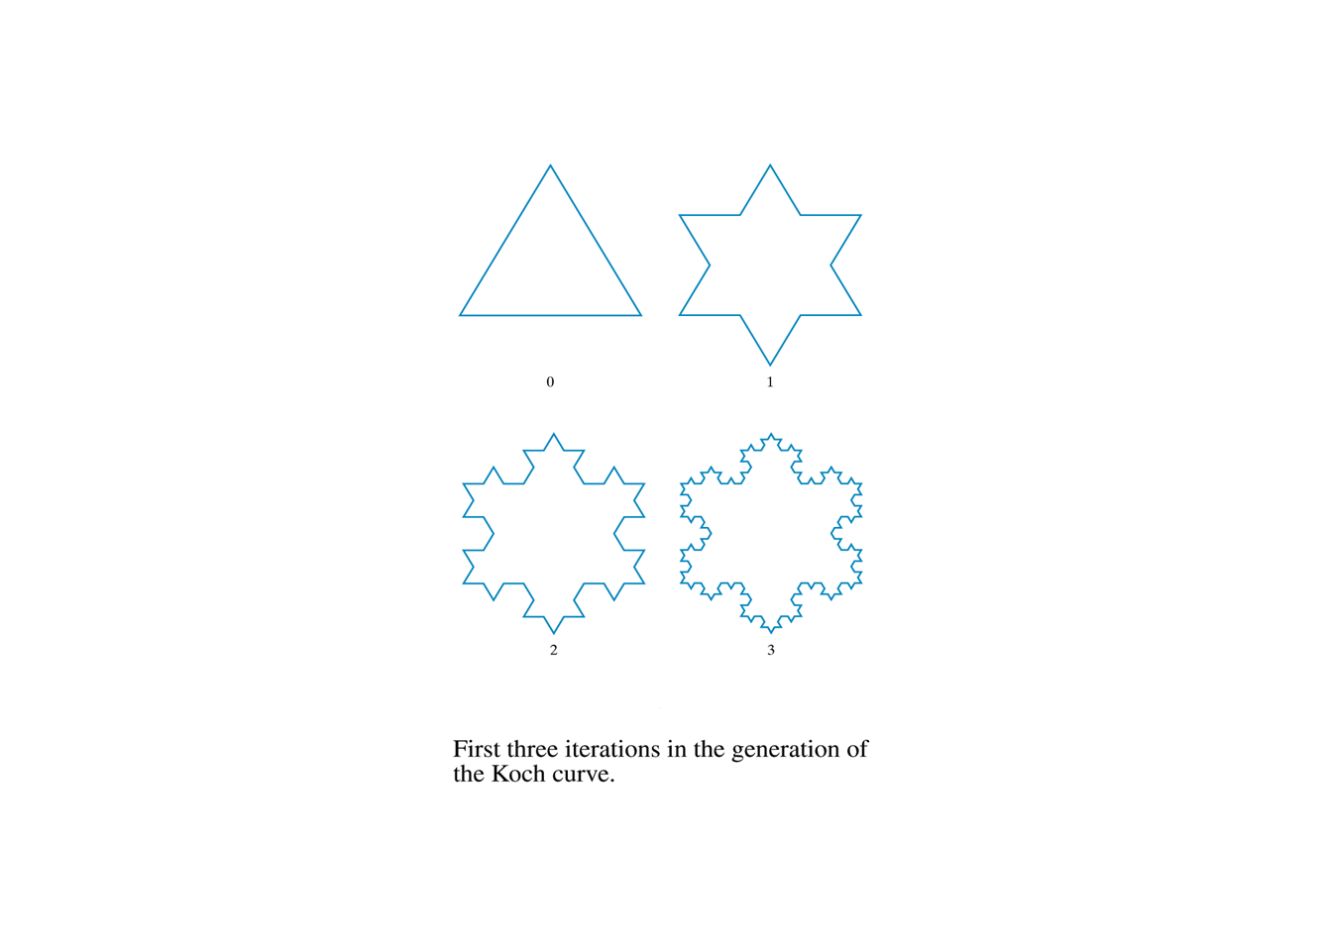
KOCH curve

Slide 7
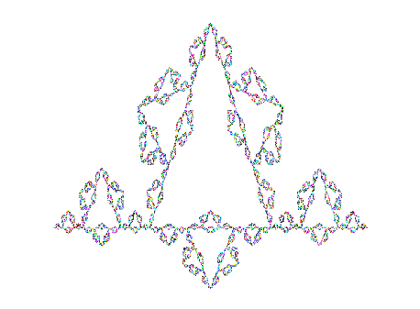
Koch Curve
At level k, the length is (4/3)^{k} so in the limit, the
length of the curve approaches infinity.

Slide 8
KOCH CURVE- One of the Simplest Examples (cont.)
Step 0: length = 1, s = 1/3
Step 1: length = 4/3, s = 1/9
Scaling factor s is applied.
This continues iteratively, where at each level, the
segments are divided into thirds and the same
pattern is repeated.
The definition of the curve requires that this be
repeated forever.

Slide 9
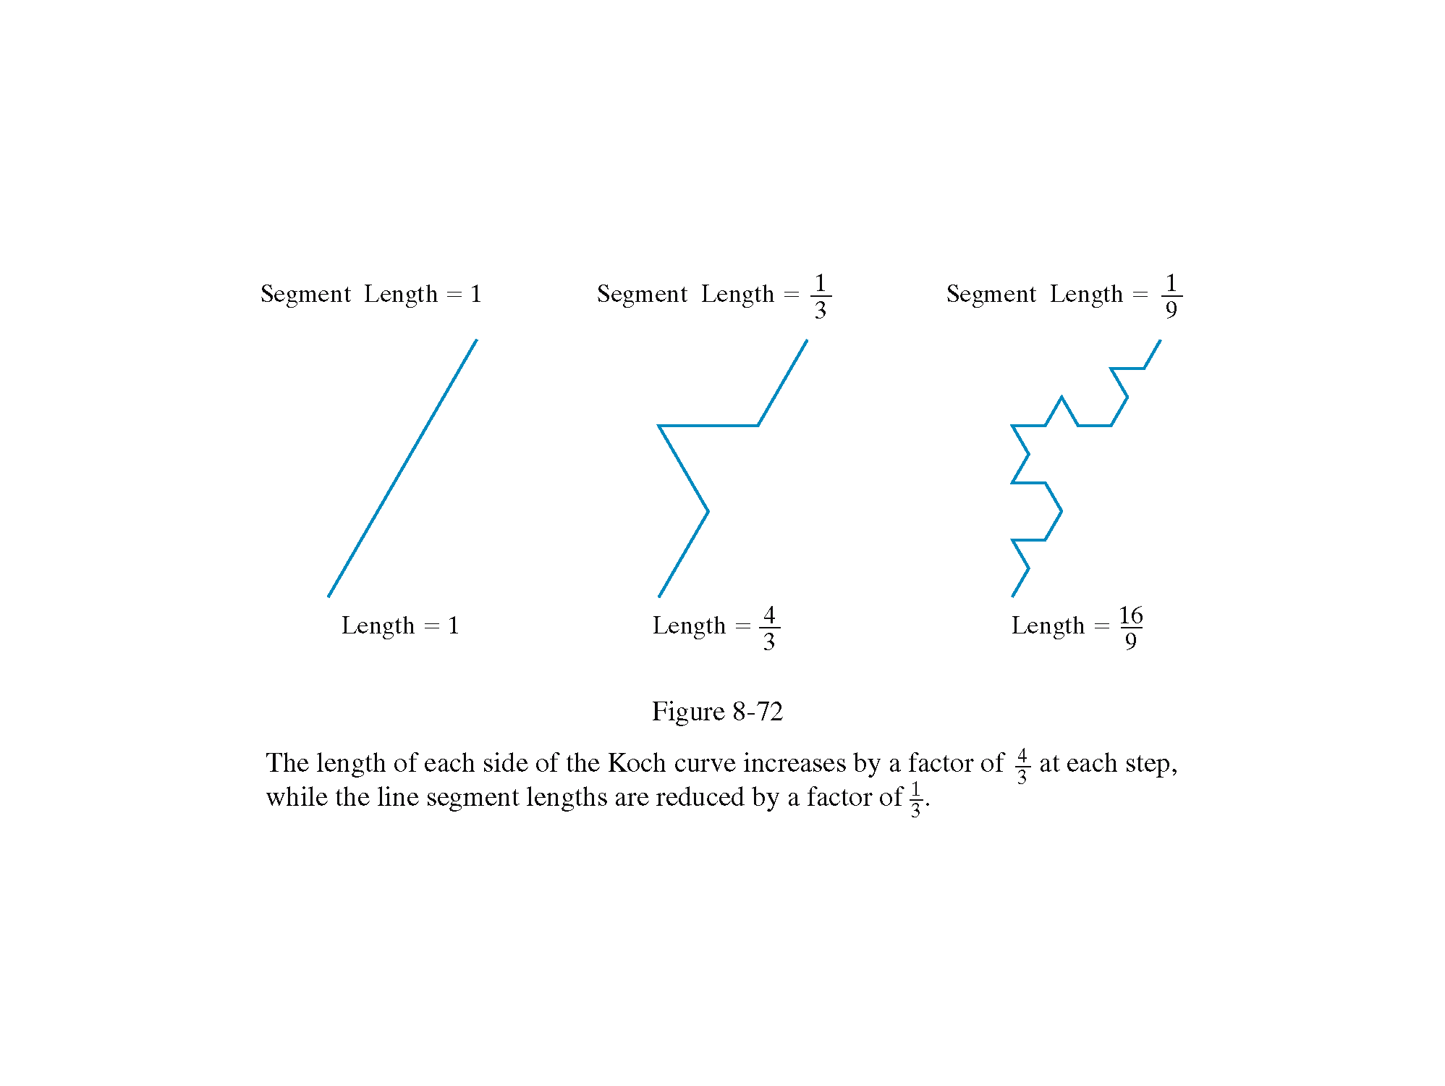
KOCH curve

Slide 10
Self Squaring Fractals
Another method for generating fractals is to repeatedly apply a transformation function to points in complex space
A complex number can be represented as z = x + iy where x and y are real numbers and i² = -1
A function rich in fractals is the squaring transformation
z’=f(z) = λz (1 - z)

Slide 11
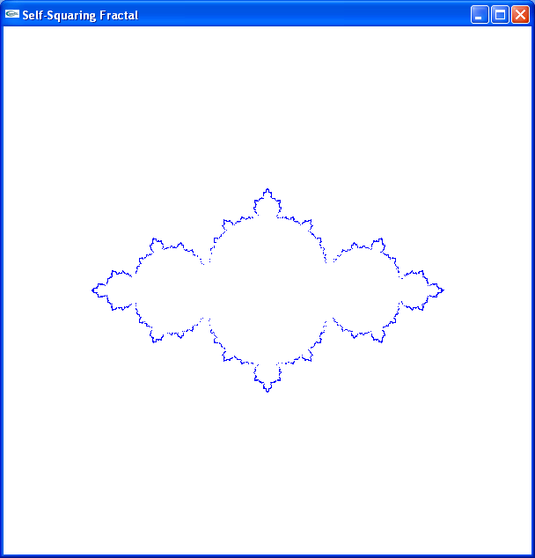
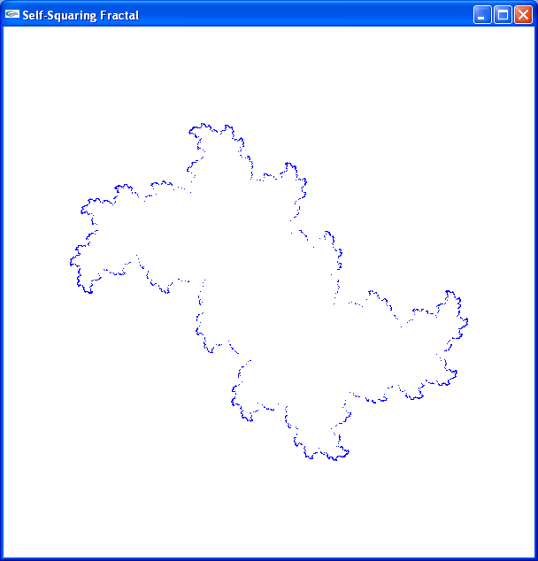
Self Squaring Fractals
λ = 3
λ = 2 + i
ch23SelfSquareFractal.cpp

Slide 12
Mandelbrot Set
Squaring functions were difficult to analyze without the aid of a computer
Using more sophisticated computer graphics techniques, Benoit Mandelbrot studied this function and found the set of points known as Mandelbrot set

Slide 13
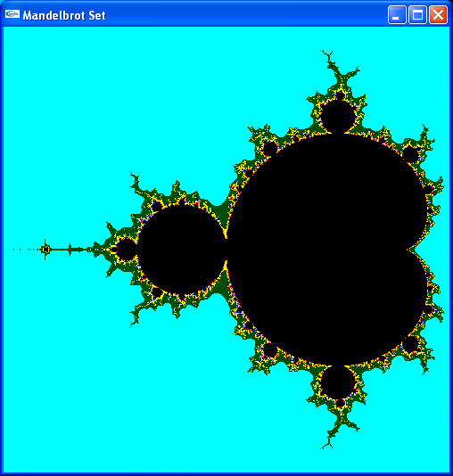
Mandelbrot Set (cont.)
ch23MandelbrotSet.cpp

Slide 14
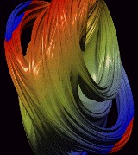
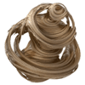
OTHER FRACTAL IMAGES
Quaternion generated Julian Sets in 3D space

Slide 15
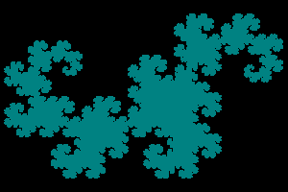
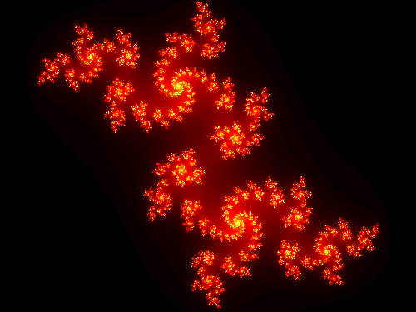

OTHER FRACTAL IMAGES (cont.)
Various colorings of dragon curves

Slide 16
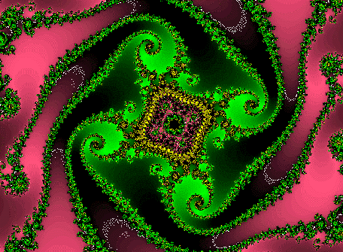
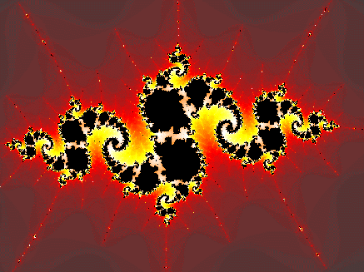
OTHER FRACTAL IMAGES (cont.)
Each is produced by following a fractal generating algorithm and selecting colors to represent points with certain properties.

Slide 17
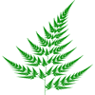
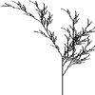
OTHER FRACTAL IMAGES (cont.)
Trees and bushes generated by fractals

Slide 18
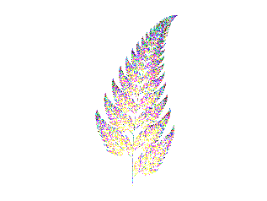
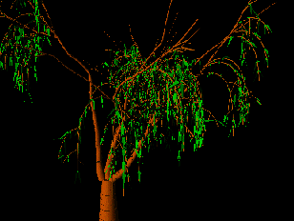
OTHER MODIFICATIONS PRODUCE

Slide 19
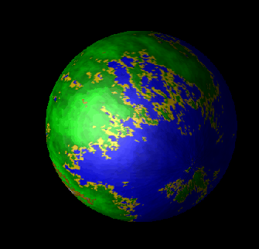
A Fractal Texture Mapped Onto A Sphere

Slide 20
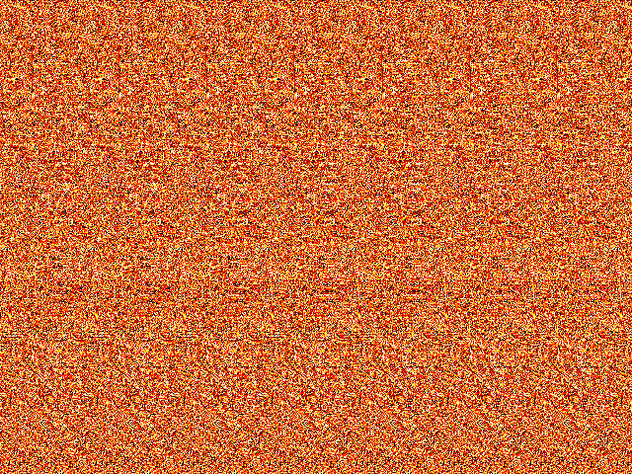
and, some interesting fractals in stereo-depth formats ...

Slide 21
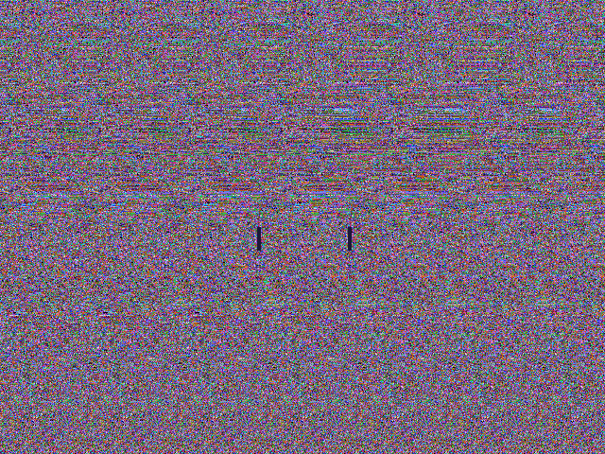

Slide 22
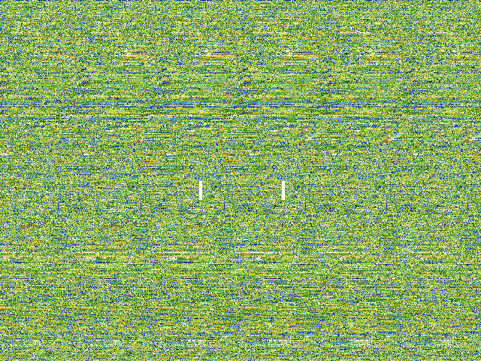

Slide 23
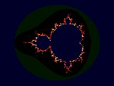
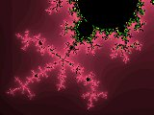
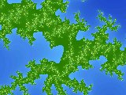
Stereo-depth views at this excellent fractal gallery
Basis for orange stereo-depth view
Basis for purple stereo-depth view
Basis for green stereo-depth view

