Slide 1
Neural Networks: A Statistical Pattern Recognition Perspective
‹#›/67

Slide 2
Statistical Framework
The natural framework for studying the design and capabilities of pattern classification machines is statistical
Nature of information available for decision making is probabilistic
‹#›/67

Slide 3
Feedforward Neural Networks
Have a natural propensity for performing classification tasks
Solve the problem of recognition of patterns in the input space or pattern space
Pattern recognition:
Concerned with the problem of decision making based on complex patterns of information that are probabilistic in nature.
Network outputs can be shown to find proper interpretation of conventional statistical pattern recognition concepts.
‹#›/67

Slide 4
Pattern Classification
Linearly separable pattern sets:
only the simplest ones
Iris data: classes overlap
Important issue:
Find an optimal placement of the discriminant function so as to minimize the number of misclassifications on the given data set, and simultaneously minimize the probability of misclassification on unseen patterns.
‹#›/67

Slide 5
Notion of Prior
The prior probability P(C_{k}) of a pattern belonging to class C_{k} is measured by the fraction of patterns in that class assuming an infinite number of patterns in the training set.
Priors influence our decision to assign an unseen pattern to a class.
‹#›/67

Slide 6
Assignment without Information
In the absence of all other information:
Experiment:
In a large sample of outcomes of a coin toss experiment the ratio of Heads to Tails is 60:40
Is the coin biased?
Classify the next (unseen) outcome and minimize the probability of mis-classification
(Natural and safe) Answer: Choose Heads!
‹#›/67

Slide 7
Introduce Observations
Can do much better with an observation…
Suppose we are allowed to make a single measurement of a feature x of each pattern of the data set.
x is assigned a set of discrete values
{x¹, x², …, x^{d}}
‹#›/67

Slide 8
Joint and Conditional Probability
Joint probability P(C_{k},x^{l}) that x^{l} belongs to C_{k} is the fraction of total patterns that have value x^{l} while belonging to class C_{k}
Conditional probability P(x^{l}|C_{k}) is the fraction of patterns that have value x^{l} given only patterns from class C_{k}
‹#›/67

Slide 9
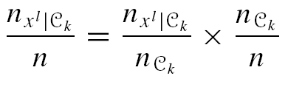
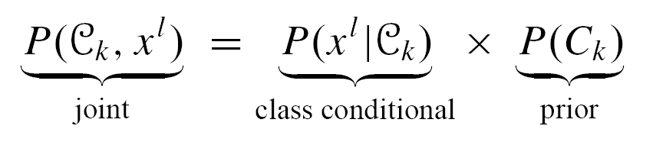
Joint Probability = Conditional Probability × Class Prior
Number of patterns with value x^{l} in class C_{k}
Total number of patterns
Number of patterns in class C_{k}
‹#›/67

Slide 10
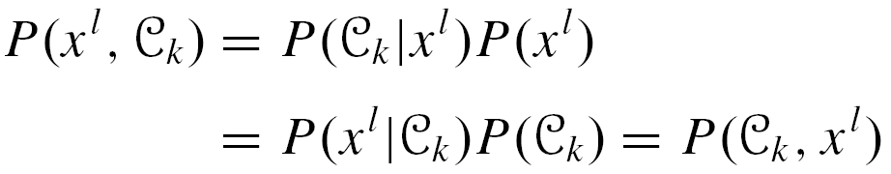
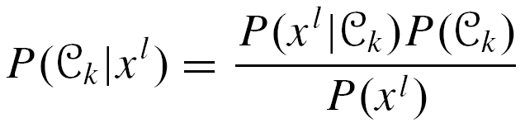
Posterior Probability: Bayes’ Theorem
Note: P(C_{k}, x^{l}) = P(x^{l}, C_{k})
P(C_{k}, x^{l}) is the posterior probability: probability that feature value x^{l} belongs to class C_{k}
Bayes’ Theorem
‹#›/67

Slide 11
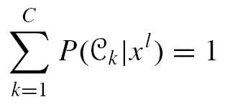
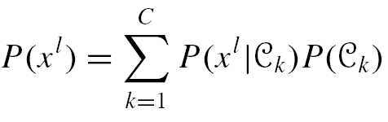
Bayes’ Theorem and Classification
Bayes’ Theorem provides the key to classifier design:
Assign pattern x^{l} to class C_{K} for which the posterior is the highest!
Note therefore that all posteriors must sum to one
And
‹#›/67

Slide 12
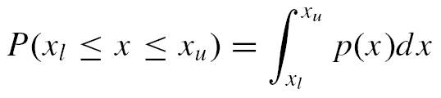
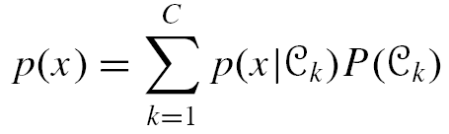
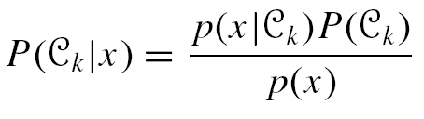
Bayes’ Theorem for Continuous Variables
Probabilities for discrete intervals of a feature measurement are then replaced by probability density functions p(x)
‹#›/67

Slide 13
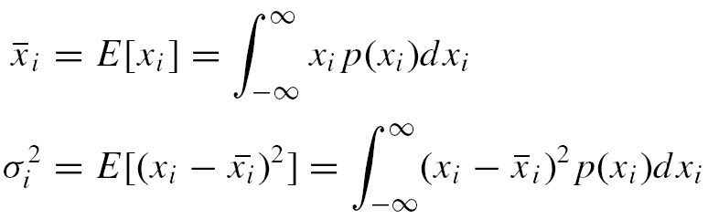
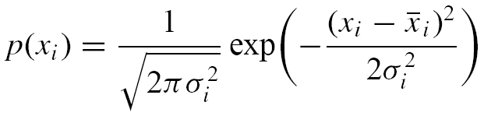
Gaussian Distributions
Distribution Mean and Variance
Two-class one dimensional Gaussian probability density function
variance
‹#›/67
normalizing factor
mean

Slide 14
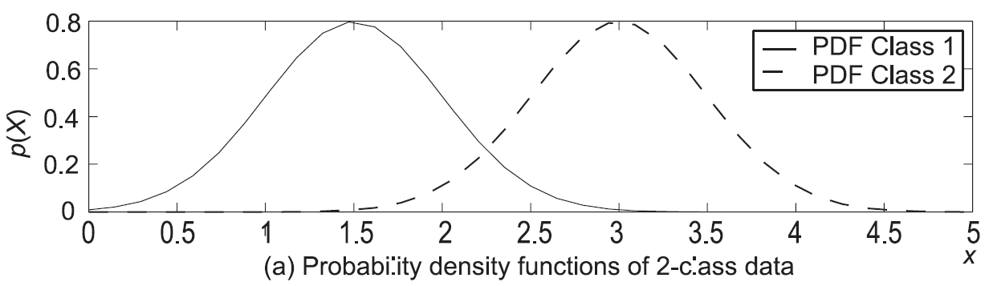
Example of Gaussian Distribution
Two classes are assumed to be distributed about means 1.5 and 3 respectively, with equal variances 0.25.
‹#›/67

Slide 15
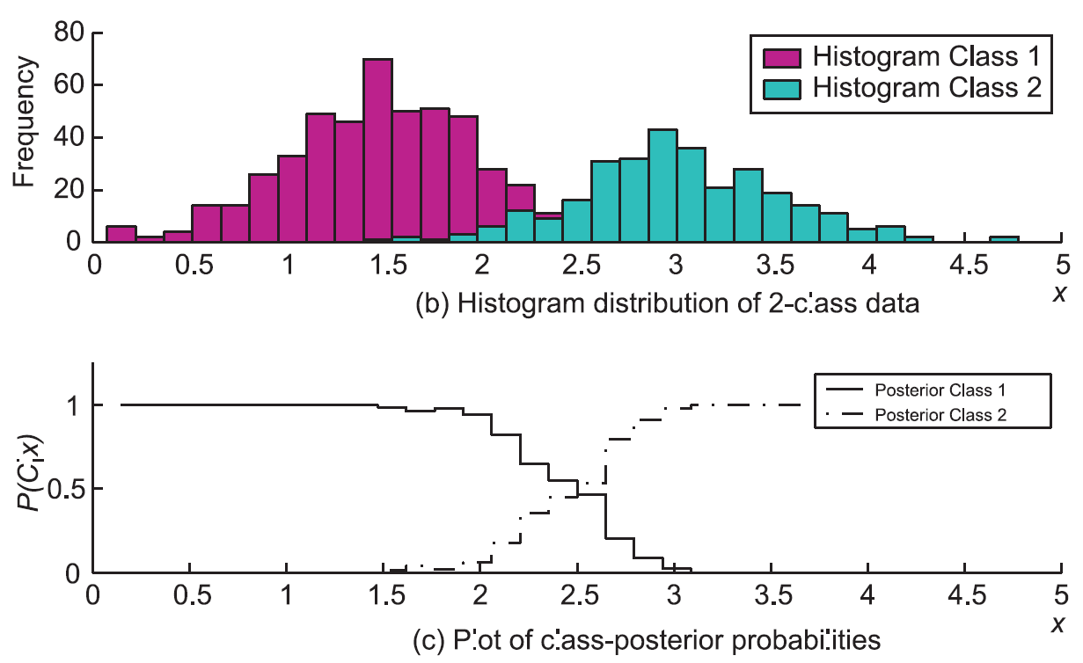
Example of Gaussian Distribution
‹#›/67

Slide 16
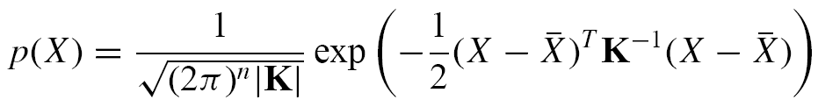


Extension to n-dimensions
The probability density function expression extends to the following
Mean
Covariance matrix
‹#›/67

Slide 17
Covariance Matrix and Mean
Covariance matrix
describes the shape and orientation of the distribution in space
Mean
describes the translation of the scatter from the origin
‹#›/67

Slide 18
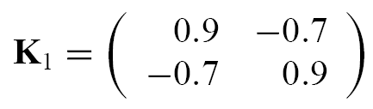



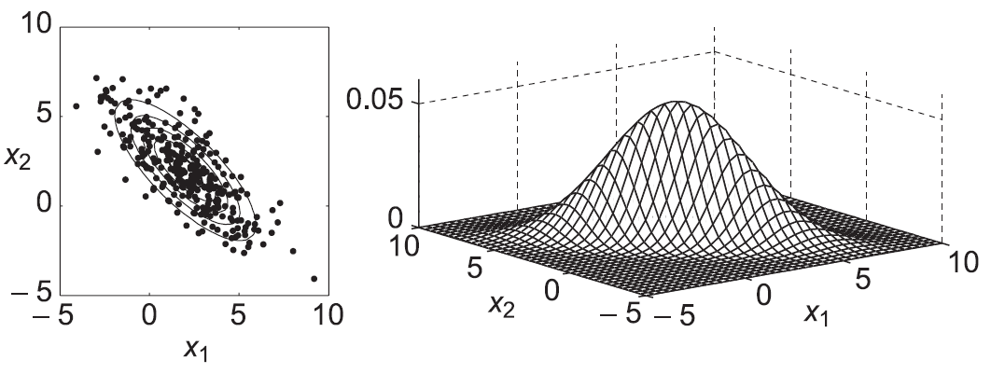
Covariance Matrix and Data Scatters
‹#›/67

Slide 19

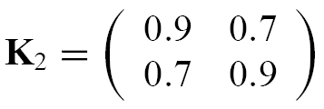


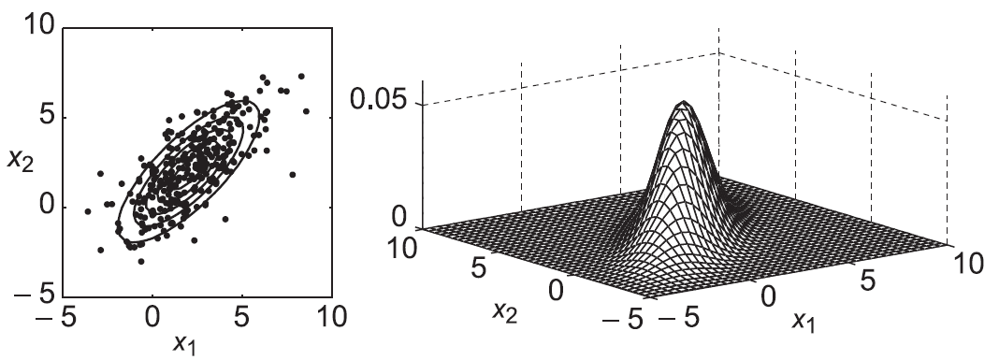
Covariance Matrix and Data Scatters
‹#›/67

Slide 20
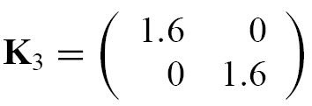


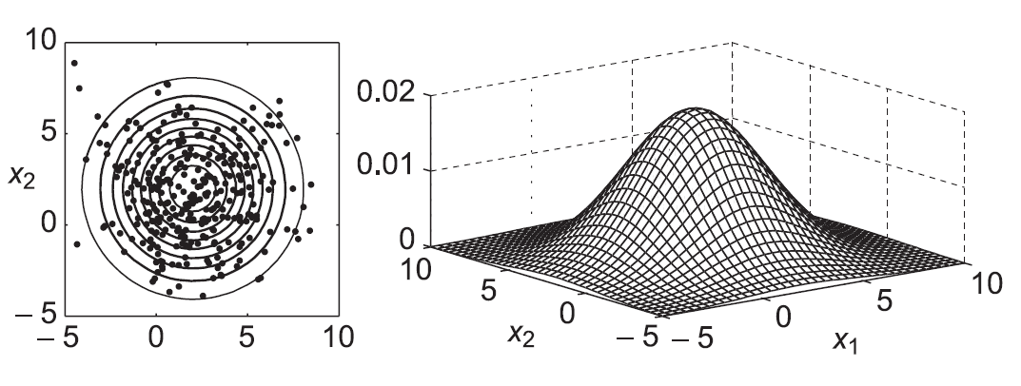
Covariance Matrix and Data Scatters
‹#›/67

Slide 21

Probability Contours
Contours of the probability density function are loci of equal Mahalanobis distance
‹#›/67

Slide 22

Classification Decisions with Bayes’ Theorem
Key: Assign X to Class C_{k} such that
or,
‹#›/67

Slide 23
Placement of a Decision Boundary
Decision boundary separates the classes in question
Where do we place decision region boundaries such that the probability of misclassification is minimized?
‹#›/67

Slide 24

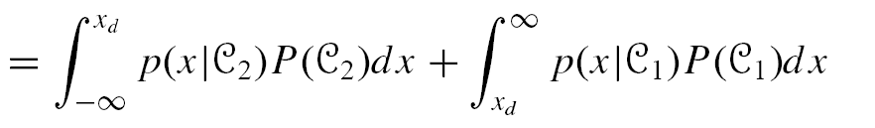
Quantifying the Classification Error
Example: 1-dimension, 2 classes identified by regions R₁, R₂
P_{error} = P(x ∈ R₁, C₂) + P(x ∈ R₂, C₁)
‹#›/67

Slide 25
Quantifying the Classification Error
Place decision boundary such that
point x lies in R₁ (decide C₁) if p(x|C₁)P(C₁) > p(x|C₂)P(C₂)
point x lies in R₂ (decide C₂) if p(x|C₂)P(C₂) > p(x|C₁)P(C₁)
‹#›/67

Slide 26
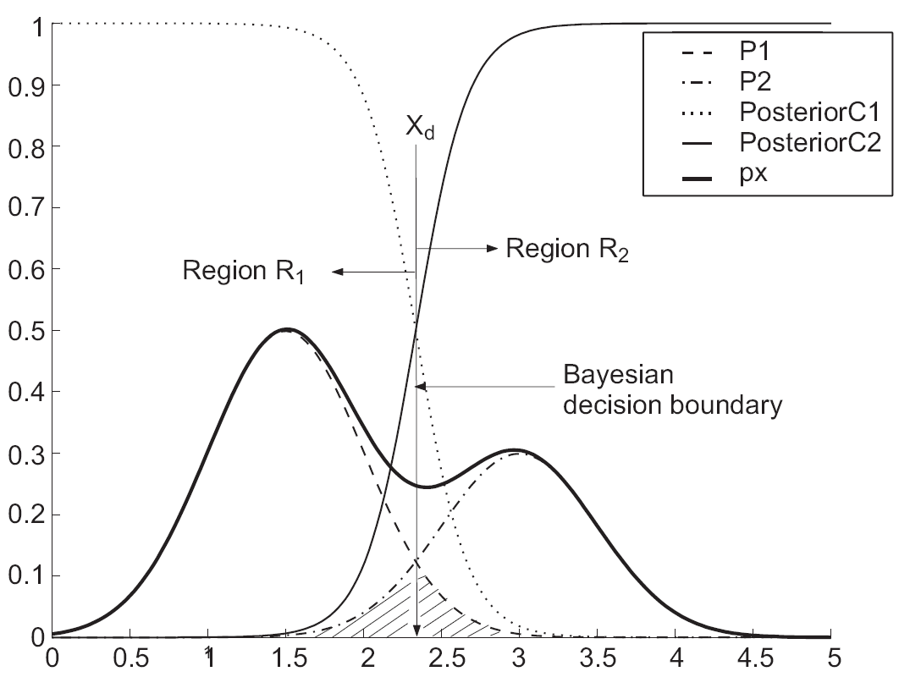
Optimal Placement of A Decision Boundary
Bayesian Decision Boundary:
The point
where the unnormalized probability density functions crossover
‹#›/67

Slide 27
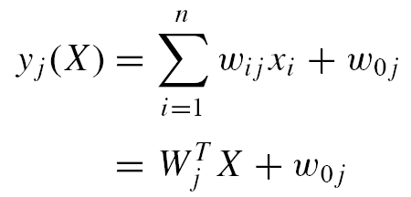

Probabilistic Interpretation of a Neuron Discriminant Function
An artificial neuron implements the discriminant function:
Each of C neurons implements its own discriminant function for a C-class problem
An arbitrary input vector X is assigned to class C_{k} if neuron k has the largest activation
‹#›/67

Slide 28

Probabilistic Interpretation of a Neuron Discriminant Function
An optimal Bayes’ classification chooses the class with maximum posterior probability P(C_{j}|X)
Discriminant function y_{j} = P(X|C_{j}) P(C_{j})
y_{j} notation re-used for emphasis
Relative magnitudes are important: use any monotonic function of the probabilities to generate a new discriminant function
‹#›/67

Slide 29
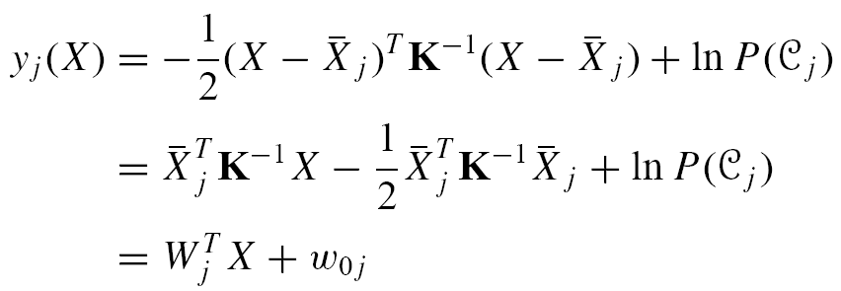
Probabilistic Interpretation of a Neuron Discriminant Function
Assume an n-dimensional density function
This yields,
Ignore the constant term, assume that all covariance matrices are the same:
‹#›/67

Slide 30
Plotting a Bayesian Decision Boundary: 2-Class Example
Assume classes C₁, C₂, and discriminant functions of the form,
Combine the discriminants y(X) = y₂(X) – Y₁(X)
New rule:
Assign X to C₂ if y(X) > 0; C₁ otherwise
‹#›/67

Slide 31
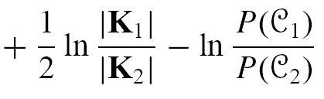
Plotting a Bayesian Decision Boundary: 2-Class Example
This boundary is elliptic
If K₁ = K₂ = K then the boundary becomes linear…
‹#›/67

Slide 32
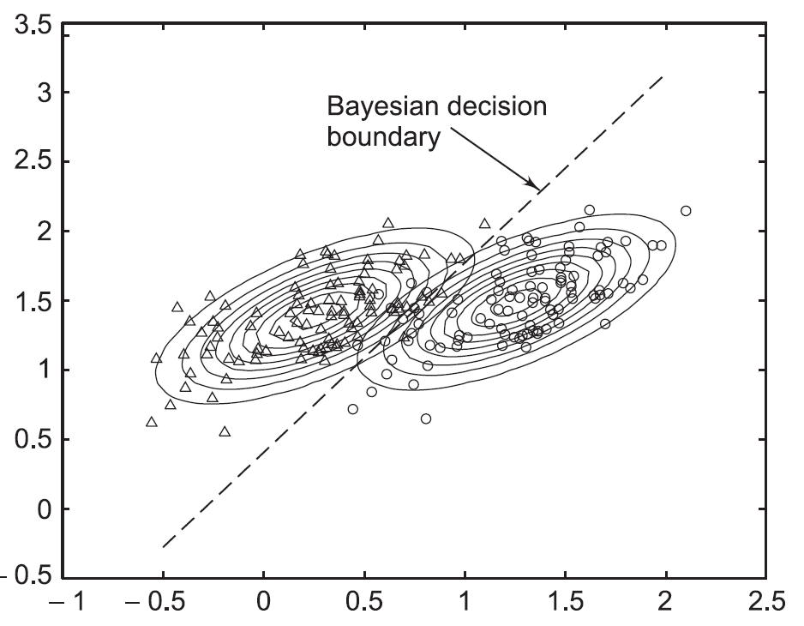
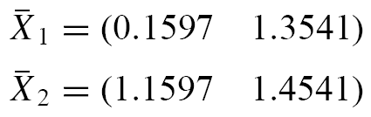
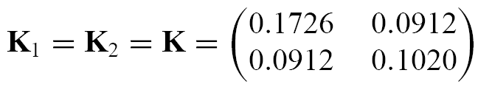
Bayesian Decision Boundary
‹#›/67

Slide 33
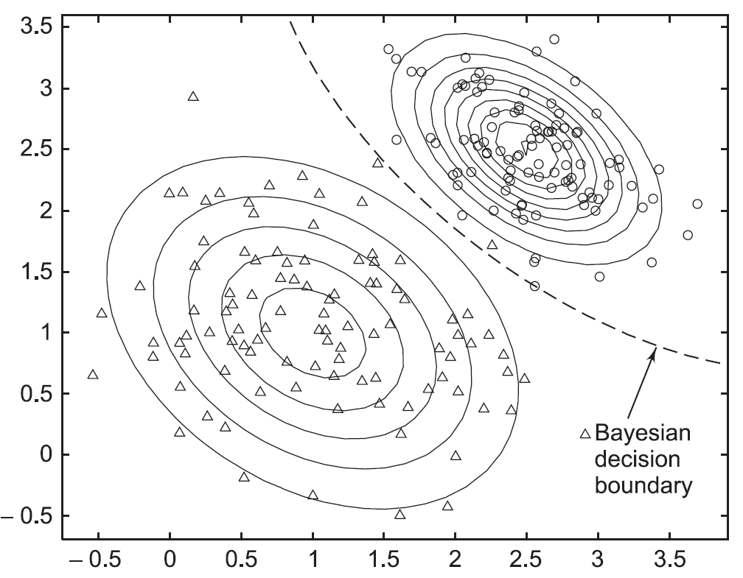
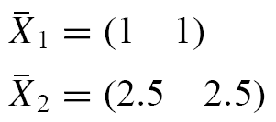
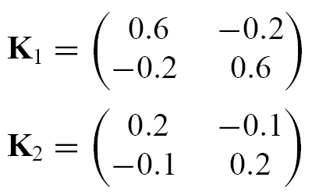
Bayesian Decision Boundary
‹#›/67

Slide 34
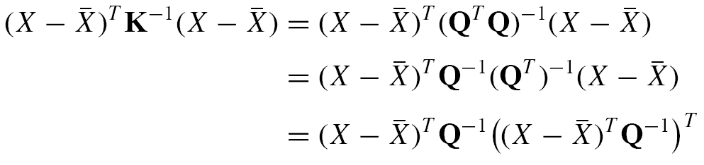
Cholesky Decomposition of Covariance Matrix K
Returns a matrix Q such that Q^{T}Q = K and Q is upper triangular
‹#›/67

Slide 35
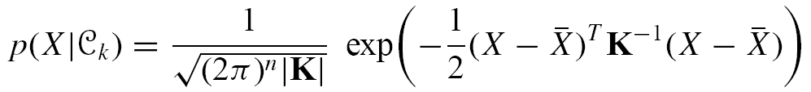
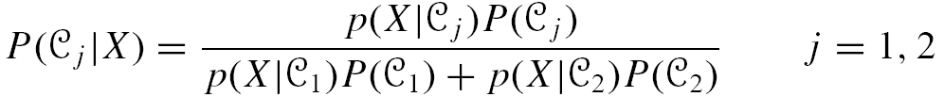
Interpreting Neuron Signals as Probabilities: Gaussian Data
Gaussian Distributed Data
2-Class data, K₂ = K₁ = K
From Bayes’ Theorem, we have the posterior probability
‹#›/67

Slide 36
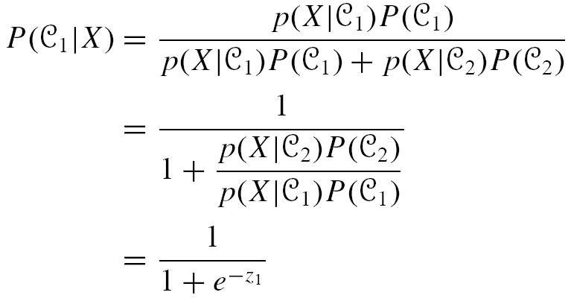
Interpreting Neuron Signals as Probabilities: Gaussian Data
Consider Class 1
Sigmoidal neuron ?
‹#›/67

Slide 37
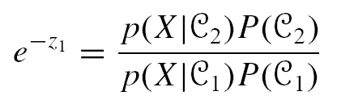
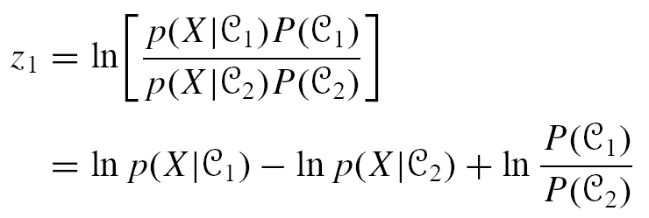
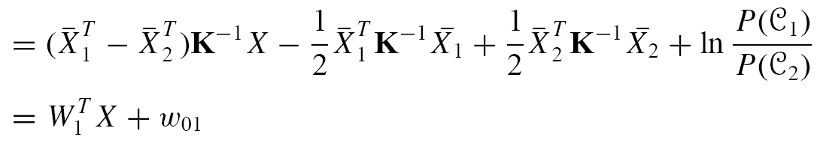
Interpreting Neuron Signals as Probabilities: Gaussian Data
We substituted
or,
Neuron activation !
‹#›/67

Slide 38

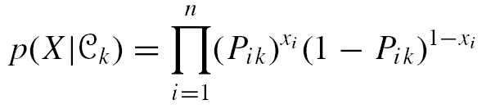
Interpreting Neuron Signals as Probabilities
Bernoulli Distributed Data
Random variable x_{i} takes values 0,1
Bernoulli distribution
Extending this result to an n-dimensional vector of independent input variables
‹#›/67

Slide 39

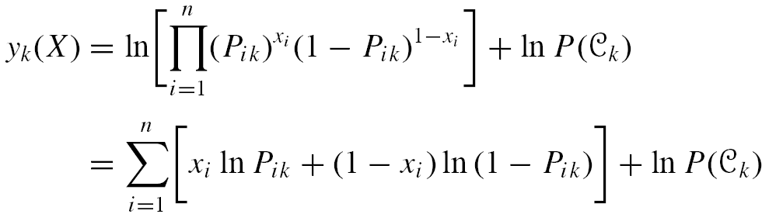
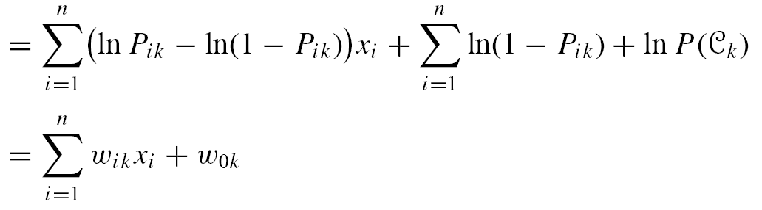
Interpreting Neuron Signals as Probabilities: Bernoulli Data
Bayesian discriminant
Neuron activation
‹#›/67

Slide 40
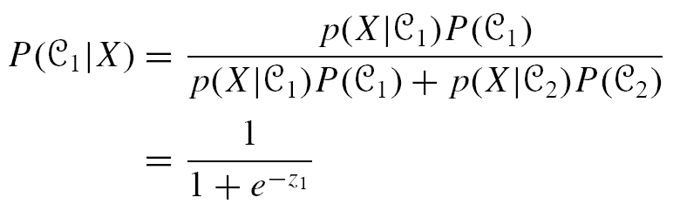
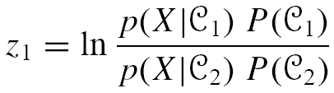
Interpreting Neuron Signals as Probabilities: Bernoulli Data
Consider the posterior probability for class C₁
where
‹#›/67

Slide 41
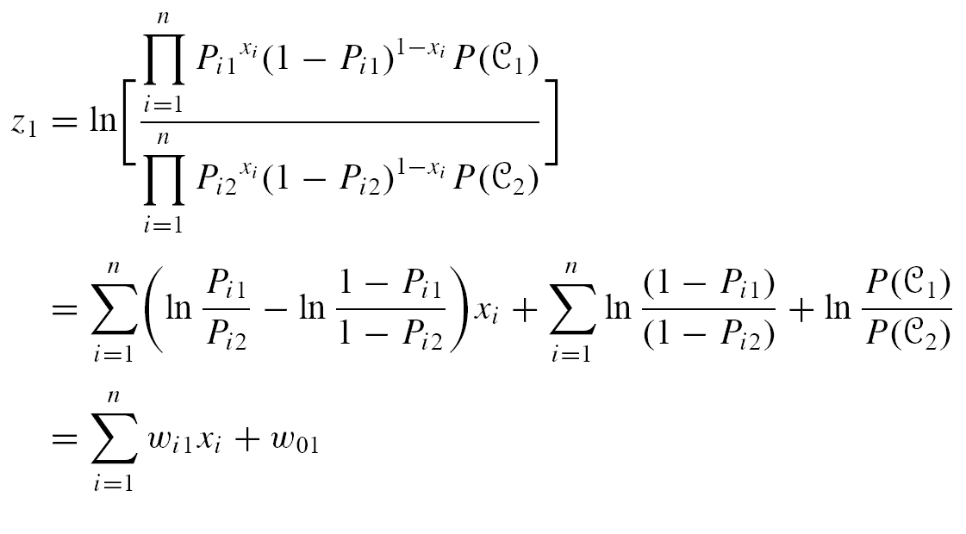
Interpreting Neuron Signals as Probabilities: Bernoulli Data
‹#›/67

Slide 42
Multilayered Networks
The computational power of neural networks stems from their multilayered architecture
What kind of interpretation can the outputs of such networks be given?
Can we use some other (more appropriate) error function to train such networks?
If so, then with what consequences in network behaviour?
‹#›/67

Slide 43
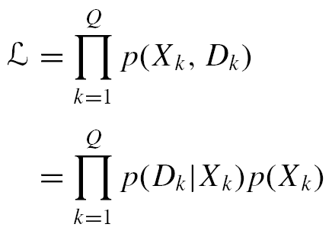
Likelihood
Assume a training data set T={X_{k},D_{k}} drawn from a joint p.d.f. p(X,D) defined on ℜ^{n×p}
Joint probability or likelihood of T
‹#›/67

Slide 44
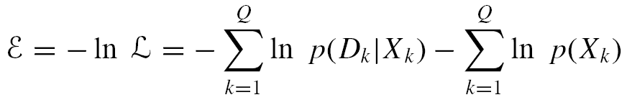
Sum of Squares Error Function
Motivated by the concept of maximum likelihood
Context: neural network solving a classification or regression problem
Objective: maximize the likelihood function
Alternatively: minimize negative likelihood:
Drop this constant
‹#›/67

Slide 45
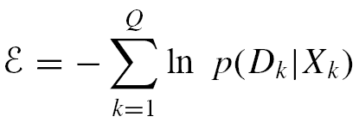
Sum of Squares Error Function
Error function is the negative sum of the log-probabilities of desired outputs conditioned on inputs
A feedforward neural network provides a framework for modelling p(D|X)
‹#›/67

Slide 46
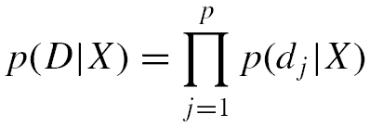

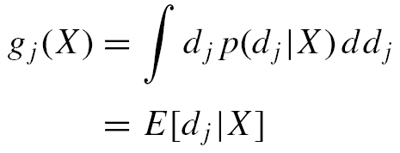
Normally Distributed Data
Decompose the p.d.f. into a product of individual density functions
Assume target data is Gaussian distributed
∈_{j} is a Gaussian distributed noise term
g_{j}(X) is an underlying deterministic function
‹#›/67

Slide 47
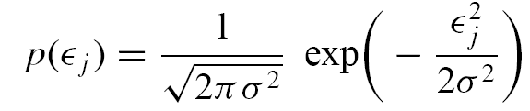


From Likelihood to Sum Square Errors
Noise term has zero mean and s.d. σ
Neural network expected to provide a model of g(X)
Since f(X,W) is deterministic p(d_{j}|X) = p(∈_{j})
‹#›/67

Slide 48


From Likelihood to Sum Square Errors
Neglecting the constant terms yields
‹#›/67

Slide 49


Interpreting Network Signal Vectors
Re-write the sum of squares error function
1/Q provides averaging, permits replacement of the summations by integrals
‹#›/67

Slide 50

Interpreting Network Signal Vectors
Algebra yields
Error is minimized when f_{j}(X,W) = E[d_{j}|X] for each j.
The error minimization procedure tends to drive the network map f_{j}(X,W) towards the conditional average E[d_{j},X] of the desired outputs
At the error minimum, network map approximates the regression of d conditioned on X!
‹#›/67

Slide 51

Numerical Example
Noisy distribution of 200 points distributed about the function
Used to train a neural network with 7 hidden nodes
Response of the network is plotted with a continuous line
‹#›/67

Slide 52


Residual Error
The error expression just presented neglected an integral term shown below
If the training environment does manage to reduce the error on the first integral term in to zero, a residual error still manifests due to the second integral term
‹#›/67

Slide 53
Notes…
The network cannot reduce the error below the average variance of the target data!
The results discussed rest on the three assumptions:
The data set is sufficiently large
The network architecture is sufficiently general to drive the error to zero.
The error minimization procedure selected does find the appropriate error minimum.
‹#›/67

Slide 54
An Important Point
Sum of squares error function was derived from maximum likelihood and Gaussian distributed target data
Using a sum of squares error function for training a neural network does not require target data be Gaussian distributed.
A neural network trained with a sum of squares error function generates outputs that provide estimates of the average of the target data and the average variance of target data
Therefore, the specific selection of a sum of squares error function does not allow us to distinguish between Gaussian and non-Gaussian distributed target data which share the same average desired outputs and average desired output variances…
‹#›/67

Slide 55

Classification Problems
For a C-class classification problem, there will be C-outputs
Only 1-of-C outputs will be one
Input pattern X_{k} is classified into class J if
A more sophisticated approach seeks to represent the outputs of the network as posterior probabilities of class memberships.
‹#›/67

Slide 56
Advantages of a Probabilistic Interpretation
We make classification decisions that lead to the smallest error rates.
By actually computing a prior from the network pattern average, and comparing that value with the knowledge of a prior calculated from class frequency fractions on the training set, one can measure how closely the network is able to model the posterior probabilities.
The network outputs estimate posterior probabilities from training data in which class priors are naturally estimated from the training set. Sometimes class priors will actually differ from those computed from the training set. A compensation for this difference can be made easily.
‹#›/67

Slide 57


NN Classifiers and Square Error Functions
Recall: feedforward neural network trained on a squared error function generates signals that approximate the conditional average of the desired target vectors
If the error approaches zero,
The probability that desired values take on 0 or 1 is the probability of the pattern belonging to that class
‹#›/67

Slide 58


Network Output = Class Posterior
The j^{th} output s_{j} is
Class posterior
‹#›/67

Slide 59
Relaxing the Gaussian Constraint
Design a new error function
Without the Gaussian noise assumption on the desired outputs
Retain the ability to interpret the network outputs as posterior probabilities
Subject to constraints:
signal confinement to (0,1) and
sum of outputs to 1
‹#›/67

Slide 60

Neural Network With A Single Output
Output s represents Class 1 posterior
Then 1-s represents Class 2 posterior
The probability that we observe a target value d_{k} on pattern X_{k}
Problem: Maximize the likelihood of observing the training data set
‹#›/67

Slide 61


Cross Entropy Error Function
Maximizing the probability of observing desired value d_{k} for input X_{k} on each pattern in T
Likelihood
Convenient to minimize the negative log-likelihood, which we denote as the error:
‹#›/67

Slide 62

Architecture of Feedforward Network Classifier
‹#›/67

Slide 63


Network Training
Using the chain rule (Chapter 6) with the cross entropy error function
Input – hidden weight derivatives can be found similarly
‹#›/67

Slide 64



C-Class Problem
Assume a 1 of C encoding scheme
Network has C outputs
and
Likelihood function
‹#›/67

Slide 65



Modified Error Function
Cross entropy error function for the C- class case
Minimum value
Subtracting the minimum value ensures that the minimum is always zero
‹#›/67

Slide 66

Softmax Signal Function
Ensures that
the outputs of the network are confined to the interval (0,1) and
simultaneously all outputs add to 1
Is a close relative of the sigmoid
‹#›/67

Slide 67


Error Derivatives
For hidden-output weights
The remaining part of the error backpropagation algorithm remains intact
‹#›/67

