Slide 1
Paper II : CE – I Neural Network UNIT – I Artificial Neurons, Neural Networks and Architectures
ONLINE / LIVE TEACHING CLASSES
SESSION 2020-2021
DATE: 21 September 2021
‹#›

Slide 2
Artificial Neurons, Neural Networks and Architectures
History of ANNs

Slide 3
History of Artificial Neural Networks
1943: McCulloch and Pitts proposed a model of a neuron --> Perceptron
1960s: Widrow and Hoff explored Perceptron networks (which they called “Adalines”) and the delta rule.
1962: Rosenblatt proved the convergence of the perceptron training rule.
1969: Minsky and Papert showed that the Perceptron cannot deal with nonlinearly-separable data sets---even those that represent simple function such as X-OR.
1970-1985: Very little research on Neural Nets
1986: Invention of Backpropagation [Rumelhart and McClelland, but also Parker and earlier on: Werbos] which can learn from nonlinearly-separable data sets.
Since 1985: A lot of research in Neural Nets
‹#›

Slide 4
Artificial Neural Networks
Artificial Neurons

Slide 5
Artificial Neural Networks (ANN)
What is an Artificial Neural Network?
Artificial Neural Networks are crude attempts to model the highly massive parallel and distributed processing we believe takes place in the brain.
‹#›

Slide 6
Neuron Abstraction
Neurons transduce signals—electrical to chemical, and from chemical back again to electrical.
Each synapseis associated with what we call the synaptic efficacy - the efficiency with which a signal is transmitted from the presynaptic to postsynaptic neuron
S
‹#›/48

Slide 7

Artificial Neuron
Incoming signals to a unit are combined by summing their weighted values
Output function: Activation functions include Step function, Linear function, Sigmoid function, …
x₁
w₁
f(∑)
Inputs
Output=f(∑)
x_{p}
w_{p}
∑x_{i}w_{i}
w₀
1
‹#›

Slide 8
Activation functions
Sign function
Linear function
Step function
Sigmoid
(logistic) function
step(x) = 1, if x >= threshold
0, if x < threshold
(in picture above, threshold = 0)
sign(x) = +1, if x >= 0
-1, if x < 0
sigmoid(x) = 1/(1+e^{-x})
pl(x) =x
Adding an extra input with activation a₀ = -1 and weight
W_{0,j} = t (called the bias weight) is equivalent to having a
threshold at t. This way we can always assume a 0 threshold.
‹#›

Slide 9
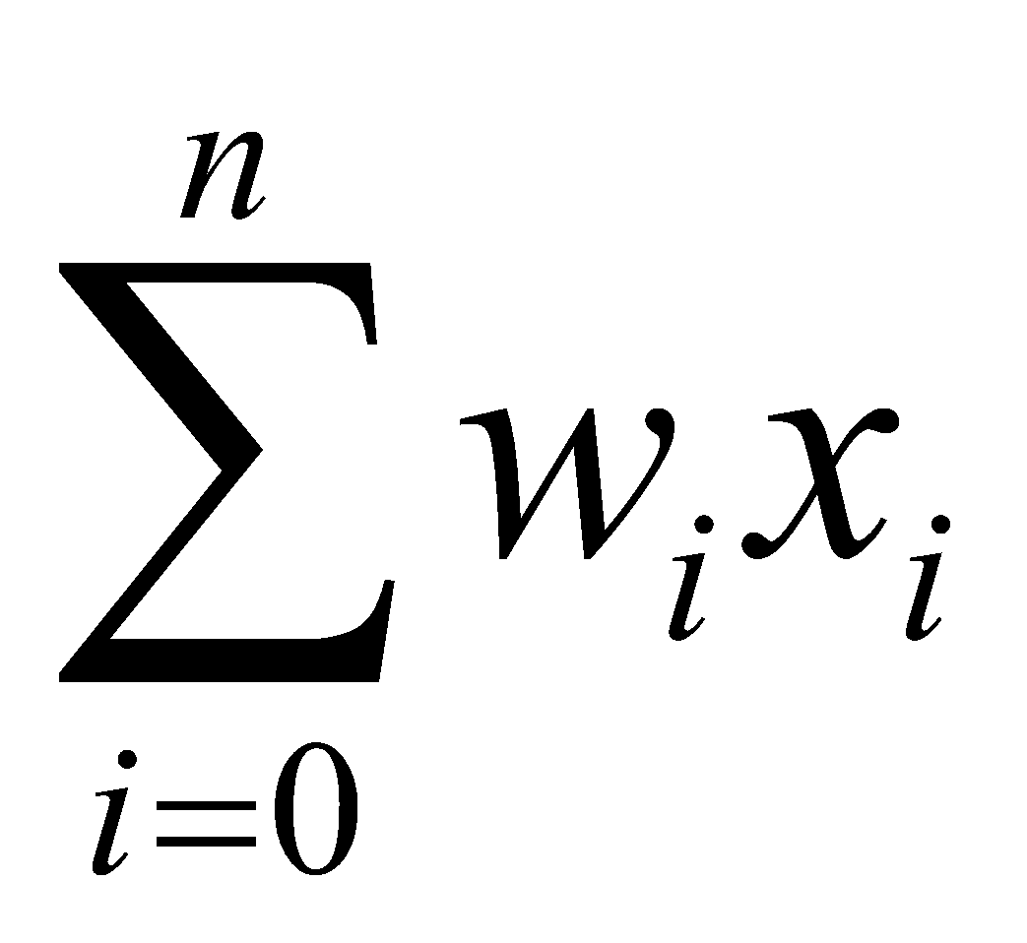

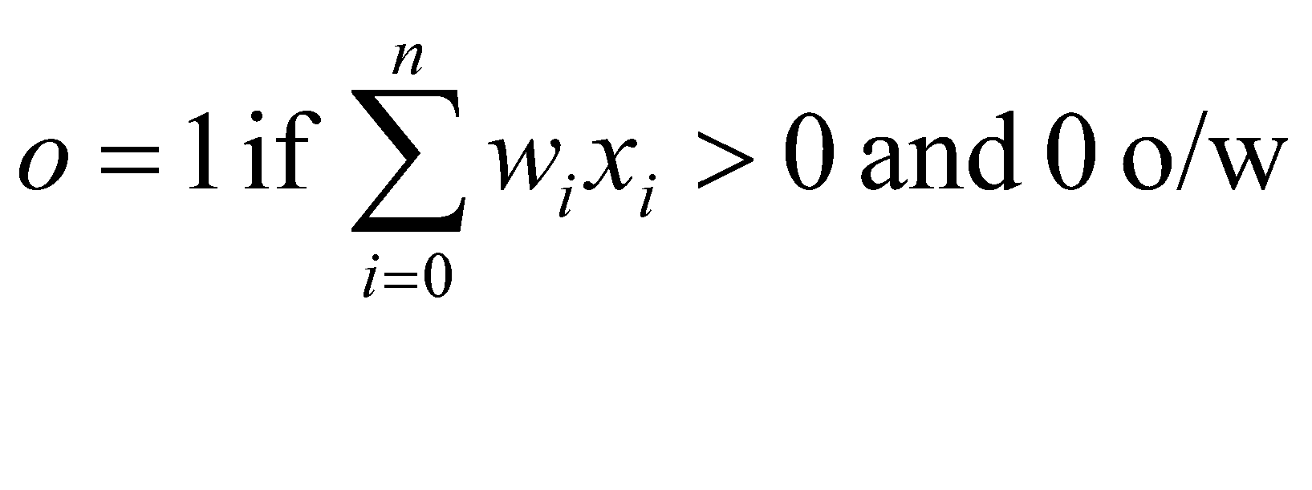
Real vs. Artificial Neurons
dendrites
cell
axon
synapse
dendrites
x₀
w₀
Threshold units
o
x_{n}
w_{n}
‹#›

Slide 10
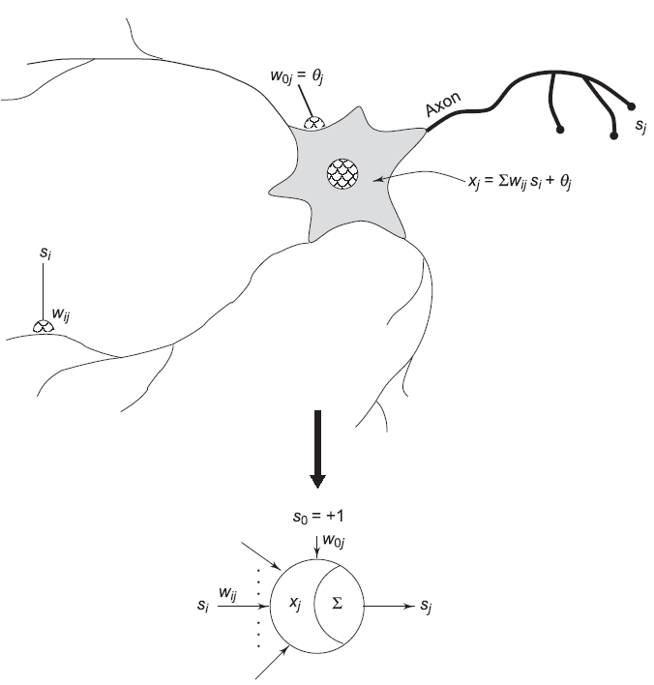
Neuron Abstraction
S
‹#›

Slide 11
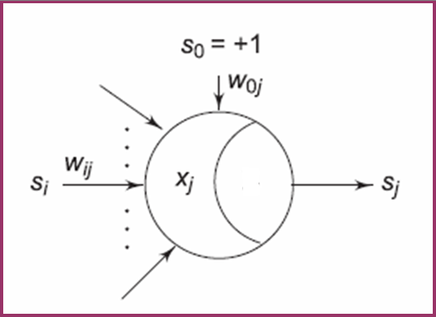
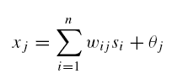
Neuron Abstraction: Activations and Weights
the j^{th} artificial neuron that receives input signals s_{i} , from possibly n different sources
an internal activation x_{j} which is a linear weighted aggregation of the impinging signals, modified by an internal threshold, θ_{j}
S
‹#›

Slide 12
Neuron Abstraction: Activations and Weights
the j ^{th} artificial neuron that connection weights w_{ij} model the synaptic efficacies of various interneuron synapses.
S
‹#›

Slide 13
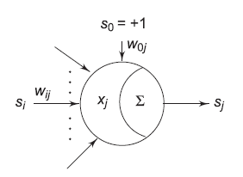

Notation:
w_{ij} denotes the weight from neuron i to neuron j .
S
‹#›

Slide 14
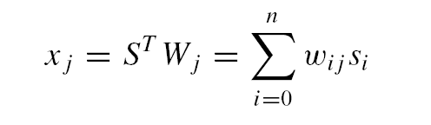
Activations Measure Similarities
The activation x_{j} is simply the binner product of the impinging signal vector
S = (s₀, . . . , s_{n})^{T} , with the neuronal weight vector W_{j} = (w_{0j} , . . . ,w_{nj} )^{T}
Adaptive
Filter
‹#›

Slide 15
Neurons as Universal computing machine
In 1943, McCulloch and Pitts showed that a synchronous assembly of such neurons is a universal computing machine. That is, any Boolean function can be implemented with threshold (step function) units.
‹#›

Slide 16
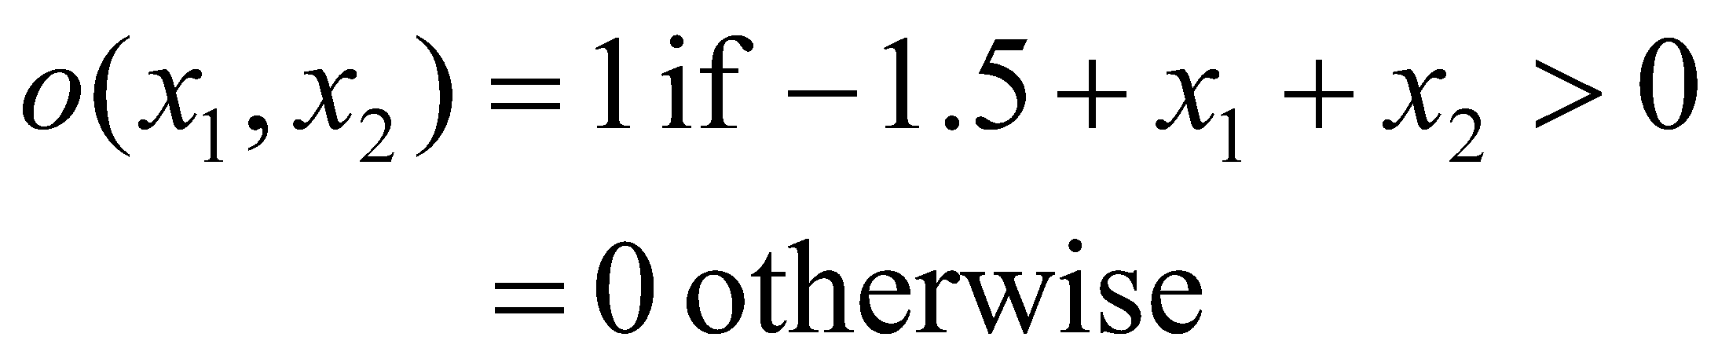
Implementing AND
-1
x₁
1
W=1.5
o(x₁,x₂)
x₂
1
‹#›

Slide 17
Implementing OR
-1
x₁
1
W=0.5
o(x₁,x₂)
x₂
1
o(x1,x2) = 1 if –0.5 + x1 + x2 > 0
= 0 otherwise
‹#›

Slide 18
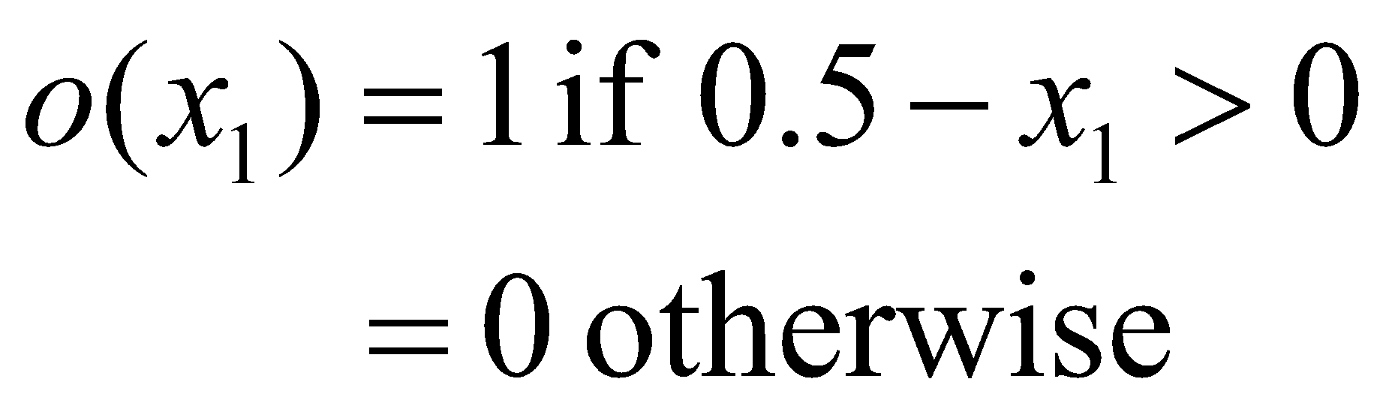
Implementing NOT
-1
W=-0.5
-1
x₁
o(x₁)
‹#›

Slide 19

Implementing more complex Boolean functions
-1
1
0.5
x₁
x₁ or x₂
1
-1
x₂
1
1.5
1
x₃
(x₁ or x₂) and x₃
‹#›

Slide 20
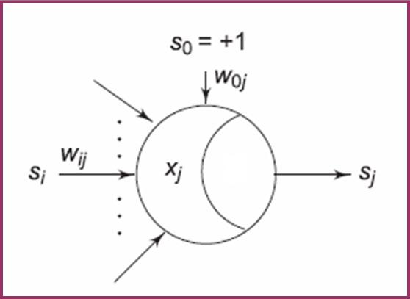
Neuron Abstraction: Signal Function
The activation of the neuron is subsequently transformed through a signal function S(·)
Generates the output signal
s_{j} = S(x_{j} ) of the neuron.
S
‹#›

Slide 21
Neuron Abstraction: Signal Function
a signal function may typically be
binary threshold
linear threshold
sigmoidal
Gaussian
probabilistic.
S
‹#›

Slide 22
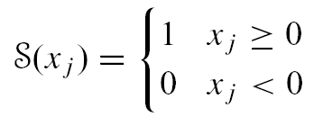
Neuron Signal Functions: Binary Threshold Signal Function
Net positive activations translate to a +1 signal value
Net negative activations translate to a 0 signal value.
‹#›

Slide 23
Neuron Signal Functions: Binary Threshold Signal Function
The threshold logic neuron is a two state machine
s_{j} = S(x_{j} ) ∈ {0, 1}
‹#›

Slide 24
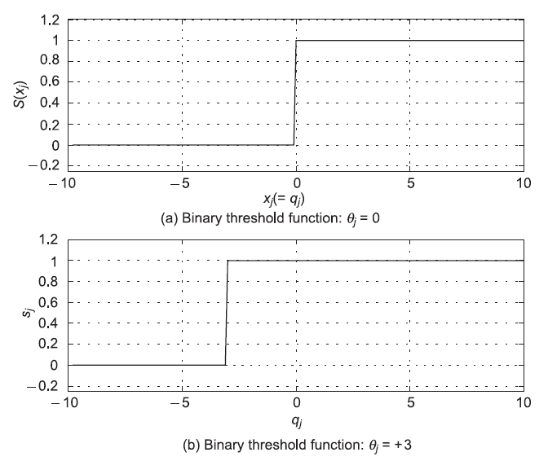
Neuron Signal Functions: Binary Threshold Signal Function
‹#›

Slide 25
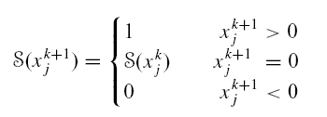

Threshold Logic Neuron (TLN) in Discrete Time
The updated signal value S(x_{j}^{k+1}) at time instant k + 1 is generated from the neuron activation x_{i}^{k+1} , sampled at time instant k + 1.
The response of the threshold logic neuron as a two-state machine can be extended to the bipolar case where the signals are
s_{j} ∈ {−1, 1}
‹#›

Slide 26
Threshold Logic Neuron (TLN) in Discrete Time
The resulting signal function is then none other than the signum function, sign(x) commonly encountered in communication theory.
‹#›

Slide 27
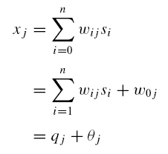
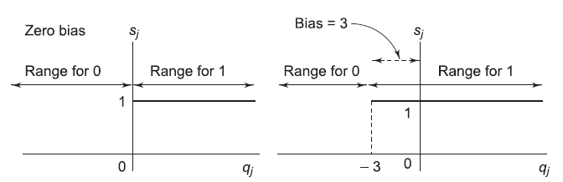
Interpretation of Threshold
From the point of view of the net activation x_{j}
the signal is +1 if x_{j} = q_{j} + θ_{j} ≥ 0, or q_{j} ≥ −θ_{j} ;
and is 0 if q_{j} < −θ_{j} .
‹#›

Slide 28
Interpretation of Threshold
The neuron thus “compares” the net external input q_{j}
if q_{j} is greater than the negative threshold, it fires +1, otherwise it fires 0.
‹#›

Slide 29
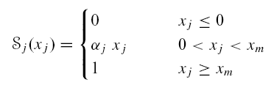
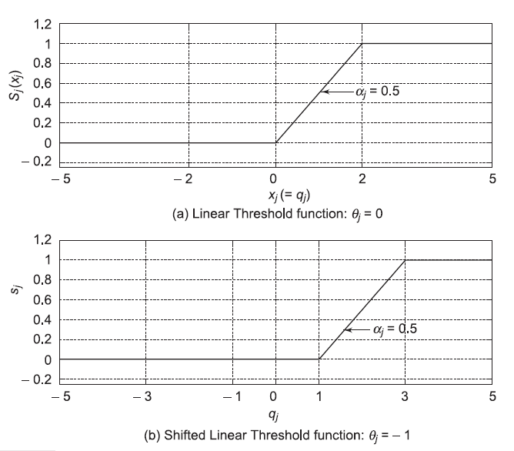
Linear Threshold Signal Function
α_{j} = 1/x_{m} is the slope parameter of the function
Figure plotted for x_{m} = 2 and α_{j} = 0.5. .
‹#›

Slide 30
Linear Threshold Signal Function
S_{j} (x_{j} ) = max(0, min(α_{j}x_{j} , 1))
Note that in this course we assume that neurons within a network are homogeneous.
‹#›

Slide 31

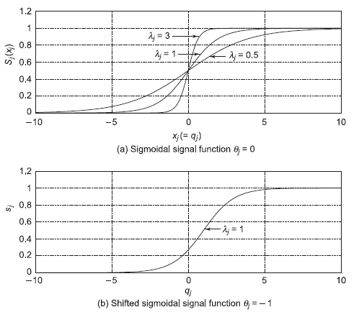
Sigmoidal Signal Function
λ_{j} is a gain scale factor
In the limit, as λ_{j} →∞ the smooth logistic function approaches the non-smooth binary threshold function.
‹#›

Slide 32
Sigmoidal Signal Function
The sigmoidal signal function has some very useful mathematical properties. It is
monotonic
continuous
bounded
‹#›

Slide 33

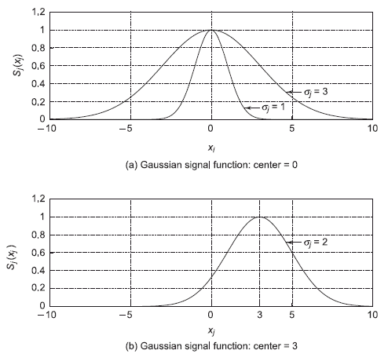
Gaussian Signal Function
σ_{j} is the Gaussian spread factor and c_{j} is the center.
Varying the spread makes the function sharper or more diffuse.
‹#›

Slide 34
Gaussian Signal Function
Changing the center shifts the function to the right or left along the activation axis
This function is an example of a non-monotonic signal function
‹#›

Slide 35

Stochastic Neurons
The signal is assumed to be two state
s_{j} ∈ {0, 1} or {−1, 1}
Neuron switches into these states depending upon a probabilistic function of its activation, P(x_{j} ).
‹#›

Slide 36
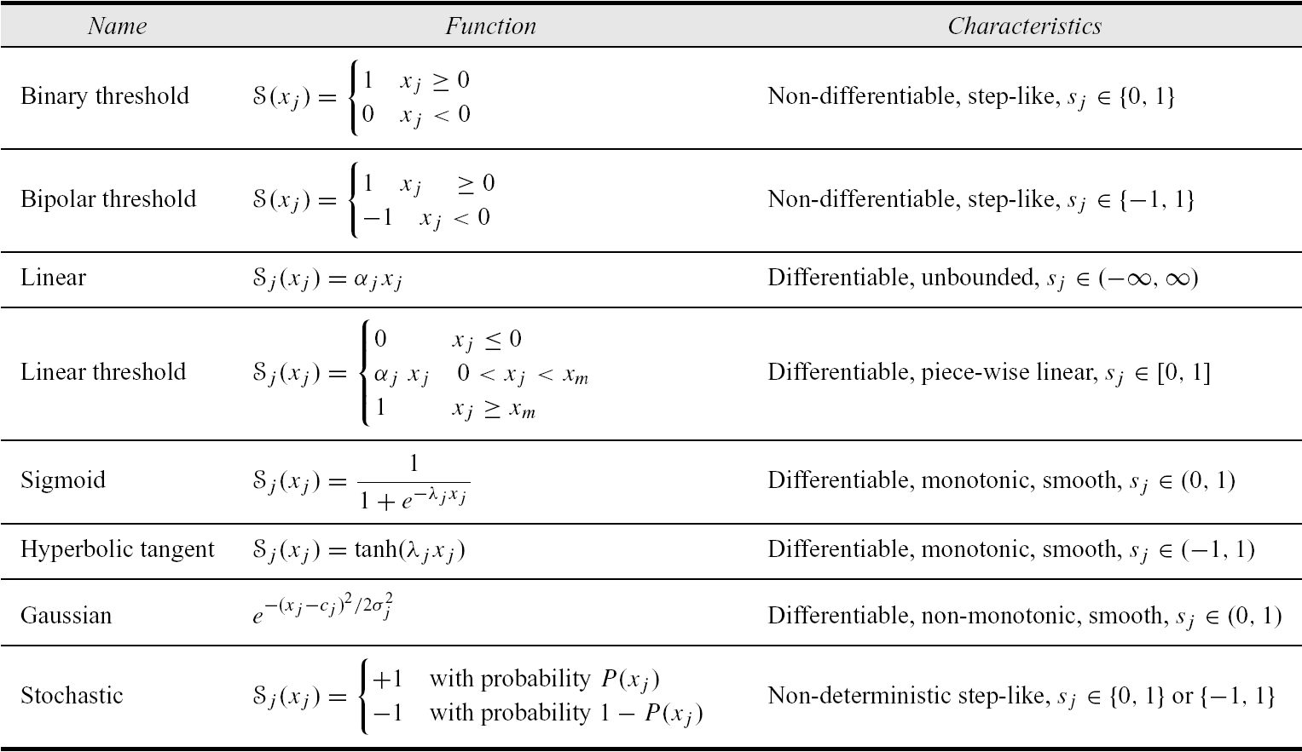
Summary of Signal Functions
‹#›/48

Slide 37
Mathematical Preliminaries
Notation
Interval,Sequence and Set Closure
Vector Spaces
Functions and Continuity
Matrices , Linear Transformations and Eigen vectors
Expectations and covariance Matrices
‹#›

Slide 38
Neural Networks Defined
Artificial neural networks are massively parallel adaptive networks of simple nonlinear computing elements called neurons which are intended to abstract and model some of the functionality of the human nervous system in an attempt to partially capture some of its computational strengths.
‹#›

Slide 39
Eight Components of Neural Networks
1.Neurons. These can be of three types:
Input: receive external stimuli
Hidden: compute intermediate functions
Output: generate outputs from the network
2.Activation state vector. This is a vector of the activation level x_{i} of individual neurons in the neural network,
X = (x₁, . . . , x_{n})^{T} ∈ R^{n}.
‹#›

Slide 40
Eight Components of Neural Networks
3.Signal function. A function that generates the output signal of the neuron based on its activation.
4.Pattern of connectivity. This essentially determines the inter-neuron connection architecture or the graph of the network. Connections which model the inter-neuron synaptic efficacies, can be
excitatory (+)
inhibitory (−)
absent (0).
‹#›

Slide 41
Eight Components of Neural Networks
5.Activity aggregation rule. A way of aggregating activity at a neuron, and is usually computed as an inner product of the input vector and the neuron fan-in weight vector.
‹#›

Slide 42
Eight Components of Neural Networks
6.Activation rule. A function that determines the new activation level of a neuron on the basis of its current activation and its external inputs.
7.Learning rule. Provides a means of modifying connection strengths based both on external stimuli and network performance with an aim to improve the latter.
‹#›

Slide 43
Eight Components of Neural Networks
8.Environment. The environments within which neural networks can operate could be
deterministic (noiseless) or
stochastic (noisy).
‹#›

Slide 44
Artificial Neural Networks
When using ANN, we have to define:
Artificial Neuron Model
ANN Architecture
Learning mode
‹#›

Slide 45
ANN Architectures: Feedforward and Feedback
Local groups of neurons can be connected in either,
a feedforward architecture, in which the network has no loops, or
a feedback (recurrent) architecture, in which loops occur in the network because of feedback connections.
‹#›

Slide 46
ANN Architecture
Feedforward: Links are unidirectional, and there are no cycles, i.e., the network is a directed acyclic graph (DAG). Units are arranged in layers, and each unit is linked only to units in the next layer. There is no internal state other than the weights.
Recurrent: Links can form arbitrary topologies, which can implement memory. Behavior can become unstable, oscillatory, or chaotic.
‹#›

Slide 47
Artificial Neural Network Feedforward Network
Output layer
fully connected
Hidden layers
Input layer
sparsely connected
‹#›

Slide 48
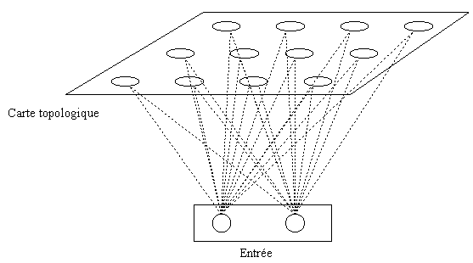
Artificial Neural Network FeedForward Architecture
Information flow unidirectional
Multi-Layer Perceptron (MLP)
Radial Basis Function (RBF)
Kohonen Self-Organising Map (SOM)
‹#›

Slide 49
Artificial Neural Network Recurrent Architecture
Feedback connections
Hopfield Neural Networks: Associative memory
Adaptive Resonance Theory (ART)
‹#›

Slide 50
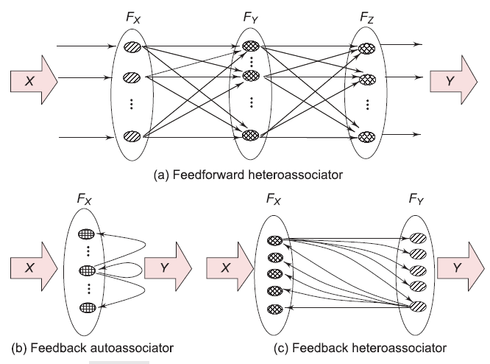
Architectures: Feedforward and Feedback
‹#›

Slide 51
Neural Networks Generate Mappings
f : R^{n} → R^{p}
Multilayered networks that associate vectors from one space to vectors of another space are called heteroassociators.
Map or associate two different patterns with one another—one as input and the other as output. Mathematically we write, f : R^{n} → R^{p}.
‹#›

Slide 52
Neural Networks Generate Mappings
When neurons in a single field connect back onto themselves the resulting network is called an autoassociator since it associates a single pattern in R^{n} with itself.
f : R^{n} → R^{n}
‹#›

Slide 53
Activation and Signal State Spaces
For a p-dimensional field of neurons, the activation state space is R^{p}.
The signal state space is the Cartesian cross space,
I^{p} = [0, 1]×· · ·×[0, 1] p times = [0, 1]^{p} ⊂ R^{p} if the neurons have continuous signal functions in the interval [0, 1]
[−1, 1]^{p} if the neurons have continuous signal functions in the interval [−1, 1].
‹#›

Slide 54
Activation and Signal State Spaces
For the case when the neuron signal functions are binary threshold, the signal state space is
B^{p} = {0, 1}×· · ·×{0, 1} p times = {0, 1}^{p} ⊂ I^{p} ⊂ R^{p}
{−1, 1}^{p} when the neuron signal functions are bipolar threshold.
‹#›

Slide 55
Feedforward vs Feedback: Multilayer Perceptrons
Organized into different layers
Unidirectional connections
memory-less: output depends only on the present input
X ∈ R^{n}
S = f (X)
‹#›

Slide 56
Feedforward vs Feedback: Multilayer Perceptrons
Possess no dynamics
Demonstrate powerful properties
Universal function approximation
Find widespread applications in pattern classification.
X ∈ R^{n}
S = f (X)
‹#›

Slide 57
Feedforward vs Feedback: Recurrent Neural Networks
Non-linear dynamical systems
New state of the network is a function of the current input and the present state of the network
‹#›

Slide 58
Feedforward vs Feedback: Recurrent Neural Networks
Possess a rich repertoire of dynamics
Capable of performing powerful tasks such as
pattern completion
topological feature mapping
pattern recognition
‹#›

Slide 59

More on Feedback Networks
Network activations and signals are in a flux of change until they settle down to a steady value
Issue of Stability: Given a feedback network architecture we must ensure that the network dynamics leads to behavior that can be interpreted in a sensible way.
‹#›

Slide 60
More on Feedback Networks
Dynamical systems have variants of behavior like
fixed point equilibria where the system eventually converges to a fixed point
Chaotic dynamics where the system wanders aimless in state space
‹#›

Slide 61
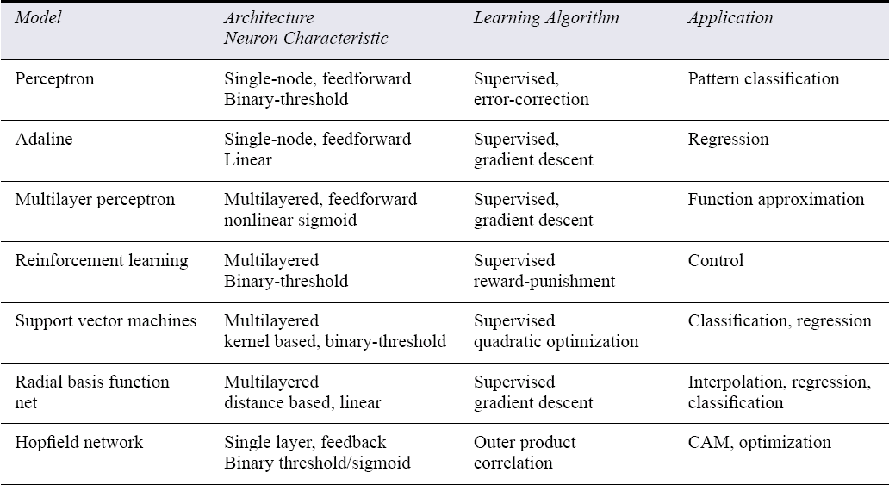
Summary of Major Neural Networks Models
‹#›/48

Slide 62
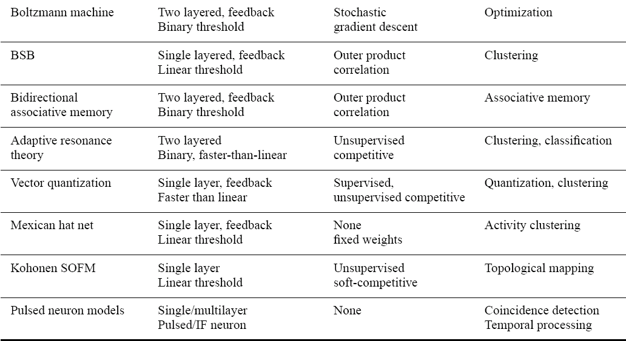
Summary of Major Neural Networks Models

Slide 63
Artificial Neural Network Learning paradigms
Supervised learning:
Teacher presents ANN input-output pairs,
ANN weights adjusted according to error
Classification
Control
Function approximation
Associative memory
Unsupervised learning:
no teacher
Clustering
‹#›

Slide 64
Salient Properties of Neural Networks
Robustness Ability to operate, albeit with some performance loss, in the event of damage to internal structure.
Associative Recall Ability to invoke related memories from one concept.
For e.g. a friend’s name elicits vivid mental pictures and related emotions
‹#›

Slide 65
Salient Properties of Neural Networks
Function Approximation and Generalization Ability to approximate functions using learning algorithms by creating internal representations and hence not requiring the mathematical model of how outputs depend on inputs. So neural networks are often referred to as adaptive function estimators.
‹#›

Slide 66
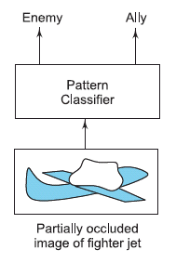
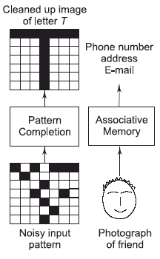
Application Domains of Neural Networks
Fault Tolerance
Associative Recall
‹#›

Slide 67
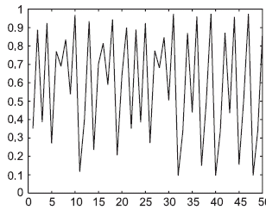
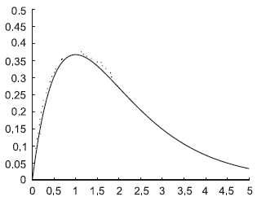
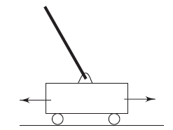
Application Domains of Neural Networks
Prediction
Function Approximation
Control
‹#›

Slide 68
Some Applications of ANNs
Pronunciation: NETtalk program (Sejnowski & Rosenberg 1987) is a neural network that learns to pronounce written text: maps characters strings into phonemes (basic sound elements) for learning speech from text
Speech recognition
Handwritten character recognition:a network designed to read zip codes on hand-addressed envelops
ALVINN (Pomerleau) is a neural network used to control vehicles steering direction so as to follow road by staying in the middle of its lane
Face recognition
Backgammon learning program
Forecasting e.g., predicting behavior of stock market
‹#›

Slide 69
ANN capabilities
Learning
Approximate reasoning
Generalisation capability
Noise filtering
Parallel processing
Distributed knowledge base
Fault tolerance
‹#›

Slide 70
Main Problems with ANN
Contrary to Expert sytems, with ANN the Knowledge base is not transparent (black box)
Learning sometimes difficult/slow
Limited storage capability
‹#›

Slide 71
When to use ANNs?
Input is high-dimensional discrete or real-valued (e.g. raw sensor input).
Inputs can be highly correlated or independent.
Output is discrete or real valued
Output is a vector of values
Possibly noisy data. Data may contain errors
Form of target function is unknown
Long training time are acceptable
Fast evaluation of target function is required
Human readability of learned target function is unimportant
⇒ ANN is much like a black-box
‹#›

