Slide 1
Paper II : CE – I Neural Network UNIT – I Geometry of Binary Threshold Neurons and their Networks
ONLINE / LIVE TEACHING CLASSES
SESSION 2020-2021
DATE: 28 September 2021
‹#›

Slide 2


Pattern Recognition and Data Classification
Pattern recognition is
concerned with machine recognition of regularities in noisy or complex environments.
the search for structure in data.
Involves placing an input pattern into one of possibly many decision classes.
*$#@?!
Brain ?!
Neurons ?!
Pattern
Recognition
Machine
‹#›/63

Slide 3
Recognition
The ability to classify data into (known) categories.
Human beings have an innate ability to recognize complex patterns with effortless ease, based on categories created internally without conscious intervention.
Parents recognize the cry of a child
Easily identify an individual from a silhouette
Recognize a fast moving car at dusk.
‹#›/63

Slide 4
Recognition
Real world embedded pattern recognition systems draw on the brain metaphor
Applications include
ZIP code readers
DNA fingerprinting
Medical diagnosis
Occluded target recognition
Signature verification
‹#›/63

Slide 5

A Pattern Classifier
Rain
temperature
wind velocity
relative humidity
cloud cover
Pattern Recognition
Machine
Sunny
Vector of feature measurements
FEATURE VECTOR
PATTERN CLASSES
‹#›/63

Slide 6
A Decision Boundary
Class 2
New measurement
Class 1
Class Separating
Boundary
‹#›/63

Slide 7
Basic Pattern Classification Problem
Given some samples of data measurements of a real world system along with correct classifications for patterns in that data set, make accurate decisions for future unseen examples.
‹#›/63

Slide 8
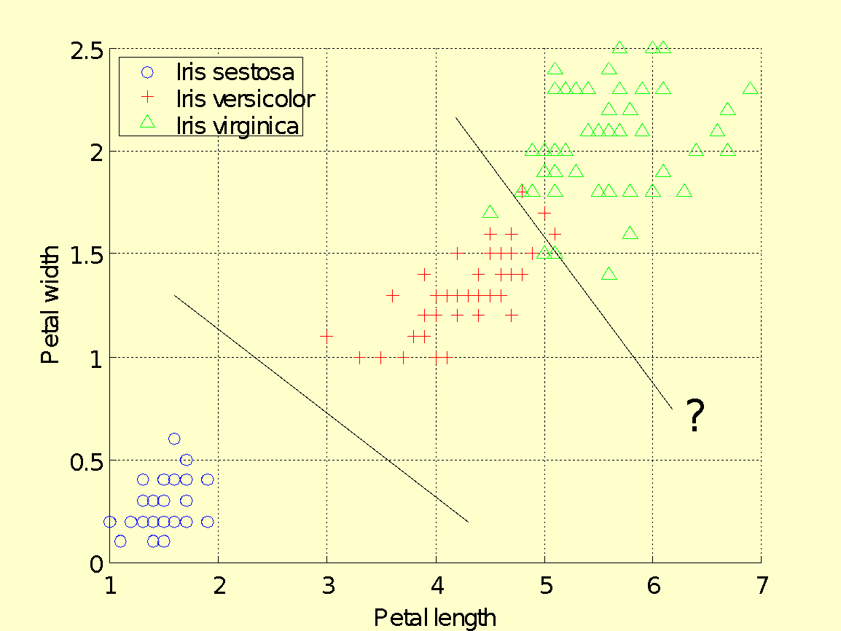
Iris Data Classification
It is easy to separate iris sestosa data from iris versicolor and iris virginica
It is much more difficult to decide where to place a separating line between iris versicolor and iris virginica
‹#›/63

Slide 9
Iris Data Classification
Any placement of the straight line will cause some pattern to get misclassified!
‹#›/63

Slide 10
Two-Class Data Classification Problem
Given a set of Q data samples or patterns X = {X₁, . . . ,X_{Q}},X_{i} ∈ R^{n}, drawn from two classes C₁ and C₂, find an appropriate hyperplane that separates the two classes so that the resulting classification decisions based on this class assignment are on average in close agreement with the actual outcome.
‹#›/63

Slide 11
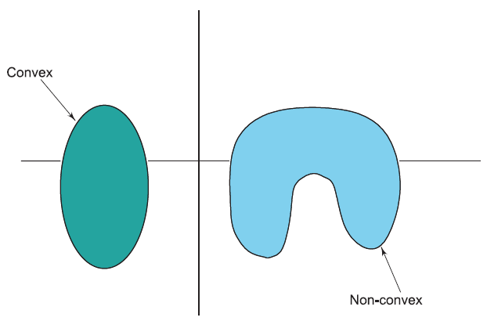
Convex Sets, Convex Hulls and Linear Separability
Let X, Y ∈ S ⊂ R^{n}, then S is convex iff λX + (1 − λ)Y ∈ S, 0 ≤ λ ≤ 1, ∀X, Y ∈S.
Equivalently, a set S is convex if it contains all points on all line segments with end points in S.
‹#›/63

Slide 12

Convex Hull
The convex hull, C(X_{i} ), of a pattern set X_{i} is the smallest convex set in R^{n} which contains the set X_{i} .
Consider every convex set S_{α}, such that X_{i} ⊂ S_{α}⊂ R^{n}, α ∈ I, where I is an index set. Then the convex hull of X_{i,} C(X_{i} ) =
∩_{α∈I} S_{α}.(intersection of all R^{n} subsets that contains the pattern set)
‹#›/63

Slide 13
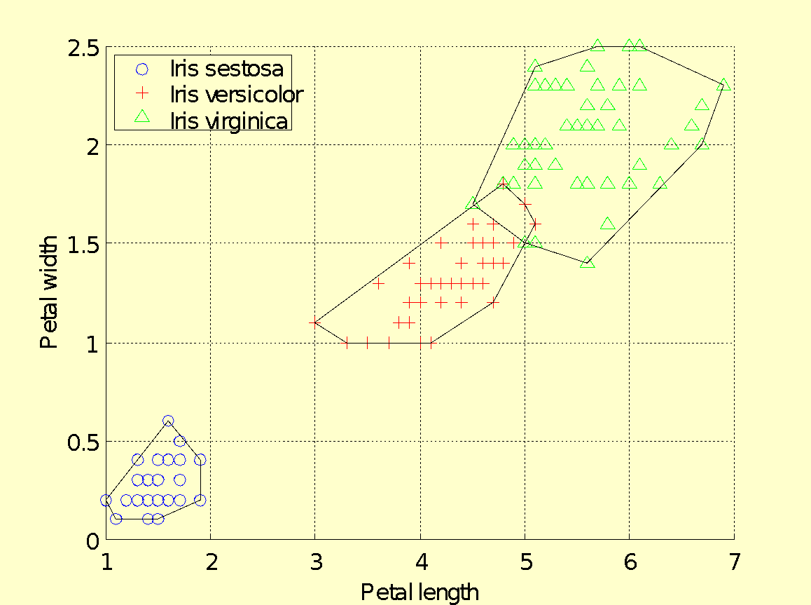
MATLAB Generated Convex Hulls For Iris Data
‹#›/63

Slide 14
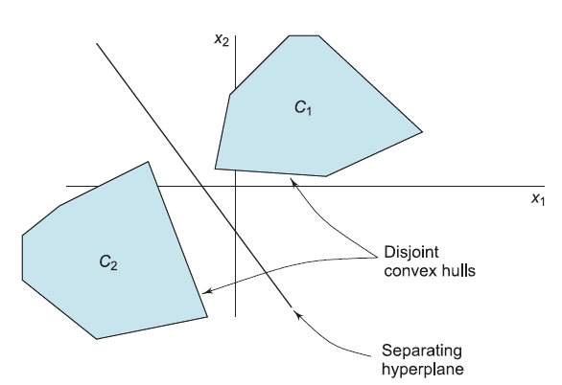
Linearly Separable Classes and Separating Hyperplane
Two pattern sets X_{i} and X_{j} are said to be linearly separable if their convex hulls are disjoint, that is if C(X_{i} ) ∩ C(X_{j} ) = φ.
‹#›/63

Slide 15
Linearly Separable Classes and Separating Hyperplane
One separating hyperplane is the perpendicular bisector of the straight line joining the closest two points on the disjoint convex hulls.
‹#›/63

Slide 16
Space of Boolean Functions
An n-dimensional Boolean function is a map from a domain space that comprises 2^{n} possible combinations of the n variables into the set {0, 1}.
B²
(0,1) = {x₂}
(1,1) = X
(0,0) = φ
(1,0) ={x₁}
‹#›/63

Slide 17
Boolean Functions in n-Dimensions
In a Boolean function, each of 2^{n} domain points maps to either 0 or 1, f : B^{n} → {0, 1}.
Let X₀ denote the set of points that map to 0 and X₁, the set of those that map to 1. Sets X₀,X₁ comprise points that are pre-images of range points 0, 1: X₀ = f ⁻¹(0) and X₁ = f ⁻¹(1).
‹#›/63

Slide 18
Boolean Functions in n-Dimensions
Each unique assignment of 0-1 values to the 2^{n} possible inputs in n-dimensions represents a Boolean function.
Therefore, in n-dimensions, there are 2^{2n} such unique assignments that can be made, and thus 2^{2n} possible functions.
‹#›/63

Slide 19
Separability of Boolean Functions
Linearly separable sets can be separated by a straight line in 2 dimensions.
In higher dimensions we say the sets are segregated by a separating hyperplane
‹#›/63

Slide 20

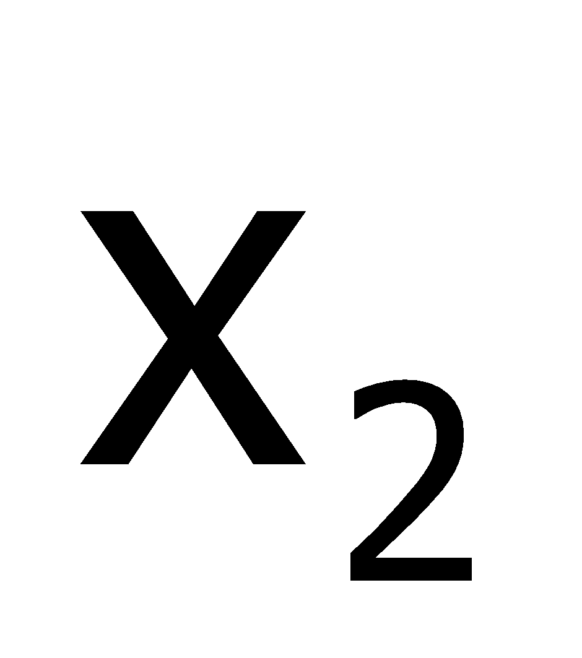

The Boolean AND Function is Linearly Separable
Truth Table
(1,1) maps to 1
as indicated by
a filled circle
x₂
0
0
1
1
0
1
0
1
0
0
0
1
Separating line
(0,0)
(0,1)
(1,0)
(1,1)
0
x₁
1
(0,0), (0,1), and (1,0) map to 0,
as indicated by unfilled circles.
‹#›/63

Slide 21
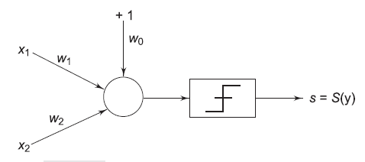
Binary Neurons are Pattern Dichotomizers
Neuron Input vector X = (1, x₁, x₂) Weight vector W = (w₀,w₁,w₂)
Internal bias modeled by weight w₀, with a constant +1 input.
‹#›/63

Slide 22
Binary Neurons are Pattern Dichotomizers
Neuronal activation
y = X^{T}W = w₁x₁ + w₂x₂ + w₀
Neuron discriminant function y(X) = 0
if y > 0, s = 1, and
if y < 0, s = 0.
‹#›/63

Slide 23

Discriminant Function
Given a fixed set of weights, the neuron fires a +1 signal for inputs (x₁, x₂) which yield positive activation and fires a 0 for inputs that yield negative activation.
Inputs are thus separated into two “classes”. Inputs satisfying the discriminant function yield zero activation.
The discriminant function can be written as
‹#›/63

Slide 24
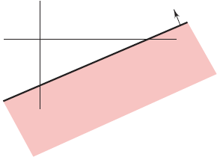
Discriminant Function
Small arrow on the straight line
indicate the half plane that
translates to +1 signal value
The neuron discriminant function thus represents a straight line in the two dimensional pattern space
This straight line slices the plane into two halves:
one half where patterns cause the neuron to generate positive inner products and thus fire a +1;
the other half where pattern space points cause the neuron to generate negative inner products and thus fire a 0.
‹#›/63

Slide 25
Example: Geometrical Design of AND Classifier
x₂
Intercept = - w₀ / w₂
slope m = −w₁/w₂ = −1, intercept c = −w₀/w₂ = 1.5.
Choosing w₁ = w₂ = 1 and w₀ = −1.5 yields a neuron classifier that appropriately partitions the pattern space for AND classification.
The value of the threshold is −1.5.
Slope = - w₁ / w₂
1.5
(1,1)
1
(0,0)
1
1.5
‹#›/63

Slide 26
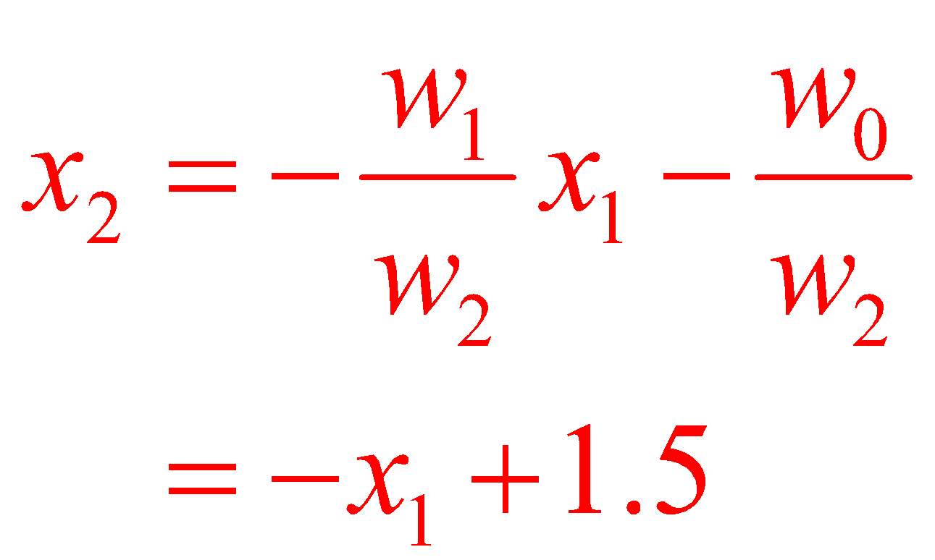
Example: Geometrical Design of AND Classifier
x₂
Pattern points
on this side of
the separating
line cause the
neuron to fire
a +1 signal
Discriminant function thus becomes
Intercept = - w₀ / w₂
Slope = - w₁ / w₂
1.5
+
(1,1)
1
x₂ = -x₁ + 1.5
-
Pattern points on
this side cause the
neuron to fire a 0 signal
x₁
(0,0)
1
1.5
‹#›/63

Slide 27
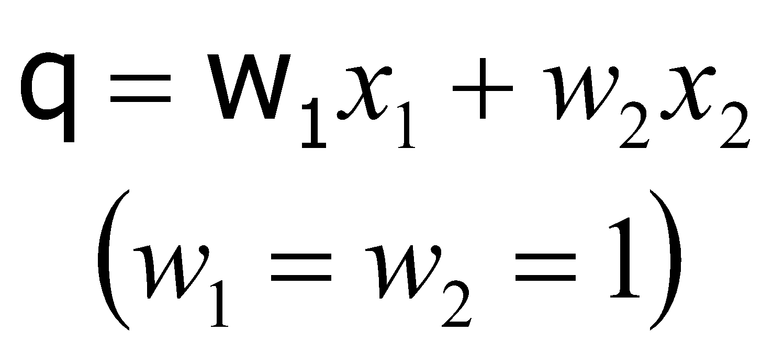
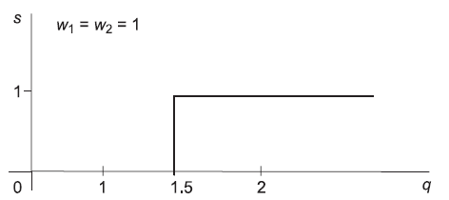
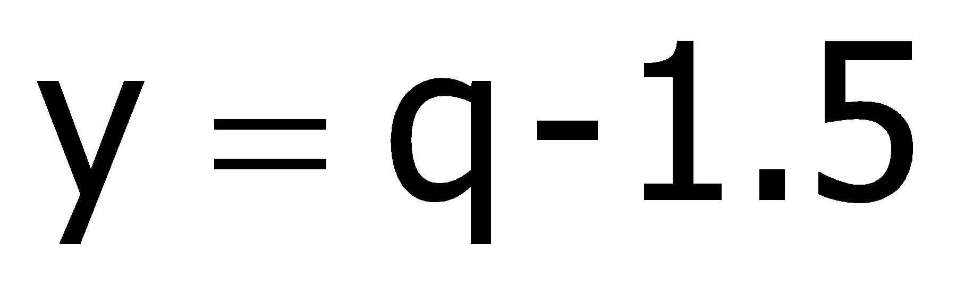

Solving The AND Problem By Setting The Signal Function Shift In (1,2)
0
0
1
1
0
1
0
1
0
1
1
2
-1.5
-0.5
-0.5
0.5
0
0
0
1
Looking at the design problem in s-q plane, s should be 1 only if q = 2 and zero otherwise.
The signal function anywhere in the interval (1,2) i.e., 1+ε and 2-ε would get the appropriate result.
Our design placed signal function at 1.5
‹#›/63

Slide 28
Summary of Important Properties of TLNs
A threshold logic neuron employs a single inner product based linear discriminant function
y : R^{n+1} → R, y(X) = X^{T}W where X,W ∈ R^{n+1} and the bias or threshold value w₀, is included into the weight vector.
The hyperplane decision surface y(X) = 0 divides the space into two regions, one of which the TLN assigns to class C₀ and the other to class C₁.We say that the TLN dichotomizes patterns by a hyperplane decision surface in R^{n}.
‹#›/63

Slide 29
Summary of Important Properties of TLNs (contd.)
The orientation of the hyperplane is determined by the weights w₁, . . . ,w_{n}.
The position of the hyperplane is proportional to w₀.
The distance from the hyperplane to an arbitrary point X ∈ R^{n} is proportional to the value of y(X).
A pattern classifier which employs linear discriminant functions is called a linear machine.
‹#›/63

Slide 30
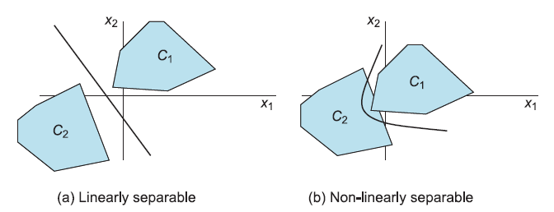
Non-linearly Separable Problems
The two convex hulls C₁ and C₂ of two pattern sets in figure (a) are sufficiently separated to ensure decision surfaces comprise only of hyperplanes.
When convex hulls overlap as in figure (b), the pattern sets become linearly non-separable,but may be non-linearly separable.
‹#›/63

Slide 31

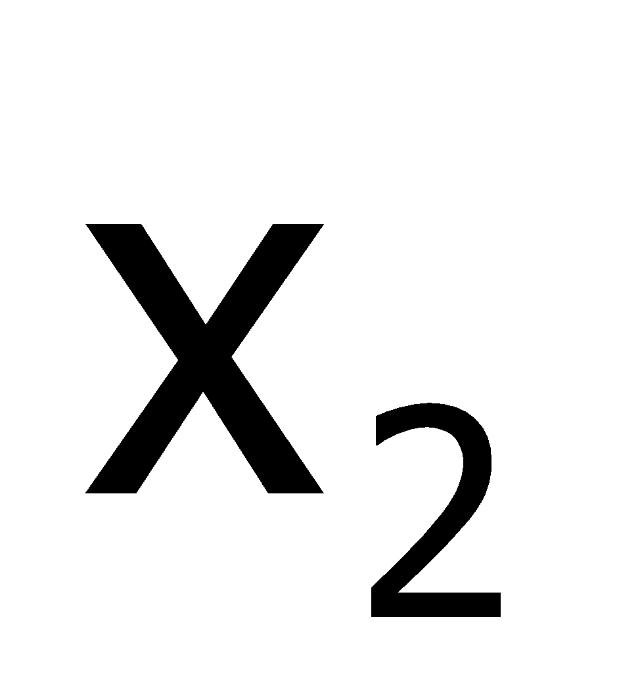

XOR is Not Linearly Separable
Truth Table
Region of 1’s
0
0
1
1
0
1
0
1
0
1
1
0
The geometry of the Boolean XOR function shows that two straight lines are required for proper class separation
‹#›/63

Slide 32
Theorem
No single threshold logic neuron exists that can solve the XOR classification problem
‹#›/63

Slide 33
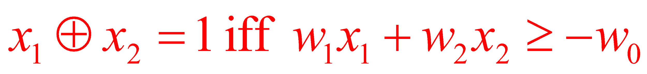
Proof: By Contradiction
Note: XOR classification problem is equivalent to the simple modulo-2 addition(2mod(x₁+x₂))
Assume a TLN with weights (w₀, w₁, w₂) and inputs x₁ and x₂.
For XOR operation
Truth Table
0
0
1
1
0
1
0
1
0
1
1
0
‹#›/63

Slide 34
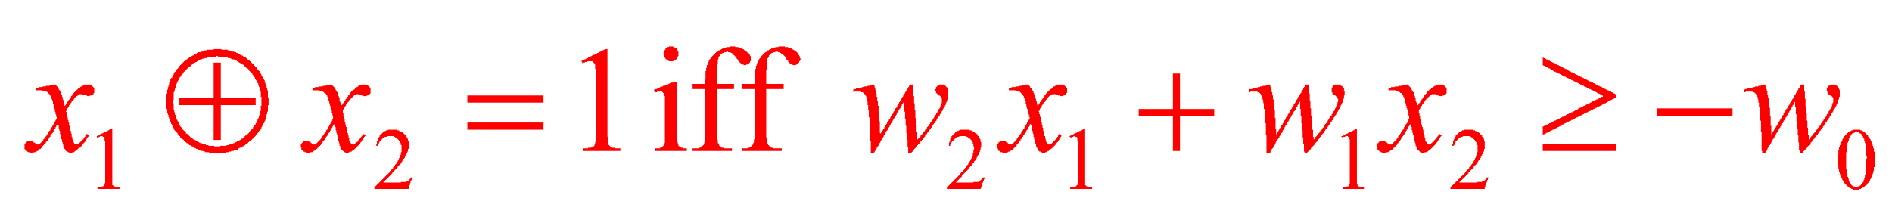
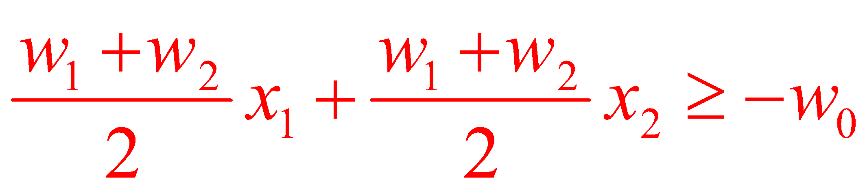
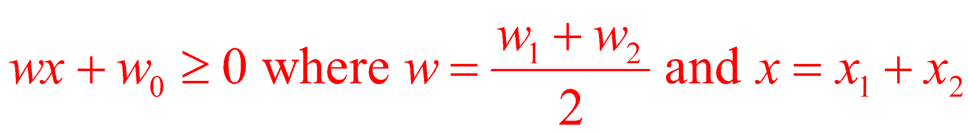

Proof: By Contradiction
Since mod 2 arithmetic is symmetric,
This implies
‹#›/63

Slide 35



Proof: By Contradiction (contd.)
Notice that wx + w₀ is a first degree polynomial in x, which must be less than zero for x=0 (0 0), greater than zero for x=1 (0 1 and 1 0), and less than zero for x = 2 (1 1).
This is impossible since a first degree polynomial is monotonic and cannot therefore change sign more than once.
We thus conclude that there is no such polynomial, and that there is no TLN that can solve the XOR problem.
‹#›/63

Slide 36
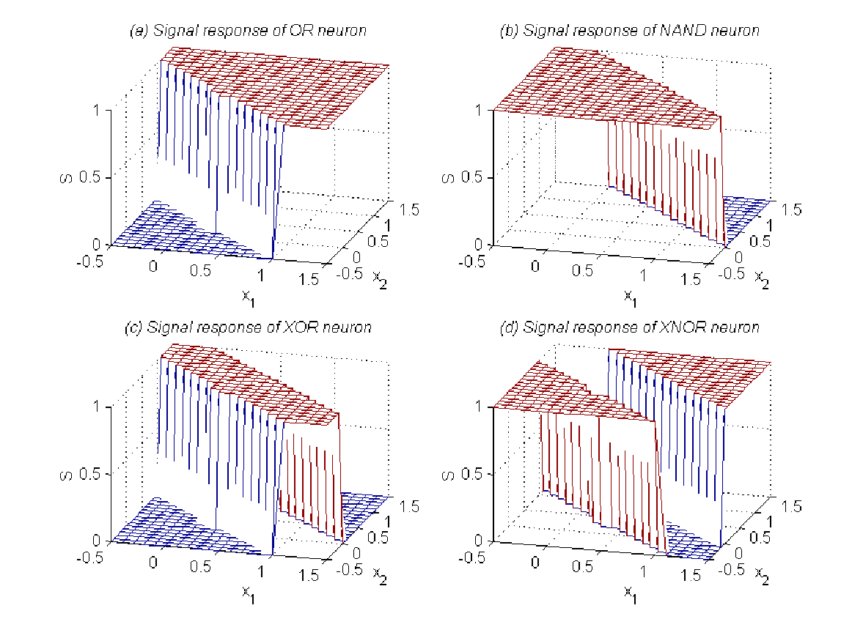
Solving XOR Problem
OR and NAND functions realizable using a single binary neuron
Combining OR and NAND neurons using a logical AND (which can be implemented using a third binary neuron), XOR problem can be solved
‹#›/63

Slide 37
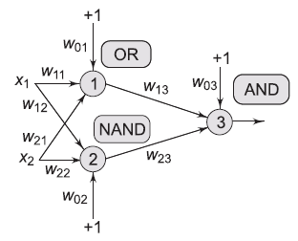
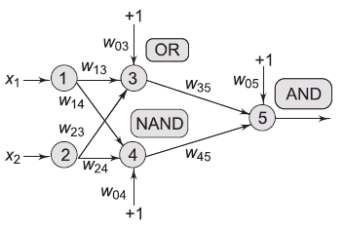
Network of TLNs to solve XOR
A two-layered network architecture to implement the XOR function.
A more common three-layered version of the same network with linear input units shown explicitly
‹#›/63

Slide 38
Capacity of a Simple Threshold Logic Neuron
A simple TLN implements a specific class of functions from R^{n} into the set {0, 1}, namely, the class of linearly separable functions.
If we were to arbitrarily assign image points 0 or 1 to some p domain points, how many such random assignments could we expect the TLN to successfully implement?
The number of such assignments that the TLN can correctly implement is called its capacity.
‹#›/63

Slide 39
Points in General Position
Denote the number of linear dichotomies that can be induced on p points in n–dimensional space as L(p, n).
L(p, n) is then equal to twice the number of ways in which p points can be partitioned by an (n − 1)–dimensional hyperplane, since for each distinct partition, there are two different classifications.
Assumption: No three points in space are collinear, since this would effectively reduce the number of inducible dichotomies.
‹#›/63

Slide 40
Definition: General Position
For p > n, we say that a set of p points is in general position in a n–dimensional space if and only if no subset of n + 1 points lie on an (n − 1)–dimensional hyperplane.
When p ≤ n, a set of p points is in general position if no (n − 2)–dimensional hyperplane contains the set.
‹#›/63

Slide 41
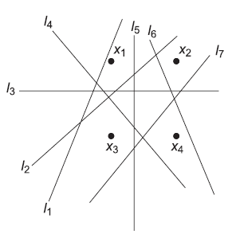
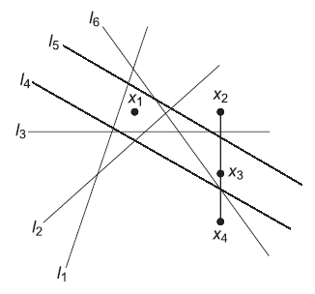
Example
Points in general position;
In top figure. Points are in general position. In bottom figure, points are not in general position.
The lines l₁, . . . , l₇ implement all possible linear partitions of four points in top figure.
Line l₃ in bottom figure could be a decision surface that implements either one of the following classifications: {X₁,X₂} ∈ C₀, {X₃,X₄} ∈ C₁; or {X₁,X₂} ∈ C₁ and {X₃,X₄} ∈ C₀.
Points not in general position
‹#›/63

Slide 42
Example
Points in general position;
C₀ is the class identified by a TLN signal 0; C₁ is the class identified by a TLN signal 1.
In top figure, L(p,n)=2*7=14.
Points not in general position
‹#›/63

Slide 43
The Essential Question
Given a set of p random points in n–dimensional space, for how many of the 2^{p} possible {0, 1} assignments can we find a separating hyperplane that divides one class from another?
The answer is precisely L(p, n).
‹#›/63

Slide 44
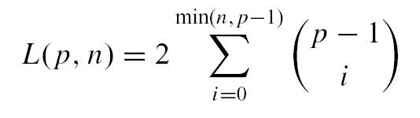
Number of Dichotomies
See text for details of the derivation
‹#›/63

Slide 45
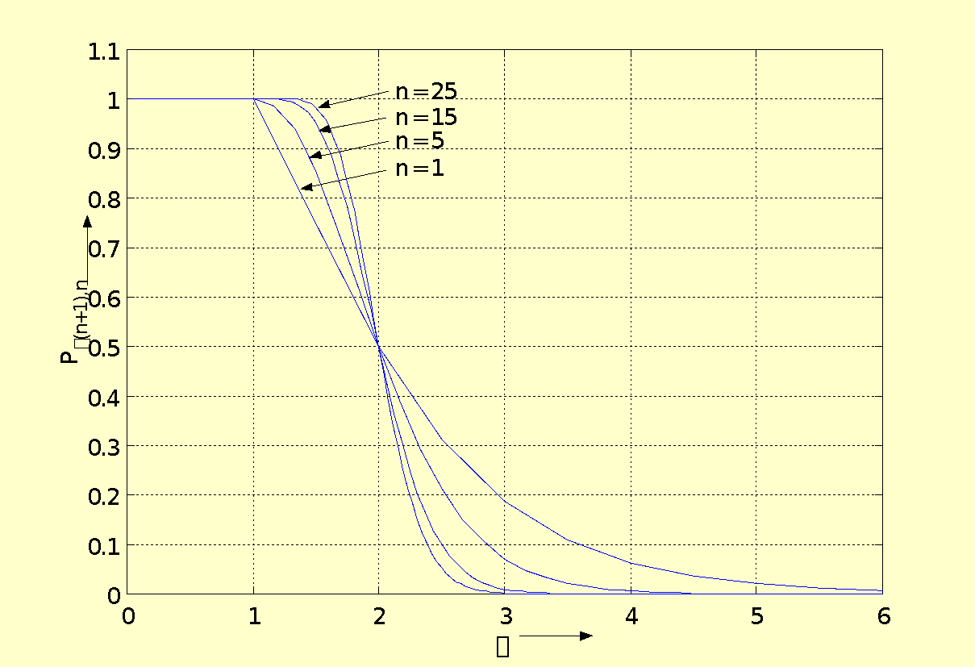
Probabilistic Estimate of Computable Dichotomies
With p points in n–dimensions there are 2^{p} possible functions. The probability that they are implementable by a TLN is then directly the ratio of L(p, n) and 2^{p}.
Capacity of a TLN
‹#›/63

Slide 46


Probabilistic Estimate of Computable Dichotomies
The probability that a dichotomy defined on p points in n–dimensions is computable by a TLN is
Capacity of a TLN
‹#›/63

Slide 47
Revisiting the XOR Problem
The number of dichotomies L(p, n) of p points in n dimensions provides a direct measure of the number of Boolean functions defined on p points that are computable by a TLN with n inputs.
For example, a TLN with 2 inputs (and a bias weight) can compute the entire set of Boolean functions that are defined on 3 points in R².
‹#›/63

Slide 48
Revisiting the XOR Problem
Because the total number of functions that can be defined on 3 points is 2³ = 8; and the total number of dichotomies that can be generated by 3 points in 2 dimensions is L(3, 2) = 8.
Adding a fourth point increases the total number of possible functions to 2⁴ = 16, whereas the total number of dichotomies that can be generated with 4 points in 2 dimensions is only L(4, 2) = 14.
‹#›/63

Slide 49
Revisiting the XOR Problem
Two functions (for example, XOR and XNOR considering the functions defined on B²) are not computable by a TLN (because they are not linearly separable).
‹#›/63

Slide 50
To gain further insight…
If we have a large number of dichotomies, the probability that the TLN will be able to solve a classification problem increases i.e., there is a larger chance that some dichotomy will be able to solve the problem.
Since a TLN can solve only a linearly separable problem, to solve a linearly non-separable problem we have to make it linearly separable. How can this transformation be effected ?
‹#›/63

Slide 51
To gain further insight…
There are two ways:
If somehow we can reduce the number of points p, then it might be possible that the mapping from the reduced set of points into the range space may become linearly separable.
We might increase the dimension since the number of possible linear dichotomies then increases, and the probability that the linearly nonseparable problem at hand becomes linearly separable, increases.
‹#›/63

Slide 52
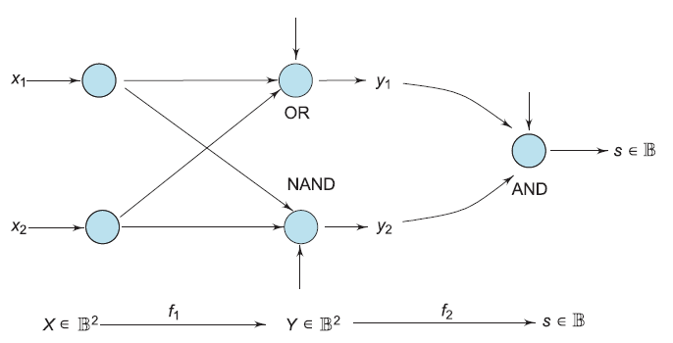
Solution 1: Reduce the Number of Points
The logical functions implemented by each TLN (first layer nodes do not compute anything) is indicated in the figure.
‹#›/63

Slide 53
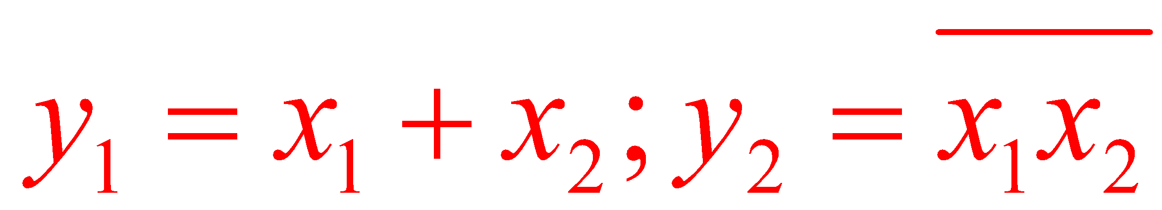
Solution 1: Reduce the Number of Points
The XOR problem has been solved in two steps:
first there is a map f₁ : B² → B²
Then, there is a second map f₂ : B² → B
Note that Y = f₁(X) where
‹#›/63

Slide 54
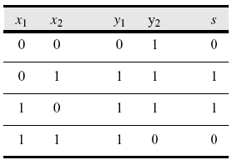
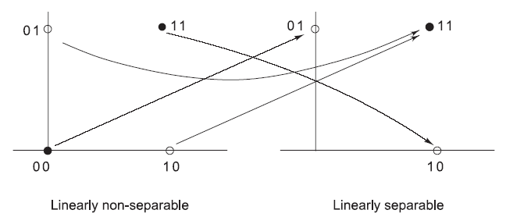
Four Points In 2-d Mapped To Three Make XOR Linearly Separable
‹#›/63

Slide 55
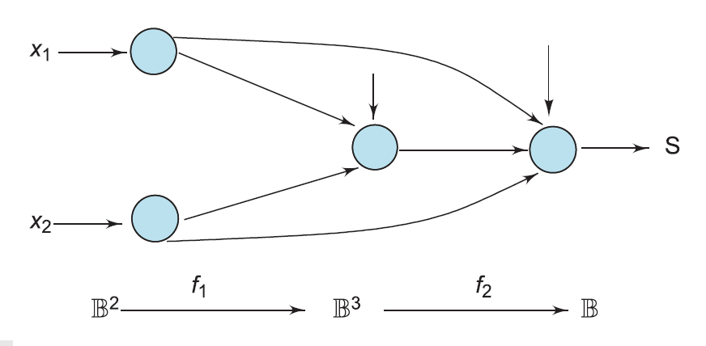
Solution 2: Increase the Dimension
We are now looking for an appropriate mapping f₁ : B² → B³ such that f₂ : B³ → B is linearly separable.
‹#›/63

Slide 56
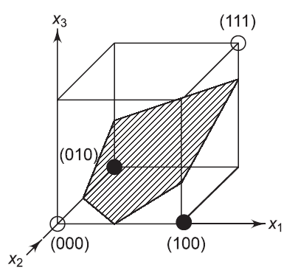
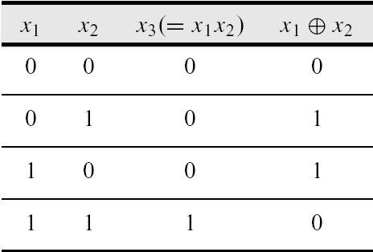
The AND Function Added As The Third Dimension
‹#›/63

Slide 57
Multilayer Networks
TLNs can be connected into multiple layers in a feedforward fashion.
It is common to have more than one hidden layer when solving a classification problem especially when one has a number of disjoint regions in the pattern space that are associated into a single class.
‹#›/63

Slide 58
Multilayer Networks
We make the following observations for TLNs with two hidden layers apart from the input and the output layer.
Each neuron in the first hidden layer forms a hyperplane in the input pattern space.
A neuron in the second hidden layer can form a hyper-region from the outputs of the first layer neurons by performing an AND operation on the hyperplanes. These neurons can thus approximate the boundaries between pattern classes.
The output layer neurons can then combine disjoint pattern classes into decision regions made by the neurons in the second hidden layer by performing logical OR operations.
‹#›/63

Slide 59
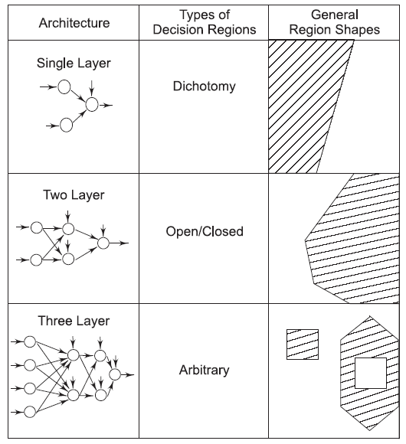
The Geometry Of Multilayered TLN Networks
‹#›/63

Slide 60
Theorem
No more than three layers in binary threshold feedforward networks are required to form arbitrarily complex decision regions.
‹#›/63

Slide 61
Proof: By Construction
Consider the n–dimensional case: X ∈ R^{n}.
Partition the desired decision regions into small hypercubes.
Each hypercube requires 2n neurons in the first layer (one for each side of the hypercube).
‹#›/63

Slide 62
Proof: By Construction
One neuron in the second layer takes the logical AND of the outputs from the first layer neurons. Outputs of second layer neurons will be high only for points within the hypercube.
Hypercubes are assigned to the proper decision regions by connecting the outputs of second layer neurons to third layer neurons corresponding to the decision region that the hypercubes represent by taking the logical OR of appropriate second layer outputs.
‹#›/63

Slide 63
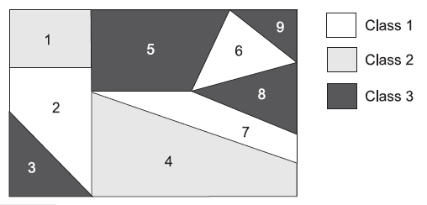

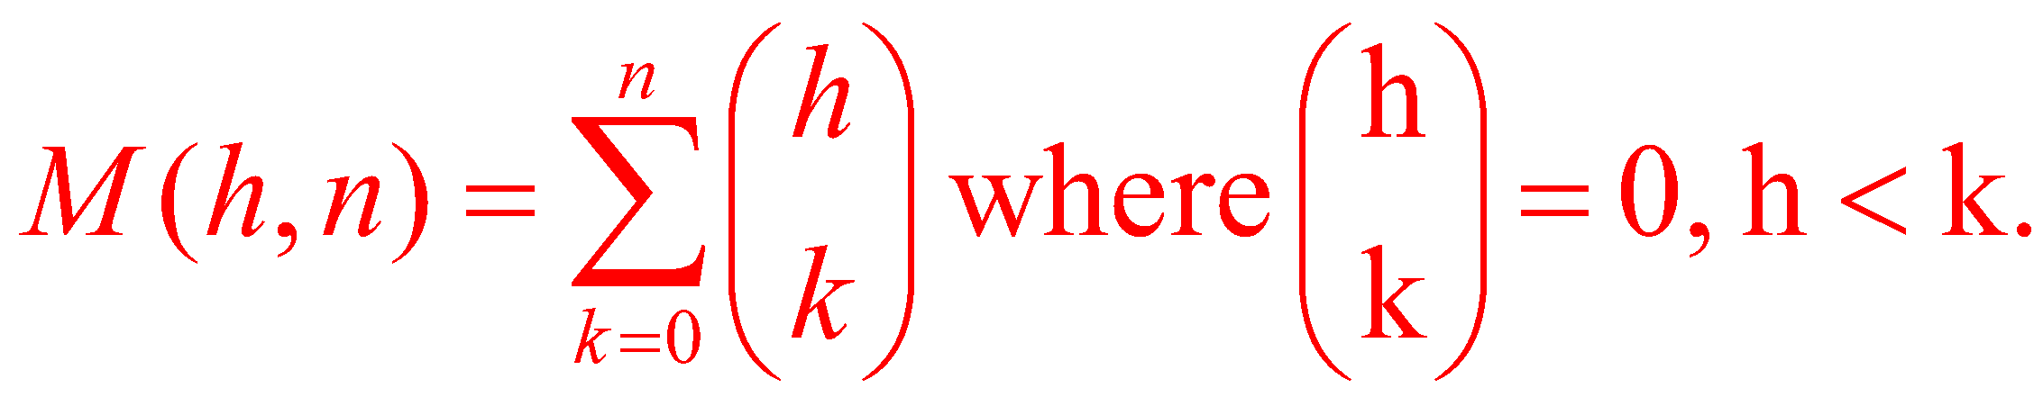
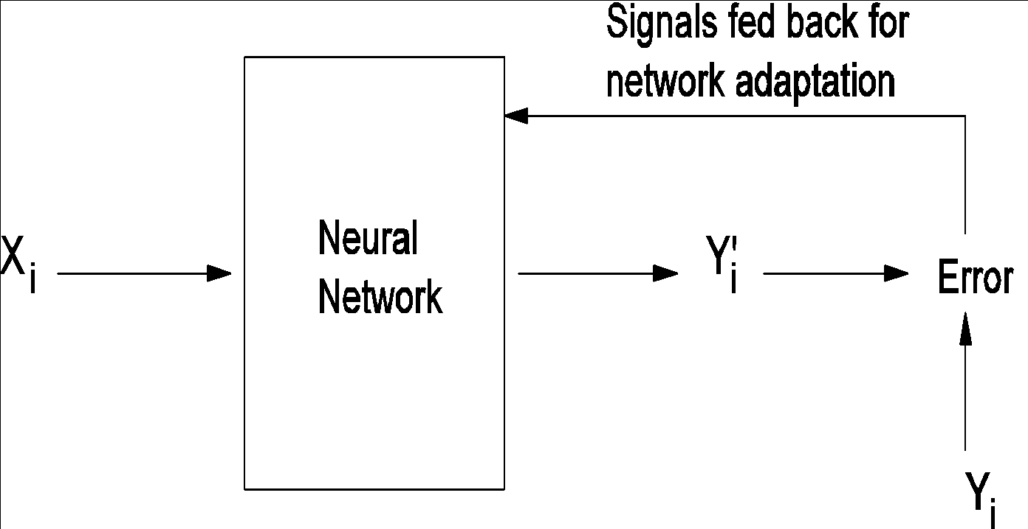
How Many Hidden Nodes Are Enough? Theorem (Cao, Mirchandani, 1989)
In n-dimensional space, the maximum number of regions that are linearly separable using h hidden nodes are
See text for details.
‹#›/63

