Slide 1
Supervised Learning II: Backpropagation and Beyond
‹#›

Slide 2
Multilayered Network Architectures
Input layer
Hidden layer
Output layer
Linear neuron
Sigmoidal neuron
‹#›/83

Slide 3
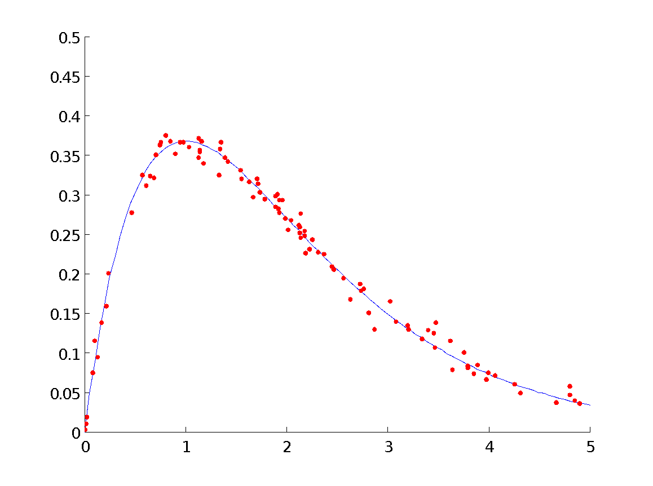
Approximation and Generalization
What kind of network is required to learn with sufficient accuracy a function that is represented by a finite data set?
Does the trained network predict values correctly on unseen inputs?
‹#›/83

Slide 4
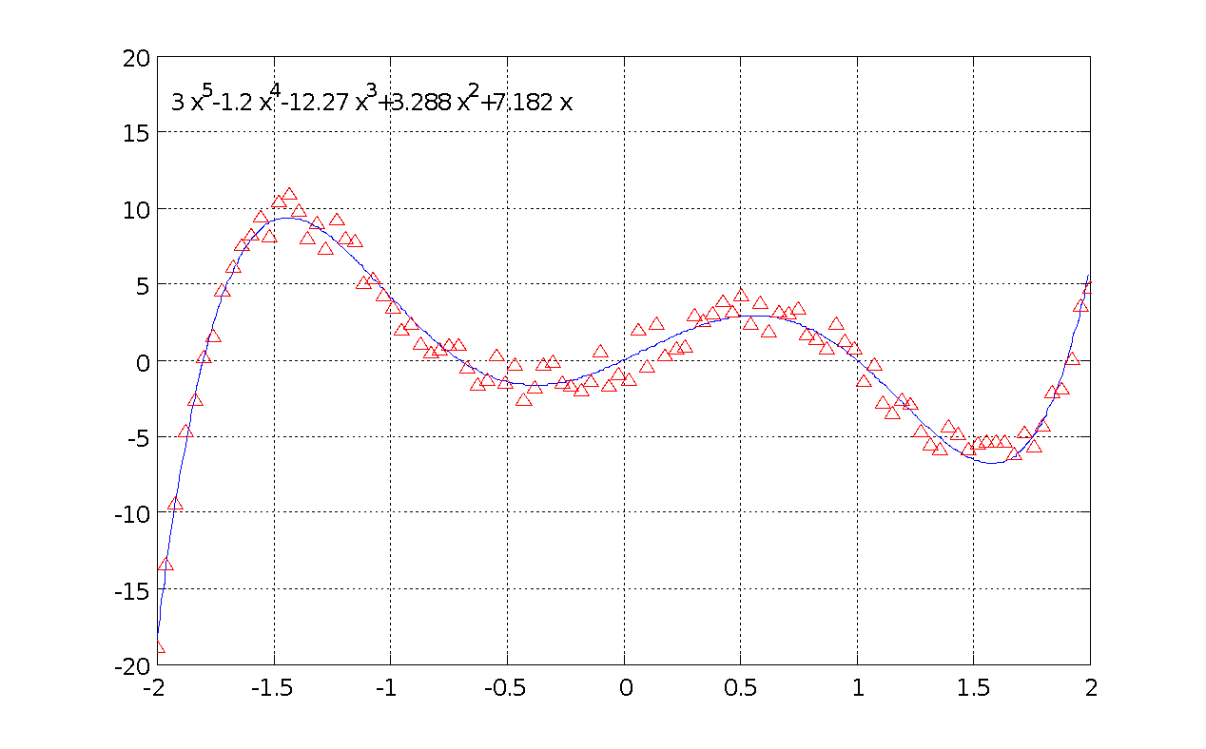

Function Described by Discrete Data
Assume a set of Q training vector pairs: T = (X_{k},D_{k}) k=1…Q X_{k} ∈ R^{n}, D_{k} ∈ R^{p}, where D_{k} is a vector response desired when input X_{k} is presented as input to the network.
‹#›/83

Slide 5
Supervised Learning Procedure
Error information fed back for network adaptation
X_{k}
S_{k}
Error
D_{x}
Neural Network
‹#›/83

Slide 6
Backpropagation Weight Update Procedure
Select a pattern X_{k} from the training set T present it to the network.
Forward Pass: Compute activations and signals of input, hidden and output neurons in that sequence.
‹#›/83

Slide 7
Backpropagation Weight Update Procedure
Error Computation: Compute the error over the output neurons by comparing the generated outputs with the desired outputs.
Compute Weight Changes: Use the error to compute the change in the hidden to output layer weights, and the change in input to hidden layer weights such that a global error measure gets reduced.
‹#›/83

Slide 8
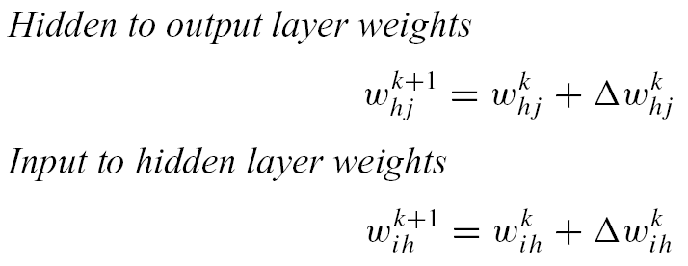
Backpropagation Weight Update Procedure
Update all weights of the network.
Repeat Steps 1 through 5 until the global error falls below a predefined threshold.
‹#›/83

Slide 9
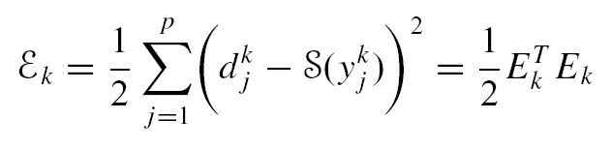
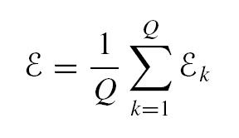
Square Error Function
The instantaneous summed squared error ε_{k} is the sum of the squares of each individual output error e_{j}^{k}, scaled by one-half:
‹#›/83

Slide 10
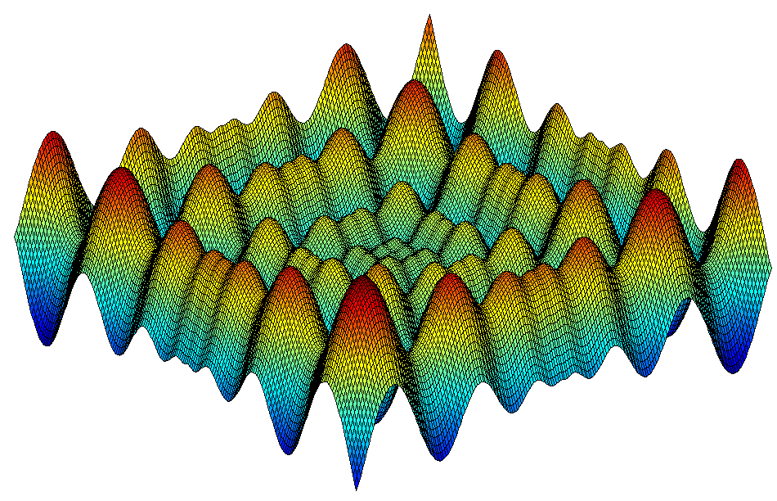
Error Surface
‹#›/83

Slide 11
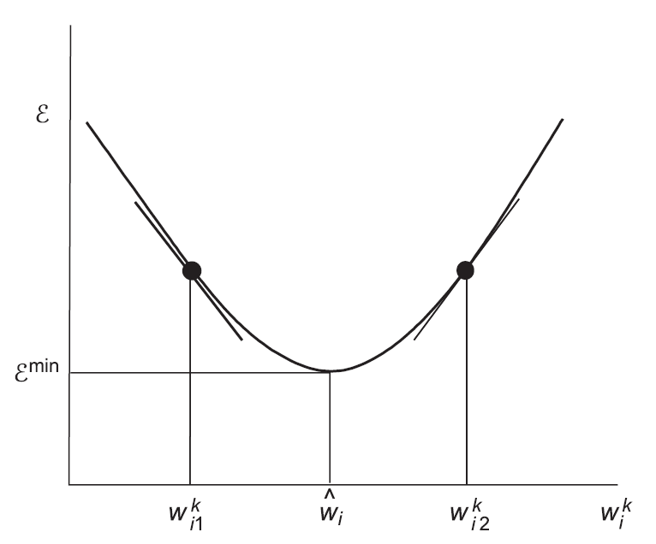
Gradient Descent Procedure
‹#›/83

Slide 12
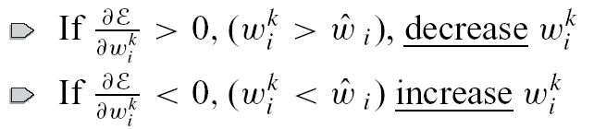
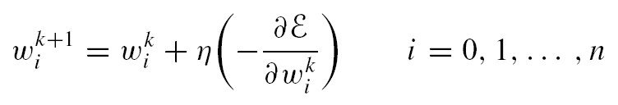
Recall: Gradient Descent Update Equation
It follows logically therefore, that the weight component should be updated in proportion with the negative of the gradient as follows:
‹#›/83

Slide 13
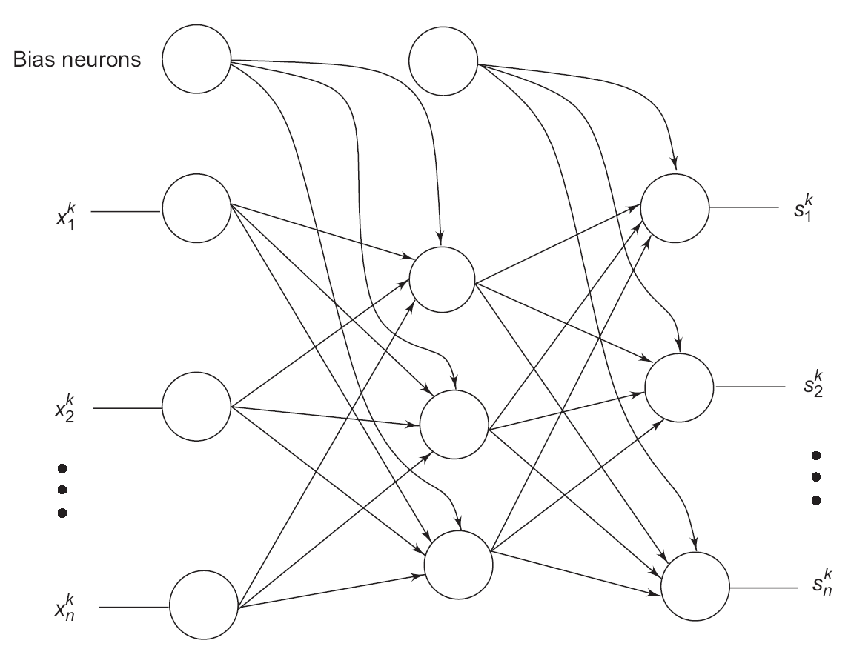

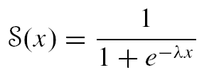
Neuron Signal Functions
Input layer neurons are linear.
Hidden and output layer neurons are sigmoidal.
‹#›/83

Slide 14

Neuron Signal Functions
A training data set is assumed to be given which will be used to train the network.
‹#›/83

Slide 15
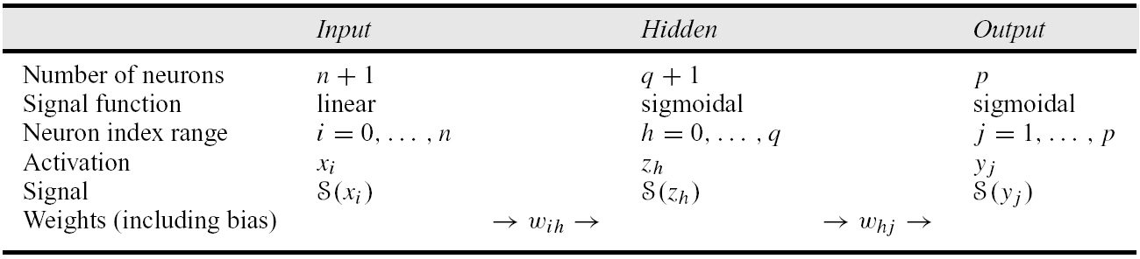
Notation for Backpropagation Algorithm Derivation
‹#›/83

Slide 16
The General Idea Behind Iterative Training…
Employ the gradient of the pattern error in order to reduce the global error over the entire training set.
Compute the error gradient for a pattern and use it to change the weights in the network.
‹#›/83

Slide 17
The General Idea Behind Iterative Training…
Such weight changes are effected for a sequence of training pairs (X₁,D₁), (X₂,D₂), . . . , (X_{k},D_{k}), . . . picked from the training set.
Each weight change perturbs the existing neural network slightly, in order to reduce the error on the pattern in question.
‹#›/83

Slide 18
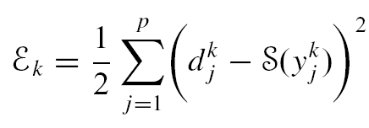
Square Error Performance Function
The k^{th} training pair (X_{k},D_{k}) then defines the instantaneous error:
E_{k} = D_{k} − S(Y_{k}) where
E_{k} = (e₁^{k}, . . . , e_{p}^{k})
= (d₁^{k} − S(y₁^{k} ), . . . , d_{p}^{k} − S(y_{p}^{k}))
The instantaneous summed squared error E_{k} is the sum of the squares of each individual output error e_{j}^{k}, scaled by one-half:
‹#›/83

Slide 19
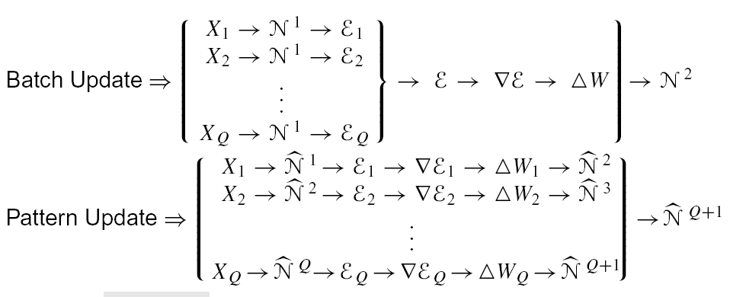
The Difference Between Batch and Pattern Update
‹#›/83

Slide 20

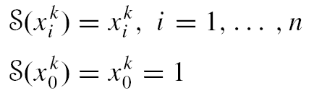
Derivation of BP Algorithm: Forward Pass-Input Layer
‹#›/83

Slide 21
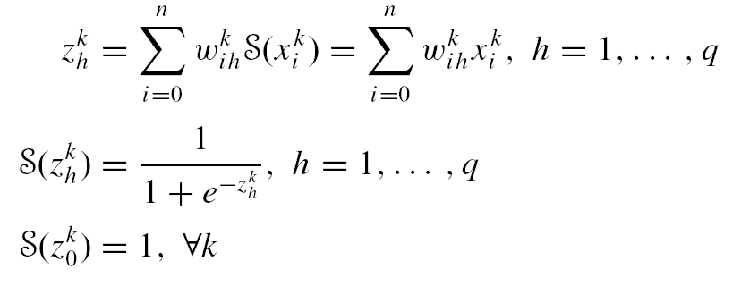
Derivation of BP Algorithm: Forward Pass-Hidden Layer
‹#›/83

Slide 22
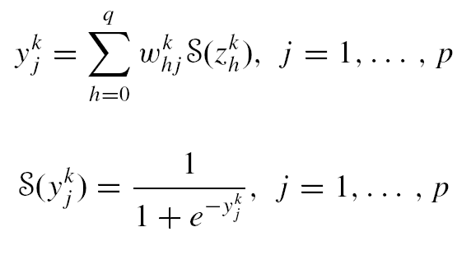
Derivation of BP Algorithm: Forward Pass-Output Layer
‹#›/83

Slide 23
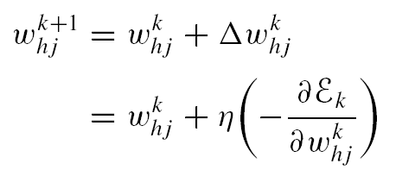
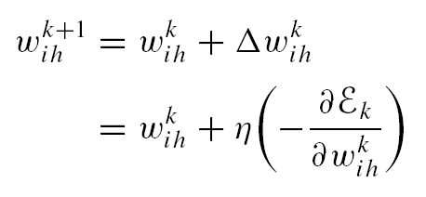
Recall the Gradient Descent Update Equation
A weight gets updated based on the negative of the error gradient with respect to the weight
‹#›/83

Slide 24
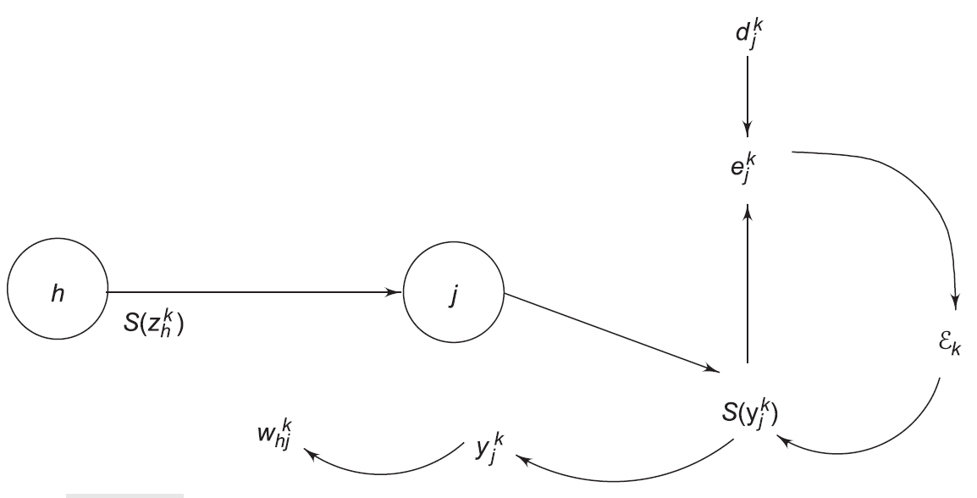
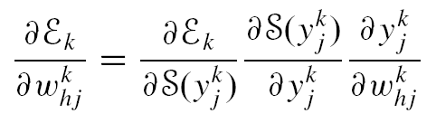
Derivation of BP Algorithm: Computation of Gradients
‹#›/83

Slide 25
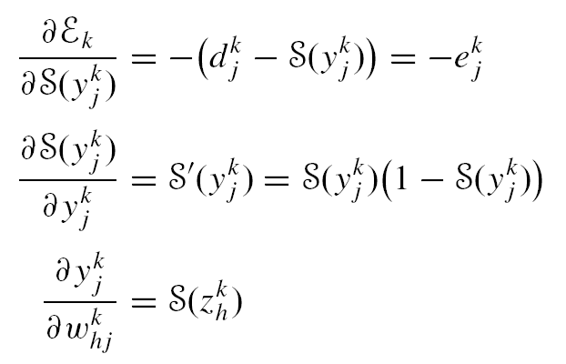
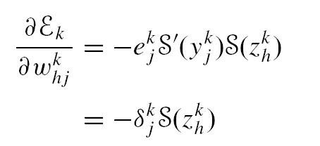
Derivation of BP Algorithm: Computation of Gradients
‹#›/83

Slide 26
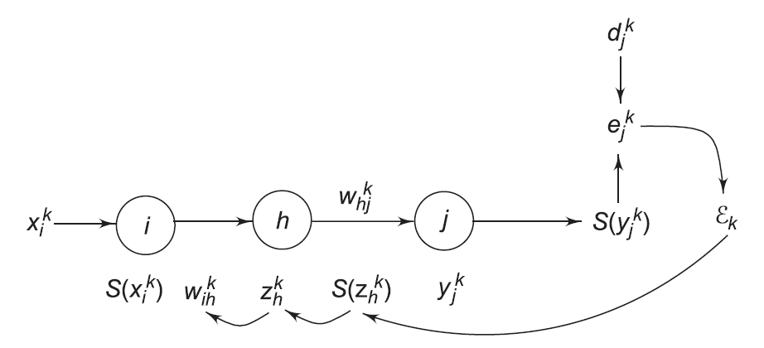
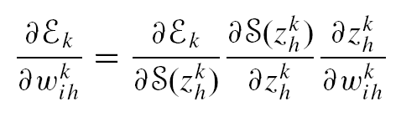
Derivation of BP Algorithm: Computation of Gradients
‹#›/83

Slide 27
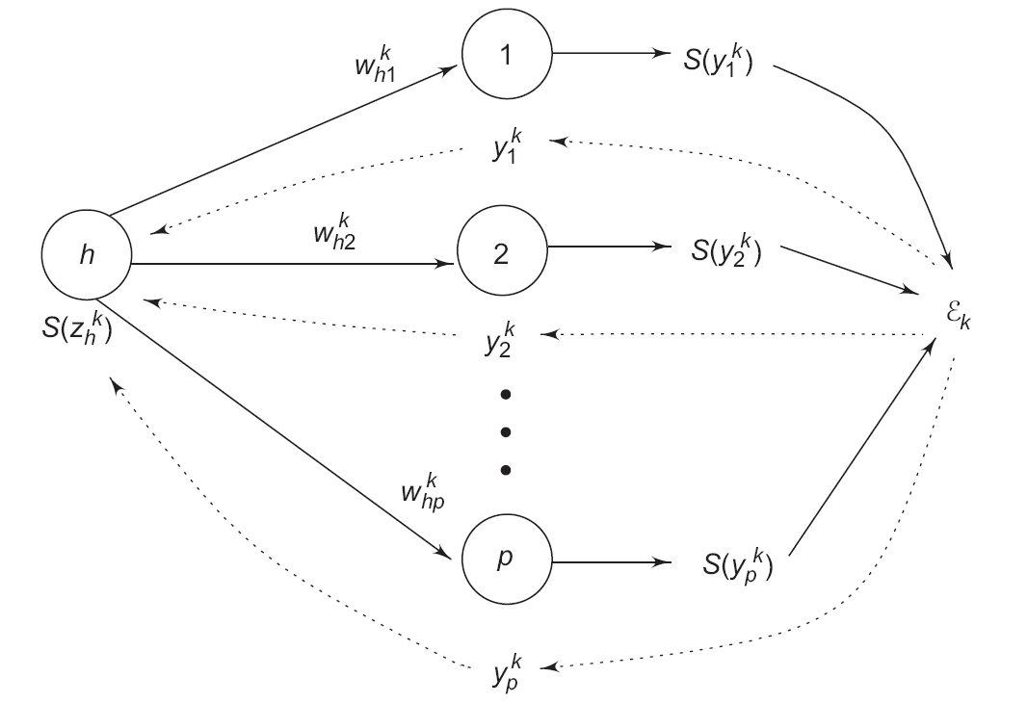
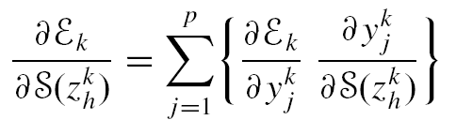
Derivation of BP Algorithm: Computation of Gradients
‹#›/83

Slide 28
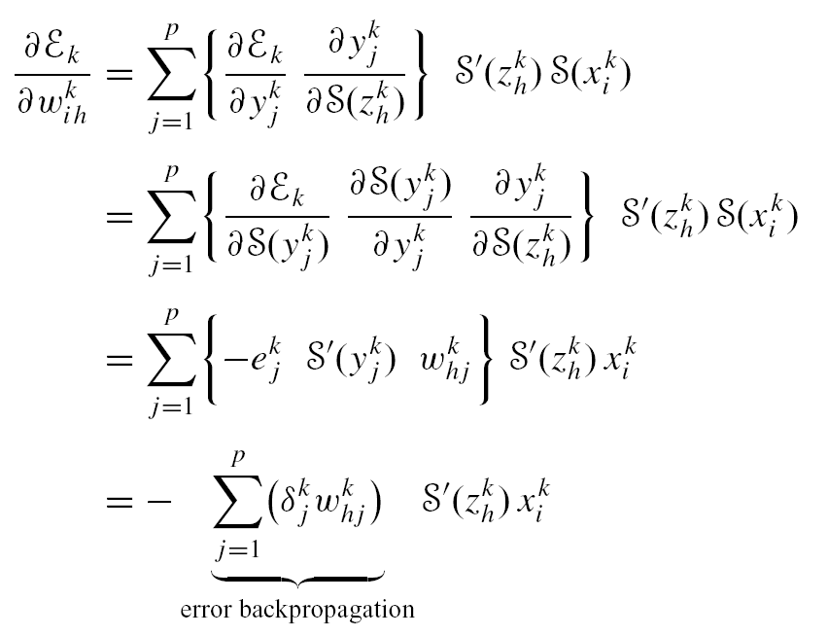
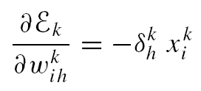
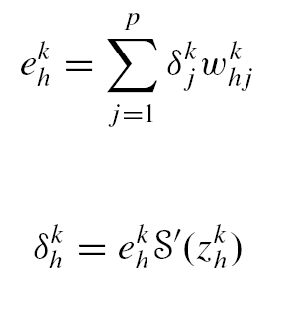
Derivation of BP Algorithm: Computation of Gradients
‹#›/83

Slide 29
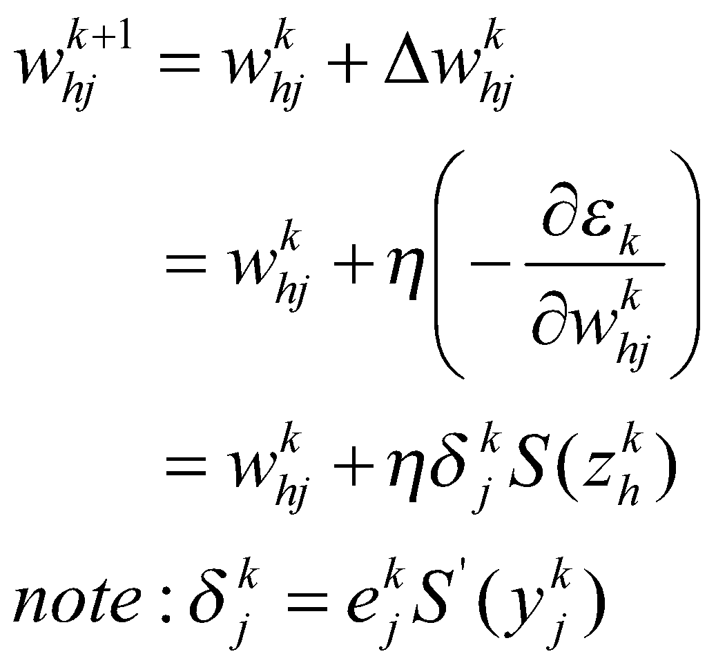
Summary of BP Algorithm(1/2)
1. For hidden to output layer weights:
‹#›/83

Slide 30
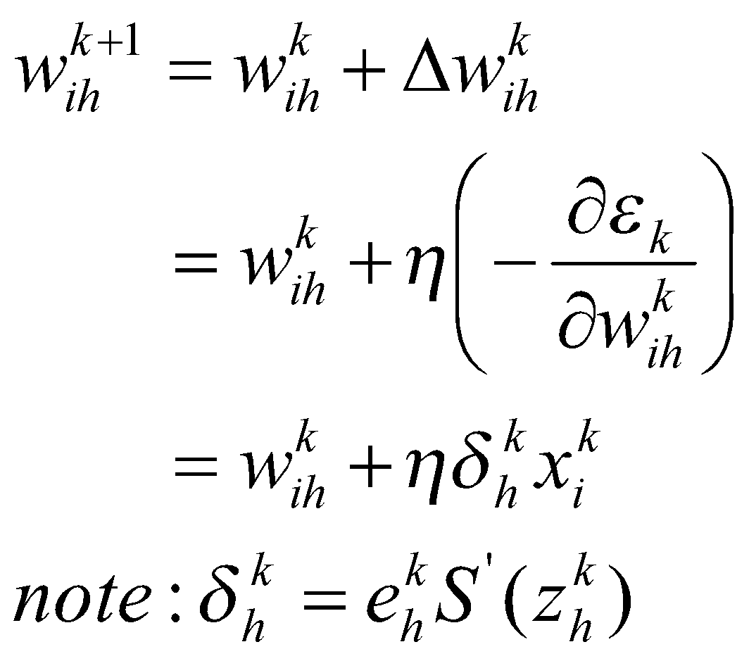
Summary of BP Algorithm(2/2)
2. For input to hidden layer weights:
‹#›/83

Slide 31
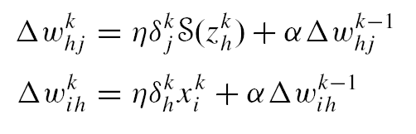
Generalized Delta Rule: Momentum
Increases the rate of learning while maintaining stability
‹#›/83

Slide 32


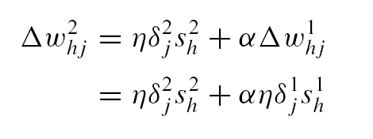
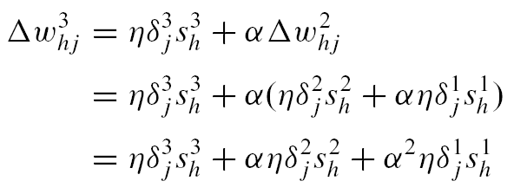
How Momentum Works
Momentum should be less than 1 for convergent dynamics.
If the gradient has the same sign on consecutive iterations the net weight change increases over those iterations accelerating the descent.
‹#›/83

Slide 33
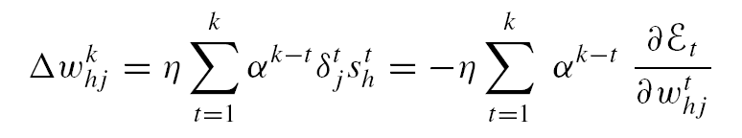
How Momentum Works
If the gradient has different signs on consecutive iterations then the net weight change decreases over those iterations and the momentum decelerates the weight space traversal. This helps avoid oscillations.
‹#›/83

Slide 34
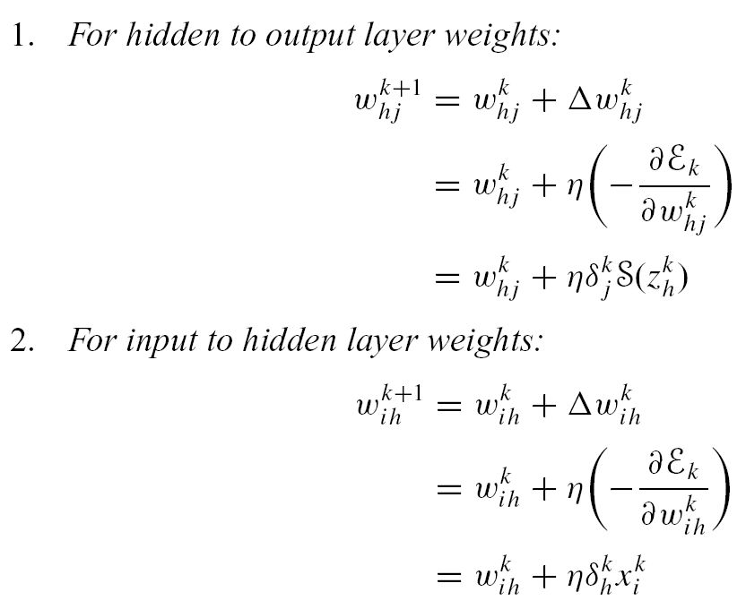
Derivation of BP Algorithm: Finally…!
‹#›/83

Slide 35
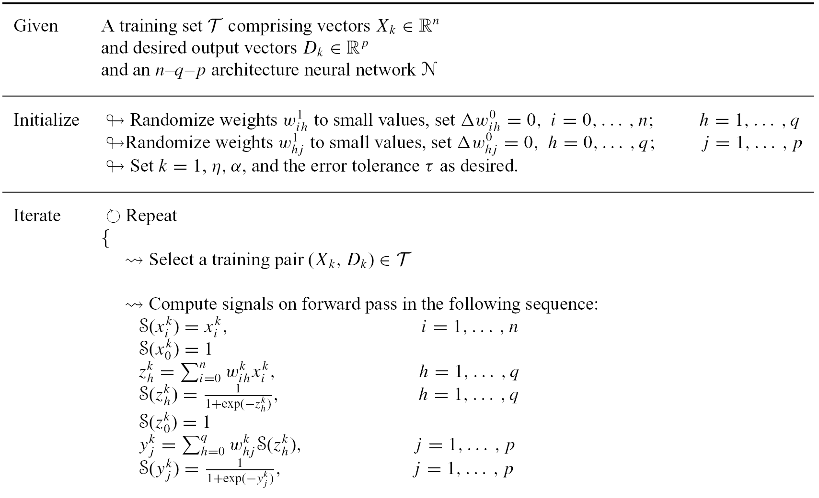
Backpropagation Algorithm: Operational Summary
‹#›/83

Slide 36
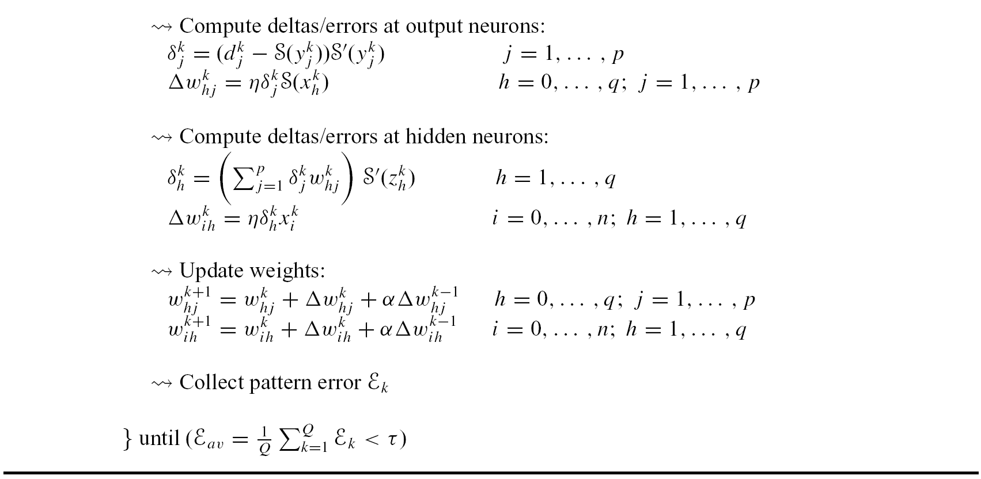
Backpropagation Algorithm: Operational Summary(contd.)
‹#›/83

Slide 37
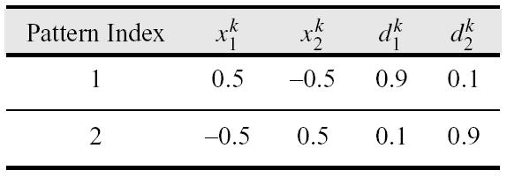
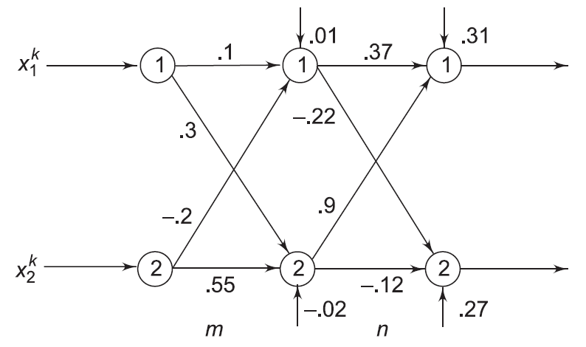
Hand-worked Example
‹#›/83

Slide 38
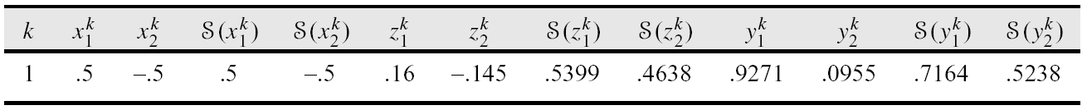
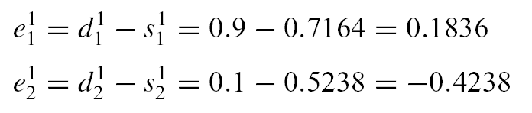
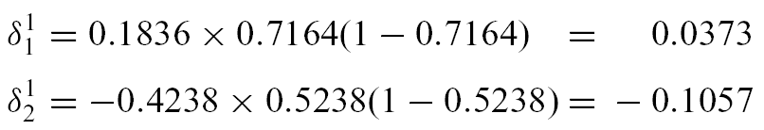
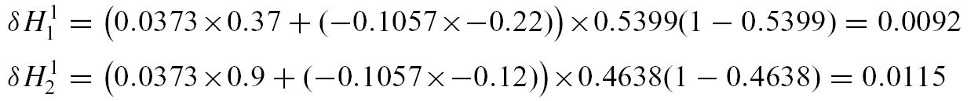
Forward Pass 1/Backprop Pass 1
‹#›/83

Slide 39
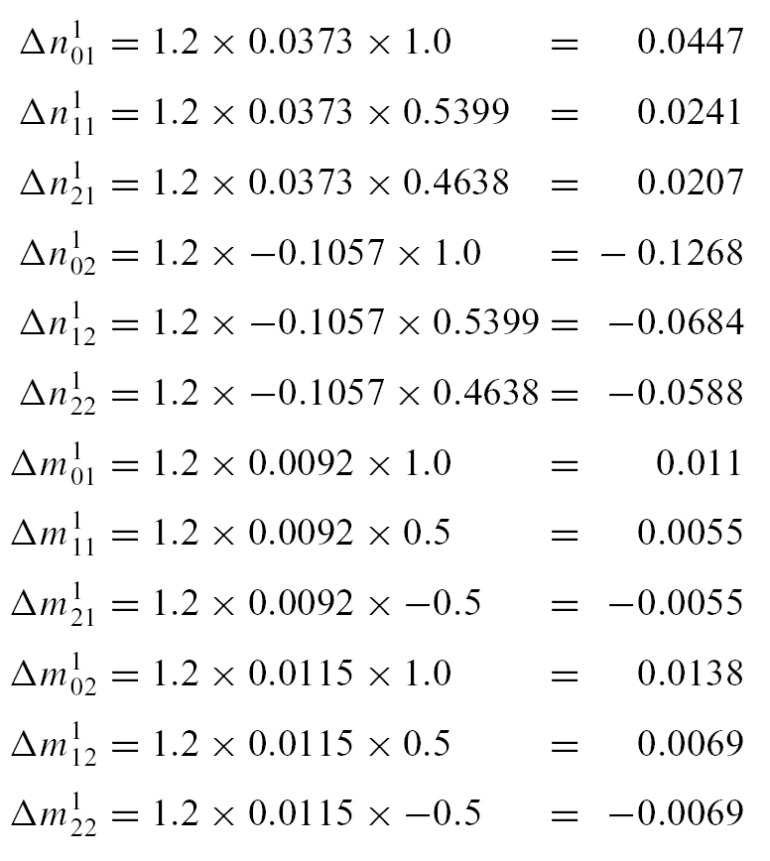
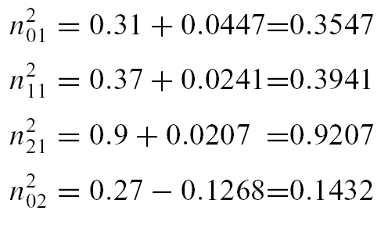
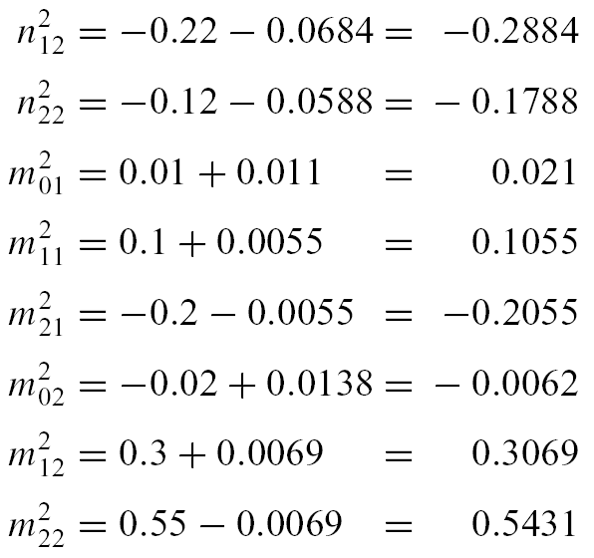
Weight Changes: Pass 1
‹#›/83

Slide 40
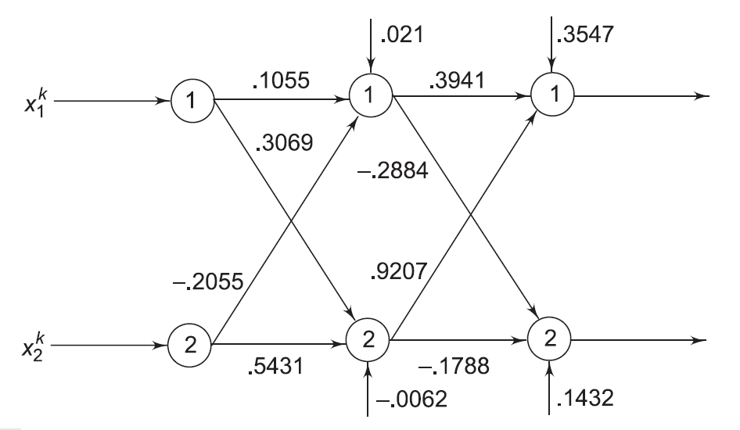
Network N² after first iteration
‹#›/83

Slide 41
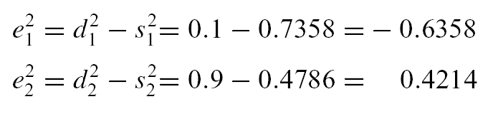


Forward Pass 2/Backprop Pass 2
‹#›/83

Slide 42



Weight Changes: Pass 2
‹#›/83

Slide 43

Network N³ after second iteration
‹#›/83

Slide 44

MATLAB Simulation Example 1 Two Dimensional XOR Classifier
Specifying a 0 or 1 desired value does not make sense since a sigmoidal neuron can generate a 0 or 1 signal only at an activation value −∞ or ∞. So it is never going to quite get there.
‹#›/83

Slide 45
MATLAB Simulation Example 1 Two Dimensional XOR Classifier
The values 0.05, 0.95 are somewhat more reasonable representatives of 0 and 1.
Note that the inputs can still be 0 and 1 but the desired values must be changed keeping in mind the signal range.
‹#›/83

Slide 46


Generalization Surface, Grayscale Map of the Network Response
‹#›/83

Slide 47
MATLAB Simulation 2: Function Approximation
f(x, y)=sin(x)cos(y)
Defined on cross space of [-π, π]x[-π, π]
625 evenly spaced pattern
‹#›/83

Slide 48


MATLAB Simulation 2: Function Approximation
‹#›/83

Slide 49

MATLAB Simulation 2: Error vs Epochs
‹#›/83

Slide 50

MATLAB Simulation 2: Simulation Snapshots
‹#›/83

Slide 51

MATLAB Simulation 2: Error Histogram and Error Mesh
‹#›/83

Slide 52
Practical Considerations: Pattern or Batch Mode Training
Pattern Mode:
🠟 Present a single pattern
🠟 Compute local gradients
🠟 Change the network weights
Given Q training patterns {X_{i},D_{i}}_{i=1}^{Q} , and some initial neural network N₀, pattern mode training generates a sequence of Q neural networks N₁, . . . ,N_{Q} over one epoch of training.
‹#›/83

Slide 53
Practical Considerations: Pattern or Batch Mode Training
Batch Mode (true gradient descent) :
🠟 Collect the error gradients over an entire epoch
🠟 Change the weights of the initial neural network N₀ in one shot.
‹#›/83

Slide 54
Practical Considerations: When Do We Stop Training?
Compare absolute value of squared error averaged over one epoch, E_{av}, with a training tolerance, typically 0.01 or as low as 0.0001.
Alternatively use the absolute rate of change of the mean squared error per epoch.
‹#›/83

Slide 55
Practical Considerations: When Do We Stop Training?
Stop the training process if the Euclidean norm of the error gradient falls below a sufficiently small threshold. (Requires computation of the gradient at the end of each epoch.)
‹#›/83

Slide 56
Practical Considerations: When Do We Stop Training?
Check the generalization ability of the network. The network generalizes well if it is able to predict correct or near correct outputs for unseen inputs.
Partition the data set T into two subsets: T_{training} (used for estimation) and T_{test} (used for evaluation of the network)
T_{training} is divided into T_{learning} and T_{validation}. (T_{validation} might comprise 20 − 30 per cent of the patterns in T_{training}.
‹#›/83

Slide 57
Practical Considerations: When Do We Stop Training?
Use T_{learning} to train the network using backpropagation.
Evaluate network performance at the end of each epoch using T_{validation}.
Stop the training process when the error on T_{validation} starts to rise.
‹#›/83

Slide 58
Practical Considerations: Use a Bipolar Signal Function
Introducing a bipolar signal function such as the hyperbolic tangent function can cause a significant speed up in the network convergence.
Specifically, S(x) = a tanh(λx) with a = 1.716 and λ = 0.66 being suitable values.
The use of this function comes with the added advantage that the range of valid desired signals extends to [−1 + ε, 1 − ε] where ε > 0.
‹#›/83

Slide 59
Practical Considerations: Weight Initialization
Choose small random values within some interval [−ε, +ε]. (Identical initial values can lead to network paralysis —the network learns nothing.)
Avoid very small ranges of weight randomization—may lead to very slow learning initially.
‹#›/83

Slide 60
Practical Considerations: Weight Initialization
Incorrect choice of weights might lead to network saturation where weight changes are almost negligible over consecutive epochs.
May be incorrectly interpreted as a local minimum.
Signal values are close to the 0 or 1; signal derivatives are infinitesimally small.
Weight changes are negligibly small.
Small weight changes allow the neuron to escape from incorrect saturation only after a very long time.
Randomization of network weights helps avoid these problems.
‹#›/83

Slide 61
Practical Considerations: Weight Initialization
For bipolar signal functions it is useful to randomize weights depending on individual neuron fan-in, f_{i} : randomized in the interval (−2.4/f_{i} , 2.4/f_{i} )
‹#›/83

Slide 62
Practical Considerations: Check the Input and Target Ranges
Given a logistic signal function which ranges in the interval (0,1) the desired outputs of patterns in the entire training set should lie in an interval [0 + ε, 1 − ε] where ε > 0 is some small number.
Desired values of 0 and 1 causes weights to grow increasingly large in order to generate these limiting values of the output.
‹#›/83

Slide 63
Practical Considerations: Check the Input and Target Ranges
To generate a 0 and 1 requires a −∞ or ∞ activation which can be accomplished by increasing the values of weights.
Algorithm cannot be expected to converge if desired outputs lie outside the interval [0,1].
If one were to use a hyperbolic tangent signal function with the range [−1.716,+1.716] , then target values of −1, 0 or +1 would be perfectly acceptable.
‹#›/83

Slide 64
Practical Considerations: Adjusting Learning Rates
For small learning rates, convergence to the local minimum in question is guaranteed but may lead to long training times.
If network learning is non-uniform, and we stop before the network is trained to an error minimum, some weights will have reached their final “optimal” values; others may not have.
In such a situation, the network might perform well on some patterns and very poorly on others.
‹#›/83

Slide 65
Practical Considerations: Adjusting Learning Rates
If we assume that the error function can be approximated by a quadratic then we can make the following observations.
An optimal learning rate reaches the error minimum in a single learning step.
Rates that are lower take longer to converge to the same solution.
Rates that are larger but less than twice the optimal learning rate converge to the error minimum but only after much oscillation.
Learning rates that are larger than twice the optimal value will diverge from the solution.
‹#›/83

Slide 66
Practical Considerations: Selection of a Network Architecture
A three-layered network can approximate any continuous function.
Problem with multilayered nets using one hidden layer:
neurons tend to interact with each other globally
interactions make it difficult to generate approximations of arbitrary accuracy.
‹#›/83

Slide 67
Practical Considerations: Selection of a Network Architecture
With two hidden layers the curve-fitting process is easier:
The first hidden layer extracts local features of the function (as binary threshold neurons partition the input space into regions.)
Global features are extracted in the second hidden layer.
‹#›/83

Slide 68
Practical Considerations: Cross Validation
Divide the data set into a training set T_{training} and a test set T_{test} .
Subdivide T_{training} into two subsets: one to train the network T_{learning}, and one to validate the network T_{validation}.
Train different network architectures on T_{learning} and evaluate their performance on T_{validation}.
‹#›/83

Slide 69
Practical Considerations: Cross Validation
Select the best network.
Finally, retrain this network architecture on T_{training}.
Test for generalization ability using T_{test.}
‹#›/83

Slide 70

Backpropagation: Two-Spirals Problem
Two inputs and one output
194 data points
‹#›/83

Slide 71

Backpropagation: Two-Spirals Problem
Solved by Lang and Witbrock 2-5-5-5-1 architecture 138 weights.
In the Lang–Witbrock network each layer of neurons is connected to every succeeding layer.
‹#›/83

Slide 72
Backpropagation: Two-Spirals Problem
Weights are randomized in the interval [-0.1, 0.1]
η= 0.001, α=0.5, up to η= 0.002, α=0.95
‹#›/83

Slide 73
Structure Growing Algorithms
Approach 1:
Starts out with a large number of weights in the network and gradually prunes them.
Idea: eliminate weights that are least important.
Examples: Optimal Brain Damage, Optimal Brain Surgeon, Hinton weight decay procedure.
‹#›/83

Slide 74
Structure Growing Algorithms
Approach 2:
Starts out with a minimal architecture which is made to grow during training.
Examples: Tower algorithm, Pyramid algorithm, cascade correlation algorithm.
‹#›/83

Slide 75
Quickprop: Fast Relative of Backprop
Works with second order error derivative information instead of only the usual first order gradients.
Based on two “risky” assumptions:
The error function E is a parabolic function of any weight w_{ij} .
The change in the slope of the error curve is independent of other concurrent weight changes.
‹#›/83

Slide 76


Quickprop: Fast Relative of Backprop
The slope of the error function is thus linear.
The algorithm pushes the weight w_{ij} directly to a value that minimizes the parabolic error.
To compute this weight, we require the previous value of the gradient ∂E/∂w_{ij} ^{k−1} and the previous weight change.
‹#›/83

Slide 77

Universal Function Approximation
Kolmogorov proved that any continuous function f defined on an n-dimensional cube is representable by sums and superpositions of continuous functions of exactly one variable:
‹#›/83

Slide 78
Applications of BP: Steering Autonomous Vehicles
The primary objective is to steer a robot vehicle like Carnegie Mellon University’s (CMU) Navlab, which is equipped with motors on the steering wheel, brake and accelerator pedal thereby enabling computer control of the vehicles’ trajectory.
‹#›/83

Slide 79

Applications of BP: Steering Autonomous Vehicles-ALVINN
ALVINN
(autonomous land vehicle in a neural network)
‹#›/83

Slide 80
ALVINN Network Architecture
Input to the system is a 30 × 32 neuron “retina”
Video images are projected onto the retina.
Each of these 960 input neurons is connected to four hidden layer neurons which are connected to 30 output neurons.
Output neurons represent different steering directions—the central neuron being the “straight ahead” and the first and last neurons denoting “sharp left” and “sharp right” turns of 20 m radius respectively.
‹#›/83

Slide 81
ALVINN Network Architecture
To compute an appropriate steering angle, an image from a video camera is reduced to 30 × 32 pixels and presented to the network.
The output layer activation profile is translated to a steering command using a center of mass around the hill of activation surrounding the output neuron with the largest activation.
Training of ALVINN involves presentation of video images as a person drives the vehicle using the steering angle as the desired output.
‹#›/83

Slide 82
CMU NAVLAB and ALVINN
ALVINN runs on two SUNSPARC stations on board Navlab and training on the fly takes about two minutes.
During this time the vehicle is driven over a 1/4 to 1/2 mile stretch of the road and ALVINN is presented about 50 images, each transformed 15 times to generate 750 images.
‹#›/83

Slide 83
CMU NAVLAB and ALVINN
The ALVINN system successfully steers NAVLAB in a variety of weather and lighting conditions. With the system capable of processing 10 images/second Navlab can drive at speeds up to 55 mph, five times faster than any other connectionist system.
On highways, ALVINN has been trained to navigate at up to 90 mph!
‹#›/83

