Slide 1

ATLIQ MART
SALES AND PROMOTIONS ANALYSIS

Slide 2
Contents
Problem Statement
Objectives
Dataset and Data Model
Tools Used
Requested Ad-Hoc Insights
Other Important Insights
Dashboards
Important Links

Slide 3
Problem Statement
AtliQ Mart is a retail giant with over 50 supermarkets in the southern region of India.
All their 50 stores ran a massive promotion during the Diwali 2023 and Sankranti 2024 (festive time in India) on their AtliQ branded products. Now the sales director wants to understand which promotions did well and which did not so that they can make informed decisions for their next promotional period.
Sales director Bruce Haryali wanted this immediately but the analytics manager Tony is engaged on another critical project. Tony decided to give this work to Peter Pandey who is the curious data analyst of AtliQ Mart. Since these insights will be directly reported to the sales director, Tony also provided some notes to Peter to support his work.

Slide 4

Objectives
Perform data cleaning.
To conduct data analysis and create an interactive dashboard with important KPIs and key Metrics.
To include charts and graphs in the dashboard for data visualization.
Complete Ad-Hoc requests using SQL.
Extract useful Insights.

Slide 5
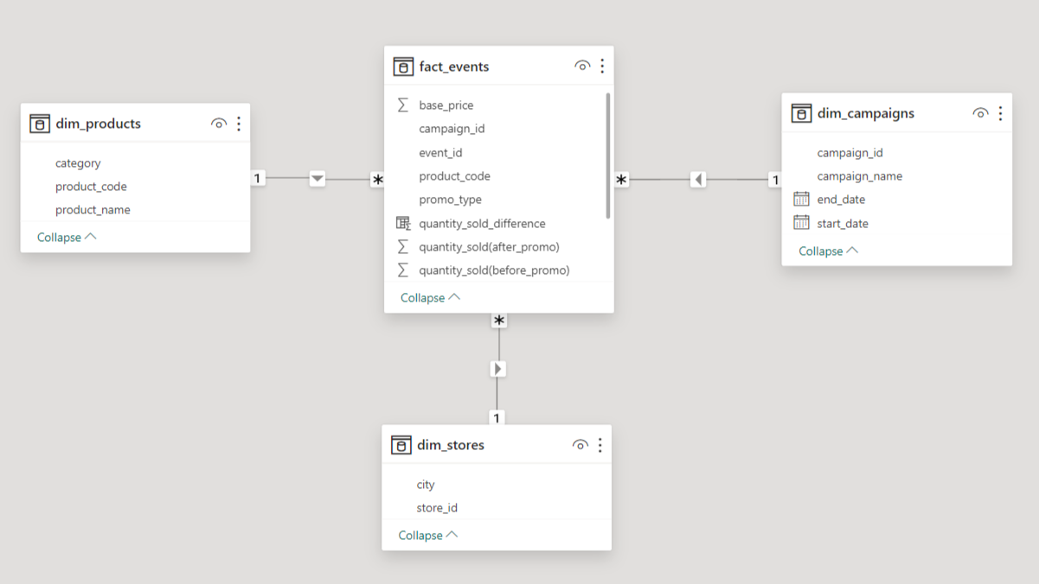
Dataset and Data Model

Slide 6

Tools Used
Power BI
MySQL
MS PowerPoint
AI Tools (ChatGPT and Bard)

Slide 7

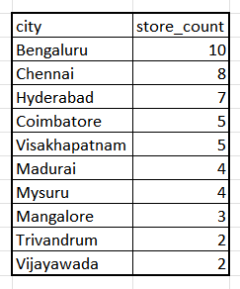
> Requested Ad-Hoc Insights:
List of products with a base price greater than $500 and that are featured in promo type of 'BOGOF' (Buy One Get One Free).
Number of stores in each city.

Slide 8
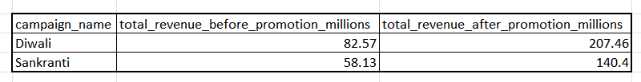
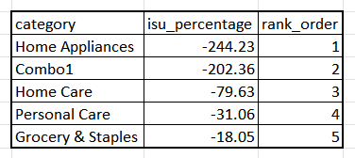
3. Total revenue generated before and after the campaign.
4. Incremental Sold Quantity (ISU%) for each category during the Diwali campaign.

Slide 9
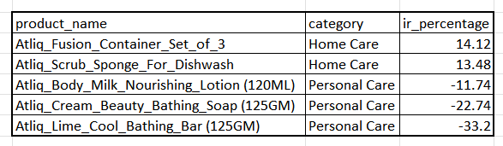
5. Top 5 products, ranked by Incremental Revenue Percentage (IR%), across all campaigns.

Slide 10
Other Important Insights
Although the best performing city based on ISU was Bangalore, the best performing store based on both ISU and IR was in Mysore.
Least performing store based on ISU was in Mangalore STMLR-0
Promo Type 25% Off performed negatively.
Promo Type 50% Off performed very low.
The category "Grocery and Staples" was the best seller (53%).
The category "Combo1" generated the highest Incremental Revenue (IR) (59%).
The product "Atliq_Home_Essential_8_Product_Combo" generated the highest IR (59%).
The product "Atliq_Farm_Chakki_Atta (1KG)" had the highest ISU (21%).

Slide 11
Important Links
Power BI Live Dashboard: https://app.powerbi.com/view?r=eyJrIjoiNzE5YTdiNTgtMjZhNy00M2NmLWE0YmQtNjc1N2ZkZDAzYmZkIiwidCI6ImM2ZTU0OWIzLTVmNDUtNDAzMi1hYWU5LWQ0MjQ0ZGM1YjJjNCJ9
GitHub Repo: https://github.com/pranaysingh-27/atliq_mart_promo
LinkedIn Post: https://www.linkedin.com/posts/pranaysingh7_github-pranaysingh-27atliqmartpromo-activity-7170820951641731072-hVy6?utm_source=share&utm_medium=member_desktop

Slide 12
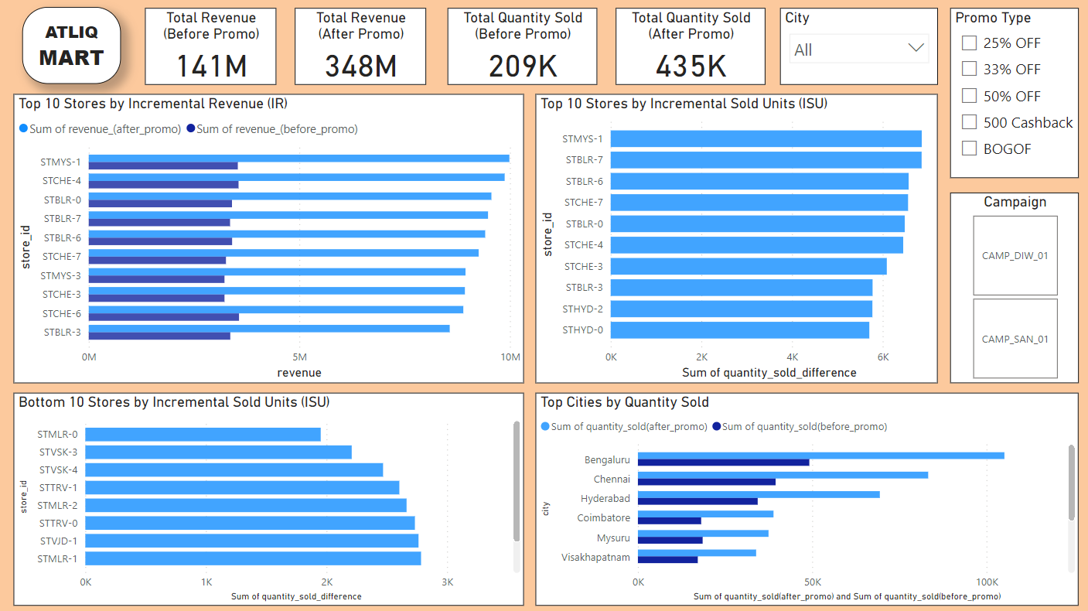
Dashboard 1

Slide 13
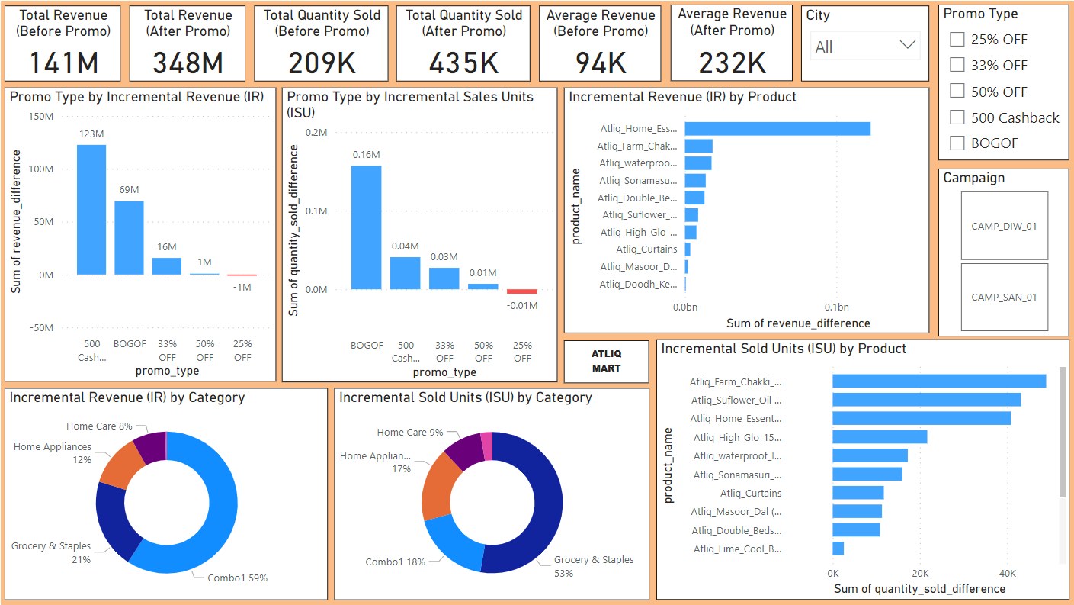
Dashboard 2

Slide 14

Thank You

