Slide 1

Rate of Diminishing Water Bodies
TEAM-D4
Yashwanth Reddy (15241A05J3)
Pranay Mahendra (15241A05M5)
Ajay Krishna (15241A05L1)
Rohan Varma (15241A05L4)
Internal Guide:
Prof.G. Mallikarjun Rao

Slide 2
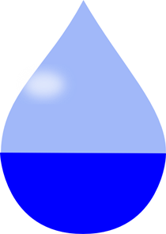
Contents
Objective
Abstract
System Requirements
Existing System
Proposed System
Advantages
Disadvantages

Slide 3
Objective
To detect the amount of water that is being diminished every year by using the satellite images.

Slide 4
Abstract
Using this , Government can keep track of the percentage of water body that is decreased over the years.
This will help the government to find the constructions which are built on the water bodies illegally and it can take appropriate action on them.

Slide 5

System Requirements
Language – Matlab
Software– Matlab
OS – Windows 10
RAM – 2GB minimum (1.8Ghz, i3 processor)
Hard disk – minimum 500GB
Disk space – maximum 500MB

Slide 6




Modules, IDE’s ,Source & os’s
MATLAB

Slide 7
Existing System
Bhuvan site launched by NRSC ISRO (National Remote Sensing Centre ISRO) has a feature to find the water bodies in the satellite images, but using that we can’t find the amount of water body that is diminished in a particular period.

Slide 8
Proposed System
The satellite images are downloaded from the Bhuvan site manually and they are placed in a folder.
Matlab interacts with the images present in that folder and calculates the amount of water body present in that image using image processing.
The binary images generated are fused together and displayed , along with the percentage of water diminished .

Slide 9
Advantages
Useful to the government-
In finding illegal constructions
Having an estimate of water that is being diminished every year.

Slide 10
Disadvantages
It can’t find the volume of water that is decreased.

Slide 11
How we are going to achieve this?
We are using Matlab and doing image processing to achieve this.
We take 2 images of a water body, one image of 2009 and another one which is recent.
These 2 images are then converted into binary images.
Now the white portion shows the water body.
These 2 images will be fused and the diminished area of water body can be seen

Slide 12
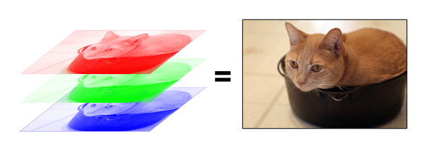
RGB layers of an image

Slide 13
Shape file to image file
We download the shape files from bhuvan site and convert it .png files.
These images files are then converted to grayscale images.
These grayscale images are then converted to binary images which contain 0’s and 1’s. this is done by taking the threshold values of water bodies
Using these binary images we get the diminished area of the water body

Slide 14
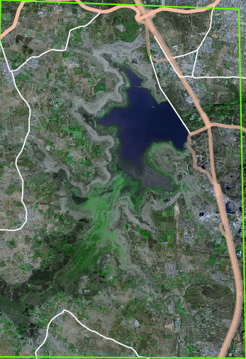
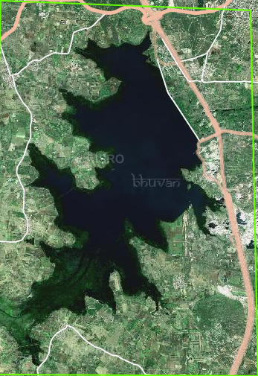
Satellite images from taken from bhuvan site
2017
2009

Slide 15
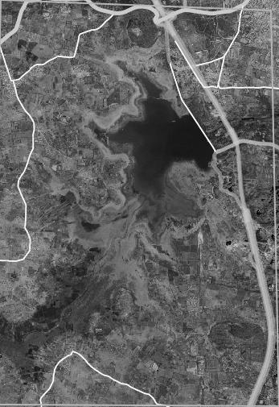
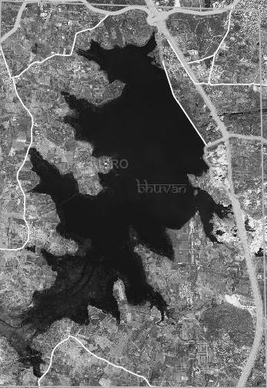
Grayscale images
2017
2009

Slide 16
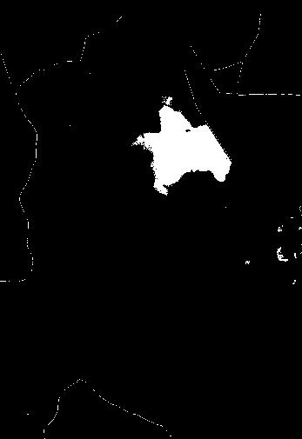
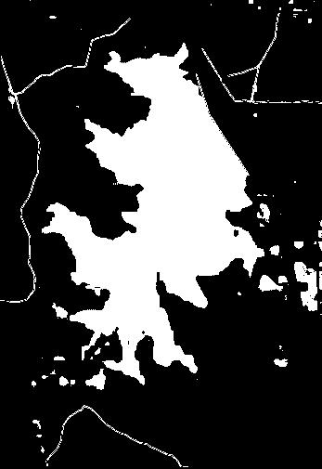
Binary images
2017
2009

Slide 17
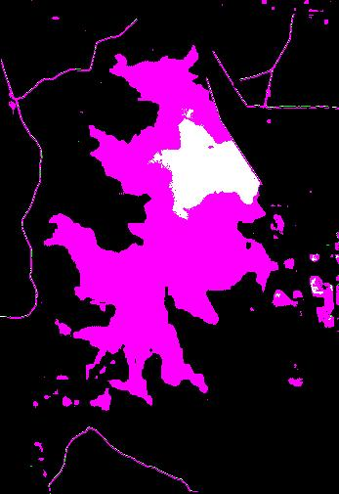
Final result with percentage of diminished water body
85.6953 percentage of area has been diminished from 2009 to 2017
294024000 square meters has been
diminished

Slide 18
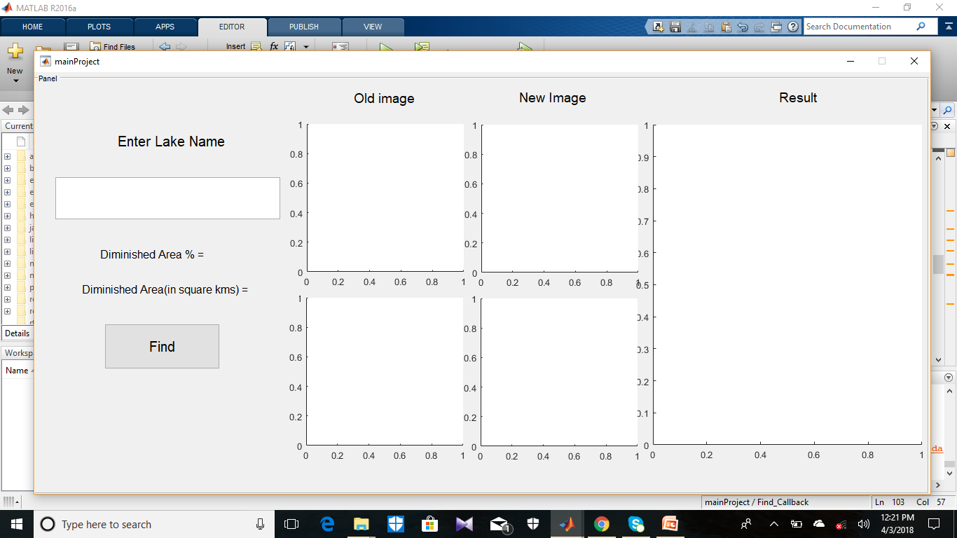
interface

Slide 19
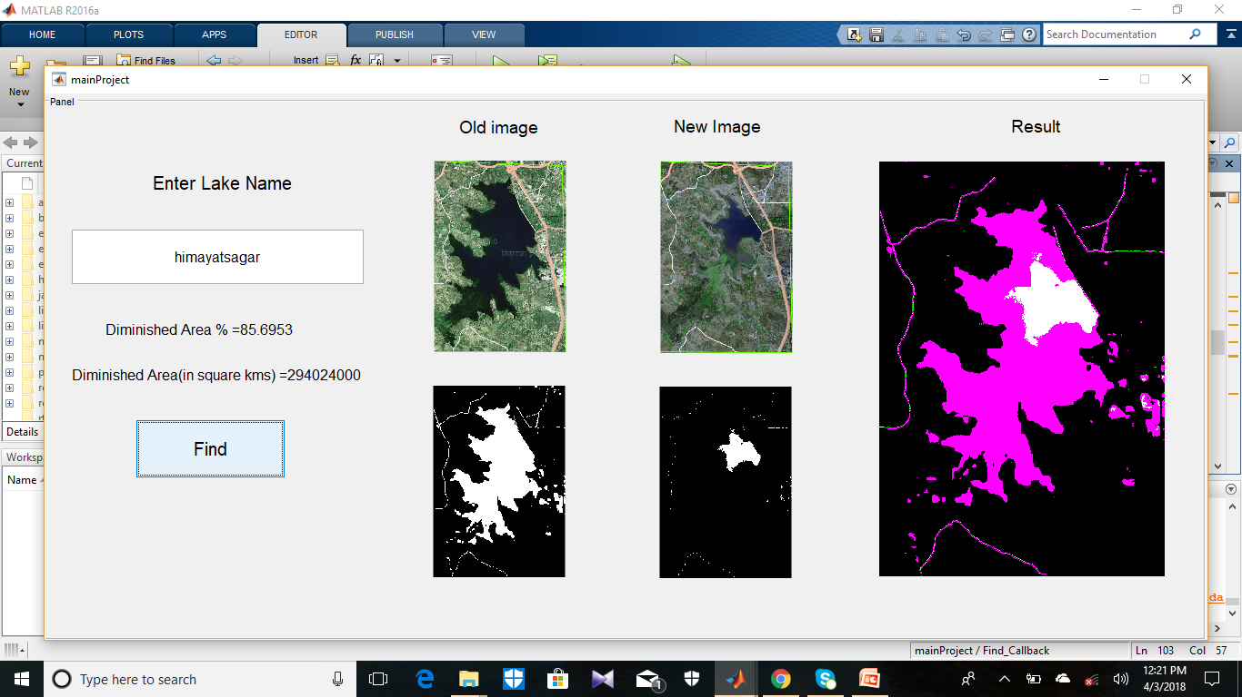

Slide 20
Thank you

