Slide 1

Utilizing Patient Data for Accurate Prediction of Postoperative Complications
Presented by:
Gajanan Satote

Slide 2
INTRODUCTION
Instances : 14635
Features: 25
Historical medical demographic information of patients in united states.
This project has the potential to greatly impact real-life healthcare scenarios by assisting medical professionals in identifying patients who may be at a higher risk of complications.

Slide 3
PROBLEM STATEMENT
Identify the key factors that influence patients' postoperative conditions.
Develop a reliable prediction model to identify patients at risk of postoperative complications.

Slide 4
WORK FLOW
Data Collection & understanding
Data Wrangling & Data Cleaning
EDA
Rebuilding model
Model selection, model building and evaluation
Feature Engineering
Conclusion

Slide 5
ATTRIBUTE INFORMATION
bmi: Body mass Index
Age:
mortality_rsi: The Mortality Risk Stratification Index (RSI)
mort30: Mortality within 30 days of surgery
moonphase: The moon phase.
Month : month of the year in which surgery is performed.
hour: The time of day at which surgery is performed.
gender:
dow: The day of the week on which surgery is performed.
complication_rsi: The Complication Risk Stratification Index (RSI)
ccsMort30Rate: The 30-day mortality rate based on the Clinical Classifications Software (CCS)
ccsComplicationRate: The rate of postoperative complications based on the Clinical Classifications Software (CCS)
ahrq_ccs: The Agency for Healthcare Research and Quality (AHRQ) Clinical Classifications Software (CCS)
baseline_pulmonary: Baseline pulmonary disease.
baseline_psych: Baseline psychological conditions
baseline_osteoart: Baseline osteoarthritis.
baseline_digestive: Baseline digestive disease
baseline_diabetes: Baseline diabetes.
baseline_dementia: diagnosis of dementia
baseline_cvd: history of cardiovascular disease (CVD)
baseline_charlson: The Charlson Comorbidity Index (CCI) is a measure of a patient's overall health status
baseline_cancer:diagnosis of cancer prior to surgery.
asa_status: The American Society of Anesthesiologists (ASA) physical status
race: Ethnicity

Slide 6
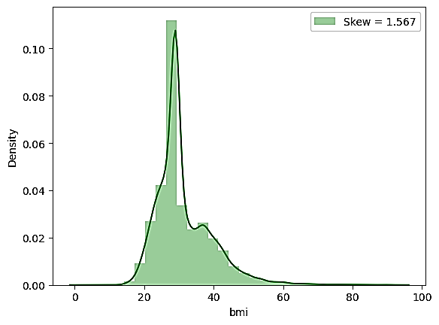
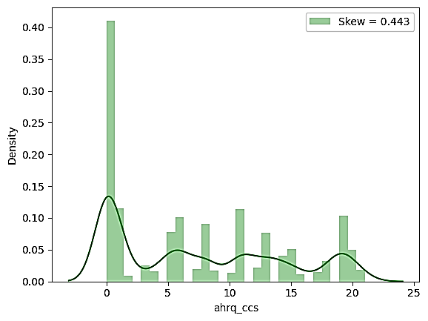
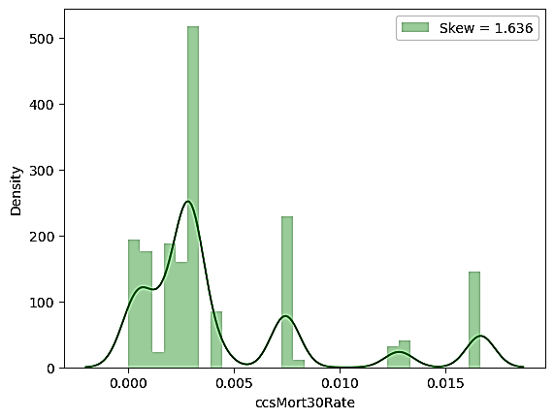
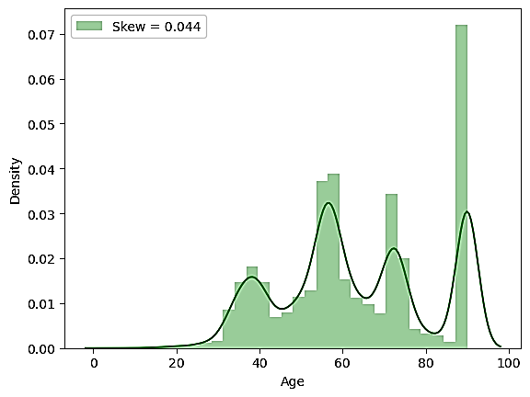
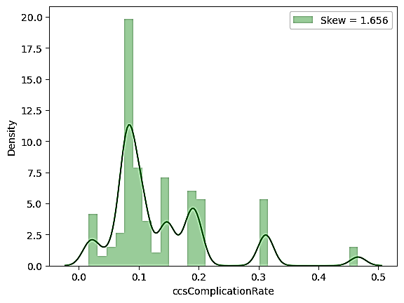
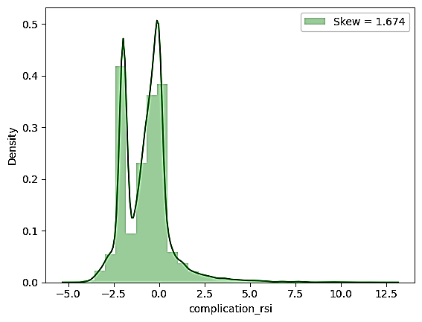
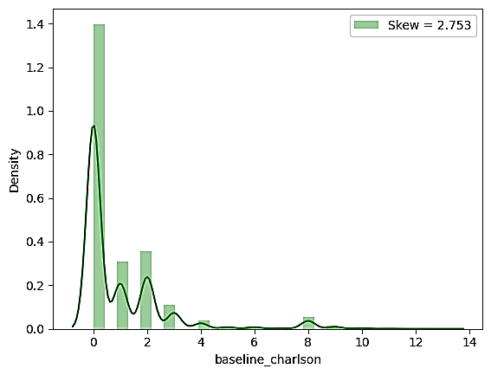
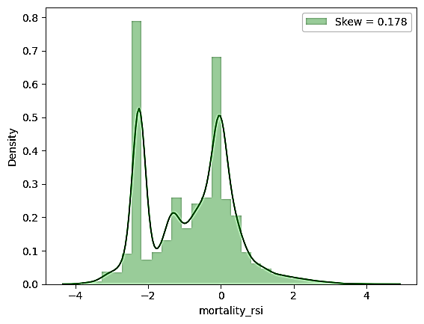
EXPLORATORY DATA ANALYSIS

Slide 7
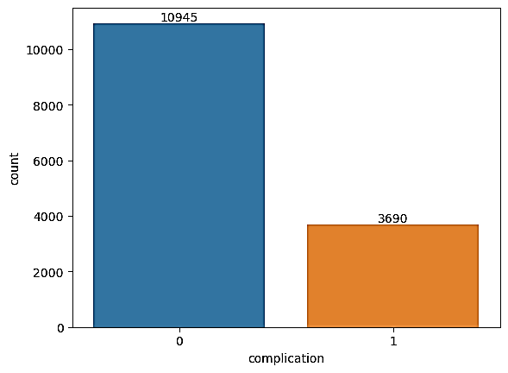
CLASS IMBALANCE
The graph shows that there is a significant difference in the number of instances between the two classes, which is commonly known as class imbalance.
This can be problematic as the model may perform poorly on the underrepresented class.

Slide 8
MACHINE LEARNING ALGORITHMS
We conducted a classification problem to predict whether patients are at risk of complications or not.
We explored various classification algorithms for this task.
The focus was on identifying the risk of complications based on the patient's information.
Our goal was to select the most appropriate algorithm that could effectively classify patients into risk and non-risk categories.
Algorithms Used:
Logistic Regression
Decision tree Classifier
Random Forest Classifier
Gradient Boosting Classifier
Ada Boosting Classifier
XGB Classifier (Extreme Gradient Boosting)
SVC (Support vector Classifier)
KNN Classifier

Slide 9
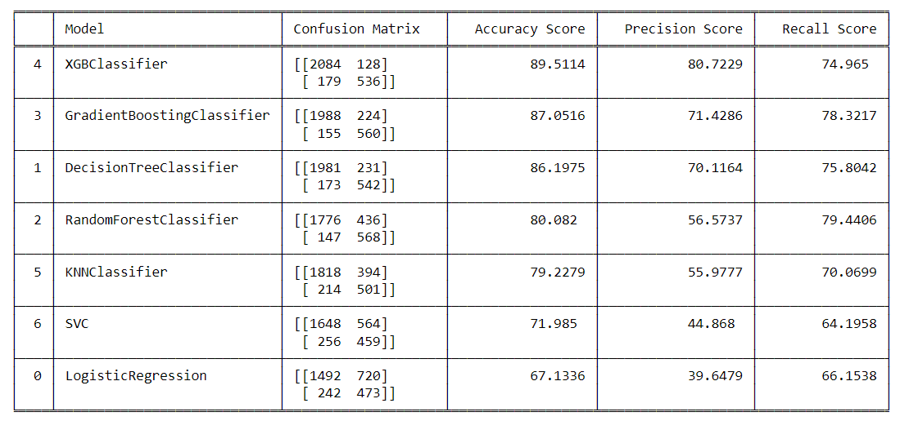
MODEL BUILDING AND EVALUATION
From the evaluation table, we can see that the XGBClassifier gives us the best results among all other models. Additionally, it has a accuracy of 89%,high recall Score of around 75% & Precision Score of around 80%, indicating that we can target patients who may be at risk of experiencing complications during or after surgery

Slide 10
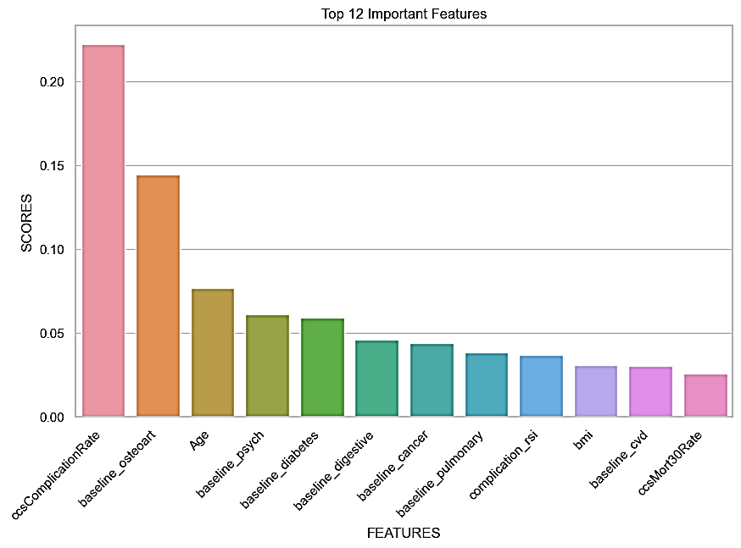
FEATURE ENGINEERING
As we have numerous features in our data, collecting records for each feature is not feasible and time-consuming. Moreover, there can be many insignificant features that further complicate the model.
To address this issue, I have selected the 12 most significant variables that have an impact on the patients' health after operations. Using these features, I built an XGBClassifier model, which yielded similar evaluation parameters. The reduced feature set allows for easier learning and decreases the complexity of the model.

Slide 11
REBUILDING THE MODEL
With only these 12 Important features, we build a same XGB Classifier model.
Which gives evaluation parameters as follow:
Accuracy Score: 89.23%
Precision Score: 83.15 %
Recall Score: 72.87%

Slide 12
CONCLUSION
We can simplify the analysis by focusing on the top 12 important features that are most predictive of the surgical complications. This will allow us to identify the key factors that we can address to reduce the likelihood of complications for patients undergoing surgery.
We can further investigate these features and identify strategies to mitigate the risks associated with them. By focusing on these important features, we can prioritize our efforts to improve patient outcomes after surgery.
This project opens the door to early identification and intervention, potentially reducing the overall risk and impact of post-operative complications. It has the potential to improve patient outcomes, optimize healthcare resource allocation, and contribute to more personalized and effective medical care. With further advancements in machine learning techniques and the availability of larger and more diverse datasets, the potential impact of this models is expected to grow even further.

Slide 13
Thank You!

