Slide 1

Reality Compiler: A Language-Driven Process Verification Engine
Computer Science Cluster: SDG-9

Slide 2
Team Members
NAME | USN
PRANEEL K A | 1RV24CS200
ANURANJAN S NAIK | 1RV24CS041
B GYANENDRA REDDY | 1RV24CD013
TARUN R A | 1RV24CI133
Mentor
Dr Nityashree G D
Assistant Professor
Dept. Of CSE

Slide 3
EL Phase-I
Presentation Outline
Introduction
Literature Review
Problem Definition
Objectives
Methodology
Proposed Outcomes
Timeline of the project
Conclusion
References

Slide 4
Introduction
Overview of the Topic
Reality Compiler is an AI-powered system that transforms natural-language descriptions of procedures into structured, visual workflow models.
Users can describe a process in plain language or specify a goal through interactive questions to clarify the required steps and conditions.
The system uses Large Language Models (LLMs) to extract activities, actors, decisions, and transitions, organizing them into a workflow graph.
Graph-based analysis enables workflow exploration, verification of process logic, and what-if simulation to understand alternative execution paths.
Each element in the generated workflow is linked to its source text, providing transparency and traceability for user review.

Slide 5
Literature Review
TITLE | SOURCE | METHODS & FINDINGS | RELEVANCE TO THE PROJECT | RESEARCH GAPS | LINK
Process Model Generation from Natural Language Text | Friedrich, Mendling & Puhlmann, CAiSE 2011 | Rule-based NLP pipeline generates BPMN models from natural-language process descriptions. | Provides foundational text-to-process modeling work. | Traditional NLP approach; limited adaptability to varied language and no LLM-based uncertainty handling. | https://doi.org/10.1007/978-3-642-21640-4_36
Conversational Process Modeling: Can Generative AI Empower Domain Experts in Creating and Redesigning Process Models? | Klievtsova et al., 2023; arXiv | Reviews conversational process-modeling scenarios and evaluates model completeness and correctness. | Supports natural language as an interface for domain experts. | Does not provide the full graph-verification pipeline proposed here. | https://arxiv.org/abs/2304.11065
Process Modeling With Large Language Models | Kourani et al., 2024; arXiv / Springer | LLMs generate and iteratively refine process models from text using prompting, validation and error handling. | Supports natural-language-to-workflow extraction and iterative refinement. | Does not center on source-sentence provenance or systematically surfacing unstated assumptions. | https://arxiv.org/abs/2403.07541

Slide 6
Literature Review
TITLE | SOURCE | METHODS & FINDINGS | RELEVANCE TO THE PROJECT | RESEARCH GAPS | LINK
GIVUP: Automated Generation and Verification of Textual Process Descriptions | Nivon et al., FSE 2025 Demonstrations | Converts text into BPMN and properties into LTL, then verifies them using model checking. | Provides a direct comparison for formal workflow verification. | Does not explicitly address unstated assumptions or systematically detect missing exception paths. | https://doi.org/10.1145/3696630.3728593
nl2spec: Interactively Translating Unstructured Natural Language to Temporal Logics with Large Language Models | Cosler et al., CAV 2023 | LLMs translate natural-language requirements into temporal logic; users iteratively resolve ambiguity with source-linked sub-translations. | Supports translating rules into checkable properties with traceability. | Targets formal specifications rather than complete workflow extraction and graph verification. | https://arxiv.org/abs/2303.04864
Knowledge-Driven Hallucination in Large Language Models: An Empirical Study on Process Modeling | Kourani et al., arXiv preprint 2025 | Evaluates how LLM-generated process models can contradict explicit source evidence when prior knowledge overrides the input. | Motivates source-sentence traceability and checks against unsupported workflow elements. | Studies the evidence-fidelity problem; does not itself provide the complete extraction, assumption detection and graph-verification system proposed here. | https://arxiv.org/abs/2509.15336

Slide 7
Problem Definition
Problem Statement:
There is a lack of a unified system that converts natural-language process descriptions into structured workflow models, detects ambiguities and missing cases, verifies process logic, and provides traceable, evidence-based explanations before deployment.
Organizations run on processes such as approvals, procurement, maintenance and quality sign-offs. These are often documented as free-text SOPs, emails or policy notes.
Free text can be ambiguous or incomplete. Dead ends, missing rejection paths and by-passable approvals may only be discovered after deployment.

Slide 8
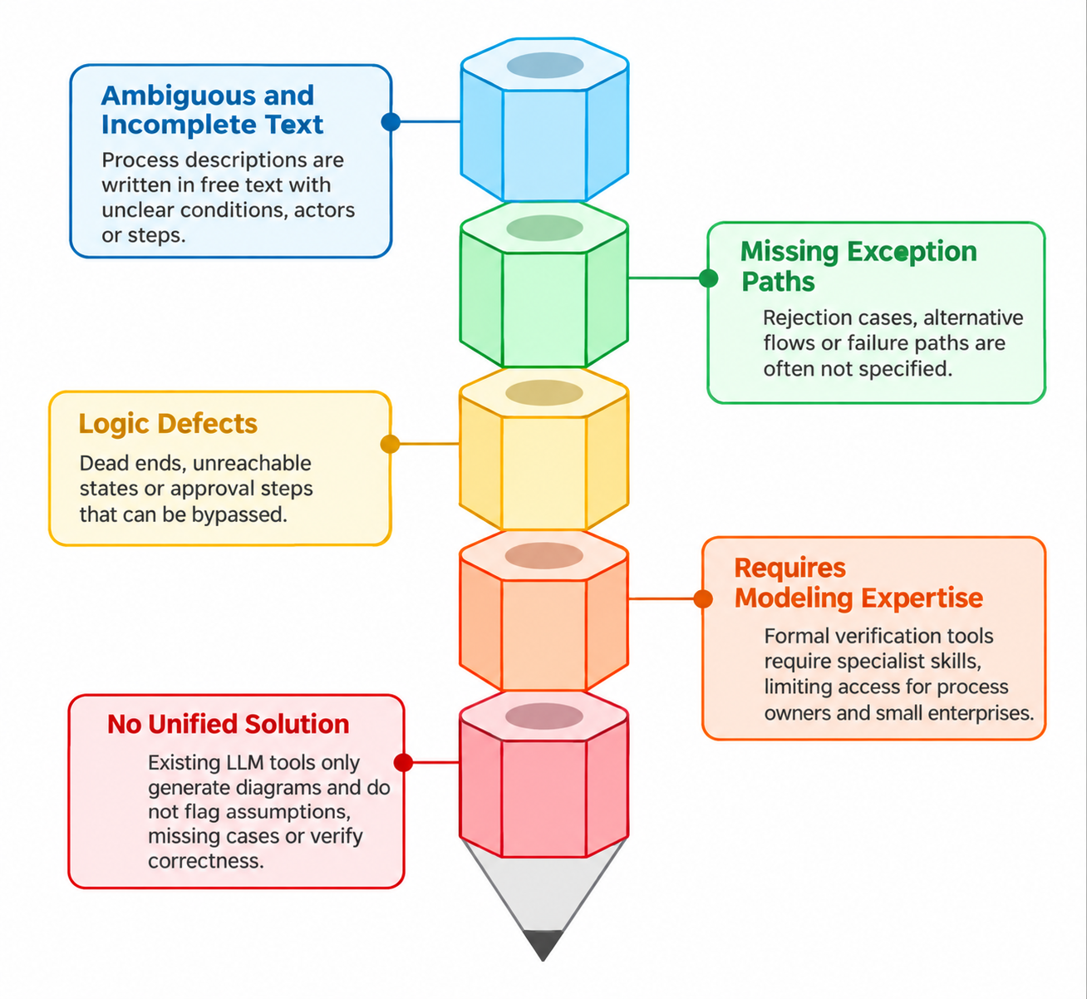
Problem Definition
Challenges in current process documentation

Slide 9
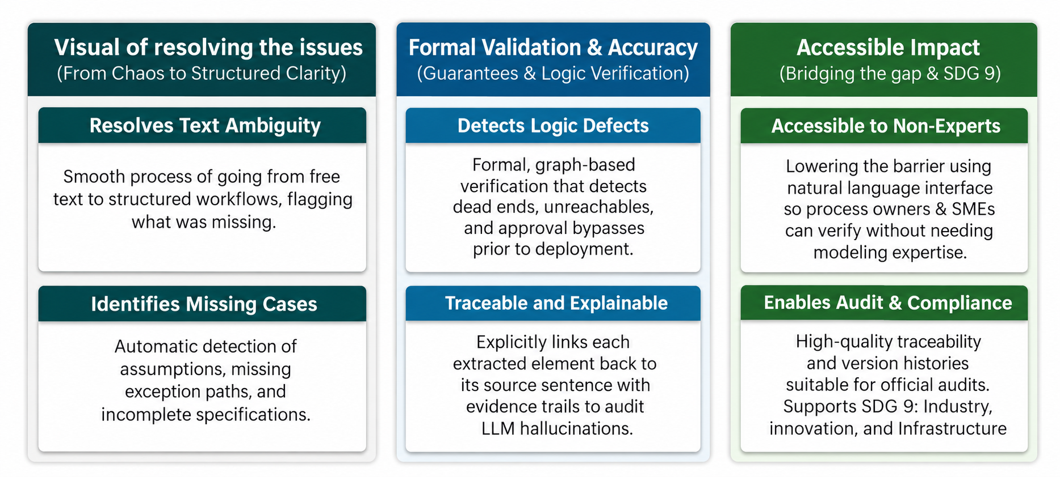
Problem Definition
Significance of Addressing the Problem

Slide 10
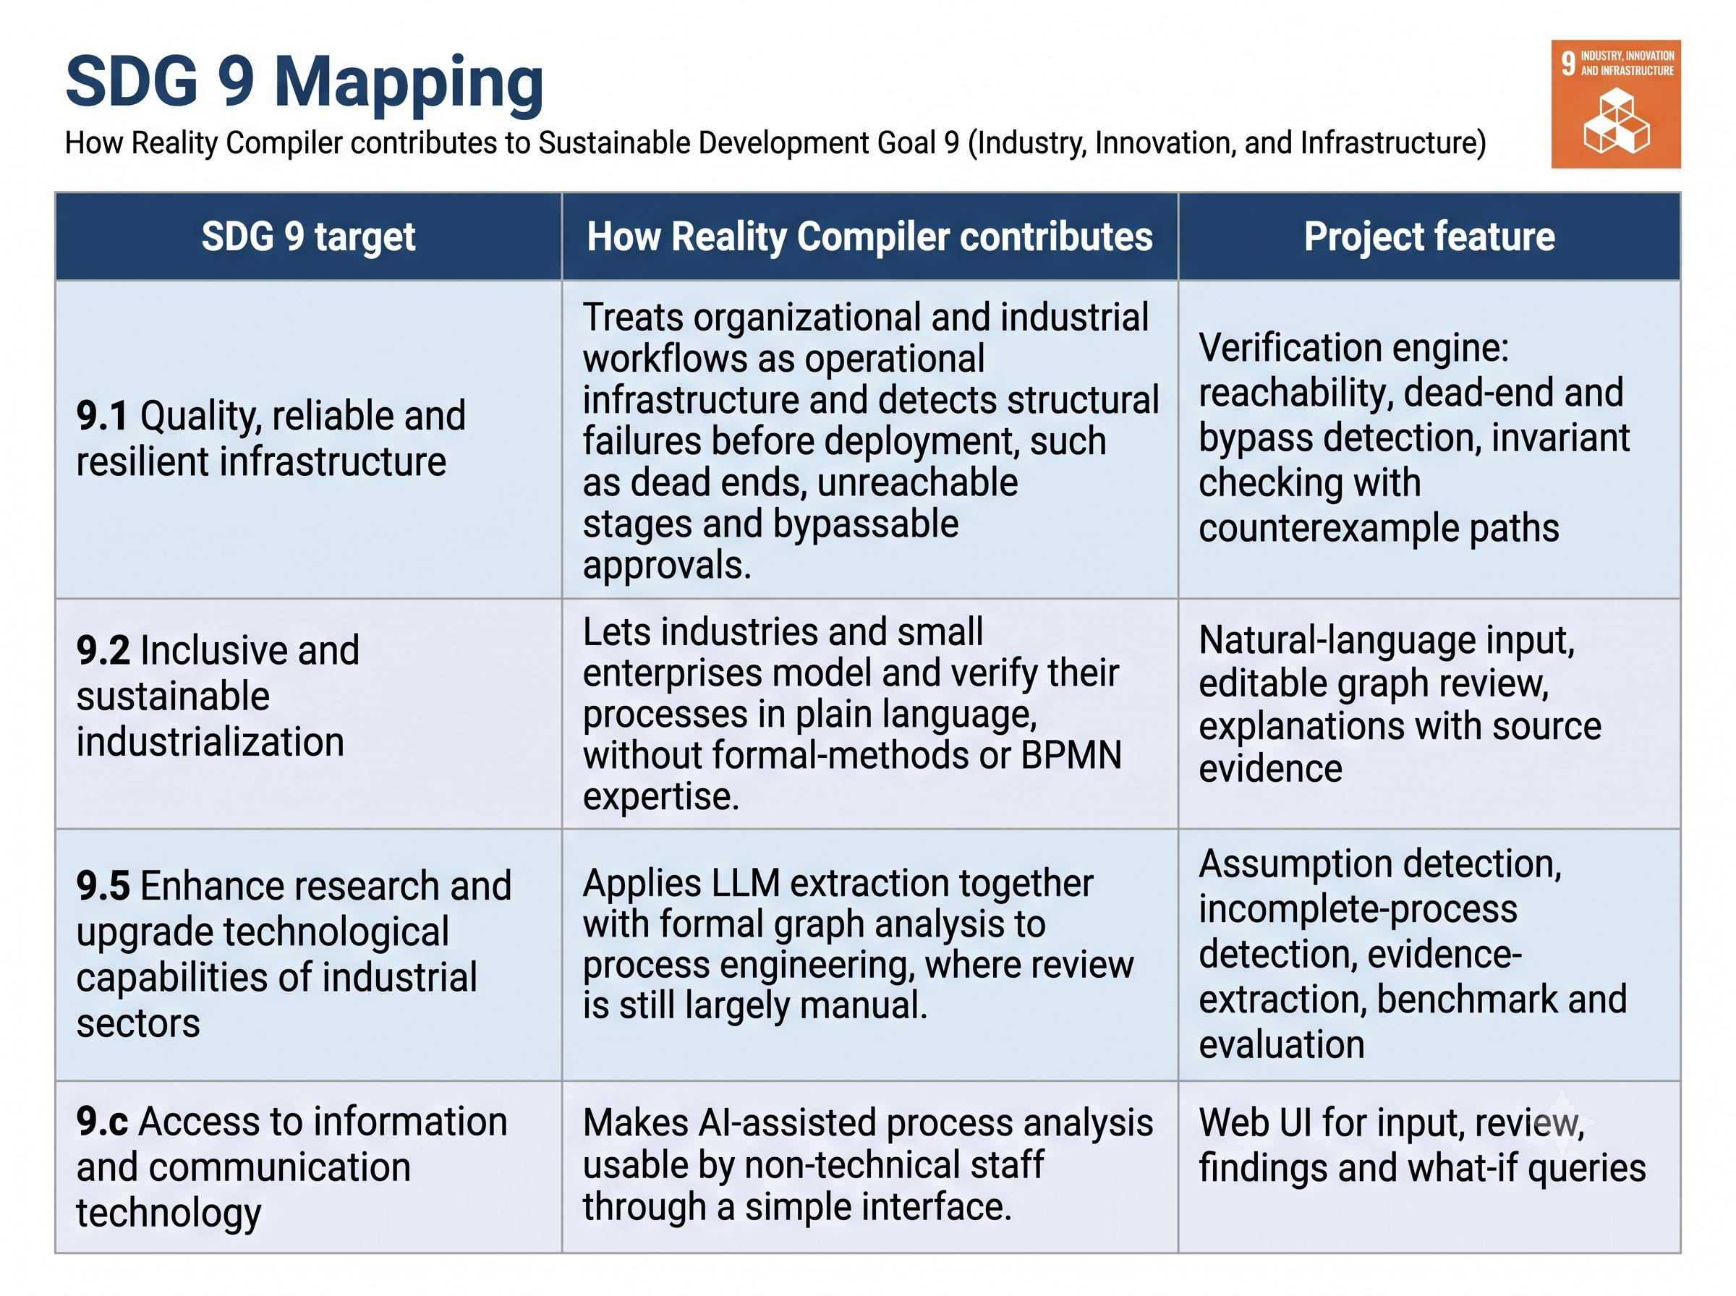
SDG 9 Mapping

Slide 11
Objectives
Convert natural-language process descriptions into structured workflow models containing states, transitions, actors and conditions.
Flag assumptions and identify missing rejection, exception and failure paths.
Link every extracted element to its source sentence for traceability.
Detect dead ends, unreachable states, bypass paths and invariant violations, with counterexample paths.
Enable interactive Q&A-based workflow generation from natural-language goals, with step-by-step workflows and visual graphs.

Slide 12
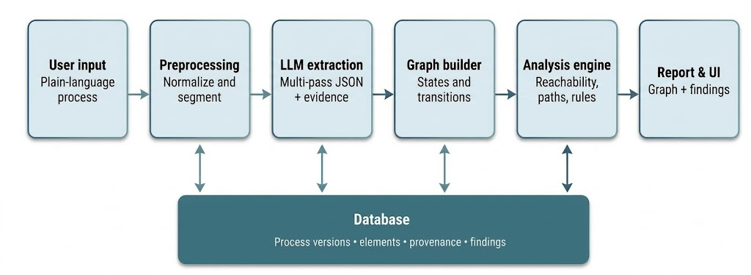
System Architecture

Slide 13
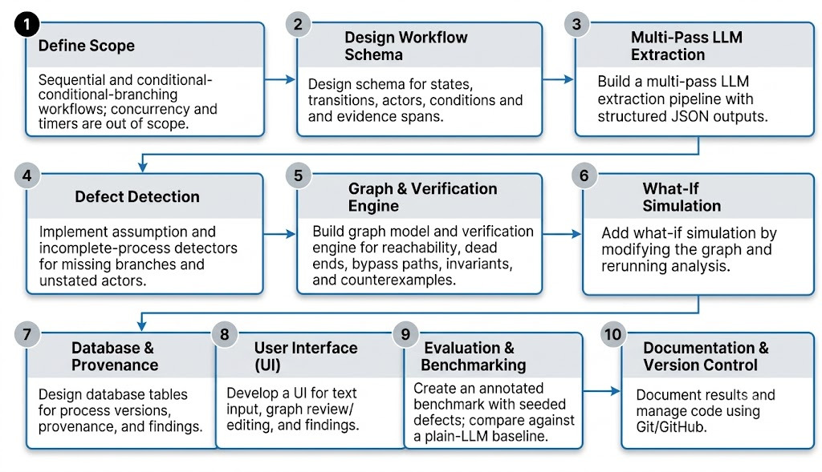
Methodology

Slide 14
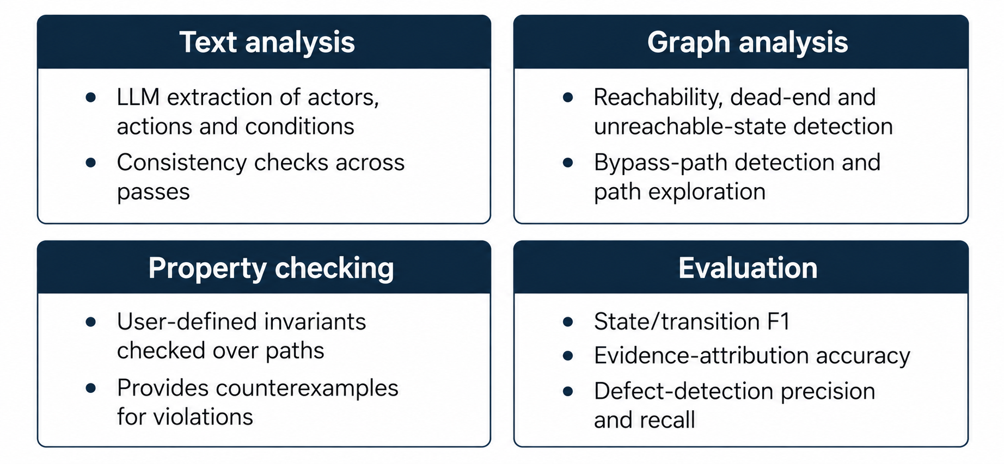
Methodology
Analysis techniques

Slide 15
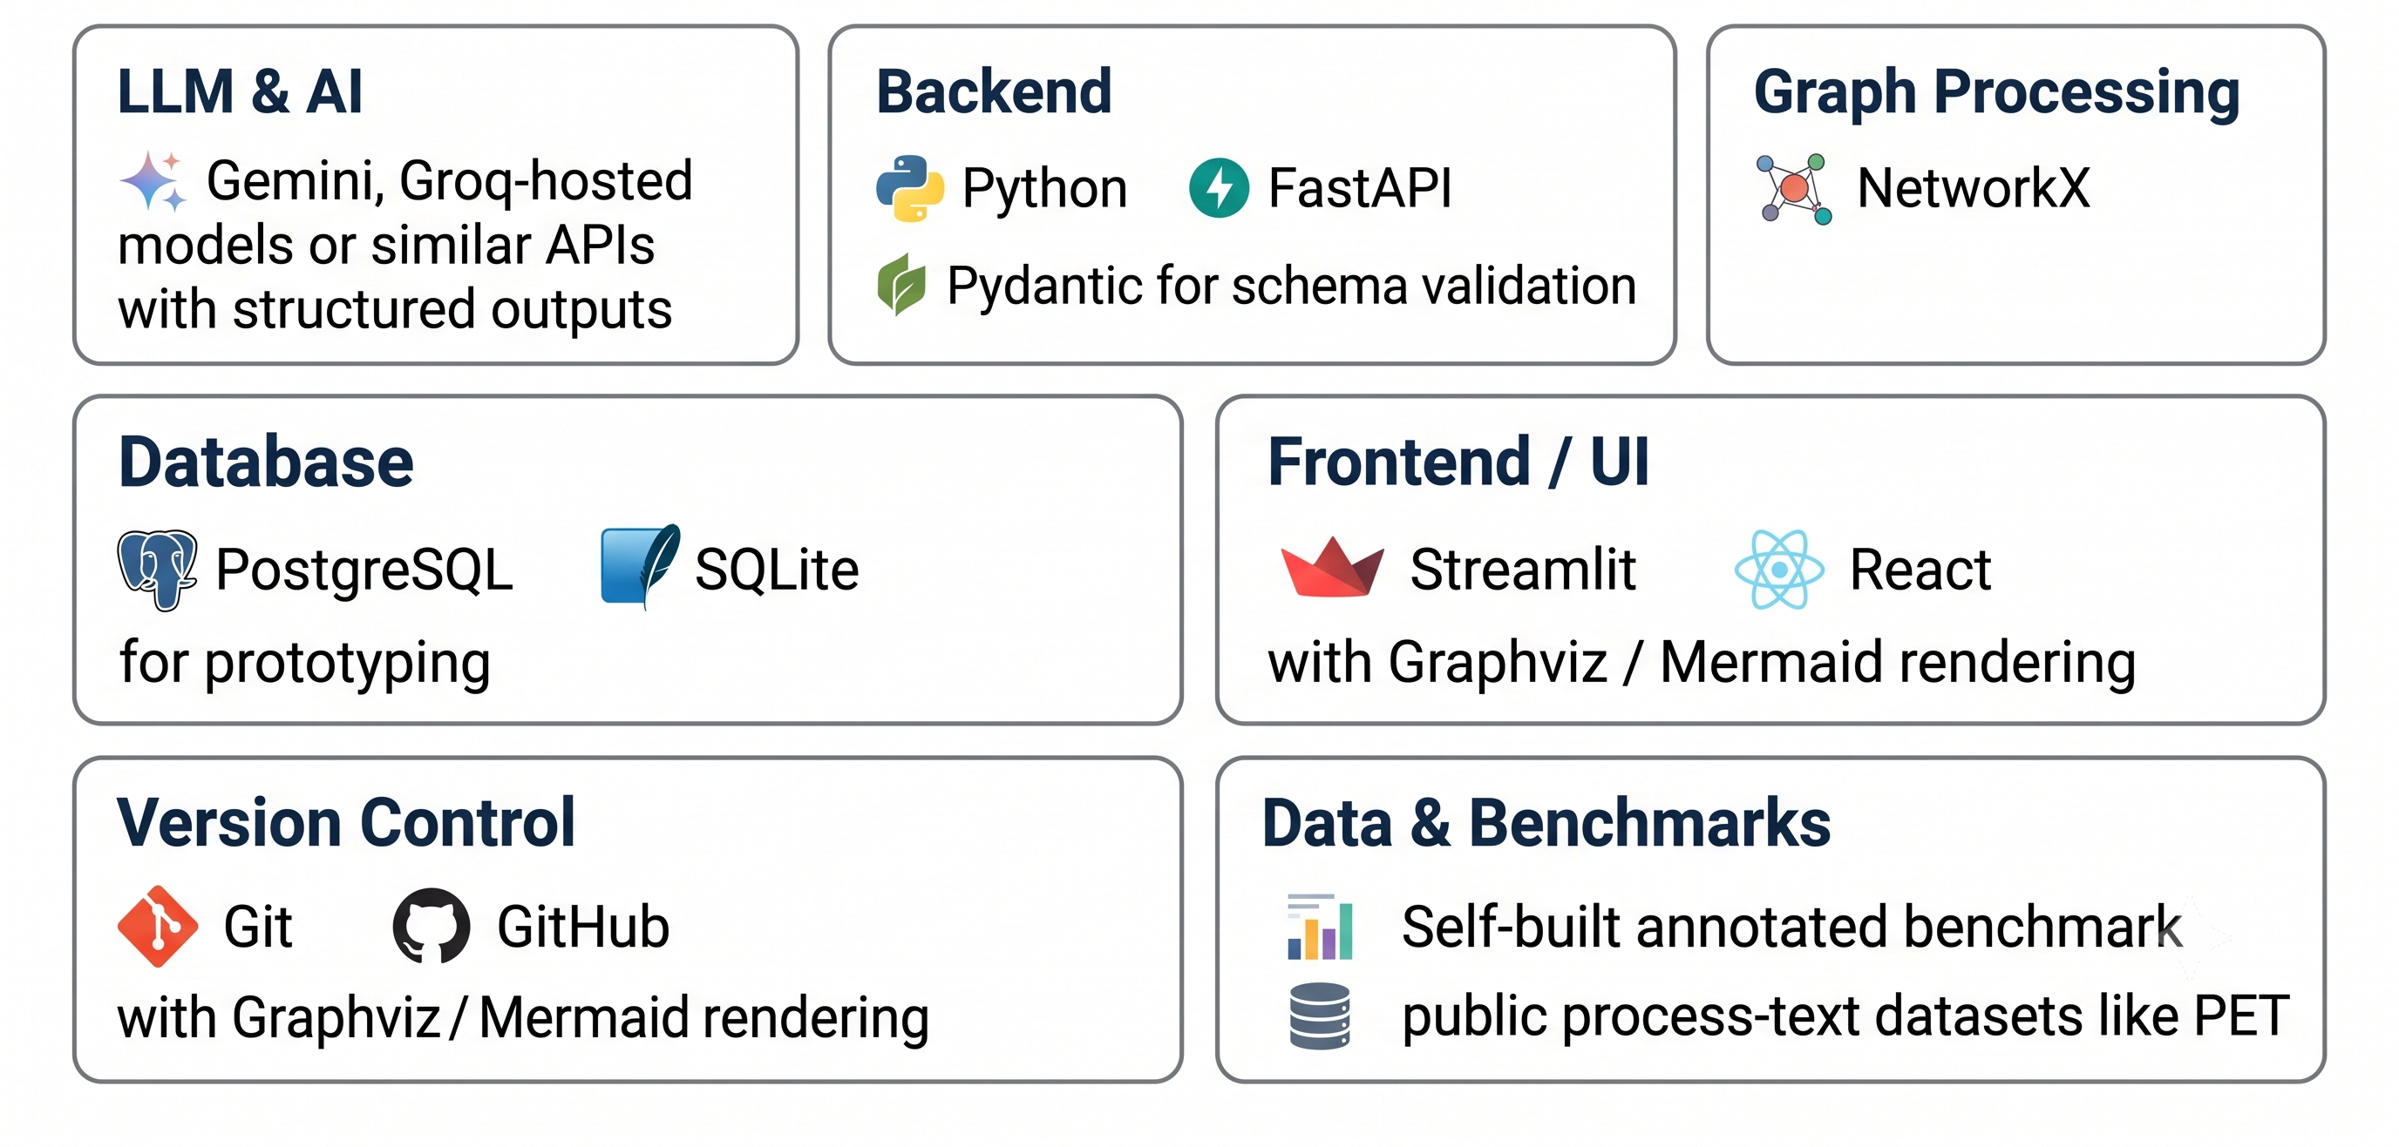
Methodology
Tools and resources

Slide 16
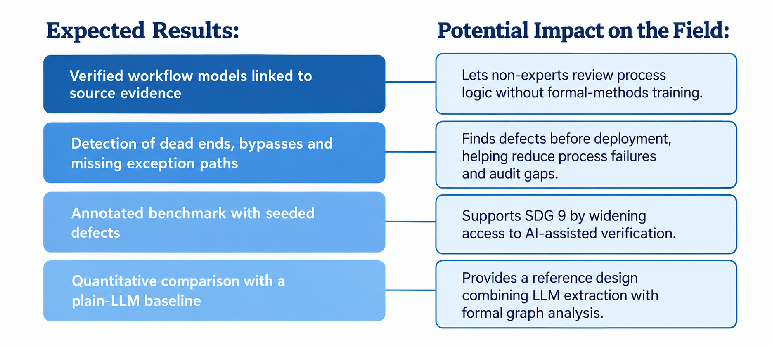
Proposed Outcomes

Slide 17
References
[1] F. Friedrich, J. Mendling, and F. Puhlmann, “Process Model Generation from Natural Language Text,” in Proc. 23rd Int. Conf. Advanced Information Systems Engineering (CAiSE), 2011, pp. 482–496. [Online]. Available: https://doi.org/10.1007/978-3-642-21640-4_36
[2] N. Klievtsova et al., “Conversational Process Modeling: Can Generative AI Empower Domain Experts in Creating and Redesigning Process Models?,” arXiv:2304.11065, 2023. https://arxiv.org/abs/2304.11065
[3] H. Kourani et al., “Process Modeling With Large Language Models,” arXiv:2403.07541, 2024. https://arxiv.org/abs/2403.07541
[4] Q. Nivon, G. Salaün, and F. Lang, “GIVUP: Automated Generation and Verification of Textual Process Descriptions,” in Proc. 33rd ACM Int. Conf. Foundations of Software Engineering (FSE Companion), 2025. [Online]. Available: https://doi.org/10.1145/3696630.3728593
[5] M. Cosler et al., “nl2spec: Interactively Translating Unstructured Natural Language to Temporal Logics with Large Language Models,” CAV, pp. 383–396, 2023. https://doi.org/10.1007/978-3-031-37703-7_18
[6] H. Kourani, A. Antonov, A. Berti, and W. M. P. van der Aalst, “Knowledge-Driven Hallucination in Large Language Models: An Empirical Study on Process Modeling,” arXiv preprint arXiv:2509.15336, 2025. [Online]. Available: https://arxiv.org/abs/2509.15336

Slide 18


