Slide 1

Reality Compiler: A Language-Driven Process Verification Engine
Computer Science Cluster: SDG-9

Slide 2
Team Members
NAME | USN
PRANEEL K A | 1RV24CS200
ANURANJAN S NAIK | 1RV24CS041
B GYANENDRA REDDY | 1RV24CD013
TARUN R A | 1RV24CI133
Mentor
Dr Nityashree G D
Assistant Professor
Dept. Of CSE

Slide 3
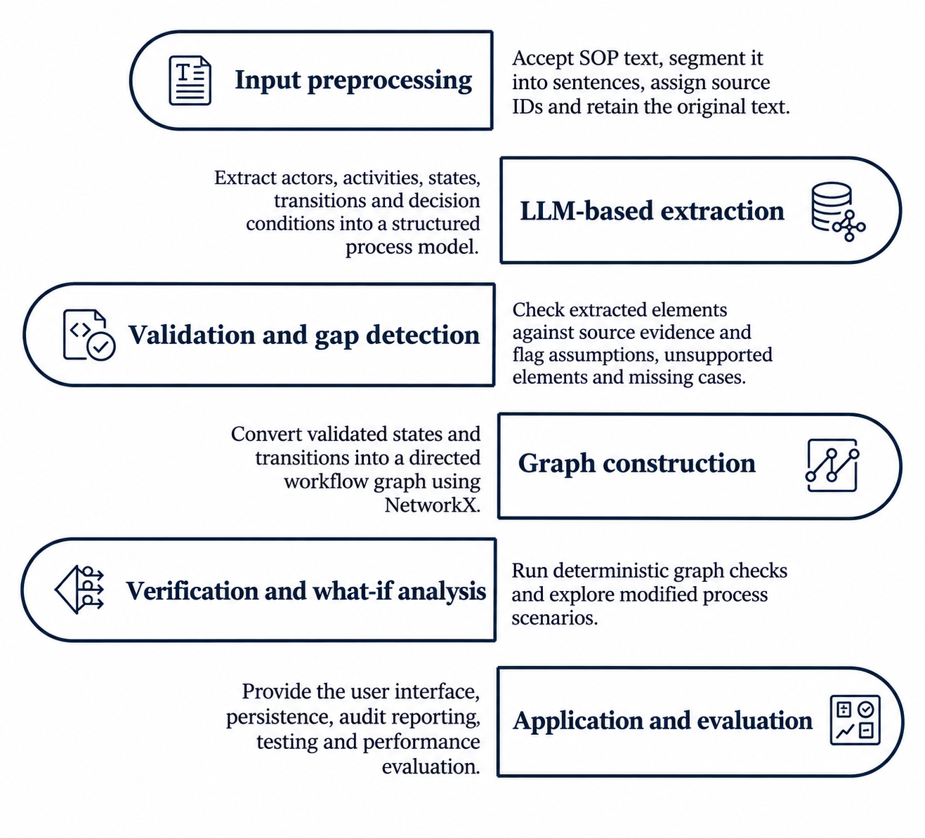
Overall System Architecture and Execution Flow
3

Slide 4
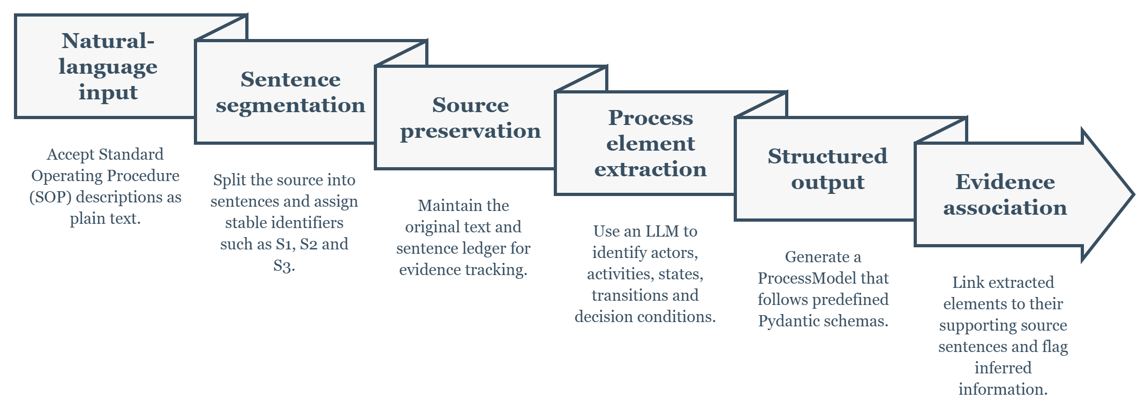
SOP Preprocessing and LLM-Based Extraction
4

Slide 5
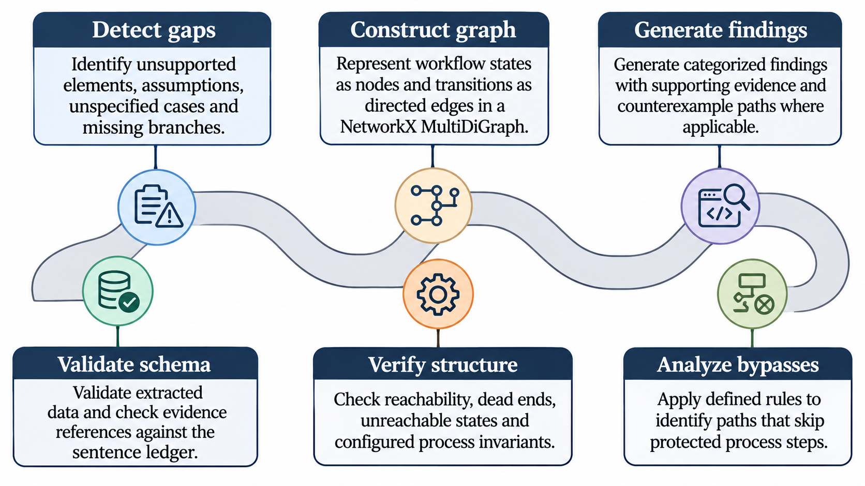
Validation, Graph Construction and Verification
5

Slide 6
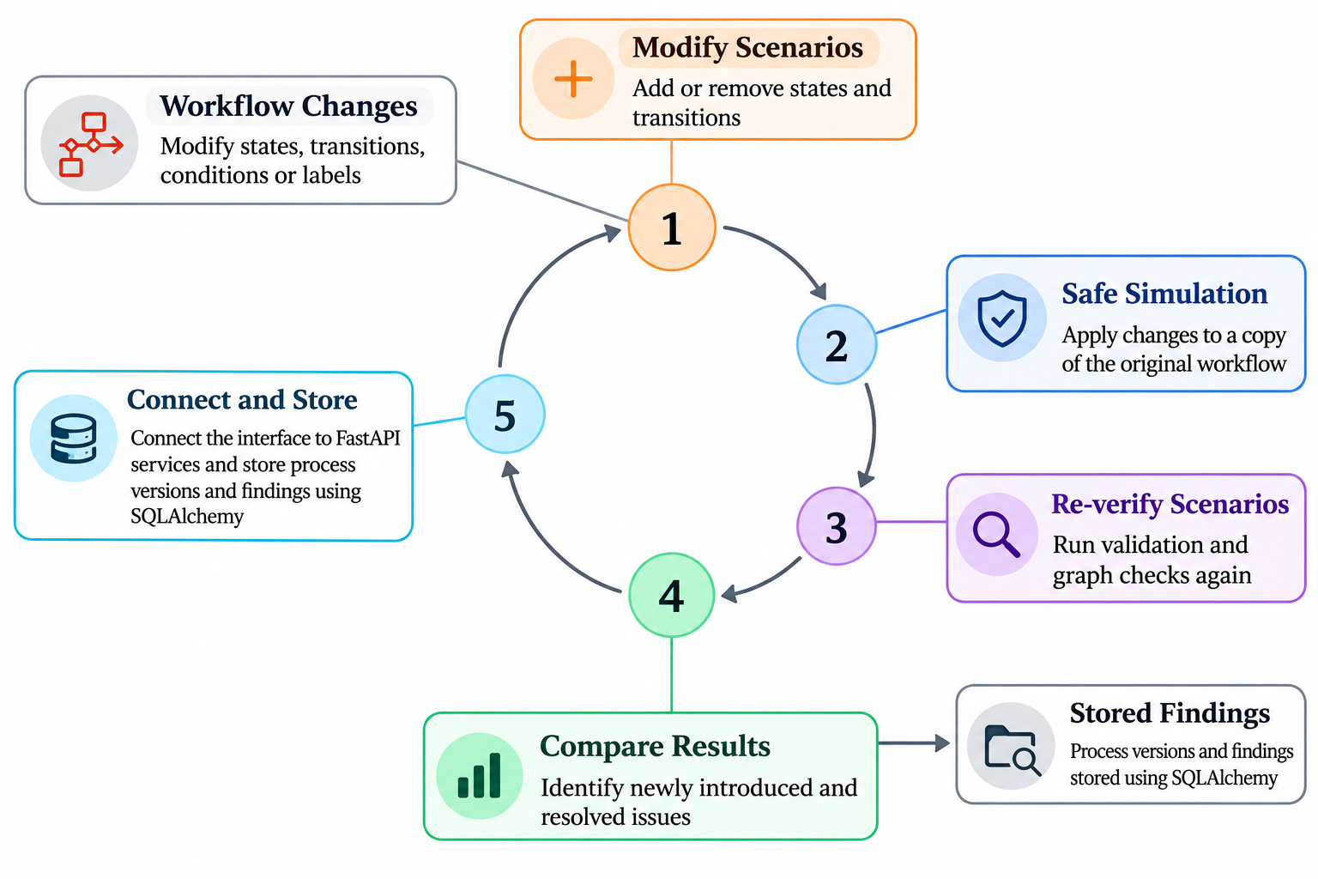
What-If Analysis, Interface and System Integration
6

Slide 7
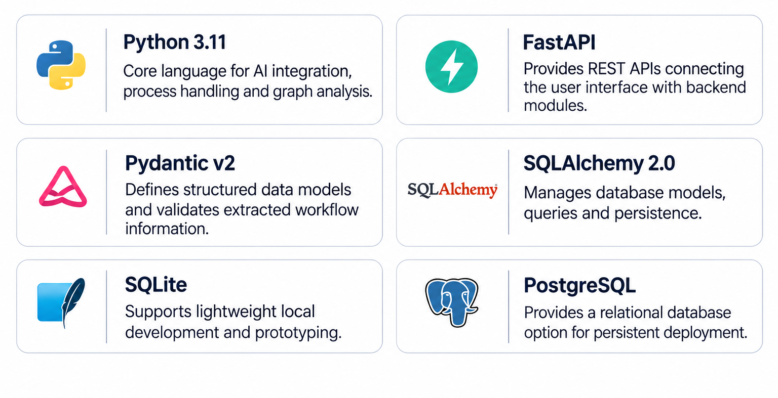
Tools and Technologies
7

Slide 8
Tools and Techniques
LLM assisted Process Extraction
• Configured hosted LLM: Understands natural-language SOP descriptions and extracts process elements.
• LLMClient interface: Separates application logic from the selected LLM provider.
• Structured prompt engineering: Guides extraction of actors, states, activities, transitions and conditions.
• Pydantic validation: Checks whether model output follows the required data schema.
• Sentence-level evidence mapping: Links extracted elements to their supporting source sentences.
• Consistency checking: Flags inconsistent or inferred elements for review rather than silently treating them as facts.
8

Slide 9
Tools and Techniques
Graph-Based Analysis
• NetworkX MultiDiGraph: Represents workflow states and directed transitions, including multiple edges between states.
• Reachability analysis: Checks whether workflow states can be reached from the designated start state.
• Dead-end detection: Identifies non-terminal states without valid outgoing transitions.
• Unreachable-state detection: Finds states that cannot be reached through the workflow.
• Bypass detection: Checks whether defined mandatory steps can be skipped.
• Invariant checking and counterexamples: Evaluates configured process rules and provides paths that demonstrate detected issues.
9

Slide 10
Tools and Techniques
Application and Development
• Streamlit: Provides the interactive application interface for entering SOPs and reviewing results.
• Graphviz: Renders workflow graphs for visual inspection.
• SQLAlchemy and Alembic: Support database access and schema migration.
• pytest: Supports unit and integration testing of individual modules.
• Ruff and mypy: Support code formatting, linting and static type checking.
• Git, GitHub and GitHub Actions: Support version control, collaboration and automated checks.
• Docker and Docker Compose: Support reproducible, containerized development and execution.
10

Slide 11
Partial Results
Workflow Extraction and Visualization
• SOP processing: Natural-language process descriptions are accepted and segmented into uniquely identified source sentences.
• Structured extraction: The extraction stage organizes process information into actors, states, activities and transitions.
• Conditional workflow representation: Decision conditions and alternative branches are represented in the structured process model.
• Workflow graph generation: The structured model is converted into a directed graph for process visualization.
• Evidence traceability: Extracted elements retain references to the source sentences used to derive them.
• Review support: Users can inspect the extracted model and its evidence before proceeding to verification.
11

Slide 12
Partial Results
Verification and What-If Analysis
• Structural verification: The verification pipeline is designed to check reachability, dead ends, unreachable states and configured invariants.
• Defect analysis: Defined checks are used to examine missing branches and potential bypass paths.
• Evidence-backed findings: Verification findings are associated with affected workflow elements and supporting source evidence.
• Counterexample paths: Paths can be presented to illustrate how a detected structural issue occurs.
• What-if scenarios: Modified workflow copies can be revalidated and reverified without changing the original model.
• Evaluation preparation: Benchmark workflows with labelled defects and baseline comparisons are prepared for quantitative evaluation.
12

