Slide 1


| Tech Management, SRI-B
CLAWS
CLASH OF THE
R.V. College of Engineering- ClawForge
Stop Waiting. Start Shipping. Let AI Review
Prateek Khemka, Praneel K A, Rakshak S, RVS Nikhil

Slide 2
Idea
Problem Statement
In modern agile development, the Pull Request (PR) is intended to be a quality gate, but in practice, it often becomes a bottleneck that drains engineering velocity and morale.
The Bottleneck (Velocity)
Software teams aim for high deployment frequency, but PRs often sit in "Review Required" limbo for 24–48 hours. This causes context switching: a developer moves on to a new task, only to be pulled back days later to fix a minor variable naming issue or a missed edge case.
The Fatigue (Quality)
Senior engineers—the "force multipliers"—spend up to 30% of their week reviewing code. Under pressure to ship, "rubber-stamping" (approving without a deep look) becomes common. This is where silent killers like N+1 queries or thread-safety issues slip into production.
The Knowledge Gap (Consistency)
Human reviewers are subjective. One reviewer might be a stickler for SOLID principles, while another only cares about test coverage. This inconsistency leads to "codebase drift," where different modules follow different standards, making long-term maintenance a nightmare.

Slide 3
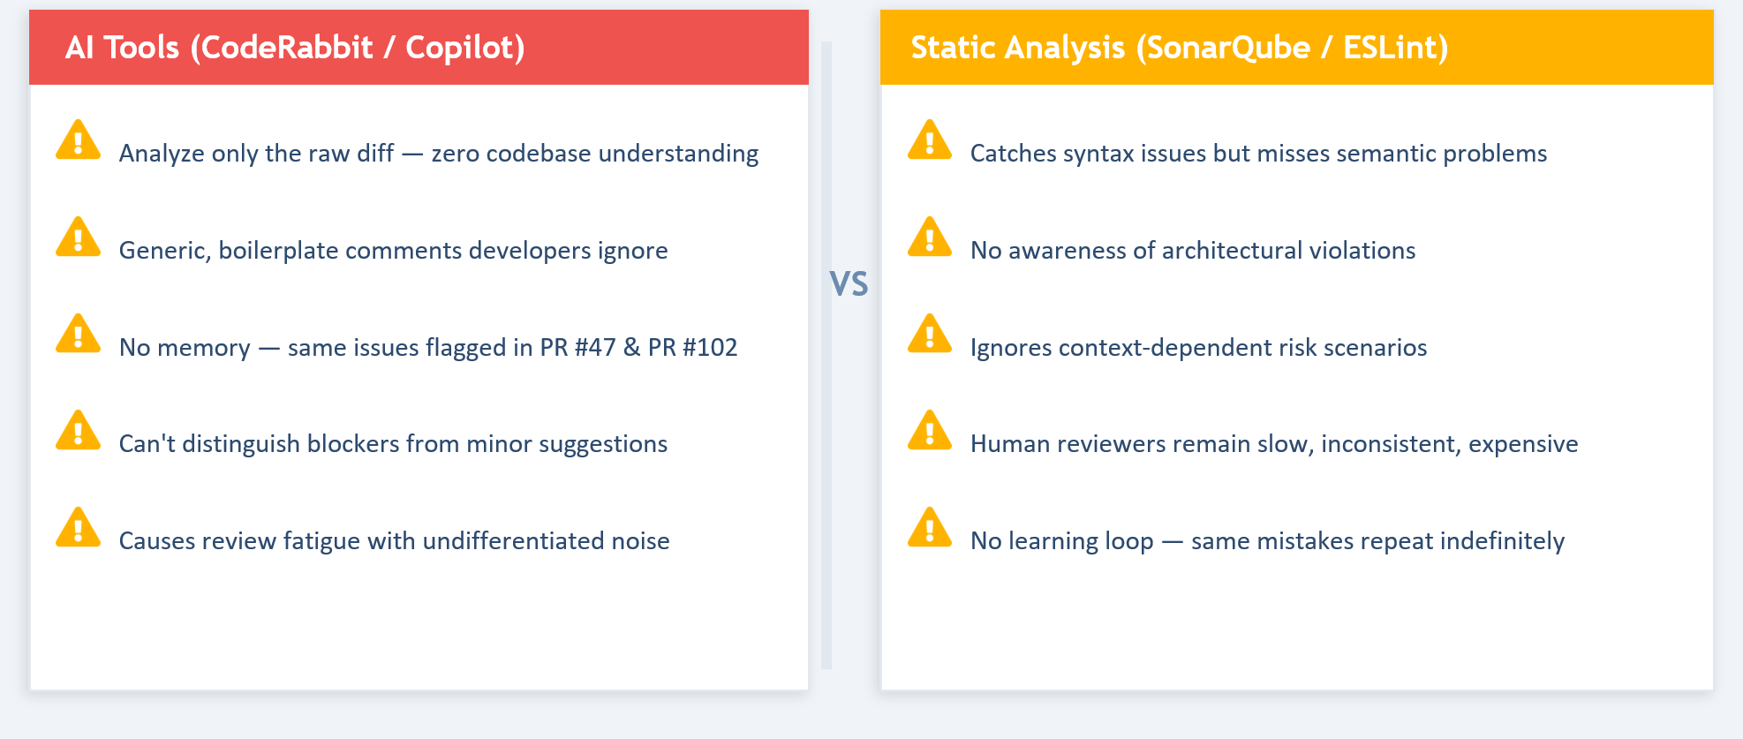
Idea
Current Solution & Gaps

Slide 4
Idea
Your Solutions
CLAWSIGHT is a self-hosted autonomous AI code review system built on OpenClaw that continuously monitors GitHub Pull Requests and performs repository-aware AI reviews without requiring manual intervention.
Unlike traditional diff-only review tools, CLAWSIGHT understands the broader codebase by retrieving related functions, test files, historical bugs, and team coding conventions using a ChromaDB-powered RAG pipeline.
Whenever a PR is opened or updated, the system automatically launches 4 parallel Claude-powered specialist reviewer agents focused on Security, Performance, Test Coverage, and Architecture analysis. Their outputs are aggregated into a centralized reasoning engine that computes regression risk, prioritizes findings by severity, and generates explainable review feedback.
CLAWSIGHT then automatically posts structured review comments to GitHub, escalates critical issues through Slack/Discord notifications, and continuously improves over time using persistent repository memory that learns team conventions, author patterns, and historical review behavior.

Slide 5
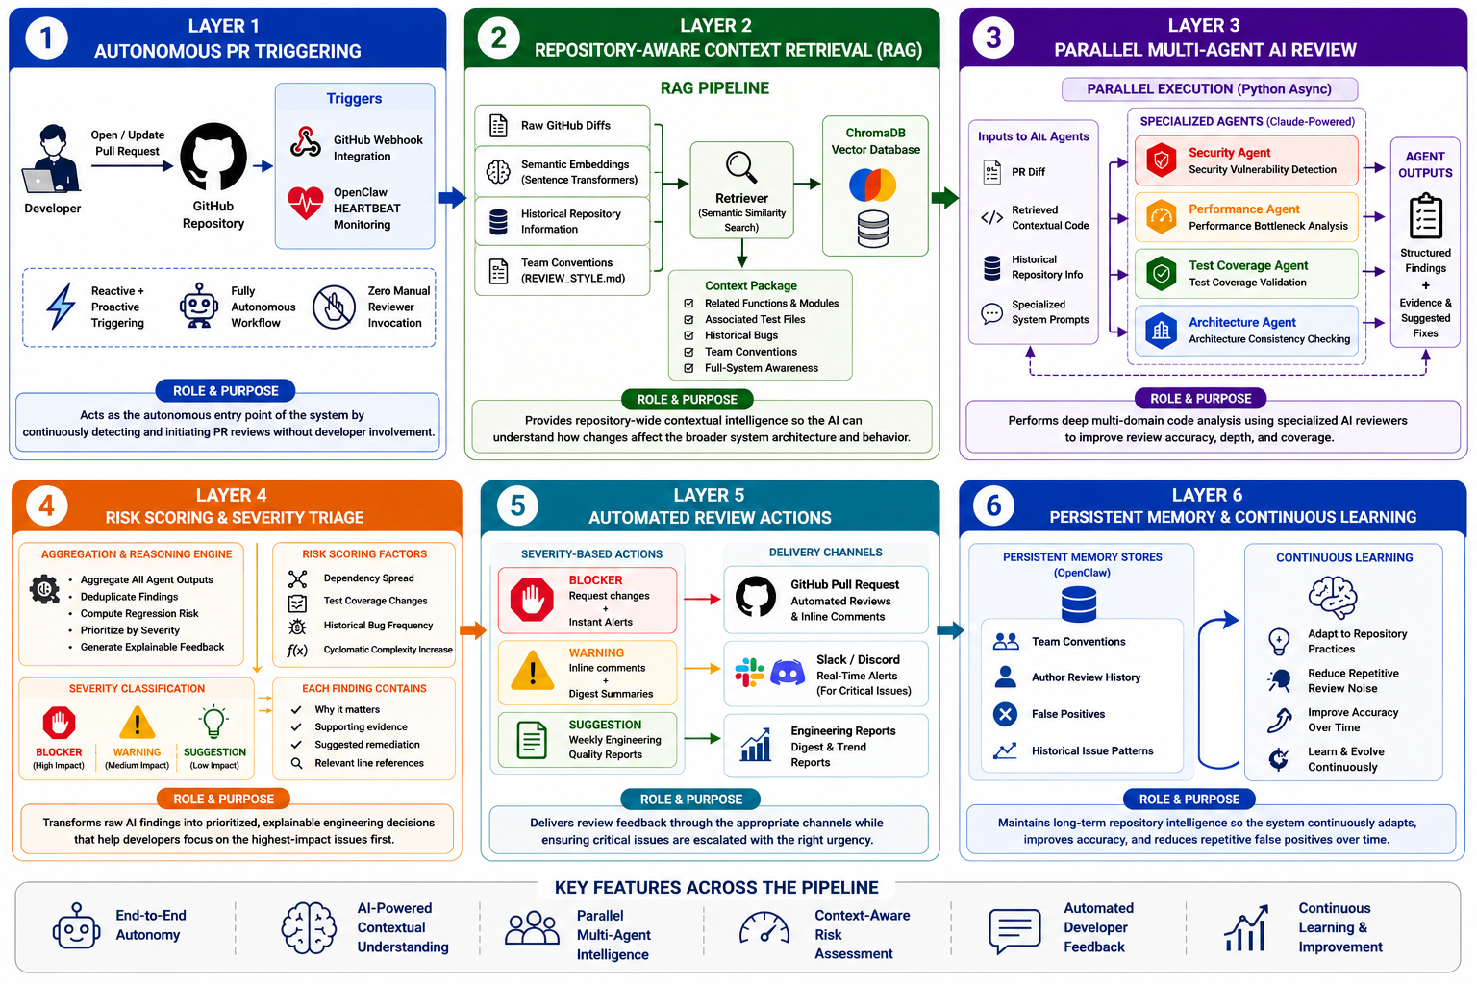

Slide 6
Idea
Demo/Product Walkthrough
Screen/Flow How User Interacts
Key Moments
This is the most important Slide

Slide 7
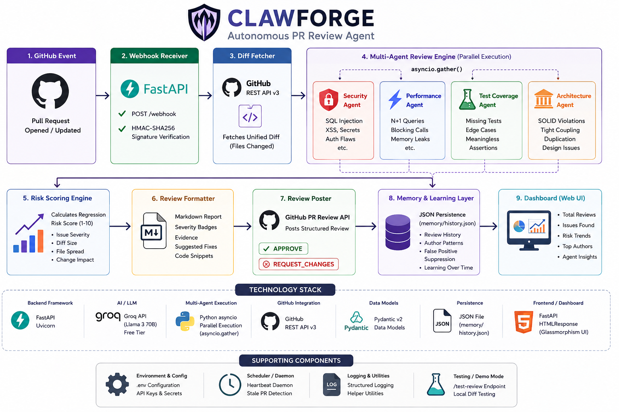
Idea
Tech & Architecture

Slide 8
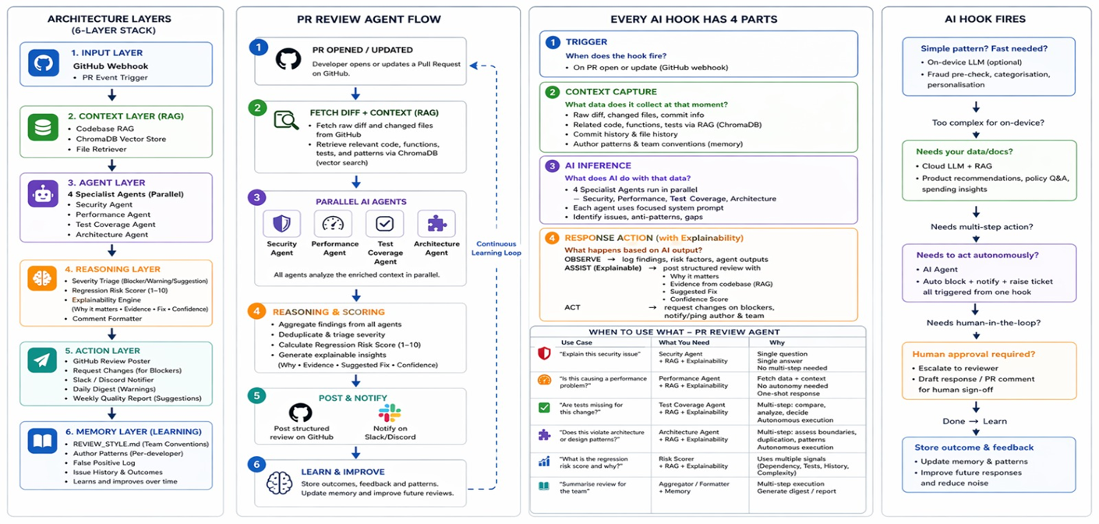
Idea

Slide 9
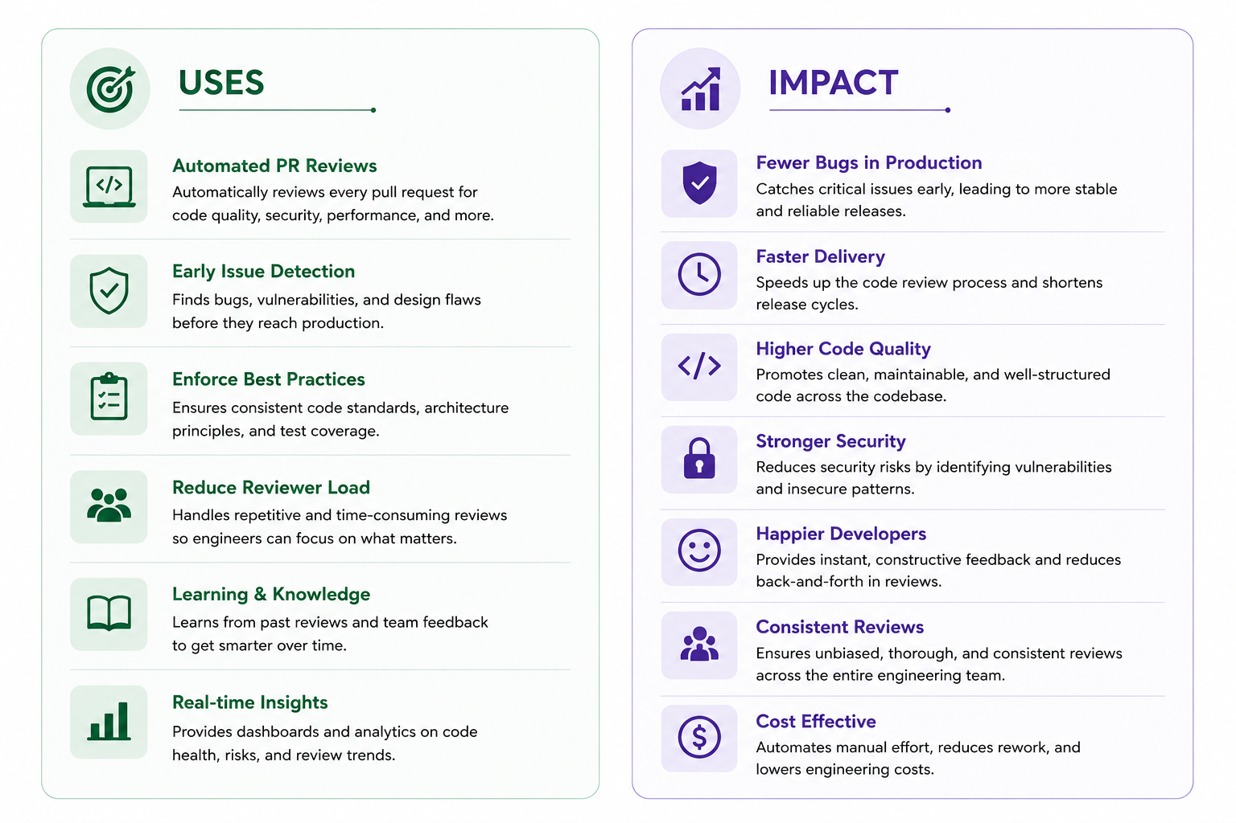
Idea
Impact & Use cases

Slide 10
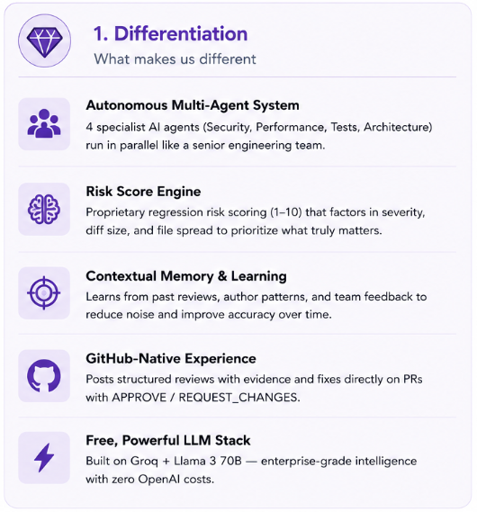
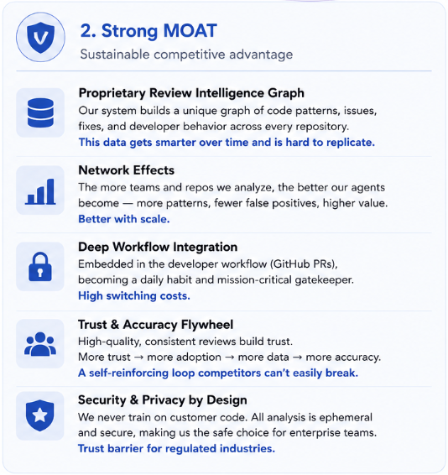
Idea
Differentiation

Slide 11
Idea
Demo Link
GitHub Repo Demo Link Document submitted

Slide 12
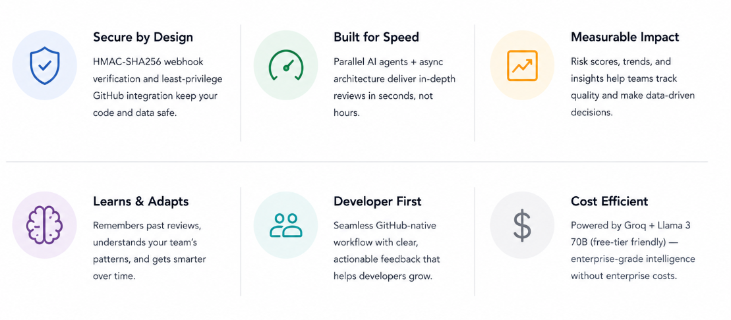
Idea

