Slide 1
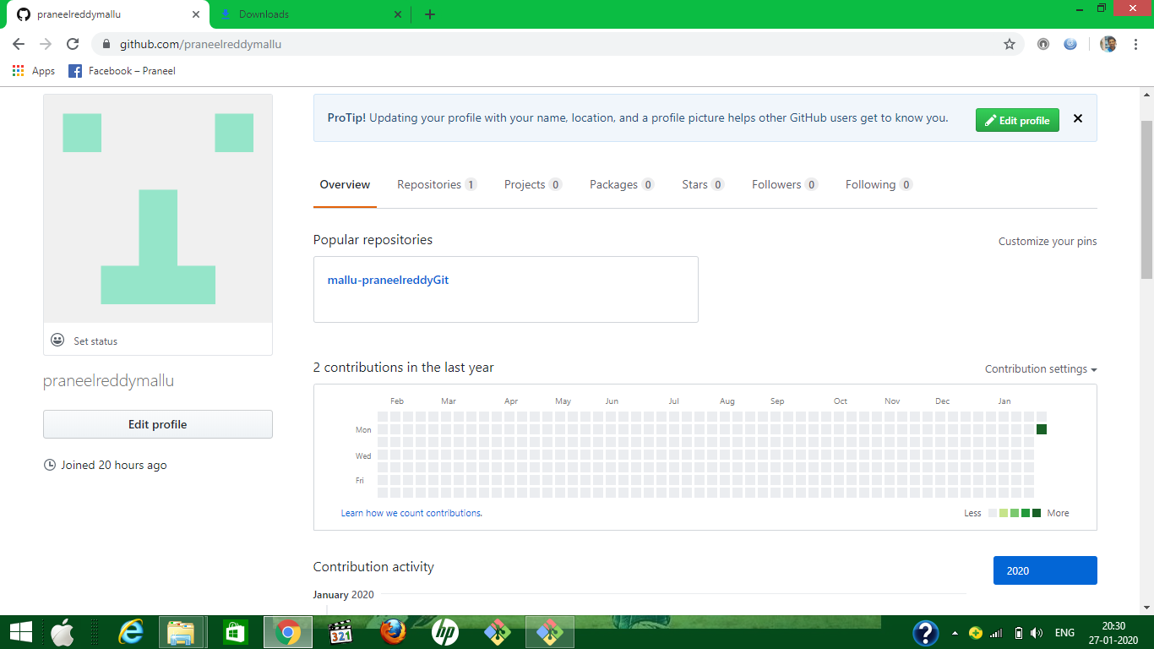
1.Create account on GitHub

Slide 2
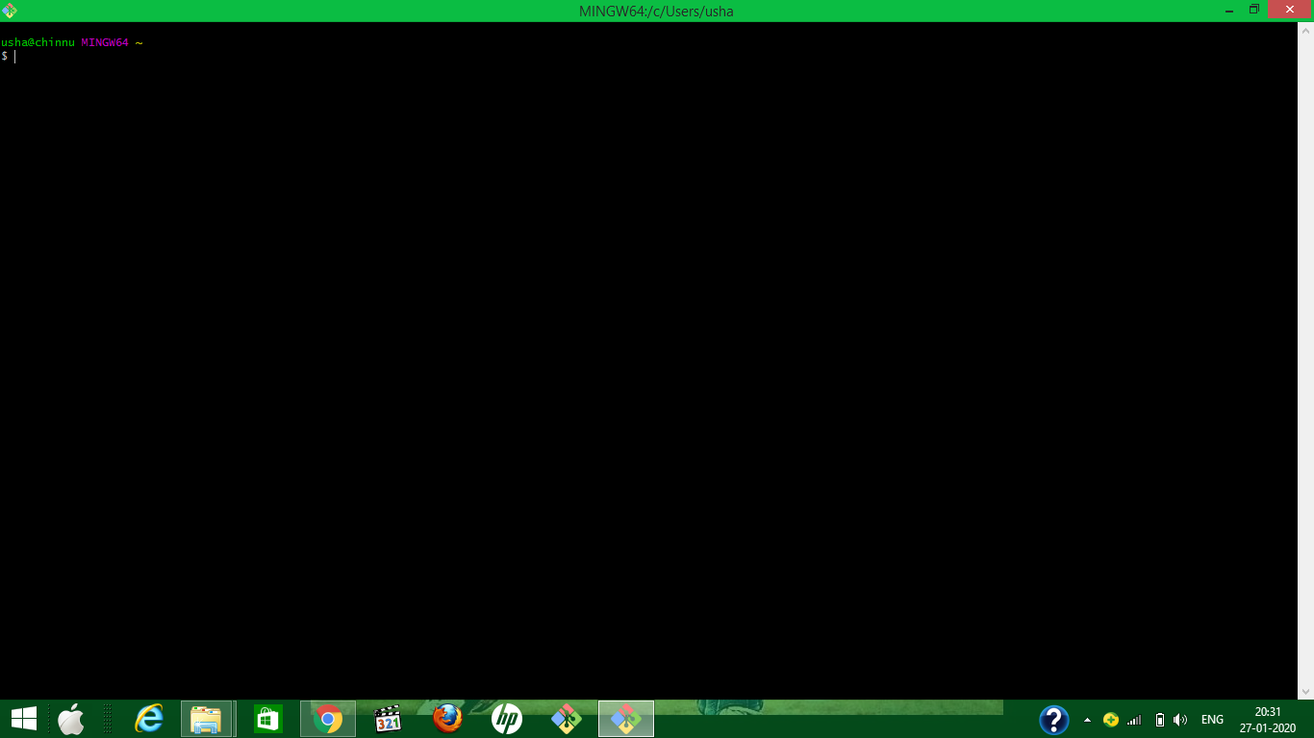
2.Install the GIT in your local machine

