Slide 1
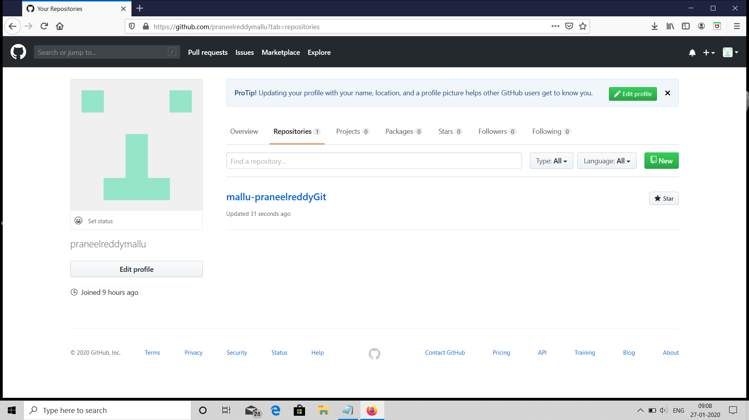
GITHUB ACCOUNT PROFILE
Step1: created the github account and profile of my github account.

Slide 2
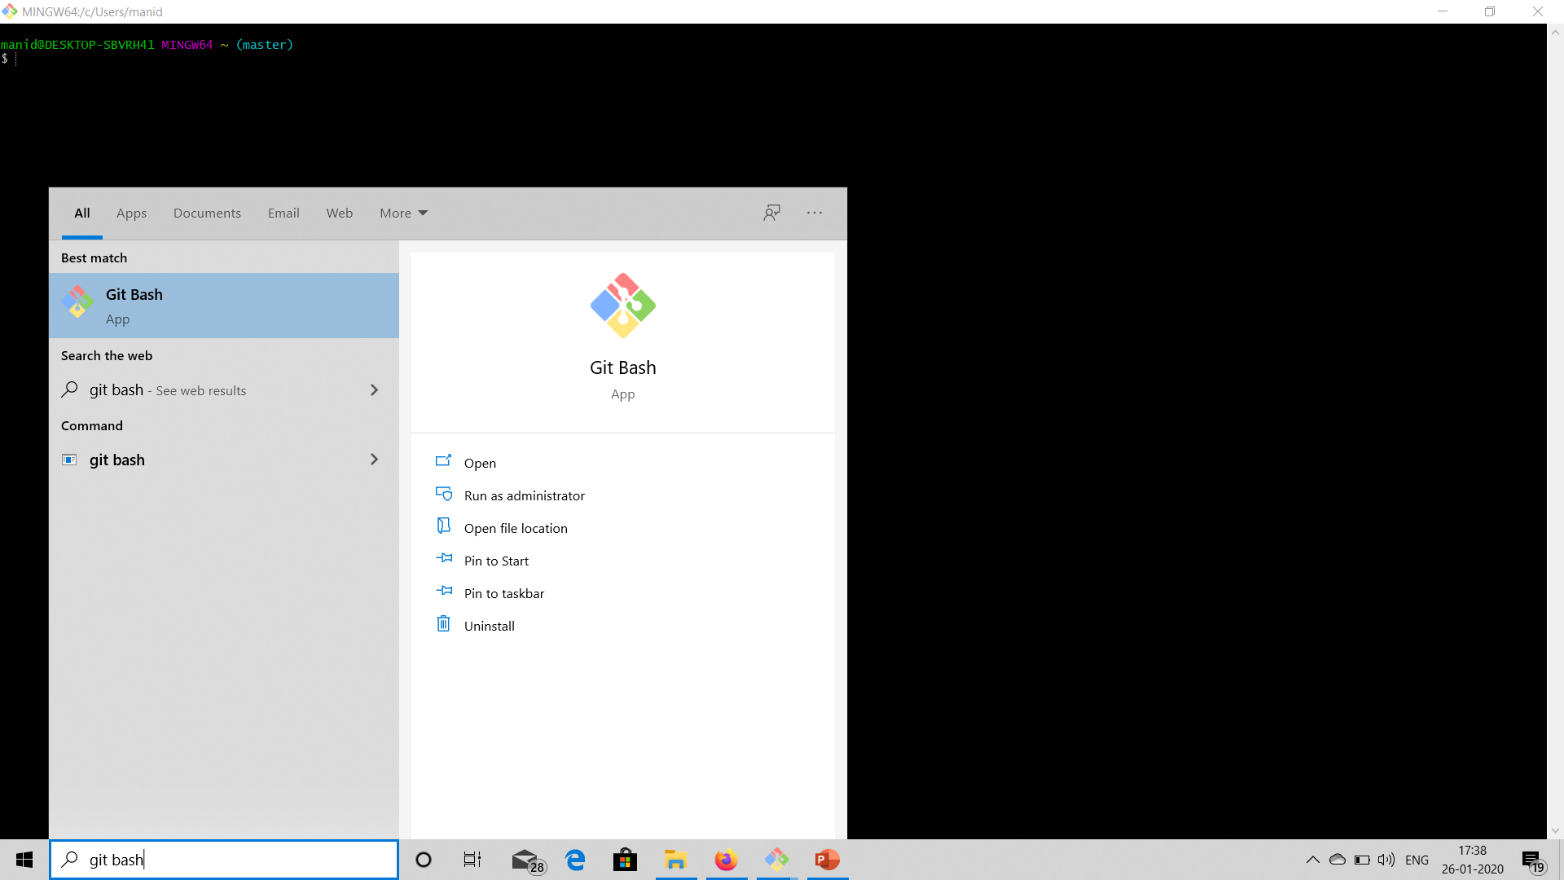
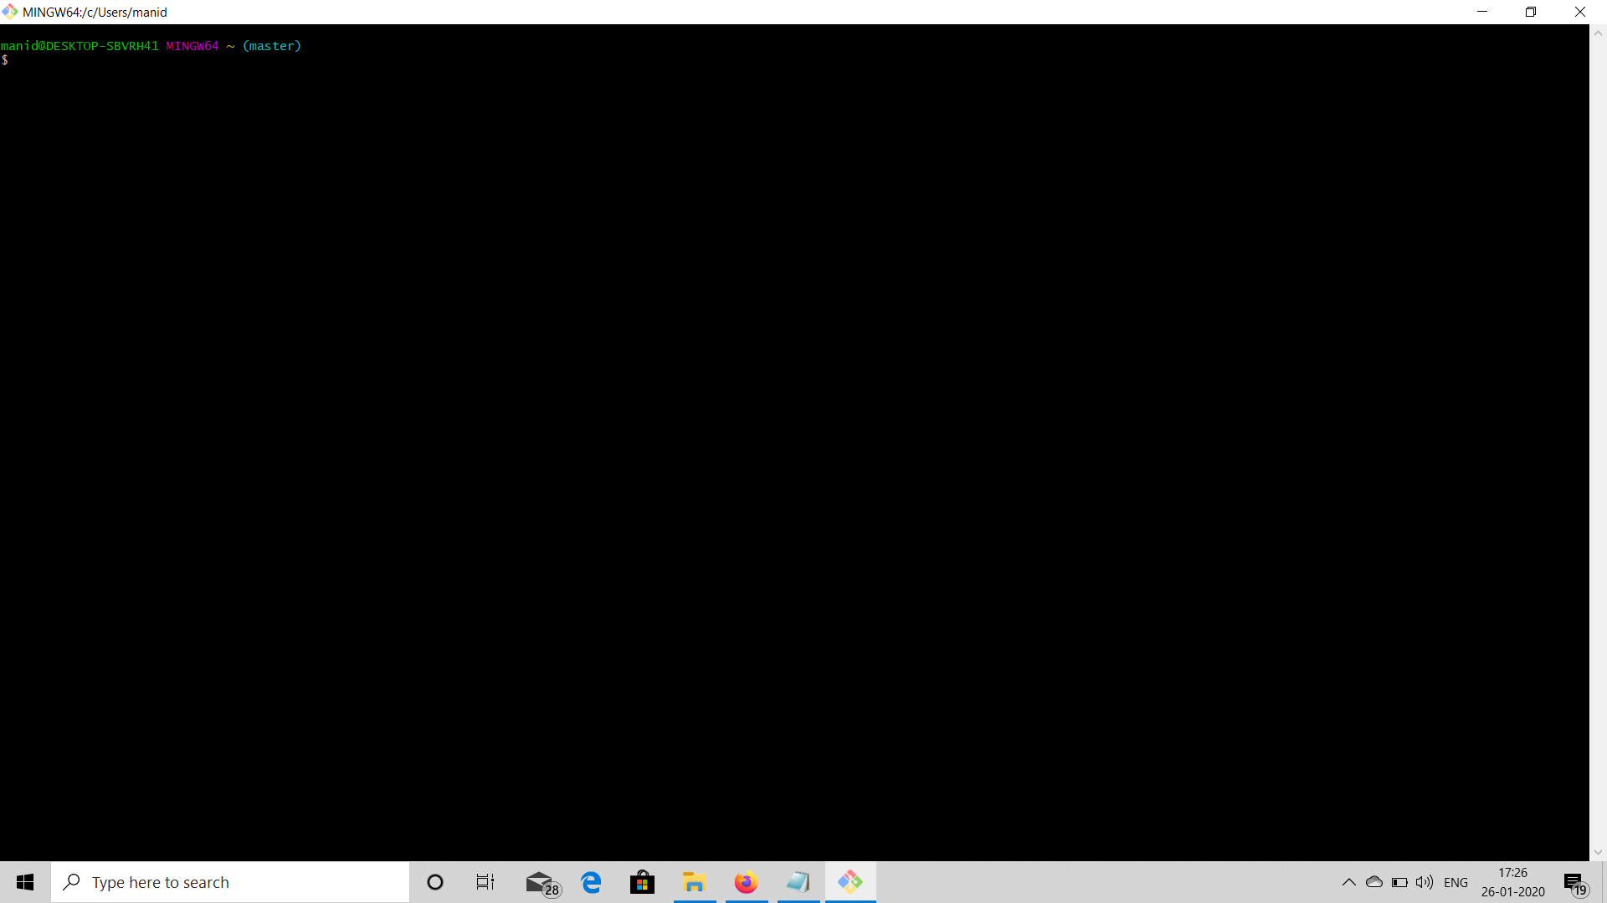
Step 2:Installed git in my personal computer

Slide 3
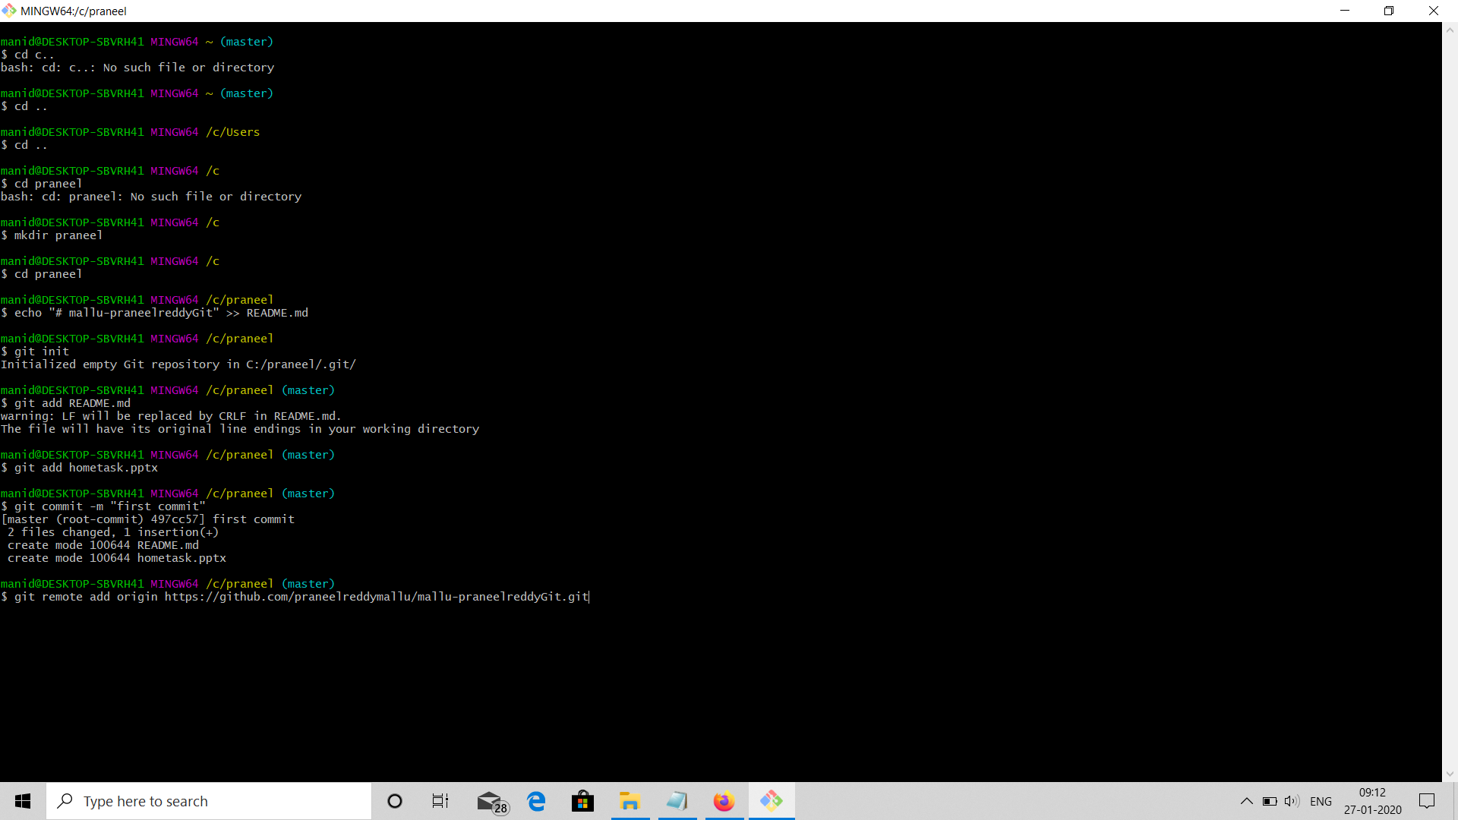
Step3:creating repository using the git commands and add,commit the files

Slide 4
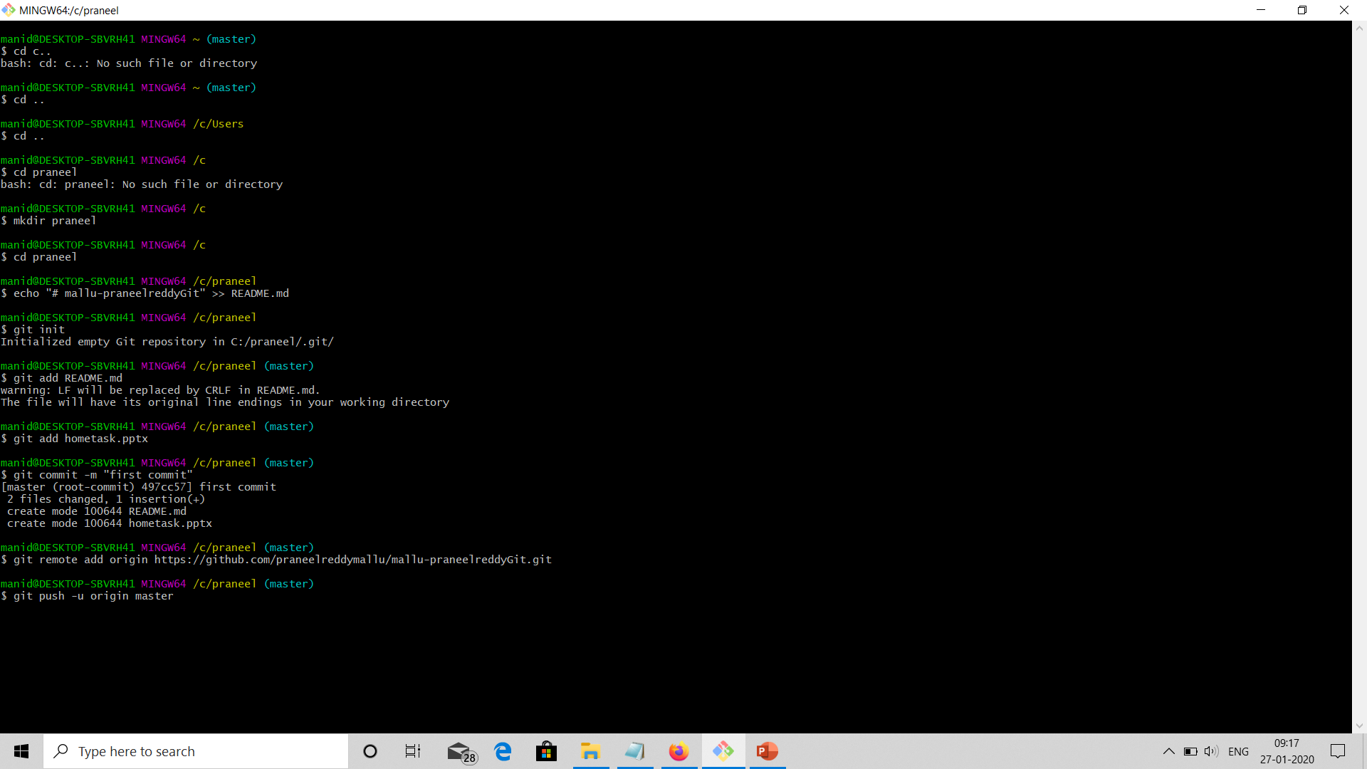
Step4:pushing the changes into the remote server by defining the path

