Slide 1

Gengo
Everything we made, with links
Free · no account · budget ₹0
Open the app
GitHub repo

Slide 2
You look up a word.
You nod.
By Friday, it’s gone.
Gengo fixes that.
For final-year students prepping for placements
Launch note: who it is for
@learnwithgenn · praneet-admin.github.io/gengo

Slide 3
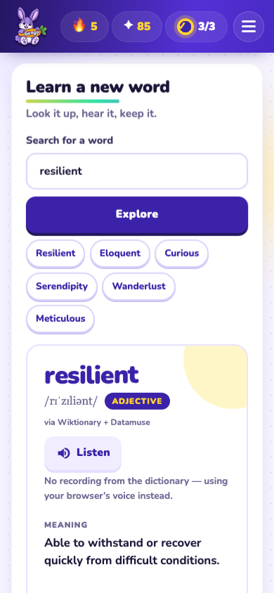
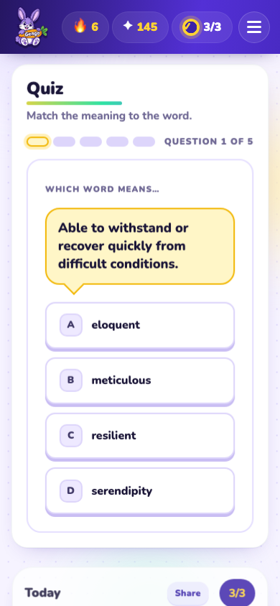
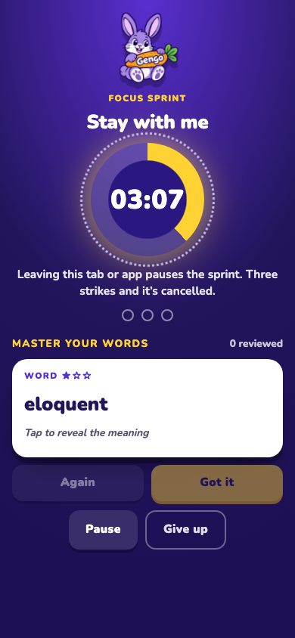
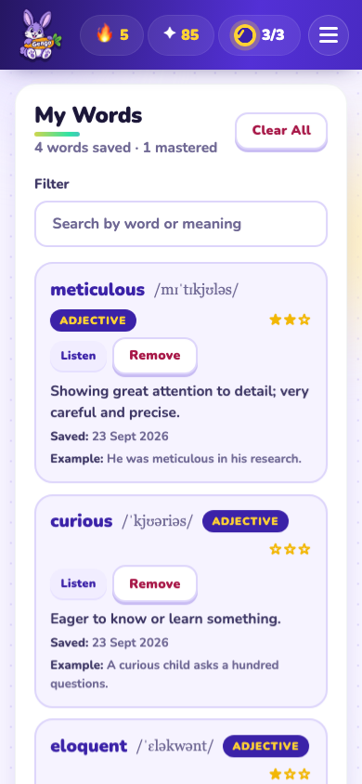
The app
Look it up
Get quizzed
Focus Sprint
Keep the streak
Try it
User guide
UI/UX walkthrough
README
@learnwithgenn · praneet-admin.github.io/gengo

Slide 4
Three launch jobs
1
2
3
Marketing
Support
Pricing
Get heard
Help fast
₹0, forever
Launch note
Post kit
Support policy
Issue forms
@learnwithgenn · praneet-admin.github.io/gengo

Slide 5
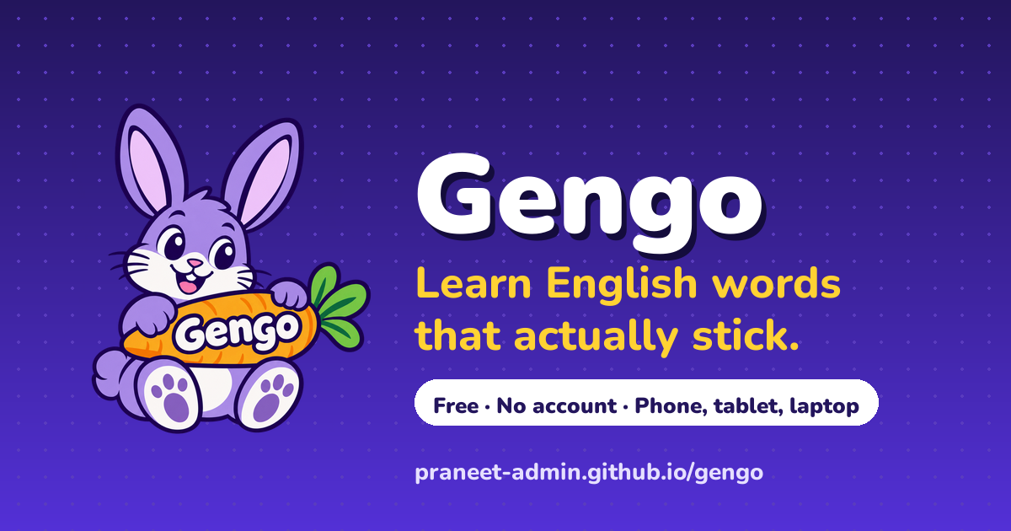
Every share unfurls into this
“I’m on a 5-day streak learning English words with Gengo 🐰”
One-tap Share. The learner is the ad.
Preview card (og-image)
Post copy (WhatsApp, LinkedIn, Reddit, X)
Installable app
@learnwithgenn · praneet-admin.github.io/gengo

Slide 6
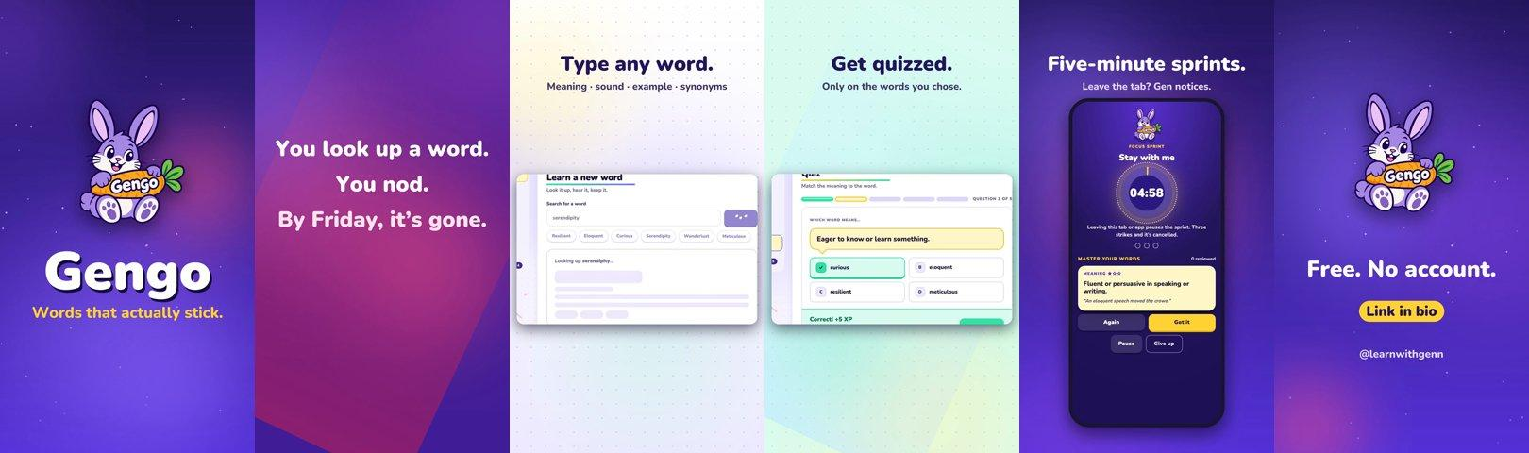
Promo video · 57 s · real footage
Watch the video
File on GitHub
@learnwithgenn · praneet-admin.github.io/gengo

Slide 7
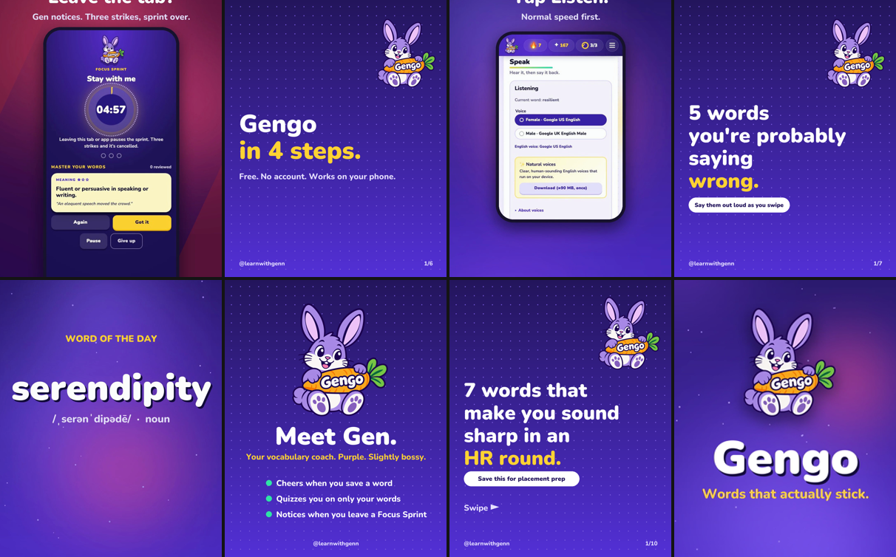
Instagram · @learnwithgenn
8 posts on day one
Open the profile
Post files and captions
@learnwithgenn · praneet-admin.github.io/gengo

Slide 8
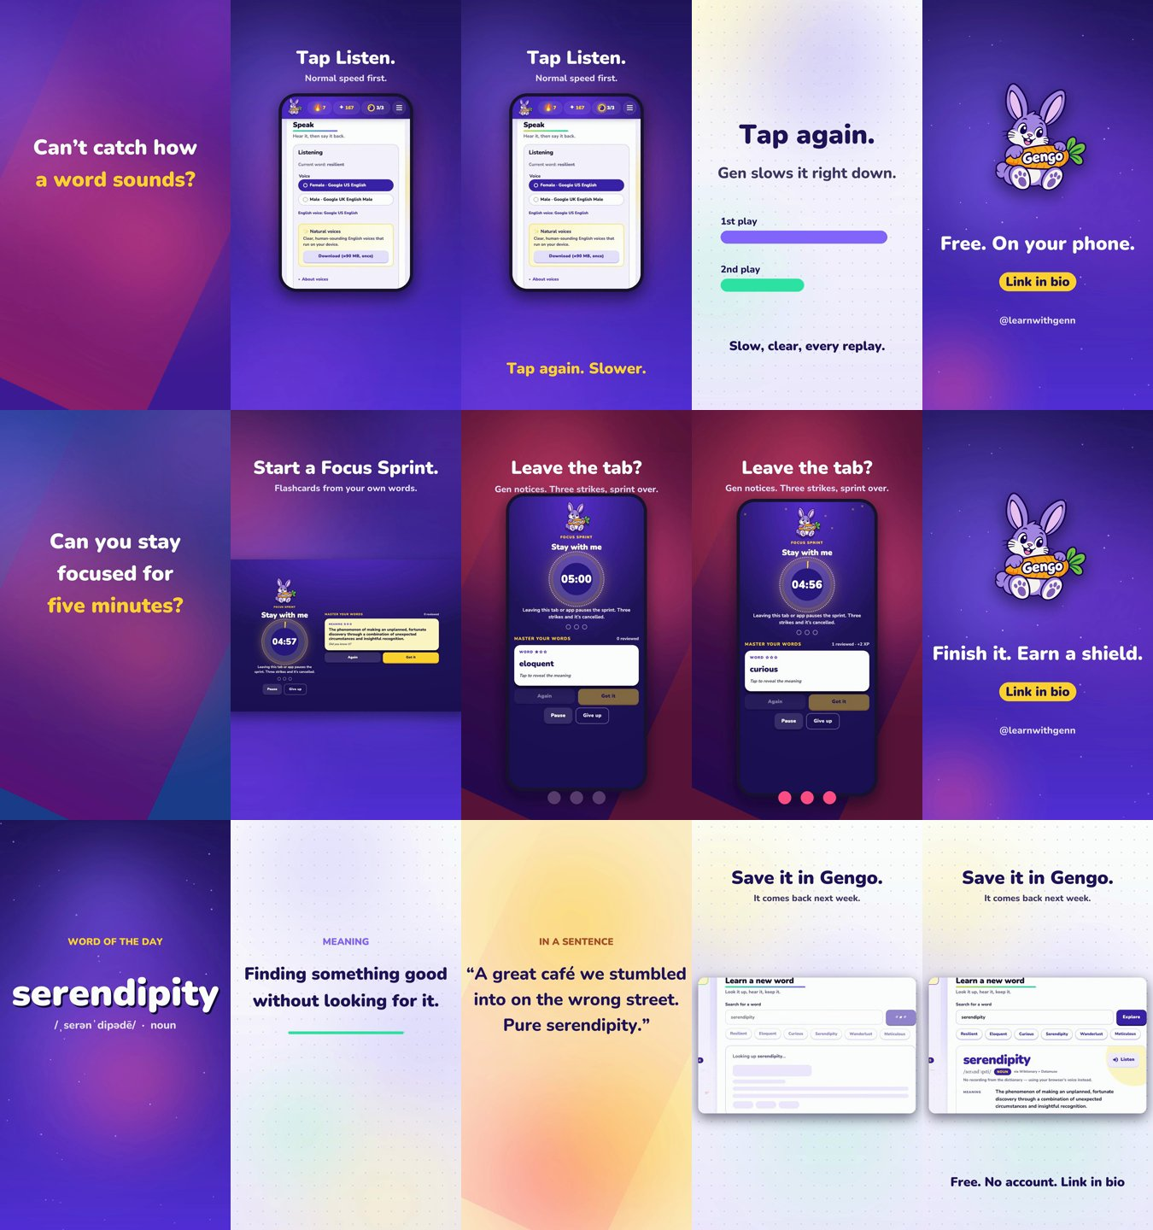
Reels
Launch reel
Word of the day
Listen again, slower
Focus Sprint
@learnwithgenn · praneet-admin.github.io/gengo

Slide 9
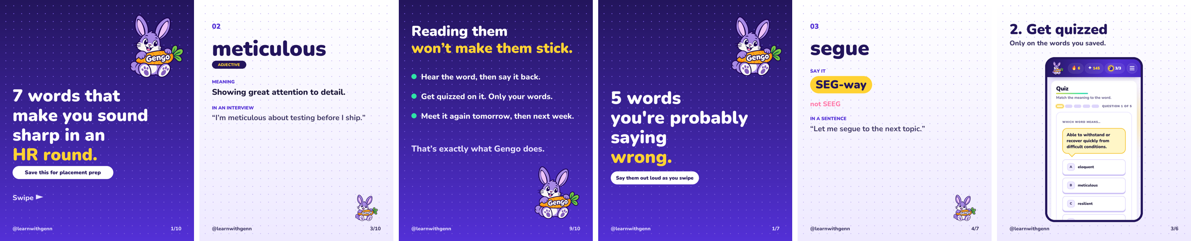
Carousels
7 words for an HR round
5 words you’re saying wrong
Gengo in 4 steps
@learnwithgenn · praneet-admin.github.io/gengo

Slide 10
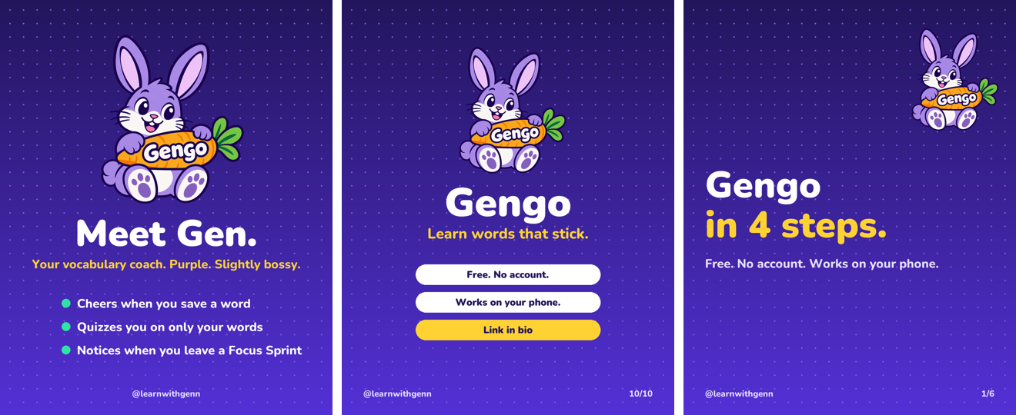
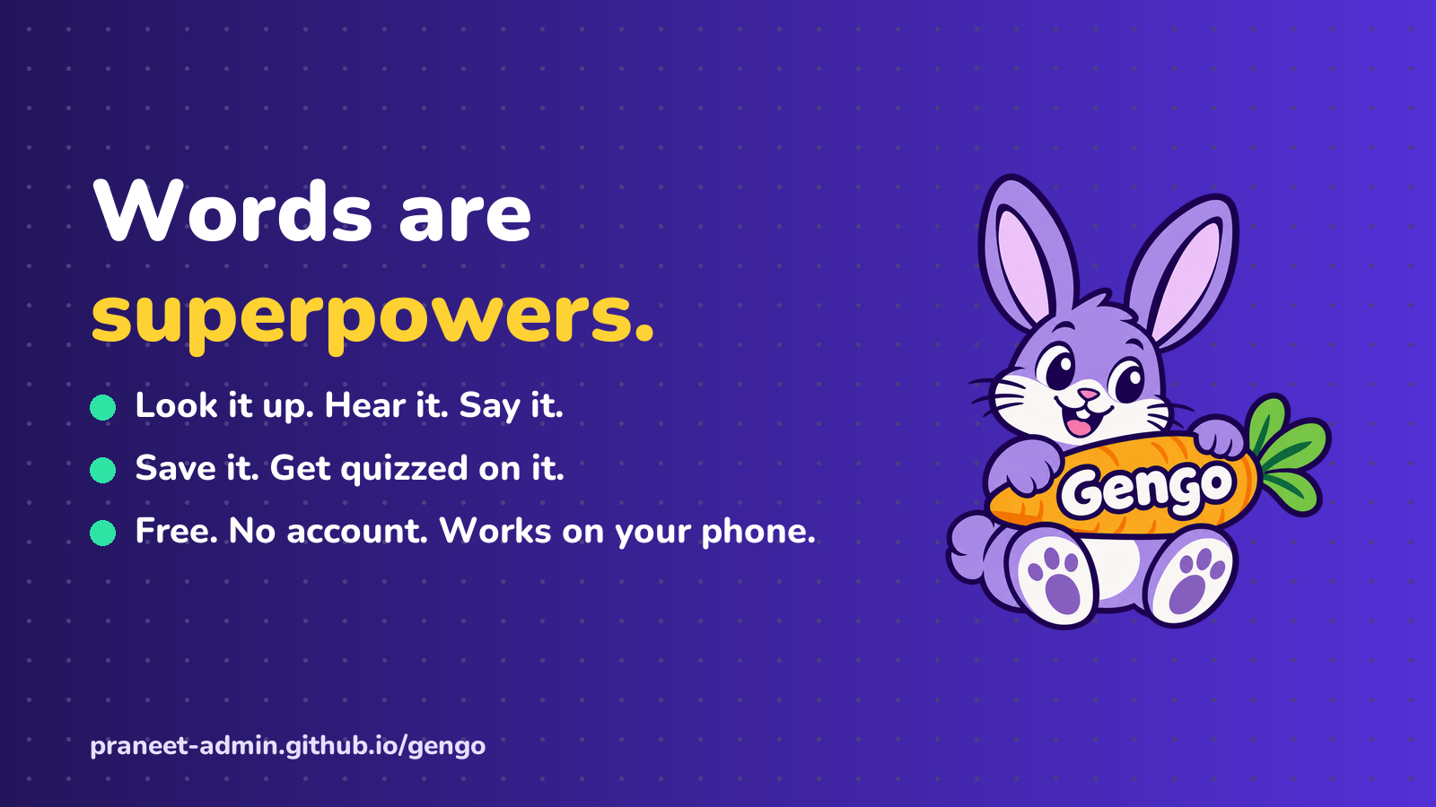
Posts & the blog
Medium: “Meet Gengo: Turn One New Word Into a Superpower” (draft, publishing next)
Meet Gen post
Medium draft
Blog text
Campaign images
@learnwithgenn · praneet-admin.github.io/gengo

Slide 11
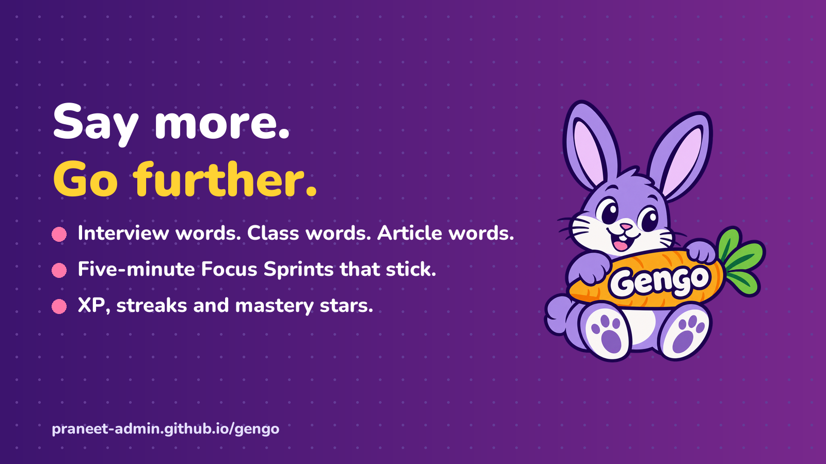
The brand
Gen artwork + icons
Campaign notes
@learnwithgenn · praneet-admin.github.io/gengo

Slide 12
Done in 30 days means
10
5
1
WhatsApp shares
GitHub issues
faculty reply
Next: link in bio · publish Medium · one Reel a day
Open the app
Instagram
GitHub
@learnwithgenn · praneet-admin.github.io/gengo

