Slide 1

Gengo
Launch, marketing & the business side
A free, no-account English vocabulary trainer.
What we shipped, who it is for, how we told people, and what "done" looks like.
September 2026 · budget ₹0 · one person and a purple rabbit

Slide 2
The problem, and who it is for
Audience statement from the launch note
You look up a word.
You nod.
By Friday, it’s gone.
✓
For
Final-year students in India preparing for campus placements: the verbal-ability section of aptitude tests and the HR / communication rounds.
Today’s loop: google → read one definition → maybe a screenshot → move on. Nothing tests you, speaks the word, or notices when you stop.
✕
Explicitly not for
Children (no parental layer), absolute beginners (the app is in English), IELTS/TOEFL band-chasers, teachers wanting a classroom dashboard.
Gengo · learnwithgenn · praneet-admin.github.io/gengo
2

Slide 3
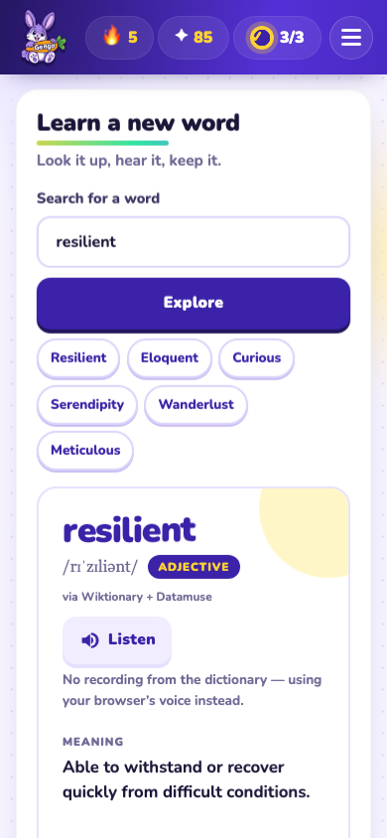
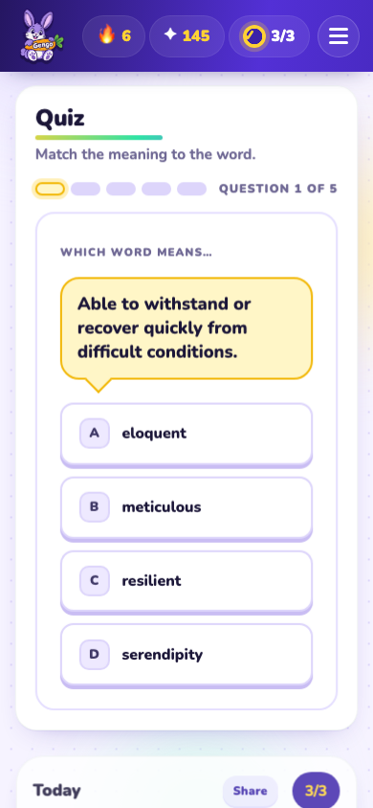
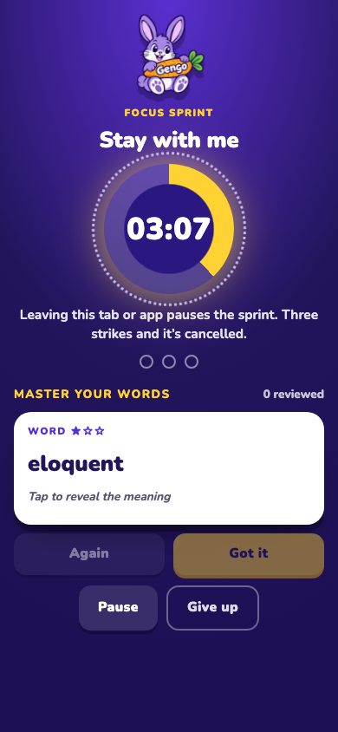
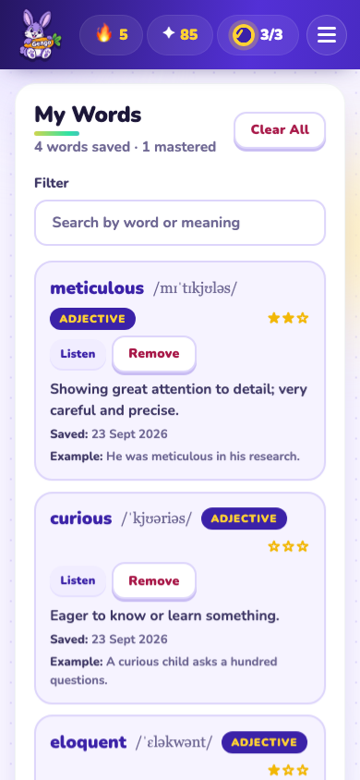
What we built
praneet-admin.github.io/gengo · plain HTML/CSS/JS · free public APIs · phone, tablet, laptop
Look it up
Get quizzed
Focus Sprint
Keep the streak
meaning · sound · example · synonyms
only on the words you saved
5 min · flashcards · Gen notices if you leave
spaced review · mastery ★★★ · shields
Gengo · learnwithgenn · praneet-admin.github.io/gengo
3

Slide 4
Three jobs we picked for launch
From the assignment list: everything had to keep working while nobody is standing next to it
1
Marketing
2
Support
3
Pricing
Get people to hear about it
Help the stuck and the annoyed
Decide what it costs
Link previews, a Share-my-streak loop, an installable app, a post kit, a blog, a promo video, and now an Instagram account.
In-app Help + guided tour, Report-a-problem that pre-fills a GitHub issue, structured issue forms, SUPPORT.md with honest expectations.
Free, forever, no tiers. It costs nothing to run and the audience is three months from a first salary.
Gengo · learnwithgenn · praneet-admin.github.io/gengo
4

Slide 5
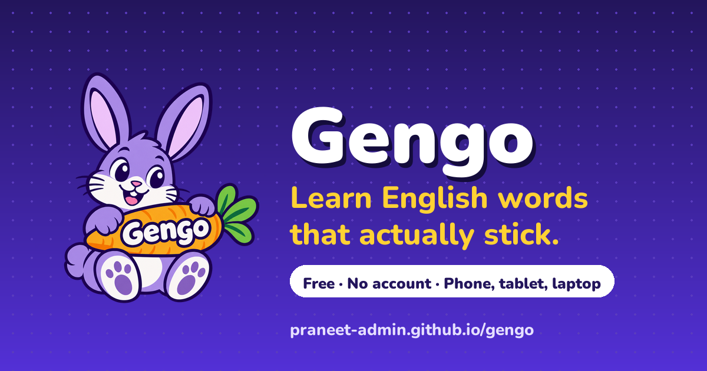
Marketing that runs unattended
Built into the product, so every learner is a channel
Share my streak: one tap sends “I’m on a 5-day streak learning English words with Gengo 🐰 …” via the phone share sheet. The learner with a streak is the ad.
Installable app: web manifest + service worker, so Chrome and Safari offer “Add to Home Screen”. An icon beats a bookmark for daily return.
Post kit: WhatsApp group message, LinkedIn, Reddit (rules-compliant), X, Product Hunt tagline, faculty email. Anyone can paste it.
Long-form: a Medium-style blog (“Words Are Superpowers”) with three social images.
Promo video: 57 s, real screen recordings, narrated.
Link preview card: every share on WhatsApp, LinkedIn, X or Slack unfurls into this instead of a bare URL.
Gengo · learnwithgenn · praneet-admin.github.io/gengo
5

Slide 6
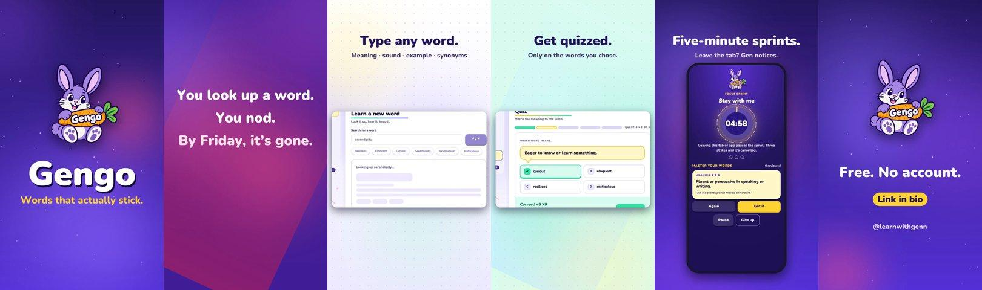
The promo video
docs/gengo-promo.mp4 · 57 seconds · 1080p · real footage, not a collage
Recorded from the live app with Chrome’s DevTools screencast at 30–60 fps, laptop and phone sizes.
Composited in Python (1080p60, push transitions, captions), narrated by a neural voice (Ava) with a hard-G “Gengo”, procedural music bed.
Cut to under a minute after the first 1:42 version felt slow; the same pipeline now makes every Instagram Reel.
Gengo · learnwithgenn · praneet-admin.github.io/gengo
6

Slide 7
Support: help before anyone writes in
Self-serve first, async within 48 h on weekdays, complaints read first
?
In-app Help
!
Report a problem
Instructions dialog, guided tour (7 steps incl. accessibility), keyboard shortcuts, FAQ covering the top ten questions: mic, voices, quota, quiz locked, old version, offline.
One button opens a GitHub issue with app version, browser, viewport, section, speech support and settings already filled in. The learner only describes what happened.
⌘
Issue forms
≡
SUPPORT.md
🐛 bug and 💡 idea templates with a “read the FAQ first” link. Structured, labelled, triage-able from a phone.
States what we do, how fast, and honestly what we don’t do, so silence never reads as neglect.
Gengo · learnwithgenn · praneet-admin.github.io/gengo
7

Slide 8
Pricing
The shortest section, on purpose
₹0
1
Reason 1: it costs nothing to run
No server, no accounts, free public APIs (Wiktionary, Datamuse, MyMemory, Wikipedia), GitHub Pages hosting. There is nothing to bill for.
Free. Forever. No tiers.
2
Reason 2: the audience
Three months away from a first salary. A vocabulary app that charges them is solving the wrong problem. Being free also keeps Reddit and WhatsApp posts within self-promotion rules.
Gengo · learnwithgenn · praneet-admin.github.io/gengo
8

Slide 9
Jobs we dropped, and why
Saying no is part of the plan
Sales
Nothing to buy. “One person saying yes” = one student opening the link, which Marketing covers.
Public relations
No story a journalist needs yet (no users, no numbers). The blog and video are the PR kit for when there is one.
Partners
The right partner is a college communication-skills faculty. Email drafted, but partnerships need a human follow-up.
Marketplace
Not in an app store by design. The PWA manifest gives “install” without a store or review cycle.
Community
A Discord with zero members is a liability. GitHub Issues is the conversation; the Share loop is how the first hundred users meet.
Gengo · learnwithgenn · praneet-admin.github.io/gengo
9

Slide 10
Where the message goes
launch/posts.md: copy that anyone can paste without asking
WhatsApp
LinkedIn
Reddit
College placement groups. Where this audience actually lives. Sent once, by a real person.
Founder/student voice: “I forgot every word I looked up during placement prep. So I built Gengo.”
r/EnglishLearning, r/Indian_Academia, r/developersIndia. Fits self-promo rules: free, no sign-up, open source.
X / Threads
Product Hunt
Faculty email
“Words you look up shouldn’t vanish by Friday.”
Tagline: Free vocabulary trainer that quizzes you on your own words.
Kept for the Partners job later: “try it with one batch and tell me what breaks.”
Gengo · learnwithgenn · praneet-admin.github.io/gengo
10

Slide 11
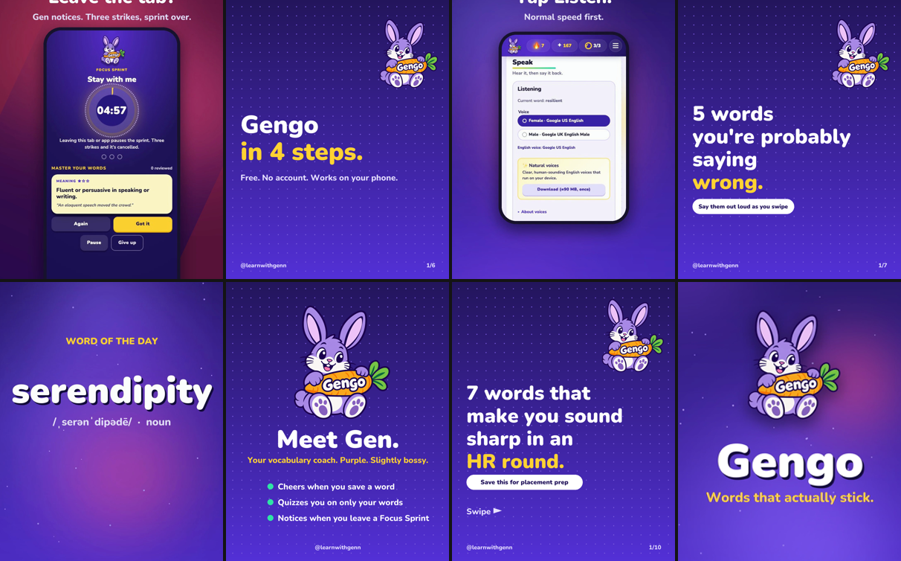
Instagram: @learnwithgenn
Opened 28 Sep 2026 · 8 posts on day one · profile, bio and photo set
4 Reels: launch promo, Word of the day “serendipity”, Listen-again-slower, Focus Sprint.
3 carousels: “7 words for an HR round”, “5 words you’re probably saying wrong”, “Gengo in 4 steps”.
1 single: Meet Gen.
Every caption ends “Free, no account. Link in bio 🐰” with placement and English-learning hashtags.
Gengo · learnwithgenn · praneet-admin.github.io/gengo
11

Slide 12
How a Reel gets made in ~10 minutes
One pipeline for the promo, the Reels and the carousels
1
2
3
4
5
Record
Compose
Narrate
Mix & encode
Post
Headless Chrome screencast of the real app, seeded state, phone + laptop
Python compositor: 9:16 scenes, captions, phone frame, transitions
Ava neural voice per line, timings drive scene lengths
Music bed, loudness-normalised, 30 fps / 48 kHz H.264 that Instagram accepts
Crop 9:16, custom cover frame, caption from captions.md
Word-of-the-day Reels are now a one-line change: swap the word, re-render, post. That is the daily content engine.
Gengo · learnwithgenn · praneet-admin.github.io/gengo
12

Slide 13
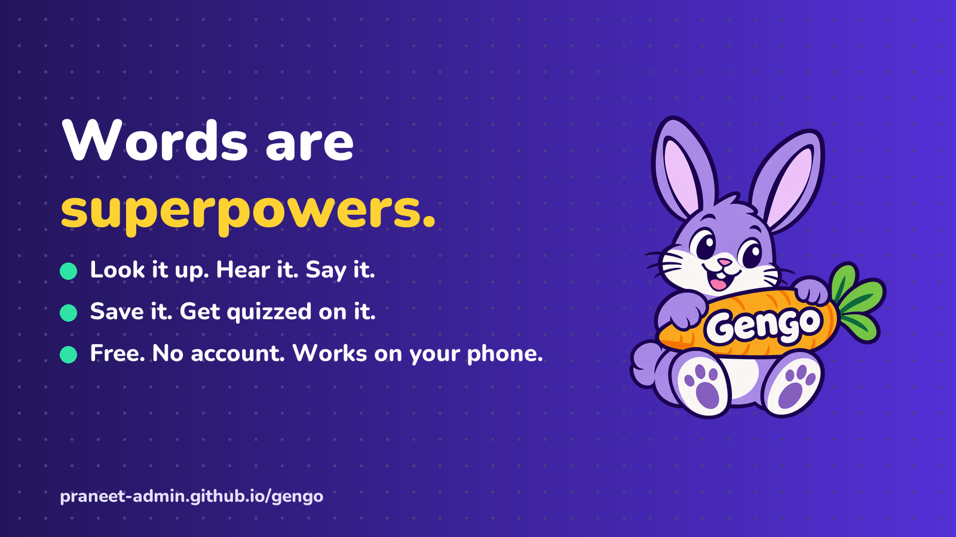
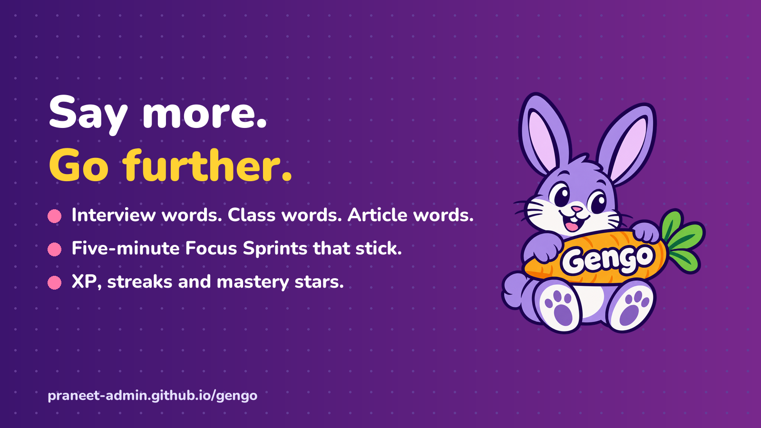
The brand in one look
Gen the rabbit, deep violet, sunny yellow, mint, rounded cards
Indigo 23155C
Violet 5330D6
Yellow FFD233
Mint 2FE3A5
Pink FF78AA
Gengo · learnwithgenn · praneet-admin.github.io/gengo
13

Slide 14
What “done” looks like in 30 days
If none of this happens, the audience statement is wrong before the product is
10
5
1
WhatsApp shares
I didn’t send myself
GitHub issues
from strangers
faculty reply
Next, in order
Add the website link in the Instagram bio (phone app only), then post one Word-of-the-day Reel a day.
Publish the Medium post once signed in; share the LinkedIn and WhatsApp copy from the kit.
Send the faculty email to one college; that is the Partners job.
AI b-roll (Higgsfield / Magnific) only once their billing is sorted; the current pipeline needs neither.
Gengo · learnwithgenn · praneet-admin.github.io/gengo
14

