Slide 1
If You Know What I’ve Seen
An Audio Landmark Detection based approach for Video Fingerprinting
Team 11: Manu Ramesh, Praneet Singh

Slide 2
Overview
Introduction
Method
Experiments
Mitigation Strategies
Conclusions

Slide 3
Introduction
What movie is that, playing on the giant screen on the building?
What is the source of this viral meme video?
I remember seeing this exact scene in another movie. I don’t recall. Do you?
Plagiarism?
Piracy?
If You Know What I’ve Seen

Slide 4
Related Work
Image Retrieval & Searching
Audio Fingerprinting
Shazam
Landmark detection
Video Retrieval & Searching
Video Fingerprinting
Using 3D CNNs
I Y K W I S
Audio Landmark based approach for
Video Fingerprinting

Slide 5
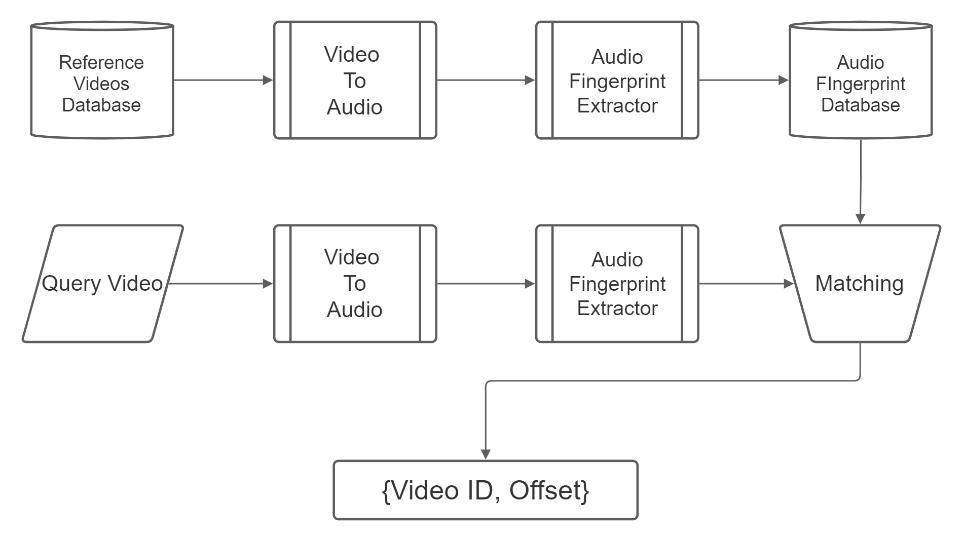
Video Fingerprinting using Audio Landmarks

Slide 6
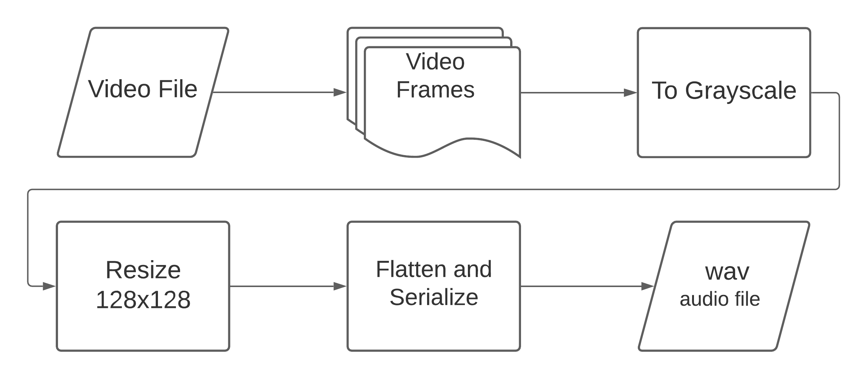
Video To Audio

Slide 7
Experiments
UCF-101 Activity Recognition Dataset
We compare the performance of our technique to a recent learning-based approach
X. Li et al – Video fingerprinting based on quadruplet convolutional neural network, 2021
Tested our method on several common distortions

Slide 8
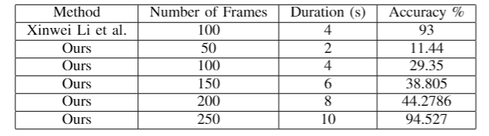
Comparison with 3D ResNets
Video Fingerprinting using 3D ResNets in X. Li et al
We could not train the model as the paper uses 4 3D ResNets in conjunction
No pre-trained models available
Comparable to the learning-based approach, but requires more frames in the query

Slide 9
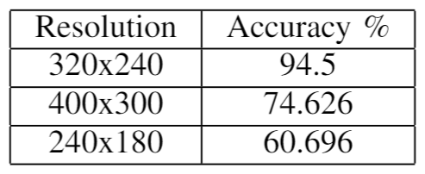
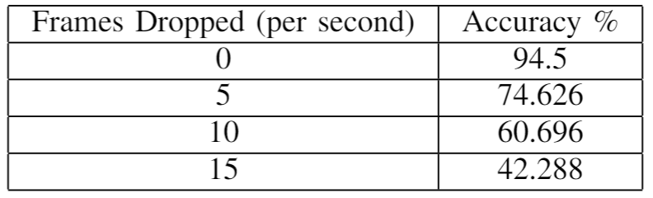
Frame Resizing & Frame Drop
Resized the queries to different resolutions while maintaining aspect ratios
Dropped frames consistently in the queries

Slide 10
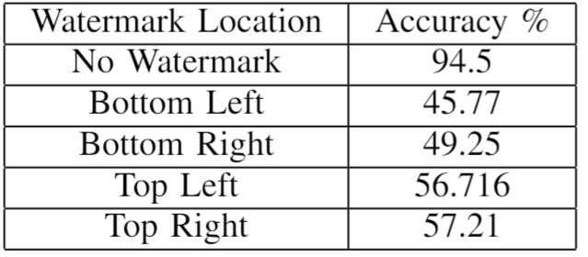
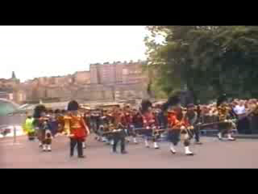
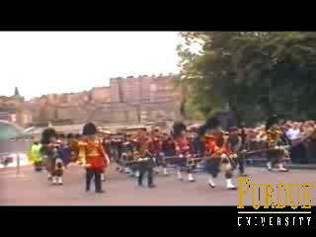
Watermarking
Original
Water Marked
Bottom Right

Slide 11




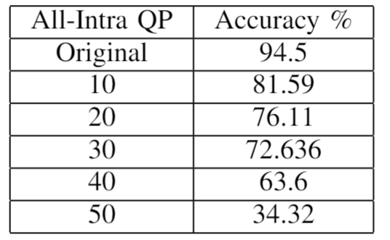
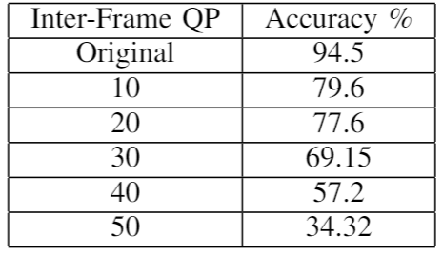
Compression
QP : 10
QP : 20
QP : 30
QP : 40
QP : 50

Slide 12
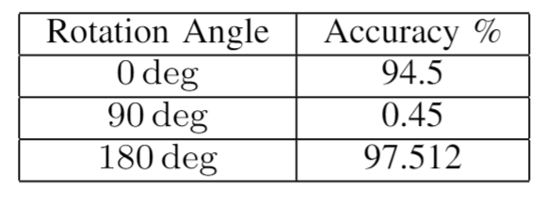
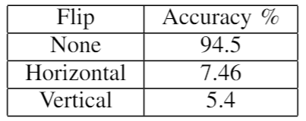
Frame Rotation & Flip
Original
Rotated 90 ̊
Rotated 180 ̊
Horizontal Flip
Vertical Flip

Slide 13
Mitigation Strategies
Multi Scale Approach
Rotation and Flip Invariance

Slide 14
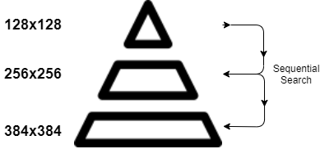
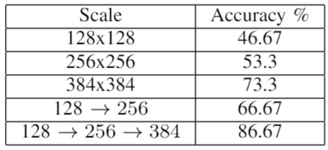
Multi-Scale Approach
The reviewers of our initial report encouraged us to test on higher resolution videos
Compiled a small dataset of 15, 720p YouTube Videos

Slide 15
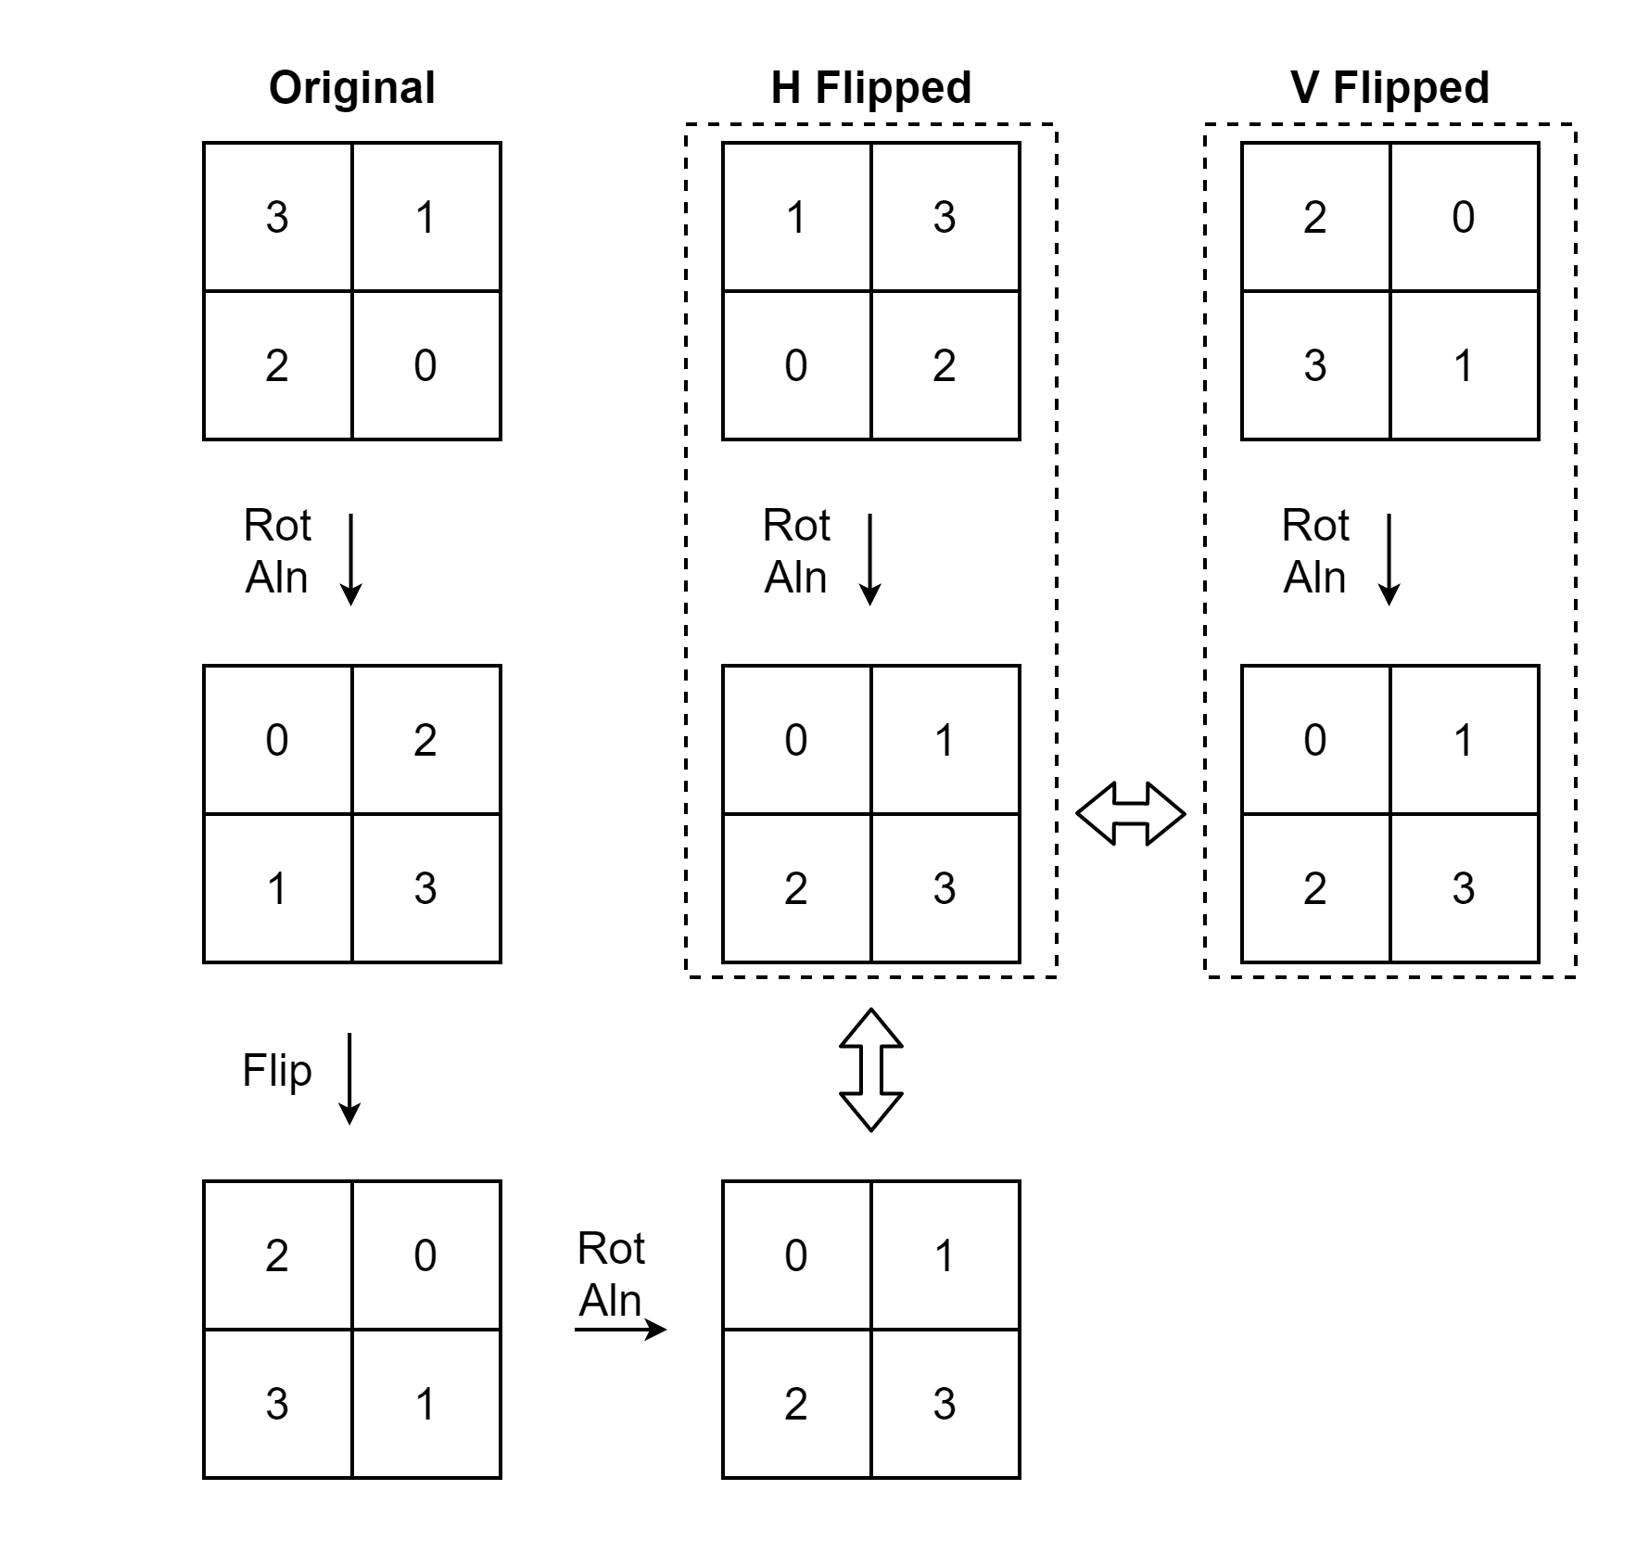
Rotation and Flip Alignment
Force dataset and query frames to same orientation

Slide 16
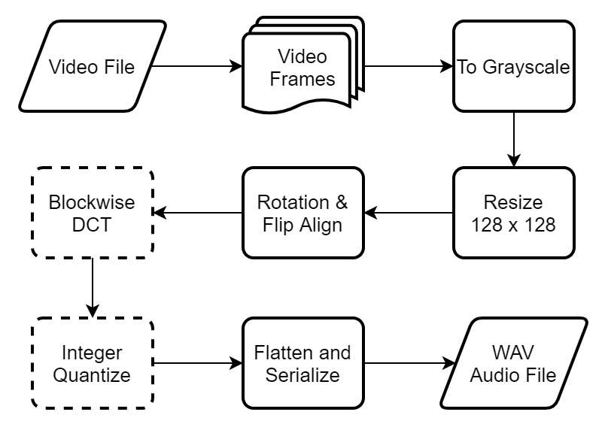
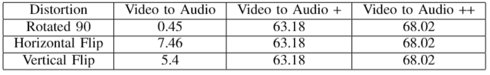
Video To Audio++

Slide 17
Conclusion
A cross-domain approach
Completely CPU based
No need of incremental training
Database size of about 1.4MB
Comparable to learning based models
Our technique can be made scale, rotation and flip invariant
Multi-Scale , Video to Audio +, Video to Audio ++
Works needs to be done to improve accuracy while dealing with watermarks and frame drops

