Slide 1
IDRSemi Strategic Analysis
Pacetronix Partnership vs RISC-V Development
January 2026

Slide 2
Agenda
1. Executive Summary
2. Market Analysis
3. Option 1: Pacetronix Partnership
4. Option 2: RISC-V Development
5. Financial Projections
6. Risk Assessment
7. Recommendation & Next Steps

Slide 3
Executive Summary
• Timeline: Pacetronix: 6-9 months to revenue | RISC-V: 12-18 months
• Investment: Pacetronix: $50K-100K | RISC-V: $200K-500K
• Risk Level: Pacetronix: Medium (regulatory) | RISC-V: High (market)
• Growth Potential: Pacetronix: Steady | RISC-V: Exponential
Strategic Decision Point
Choose between immediate revenue (Pacetronix) or long-term IP ownership (RISC-V)

Slide 4
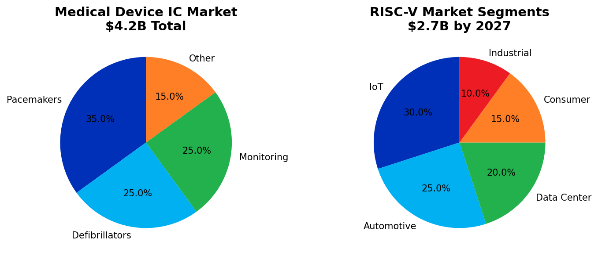
Market Analysis
Key Market Insights:
• Medical device market: 7.2% CAGR, highly regulated but stable
• RISC-V market: 35% CAGR, emerging technology with high growth potential
• Both markets offer significant opportunities with different risk profiles

Slide 5
Option 1: Pacetronix Partnership
Advantages
✓ Immediate revenue opportunity
✓ Established customer with clear needs
✓ High-margin medical market
✓ Valuable regulatory experience
✓ Potential for long-term partnership
✓ Reference customer for future deals
Challenges
⚠ Strict FDA compliance required
⚠ 18-24 month development cycle
⚠ High liability insurance needs
⚠ Conservative design constraints
⚠ Limited IP ownership
⚠ Dependency on single customer

Slide 6
Pacetronix: Technical Requirements
Core Specifications
• Process Node: 180nm/130nm (mature, reliable)
• Power Budget: < 10µW active, < 100nA standby
• Operating Voltage: 1.0V - 3.6V (battery operation)
• Temperature Range: -10°C to +55°C (implant conditions)
• Lifetime: 10+ years continuous operation
• Safety: Triple redundancy, fail-safe mechanisms
DV Excellence Required
• ISO 13485 compliant verification
• 100% code coverage mandatory
• Formal verification for critical blocks

Slide 7
Option 2: RISC-V Development
Advantages
✓ Full IP ownership
✓ Hot technology trend
✓ Large ecosystem support
✓ Multiple market opportunities
✓ Design freedom & innovation
✓ Potential for licensing revenue
Challenges
⚠ No immediate customer
⚠ Highly competitive market
⚠ Longer development timeline
⚠ Higher upfront investment
⚠ Marketing & sales required
⚠ Need strong differentiation

Slide 8
RISC-V: Technical Approach
Proposed Architecture: RV32IMC + Custom Extensions
• Base: RV32I (minimal 32-bit integer ISA)
• M Extension: Hardware multiply/divide
• C Extension: Compressed instructions (code density)
• Custom: Domain-specific accelerators
Key Differentiators
• Security Focus: Hardware root of trust, secure boot, crypto extensions
• Power Optimization: Dynamic voltage scaling, power domains, sleep modes
• AI/ML Ready: Custom instructions for inference, SIMD operations
• Verification IP: Pre-verified UVM testbenches included

Slide 9
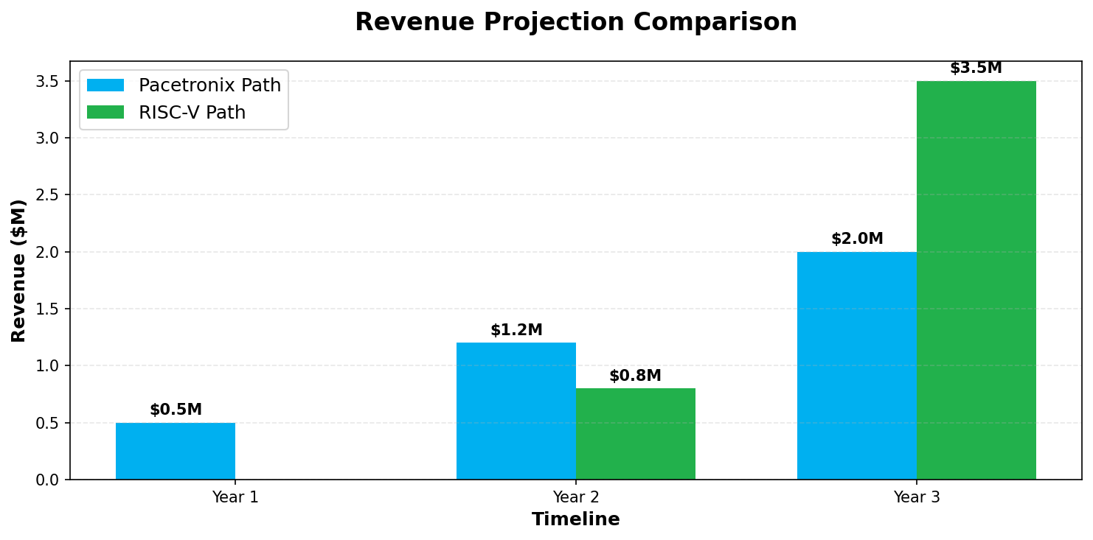
Financial Projections (3-Year)
Metric | Pacetronix Path | RISC-V Path
Initial Investment | $50K - $100K | $200K - $500K
Break-even | Month 9 | Month 18
3-Year Revenue | $3.7M | $4.3M
Gross Margin | 45% | 65%
Risk Level | Medium | High

Slide 10
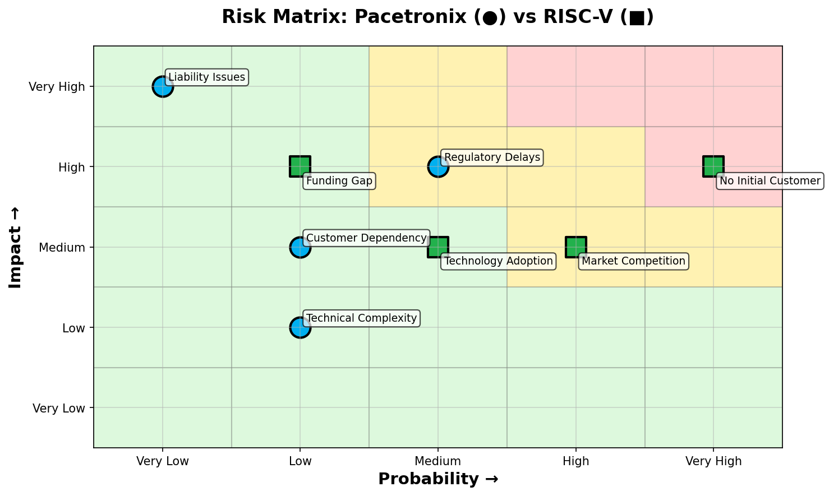
Risk Assessment Matrix

Slide 11
Strategic Recommendation
Recommended Strategy: Hybrid Approach
Start with Pacetronix for immediate revenue while developing RISC-V IP in parallel
Implementation Timeline
• Months 1-3: Finalize Pacetronix contract, Begin architecture design
• Months 4-6: Medical ASIC development, Start RISC-V core design
• Months 7-9: Pacetronix verification phase, RISC-V prototype
• Months 10-12: Pacetronix tape-out, RISC-V customer demos
• Year 2: Pacetronix production, RISC-V first customers

Slide 12
Immediate Next Steps
Pacetronix Partnership (This Week)
✓ Schedule technical deep-dive meeting
✓ Request detailed specifications
✓ Discuss NDA and contract terms
✓ Estimate resource requirements
✓ Define success metrics
RISC-V Preparation (Next 30 Days)
◆ Complete market research & competitive analysis
◆ Define core architecture & differentiators
◆ Build DV infrastructure & methodology
◆ Identify potential pilot customers
◆ Create funding plan & investor pitch

Slide 13
Appendix: DV Strategy for Both Paths
Leveraging Your DV Expertise
Pacetronix DV Focus:
- ISO 13485 compliant verification methodology
- Fault injection & safety verification
- Power-aware verification for battery life
- Analog mixed-signal verification
RISC-V DV Advantage:
- Pre-built UVM testbenches as product differentiator
- RISC-V compliance test suite integration
- Performance verification infrastructure
- Open-source contribution opportunity
Common DV Infrastructure:
- Reusable verification IP development
- Continuous integration setup
- Coverage-driven verification
- Formal verification for critical blocks

